Slide 1

Segment Routing over IPv6 dataplane
(SRv6)
Trust the Strong
Vladimír Bureš
vladimir.bures@alef.com
Version 2.06

Slide 2
Agenda
Classic MPLS - Recap
Segment Routing over MPLS dataplane (SR-MPLS, IPv4) - Recap
  Global and Local Segments
  SR IGP Control Plane
Segment Routing over IPv6 dataplane (SRv6)
  Segment Routing extension Header (SRH)
  Locator
  SRv6 Full SID
  L3VPN over SRv6
  L2VPN over SRv6
  SRv6 uSID (Compressed SRv6 SID)
  Function
  MPLS / SRv6 interoperability
    Dual connected PE
    MPLS/SRv6 VPN
  TI-LFA for SRv6
  SRv6 Traffic Engineering
  SRv6 Flex Algo
  SRv6 Design
  Network Migration MPLS -> SRv6
    Dual-stack Core
    Service Migration - L3VPN
    Service Migration - L2VPN
  VPLS
  VPWS
  SRv6 support on IOS-XE, restrictions

Slide 3
Segment Routing over MPLS/IPv6 dataplane
SRv6
Introduction
SRv6
Notes:
ATM was complex technology to be able to do everything… and disappered
MPLS is simple technology to be able to do the same as ATM …. But become complex to be useful for every “possible” usecase … it will disappear
SRv6 is simple and is able to to “everything” ☺

Slide 4
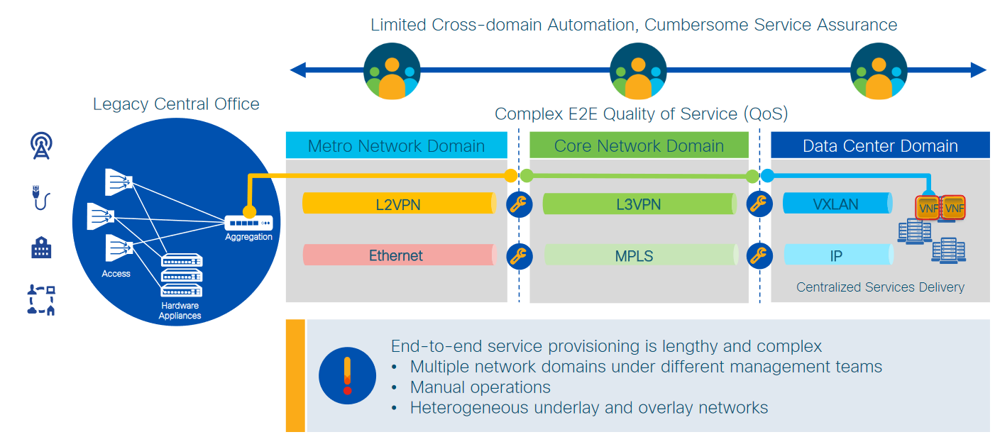
Understanding Today’s Service Creation
Notes:
Due to scale and technology limitation each part of data path, part of network needs to be managed separately and build “stitching” points on the edge of Access, Core and DataCenter domain
It is complex, hard to Automate, different teams are involved in configuration, different technologies and Vendors are used

Slide 5
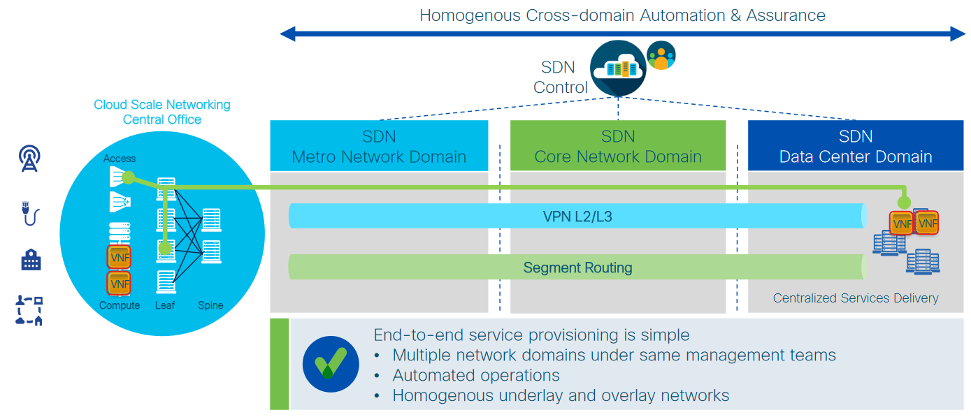
SR-MPLS: SDN ready “Network as a Fabric” for Service Creation
Notes:
This is simplification by using Segment routing (about 10 years ago),
Lets build One single large network, it is possible by using SR MPLS – huge simplification. Just One technology span across whole network, network forwarding is simple and Stitching point are gone. You can build your service End-to-end

Slide 6
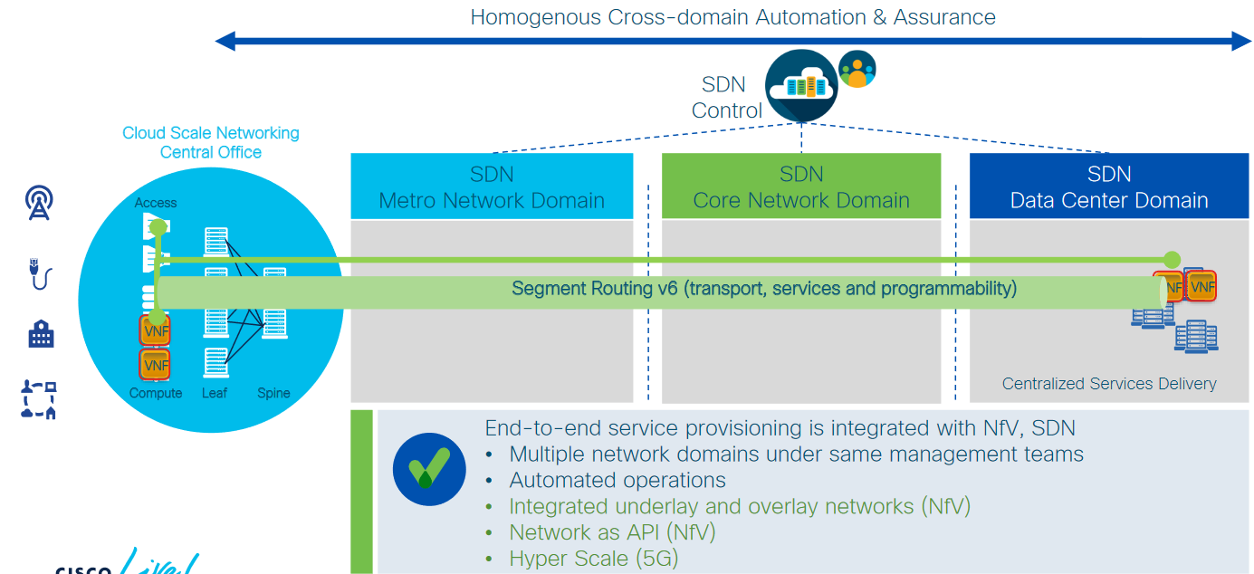
SRv6: SDN, NfV, 5G ready “Network as an API” for Service Creation
Notes:
Homogenous network, very simple routing. Service is moved to “compute”

Slide 7
Segment Routing over MPLS/IPv6 dataplane
Classic MPLS
Classic MPLS (LDP) Quick Review
SRv6 and service migration

Slide 8
MPLS
MPLS - Multi Protocol Label Switching
MPLS is a forwarding mechanism in which network devices switch packets according to the labels carried by every MPLS packet
Labels usually corresponds to the destination IP networks (the same as traditional IP forwarding)
Labels can also correspond to the other parameters such as QoS, destination network, VPN, etc.
MPLS was not designed only for IP, it also supports forwarding of other protocols (multiprotocol)
Notes:
IETF's MPLS Working Group was formed in 1997
1998 First MPLS VPNs Deployed
1999 MPLS TE

Slide 9
MPLS Label Format
MPLS uses a 32-bit label field that contains the following information:
  20-bit label
  3-bit experimental field (EXP renamed to Traffic Class = TC)
  1-bit bottom-of-stack indicator
  8-bit time-to-live (TTL) field
RFC 5462
RFC 3032
TC
LABEL
EXP
S
TTL
0
19
20
22
23
24
31

Slide 10
Label Encapsulation
Label stack“ record is placed between data-link layer header (L2) and network layer header (L3)
The beginning of „label stack“ (top label) directly follows the data-link layer (L2)
Network layer header is placed directly after the „label stack“ record which has the „s“ bit flag set
MPLS Label Stack
L2 Header
MPLS Label
s=0
MPLS Label
s=0
MPLS Label
s=1
L3 Header
DATA
L2 CRC
L2 Header
MPLS Label
s=0
MPLS Label
s=1
L3 Header
DATA
L2 CRC
L2 Header
MPLS Label
s=1
L3 Header
DATA
L2 CRC

Slide 11
Label Allocation
Label allocation and distribution in a frame-mode (packet-mode) MPLS environment follow these steps:
  IP routing protocols build the IP routing table.
  Each LSR assigns a label to every destination in the IP routing table independently (not learned from BGP – default).
  LSRs announce their own assigned labels to all other LSRs.
Each LSR builds its own LIB, LFIB, and FIB data structures based on received labels.

Slide 12
MPLS Services
Control Plane
Unicast
IP Routing
Multicast
IP Routing
MPLS Traffic
Engineering
Quality of
Service
MPLS/VPN
Any IGP
OSPF or IS-IS
Any IGP
Any IGP
Unicast IP
routing table
Multicast
IP routing table
Unicast IP
routing table
Unicast IP
routing table
Unicast IP
routing tables
LDP
PIM, mLDP, BIER
LDP
RSVP
LDP
LDP
BGP
Data Plane
Label forwarding table

Slide 13
MPLS Issues
Too complex control plane (LDP, RSVP-TE)
  LDP
    Redundant to IGP
    LDP-IGP synchronization issues
  RSVP-TE
    Weak deployment, scaling issues, operational complexity
    Not ECMP friendly
    MPLS FRR “replaced” by IP LFA/R-LFA
Microloop avoidance not solved
Notes:
RSVP-TE – ATM/FR circuit based approach
MPLS-FRR – SONET/SDH approach

Slide 14
Segment Routing over MPLS/IPv6 dataplane
Segment Routing
Introduction
SRv6 and service migration

Slide 15
Why Segment Routing ?
Simplicity
  automation: TILFA sub-50msec FRR
  protocol elimination: LDP, RSVP-TE, VxLAN, NSH, GTP, ...
Application Engineered Routing
  Scalable - the network fabric does not hold any per-flow state for TE or NFV
  Stateless - Source Routing - the topological and service (NFV) path is encoded in packet header
  Programmable
  Ease of configuration and troubleshooting
End-to-End
  DC, Metro, WAN
Notes:
https://www.esnog.net/gore23/gore23-files/20190515-ESNOG-SRv6.pdf

Slide 16
What is Segment Routing ?
Source Routing
  the source chooses a path and encodes it in the packet header as an ordered list of segments
  the rest of the network executes the encoded instructions
Segment
  an identifier for any type of instruction (forwarding or service)
    example of instruction “go to node N using the shortest path, use ECMP when possible”
Segment List
  a list of segments
Notes:
In this presentation: IGP-based forwarding construct

Slide 17
IPv4 limitations & workarounds
Address space 32-bit limitation
No optional header
IPv4 header doesn’t support
VPN
Traffic Engineer
Service Chaining
Engineered Flow optimization
Source-Routing
Network Function
IPv4
Reachability
No engineered Load Balancing
No VPN
No Traffic Engineering
No Service Chaining
IPv4 Header
MPLS Entropy Label, VxLAN UDP
MPLS VPN’s, VxLAN
RSVP-TE, SR-TE MPLS
NSH
Data (L5, L6 & L7)
Socket header (L4)
Data (L5, L6 & L7)
IPv4 header (L3)
Socket header (L4)
NSH
IPv4 header (L3)
workarounds
MPLS VPN / EVPN
Ethernet (L2)
MPLS / VxLAN (+ IP and UDP)
Ethernet (L2)

Slide 18

SRv6 solution
Pv6 Address 128bits
IPv6 Flow Header
Engineered Flow optimization
SRv6 Header
Source-Routing
Traffic Engineering
VPN
Service Chaining
Network Functions
IPv6
Reachability
Engineered Load Balancing
VPN
Traffic Engineering
Source Routing
No Service Chaining
IPv6 Header
IPv6 Header
IPv6 Header
IPv6 Header
IPv6 Header
IPv6 Header
Data (L5, L6 & L7)
Socket header (L4)
IPv4 header (L3)
Data (L5, L6 & L7)
Simplicity
(back to the
OSI model)
Socket header (L4)
NSH
MPLS VPN / EVPN
IPv6 header (L3)
MPLS / VxLAN (+ IP and UDP)
Ethernet (L2)
Ethernet (L2)

Slide 19
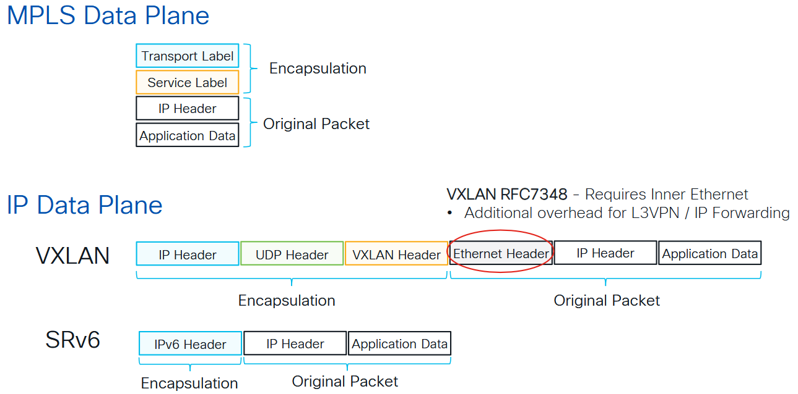
L3VPN Services Overlay Encapsulation
Notes:
https://www.ciscolive.com/c/dam/r/ciscolive/emea/docs/2025/pdf/BRKMPL-2253.pdf

Slide 20
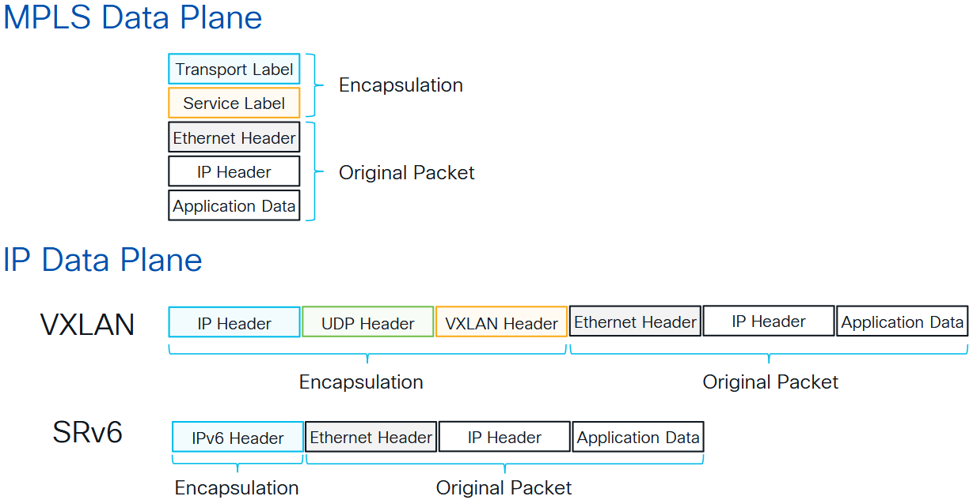
L2VPN Services Overlay Encapsulation
Notes:
https://www.ciscolive.com/c/dam/r/ciscolive/emea/docs/2025/pdf/BRKMPL-2253.pdf

Slide 21
Segment Routing Data Plane
MPLS -> SR-MPLS
  an ordered list of segments is represented as a stack of labels
    1 segment = 1 label, a segment list = a labelstack
  Segment Routing re-uses MPLS data plane without any change
  Segment represented as MPLS label
  Applicable to IPv4 and IPv6 address families
IPv6 -> SRv6
  an ordered list of segments is encoded in a routing extension header
    1 segment = 1 IPv6 address, a segment list = an IPv6 address list in the SRH
  leverages RFC2460 RFC8200 provision for source routing extension header
Notes:
In this presentation: IGP-based forwarding construct

Slide 22
Types of Segments
IGP Segments
  Prefix Segments
    Node segments
    Anycast Segments
  Adjacency Segments
BGP Segments
  Prefix segments
  Egress Peer Engineering (EPE) Segments
    Peer Node Segments
    Peer Adjacency Segments
    Peer Set Segments
Notes:
455-436-SR-MENOG-18-km.pptx - odsud doplnit

Slide 23
Global and Local Segment
Global Segment
  Any node in SR domain understands associated instruction
  Each node in SR domain installs the associated instruction in its forwarding table
  MPLS: global label value in Segment Routing Global Block (SRGB)
Local Segment
  Only originating node understands associated instruction
  MPLS: locally allocated label

Slide 24
Global Segments - Global Label Indexes
Global Segments always distributed as a label range (SRGB)+Index
  Index must be unique in Segment Routing Domain
Best practice: same SRGB on all nodes
  “Global model”, requested by all operators
  Global Segments are global label values, simplifying network operations
Default SRGB: 16,000 – 23,999
  Other vendors also use this label range

Slide 25
IGP Segments
Two basic building blocks distributed by IGP
  Prefix Segments
  Adjacency Segments

Slide 26
IGP Prefix Segment – SR-MPLS
Shortest-path to the IGP prefix
Equal Cost MultiPath (ECMP)-aware
Global Segment
Label = 16000 + Index
Advertised as index
Distributed by ISIS/OSPF
1
2
1.1.1.5/32
16005
16005
16005
5
3
4
16005
16005
All nodes use default SRGB 16.000-23.999

Slide 27
IGP Prefix Segment – SR-MPLS
Shortest-path to the IGP prefix
Equal Cost MultiPath (ECMP)-aware
Global Segment
Label = 16000 + Index
Advertised as index
Distributed by ISIS/OSPF
1
2
16004
16004
5
3
4
16004
16004
16004
1.1.1.4/32
All nodes use default SRGB 16.000-23.999

Slide 28
IGP Adjacency Segment – SR-MPLS
Forward on the IGP adjacency
Local Segment
Advertised as label value
Distributed by ISIS/OSPF
Adj to 5
1
2
24025
Adj to 4
24024
5
3
4
All nodes use default SRGB 16.000-23.999

Slide 29
Combining IGP Segments – SR-MPLS
Steer traffic on any path through the network
Path is specified by list of segments in packet header, a stack of labels
No path is signaled
No per-flow state is created
Single protocol: IS-IS or OSPF
16004
24045
Packet to 5
1
2
24045
5
Packet to 5
3
4
16004
24045
All nodes use default SRGB 16.000-23.999

Slide 30
Segment Routing over MPLS/IPv6 dataplane
IGP Control Plane
SRv6 “extension”
SRv6 and service migration

Slide 31
ISIS easily extensible
Router 1
Uses TLVs
For SRv6:
  Locator – for Reachability (twice for backward compatibility)
  END function - TI-LFA and TE
  END.X function for each interface in routing protocol TI-LFA and TE
Capabilities:
Max SID depth for different functions
OSPF will follow (RFC9513) but not (yet) supported on Cisco
END: B::1
END.X: B::41
2001::12/64
Lo0
Te0/0/0/0
A::1/128
END.X: B::42
FE80::1/64
Te0/0/0/1
Locator: B::/64
Notes:
Twice is just for Algo 0

Slide 32
Segment Routing over MPLS/IPv6 dataplane
Segment Routing
SRv6
IPv6 Data Plane
SRv6 and service migration

Slide 33
SR for IPv6 Dataplane
SR-IPv6 allows Segment Routing to be deployed over non-MPLS networks and/or in areas of the network where MPLS is not present (e.g.: datacenters)
Difference is in the bits encoded in the packet not in the architecture
Enabling SR-IPv6, means that ONLY the nodes that have to process the packet header must have SR-IPv6 dataplane support
  All other nodes in the infrastructure are just plain IPv6 nodes

Slide 34
MPLS vs IPv6 Data Plane
MPLS
  leverage the mature MPLS HW with only SW upgrade
  1 segment = 1 label
  a segment list = a label stack
IPv6
  leverages RFC8200 provision for source routing extension header
  1 segment = 1 address
  a segment list = an address list in the SRH
Segment Routing

Slide 35
SR for IPv6 Dataplane
Segment Routing for IPv6 Dataplane
  Defines SID as 128 bit IPv6 addresses (no label or MPLS Data Plane)
  Much simpler from a signaling perspective: no need to advertise anything else than IPv6 prefixes (the prefix is the SID)
Segments are coded at Header of IPv6 Packet
  Define a new Routing Extensions Header type
    Segment Routing Header (SRH)
    Contains Segment List
    VERY close to what already specified in RFC2460
IPv6 Hdr
Label C
Label F
SR header
Segments:C,F,H
Label H
IPv4 or IPv6 Hdr
PAYLOAD
PAYLOAD
SR-IPv6
SR-MPLS

Slide 36
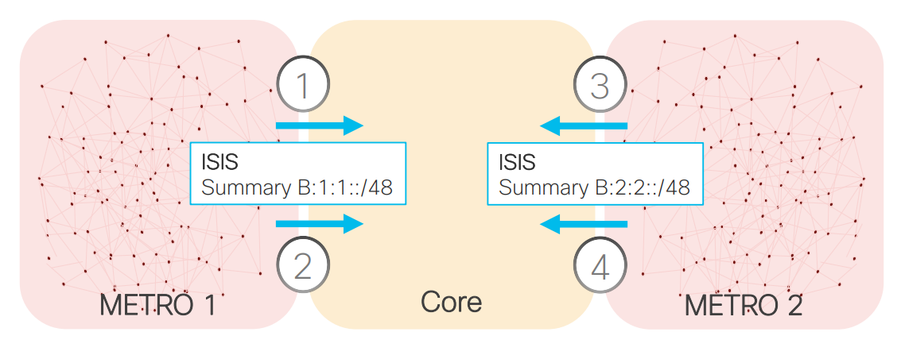
Prefix Summarization
Back to basic IP routing and summarization
1000 times less IGP routes than with MPLS
End-to-End Flex Algo Continuity
No BGP inter-AS Option A/B/C
Allocation
B000:0000::/32 Low-cost
B000:0001::/32 Low-delay
ISIS
Summary B000:0000:01::/40 Low-cost
Summary B000:0001:01::/40 Low-delay
ISIS
Summary B000:0000:02::/40 Low-cost
Summary B000:0001:02::/40 Low-delay

Slide 37
IPv6 SR Header
IPv6 header
  Next header field: Indicates what comes next
  Destination address
0 1 2 3
0 1 2 3 4 5 6 7 8 9 0 1 2 3 4 5 6 7 8 9 0 1 2 3 4 5 6 7 8 9 0 1
+-+-+-+-+-+-+-+-+-+-+-+-+-+-+-+-+-+-+-+-+-+-+-+-+-+-+-+-+-+-+-+-+
|Version| Traffic Class | Flow Label |
+-+-+-+-+-+-+-+-+-+-+-+-+-+-+-+-+-+-+-+-+-+-+-+-+-+-+-+-+-+-+-+-+
| Payload Length | Next Header | Hop Limit |
+-+-+-+-+-+-+-+-+-+-+-+-+-+-+-+-+-+-+-+-+-+-+-+-+-+-+-+-+-+-+-+-+
| |
| Source Address |
| |
| |
+-+-+-+-+-+-+-+-+-+-+-+-+-+-+-+-+-+-+-+-+-+-+-+-+-+-+-+-+-+-+-+-+
| |
| Destination Address |
| |
| |
+-+-+-+-+-+-+-+-+-+-+-+-+-+-+-+-+-+-+-+-+-+-+-+-+-+-+-+-+-+-+-+-+
Notes:
Next header is something which was name “PROTOCOL” in IPv4 = What is encapsulated in IPv6 packet

Slide 38
IPv6 SR Header
IPv6 header
  Next header: 17 -> UDP
0 1 2 3
0 1 2 3 4 5 6 7 8 9 0 1 2 3 4 5 6 7 8 9 0 1 2 3 4 5 6 7 8 9 0 1
+-+-+-+-+-+-+-+-+-+-+-+-+-+-+-+-+-+-+-+-+-+-+-+-+-+-+-+-+-+-+-+-+
|Version| Traffic Class | Flow Label |
+-+-+-+-+-+-+-+-+-+-+-+-+-+-+-+-+-+-+-+-+-+-+-+-+-+-+-+-+-+-+-+-+
| Payload Length | 17 | Hop Limit |
+-+-+-+-+-+-+-+-+-+-+-+-+-+-+-+-+-+-+-+-+-+-+-+-+-+-+-+-+-+-+-+-+
| |
| Source Address |
| |
| |
+-+-+-+-+-+-+-+-+-+-+-+-+-+-+-+-+-+-+-+-+-+-+-+-+-+-+-+-+-+-+-+-+
| |
| Destination Address |
| |
| |
+-+-+-+-+-+-+-+-+-+-+-+-+-+-+-+-+-+-+-+-+-+-+-+-+-+-+-+-+-+-+-+-+
+-+-+-+-+-+-+-+-+-+-+-+-+-+-+-+-+-+-+-+-+-+-+-+-+-+-+-+-+-+-+-+-+
| Source Port | Destination Port |
+-+-+-+-+-+-+-+-+-+-+-+-+-+-+-+-+-+-+-+-+-+-+-+-+-+-+-+-+-+-+-+-+
| Length | Checksum |
+-+-+-+-+-+-+-+-+-+-+-+-+-+-+-+-+-+-+-+-+-+-+-+-+-+-+-+-+-+-+-+-+
| data |
+-+-+-+-+-+-+-+-+-+-+-+-+-+-+-+-+-+-+-+-+-+-+-+-+-+-+-+-+-+-+-+-+
Notes:
Typical Encapsulation is UDP Protocol

Slide 39
IPv6 SR Header
0 1 2 3
0 1 2 3 4 5 6 7 8 9 0 1 2 3 4 5 6 7 8 9 0 1 2 3 4 5 6 7 8 9 0 1
+-+-+-+-+-+-+-+-+-+-+-+-+-+-+-+-+-+-+-+-+-+-+-+-+-+-+-+-+-+-+-+-+
|Version| Traffic Class | Flow Label |
+-+-+-+-+-+-+-+-+-+-+-+-+-+-+-+-+-+-+-+-+-+-+-+-+-+-+-+-+-+-+-+-+
| Payload Length | 6 | Hop Limit |
+-+-+-+-+-+-+-+-+-+-+-+-+-+-+-+-+-+-+-+-+-+-+-+-+-+-+-+-+-+-+-+-+
| |
| Source Address |
| |
| |
+-+-+-+-+-+-+-+-+-+-+-+-+-+-+-+-+-+-+-+-+-+-+-+-+-+-+-+-+-+-+-+-+
| |
| Destination Address |
| |
| |
+-+-+-+-+-+-+-+-+-+-+-+-+-+-+-+-+-+-+-+-+-+-+-+-+-+-+-+-+-+-+-+-+
+-+-+-+-+-+-+-+-+-+-+-+-+-+-+-+-+-+-+-+-+-+-+-+-+-+-+-+-+-+-+-+-+
| Source Port | Destination Port |
+-+-+-+-+-+-+-+-+-+-+-+-+-+-+-+-+-+-+-+-+-+-+-+-+-+-+-+-+-+-+-+-+
| Sequence Number |
+-+-+-+-+-+-+-+-+-+-+-+-+-+-+-+-+-+-+-+-+-+-+-+-+-+-+-+-+-+-+-+-+
| Acknowledgment Number |
+-+-+-+-+-+-+-+-+-+-+-+-+-+-+-+-+-+-+-+-+-+-+-+-+-+-+-+-+-+-+-+-+
| Data | |U|A|P|R|S|F| |
| Offset| Reserved |R|C|S|S|Y|I| Window |
| | |G|K|H|T|N|N| |
+-+-+-+-+-+-+-+-+-+-+-+-+-+-+-+-+-+-+-+-+-+-+-+-+-+-+-+-+-+-+-+-+
| Checksum | Urgent Pointer |
+-+-+-+-+-+-+-+-+-+-+-+-+-+-+-+-+-+-+-+-+-+-+-+-+-+-+-+-+-+-+-+-+
| Options | Padding |
+-+-+-+-+-+-+-+-+-+-+-+-+-+-+-+-+-+-+-+-+-+-+-+-+-+-+-+-+-+-+-+-+
| data |
+-+-+-+-+-+-+-+-+-+-+-+-+-+-+-+-+-+-+-+-+-+-+-+-+-+-+-+-+-+-+-+-+
IPv6 header
  Next header: 6 -> TCP
Notes:
Typical Encapsulation or TCP Protocol

Slide 40
IPv6 SR Header
0 1 2 3
0 1 2 3 4 5 6 7 8 9 0 1 2 3 4 5 6 7 8 9 0 1 2 3 4 5 6 7 8 9 0 1
+-+-+-+-+-+-+-+-+-+-+-+-+-+-+-+-+-+-+-+-+-+-+-+-+-+-+-+-+-+-+-+-+
|Version| Traffic Class | Flow Label |
+-+-+-+-+-+-+-+-+-+-+-+-+-+-+-+-+-+-+-+-+-+-+-+-+-+-+-+-+-+-+-+-+
| Payload Length | 4 | Hop Limit |
+-+-+-+-+-+-+-+-+-+-+-+-+-+-+-+-+-+-+-+-+-+-+-+-+-+-+-+-+-+-+-+-+
| |
| Source Address |
| |
| |
+-+-+-+-+-+-+-+-+-+-+-+-+-+-+-+-+-+-+-+-+-+-+-+-+-+-+-+-+-+-+-+-+
| |
| Destination Address |
| |
| |
+-+-+-+-+-+-+-+-+-+-+-+-+-+-+-+-+-+-+-+-+-+-+-+-+-+-+-+-+-+-+-+-+
+-+-+-+-+-+-+-+-+-+-+-+-+-+-+-+-+-+-+-+-+-+-+-+-+-+-+-+-+-+-+-+-+
|Version| IHL |Type of Service| Total Length |
+-+-+-+-+-+-+-+-+-+-+-+-+-+-+-+-+-+-+-+-+-+-+-+-+-+-+-+-+-+-+-+-+
| Identification |Flags| FragmentOffset |
+-+-+-+-+-+-+-+-+-+-+-+-+-+-+-+-+-+-+-+-+-+-+-+-+-+-+-+-+-+-+-+-+
| Time to Live | Protocol | HeaderChecksum |
+-+-+-+-+-+-+-+-+-+-+-+-+-+-+-+-+-+-+-+-+-+-+-+-+-+-+-+-+-+-+-+-+
| Source Address |
+-+-+-+-+-+-+-+-+-+-+-+-+-+-+-+-+-+-+-+-+-+-+-+-+-+-+-+-+-+-+-+-+
| Destination Address |
+-+-+-+-+-+-+-+-+-+-+-+-+-+-+-+-+-+-+-+-+-+-+-+-+-+-+-+-+-+-+-+-+
| Options | Padding |
+-+-+-+-+-+-+-+-+-+-+-+-+-+-+-+-+-+-+-+-+-+-+-+-+-+-+-+-+-+-+-+-+
IPv6 header
  Next header: 4 -> IPv4
  ~~ “L3 VPN”
IPv6 Header
IPv4 packet
Notes:
We can encapsulate also IPv4 protocol.
It is IPv6 packet transporting IPv4. It is kind of TUNELLING

Slide 41
IPv6 SR Header
0 1 2 3
0 1 2 3 4 5 6 7 8 9 0 1 2 3 4 5 6 7 8 9 0 1 2 3 4 5 6 7 8 9 0 1
+-+-+-+-+-+-+-+-+-+-+-+-+-+-+-+-+-+-+-+-+-+-+-+-+-+-+-+-+-+-+-+-+
|Version| Traffic Class | Flow Label |
+-+-+-+-+-+-+-+-+-+-+-+-+-+-+-+-+-+-+-+-+-+-+-+-+-+-+-+-+-+-+-+-+
| Payload Length | 143 | Hop Limit |
+-+-+-+-+-+-+-+-+-+-+-+-+-+-+-+-+-+-+-+-+-+-+-+-+-+-+-+-+-+-+-+-+
| |
| Source Address |
| |
| |
+-+-+-+-+-+-+-+-+-+-+-+-+-+-+-+-+-+-+-+-+-+-+-+-+-+-+-+-+-+-+-+-+
| |
| Destination Address |
| |
| |
+-+-+-+-+-+-+-+-+-+-+-+-+-+-+-+-+-+-+-+-+-+-+-+-+-+-+-+-+-+-+-+-+
+-+-+-+-+-+-+-+-+-+-+-+-+-+-+-+-+-+-+-+-+-+-+-+-+-+-+-+-+-+-+-+-+
| Destination MAC |
+-+-+-+-+-+-+-+-+-+-+-+-+-+-+-+-+-+-+-+-+-+-+-+-+-+-+-+-+-+-+-+-+
| Destination MAC | Source MAC |
+-+-+-+-+-+-+-+-+-+-+-+-+-+-+-+-+-+-+-+-+-+-+-+-+-+-+-+-+-+-+-+-+
| Source MAC |
+-+-+-+-+-+-+-+-+-+-+-+-+-+-+-+-+-+-+-+-+-+-+-+-+-+-+-+-+-+-+-+-+
| Ethertype | |
+-+-+-+-+-+-+-+-+-+-+-+-+-+-+-+-+ |
| |
| Payload |
| |
| |
| |
+-+-+-+-+-+-+-+-+-+-+-+-+-+-+-+-+-+-+-+-+-+-+-+-+-+-+-+-+-+-+-+-+
IPv6 header
  Next header: 143 -> Ethernet
  ~~ “L2VPN”
  Next header field:
    TCP, UDP, ICMP....
    IPv4, IPv6
IPv6 Header
L2 frame
Notes:
We can encapsulate also IPv4 protocol.
It is IPv6 packet transporting Ethernet Frame. It is kind of L2 VPN
IPv6 just encapsulate payload and transport as regular IPv6 packet
143 Ethernet Ethernet [RFC8986]

Slide 42
IPv6 SR Header
0 1 2 3
0 1 2 3 4 5 6 7 8 9 0 1 2 3 4 5 6 7 8 9 0 1 2 3 4 5 6 7 8 9 0 1
+-+-+-+-+-+-+-+-+-+-+-+-+-+-+-+-+-+-+-+-+-+-+-+-+-+-+-+-+-+-+-+-+
|Version| Traffic Class | Flow Label |
+-+-+-+-+-+-+-+-+-+-+-+-+-+-+-+-+-+-+-+-+-+-+-+-+-+-+-+-+-+-+-+-+
| Payload Length | 51 | Hop Limit |
+-+-+-+-+-+-+-+-+-+-+-+-+-+-+-+-+-+-+-+-+-+-+-+-+-+-+-+-+-+-+-+-+
| |
| Source Address |
| |
| |
+-+-+-+-+-+-+-+-+-+-+-+-+-+-+-+-+-+-+-+-+-+-+-+-+-+-+-+-+-+-+-+-+
| |
| Destination Address |
| |
| |
+-+-+-+-+-+-+-+-+-+-+-+-+-+-+-+-+-+-+-+-+-+-+-+-+-+-+-+-+-+-+-+-+
+-+-+-+-+-+-+-+-+-+-+-+-+-+-+-+-+-+-+-+-+-+-+-+-+-+-+-+-+-+-+-+-+
| Next Header | Payload Len | RESERVED |
+-+-+-+-+-+-+-+-+-+-+-+-+-+-+-+-+-+-+-+-+-+-+-+-+-+-+-+-+-+-+-+-+
| Security Parameters Index (SPI) |
+-+-+-+-+-+-+-+-+-+-+-+-+-+-+-+-+-+-+-+-+-+-+-+-+-+-+-+-+-+-+-+-+
| Sequence Number Field |
+-+-+-+-+-+-+-+-+-+-+-+-+-+-+-+-+-+-+-+-+-+-+-+-+-+-+-+-+-+-+-+-+
| |
+ Integrity Check Value-ICV (variable) |
| |
+-+-+-+-+-+-+-+-+-+-+-+-+-+-+-+-+-+-+-+-+-+-+-+-+-+-+-+-+-+-+-+-+
+-+-+-+-+-+-+-+-+-+-+-+-+-+-+-+-+-+-+-+-+-+-+-+-+-+-+-+-+-+-+-+-+
| Source Port | Destination Port |
+-+-+-+-+-+-+-+-+-+-+-+-+-+-+-+-+-+-+-+-+-+-+-+-+-+-+-+-+-+-+-+-+
| Sequence Number |
+-+-+-+-+-+-+-+-+-+-+-+-+-+-+-+-+-+-+-+-+-+-+-+-+-+-+-+-+-+-+-+-+
| Acknowledgment Number |
+-+-+-+-+-+-+-+-+-+-+-+-+-+-+-+-+-+-+-+-+-+-+-+-+-+-+-+-+-+-+-+-+
| Data | |U|A|P|R|S|F| |
| Offset| Reserved |R|C|S|S|Y|I| Window |
| | |G|K|H|T|N|N| |
+-+-+-+-+-+-+-+-+-+-+-+-+-+-+-+-+-+-+-+-+-+-+-+-+-+-+-+-+-+-+-+-+
| Checksum | Urgent Pointer |
+-+-+-+-+-+-+-+-+-+-+-+-+-+-+-+-+-+-+-+-+-+-+-+-+-+-+-+-+-+-+-+-+
| Options | Padding |
+-+-+-+-+-+-+-+-+-+-+-+-+-+-+-+-+-+-+-+-+-+-+-+-+-+-+-+-+-+-+-+-+
| data |
+-+-+-+-+-+-+-+-+-+-+-+-+-+-+-+-+-+-+-+-+-+-+-+-+-+-+-+-+-+-+-+-+
IPv6 header
  Next header: 51 -> AH
  Next header: 6 -> TCP
IPv6 Header
51
6
AH packet
TCP Header
Notes:
Chaining Headers

Slide 43
IPv6 SR Header
IPv6 header
  Next header: 43 -> Routing
IPv6 Routing extension header
  Generic header format defined in RFC 2460
    Next Header: IPv4, TCP, UDP, ...
    Hdr Ext Len: Any IPv6 device can skip this header
    Segments Left: Ignore extension header if equal to 0
  Specific data depends on Routing Type field:
    0 - Source Route (deprecated since 2007)
    1 – Nimrod (deprecated since 2009)
    2 - Mobility (RFC 6275)
    3 - RPL Source Route (RFC 6554)
    4 – Segment Routing
0 1 2 3
0 1 2 3 4 5 6 7 8 9 0 1 2 3 4 5 6 7 8 9 0 1 2 3 4 5 6 7 8 9 0 1
+-+-+-+-+-+-+-+-+-+-+-+-+-+-+-+-+-+-+-+-+-+-+-+-+-+-+-+-+-+-+-+-+
|Version| Traffic Class | Flow Label |
+-+-+-+-+-+-+-+-+-+-+-+-+-+-+-+-+-+-+-+-+-+-+-+-+-+-+-+-+-+-+-+-+
| Payload Length | 43 | Hop Limit |
+-+-+-+-+-+-+-+-+-+-+-+-+-+-+-+-+-+-+-+-+-+-+-+-+-+-+-+-+-+-+-+-+
| |
| Source Address |
| |
| |
+-+-+-+-+-+-+-+-+-+-+-+-+-+-+-+-+-+-+-+-+-+-+-+-+-+-+-+-+-+-+-+-+
| |
| Destination Address |
| |
| |
+-+-+-+-+-+-+-+-+-+-+-+-+-+-+-+-+-+-+-+-+-+-+-+-+-+-+-+-+-+-+-+-+
+-+-+-+-+-+-+-+-+-+-+-+-+-+-+-+-+-+-+-+-+-+-+-+-+-+-+-+-+-+-+-+-+
| Next Header | Hdr Ext Len | Routing Type | Segments Left |
+-+-+-+-+-+-+-+-+-+-+-+-+-+-+-+-+-+-+-+-+-+-+-+-+-+-+-+-+-+-+-+-+
| |
. .
. Type-specific data .
. .
| |
+-+-+-+-+-+-+-+-+-+-+-+-+-+-+-+-+-+-+-+-+-+-+-+-+-+-+-+-+-+-+-+-+

Slide 44
IPv6 SR Header
0 1 2 3
0 1 2 3 4 5 6 7 8 9 0 1 2 3 4 5 6 7 8 9 0 1 2 3 4 5 6 7 8 9 0 1
+-+-+-+-+-+-+-+-+-+-+-+-+-+-+-+-+-+-+-+-+-+-+-+-+-+-+-+-+-+-+-+-+
|Version| Traffic Class | Flow Label |
+-+-+-+-+-+-+-+-+-+-+-+-+-+-+-+-+-+-+-+-+-+-+-+-+-+-+-+-+-+-+-+-+
| Payload Length | Next Header | Hop Limit |
+-+-+-+-+-+-+-+-+-+-+-+-+-+-+-+-+-+-+-+-+-+-+-+-+-+-+-+-+-+-+-+-+
| |
| Source Address |
| (128 bit) |
| |
+-+-+-+-+-+-+-+-+-+-+-+-+-+-+-+-+-+-+-+-+-+-+-+-+-+-+-+-+-+-+-+-+
| |
| Destination Address |
| (128 bit) |
| |
+-+-+-+-+-+-+-+-+-+-+-+-+-+-+-+-+-+-+-+-+-+-+-+-+-+-+-+-+-+-+-+-+
+-+-+-+-+-+-+-+-+-+-+-+-+-+-+-+-+-+-+-+-+-+-+-+-+-+-+-+-+-+-+-+-+
| Next Header | Hdr Ext Len | Routing Type | Segments Left |
+-+-+-+-+-+-+-+-+-+-+-+-+-+-+-+-+-+-+-+-+-+-+-+-+-+-+-+-+-+-+-+-+
| First Segment | Flags | Tag |
+-+-+-+-+-+-+-+-+-+-+-+-+-+-+-+-+-+-+-+-+-+-+-+-+-+-+-+-+-+-+-+-+
| |
| Segment List[0] (128 bits IPv6 address) |
| |
| |
+-+-+-+-+-+-+-+-+-+-+-+-+-+-+-+-+-+-+-+-+-+-+-+-+-+-+-+-+-+-+-+-+
| |
. .
. .
. ... .
| |
+-+-+-+-+-+-+-+-+-+-+-+-+-+-+-+-+-+-+-+-+-+-+-+-+-+-+-+-+-+-+-+-+
| |
| Segment List[n-1] (128 bits IPv6 address) |
| |
| |
+-+-+-+-+-+-+-+-+-+-+-+-+-+-+-+-+-+-+-+-+-+-+-+-+-+-+-+-+-+-+-+-+
// //
// Optional Type Length Value objects (variable) //
// //
+-+-+-+-+-+-+-+-+-+-+-+-+-+-+-+-+-+-+-+-+-+-+-+-+-+-+-+-+-+-+-+-+
IPv6 header
  Next header: 43 -> Routing
IPv6 Routing extension header
  Generic header format defined in RFC 2460
    Next Header: IPv4, TCP, UDP, ...
    Hdr Ext Len: Any IPv6 device can skip this header
    Segments Left: Ignore extension header if equal to 0
  Specific data depends on Routing Type field:
    0 - Source Route (deprecated since 2007)
    1 – Nimrod (deprecated since 2009)
    2 - Mobility (RFC 6275)
    3 - RPL Source Route (RFC 6554)
    4 – Segment Routing
43
RFC 2460
4
SR specific
Notes:
https://www.ciscolive.com/c/dam/r/ciscolive/us/docs/2019/pdf/BRKSPG-3001.pdf
Jakub Horn

Slide 45
0 1 2 3
0 1 2 3 4 5 6 7 8 9 0 1 2 3 4 5 6 7 8 9 0 1 2 3 4 5 6 7 8 9 0 1
+-+-+-+-+-+-+-+-+-+-+-+-+-+-+-+-+-+-+-+-+-+-+-+-+-+-+-+-+-+-+-+-+
|Version| Traffic Class | Flow Label |
+-+-+-+-+-+-+-+-+-+-+-+-+-+-+-+-+-+-+-+-+-+-+-+-+-+-+-+-+-+-+-+-+
| Payload Length | Next Header | Hop Limit |
+-+-+-+-+-+-+-+-+-+-+-+-+-+-+-+-+-+-+-+-+-+-+-+-+-+-+-+-+-+-+-+-+
| |
| Source Address |
| (128 bit) |
| |
+-+-+-+-+-+-+-+-+-+-+-+-+-+-+-+-+-+-+-+-+-+-+-+-+-+-+-+-+-+-+-+-+
| “Active segment” |
| Destination Address |
| (128 bit) |
| |
+-+-+-+-+-+-+-+-+-+-+-+-+-+-+-+-+-+-+-+-+-+-+-+-+-+-+-+-+-+-+-+-+
| Next Header | Hdr Ext Len | Routing Type | Segments Left |
+-+-+-+-+-+-+-+-+-+-+-+-+-+-+-+-+-+-+-+-+-+-+-+-+-+-+-+-+-+-+-+-+
| First Segment | Flags | Tag |
+-+-+-+-+-+-+-+-+-+-+-+-+-+-+-+-+-+-+-+-+-+-+-+-+-+-+-+-+-+-+-+-+
| “Last Segment” = Final Destination |
| Segment List[0] (128 bits IPv6 address) |
| |
+-+-+-+-+-+-+-+-+-+-+-+-+-+-+-+-+-+-+-+-+-+-+-+-+-+-+-+-+-+-+-+-+
| |
. “Active Segment”
. Segment list [Segments Left] (128 bits IPv6 addr) .
. ... .
| |
+-+-+-+-+-+-+-+-+-+-+-+-+-+-+-+-+-+-+-+-+-+-+-+-+-+-+-+-+-+-+-+-+
| “First Segment” | | |
| Segment List[n-1] (128 bits IPv6 address) |
| |
+-+-+-+-+-+-+-+-+-+-+-+-+-+-+-+-+-+-+-+-+-+-+-+-+-+-+-+-+-+-+-+-+
// //
// Optional Type Length Value objects (variable) //
// //
+-+-+-+-+-+-+-+-+-+-+-+-+-+-+-+-+-+-+-+-+-+-+-+-+-+-+-+-+-+-+-+-+
IPv6 SR Header
43
IPv6 header
  Next header: 43 -> Routing
  First Segment
    Pointer to very first SID
copy
4
Pointer to the First segment
(= last record in the SRH)
Notes:
AI:
In SRv6, the Segment Routing Header (SRH) is used to encode a list of instructions or segments for a packet's path. The "Tag" field within the SRH is a 16-bit field that can be used to tag a packet as part of a specific group or class of packets.
Here's an example of how the Tag field might be used:
Scenario: You want to prioritize certain traffic based on its application, like video conferencing or VoIP.
1. Source Node:
The source node can set the "Tag" field in the SRH to a specific value that identifies the application type (e.g., Tag = 1 for video, Tag = 2 for VoIP).
2. SRv6 Nodes:
Along the path, SRv6 nodes can check the "Tag" field and apply different forwarding rules based on the tagged application. For example, they might prioritize packets with Tag = 1 (video) over those with Tag = 2 (VoIP) or apply specific QoS policies.
SRH Flags:
The flag field provides instructions for the node to process the packet (e.g., decrement SL, perform specific actions based on the SRv6 SID type).
RFC8754:
Tag: Tag a packet as part of a class or group of packets -- e.g., packets sharing the same set of properties. When Tag is not used at the source, it MUST be set to zero on transmission. When Tag is not used during SRH processing, it SHOULD be ignored. Tag is not used when processing the SID defined in Section 4.3.1. It may be used when processing other SIDs that are not defined in this document. The allocation and use of tag is outside the scope of this document.
Flags: 8 bits of flags. Section 8.1 creates an IANA registry for new flags to be defined.
The following flags are defined:
0 1 2 3 4 5 6 7
+-+-+-+-+-+-+-+-+
| U U U U U U U U |
+-+-+-+-+-+-+-+-+
U: Unused and for future use. MUST be 0 on transmission and ignored on receipt.

Slide 46
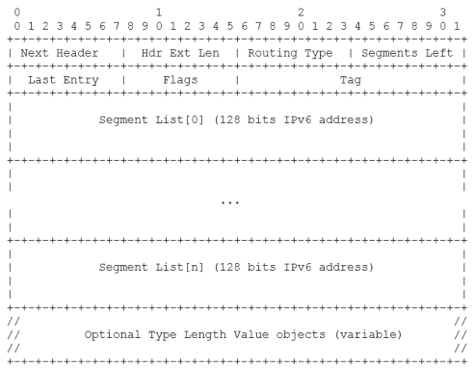
SRv6 Dataplane # n
Segment Left - pointer to active Segment from Segment List
Only value of Pointer is changed - Segments List [xxx] is not removed like MPLS label
Last Segment of SR Policy (index = 0)
First Segment of SR Policy (index = n)
Notes:
https://www.rfc-editor.org/rfc/rfc8754.html

Slide 47
SRv6 Dataplane # n-1
Segment Left - pointer to active Segment from Segment List
Only value of Pointer is changed - Segments List [xxx] is not removed like MPLS label
Last Segment of SR Policy (index = 0)
First Segment of SR Policy (index = n)
Notes:
https://www.rfc-editor.org/rfc/rfc8754.html

Slide 48
SRv6 Dataplane # n-2 ….
Segment Left - pointer to active Segment from Segment List
Only value of Pointer is changed - Segments List [xxx] is not removed like MPLS label
Last Segment of SR Policy (index = 0)
First Segment of SR Policy (index = n)
Notes:
https://www.rfc-editor.org/rfc/rfc8754.html

Slide 49
SRv6 Dataplane # 3
Segment Left - pointer to active Segment from Segment List
Only value of Pointer is changed - Segments List [xxx] is not removed like MPLS label
Last Segment of SR Policy (index = 0)
First Segment of SR Policy (index = n)
Notes:
https://www.rfc-editor.org/rfc/rfc8754.html

Slide 50
SRv6 Dataplane # 2
Segment Left - pointer to active Segment from Segment List
Only value of Pointer is changed - Segments List [xxx] is not removed like MPLS label
Last Segment of SR Policy (index = 0)
First Segment of SR Policy (index = n)
Notes:
https://www.rfc-editor.org/rfc/rfc8754.html

Slide 51
SRv6 Dataplane # 1
Segment Left - pointer to active Segment from Segment List
Only value of Pointer is changed - Segments List [xxx] is not removed like MPLS label
Last Segment of SR Policy (index = 0)
First Segment of SR Policy (index = n)
Notes:
https://www.rfc-editor.org/rfc/rfc8754.html

Slide 52
SRv6 Dataplane # 0 (last)
Segment Left - pointer to active Segment from Segment List
Only value of Pointer is changed - Segments List [xxx] is not removed like MPLS label
Last Segment of SR Policy (index = 0)
First Segment of SR Policy (index = n)
0
0
Notes:
https://www.rfc-editor.org/rfc/rfc8754.html

Slide 53
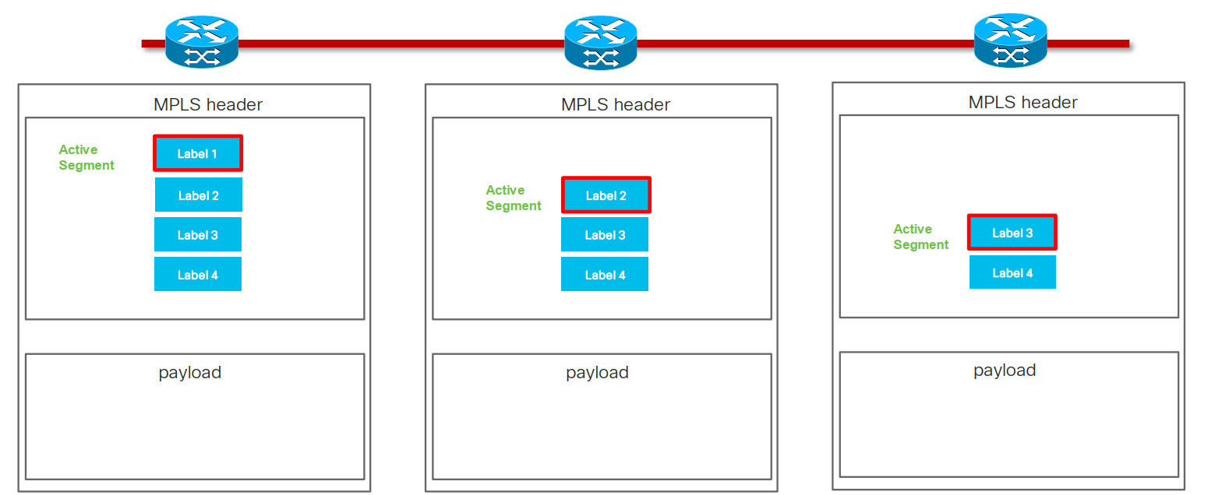
Segment Routing Segments - MPLS
Notes:
MPLS labels are imposed to MPLS packet and there removed as packet is transported through the network

Slide 54
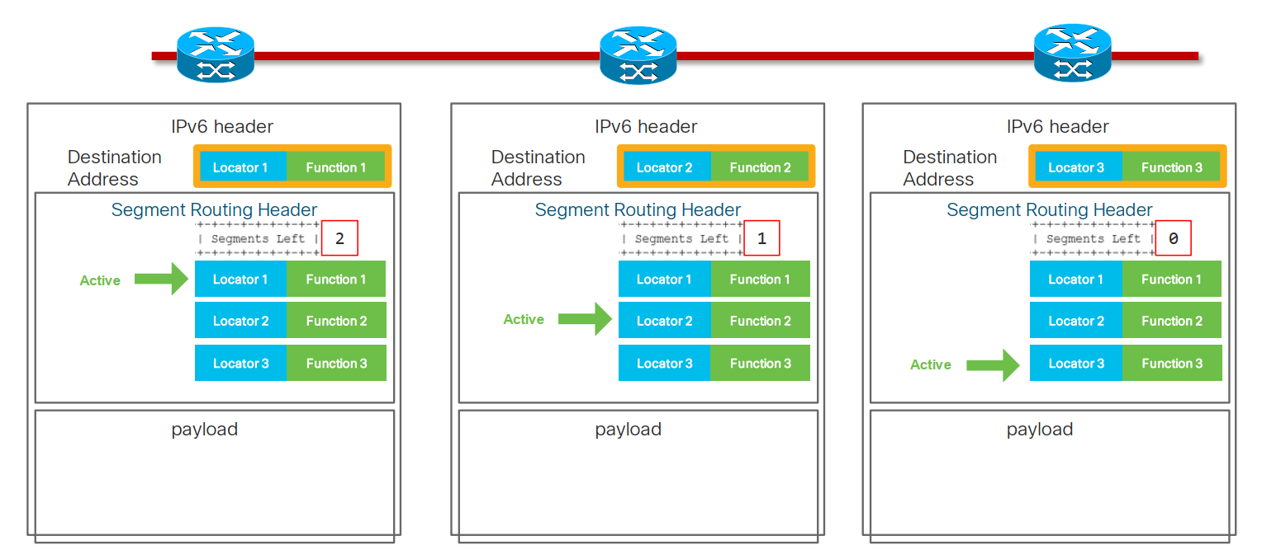
Segment Routing Segments - IPv6
Locator1
Function1
Locator2
Function2
Locator3
Function3
Locator3
Function3
Locator3
Function3
Active
Locator3
Function3
Locator2
Function2
Locator2
Function2
Active
Locator2
Function2
Locator2
Function2
Locator1
Function1
Active
Locator1
Function1
Locator1
Function1
Locator1
Function1

Slide 55
Network instruction
128-bit SRv6 SID
  Locator: routed to the node performing the function
  Function: any possible function (optional argument)
    either local to NPU or app in VM/Container
Flexible bit-length selection
Locator
Function (arg)

Slide 56
Network Program #1
Node A
Node B
Node C
Loc4
Node D
Node E
Loc3
Node F
Node G
Loc2
Node H
Locator 4
Function 4
IPv6 DST Addr.
Node I
Loc1
Locator 0
Function 0
Locator 1
Function 1
Node J
Locator 2
Function 2
SHR
Locator 3
Function 3
Active segment
Locator 4
Function 4
Node K
Loc0

Slide 57
Network Program #2
Node A
Node B
Node C
Loc4
Node D
Node E
Loc3
Node F
Node G
Loc2
Node H
Locator 4
Function 4
IPv6 DST Addr.
Node I
Loc1
Locator 0
Function 0
Locator 1
Function 1
Node J
Locator 2
Function 2
SHR
Locator 3
Function 3
Active segment
Locator 4
Function 4
Node K
Loc0

Slide 58
Network Program #3
Node A
Node B
Node C
Loc4
Node D
Node E
Loc3
Node F
Node G
Loc2
Node H
Locator 4
Function 4
IPv6 DST Addr.
Node I
Loc1
Locator 0
Function 0
Locator 1
Function 1
Node J
Locator 2
Function 2
SHR
Locator 3
Function 3
Active segment
Locator 4
Function 4
Node K
Loc0

Slide 59
Network Program #4
Node A
Node B
Node C
Loc4
Node D
Node E
Loc3
Node F
Node G
Loc2
Node H
Locator 3
Function 3
IPv6 DST Addr.
Node I
Loc1
Locator 0
Function 0
Locator 1
Function 1
Node J
Locator 2
Function 2
SHR
Active segment
Locator 3
Function 3
Locator 4
Function 4
Node K
Loc0

Slide 60
Network Program #5
Node A
Node B
Node C
Loc4
Node D
Node E
Loc3
Node F
Node G
Loc2
Node H
Locator 3
Function 3
IPv6 DST Addr.
Node I
Loc1
Locator 0
Function 0
Locator 1
Function 1
Node J
Locator 2
Function 2
SHR
Active segment
Locator 3
Function 3
Locator 4
Function 4
Node K
Loc0

Slide 61
Network Program #6
Node A
Node B
Node C
Loc4
Node D
Node E
Loc3
Node F
Node G
Loc2
Node H
Locator 2
Function 2
IPv6 DST Addr.
Node I
Loc1
Locator 0
Function 0
Locator 1
Function 1
Node J
Active segment
Locator 2
Function 2
SHR
Locator 3
Function 3
Locator 4
Function 4
Node K
Loc0

Slide 62
Network Program #7
Node A
Node B
Node C
Loc4
Node D
Node E
Loc3
Node F
Node G
Loc2
Node H
Locator 2
Function 2
IPv6 DST Addr.
Node I
Loc1
Locator 0
Function 0
Locator 1
Function 1
Node J
Active segment
Locator 2
Function 2
SHR
Locator 3
Function 3
Locator 4
Function 4
Node K
Loc0

Slide 63
Network Program #8
Node A
Node B
Node C
Loc4
Node D
Node E
Loc3
Node F
Node G
Loc2
Node H
Locator 1
Function 1
IPv6 DST Addr.
Node I
Loc1
Locator 0
Function 0
Active segment
Locator 1
Function 1
Node J
Locator 2
Function 2
SHR
Locator 3
Function 3
Locator 4
Function 4
Node K
Loc0

Slide 64
Network Program #9
Node A
Node B
Node C
Loc4
Node D
Node E
Loc3
Node F
Node G
Loc2
Node H
Locator 1
Function 1
IPv6 DST Addr.
Node I
Loc1
Locator 0
Function 0
Active segment
Locator 1
Function 1
Node J
Locator 2
Function 2
SHR
Locator 3
Function 3
Locator 4
Function 4
Node K
Loc0

Slide 65
Network Program #10 – without Penultimate Segment Popping (PSP)
Node A
Node B
Node C
Loc4
Node D
Node E
Loc3
Node F
Node G
Loc2
Node H
Locator 0
Function 0
IPv6 DST Addr.
Node I
Loc1
Active segment
Locator 0
Function 0
Locator 1
Function 1
Node J
Locator 2
Function 2
SHR
Locator 3
Function 3
Locator 4
Function 4
Node K
Loc0

Slide 66
Network Program #11 – without Penultimate Segment Popping (PSP)
Node A
Node B
Node C
Loc4
Node D
Node E
Loc3
Node F
Node G
Loc2
Node H
Locator 0
Function 0
IPv6 DST Addr.
Node I
Loc1
Active segment
Locator 0
Function 0
Locator 1
Function 1
Node J
Locator 2
Function 2
SHR
Locator 3
Function 3
Locator 4
Function 4
Node K
Loc0

Slide 67
Network Program #12 – without Penultimate Segment Popping (PSP)
Node A
Node B
Node C
Loc4
Node D
Node E
Loc3
Node F
Node G
Loc2
Node H
Locator 0
Function 0
IPv6 DST Addr.
Node I
Loc1
X
Locator 0
Function 0
Locator 1
Function 1
Node J
Locator 2
Function 2
SHR
Locator 3
Function 3
Locator 4
Function 4
Node K
Loc0

Slide 68
Penultimate Segment Popping (PSP)
Penultimate Segment Popping (PSP) flavor enables penultimate endpoint node along SR path to remove the exhausted SRH from packed header
Save overhead as SRH is not needed anymore for forwarding
PSP is different from MPLS PHP
  PSP
    done on penultimate segment endpoint
    Remove entire SRH
  PHP
    penultimate routing hop in MPLS
    Remove top MPLS label

Slide 69
Network Program #10 – with Penultimate Segment Popping (PSP)
Node A
Node B
Node C
Loc4
Node D
Node E
Loc3
Node F
Node G
Loc2
Node H
Locator 0
Function 0
IPv6 DST Addr.
Node I
Loc1
1
X
Active segment
Locator 0
Function 0
Locator 1
Function 1
Node J
2
SHR
Locator 2
Function 2
Locator 3
Function 3
Locator 4
Function 4
Node K
Loc0

Slide 70
Network Program #11 – with Penultimate Segment Popping (PSP)
Node A
Node B
Node C
Loc4
Node D
Node E
Loc3
Node F
Node G
Loc2
Node H
Locator 0
Function 0
IPv6 DST Addr.
Node I
Loc1
Node J
Node K
Loc0

Slide 71
Network Program #12 – with Penultimate Segment Popping (PSP)
Node A
Node B
Node C
Loc4
Node D
Node E
Loc3
Node F
Node G
Loc2
Node H
Locator 0
Function 0
IPv6 DST Addr.
Node I
Loc1
Node J
Node K
Loc0

Slide 72
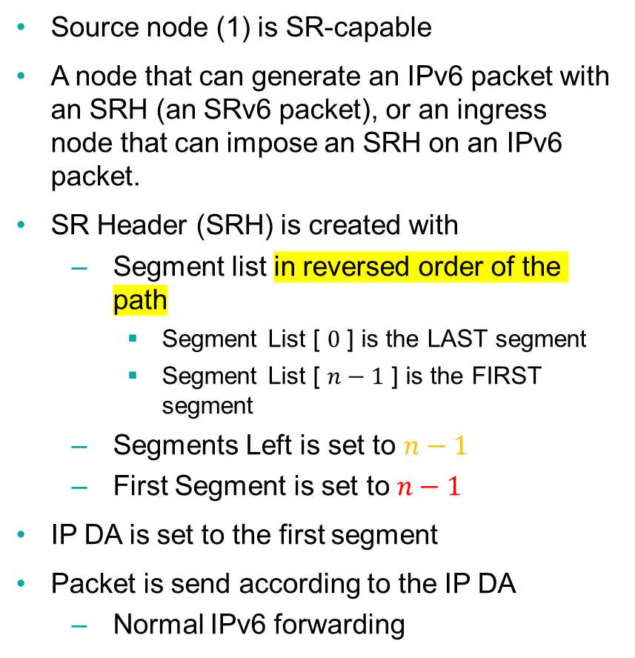
Forwarding – Source Node
Source node (1) is SR-capable
A node that can generate an IPv6 packet with an SRH (an SRv6 packet), or an ingress node that can impose an SRH on an IPv6 packet.
SR Header (SRH) is created with
  Segment list in reversed order of the path
    Segment List [ $0$ ] is the LAST segment
    Segment List [ $n−1$ ] is the FIRST segment
  Segments Left is set to $n−1$
  First Segment is set to $n−1$
IP DA is set to the first segment
Packet is send according to the IP DA
  Normal IPv6 forwarding
1
A1::
2
A2::
3
A3::
4
A4::
R
IPv6 Hdr
SA = A1::, DA = A2::
SR Hdr
( A4::, A3::, A2:: ) SL=2
Payload
Version
Traffic Class
Flow Label
Flow Label
Payload Length
Next = 43
Hop Limit
IPv6 Hdr
Source Address = A1::
Destination Address = A2::
Next Header
Len= 6
Type = 4
SL = 2
First = 2
Flags
TAG
SR Hdr
Segment List [ 0 ] = A4::
Segment List [ 1 ] = A3::
Segment List [ 2 ] = A2::
Payload
Notes:
Here we assume that the source node is SR-capable.
But of course we are also able to handle cases where the source is either not SR capable or not aware that SR is used at some point in the network. In these cases the SR information can be added later on the path.
We'll see that in the use-case section
Summarized representation of the headers

Slide 73
Forwarding - Non-SR Transit Node (R)
Plain IPv6 forwarding
Solely based on IPv6 DA (IPv6 DA does not correspond to transit node)
No SRH inspection or update
1
A1::
2
A2::
3
A3::
4
A4::
R
IPv6 Hdr
SA = A1::, DA = A2::
SR Hdr
( A4::, A3::, A2:: ) SL=2
Payload
Notes:
Before reaching 2, the packet may traverse a non-SR transit node.
And this is not a problem at all.
Since the IP DA is A2::, the SR H will not even be looked at before reaching 2.

Slide 74
Forwarding - SR Segment Endpoints (2)
SR Endpoints: SR-capable nodes whose address is in the IP DA
SR Endpoints inspect the SRH and do:
  IF Segments Left > 0, THEN
    Decrement Segments Left ( -1 )
    Update DA with Segment List [ Segments Left ]
    Forward according to the new IP DA
1
A1::
2
A2::
3
A3::
4
A4::
R
IPv6 Hdr
SA = A1::, DA = A3::
SR Hdr
( A4::, A3::, A2:: ) SL=1
Payload
Version
Traffic Class
Flow Label
Flow Label
Payload Length
Next = 43
Hop Limit
IPv6 Hdr
Source Address = A1::
Destination Address = A3::
Next Header
Len= 6
Type = 4
SL = 1
First = 2
Flags
TAG
SR Hdr
Segment List [ 0 ] = A4::
Segment List [ 1 ] = A3::
Segment List [ 2 ] = A2::
Payload
Notes:
At 2 we have reached the IP Destination Address
At this point the forwarding engine will look at whatever is next in the packet

Slide 75
Forwarding - SR Segment Endpoints
SR Endpoints: SR-capable nodes whose address is in the IP DA
SR Endpoints inspect the SRH and do:
  IF Segments Left > 0, THEN
    Decrement Segments Left ( -1 )
    Update DA with Segment List [ Segments Left ]
    Forward according to the new IP DA
  ELSE (Segments Left = 0)
    Remove the IP and SR header
    Process the payload:
      Inner IP: Lookup DA and forward
      TCP / UDP: Send to socket
      …
1
A1::
2
A2::
3
A3::
4
A4::
R
IPv6 Hdr
SA = A1::, DA = A4::
SR Hdr
( A4::, A3::, A2:: ) SL=0
Payload
Version
Traffic Class
Flow Label
Flow Label
Payload Length
Next = 43
Hop Limit
IPv6 Hdr
Source Address = A1::
Destination Address = A4::
Next Header
Len= 6
Type = 4
SL = 0
Standard IPv6 processing
The final destination does not have to be SR-capable.
First = 2
Flags
TAG
SR Hdr
Segment List [ 0 ] = A4::
Segment List [ 1 ] = A3::
Segment List [ 2 ] = A2::
Payload

Slide 76
SR header and encapsulation
While not explicitly mentioned, RFC2460 assumes only the source is allowed to insert a routing header
  Remember: the SRH is a type of routing header
Segment Routing for IPv6 allows multiple operational modes
  All compliant to base IPv6 specification

Slide 77
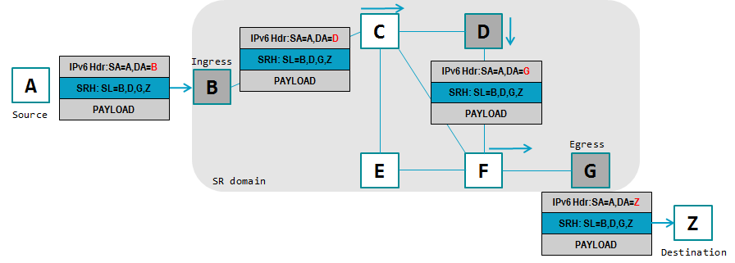
Header Insertion at the Source
Source originates the packet with the SRH
SRH is kept and used along the path
Packet is delivered to destination with the SRH (plain IPv6 operations)
Optionally, the SRH may be removed prior to deliver the packet to destination
Use case: source is SRv6 capable

Slide 78
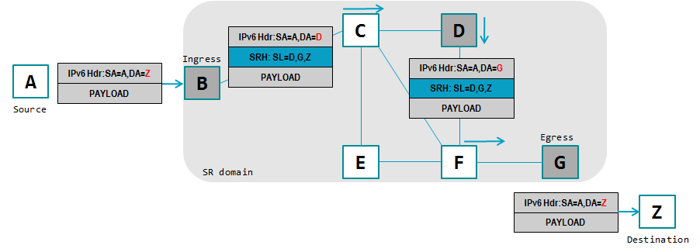
Header Insertion at Ingress
Source originates the packet without any SRH
SRH is inserted at ingress
SRH is removed prior to deliver the packet to the destination
Use case: source is not SRv6 capable

Slide 79
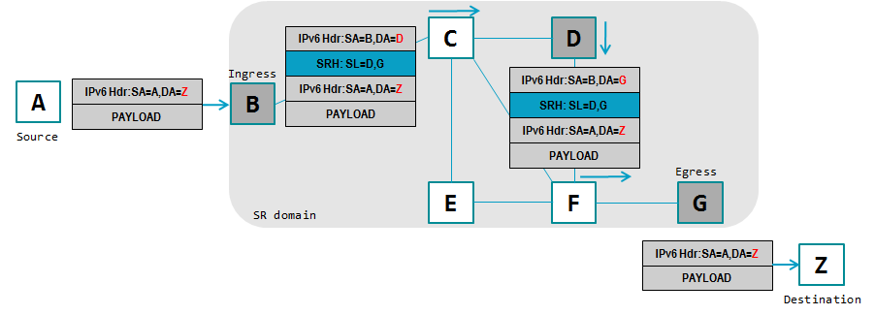
Encapsulation at Ingress
Source originates the packet without any SRH
Ingress encapsulates the incoming packet into a new outer IPv6 header followed by the SRH
Packet is decapsulated at egress (both outer IPv6 header and SRH are removed)
Unchanged

Slide 80
Example of Explicit Path
How to express an explicit (source routed) path knowing that:
  Nodes may represent routers, hosts, servers, application instances, services, chains of services, etc.
  A path is encoded into the packet by the originator (or ingress) node using a list of IPv6 addresses
  The network may have plurality of nodes not all supporting Segment Routing
  A path can be “loose” or “strict”
    Likely to be loose…
A single mechanism, a single placeholder where the “path” of the packet is expressed

Slide 81
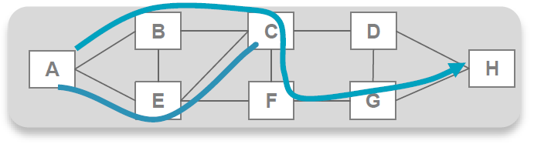
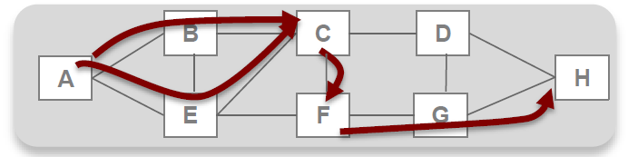
Example of Explicit Path
In following topology:
Q: How to best express path: [A, B, C, F, G, H]
Note well: node A has two shortest paths to C (ECMP)
A: Source rooted path with segments: [C,F,H]
  First segment: set of shortest paths from A to C (ECMP aware)
  Second segment: adjacency/link from C to F
  Third segment: shortest path from F to H
Loose Source Routing

Slide 82
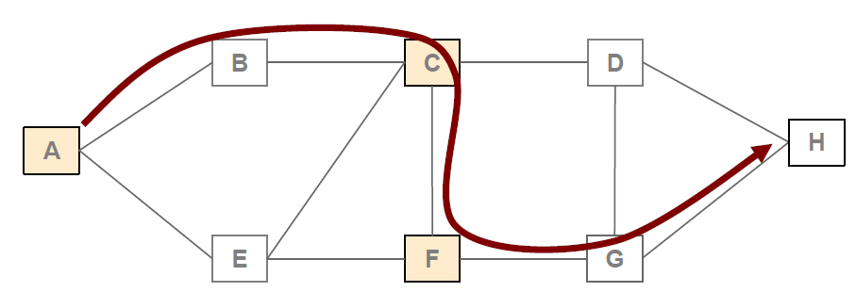
Interoperability
Not all nodes needs to be SR capable
Example:
  Traffic Engineering from A to H through path ABCFGH
  Nodes A, C and F are SR capable
  Nodes B, D, E, G and H are plain ipv6 forwarders

Slide 83
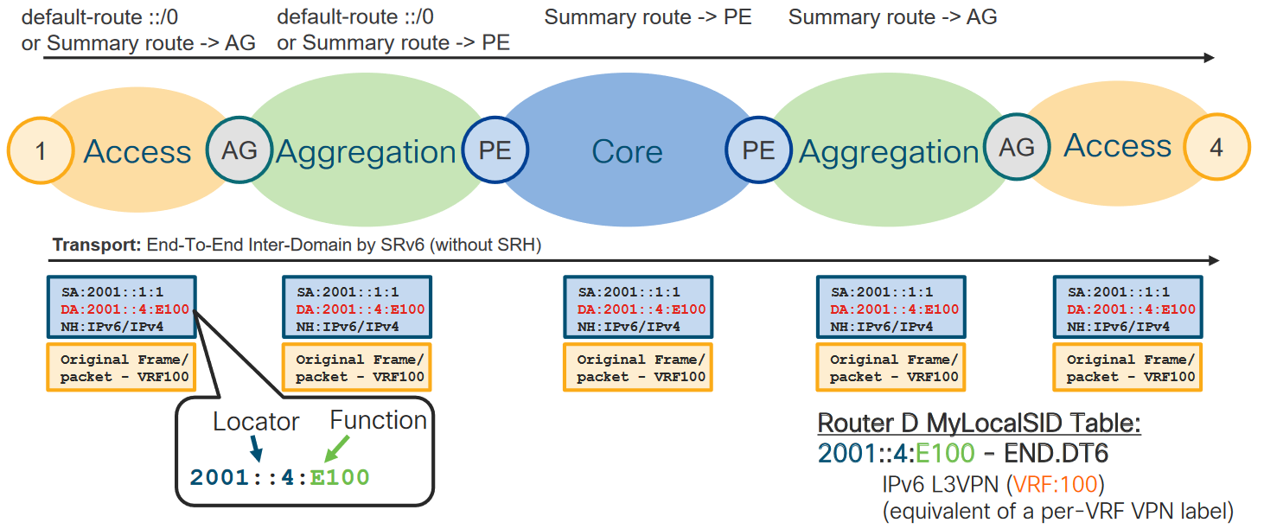
Inter-Domain SRv6 without SRH

Slide 84
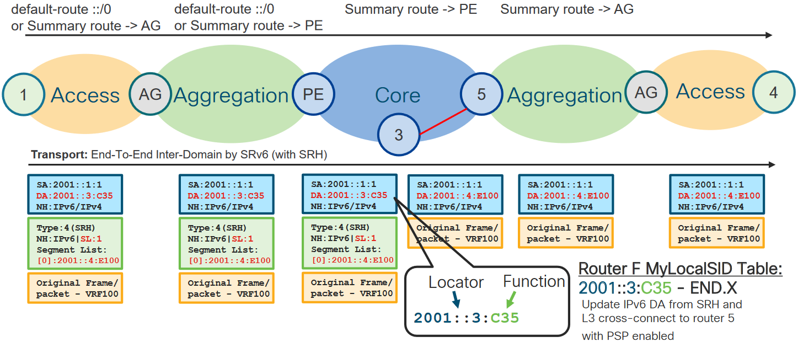
Inter-Domain SRv6 with SRH – traffic steering

Slide 85
Segment Routing over IPv6 dataplane
SRv6 SID
Full SID format
SRv6 and service migration

Slide 86
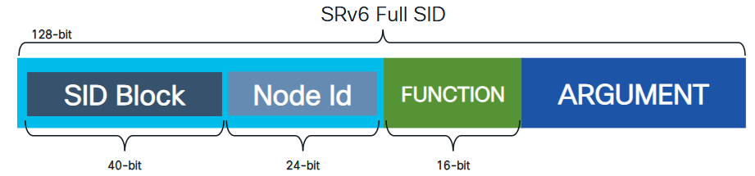
SRv6 SID Format (Full SID)
Guidelines and Restrictions while configuring SRv6
All routers in the SRv6 domain should have the same SID block (network designator) in their locator
The locator length should be 64-bits long (Full SID , Format F1).
  The SID block portion (MSBs) cannot exceed 40 bits. If this value is less than 40 bits, user should use a pattern of zeros as a filler.
  The Node Id portion (LSBs) cannot exceed 24 bits.
You can configure up to 8 locators to support SRv6 Flexible Algorithm. All locators prefix must share the same SID block (first 40-bits).
Router(config)#segment-routing srv6
Router(config-srv6)#locators
Router(config-srv6-locators)#locator myLoc1
Router(config-srv6-locator)#prefix 2001:db8:0:2::/64
2001:0db8:0000:0002::/64
Notes:
https://www.cisco.com/c/en/us/td/docs/routers/asr9000/software/24xx/segment-routing/configuration/guide/b-segment-routing-cg-asr9000-24xx/configure-srv6-full-length-sid.html#id_94209__section_Configuring_SRv6_Base
platne od IOS-XR 7.5

Slide 87
Full SID configuration example – IOS-XR
!
segment-routing
srv6
logging locator status
locators
locator MyFullLoc01
prefix fc00:ab00:2::/64
!
router isis 1
is-type level-2-only
net 49.0001.0000.0000.0002.00
!
address-family ipv6 unicast
metric-style wide
segment-routing srv6
locator MyFullLoc01
level 2
!
!
!
interface Loopback0
passive
circuit-type level-2-only
address-family ipv6 unicast
!
!
interface GigabitEthernet0/0/0/0
circuit-type level-2-only
point-to-point
address-family ipv6 unicast
!
!
Locator name
Locator value in IPv6 address format
Routing protocol for IPv6 routing

Slide 88
Full SID show commands example – IOS-XR
SIDs associated with MyFullLoc01
RP/0/RP0/CPU0:R02#sh segment-routing srv6 locator MyFullLoc01 internal
Thu Nov 7 11:26:11.810 UTC
Name ID Algo Prefix Status Flags
-------------------- ------- ---- ------------------------ ------- --------
MyFullLoc01 3 0 fc00:ab00:2::/64 Up
Index: 3
Flags: 0x0
Format: base <40B/24N/16F/8A> (1)
FSM state: UP
Global OOR State: Resource Available
Local SID OOR State: Resource Available
Interface:
Name: srv6-MyFullLoc01
IFH : 0x0000002c
IPv6 address: fc00:ab00:2::/64 (IM notified: fc00:ab00:2::/64)
Algo: 0 (IM notified: 0)
Number of SIDs: 3
Chkpt Obj ID: 0x2f60
Number of SID CTX: 4
Number of Auto SIDs: 1
TI Object:
Type: Entry
Ptr: 0x139839370908128, Producer ID: 0
Flags:
Generic: 0x0 ()
Specific: 0x0 ()
Modified: Tue Nov 05 14:12:54 UTC 2024 (1d21h ago)
Created: Nov 5 14:12:55.129 (1d21h ago)
Event history:
-- cut --
Configured Locators
Locator
Function (Arg)
RP/0/RP0/CPU0:R02#sh segment-routing srv6 locator MyFullLoc01
Name ID Algo Prefix Status Flags
-------------------- ------- ---- ------------------------ ------- --------
MyFullLoc01 3 0 fc00:ab00:2::/64 Up
RP/0/RP0/CPU0:R02#sh segment-routing srv6 locator MyFullLoc01 detail
Name ID Algo Prefix Status Flags
-------------------- ------- ---- ------------------------ ------- --------
MyFullLoc01 3 0 fc00:ab00:2::/64 Up
Interface:
Name: srv6-MyFullLoc01
IFH : 0x0000002c
IPv6 address: fc00:ab00:2::/64
Number of SIDs: 3
Created: Nov 5 14:12:55.129 (1d21h ago)
RP/0/RP0/CPU0:R02#
RP/0/RP0/CPU0:R02#sh segment-routing srv6 locator MyFullLoc01 sid
SID Behavior Context Owner State RW
-------------------------- ---------------- -------------------------------- ------------------ ----- --
fc00:ab00:2:0:1:: End (PSP/USD) 'default':1 sidmgr InUse Y
fc00:ab00:2:0:40:: End.X (PSP/USD) [Gi0/0/0/0, Link-Local] isis-1 InUse Y
fc00:ab00:2:0:41:: End.X (PSP/USD) [Gi0/0/0/2, Link-Local] isis-1 InUse Y
fc00:ab00:2:0:42:: End.X (PSP/USD) [Gi0/0/0/4, Link-Local] isis-1 InUse Y
RP/0/RP0/CPU0:R02#

Slide 89
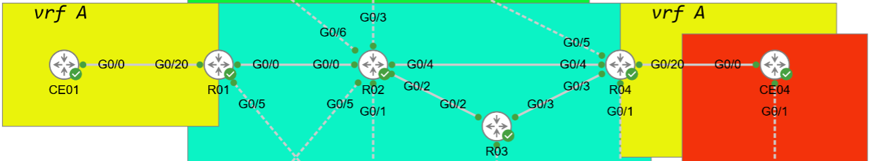
Full SID
R01: Lo0=2001:9999::1/128; Locator=fc00:ab00:1::/64; NET=49.0001.0000.0000.0001.00
R02: Lo0=2001:9999::2/128; Locator=fc00:ab00:2::/64; NET=49.0001.0000.0000.0002.00
R03: Lo0=2001:9999::3/128; Locator=fc00:ab00:3::/64; NET=49.0001.0000.0000.0003.00
R04: Lo0=2001:9999::4/128; Locator=fc00:ab00:4::/64; NET=49.0001.0000.0000.0004.00
RP/0/RP0/CPU0:R01#sh route ipv6
-- Cut --
L ::ffff:127.0.0.0/104
[0/0] via ::, 02:46:07
L 2001:9999::1/128 is directly connected,
01:54:38, Loopback0
i L2 2001:9999::2/128
[115/10] via fe80::5054:ff:fe17:af75, 01:53:07, GigabitEthernet0/0/0/0
i L2 2001:9999::3/128
[115/20] via fe80::5054:ff:fe17:af75, 01:51:57, GigabitEthernet0/0/0/0
i L2 2001:9999::4/128
[115/20] via fe80::5054:ff:fe17:af75, 01:50:30, GigabitEthernet0/0/0/0
L fc00:ab00:1:0:1::/128, SRv6 Endpoint End (PSP/USD)
[0/0] via ::, 02:48:04
L fc00:ab00:1:0:40::/128, SRv6 Endpoint End.X (PSP/USD)
[0/0] via fe80::5054:ff:fe17:af75, 02:45:19, GigabitEthernet0/0/0/0
i L2 fc00:ab00:2::/64
[115/11] via fe80::5054:ff:fe17:af75, 01:53:07, GigabitEthernet0/0/0/0
i L2 fc00:ab00:3::/64
[115/21] via fe80::5054:ff:fe17:af75, 01:51:57, GigabitEthernet0/0/0/0
i L2 fc00:ab00:4::/64
[115/21] via fe80::5054:ff:fe17:af75, 01:50:30, GigabitEthernet0/0/0/0
-- Cut --
RP/0/RP0/CPU0:R01#
RP/0/RP0/CPU0:R01#show segment-routing srv6 locator
Name ID Algo Prefix Status Flags
-------------------- ------- ---- ------------------------ ------- --------
MyFullLoc01 1 0 fc00:ab00:1::/64 Up
RP/0/RP0/CPU0:R01#show segment-routing srv6 sid all
*** Locator: 'MyFullLoc01' ***
SID Behavior Context Owner State RW
-------------------------- ---------------- -------------------------------- ------------------ ----- --
fc00:ab00:1:0:1:: End (PSP/USD) 'default':1 sidmgr InUse Y
fc00:ab00:1:0:40:: End.X (PSP/USD) [Gi0/0/0/0, Link-Local] isis-1 InUse Y
RP/0/RP0/CPU0:R01#

Slide 90
Full SID
R01: Lo0=2001:9999::1/128; Locator=fc00:ab00:1::/64; NET=49.0001.0000.0000.0001.00
R02: Lo0=2001:9999::2/128; Locator=fc00:ab00:2::/64; NET=49.0001.0000.0000.0002.00
R03: Lo0=2001:9999::3/128; Locator=fc00:ab00:3::/64; NET=49.0001.0000.0000.0003.00
R04: Lo0=2001:9999::4/128; Locator=fc00:ab00:4::/64; NET=49.0001.0000.0000.0004.00
RP/0/RP0/CPU0:R02#sh route ipv6
-- Cut --
L ::ffff:127.0.0.0/104
[0/0] via ::, 03:21:51
i L2 2001:9999::1/128
[115/10] via fe80::5054:ff:fe14:94d4, 02:29:44, GigabitEthernet0/0/0/0
L 2001:9999::2/128 is directly connected,
02:28:14, Loopback0
i L2 2001:9999::3/128
[115/10] via fe80::5054:ff:fe1c:96f4, 02:27:03, GigabitEthernet0/0/0/2
i L2 2001:9999::4/128
[115/10] via fe80::5054:ff:fe09:6ab0, 02:25:36, GigabitEthernet0/0/0/4
i L2 fc00:ab00:1::/64
[115/11] via fe80::5054:ff:fe14:94d4, 02:29:44, GigabitEthernet0/0/0/0
L fc00:ab00:2:0:1::/128, SRv6 Endpoint End (PSP/USD)
[0/0] via ::, 03:23:20
L fc00:ab00:2:0:40::/128, SRv6 Endpoint End.X (PSP/USD)
[0/0] via fe80::5054:ff:fe1c:96f4, 03:20:25, GigabitEthernet0/0/0/2
L fc00:ab00:2:0:41::/128, SRv6 Endpoint End.X (PSP/USD)
[0/0] via fe80::5054:ff:fe14:94d4, 03:20:25, GigabitEthernet0/0/0/0
L fc00:ab00:2:0:42::/128, SRv6 Endpoint End.X (PSP/USD)
[0/0] via fe80::5054:ff:fe09:6ab0, 03:17:50, GigabitEthernet0/0/0/4
i L2 fc00:ab00:3::/64
[115/11] via fe80::5054:ff:fe1c:96f4, 02:27:03, GigabitEthernet0/0/0/2
i L2 fc00:ab00:4::/64
[115/11] via fe80::5054:ff:fe09:6ab0, 02:25:36, GigabitEthernet0/0/0/4
-- Cut --
RP/0/RP0/CPU0:R02#
RP/0/RP0/CPU0:R02#show segment-routing srv6 locator
Name ID Algo Prefix Status Flags
-------------------- ------- ---- ------------------------ ------- --------
MyFullLoc01 1 0 fc00:ab00:2::/64 Up
RP/0/RP0/CPU0:R02#show segment-routing srv6 sid all
*** Locator: 'MyFullLoc01' ***
SID Behavior Context Owner State RW
-------------------------- ---------------- -------------------------------- ------------------ ----- --
fc00:ab00:2:0:1:: End (PSP/USD) 'default':1 sidmgr InUse Y
fc00:ab00:2:0:40:: End.X (PSP/USD) [Gi0/0/0/2, Link-Local] isis-1 InUse Y
fc00:ab00:2:0:41:: End.X (PSP/USD) [Gi0/0/0/0, Link-Local] isis-1 InUse Y
fc00:ab00:2:0:42:: End.X (PSP/USD) [Gi0/0/0/4, Link-Local] isis-1 InUse Y
RP/0/RP0/CPU0:R02#

Slide 91
Full SID
R01: Lo0=2001:9999::1/128; Locator=fc00:ab00:1::/64; NET=49.0001.0000.0000.0001.00
R02: Lo0=2001:9999::2/128; Locator=fc00:ab00:2::/64; NET=49.0001.0000.0000.0002.00
R03: Lo0=2001:9999::3/128; Locator=fc00:ab00:3::/64; NET=49.0001.0000.0000.0003.00
R04: Lo0=2001:9999::4/128; Locator=fc00:ab00:4::/64; NET=49.0001.0000.0000.0004.00
RP/0/RP0/CPU0:R03#sh route ipv6
-- Cut --
L ::ffff:127.0.0.0/104
[0/0] via ::, 03:47:48
i L2 2001:9999::1/128
[115/20] via fe80::5054:ff:fe03:dd9a, 02:55:45, GigabitEthernet0/0/0/2
i L2 2001:9999::2/128
[115/10] via fe80::5054:ff:fe03:dd9a, 02:54:15, GigabitEthernet0/0/0/2
L 2001:9999::3/128 is directly connected,
02:53:05, Loopback0
i L2 2001:9999::4/128
[115/10] via fe80::5054:ff:fe11:2f5e, 02:51:37, GigabitEthernet0/0/0/3
i L2 fc00:ab00:1::/64
[115/21] via fe80::5054:ff:fe03:dd9a, 02:55:45, GigabitEthernet0/0/0/2
i L2 fc00:ab00:2::/64
[115/11] via fe80::5054:ff:fe03:dd9a, 02:54:15, GigabitEthernet0/0/0/2
L fc00:ab00:3:0:1::/128, SRv6 Endpoint End (PSP/USD)
[0/0] via ::, 03:49:21
L fc00:ab00:3:0:40::/128, SRv6 Endpoint End.X (PSP/USD)
[0/0] via fe80::5054:ff:fe03:dd9a, 03:46:26, GigabitEthernet0/0/0/2
L fc00:ab00:3:0:41::/128, SRv6 Endpoint End.X (PSP/USD)
[0/0] via fe80::5054:ff:fe11:2f5e, 03:43:51, GigabitEthernet0/0/0/3
i L2 fc00:ab00:4::/64
[115/11] via fe80::5054:ff:fe11:2f5e, 02:51:37, GigabitEthernet0/0/0/3
-- Cut --
RP/0/RP0/CPU0:R03#
RP/0/RP0/CPU0:R03#show segment-routing srv6 locator
Name ID Algo Prefix Status Flags
-------------------- ------- ---- ------------------------ ------- --------
MyFullLoc01 1 0 fc00:ab00:3::/64 Up
RP/0/RP0/CPU0:R03#show segment-routing srv6 sid all
*** Locator: 'MyFullLoc01' ***
SID Behavior Context Owner State RW
-------------------------- ---------------- -------------------------------- ------------------ ----- --
fc00:ab00:3:0:1:: End (PSP/USD) 'default':1 sidmgr InUse Y
fc00:ab00:3:0:40:: End.X (PSP/USD) [Gi0/0/0/2, Link-Local] isis-1 InUse Y
fc00:ab00:3:0:41:: End.X (PSP/USD) [Gi0/0/0/3, Link-Local] isis-1 InUse Y
RP/0/RP0/CPU0:R03#

Slide 92
Full SID
R01: Lo0=2001:9999::1/128; Locator=fc00:ab00:1::/64; NET=49.0001.0000.0000.0001.00
R02: Lo0=2001:9999::2/128; Locator=fc00:ab00:2::/64; NET=49.0001.0000.0000.0002.00
R03: Lo0=2001:9999::3/128; Locator=fc00:ab00:3::/64; NET=49.0001.0000.0000.0003.00
R04: Lo0=2001:9999::4/128; Locator=fc00:ab00:4::/64; NET=49.0001.0000.0000.0004.00
RP/0/RP0/CPU0:R04#sh route ipv6
-- Cut --
L ::ffff:127.0.0.0/104
[0/0] via ::, 04:39:49
i L2 2001:9999::1/128
[115/20] via fe80::5054:ff:fe05:ee55, 03:50:33, GigabitEthernet0/0/0/4
i L2 2001:9999::2/128
[115/10] via fe80::5054:ff:fe05:ee55, 03:49:03, GigabitEthernet0/0/0/4
i L2 2001:9999::3/128
[115/10] via fe80::5054:ff:fe1f:b0f5, 03:47:53, GigabitEthernet0/0/0/3
L 2001:9999::4/128 is directly connected,
03:46:26, Loopback0
i L2 fc00:ab00:1::/64
[115/21] via fe80::5054:ff:fe05:ee55, 03:50:33, GigabitEthernet0/0/0/4
i L2 fc00:ab00:2::/64
[115/11] via fe80::5054:ff:fe05:ee55, 03:49:03, GigabitEthernet0/0/0/4
i L2 fc00:ab00:3::/64
[115/11] via fe80::5054:ff:fe1f:b0f5, 03:47:53, GigabitEthernet0/0/0/3
L fc00:ab00:4:0:1::/128, SRv6 Endpoint End (PSP/USD)
[0/0] via ::, 04:43:52
L fc00:ab00:4:0:40::/128, SRv6 Endpoint End.X (PSP/USD)
[0/0] via fe80::5054:ff:fe05:ee55, 04:38:40, GigabitEthernet0/0/0/4
L fc00:ab00:4:0:41::/128, SRv6 Endpoint End.X (PSP/USD)
[0/0] via fe80::5054:ff:fe1f:b0f5, 04:38:40, GigabitEthernet0/0/0/3
-- Cut --
RP/0/RP0/CPU0:R04#
RP/0/RP0/CPU0:R04#sh segment-routing srv6 locator
Wed Oct 2 13:11:57.420 UTC
Name ID Algo Prefix Status Flags
-------------------- ------- ---- ------------------------ ------- --------
MyFullLoc01 1 0 fc00:ab00:4::/64 Up
RP/0/RP0/CPU0:R04#sh segment-routing srv6 sid all
Wed Oct 2 13:12:02.846 UTC
*** Locator: 'MyFullLoc01' ***
SID Behavior Context Owner State RW
-------------------------- ---------------- -------------------------------- ------------------ ----- --
fc00:ab00:4:0:1:: End (PSP/USD) 'default':1 sidmgr InUse Y
fc00:ab00:4:0:40:: End.X (PSP/USD) [Gi0/0/0/4, Link-Local] isis-1 InUse Y
fc00:ab00:4:0:41:: End.X (PSP/USD) [Gi0/0/0/3, Link-Local] isis-1 InUse Y
RP/0/RP0/CPU0:R04#

Slide 93
Optional config
Configuring Encapsulation Parameters
  segment-routing srv6 encapsulation source-address ipv6-add
    Source Address of outer encapsulating IPv6 header.
    The default source address for encapsulation is one of the loopback addresses.
  segment-routing srv6 encapsulation hop-limit {count | propagate}
    The hop limit of outer-encapsulating IPv6 header.
    The default = 255; valid range is from 1 to 255
    Use propagate to set the hop-limit value by propagation (from incoming packet/frame).
Router(config)# segment-routing srv6
Router(config-srv6)# encapsulation source-address 1::1
Router(config-srv6)# hop-limit 60
Notes:
RP/0/RP0/CPU0:R33(config)#show configuration failed
Mon Jun 9 10:59:55.640 UTC
!! SEMANTIC ERRORS: This configuration was rejected by
!! the system due to semantic errors. The individual
!! errors with each failed configuration command can be
!! found below.
segment-routing
srv6
encapsulation
hop-limit propagate
!!% Operation not supported: SRv6 config option not supported on this platform
!
!
!
end
RP/0/RP0/CPU0:R33(config)#

Slide 94
Optional config
Enabling Syslog Logging for Locator Status Changes
  logging locator status
Router(config)# segment-routing srv6
Router(config-srv6)# logging locator status

Slide 95
SRv6 Manager - show
Router# show segment-routing srv6 manager
Parameters:
Parameters:
SRv6 Enabled: Yes
SRv6 Operational Mode:
Base:
SID Base Block: 2001:db8::/40
Encapsulation:
Source Address:
Configured: 1::1
Default: 5::5
Hop-Limit: Default
Traffic-class: Default
Summary:
Number of Locators: 1 (1 operational)
Number of SIDs: 4 (0 stale)
Max SIDs: 64000
OOR:
Thresholds: Green 3200, Warning 1920
Status: Resource Available
History: (0 cleared, 0 warnings, 0 full)
Block 2001:db8:0:a2::/64:
Number of SIDs free: 65470
Max SIDs: 65470
Thresholds: Green 3274, Warning 1965
Status: Resource Available
History: (0 cleared, 0 warnings, 0 full)
Platform Capabilities:
SRv6: Yes
TILFA: Yes
Microloop-Avoidance: Yes
Endpoint behaviors:
End (PSP)
End.X (PSP)
End.DX6
End.DX4
End.DT6
End.DT4
End.DX2
uN (PSP/USD)
uA (PSP/USD)
uDT6
uDT4
uDX2
uB6 (Insert.Red)
Headend behaviors:
T
H.Insert.Red
H.Encaps.Red
Security rules:
SEC-1
SEC-2
SEC-3
Counters:
CNT-1
CNT-3
Signaled parameters:
Max-SL : 3
Max-End-Pop-SRH : 3
Max-H-Insert : 3 sids
Max-H-Encap : 3 sids
Max-End-D : 4
Configurable parameters (under srv6):
Encapsulation:
Source Address: Yes
Hop-Limit : value=Yes, propagate=No
Traffic-class : value=Yes, propagate=Yes
Max SIDs: 64000
SID Holdtime: 3 mins

Slide 96
SRv6 SID - show
Router# show segment-routing srv6 locator myLoc1 detail
Name ID Prefix Status
-------------------- ------- ------------------------ -------
myLoc1* 5 2001:db8:0:a2::/64 Up
(*): is-default
Interface:
Name: srv6-myLoc1
IFH : 0x00000170
IPv6 address: 2001:db8:0:a2::/64
Chkpt Obj ID: 0x2fc8
Created: Apr 25 06:21:57.077 (00:03:37 ago)
Router# show segment-routing srv6 locator myLoc1 sid
SID Function Context Owner State RW
-------------------------- ----------- ------------------------------ ------------------ ----- --
2001:db8:0:a2:1:: End (PSP) 'default':1 sidmgr InUse Y
2001:db8:0:a2:40:: End.DT4 'VRF1' bgp-100 InUse Y
2001:db8:0:a2:41:: End.X (PSP) [Hu0/1/0/1, Link-Local] isis-srv6 InUse Y
Router# show segment-routing srv6 locator myLoc1 sid 2001:db8:0:a2:40:: detail
SID Function Context Owner State RW
-------------------------- ----------- ------------------------------ ------------------ ----- --
2001:db8:0:a2:40:: End.DT4 'VRF1' bgp-100 InUse Y
SID context: { table-id=0xe0000011 ('VRF1':IPv4/Unicast) }
Locator: myLoc1'
Allocation type: Dynamic
Created: Feb 1 14:04:02.901 (3d00h ago)
Notes:
https://www.cisco.com/c/en/us/td/docs/routers/asr9000/software/24xx/segment-routing/configuration/guide/b-segment-routing-cg-asr9000-24xx/configure-srv6-full-length-sid.html#id_94209__section_Configuring_SRv6_Base

Slide 97
Segment Routing MPLS and SRv6
L3VPN
SRv6 and service migration

Slide 98
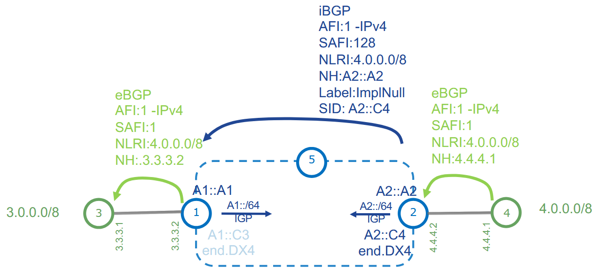
VPNv4 – Basic SRv6 VPN –Control Plane

Slide 99
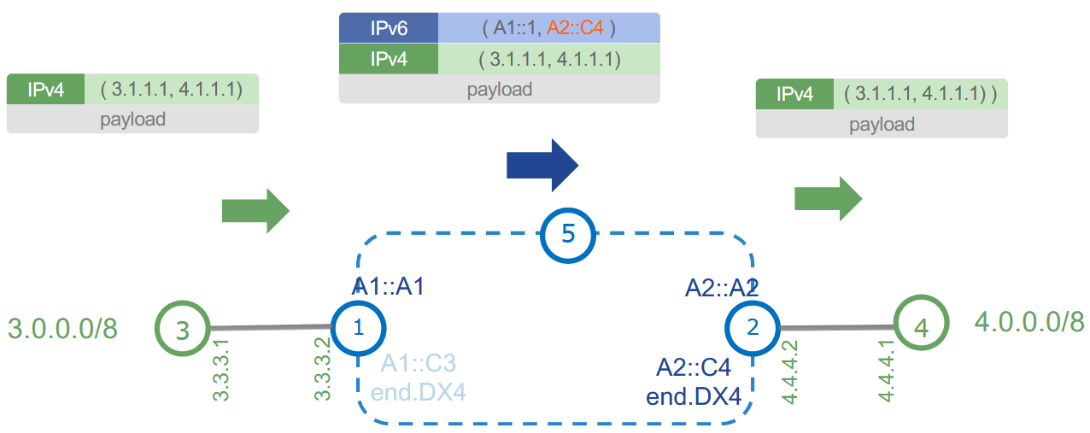
VPNv4 – Basic SRv6 VPN -Data Plane

Slide 100
L3VPN over SRv6
BGP Control Plane - VPNv4 (VPNv6) information exchange
  Internal BGP, BGP RR
  IPv4 or IPv6 transport (BGP session)
VRF config
  Exactly same as for MPLS/SR based L3 VPN
PE-CE routing
  Exactly same as for MPLS/SR based L3 VPN
VRF config under BGP
router bgp 100
vrf A
rd 65000:1
address-family ipv4 unicast
segment-routing srv6
locator My_locator
alloc mode per-vrf
!
redistribute connected

Slide 101
L3VPN over SRv6 – alloc mode
default label allocation mode for VRF in Cisco MPLS L3VPN is per-prefix
  per-prefix is not supported in SRv6
supported alloc mode:
  per-ce - configured in BGP -> vrf XXX -> per address-family ipv4|ipv6
    create End.DT4 and End.DX4 or End.DT6 and End.DX6
  per-vrf - configured in BGP -> vrf XXX -> per address-family ipv4|ipv6
    create only End.DT4 or End.DT6 (not End.DX4 / End.DX6)
  per-vrf-46 – configured in BGP -> vrf XXX -> per address-family ipv4|ipv6
    create only End.DT46
router bgp 100
vrf A
rd 65000:1
address-family ipv4 unicast
segment-routing srv6
locator My_locator
alloc mode per-vrf | per-ce | per-vrf-46
!
redistribute connected

Slide 102
L3VPN over SRv6 – per-vrf
router bgp 65000
-- cut --
!
vrf A
bgp router-id 10.64.1.1
address-family ipv4 unicast
segment-routing srv6
locator MyFullLoc01
alloc mode per-vrf
!
redistribute connected
!
address-family ipv6 unicast
segment-routing srv6
locator MyFullLoc01
alloc mode per-vrf
!
redistribute connected
!
-- cut --
per vrf, per address-family configuration
supported on all platforms
RP/0/RP0/CPU0:R01#sh segment-routing srv6 sid all
*** Locator: 'MyFullLoc01' ***
SID Behavior Context Owner State RW
-------------------------- ---------------- -------------------------------- ------------------ ----- --
fc00:ab00:1:0:1:: End (PSP/USD) 'default':1 sidmgr InUse Y
fc00:ab00:1:0:40:: End.X (PSP/USD) [Gi0/0/0/0, Link-Local] isis-1 InUse Y
fc00:ab00:1:0:41:: End.DT4 'A' bgp-65000 InUse Y
fc00:ab00:1:0:42:: End.DT6 'A' bgp-65000 InUse Y
RP/0/RP0/CPU0:R01#

Slide 103
L3VPN over SRv6 – per-ce
router bgp 65000
-- cut --
!
vrf A
bgp router-id 10.64.4.1
address-family ipv4 unicast
segment-routing srv6
locator MyFullLoc01
alloc mode per-ce
!
redistribute connected
!
address-family ipv6 unicast
segment-routing srv6
locator MyFullLoc01
alloc mode per-ce
!
redistribute connected
!
-- cut --
per vrf, per address-family configuration
supported on all platforms
RP/0/RP0/CPU0:R04#sh segment-routing srv6 sid all
Mon May 12 09:03:01.863 UTC
*** Locator: 'MyFullLoc01' ***
SID Behavior Context Owner State RW
-------------------------- ---------------- -------------------------------- ------------------ ----- --
fc00:ab00:4:0:1:: End (PSP/USD) 'default':1 sidmgr InUse Y
fc00:ab00:4:0:40:: End.X (PSP/USD) [Gi0/0/0/3, Link-Local] isis-1 InUse Y
fc00:ab00:4:0:41:: End.X (PSP/USD) [Gi0/0/0/4, Link-Local] isis-1 InUse Y
fc00:ab00:4:0:42:: End.DX4 'A':1 bgp-65000 InUse Y
fc00:ab00:4:0:43:: End.DT4 'A' bgp-65000 InUse Y
fc00:ab00:4:0:44:: End.DT6 'A' bgp-65000 InUse Y
fc00:ab00:4:0:45:: End.DX6 'A':1 bgp-65000 InUse Y
RP/0/RP0/CPU0:R04#

Slide 104
L3VPN over SRv6 – per-vrf-46
router bgp 65000
-- cut --
!
vrf A
bgp router-id 10.64.1.1
address-family ipv4 unicast
segment-routing srv6
locator MyFullLoc01
alloc mode per-vrf-46
!
redistribute connected
!
address-family ipv6 unicast
segment-routing srv6
locator MyFullLoc01
alloc mode per-vrf-46
!
!
-- cut --
the same SRv6 SID for IPv4 and IPv6
RP/0/RP0/CPU0:R01#sh segment-routing srv6 sid all
Mon May 12 09:13:49.933 UTC
*** Locator: 'MyFullLoc01' ***
SID Behavior Context Owner State RW
-------------------------- ---------------- -------------------------------- ------------------ ----- --
fc00:ab00:1:0:1:: End (PSP/USD) 'default':1 sidmgr InUse Y
fc00:ab00:1:0:40:: End.X (PSP/USD) [Gi0/0/0/0, Link-Local] isis-1 InUse Y
fc00:ab00:1:0:43:: End.DT46 'A' bgp-65000 InUse Y
RP/0/RP0/CPU0:R01#

Slide 105
L3VPN over SRv6 – per-vrf-46
RP/0/RP0/CPU0:R04#sh cef vrf A 10.0.1.1
Mon May 12 09:17:13.449 UTC
10.0.1.0/24, version 251, SRv6 Headend, internal 0x5000001 0x30 (ptr 0xe5d9c08) [1], 0x400 (0xe75c618), 0x0 (0xfab3368)
Updated May 12 09:10:37.547
Prefix Len 24, traffic index 0, precedence n/a, priority 3
gateway array (0x100b1098) reference count 4, flags 0x10, source rib (7), 0 backups
[5 type 3 flags 0x8441 (0xe693f60) ext 0x0 (0x0)]
LW-LDI[type=3, refc=1, ptr=0xe75c618, sh-ldi=0xe693f60]
gateway array update type-time 1 May 12 09:10:32.585
LDI Update time May 12 09:10:32.593
LW-LDI-TS May 12 09:10:37.547
Level 1 - Load distribution: 0
[0] via fc00:ab00:1::/128, recursive
via fc00:ab00:1::/128, 5 dependencies, recursive [flags 0x6000]
path-idx 0 NHID 0x0 [0xe37a8b0 0x0]
next hop VRF - 'default', table - 0xe0800000
next hop fc00:ab00:1::/128 via fc00:ab00:1::/64
SRv6 H.Encaps.Red SID-list {fc00:ab00:1:0:43::}
Load distribution: 0 (refcount 5)
Hash OK Interface Address
0 Y GigabitEthernet0/0/0/4 remote
RP/0/RP0/CPU0:R04#
RP/0/RP0/CPU0:R04#sh cef vrf A ipv6 FC65::ABCD:10:0:1:1
Mon May 12 09:17:17.326 UTC
fc65::abcd:10:0:1:0/112, version 254, SRv6 Headend, internal 0x5000001 0x30 (ptr 0xe37aac0) [1], 0x400 (0xe4ecb18), 0x0 (0xfab3200)
Updated May 12 09:10:35.497
Prefix Len 112, traffic index 0, precedence n/a, priority 3
gateway array (0xe382198) reference count 3, flags 0x10, source rib (7), 0 backups
[4 type 3 flags 0x8441 (0xe424f08) ext 0x0 (0x0)]
LW-LDI[type=3, refc=1, ptr=0xe4ecb18, sh-ldi=0xe424f08]
gateway array update type-time 1 May 12 09:10:35.496
LDI Update time May 12 09:10:35.496
LW-LDI-TS May 12 09:10:35.496
Level 1 - Load distribution: 0
[0] via fc00:ab00:1::/128, recursive
Accounting: Disabled
via fc00:ab00:1::/128, 5 dependencies, recursive [flags 0x6000]
path-idx 0 NHID 0x0 [0xe37a8b0 0x0]
next hop VRF - 'default', table - 0xe0800000
next hop fc00:ab00:1::/128 via fc00:ab00:1::/64
SRv6 H.Encaps.Red SID-list {fc00:ab00:1:0:43::}
Load distribution: 0 (refcount 4)
Hash OK Interface Address
0 Y GigabitEthernet0/0/0/4 remote
RP/0/RP0/CPU0:R04#

Slide 106
Verifying BGP SRv6 SIDs - Eggress PE
RP/0/RP0/CPU0:R33#sh bgp vpnv4 unicast rd 65000:1 local-sids
Wed Jun 11 10:43:21.783 UTC
BGP router identifier 1.1.1.33, local AS number 65000
BGP generic scan interval 60 secs
Non-stop routing is enabled
BGP table state: Active
Table ID: 0x0
BGP table nexthop route policy:
BGP main routing table version 2044
BGP NSR Initial initsync version 40 (Reached)
BGP NSR/ISSU Sync-Group versions 0/0
BGP scan interval 60 secs
Status codes: s suppressed, d damped, h history, * valid, > best
i - internal, r RIB-failure, S stale, N Nexthop-discard
Origin codes: i - IGP, e - EGP, ? - incomplete
Network Local Sid Alloc mode Locator
Route Distinguisher: 65000:1 (default for vrf A)
Route Distinguisher Version: 2044
*>i10.0.1.0/24 NO SRv6 Sid - -
*>i10.0.4.0/24 NO SRv6 Sid - -
*>i10.0.21.0/24 NO SRv6 Sid - -
*>i10.0.31.0/24 NO SRv6 Sid - -
*> 10.0.33.0/24 fc00:ab00:33:e002:: per-vrf Loc_uSID_Algo_0
*>i10.1.1.0/24 NO SRv6 Sid - -
*>i10.1.4.0/24 NO SRv6 Sid - -
*>i10.1.21.0/24 NO SRv6 Sid - -
*>i10.1.31.0/24 NO SRv6 Sid - -
*> 10.1.33.0/24 fc00:ab00:33:e002:: per-vrf Loc_uSID_Algo_0
*>i10.2.1.0/24 NO SRv6 Sid - -
*>i10.2.4.0/24 NO SRv6 Sid - -
*>i10.2.21.0/24 NO SRv6 Sid - -
*>i10.2.31.0/24 NO SRv6 Sid - -
-- cut --

Slide 107
Verifying BGP SRv6 SIDs - Ingress PE
RP/0/RP0/CPU0:R33#sh bgp vpnv4 unicast rd 65000:1 received-sids
Wed Jun 11 10:45:38.982 UTC
BGP router identifier 1.1.1.33, local AS number 65000
BGP generic scan interval 60 secs
Non-stop routing is enabled
BGP table state: Active
Table ID: 0x0
BGP table nexthop route policy:
BGP main routing table version 2044
BGP NSR Initial initsync version 40 (Reached)
BGP NSR/ISSU Sync-Group versions 0/0
BGP scan interval 60 secs
Status codes: s suppressed, d damped, h history, * valid, > best
i - internal, r RIB-failure, S stale, N Nexthop-discard
Origin codes: i - IGP, e - EGP, ? - incomplete
Network Next Hop Received Sid
Route Distinguisher: 65000:1 (default for vrf A)
Route Distinguisher Version: 2044
*>i10.0.1.0/24 2001:9999::1 fc00:ab00:1:e001::
*>i10.0.4.0/24 2001:9999::4 fc00:ab00:4:e002::
*>i10.0.21.0/24 2001:9999::21 fc00:ab00:21:e002::
*>i10.0.31.0/24 fc00:ac00:31::1 fc00:ab00:31:e001::
*> 10.0.33.0/24 10.64.33.2 NO SRv6 Sid
*>i10.1.1.0/24 2001:9999::1 fc00:ab00:1:e001::
*>i10.1.4.0/24 2001:9999::4 fc00:ab00:4:e002::
*>i10.1.21.0/24 2001:9999::21 fc00:ab00:21:e002::
*>i10.1.31.0/24 fc00:ac00:31::1 fc00:ab00:31:e001::
*>i10.2.1.0/24 2001:9999::1 fc00:ab00:1:e001::
*>i10.2.4.0/24 2001:9999::4 C:300
fc00:ab00:4:e002::
*>i10.2.21.0/24 2001:9999::21 fc00:ab00:21:e002::
-- cut --
Notes:
https://www.ciscolive.com/c/dam/r/ciscolive/emea/docs/2025/pdf/BRKSPG-3624.pdf

Slide 108
Segment Routing MPLS and SRv6
L2VPN
SRv6 and service migration

Slide 109
L2VPN over SRv6
Only EVPN is supported
  Pseudowire needs MPLS in dataplane
  VPLS needs pseudowires and bridge-domain
BGP Control Plane – l2vpn evpn AF information exchange
EVPN config
L2VPN config
router bgp 100
bgp router-id 4.4.4.4
address-family l2vpn evpn
!
neighbor fcbb:bb00:1::1
remote-as 100
update-source Loopback0
address-family l2vpn evpn
!
evpn
interface TenGigE0/0/0/0
!
segment-routing srv6
locator My_locator
!
!
l2vpn
xconnect group 2
p2p 2
interface TenGigE0/0/0/0.2
neighbor evpn evi 2 service 2 segment-routing srv6
!

Slide 110
LAB 1 – Discovery + verification

Slide 111
LAB 2 – Full SID + L3VPN

Slide 112
Segment Routing MPLS and SRv6
Segment Routing
SRv6
uSID
SRv6 and service migration

Slide 113
Intuitive SRv6 Network Program
Program
  list of instructions contained in DA/SRH
Instruction
  SRv6 SID
Micro-program
  SRv6 SID (called container) that contains a list of micro-instructions
Micro-Instruction
  SRv6 uSID, can represent any behavior: TE, VPN, Service

Slide 114
SRv6 Micro-Segment (uSID)
SRv6 micro-segment (uSID) is an extension of the SRv6 architecture.
uSID Carrier encodes several SRv6 Micro-SID (uSID) instructions within a single 128-bit SID address
Ultra-Scale—Scalable number of globally unique nodes in the domain, for example:
  16-bit uSID ID size: 65k uSIDs per domain block
  32-bit uSID ID size: 4.3M uSIDs per domain block
Lowest MTU overhead
  6 uSIDs per uSID carrier
  e.g. 18 source-routing waypoints with only 40 bytes of overhead

Slide 115
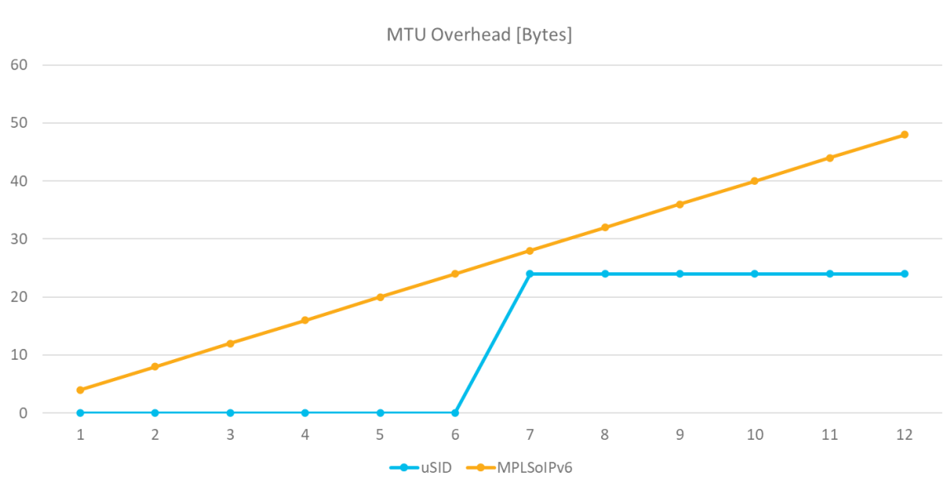
Lowest MTU Overhead
One of many benefits of SRv6 uSID

Slide 116
SRv6 Micro-Segment (uSID)
Hardware-friendliness:
  Leverages mature hardware capabilities (inline IP Destination Address edit, IP Destination Address longest match)
  Avoids any extra lookup in indexed mapping tables.
  A micro-program with 6 or fewer uSIDs requires only legacy IP-in-IP encapsulation behavior.
Scalable Control Plane:
  Summarization at area/domain boundary provides massive scaling advantage.
  No routing extension is required, a simple prefix advertisement suffices.
Seamless Deployment:
  A uSID may be used as a SID (the carrier holds a single uSID).
  The inner structure of an SR Policy can stay opaque to the source. A carrier with uSIDs is just seen as a SID by the policy headend Security.
  Leverages SRv6's native SR domain security.
Notes:
1) “A uSID may be used as a SID (the carrier holds a single uSID)”
A SID (Segment ID) in SRv6 is normally a full IPv6 address.
A uSID is a smaller segment encoded inside that address.
What this line means:
You can build an SRv6 address that contains only one uSID
That address behaves exactly like a regular SID
Implication:
No difference from a normal SRv6 hop
Legacy SRv6 nodes don’t need to understand uSID
2) “The inner structure of an SR Policy can stay opaque to the source”
In SRv6, the headend (source) pushes a segment list (policy).
With uSID:
A “carrier SID” can internally contain multiple uSIDs
But the source only sees one SID
Meaning:
The internal path (micro-segments) is hidden
The source doesn’t need to know:
how many hops exist
how they are encoded
3) “A carrier with uSIDs is just seen as a SID by the policy headend”
The headend treats the entire uSID chain as:
one destination
one segment
Example:
Instead of:
SID1 → SID2 → SID3 → SID4
You can have:
Carrier SID (contains uSID1, uSID2, uSID3, uSID4)
To the headend:
Just 1 SID
To the network:
Multiple micro-operations inside
4) “Seamless Deployment” (what this really means)
You can:
Introduce uSID in part of the network only
Keep:
existing SR policies
existing headends
existing control plane
Because:
uSID-capable nodes interpret the structure
non-uSID nodes just forward based on IPv6 destination
5) “Leverages SRv6’s native SR domain security”
SRv6 already assumes a trusted domain
Packets are validated based on:
IPv6 addressing
routing policies
uSID does not introduce:
new attack surface
new signaling
It stays within:
existing SRv6 security model

Slide 117
SRv6 Network Programming
SRv6 Network Programming (RFC8986)
  The source encodes any end-to-end program as an ordered list of instructions
  The first instruction is in the outer DA
  The remaining instructions are in the SRH
An instruction is called a SID
A Container SID may contain up to 6 micro-instructions called uSID’s
  The IETF term is “NEXT-CSID”

Slide 118
Container of 6 uSID’s
uSID ID
uSID ID
uSID ID
uSID ID
uSID ID
uSID ID
FC00:0000:1111:2222:3333:4444:5555:6666
uSID Block
We recommend to allocate uSID’s from Private IPv6 Space (FC/8)
  FC/8: unroutable outside the domain, hence more secure
  Public address is also possible
We recommend /32 Block
  /16 and /48 are also possible
In this presentation, we will use
− FC00:0000/32 for Min-Cost Slice: shortest path based on minimum ISIS cost
− FC00:0008/32 for Min-Delay Slice: shortest path based on minimum latency

Slide 119
Container of 6 uSID’s
FC00:0000:1111:2222:3333:4444:5555:6666
Min-Cost Block
uSID1
uSID2
uSID3
uSID4
uSID5
uSID6
uSID “default size” is 4 nibbles (16 bits) “:WXYZ:”
  uSID’s of different length can be mixed
  32-bits uSID’s are used for ultra-scale service
Up to 6 uSID’s in the outer DA
A uSID program reads left to right
Intuitively: within the Min-Cost Slice, first go to 1111 then 2222 then …

Slide 120
Less than 6 uSID’s in outer DA
FC00:0000:1111:2222:3333:4444:0000:0000
Min-Cost Block
uSID1
uSID2
uSID3
uSID4
EoC
EoC
Unused uSID’s in the micro program are filled with “:0000:”
“:0000:” means “End of Container” (EoC)
Notes:
DA – destination Address ☺
EoC – End of Container

Slide 121
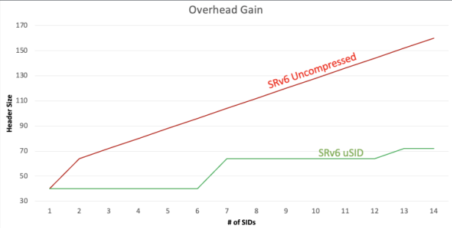
More than 6 uSID’s are required
Outer DA: FC00:0000:0001:0002:0003:0004:0005:0006
uSID1
uSID2
uSID3
uSID4
uSID5
uSID6
Outer SRH: FC00:0000:0007:0008:0009:0010:0011:0012
uSID7
uSID8
uSID9
uSID10
uSID11
uSID12
12 uSID’s with an outer SRH holding one single additional uSID container
  6 in the DA, 6 in the SRH
  With solely 24-bytes of MTU overhead
  50% less overhead than MPLS in IPv6 (12*4 bytes)
Notes:
Each MPLS label = 4 bytes (32 bits):
20 bits label
3 bits TC
1 bit S (bottom-of-stack)
8 bits TTL
So:
1 label = 4 bytes
In this example
They assume:
12 segments (12 SIDs / hops)
If implemented with MPLS:
12 labels × 4 bytes = 48 bytes overhead

Slide 122
An SRv6 uSID’s may be bound to any behavior
VPN
TILFA/uLoop
TE (Traffic Engineering)
EPE (Egress Peer Engineering)
NFV (Network Function Virtualization)
Any customer behavior
  HW: P4
  SW: Container
Notes:
P4 (Programming Protocol-Independent Packet Processors) is a programming language designed for configuring and controlling network forwarding devices, such as switches and routers. It was developed by the P4 Language Consortium, an industry group consisting of networking companies and academic institutions.
P4 Open Source Programming Language
Programming Protocol-independent Packet Processors (P4) is a domain-specific language for network devices, specifying how data plane devices (switches, NICs, routers, filters, etc.) process packets.
Before P4, vendors had total control over the functionality supported in the network. And since networking silicon determined much of the possible behavior, silicon vendors controlled the rollout of new features (e.g., VXLAN), and rollouts took years.
P4 turns the traditional model on its head. Application developers and network engineers can now use P4 to implement specific behavior in the network, and changes can be made in minutes instead of years.
https://www.trentonsystems.com/en-us/resource-hub/blog/your-all-in-one-guide-to-p4#:~:text=Utilizing%20P4%2C%20it%20provides%20flexible,)%2C%20to%20ensure%20the%20rapid%2C

Slide 123
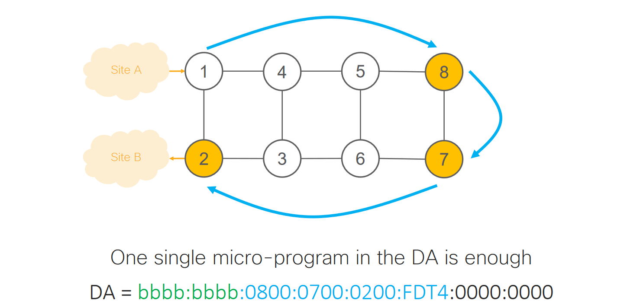
Illustration: go to 8 then 7 then 2 and decaps

Slide 124
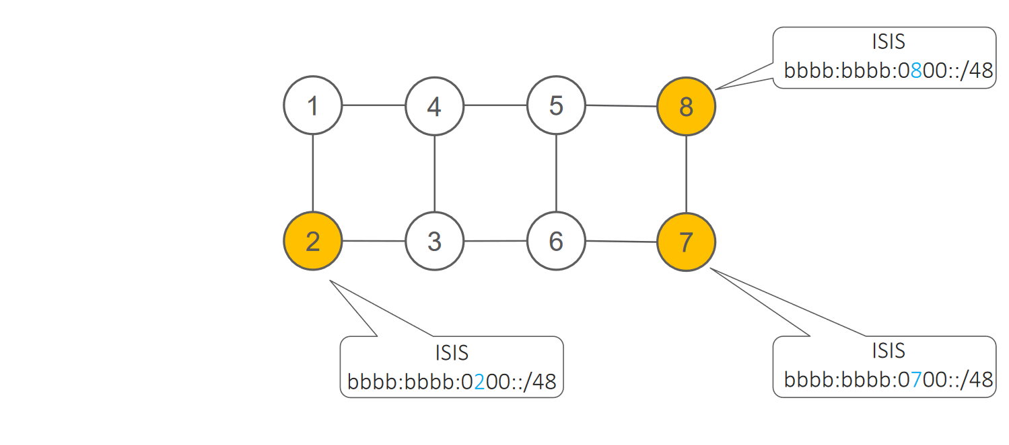
Basic IP Routing: no new extension

Slide 125
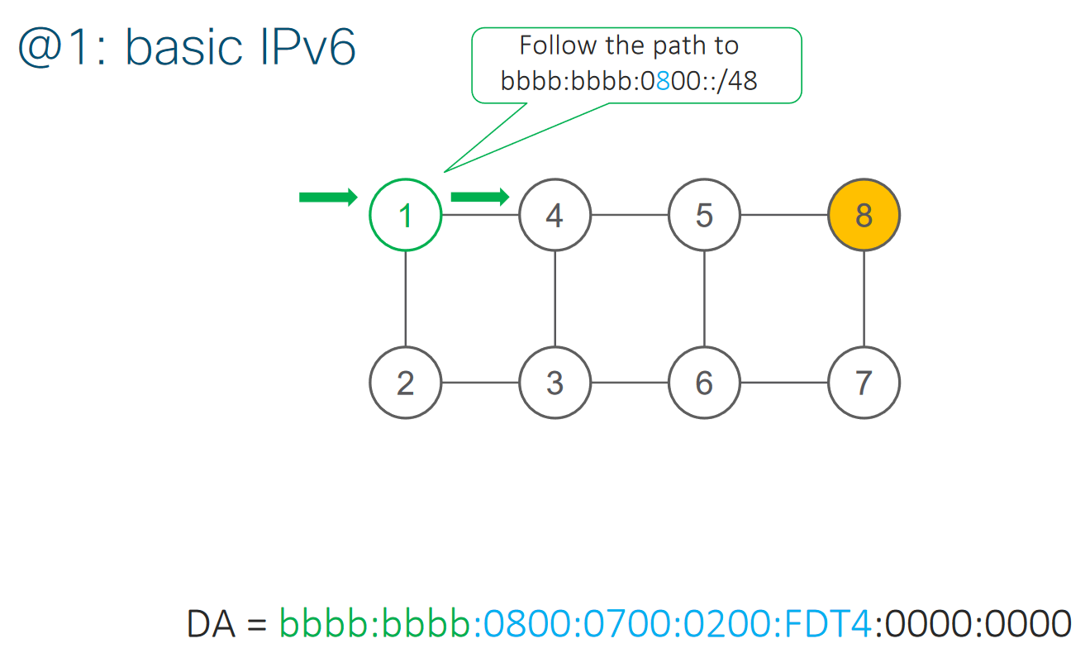
Node 1: Basic IPv6

Slide 126
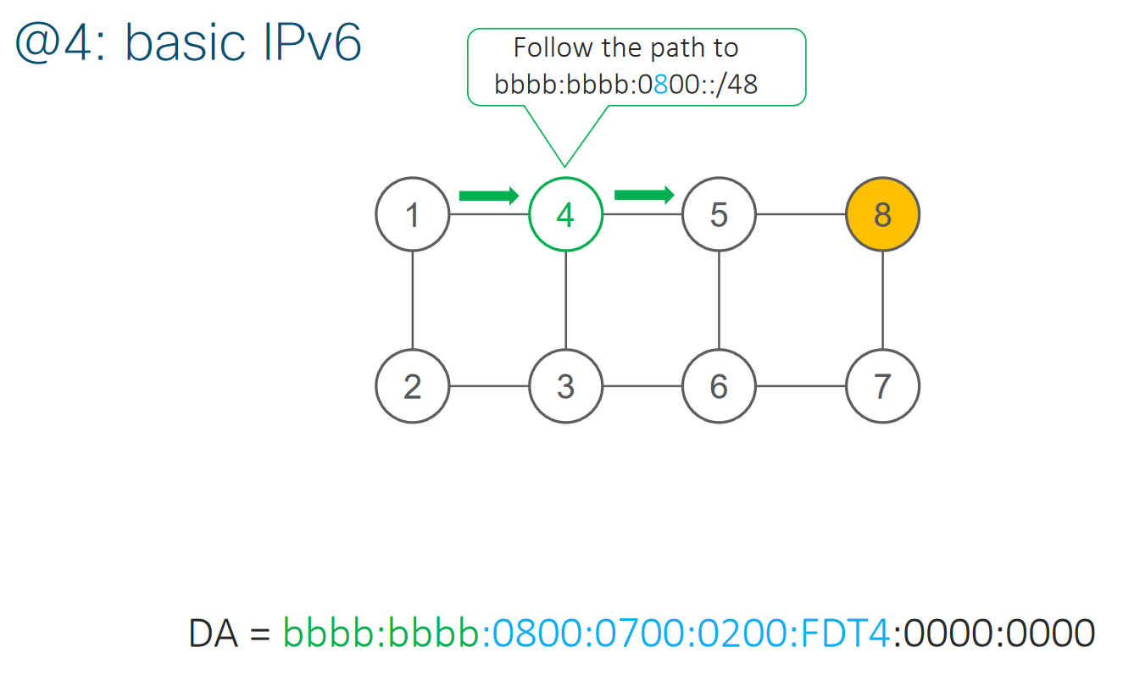
Node 4: Basic IPv6

Slide 127
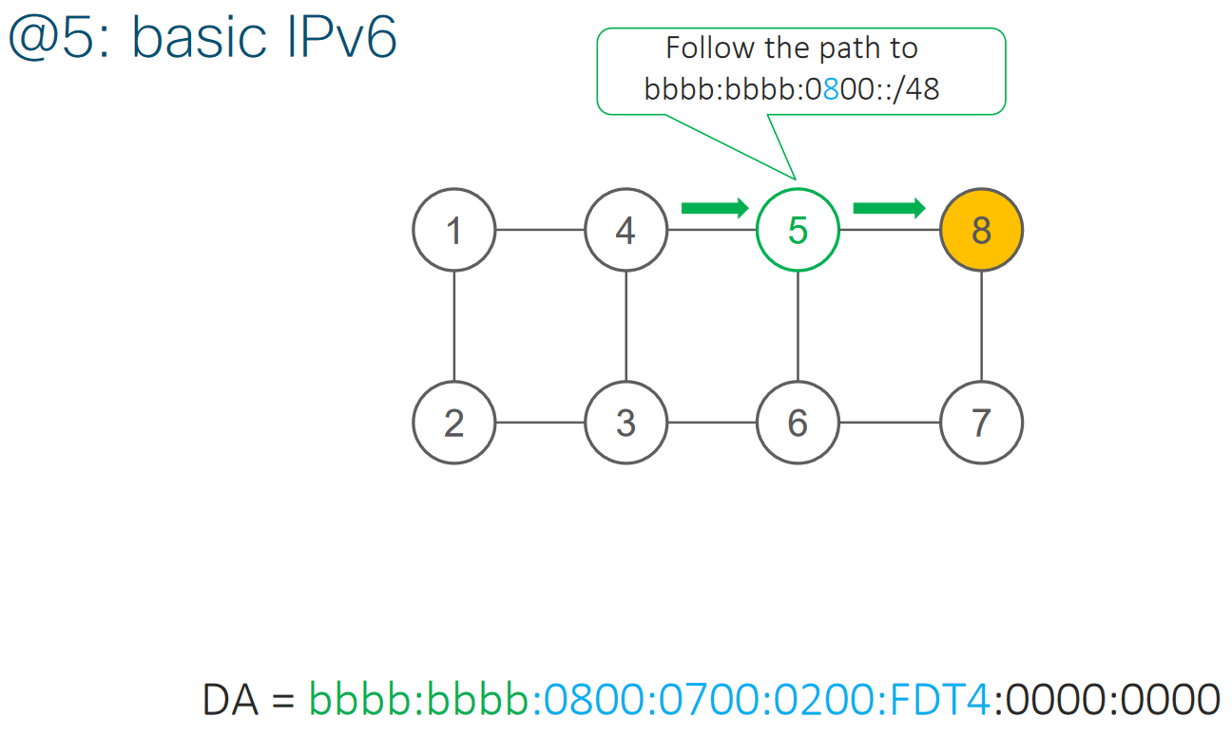
Node 5: Basic IPv6

Slide 128
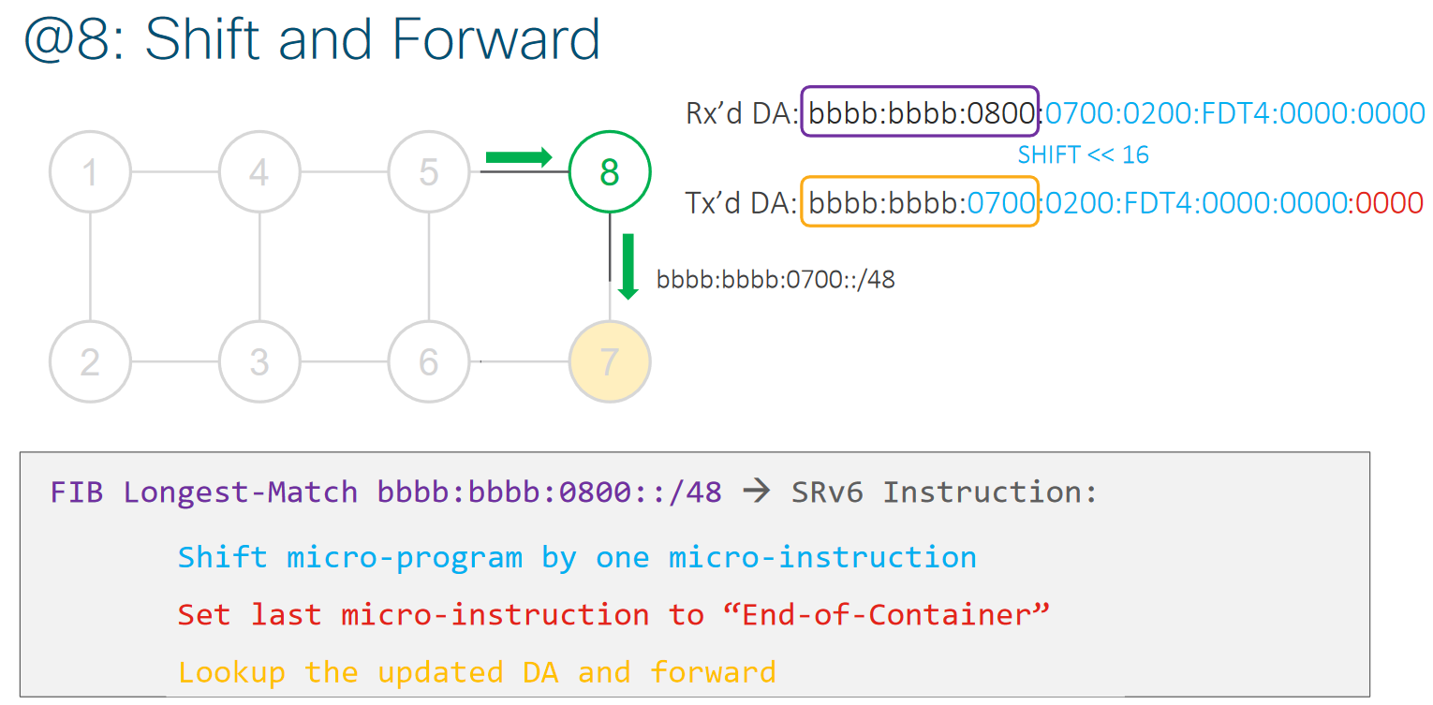
Node 8: Shift and Forward

Slide 129
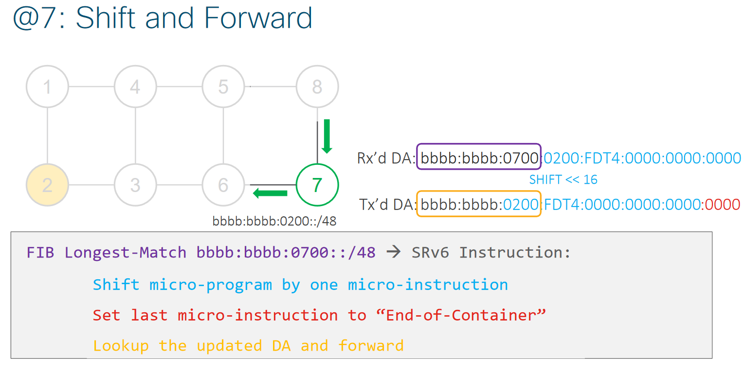
Node 7: Shift and Forward

Slide 130
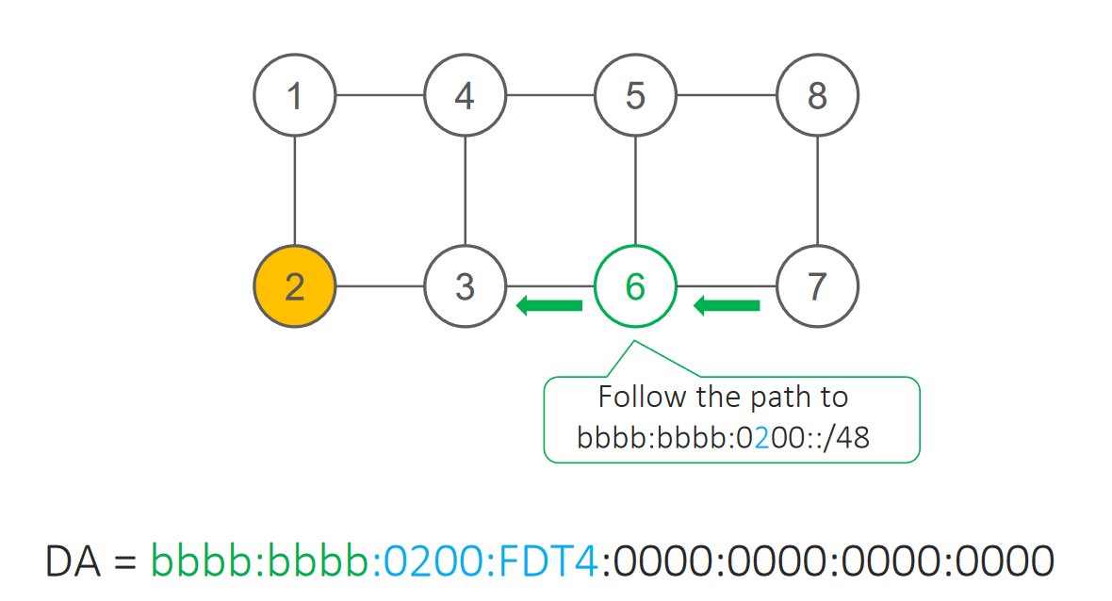
Node 6: Basic IPv6

Slide 131
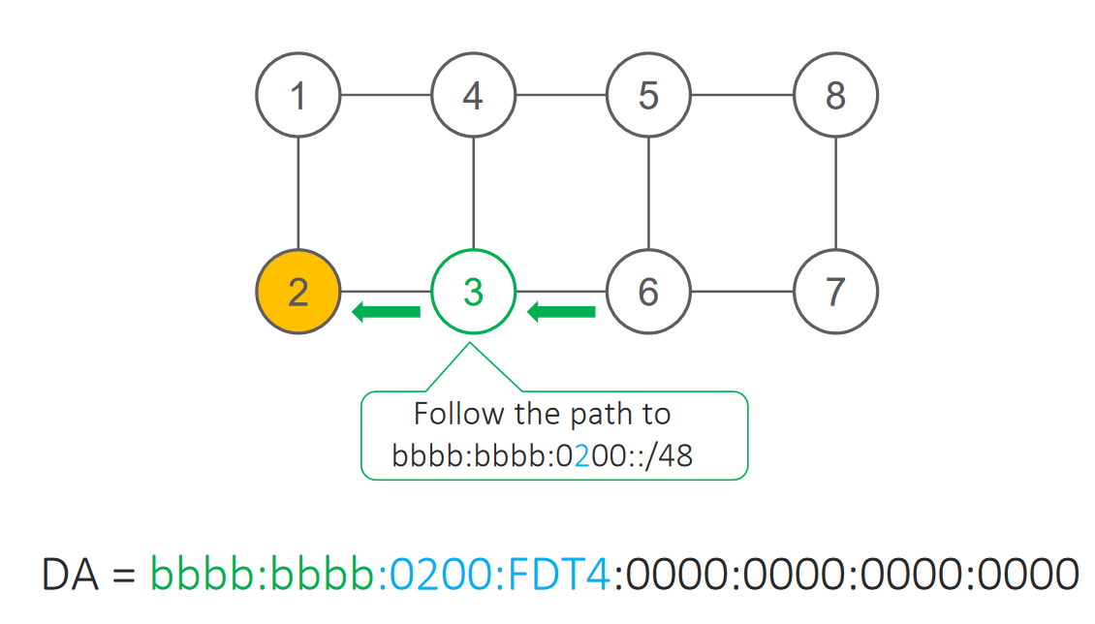
Node 3: Basic IPv6

Slide 132
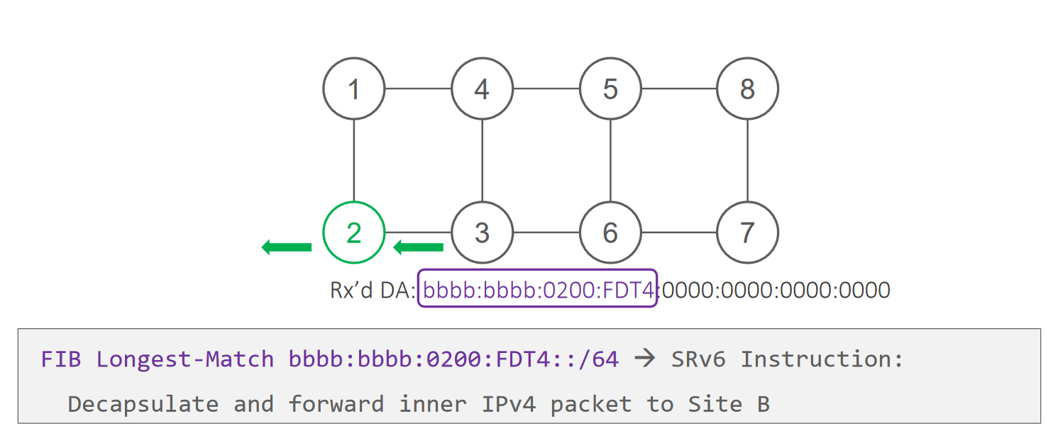
Node 2: SRv6 End.DT4 behavior

Slide 133
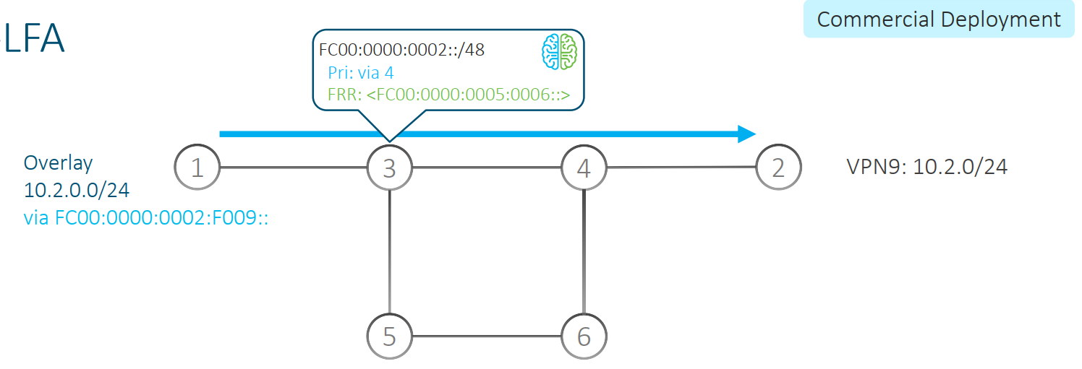
TI-LFA with uSID
50msec Protection upon local link, node or SRLG failure
Simple to operate and understand
  automatically computed by the router’s IGP process
  100% coverage across any topology
  predictable (backup = post-convergence)
Optimum backup path
  leverages the post-convergence path
  avoid any intermediate flap via alternate path
Incremental deployment
Distributed and Automated Intelligence

Slide 134
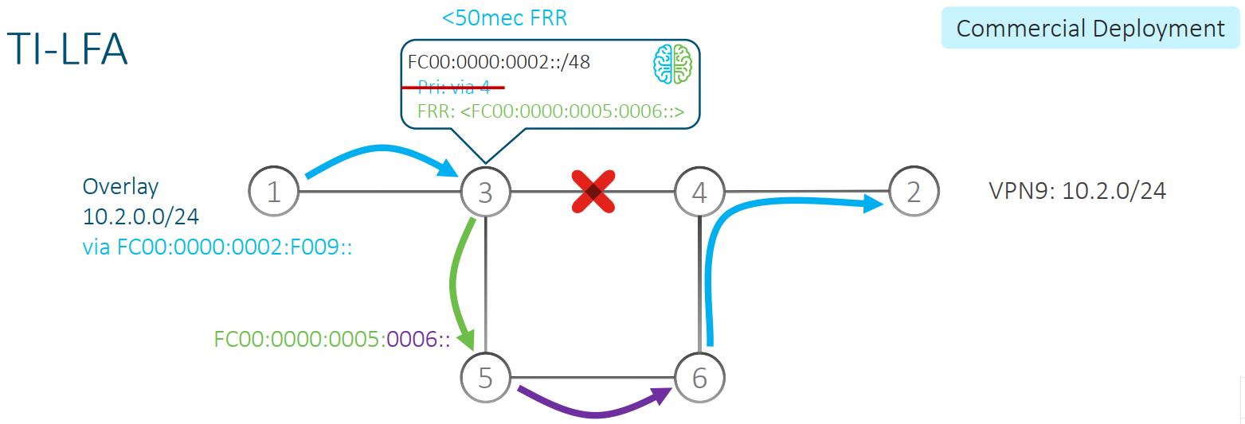
TI-LFA with uSID (protection active)
Upon failure of its outgoing interface to destination FC00:0000:0002::/48, 3 does
  Add an SRH with the received DA FC00:0000:0002:F009::
  Set DA to FC00:0000:0005:0006::
Intuitive Reading:
  FC00:0000:0005::/48 leads the packet along the shortest path to 5
  FC00:0000:0006:0000::/64 leads the packet along the shortest path to 6 and finishes the micro-program in the DA
  The next SID is then loaded from the SRH into the DA
  The packet resumes its path to 2 with original DA = FC00:0000:0002:F009::

Slide 135
uSID
Global ID block (GIB): The set of IDs available for globally scoped uSID allocation.
  A globally scoped uSID is the type of uSID that provides reachability to a node. A globally scoped uSID typically identifies a shortest path to a node in the SR domain. An IP route (for example, /48) is advertised by the parent node to each of its globally scoped uSIDs, under the associated uSID block. The parent node executes a variant of the END behavior.
  The “nodal” uSID (uN) is an example of a globally scoped behavior defined in uSID architecture.
  A node can have multiple globally scoped uSIDs under the same uSID blocks (for example, one uSID per IGP flex-algorithm). Multiple nodes may share the same globally scoped uSID (Anycast).
Local ID block (LIB): The set of IDs available for locally scoped uSID allocation.
  A locally scoped uSID is associated to a local behavior, and therefore must be preceded by a globally scoped uSID of the parent node when relying on routing to forward the packet.
  A locally scoped uSID identifies a local micro-instruction on the parent node; for example, it may identify a cross-connect to a direct neighbor over a specific interface or a VPN context. Locally scoped uSIDs are not routeable.
Wide LIB (W-LIB): The extended set of IDs available for local uSID allocation.
  The extended set of IDs is useful when a PE with large-scale Pseudowire termination requires more local uSIDs than provided from the LIB.
Notes:
https://www.cisco.com/c/en/us/td/docs/routers/asr9000/software/24xx/segment-routing/configuration/guide/b-segment-routing-cg-asr9000-24xx/configure-srv6-micro-sid.html

Slide 136
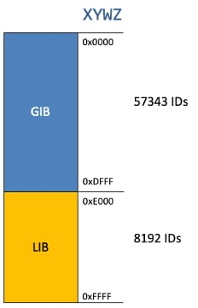
uSID example (F3216)
uSID Locator Block length: 32 bits
  uSID Locator Block: FCBB:BB00::/32 (with B being a nibble value picked by operator)
uSID length (Locator Node ID / Function ID): 16 bits
  uSID: FCBB:BB00:XYWZ::/48 (with XYWZ being variable nibbles)
A uSID FCBB:BB00:XYWZ::/48 is said to be allocated from its block (FCBB:BB00::/32).
A uSID is allocated from the GIB or LIB of block FCBB:BB00::/32 depending on the value of the "X" nibble:
  GIB: nibble X from hex(0) to hex(D)
  LIB: nibble X hex(E) or hex(F)
uSID Block FCBB:BB00::/32 supports
  up to 57343 global uSIDs (routers)
  with each router supporting up to 8192 local uSIDs.

Slide 137
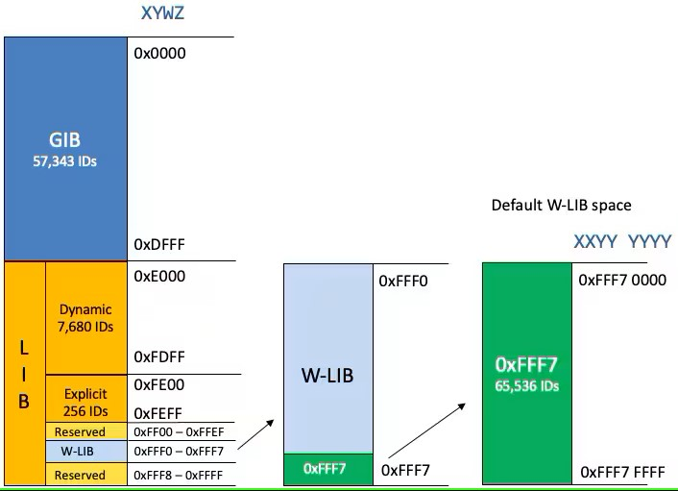
uSID example (F3216) with W-LIB
GIB for user-assigned IDs of global segments (uNs)
LIB for dynamically assigned IDs of local segments
  uA end-point behavior
  Service de-multiplexing end-point behaviors: End.DT, End.DX, End.DX2
Explicit LIB for user-assigned IDs of local segments
  Configurable explicit LIB range
  Service de-multiplexing end-point behaviors: End.DT46
Wide LIB (W-LIB)
  Explicit W-LIB for user-assigned IDs of local segments
  Configurable explicit W-LIB range
  Service de-multiplexing end-point behaviors: End.DT46
Remote W-LIB
  An SRv6 headend node is capable of receiving
  and installing remote SIDs with Wide (32-bit) functions
  Remote W-LIB is supported for Layer 3 (VPN/BGP global)
  and Layer 2 EVPN services (ELINE/ELAN)
Notes:
The range of IDs supported by the Cisco IOS XR implementation are as follows:
The range of IDs in the GIB is 0x000 to 0xDFFF.
The range of IDs by default in the LIB is divided as follows:
Dynamic: 0xE000 to 0xFDFF
Explicit: 0xFE00 to 0xFEFF
Reserved: 0xFF00 to 0xFFEF and 0xFFF8 to 0xFFFF
The range of IDs by default in the W-LIB is divided as follows:
Reserved: 0xFFF0 to 0xFFF6
Explicit: 0xFFF7

Slide 138
uSID example (F3216) with W-LIB
RP/0/RP0/CPU0:R01#sh segment-routing srv6 locator detail
Wed Mar 19 12:50:19.976 UTC
Name ID Algo Prefix Status Flags
-------------------- ------- ---- ------------------------ ------- --------
Loc_uSID_Algo_0 2 0 fc00:ab00:1::/48 Up U
(U): Micro-segment (behavior: uN (PSP/USD))
Interface:
Name: srv6-Loc_uSID_Algo_0
IFH : 0x00000024
IPv6 address: fc00:ab00:1::/48
Number of SIDs: 4
LIB Ranges:
LIB: 0xE000 - 0xFDFF
ELIB: 0xFE00 - 0xFEFF
WLIB: 0xFFF00000 - 0xFFF6FFFF
EWLIB: 0xFFF70000 - 0xFFF7FFFF
Created: Mar 19 11:54:13.845 (00:56:06 ago)
RP/0/RP0/CPU0:R01#
Notes:
The range of IDs supported by the Cisco IOS XR implementation are as follows:
The range of IDs in the GIB is 0x000 to 0xDFFF.
The range of IDs by default in the LIB is divided as follows:
Dynamic: 0xE000 to 0xFDFF
Explicit: 0xFE00 to 0xFEFF
Reserved: 0xFF00 to 0xFFEF and 0xFFF8 to 0xFFFF
The range of IDs by default in the W-LIB is divided as follows:
Reserved: 0xFFF0 to 0xFFF6
Explicit: 0xFFF7

Slide 139
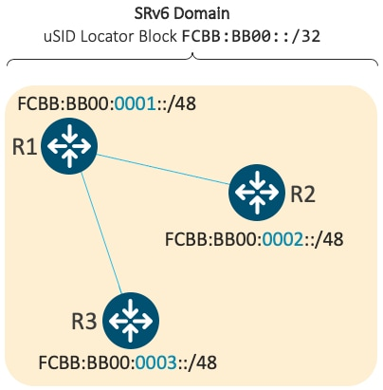
uSID allocation example
R1 - Global uSID FCBB:BB00:0001::/48
R2 - Global uSID FCBB:BB00:0002::/48
R3 - Global uSID FCBB:BB00:0003::/48
R1 also has Local uSIDs associated with uA end-point behaviors:
  Function ID 0xE000 – cross-connect to L3 neighbor R2
  Function ID 0xE001 – cross-connect to L3 neighbor R3
The underlay uSIDs present on R1 are:
  FCBB:BB00:0001::/48
  FCBB:BB00:0001:E000::/64
  FCBB:BB00:0001:E001::/64

Slide 140
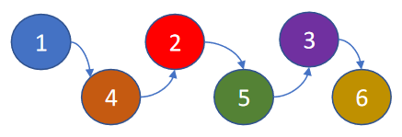
uSID Format – Quick review
Fbbuu
where:
bb – SID Block size in bits
uu – ID size in bits
Compressed SID. Can be of length 16/32 bits
Configured on the boxes in the form SRv6 locators
SRv6 Locator consists of two portions: uSID block, and a uSID.
  SRv6 Locator→ [uSID Block]:[uSID]::/L
Four different formats defining the length of the uSID block & uSID:
  F1616: 16-bit uSID block, 16-bit uSID → L = 32
  F3216: 32-bit uSID block, 16-bit uSID → L = 48 “Industry Standard”
  F4816: 48-bit uSID block, 16-bit uSID → L = 64
  F3232: 32-bit uSID block, 32-bit uSID → L = 64
L represents SRv6 locator length
F3216: uSID Container with a 32 bit uSID Block + 16 bit uSIDs making up a TE path
fccc:cc00:0001:0004:0002:0005:0003:0006/128
Max. of 6 uSIDs per container. More than 6 uSIDs, use of SRH required.
Notes:
Currently IOS-XR supports ONLY F3216 format for uSID

Slide 141
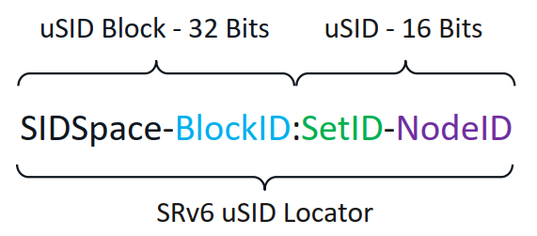
SRv6 Locator Planning
SID Space: The IPv6 address block used to allocate the SID locator. All SID Blocks in the network must come from the same 24-bit SID space
Block ID: Common prefix of a block of uSIDs. Its size depends on the uSID format, which is 8-bits in uSID format
Set IDs: Any group of uSIDs that share a certain value for the first two nibbles of the ID. A 16-bit uSID space contains 256 sets. Each set represents 256 uSID values. A set is uniquely bound to an algorithm
Node ID: Global node SID, Adjacency SID or IP overlay service SID.

Slide 142
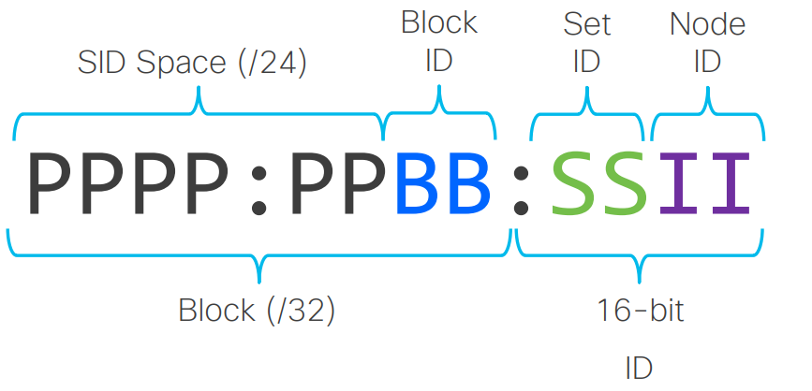
Terminology – uSID F3216 “Industry Standard”
uSID F3216: uSID format with
  uSID Block size: 32 bits
  ID size: 16 bits
uSID F3216 structure:

Slide 143
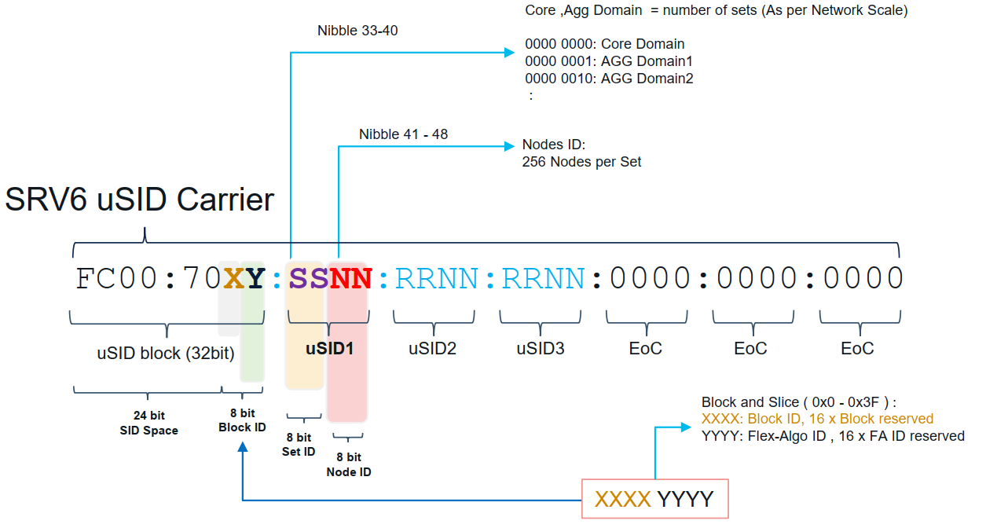
SRv6 uSID Planning Example

Slide 144
SRv6 – uSID – Configuration
Guidelines and Restrictions while configuring SRv6 uSID
  Cisco IOS XR supports uSIDs with 32-bit uSID block and 16-bit uSID IDs (Format 3216)
  All routers in the SRv6 domain should have the same SID block (network designator) in their locator
  Can configure up to 8 uSID locators to support SRv6 Flexible Algorithm.
  Use uSID block allocation from the IPv6 Unique Local Address (ULA, FC00::/8) range
Router(config)# segment-routing srv6
Router(config-srv6)# locators
Router(config-srv6-locators)# locator myLoc1
Router(config-srv6-locator)# micro-segment behavior unode psp-usd
Router(config-srv6-locator)# prefix fcbb:bb01:101::/48
fcbb:bb01:0101::/48

Slide 145
Micro SID configuration example – IOS-XR
!
segment-routing
srv6
logging locator status
locators
locator Loc_uSID_Algo_0
micro-segment behavior unode psp-usd
prefix fc00:ab00:1::/48
!
!
router isis 1
is-type level-2-only
net 49.0001.0000.0000.0002.00
!
address-family ipv6 unicast
metric-style wide
segment-routing srv6
locator Loc_uSID_Algo_0
level 2
!
!
interface Loopback0
passive
circuit-type level-2-only
address-family ipv6 unicast
!
!
interface GigabitEthernet0/0/0/0
circuit-type level-2-only
point-to-point
address-family ipv6 unicast
!
!
Locator name
Micro-SID is used
Locator value in IPv6 address format
Routing protocol for IPv6 routing

Slide 146
Micro SID show commands example – IOS-XR
SIDs associated with Loc_uSID_Algo_0
RP/0/RP0/CPU0:R01#sh segment-routing srv6 locator Loc_uSID_Algo_0 internal
Wed Mar 19 12:57:28.664 UTC
Name ID Algo Prefix Status Flags
-------------------- ------- ---- ------------------------ ------- ------
Loc_uSID_Algo_0 2 0 fc00:ab00:1::/48 Up U
(U): Micro-segment (behavior: uN (PSP/USD))
Index: 2
Flags: 0x8
Format: f3216 <32B/16NFA> (2)
FSM state: UP
Global OOR State: Resource Available
Local SID OOR State: Resource Available
Interface:
Name: srv6-Loc_uSID_Algo_0
IFH : 0x00000024
IPv6 address: fc00:ab00:1::/48 (IM notified: fc00:ab00:1::/48)
Algo: 0 (IM notified: 0)
Number of SIDs: 4
LIB Ranges:
LIB: 0xE000 - 0xFDFF
ELIB: 0xFE00 - 0xFEFF
WLIB: 0xFFF00000 - 0xFFF6FFFF
EWLIB: 0xFFF70000 - 0xFFF7FFFF
Chkpt Obj ID: 0x2f60
Number of SID CTX: 5
Number of Auto SIDs: 1
TI Object:
Type: Entry
Ptr: 0x140171559676464, Producer ID: 0
Flags:
Generic: 0x0 ()
Specific: 0x0 ()
Modified: Wed Mar 19 11:54:13 UTC 2025 (01:03:15 ago)
Created: Mar 19 11:54:13.845 (01:03:14 ago)
Event history:
SIDMGR-LOCATOR-EVENT-CLASS
Total entries : 15
-- cut --
Configured Locators
RP/0/RP0/CPU0:R01#sh segment-routing srv6 locator
Wed Mar 19 12:55:49.510 UTC
Name ID Algo Prefix Status Flags
-------------------- ------- ---- ------------------------ ------- --------
Loc_uSID_Algo_0 2 0 fc00:ab00:1::/48 Up U
RP/0/RP0/CPU0:R01#sh segment-routing srv6 locator detail
Wed Mar 19 12:55:56.965 UTC
Name ID Algo Prefix Status Flags
-------------------- ------- ---- ------------------------ ------- --------
Loc_uSID_Algo_0 2 0 fc00:ab00:1::/48 Up U
(U): Micro-segment (behavior: uN (PSP/USD))
Interface:
Name: srv6-Loc_uSID_Algo_0
IFH : 0x00000024
IPv6 address: fc00:ab00:1::/48
Number of SIDs: 4
LIB Ranges:
LIB: 0xE000 - 0xFDFF
ELIB: 0xFE00 - 0xFEFF
WLIB: 0xFFF00000 - 0xFFF6FFFF
EWLIB: 0xFFF70000 - 0xFFF7FFFF
Created: Mar 19 11:54:13.845 (01:01:43 ago)
RP/0/RP0/CPU0:R01#sh segment-routing srv6 locator Loc_uSID_Algo_0 sid
Wed Mar 19 12:56:51.119 UTC
SID Behavior Context Owner State RW
-------------------------- ---------------- -------------------------------- ------------------ ----- --
fc00:ab00:1:: uN (PSP/USD) 'default':1 sidmgr InUse Y
fc00:ab00:1:e000:: uA (PSP/USD) [Gi0/0/0/0, Link-Local]:0 isis-1 InUse Y
fc00:ab00:1:e001:: uDT4 'A' bgp-65000 InUse Y
fc00:ab00:1:e002:: uDT6 'A' bgp-65000 InUse Y
fc00:ab00:1:e003:: uA (PSP/USD) [Gi0/0/0/5, Link-Local]:0 isis-1 InUse Y
RP/0/RP0/CPU0:R01#

Slide 147
uSID
R01: Lo0=2001:9999::1/128; Locator=fc00:ab00:1::/48; NET=49.0001.0000.0000.0001.00
R02: Lo0=2001:9999::2/128; Locator=fc00:ab00:2::/48; NET=49.0001.0000.0000.0002.00
R03: Lo0=2001:9999::3/128; Locator=fc00:ab00:3::/48; NET=49.0001.0000.0000.0003.00
R04: Lo0=2001:9999::4/128; Locator=fc00:ab00:4::/48; NET=49.0001.0000.0000.0004.00
RP/0/RP0/CPU0:R01#sh route ipv6
-- Cut --
L ::ffff:127.0.0.0/104 [0/0] via ::, 1d02h
L 2001:9999::1/128 is directly connected, 1d02h, Loopback0
i L2 2001:9999::2/128
[115/10] via fe80::5054:ff:fe17:af75, 22:40:11, GigabitEthernet0/0/0/0
i L2 2001:9999::3/128
[115/20] via fe80::5054:ff:fe17:af75, 22:40:11, GigabitEthernet0/0/0/0
i L2 2001:9999::4/128
[115/20] via fe80::5054:ff:fe17:af75, 22:40:11, GigabitEthernet0/0/0/0
L fc00:ab00:1::/48, SRv6 Endpoint uN (shift)
[0/0] via ::, 1d02h
L fc00:ab00:1::/64, SRv6 Endpoint uN (PSP/USD)
[0/0] via ::, 1d02h
L fc00:ab00:1:e000::/64, SRv6 Endpoint uA (shift)
[0/0] via fe80::5054:ff:fe17:af75, 22:40:11, GigabitEthernet0/0/0/0
L fc00:ab00:1:e000::/80, SRv6 Endpoint uA (PSP/USD)
[0/0] via fe80::5054:ff:fe17:af75, 22:40:11, GigabitEthernet0/0/0/0
L fc00:ab00:1:e001::/64, SRv6 Endpoint uDT4
[0/0] via ::ffff:0.0.0.0 (nexthop in vrf A), 22:38:46
L fc00:ab00:1:e002::/64, SRv6 Endpoint uDX2
[0/0] via ::, 03:18:07, GigabitEthernet0/0/0/20
i L2 fc00:ab00:2::/48
[115/11] via fe80::5054:ff:fe17:af75, 22:40:11, GigabitEthernet0/0/0/0
i L2 fc00:ab00:3::/48
[115/21] via fe80::5054:ff:fe17:af75, 22:40:11, GigabitEthernet0/0/0/0
i L2 fc00:ab00:4::/48
[115/21] via fe80::5054:ff:fe17:af75, 22:40:11, GigabitEthernet0/0/0/0
L fc00:ab00:e000::/48, SRv6 Endpoint uA (shift)
[0/0] via fe80::5054:ff:fe17:af75, 22:40:11, GigabitEthernet0/0/0/0
L fc00:ab00:e000::/64, SRv6 Endpoint uA (PSP/USD)
[0/0] via fe80::5054:ff:fe17:af75, 22:40:11, GigabitEthernet0/0/0/0
-- Cut --
RP/0/RP0/CPU0:R01#
L3 VPN = vrf A
L2 VPN = EVPN VPWS
RP/0/RP0/CPU0:R01#show segment-routing srv6 locator
Name ID Algo Prefix Status Flags
-------------------- ------- ---- ------------------------ ------- --------
Loc_uSID_Algo_0 4 0 fc00:ab00:1::/48 Up U
RP/0/RP0/CPU0:R01#show segment-routing srv6 sid all
*** Locator: 'Loc_uSID_Algo_0' ***
SID Behavior Context Owner State RW
-------------------------- ---------------- -------------------------------- ------------------ ----- --
fc00:ab00:1:: uN (PSP/USD) 'default':1 sidmgr InUse Y
fc00:ab00:1:e000:: uA (PSP/USD) [Gi0/0/0/0, Link-Local]:0 isis-1 InUse Y
fc00:ab00:1:e001:: uDT4 'A' bgp-65000 InUse Y
fc00:ab00:1:e002:: uDX2 14:140104 l2vpn_srv6 InUse Y
RP/0/RP0/CPU0:R01#

Slide 148
uSID
RP/0/RP0/CPU0:R01#sh route ipv6
-- Cut --
L ::ffff:127.0.0.0/104 [0/0] via ::, 1d03h
i L2 2001:9999::1/128
[115/10] via fe80::5054:ff:fe14:94d4, 23:36:38, GigabitEthernet0/0/0/0
L 2001:9999::2/128 is directly connected,
1d03h, Loopback0
i L2 2001:9999::3/128
[115/10] via fe80::5054:ff:fe1c:96f4, 1d00h, GigabitEthernet0/0/0/2
i L2 2001:9999::4/128
[115/10] via fe80::5054:ff:fe09:6ab0, 1d00h, GigabitEthernet0/0/0/4
i L2 fc00:ab00:1::/48
[115/11] via fe80::5054:ff:fe14:94d4, 23:36:26, GigabitEthernet0/0/0/0
L fc00:ab00:2::/48, SRv6 Endpoint uN (shift)
[0/0] via ::, 1d03h
L fc00:ab00:2::/64, SRv6 Endpoint uN (PSP/USD)
[0/0] via ::, 1d03h
L fc00:ab00:2:e000::/64, SRv6 Endpoint uA (shift)
[0/0] via fe80::5054:ff:fe14:94d4, 23:36:41, GigabitEthernet0/0/0/0
L fc00:ab00:2:e000::/80, SRv6 Endpoint uA (PSP/USD)
[0/0] via fe80::5054:ff:fe14:94d4, 23:36:41, GigabitEthernet0/0/0/0
L fc00:ab00:2:e001::/64, SRv6 Endpoint uA (shift)
[0/0] via fe80::5054:ff:fe09:6ab0, 1d00h, GigabitEthernet0/0/0/4
L fc00:ab00:2:e001::/80, SRv6 Endpoint uA (PSP/USD)
[0/0] via fe80::5054:ff:fe09:6ab0, 1d00h, GigabitEthernet0/0/0/4
L fc00:ab00:2:e002::/64, SRv6 Endpoint uA (shift)
[0/0] via fe80::5054:ff:fe1c:96f4, 1d00h, GigabitEthernet0/0/0/2
L fc00:ab00:2:e002::/80, SRv6 Endpoint uA (PSP/USD)
[0/0] via fe80::5054:ff:fe1c:96f4, 1d00h, GigabitEthernet0/0/0/2
i L2 fc00:ab00:3::/48
[115/11] via fe80::5054:ff:fe1c:96f4, 23:58:28, GigabitEthernet0/0/0/2
i L2 fc00:ab00:4::/48
[115/11] via fe80::5054:ff:fe09:6ab0, 23:56:42, GigabitEthernet0/0/0/4
L fc00:ab00:e000::/48, SRv6 Endpoint uA (shift)
[0/0] via fe80::5054:ff:fe14:94d4, 23:36:41, GigabitEthernet0/0/0/0
L fc00:ab00:e000::/64, SRv6 Endpoint uA (PSP/USD)
[0/0] via fe80::5054:ff:fe14:94d4, 23:36:41, GigabitEthernet0/0/0/0
L fc00:ab00:e001::/48, SRv6 Endpoint uA (shift)
[0/0] via fe80::5054:ff:fe09:6ab0, 1d00h, GigabitEthernet0/0/0/4
L fc00:ab00:e001::/64, SRv6 Endpoint uA (PSP/USD)
[0/0] via fe80::5054:ff:fe09:6ab0, 1d00h, GigabitEthernet0/0/0/4
L fc00:ab00:e002::/48, SRv6 Endpoint uA (shift)
[0/0] via fe80::5054:ff:fe1c:96f4, 1d00h, GigabitEthernet0/0/0/2
L fc00:ab00:e002::/64, SRv6 Endpoint uA (PSP/USD)
[0/0] via fe80::5054:ff:fe1c:96f4, 1d00h, GigabitEthernet0/0/0/2
-- Cut --
RP/0/RP0/CPU0:R02#
R01: Lo0=2001:9999::1/128; Locator=fc00:ab00:1::/48; NET=49.0001.0000.0000.0001.00
R02: Lo0=2001:9999::2/128; Locator=fc00:ab00:2::/48; NET=49.0001.0000.0000.0002.00
R03: Lo0=2001:9999::3/128; Locator=fc00:ab00:3::/48; NET=49.0001.0000.0000.0003.00
R04: Lo0=2001:9999::4/128; Locator=fc00:ab00:4::/48; NET=49.0001.0000.0000.0004.00
RP/0/RP0/CPU0:R02#show segment-routing srv6 locator
Tue Oct 22 12:30:05.013 UTC
Name ID Algo Prefix Status Flags
-------------------- ------- ---- ------------------------ ------- --------
Loc_uSID_Algo_0 2 0 fc00:ab00:2::/48 Up U
RP/0/RP0/CPU0:R02#show segment-routing srv6 sid all
Tue Oct 22 12:30:31.536 UTC
*** Locator: 'Loc_uSID_Algo_0' ***
SID Behavior Context Owner State RW
-------------------------- ---------------- -------------------------------- ------------------ ----- --
fc00:ab00:2:: uN (PSP/USD) 'default':2 sidmgr InUse Y
fc00:ab00:2:e000:: uA (PSP/USD) [Gi0/0/0/0, Link-Local]:0 isis-1 InUse Y
fc00:ab00:2:e001:: uA (PSP/USD) [Gi0/0/0/4, Link-Local]:0 isis-1 InUse Y
fc00:ab00:2:e002:: uA (PSP/USD) [Gi0/0/0/2, Link-Local]:0 isis-1 InUse Y
RP/0/RP0/CPU0:R02#

Slide 149
uSID
R01: Lo0=2001:9999::1/128; Locator=fc00:ab00:1::/48; NET=49.0001.0000.0000.0001.00
R02: Lo0=2001:9999::2/128; Locator=fc00:ab00:2::/48; NET=49.0001.0000.0000.0002.00
R03: Lo0=2001:9999::3/128; Locator=fc00:ab00:3::/48; NET=49.0001.0000.0000.0003.00
R04: Lo0=2001:9999::4/128; Locator=fc00:ab00:4::/48; NET=49.0001.0000.0000.0004.00
RP/0/RP0/CPU0:R01#sh route ipv6
-- Cut --
L ::ffff:127.0.0.0/104 [0/0] via ::, 1d04h
i L2 2001:9999::1/128
[115/20] via fe80::5054:ff:fe03:dd9a, 23:43:28, GigabitEthernet0/0/0/2
i L2 2001:9999::2/128
[115/10] via fe80::5054:ff:fe03:dd9a, 1d00h, GigabitEthernet0/0/0/2
L 2001:9999::3/128 is directly connected, 1d04h, Loopback0
i L2 2001:9999::4/128
[115/10] via fe80::5054:ff:fe11:2f5e, 1d00h, GigabitEthernet0/0/0/3
i L2 fc00:ab00:1::/48
[115/21] via fe80::5054:ff:fe03:dd9a, 23:43:16, GigabitEthernet0/0/0/2
i L2 fc00:ab00:2::/48
[115/11] via fe80::5054:ff:fe03:dd9a, 23:43:54, GigabitEthernet0/0/0/2
L fc00:ab00:3::/48, SRv6 Endpoint uN (shift)
[0/0] via ::, 1d04h
L fc00:ab00:3::/64, SRv6 Endpoint uN (PSP/USD)
[0/0] via ::, 1d04h
L fc00:ab00:3:e000::/64, SRv6 Endpoint uA (shift)
[0/0] via fe80::5054:ff:fe03:dd9a, 1d00h, GigabitEthernet0/0/0/2
L fc00:ab00:3:e000::/80, SRv6 Endpoint uA (PSP/USD)
[0/0] via fe80::5054:ff:fe03:dd9a, 1d00h, GigabitEthernet0/0/0/2
L fc00:ab00:3:e001::/64, SRv6 Endpoint uA (shift)
[0/0] via fe80::5054:ff:fe11:2f5e, 1d00h, GigabitEthernet0/0/0/3
L fc00:ab00:3:e001::/80, SRv6 Endpoint uA (PSP/USD)
[0/0] via fe80::5054:ff:fe11:2f5e, 1d00h, GigabitEthernet0/0/0/3
i L2 fc00:ab00:4::/48
[115/11] via fe80::5054:ff:fe11:2f5e, 1d00h, GigabitEthernet0/0/0/3
L fc00:ab00:e000::/48, SRv6 Endpoint uA (shift)
[0/0] via fe80::5054:ff:fe03:dd9a, 1d00h, GigabitEthernet0/0/0/2
L fc00:ab00:e000::/64, SRv6 Endpoint uA (PSP/USD)
[0/0] via fe80::5054:ff:fe03:dd9a, 1d00h, GigabitEthernet0/0/0/2
L fc00:ab00:e001::/48, SRv6 Endpoint uA (shift)
[0/0] via fe80::5054:ff:fe11:2f5e, 1d00h, GigabitEthernet0/0/0/3
L fc00:ab00:e001::/64, SRv6 Endpoint uA (PSP/USD)
[0/0] via fe80::5054:ff:fe11:2f5e, 1d00h, GigabitEthernet0/0/0/3
-- Cut --
RP/0/RP0/CPU0:R03#
RP/0/RP0/CPU0:R03#show segment-routing srv6 locator
Name ID Algo Prefix Status Flags
-------------------- ------- ---- ------------------------ ------- --------
Loc_uSID_Algo_0 2 0 fc00:ab00:3::/48 Up U
RP/0/RP0/CPU0:R03#show segment-routing srv6 sid all
*** Locator: 'Loc_uSID_Algo_0' ***
SID Behavior Context Owner State RW
-------------------------- ---------------- -------------------------------- ------------------ ----- --
fc00:ab00:3:: uN (PSP/USD) 'default':3 sidmgr InUse Y
fc00:ab00:3:e000:: uA (PSP/USD) [Gi0/0/0/2, Link-Local]:0 isis-1 InUse Y
fc00:ab00:3:e001:: uA (PSP/USD) [Gi0/0/0/3, Link-Local]:0 isis-1 InUse Y
RP/0/RP0/CPU0:R03#

Slide 150
uSID
RP/0/RP0/CPU0:R04#sh route ipv6
-- Cut --
i L2 2001:9999::1/128
[115/20] via fe80::5054:ff:fe05:ee55, 1d00h, GigabitEthernet0/0/0/4
i L2 2001:9999::2/128
[115/10] via fe80::5054:ff:fe05:ee55, 1d00h, GigabitEthernet0/0/0/4
i L2 2001:9999::3/128
[115/10] via fe80::5054:ff:fe1f:b0f5, 1d00h, GigabitEthernet0/0/0/3
L 2001:9999::4/128 is directly connected,
1d05h, Loopback0
i L2 fc00:ab00:1::/48
[115/21] via fe80::5054:ff:fe05:ee55, 1d00h, GigabitEthernet0/0/0/4
i L2 fc00:ab00:2::/48
[115/11] via fe80::5054:ff:fe05:ee55, 1d00h, GigabitEthernet0/0/0/4
i L2 fc00:ab00:3::/48
[115/11] via fe80::5054:ff:fe1f:b0f5, 1d00h, GigabitEthernet0/0/0/3
L fc00:ab00:4::/48, SRv6 Endpoint uN (shift)
[0/0] via ::, 1d05h
L fc00:ab00:4::/64, SRv6 Endpoint uN (PSP/USD)
[0/0] via ::, 1d05h
L fc00:ab00:4:e000::/64, SRv6 Endpoint uA (shift)
[0/0] via fe80::5054:ff:fe05:ee55, 1d00h, GigabitEthernet0/0/0/4
L fc00:ab00:4:e000::/80, SRv6 Endpoint uA (PSP/USD)
[0/0] via fe80::5054:ff:fe05:ee55, 1d00h, GigabitEthernet0/0/0/4
L fc00:ab00:4:e001::/64, SRv6 Endpoint uA (shift)
[0/0] via fe80::5054:ff:fe1f:b0f5, 1d00h, GigabitEthernet0/0/0/3
L fc00:ab00:4:e001::/80, SRv6 Endpoint uA (PSP/USD)
[0/0] via fe80::5054:ff:fe1f:b0f5, 1d00h, GigabitEthernet0/0/0/3
L fc00:ab00:4:e002::/64, SRv6 Endpoint uA (shift)
[0/0] via fe80::5054:ff:fe07:91b0, 1d00h, GigabitEthernet0/0/0/6
L fc00:ab00:4:e002::/80, SRv6 Endpoint uA (PSP/USD)
[0/0] via fe80::5054:ff:fe07:91b0, 1d00h, GigabitEthernet0/0/0/6
L fc00:ab00:4:e003::/64, SRv6 Endpoint uDT4
[0/0] via ::ffff:0.0.0.0 (nexthop in vrf A), 1d00h
L fc00:ab00:4:e004::/64, SRv6 Endpoint uDX2
[0/0] via ::, 05:08:26, GigabitEthernet0/0/0/20
-- cut --
R01: Lo0=2001:9999::1/128; Locator=fc00:ab00:1::/48; NET=49.0001.0000.0000.0001.00
R02: Lo0=2001:9999::2/128; Locator=fc00:ab00:2::/48; NET=49.0001.0000.0000.0002.00
R03: Lo0=2001:9999::3/128; Locator=fc00:ab00:3::/48; NET=49.0001.0000.0000.0003.00
R04: Lo0=2001:9999::4/128; Locator=fc00:ab00:4::/48; NET=49.0001.0000.0000.0004.00
L3 VPN = vrf A
L2 VPN = EVPN VPWS
RP/0/RP0/CPU0:R04#show segment-routing srv6 locator
Name ID Algo Prefix Status Flags
-------------------- ------- ---- ------------------------ ------- --------
Loc_uSID_Algo_0 2 0 fc00:ab00:4::/48 Up U
RP/0/RP0/CPU0:R04#show segment-routing srv6 sid all
*** Locator: 'Loc_uSID_Algo_0' ***
SID Behavior Context Owner State RW
-------------------------- ---------------- -------------------------------- ------------------ ----- --
fc00:ab00:4:: uN (PSP/USD) 'default':4 sidmgr InUse Y
fc00:ab00:4:e000:: uA (PSP/USD) [Gi0/0/0/4, Link-Local]:0 isis-1 InUse Y
fc00:ab00:4:e001:: uA (PSP/USD) [Gi0/0/0/3, Link-Local]:0 isis-1 InUse Y
fc00:ab00:4:e002:: uA (PSP/USD) [Gi0/0/0/6, Link-Local]:0 isis-1 InUse Y
fc00:ab00:4:e003:: uDT4 'A' bgp-65000 InUse Y
fc00:ab00:4:e004:: uDX2 14:140104 l2vpn_srv6 InUse Y
RP/0/RP0/CPU0:R04#

Slide 151
uSID Benefits
Data Plane
  Best MTU efficiency (6 uSIDs without SRH)
  Hyper-Scalable SR-TE (18 uSIDs with 40 bytes overhead)
  Hardware-friendly (linerate on merchant silicon)
Control Plane
  Scalable number of globally unique uSIDs per domain
  No new protocol extensions
IP Power
  IP summarization and longest match is POWERFUL
  FIB efficiency 2 to 3 times gain vs. MPLS
  Optimal IPv6 load-balancing (flow label)
Notes:
https://www.segment-routing.net/images/tutorials/SRv6-TOI-rev3i-EXTERNAL.pdf

Slide 152
Segment Routing MPLS and SRv6
Segment Routing
SRv6
Function
SRv6 and service migration

Slide 153

SRv6 -Segment format
SRv6 SIDs are 128-bit addresses
  Locator: most significant bits are used to route the segment to its parent node
  Function: least significant bits identify the action to be performed on the parent node
    Argument [optional]: Last bits can be used as a local function argument
Flexible bit-length allocation
  Segment format is local knowledge on the parent node
Notes:
Parent node: node where the segment was instantiated, and where it will be processed
Function could be the basic end-point behavior that I showed in the previous slides, or something much more sophisticated... even using arguments
Fliexible bit-length...
the only thing that matters to the rest of the network is that the parent node advertises the locator prefix, so that packets can be routed to it. What it then does with the packet, so the function, is purely local
Local address: address within the locator prefix, or assigned to an interface
conversely....

Slide 154
END – Default endpoint
Default endpoint behavior (node segment)
  Decrement Segments Left, update DA
  Forward according to new DA
Node 2 advertises prefix A2::/64 (A2::/64 is the SID locator)
  Packets are forwarded to node 2 along the default routes (shortest path)
On 2, the default endpoint behavior is associated with ID 0 (0 is the function)
The SID corresponding to the default endpoint behavior on node 2 is A2::0
IPv6 Hdr
SA = A1::, DA = A2::0
2
A2:: /64
SR Hdr
(…,A3::,A2::0,…) SL=k
Payload
3
IPv6 Hdr
SA = A1::, DA = A3::
SR Hdr
(…, A3::, A2::0,…) SL=k-1
Payload

Slide 155
END.X – Endpoint then Xconnect
Endpoint xconnect behavior (adjacency segment)
  Decrement Segments Left, update DA
  Forward on the interface associated with the Xconnect segment
Node 3 advertises prefix A3::/64
  Packets are forwarded to node 3 along the default routes (shortest path)
On 3, the endpoint xconnect behavior for link 1 is associated with ID C1
The SID corresponding to endpoint xconnect-1 behavior on node 3 is A3::C1
IPv6 Hdr
SA = A1::, DA = A4::
SR Hdr
(…, A4::, A3::C1,…) SL=k-1
Payload
IPv6 Hdr
1
SA = A1::, DA = A3::C1
3
A3:: /64
4
SR Hdr
(…,A4::, A3::C1,…) SL=k
Payload
2

Slide 156
END.B6.ENCAPS – IPv6 Binding Segment (encap)
IPv6 binding segment
  Decrement Segments Left, update DA
  Push outer IP and SR headers associated with the binding segment
  Forward according to outer header DA (first segment of the new SRH)
Node 4 advertises prefix A4::/64
The SR encaps policy (SA = A4::, SL = 〈 S1, S2, S3 〉) is associated with ID 10
The corresponding binding SID is A4::10
IPv6 Hdr
IPv6 Hdr
SA = A4::, DA = S1
SA = A1::, DA = A4::10
4
A4:: /64
SR Hdr
(S3, S2, S1) SL=2
SR Hdr
(…, A5::, A4::10,…) SL=k
IPv6 Hdr
SA = A1::, DA = A5::
Payload
SR Hdr
(…, A5::, A4::10,… ) SL=k-1
Payload
Notes:
When you instantiate a binding segment on a node, you associate it with a SR policy,
and this policy defines the content of the IP and SR headers that will be pushed on the packet
We do not have to specify the IP DA because that will be the first segment

Slide 157
END.B6 – IPv6 Binding Segment (insert)
IPv6 binding segment
  Do not decrement Segments Left
  Push outer SR header associated with the binding segment
  Update DA with the first segment of the outer SR header
  Forward according to outer header DA (first segment of the new SRH)
Node 4 advertises prefix A4::/64
On 4, the SR insert policy 〈 S1, S2, S3 〉 is associated with ID 20
The corresponding binding SID is A4::20
IPv6 Hdr
IPv6 Hdr
SA = A1::, DA = A4::20
4
A4:: /64
SA = A1::, DA = S1
SR Hdr
(…,A5::, A4::20,…) SL=k
SR Hdr
( S3, S2, S1 ) SL=2
Payload
SR Hdr
(…,A5::, A4::20,…) SL=k
Payload
Notes:
When you instantiate a binding segment on a node, you associate it with a SR policy,
and this policy defines the content of the IP and SR headers that will be pushed on the packet
We do not have to specify the IP DA because that will be the first segment

Slide 158
END.BM – MPLS Binding Segment
MPLS binding segment
  Decrement Segments Left
  Push outer MPLS label stack associated with the binding segment
  Forward according to the top MPLS label
Node 4 advertises prefix A4::/64
On 4, the MPLS SR policy <L1, L2, L3> is associated with ID 30
The corresponding binding SID is A4::30
IPv6 Hdr
MPLS
SA = A1::, DA = A4::30
4
A4:: /64
{ L1, L2, L3 }
SR Hdr
(…,A5::, A4::30,…) SL=k
IPv6 Hdr
SA = A1::, DA = A5::
Payload
SR Hdr
(…,A5::, A4::30,…) SL=k-1
Payload
Notes:
When you instantiate a binding segment on a node, you associate it with a SR policy,
and this policy defines the content of the IP and SR headers that will be pushed on the packet
We do not have to specify the IP DA because that will be the first segment

Slide 159
END.PSP – Penultimate Segment Popping #1
Penultimate Segment Popping (PSP) behavior
  Decrement Segments Left, update DA
  If Segments Left = 0, remove SRH
  Forward according to new DA
Node 5 advertises prefix A5::/64
On 5, the Penultimate Segment Popping behavior is associated with ID 1
The corresponding SID is A5::1
IPv6 Hdr
IPv6 Hdr
SA = A1::, DA = A5::1
5
A5:: /64
SA = A1::, DA = A6::
SR Hdr
( A6::, A5::1,… ) SL=1
Payload
Payload
Notes:
Pop the SRH at the penultimate SR hop
Different from MPLS PHP
A5::1 is the penultimate SID in the list

Slide 160
END.PSP – Penultimate Segment Popping #2
Penultimate Segment Popping (PSP) behavior
  Decrement Segments Left, update DA
  If Segments Left = 0, remove SRH
  Forward according to new DA
Node 5 advertises prefix A5::/64
On 5, the Penultimate Segment Popping behavior is associated with ID 1
The corresponding SID is A5::1
IPv6 Hdr
SA = A1::, DA = A5::1
IPv6 Hdr
SR Hdr
( A6::, A5::1, … ) SL=1
5
A5:: /64
SA = A1::, DA = A6::
SR Hdr
( …, A7::, … ) SL=k
SR Hdr
( …, A7::, … ) SL=k
Payload
Payload
Notes:
Pop the SRH at the penultimate SR hop
Different from MPLS PHP
A5::1 is the penultimate SID in the list

Slide 161
END.USP – Ultimate Segment Popping
Ultimate Segment Popping (USP) behavior
  If Segments Left = 0
    Pop the top SRH
    Restart the END function processing on the modified packet
      Decrement Segments Left, update DA
      Forward according to new DA
Node 6 advertises prefix A6::/64
A6:: is the last segment in the top SRH
IPv6 Hdr
SA = A1::, DA = A6::
IPv6 Hdr
SR Hdr
( A6::,… ) SL=0
6
A6:: /64
SA = A1::, DA = A8::
SR Hdr
( …, A8::, A7::, … ) SL=k
SR Hdr
(…, A8::, A7::,…) SL=k-1
Payload
Payload
Notes:
Pop the SRH at the penultimate SR hop
Different from MPLS PHP
A5::1 is the penultimate SID in the list

Slide 162



SID Function – Anything
SID functions are locally defined on their parent node
  They can do anything…
An SR header contains a network program
Next Header
Len= 6
Type = 4
SL = 2
Function 3
First = 2
Flags
TAG
Args
Function 2
Segment List [ 0 ]
Args
SR Hdr
Segment List [ 1 ]
Segment List [ 2 ]
Function 1
TLVs
Global arguments
Notes:
All the state they would need could be contained in the packet itself

Slide 163
Functoins Defined in Net Programming
End Endpoint function The SRv6 instantiation of a prefix SID
End.X Endpoint function with Layer-3 cross-connect The SRv6 instantiation of a Adj SID
End.T Endpoint function with specific IPv6 table lookup
End.DX2 Endpoint with decapsulation and Layer-2 cross-connect L2VPN use-case
End.DX2V Endpoint with decapsulation and VLAN L2 table lookup EVPN Flexible cross-connect use-cases
End.DT2U Endpoint with decaps and unicast MAC L2 table lookup EVPN Bridging unicast use-cases
End.DT2M Endpoint with decapsulation and L2 table flooding EVPN Bridging BUM use-cases with ESI filtering
End.DX6 Endpoint with decapsulation and IPv6 cross-connect IPv6 L3VPN use (equivalent of a per-CE VPN label)
End.DX4 Endpoint with decapsulation and IPv4 cross-connect IPv4 L3VPN use (equivalent of a per-CE VPN label)
End.DT6 Endpoint with decapsulation and IPv6 table lookup IPv6 L3VPN use (equivalent of a per-VRF VPN label)
End.DT4 Endpoint with decapsulation and IPv4 table lookup IPv4 L3VPN use (equivalent of a per-VRF VPN label)
End.DT46 Endpoint with decapsulation and IP table lookup IP L3VPN use (equivalent of a per-VRF VPN label)
End.B6 Endpoint bound to an SRv6 policy SRv6 instantiation of a Binding SID
End.B6.Encaps Endpoint bound to an SRv6 encapsulation Policy SRv6 instantiation of a Binding SID
End.BM Endpoint bound to an SR-MPLS Policy SRv6/SR-MPLS instantiation of a Binding SID
End.S Endpoint in search of a target in table T
T.Insert Transit behavior with insertion of an SRv6 policy
T.Insert.Red Transit behavior with reduced insert of an SRv6 policy
T.Encaps Transit behavior with encapsulation in an SRv6 policy
T.Encaps.Red Transit behavior with reduced encaps in an SRv6 policy
T.Encaps.L2 T.Encaps behavior of the received L2 frame
T.Encaps.L2.Red Transit with reduce encaps of received L2 frame

Slide 164
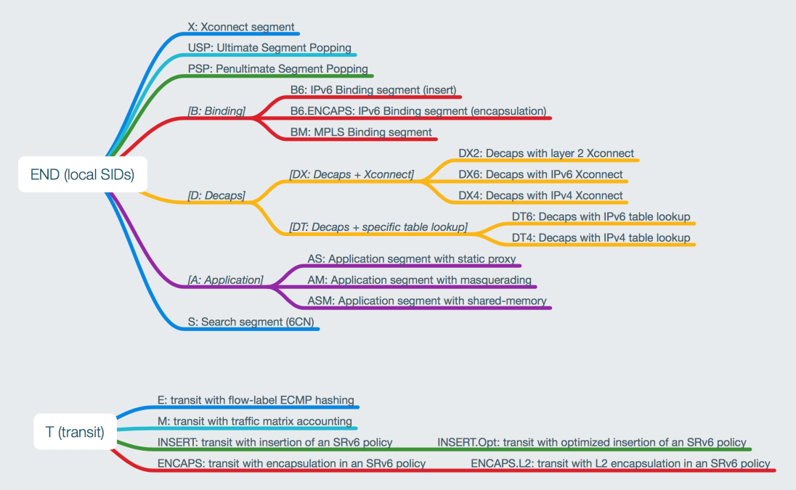
May be more Selfexplaining …

Slide 165
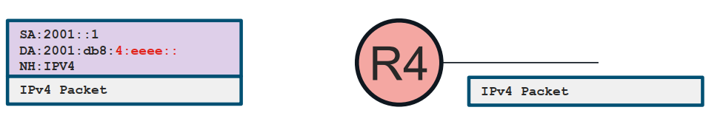
uSID based functions - Example
uDT4=END.DT4, uDT6=END.DT6
  Endpoint with Decapsulation and Table Lookup
Decapsulate and Table Lookup (VRF)
Same as Per VRF Label Allocation (aggregate label)
Must be last function in SID list

Slide 166
SRv6 functions: Steering and Services
Codename |  | Behavior | Note
End | uN | Endpoint | [Node SID]
End.X | uA | Endpoint with Layer-3 cross-connect | [Adj SID]
End.B6.Insert | uB6.Insert | Endpoint bound to an SRv6 policy | [BSID]
End.B6.Encap | uB6.Encaps | Endpoint bound to an SRv6 encapsulation policy | [BSID]
End.DX6 | uDX6 | Endpoint with decapsulation and IPv6 cross-connect | [L3VPN Per-CE]
End.DX4 | uDX4 | Endpoint with decapsulation and IPv4 cross-connect | [L3VPN Per-CE]
End.DT6 | uDT6 | Endpoint with decapsulation and specific IPv6 table lookup | [L3VPN Per-VRF]
End.DT4 | uDT4 | Endpoint with decapsulation and specific IPv4 table lookup | [L3VPN Per-VRF]
End.DX2 | uDX2 | Endpoint with decapsulation and L2 cross-connect | [E-LINE]
End.DT2U/M | uDT2U/M | Endpoint with decapsulation and L2 unicast lookup / flooding | [E-LAN]
End.DTM | uDTM | Endpoint with decapsulation and MPLS table lookup | [Interworking]
H.Insert / H.Encaps |  | Headend with Insertion / Encapsulation of / into an SRv6 policy | [TiLFA]
H. Encaps.L2 |  | H.Encaps Applied to Received L2 Frames | [L2 Port Mode]
H.Encaps.M |  | H.Encaps Applied to MPLS Label Stack | [Interworking]
Notes:
BRKMPL-2203

Slide 167
Display SRv6 capabilities on the device – IOS-XR
RP/0/RP0/CPU0:R01#sh segment-routing srv6 manager
Tue Oct 22 08:31:34.780 UTC
Parameters:
SRv6 Enabled: Yes
SRv6 Operational Mode:
Micro-segment:
SID Base Block: fc00:ab00::/24
Encapsulation:
Source Address:
Configured: ::
Default: 2001:9999::1
Hop-Limit: Default
Traffic-class: Default
Summary:
Number of Locators: 1 (1 operational)
Number of SIDs: 3 (0 stale)
Max SID resources: 64000
Number of free SID resources: 63997
OOR:
Thresholds (resources): Green 3200, Warning 1920
Status: Resource Available
History: (0 cleared, 0 warnings, 0 full)
Block fc00:ab00::/32:
Number of SIDs free: 7677
Max SIDs: 7680
Thresholds: Green 384, Warning 231
Status: Resource Available
History: (0 cleared, 0 warnings, 0 full)
Block fc00:abff::/32:
Number of SIDs free: 7680
Max SIDs: 7680
Thresholds: Green 384, Warning 231
Status: Resource Available
History: (0 cleared, 0 warnings, 0 full)
-- Cut --
Platform Capabilities:
SRv6: Yes
TILFA: Yes
Microloop-Avoidance: Yes
Endpoint behaviors:
End.DX6
End.DX4
End.DT6
End.DT4
End.DX2
End (PSP/USD)
End.X (PSP/USD)
uN (PSP/USD)
uA (PSP/USD)
uDT6
uDT4
uDX2
uDT2U
uDT2M
uB6 (Insert.Red)
Headend behaviors:
T
H.Insert.Red
H.Encaps.Red
H.Encaps.L2.Red
Security rules:
SEC-1
SEC-2
SEC-3
Counters:
CNT-1
CNT-3
-- Cut --
Signaled parameters:
Max-SL : 3
Max-End-Pop-SRH : 3
Max-H-Insert : 3 sids
Max-H-Encap : 3 sids
Max-End-D : 4
Configurable parameters (under srv6):
Encapsulation:
Source Address: Yes
Hop-Limit : value=Yes, propagate=No
Traffic-class : value=Yes, propagate=Yes
Default parameters (under srv6):
Encapsulation:
Hop-Limit : value=0, propagate=No
Traffic-class : value=0, propagate=No
Max Locators: 16
Max SIDs: 64000
SID Holdtime: 3 mins
RP/0/RP0/CPU0:R01#
RP/0/RP0/CPU0:R01# sh ver
Tue Oct 22 11:32:37.612 UTC
Cisco IOS XR Software, Version 7.7.1
Copyright (c) 2013-2022 by Cisco Systems, Inc.
Build Information:
Built By : ingunawa
Built On : Mon Jul 25 02:41:45 PDT 2022
Built Host : iox-ucs-067
Workspace : /auto/srcarchive12/prod/7.7.1/xrv9k/ws
Version : 7.7.1
Location : /opt/cisco/XR/packages/
Label : 7.7.1-0
cisco IOS-XRv 9000 () processor
System uptime is 1 day 2 hours 56 minutes
RP/0/RP0/CPU0:R01#

Slide 168
Display SRv6 capabilities on the device – IOS-XE
R21#sh segment-routing srv6 capabilities-parameters
Platform Capabilities:
SRv6:Yes
PFP:Yes
TILFA:Yes
Endpoint behaviors:
uN (PSP/USD)
uA (PSP/USD)
uDT6
uDT4
uDT46
Headend behaviors:
H.ENCAP.RED
Encap Parameters:
Max-SL :16 (H-ENCAP-MSD:16 SL-MSD:16, END-POP-MSD:16 END-ENCAP-MSD:16)
Encap :Collapsed
Hop-limit propagate :Yes
Traffic-class propagate :Yes
Path-MTU supported :static
SRH mode :
combine :Yes
stack :No
insert :Yes
Parameters in-use:
Encap Parameters:
Source Address: 2001:9999::21, Loopback0 (Default)
Hop-Limit: 64 (Default)
Traffic-class: 0 (Default)
MTU: not configured (Default)
R21#
R21#show version
Cisco IOS XE Software, Version 17.15.01a
Cisco IOS Software [IOSXE], Virtual XE Software (X86_64_LINUX_IOSD-UNIVERSALK9-M), Version 17.15.1a, RELEASE SOFTWARE (fc1)
Technical Support: http://www.cisco.com/techsupport
Copyright (c) 1986-2024 by Cisco Systems, Inc.
Compiled Wed 21-Aug-24 17:29 by mcpre
-- Cut --
License Level: network-advantage
License Type: Perpetual
Next reload license Level: network-advantage
Addon License Level: dna-advantage
Addon License Type: Subscription
Next reload addon license Level: dna-advantage
The current throughput level is 250000 kbps
Smart Licensing Status: Smart Licensing Using Policy
cisco C8000V (VXE) processor (revision VXE) with 1664235K/3075K bytes of memory.
Processor board ID 9VPXDTAML81
Router operating mode: Autonomous
20 Gigabit Ethernet interfaces
32768K bytes of non-volatile configuration memory.
3960280K bytes of physical memory.
11526144K bytes of virtual hard disk at bootflash:.
Configuration register is 0x2102
R21#

Slide 169
LAB 3 – Micro SID + L3VPN + L2VPN (EVPN)

Slide 170
Segment Routing MPLS and SRv6
MPLS and SRv6 Interworking
Dual connected PE / MPLS/SRv6 VPN Interworking Gateway
SRv6 and service migration

Slide 171
MPLS and SRv6 interworking
Two basic options
  Dual connected PE
    PE is in SRv6 and MPLS also
    use SRv6 for SRv6 destination and MPLS for MPLS destination
  MPLS/SRv6 Interworking Gateway
    on the interconnect between SRv6 and MPLS
    translate SRv6 < -- > MPLS in dataplane
    scalability issue

Slide 172
Segment Routing MPLS and SRv6
Dual connected PE
MPLS and SRv6 Interworking
SRv6 and service migration

Slide 173
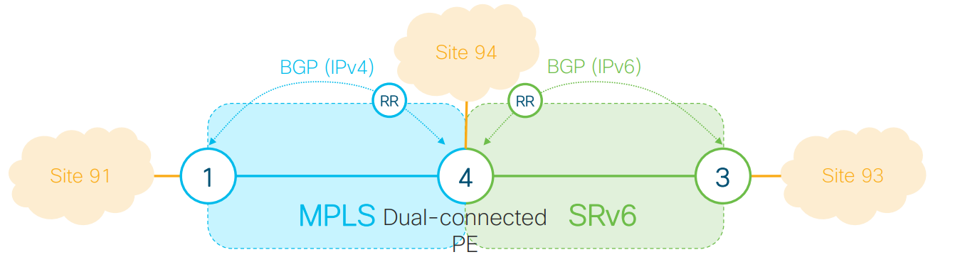
SRv6/MPLS Dual-Connected PE
The Dual-Connected PE enables customers to directly reach its services from both SRv6 and MPLS remote PEs without passing through a Gateway
The Dual-Connected PE advertises its service routes to both MPLS and SRv6 remote PEs
  MPLS service using IPv4 BGP session
  SRv6 service using IPv6 BGP session
The Dual-Connected PE directly (without GW) reaches service routes of remote SRv6 and MPLS PEs
  A service route of a remote Dual-Connected PE can be reached via SRv6 XOR MPLS (apply BGP policy to select desired path)

Slide 174
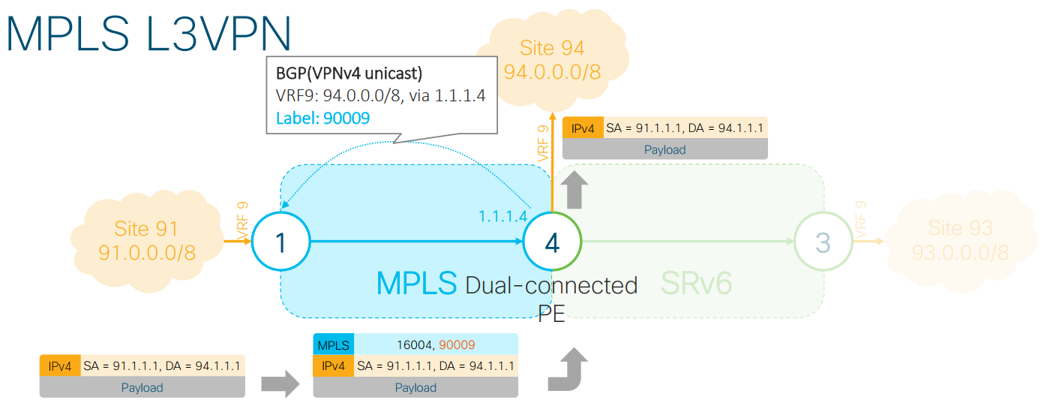
MPLS L3VPN
Dual-Connected PE4 advertises VPN route 94.0.0.0/8 in IPv4 BGP session with VPN label 90009
Remote MPLS PE1 sends VPN packets to Site 94 using MPLS encapsulation and VPN label
PE1 can use SR MPLS or LDP transport to reach PE4

Slide 175
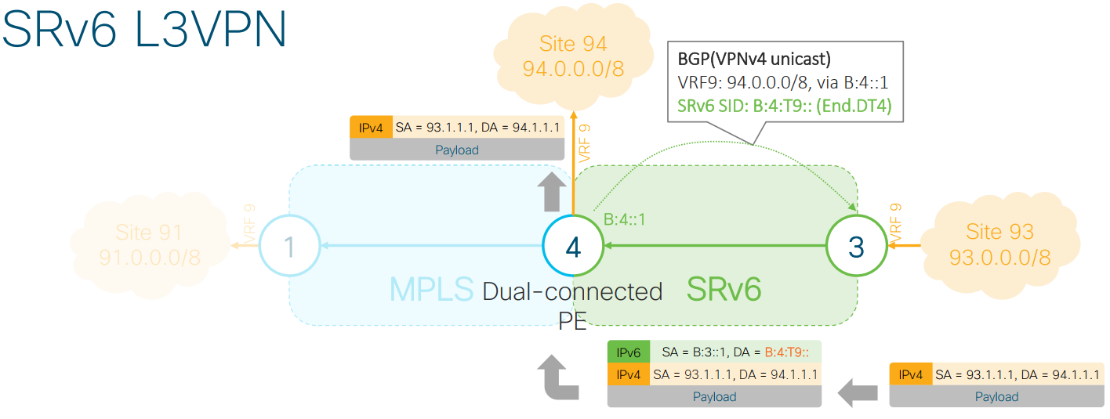
SRv6 L3VPN
Dual-Connected PE4 advertises VPN route 94.0.0.0/8 in IPv6 BGP session with End.DT4 SID B:4:T9::
Remote SRv6 PE3 sends VPN packets to Site 94 using IPv6 packets with DA = SID B:4:T9::

Slide 176
Dual connected PE
supported on ASR9000, NCS540/5500, Cisco8000
without additional config VRF prefixes are advertised ONLY over SRv6 so no local MPLS label is allocated and advertised.
By default, if a VRF prefix has both an MPLS label and an SRv6 SID, the MPLS label is sent when advertising the prefix to the PE. To advertise a VRF prefix with an SRv6 SID to an SRv6 session, use the encapsulation-type srv6 command under the neighbor VPN address-family.
Router(config)# router bgp 100
Router(config-bgp)# vrf blue
Router(config-bgp-vrf)# rd 1:10
Router(config-bgp-vrf)# address-family ipv4 unicast
Router(config-bgp-vrf-af)# mpls alloc enable
Router(config-bgp-vrf-af)# label mode per-ce << --- can be per-ce or per-vrf
Router(config-bgp-vrf-af)# segment-routing srv6
Router(config-bgp-vrf-af-srv6)# mpls alloc enable
Router(config-bgp-vrf-af-srv6)# alloc mode per-ce << --- can be per-ce or per-vrf
Router(config-bgp-vrf-af-srv6)# exit
Router(config-bgp-vrf-af)# exit
Router(config-bgp-vrf)# exit
Router(config-bgp)#
Router(config-bgp)# neighbor 192::6
Router(config-bgp-nbr)# remote-as 1
Router(config-bgp-nbr)# address-family ipv4 unicast
Router(config-bgp-nbr-af)# encapsulation-type srv6
Router(config-bgp-nbr-af)# exit

Slide 177
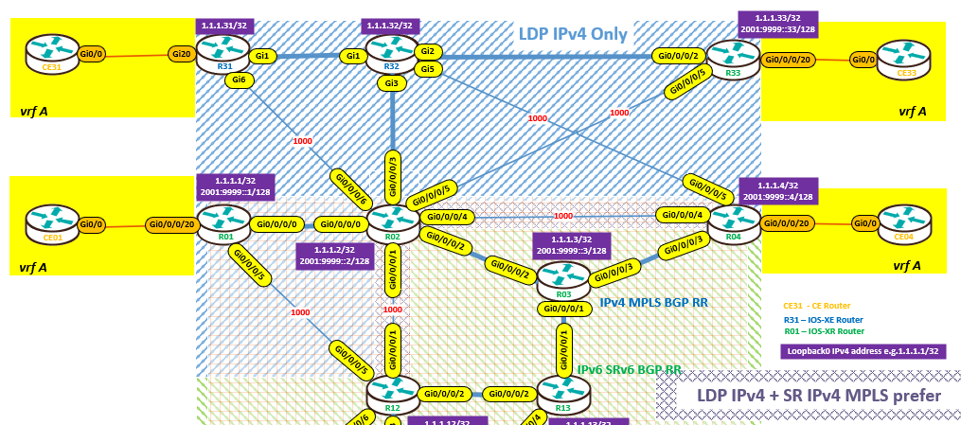
Dual connected PE – config example #1
R31 – MPLS only PE router
R01 – Dual connected PE (MPLS + SRv6)
R03 – BGP RR for IPv4 && MPLS
R04 – SRv6(/MPLS) PE router
R13 – BGP RR for IPv6 && SRv6
R02 – MPLS “P” and SRv6/pure IPv6 router

Slide 178
Dual connected PE – config example #2 (R01)
vrf A
bgp router-id 10.64.1.1
address-family ipv4 unicast
mpls alloc enable <<- allocate and send both MPLS VPN label and SRv6 SID
segment-routing srv6
locator Loc_uSID_Algo_0
alloc mode per-vrf
!
redistribute connected
!
address-family ipv6 unicast
mpls alloc enable <<- allocate and send both MPLS VPN label and SRv6 SID
segment-routing srv6
locator Loc_uSID_Algo_0
alloc mode per-vrf
!
redistribute connected
!! PE-CE routing
neighbor 10.64.1.2
remote-as 65001
address-family ipv4 unicast
route-policy PASS in
route-policy PASS out
!
!
neighbor fc64::1:2
remote-as 65001
address-family ipv6 unicast
route-policy PASS in
route-policy PASS out
!
R01 – Dual connected PE (MPLS + SRv6)
!
router bgp 65000
-- cut --
neighbor 1.1.1.3 << -- IPv4 BGP RR for “MPLS”
remote-as 65000
update-source Loopback0
address-family vpnv4 unicast
route-policy PASS in
route-policy PASS out
!
address-family vpnv6 unicast
route-policy PASS in
route-policy PASS out
!
neighbor 2001:9999::13 << -- IPv6 BGP RR for “SRv6”
remote-as 65000
update-source Loopback0
address-family vpnv4 unicast
route-policy PASS in
encapsulation-type srv6 << -- send SRv6 SID
route-policy RP-SRv6-transport-LP200 out
!
address-family vpnv6 unicast
route-policy PASS in
encapsulation-type srv6 << -- send SRv6 SID
route-policy RP-SRv6-transport-LP200 out
!
!

Slide 179
Dual connected PE – config example #3 (R01)
L3VPN BGP advertisement from R01 (CE01 subnet)
RP/0/RP0/CPU0:R01#sh bgp vpnv4 uni vrf A 10.0.1.0
Mon May 12 14:30:14.470 UTC
BGP routing table entry for 10.0.1.0/24, Route Distinguisher: 65000:1
Versions:
Process bRIB/RIB SendTblVer
Speaker 624 624
Local Label: 24011
SRv6-VPN SID: fc00:ab00:1:e001::/64
Format: f3216
Last Modified: May 12 13:45:16.371 for 00:44:58
Paths: (1 available, best #1)
Advertised to peers (in unique update groups):
1.1.1.3 2001:9999::13
Path #1: Received by speaker 0
Advertised to peers (in unique update groups):
1.1.1.3 2001:9999::13
65001
10.64.1.2 from 10.64.1.2 (10.2.1.1)
Origin IGP, metric 0, localpref 100, valid, external, best, group-best, import-candidate
Received Path ID 0, Local Path ID 1, version 624
Extended community: RT:65000:1
RP/0/RP0/CPU0:R01#
L3VPN BGP advertisement from R31 (CE31 subnet)
RP/0/RP0/CPU0:R01#sh cef vrf A 10.0.31.1
10.0.31.0/24, version 421,
-- cut --
via 1.1.1.31/32, 5 dependencies, recursive [flags 0x6000]
path-idx 0 NHID 0x0 [0xdb862b8 0x0]
recursion-via-/32
next hop VRF - 'default', table - 0xe0000000
next hop 1.1.1.31/32 via 24006/0/21
next hop 64.1.2.2/32 Gi0/0/0/0 labels imposed {24014 22}
-- cut --
RP/0/RP0/CPU0:R01#sh cef 1.1.1.31
1.1.1.31/32, version 511,
-- cut --
local label 24006 labels imposed {24014}
-- cut --

Slide 180
Dual connected PE – config example #4 (R31)
L3VPN BGP advertisement from R01 (CE01 subnet) visible on R31 (MPLS only)
R31#sh ip bgp vpnv4 vrf A 10.0.1.0
BGP routing table entry for 65000:1:10.0.1.0/24, version 282
Paths: (1 available, best #1, table A)
Flag: 0x100
Advertised to update-groups:
1
Refresh Epoch 1
65001
1.1.1.1 (metric 30) (via default) from 1.1.1.3 (1.1.1.3)
Origin IGP, metric 0, localpref 100, valid, internal, best
Extended Community: RT:65000:1
Originator: 1.1.1.1, Cluster list: 0.0.0.100
mpls labels in/out nolabel/24011
rx pathid: 0, tx pathid: 0x0
Updated on May 12 2025 13:45:20 UTC
R31#sh ip cef vrf A 10.0.1.0
10.0.1.0/24
nexthop 64.31.32.32 GigabitEthernet1 label [23|24017](ptr:0x7251E0EEC408)-(local:32) 24011
repair: attached-nexthop 64.2.31.2 GigabitEthernet6
R31#
R31#sh ip cef 1.1.1.1
1.1.1.1/32
nexthop 64.31.32.32 GigabitEthernet1 label [23|24017](ptr:0x7251E0EEC408)-(local:32)
repair: attached-nexthop 64.2.31.2 GigabitEthernet6
R31#
R31#sh mpls forwarding-table
Local Outgoing Prefix Bytes Label Outgoing Next Hop
Label Label or Tunnel Id Switched interface
-- cut --
22 No Label 10.0.31.0/24[V] 1710 BD1 10.64.31.2
-- cut --

Slide 181
Dual connected PE – config example #5 (R04)
L3VPN BGP advertisement from R01 (CE01 subnet) visible on R04 SRv6(/MPLS)
RP/0/RP0/CPU0:R04#sh bgp vpnv4 unicast vrf A 10.0.1.0/24 RECEIVED on remote router
BGP routing table entry for 10.0.1.0/24, Route Distinguisher: 65000:1
-- cut --
65001
1.1.1.1 (metric 30) from 1.1.1.3 (1.1.1.1)
Received Label 24011
Origin IGP, metric 0, localpref 100, valid, internal, import-candidate, imported
Received Path ID 0, Local Path ID 0, version 0
Extended community: RT:65000:1
Originator: 1.1.1.1, Cluster list: 0.0.0.100
Source AFI: VPNv4 Unicast, Source VRF: A, Source Route Distinguisher: 65000:1
Path #2: Received by speaker 0
Not advertised to any peer
65001
2001:9999::1 (metric 20) from 2001:9999::13 (1.1.1.1)
Received Label 0xe0010
Origin IGP, metric 0, localpref 200, valid, internal, best, group-best, import-candidate, imported
Received Path ID 0, Local Path ID 1, version 519
Extended community: RT:65000:1
Originator: 1.1.1.1, Cluster list: 0.0.0.101
PSID-Type:L3, SubTLV Count:1
SubTLV:
T:1(Sid information), Sid:fc00:ab00:1::(Transposed), Behavior:63, SS-TLV Count:1
SubSubTLV:
T:1(Sid structure):
Source AFI: VPNv4 Unicast, Source VRF: A, Source Route Distinguisher: 65000:1
RP/0/RP0/CPU0:R04#
RP/0/RP0/CPU0:R04# sh cef vrf A 10.0.1.1
10.0.1.0/24, version 340, SRv6 Headend,
-- cut --
Level 1 - Load distribution: 0
[0] via fc00:ab00:1::/128, recursive
via fc00:ab00:1::/128, 5 dependencies, recursive [flags 0x6000]
path-idx 0 NHID 0x0 [0xe37a8b0 0x0]
next hop VRF - 'default', table - 0xe0800000
next hop fc00:ab00:1::/128 via fc00:ab00:1::/48
SRv6 H.Encaps.Red SID-list {fc00:ab00:1:e001::}
Load distribution: 0 (refcount 5)
Hash OK Interface Address
0 Y GigabitEthernet0/0/0/4 remote
RP/0/RP0/CPU0:R04#

Slide 182
LAB 4a – uSID + Dual connected PE

Slide 183
Segment Routing MPLS and SRv6
MPLS/SRv6 VPN Interworking Gateway
MPLS and SRv6 Interworking
SRv6 and service migration

Slide 184
Services – MPLS/SRv6 VPN Interworking Gateway
L3VPN services
  SRv6 VPNv4 unicast ↔ MPLS (SR or LDP) VPNv4 unicast
  SRv6 VPNv6 unicast ↔ MPLS (SR or LDP) 6vPE (VPNv6 unicast over IPv4)
L3 Global Routing Table (GRT) services
  SRv6 4PE (global IPv4 unicast over IPv6) ↔ MPLS (SR or LDP) global IPv4 unicast
  SRv6 global IPv6 unicast ↔ MPLS (SR or LDP) 6PE (global IPv6 labeled unicast over IPv4)

Slide 185
Services – MPLS/SRv6 VPN Interworking Gateway
The SRv6/MPLS L3 Service Interworking Gateway provides both transport and service termination
Two sets of Route Targets
  MPLS L3VPN RTs
  SRv6 L3VPN RTs (stitching RTs)
Gateway Functions
  Gateway Imports service routes received from one domain (MPLS or SRv6)
  Gateway re-advertise exported service routes to the other domain (nexthop-self)
  Gateway stitches the service on the dataplane (uDT4/H.Encap.Red <-> service label)
  For VPNv4 and VPNv6 also
Notes:
https://www.youtube.com/watch?v=j-2FeMB8LQ8

Slide 186
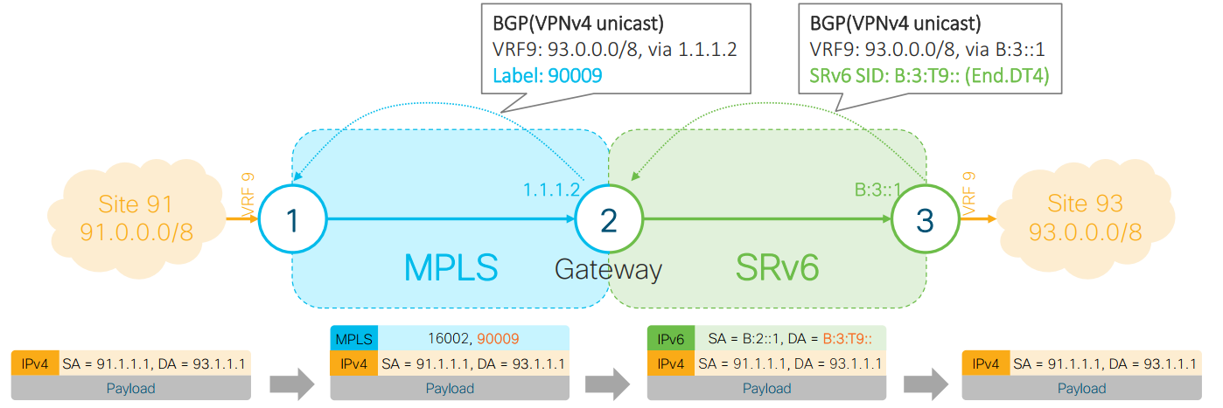
L3VPN – MPLS to SRv6
Control plane:
  Gateway imports SRv6 service route 93.0.0.0/8 and re-advertises in the MPLS domain with VPN label 90009
Data plane:
  Gateway POPs the VPN label 90009, looks up the destination in VRF 9 and pushes the appropriate SRv6 encapsulation

Slide 187

L3VPN – SRv6 to MPLS
Control plane:
  Gateway imports MPLS service route 91.0.0.0/8 and re-advertises in the SRv6 domain with End.DT4 SID B:2:T9::
Data plane:
  Gateway removes the outer IPv6 header, looks up the destination in VRF 9 and pushes the service and nexthop labels

Slide 188


SRv6/MPLS L3 Service Interworking Gateway

Slide 189
Configuration example - LAB
There is L3 VPN configured as vrf A with RD = 65000:1 (could be the same for SRv6 and MPLS since IOS-XR 24.1.1)
SRv6 L3VPN vrf A use RT= 65000:1(import + export)
MPLS L3VPN vrf A use RT=65000:1001 (import + export)
we use vrf A-GW on R02 (MPLS/SRv6 VPN Interworking GW) with RD=65000:2 (must be different than vrf A – still IOS-XR limitation)
Notes:
https://www.cisco.com/c/en/us/td/docs/routers/asr9000/software/24xx/segment-routing/configuration/guide/b-segment-routing-cg-asr9000-24xx/configure-srv6-micro-sid.html#id_133508

Slide 190
MPLS / SRv6 VPN Interworking Gateway #1/2
R02 is MPLS/SRv6 interworking GW – vrf A-GW “translation” RT65000:1001 <-> RT65000:1
R31 is MPLS only – no special config , vrf A use RT 65000:1001
R01 (IOS-XR), R21(IOS-XE) are SRv6 – no special config, vrf A use RT 65000:1
!! core part of the config
interface Loopback0
ipv4 address 1.1.1.2 255.255.255.255 !! MPLS identity
ipv6 address 2001:9999::2/128 !! SRv6
!
segment-routing
srv6
logging locator status
locators
locator Loc_uSID_Algo_0
micro-segment behavior unode psp-usd
prefix fc00:ab00:2::/48 !! SRv6 uSID
!
!! vrf A-GW
vrf A-GW
address-family ipv4 unicast
import route-target
65000:1 stitching !! SRv6
65000:1001 !! MPLS
!
export route-target
65000:1 stitching !! SRv6
65000:1001 !! MPLS
!
!
address-family ipv6 unicast
import route-target
65000:1 stitching
65000:1001
!
export route-target
65000:1 stitching
65000:1001

Slide 191
MPLS / SRv6 VPN Interworking Gateway #2/2
!
router bgp 65000
bgp router-id 1.1.1.2
segment-routing srv6
locator Loc_uSID_Algo_0
!! Activate AF
address-family ipv4 unicast
address-family vpnv4 unicast
address-family vpnv6 unicast
address-family l2vpn evpn
!! MPLS side
neighbor-group RRv4
remote-as 65000
update-source Loopback0
address-family vpnv4 unicast
import reoriginate stitching-rt
route-reflector-client
advertise vpnv4 unicast re-originated
!
address-family vpnv6 unicast
import reoriginate stitching-rt
route-reflector-client
advertise vpnv6 unicast re-originated
!
!! MPLS side PE router
neighbor 1.1.1.31
use neighbor-group RRv4
!
!! SRv6 side (BGP RR)
neighbor 2001:9999::13
remote-as 65000
update-source Loopback0
address-family vpnv4 unicast
import stitching-rt reoriginate
route-reflector-client
encapsulation-type srv6 !! send SRv6 SID not MPLS label
advertise vpnv4 unicast re-originated stitching-rt
!
address-family vpnv6 unicast
import stitching-rt reoriginate
route-reflector-client
encapsulation-type srv6 !! send SRv6 SID not MPLS label
advertise vpnv6 unicast re-originated stitching-rt
!
vrf A-GW
!! must use different RD than used in MPLS/SRv6
rd 65000:2
address-family ipv4 unicast
mpls alloc enable !! allocate MPLS label also
segment-routing srv6 !! allocate SRv6 SID
!
!
address-family ipv6 unicast
mpls alloc enable !! allocate MPLS label also
segment-routing srv6 !! allocate SRv6 SID
!

Slide 192

MPLS to SRv6 (CE31 -> CE01)
CE31
R31
R32
R02
R01
CE01
X
X

Slide 193
MPLS to SRv6 (CE31 -> CE01) #CE31
CE31#ping 10.0.1.1 source loopback 1000
Type escape sequence to abort.
Sending 5, 100-byte ICMP Echos to 10.0.1.1, timeout is 2 seconds:
Packet sent with a source address of 10.0.31.1
!!!!!
Success rate is 100 percent (5/5), round-trip min/avg/max = 7/8/12 ms
CE31#traceroute 10.0.1.1 source loopback 1000 numeric
Type escape sequence to abort.
Tracing the route to 10.0.1.1
VRF info: (vrf in name/id, vrf out name/id)
1 10.64.31.1 [AS 65000] 33 msec 2 msec 2 msec
2 64.31.32.32 [MPLS: Labels 17/24010 Exp 0] 18 msec 18 msec 12 msec
3 64.2.32.2 10 msec 7 msec 4 msec
4 64.1.2.1 6 msec 35 msec 22 msec
5 10.64.1.2 [AS 65000] 21 msec * 6 msec
CE31#
CE31#sh ip bgp 10.0.1.1
BGP routing table entry for 10.0.1.0/24, version 15
Paths: (1 available, best #1, table default)
Not advertised to any peer
Refresh Epoch 1
65000 65001
10.64.31.1 from 10.64.31.1 (10.64.31.1)
Origin IGP, localpref 100, valid, external, best
rx pathid: 0, tx pathid: 0x0
CE31#sh ip cef 10.0.1.1
10.0.1.0/24
nexthop 10.64.31.1 GigabitEthernet0/0
CE31#

Slide 194
MPLS to SRv6 (CE31 -> CE01) #R31
R31#sh ip bgp vpnv4 vrf A 10.0.1.1
BGP routing table entry for 65000:1:10.0.1.0/24, version 34
Paths: (1 available, best #1, table A)
Flag: 0x100
Advertised to update-groups:
2
Refresh Epoch 1
65001, imported path from 65000:2000:10.0.1.0/24 (global)
1.1.1.2 (metric 20) (via default) from 1.1.1.2 (1.1.1.2)
Origin IGP, metric 0, localpref 100, valid, internal, best
Extended Community: RT:65000:1 RT:65000:1001
Originator: 1.1.1.1, Cluster list: 1.1.1.2, 0.0.0.100
mpls labels in/out nolabel/24010
rx pathid: 0, tx pathid: 0x0
Updated on Nov 1 2024 15:31:07 UTC
R31#
R31#sh ip cef vrf A 10.0.1.1 detail
10.0.1.0/24, epoch 2, flags [rib defined all labels]
recursive via 1.1.1.2 label 24010
nexthop 64.31.32.32 GigabitEthernet1 label 17-(local:17)
R31#
R31# sh ip cef 1.1.1.2
1.1.1.2/32
nexthop 64.31.32.32 GigabitEthernet1 label 17-(local:17)
R31#

Slide 195
MPLS to SRv6 (CE31 -> CE01) #R32
R32#sh mpl forwarding-table
Local Outgoing Prefix Bytes Label Outgoing Next Hop
Label Label or Tunnel Id Switched interface
16 Pop Label 1.1.1.4/32 0 Gi5 64.4.32.4
17 Pop Label 1.1.1.2/32 19987 Gi3 64.2.32.2
18 24007 1.1.1.12/32 0 Gi3 64.2.32.2
19 24000 1.1.1.3/32 0 Gi3 64.2.32.2
24000 1.1.1.3/32 30701 Gi5 64.4.32.4
20 24013 1.1.1.23/32 0 Gi5 64.4.32.4
21 24002 1.1.1.1/32 0 Gi3 64.2.32.2
22 24003 1.1.1.13/32 0 Gi3 64.2.32.2
24010 1.1.1.13/32 0 Gi5 64.4.32.4
23 24004 1.1.1.22/32 0 Gi3 64.2.32.2
24 24005 1.1.1.21/32 0 Gi3 64.2.32.2
25 Pop Label 1.1.1.31/32 50621 Gi1 64.31.32.31
R32#

Slide 196
MPLS to SRv6 (CE31 -> CE01) #R02
RP/0/RP0/CPU0:R02#sh bgp vrf A-GW 10.0.1.0/24 detail
BGP routing table entry for 10.0.1.0/24, Route Distinguisher: 65000:2000
Versions:
Process bRIB/RIB SendTblVer
Speaker 96 96
Local Label: 24010 (with rewrite);
SRv6-VPN SID: fc00:ab00:2:e008::/64
Flags: 0x01001001+0x01000000;
Last Modified: Nov 1 15:30:55.875 for 02:48:32
Paths: (1 available, best #1)
Advertised to PE peers (in unique update groups):
1.1.1.31
Path #1: Received by speaker 0
Flags: 0x200060000d060205+0x00, import: 0x080
Advertised to PE peers (in unique update groups):
1.1.1.31
65001, (Received from a RR-client)
2001:9999::1 (metric 10) from 2001:9999::3 (1.1.1.1), if-handle 0x00000000
Received Label 0xe0010
Origin IGP, metric 0, localpref 100, valid, internal, best, group-best, import-candidate, imported, reoriginated
Received Path ID 0, Local Path ID 1, version 96
Extended community: RT:65000:1 RT:65000:1001
Originator: 1.1.1.1, Cluster list: 0.0.0.100
PSID-Type:L3, SubTLV Count:1, R:0x00,
SubTLV:
T:1(Sid information), Sid:fc00:ab00:1::, F:0x00, R2:0x00, Behavior:63, R3:0x00, SS-TLV Count:1
SubSubTLV:
T:1(Sid structure):
Length [Loc-blk,Loc-node,Func,Arg]:[32,16,16,0], Tpose-len:16, Tpose-offset:48
Source AFI: VPNv4 Unicast, Source VRF: default, Source Route Distinguisher: 65000:1
RP/0/RP0/CPU0:R02#
RP/0/RP0/CPU0:R02#sh mpls forwarding
Local Outgoing Prefix Outgoing Next Hop Bytes
Label Label or ID Interface Switched
------ ----------- ------------------ ------------ --------------- ------------
24000 Pop 1.1.1.3/32 Gi0/0/0/2 64.2.3.3 6998465
24001 Pop 1.1.1.4/32 Gi0/0/0/4 64.2.4.4 1830684
24002 Pop 1.1.1.1/32 Gi0/0/0/0 64.1.2.1 4781829
24003 24003 1.1.1.13/32 Gi0/0/0/2 64.2.3.3 553
24004 1.1.1.13/32 Gi0/0/0/1 64.2.12.12 517
24004 24006 1.1.1.22/32 Gi0/0/0/1 64.2.12.12 561
24005 24007 1.1.1.21/32 Gi0/0/0/1 64.2.12.12 1928832
24006 24013 1.1.1.23/32 Gi0/0/0/4 64.2.4.4 0
24007 Pop 1.1.1.12/32 Gi0/0/0/1 64.2.12.12 2192862
24008 Pop 1.1.1.32/32 Gi0/0/0/3 64.2.32.32 17032
24009 25 1.1.1.31/32 Gi0/0/0/3 64.2.32.32 16052
24010 Aggregate A-GW: Per-VRF Aggr[V] \
A-GW 3634
RP/0/RP0/CPU0:R02#show mpls label table vrf A
RSI connected: Yes
Vrf Name: Multiple VRFs Shown
Table Label Owner State Rewrite
----- ------- ------------------------------- ------ -------
0 24000 LDP(A) InUse Yes
0 24001 LDP(A) InUse Yes
0 24002 LDP(A) InUse Yes
0 24003 LDP(A) InUse Yes
0 24004 LDP(A) InUse Yes
0 24005 LDP(A) InUse Yes
0 24006 LDP(A) InUse Yes
0 24007 LDP(A) InUse Yes
0 24008 LDP(A) InUse Yes
0 24009 LDP(A) InUse Yes
0 24010 BGP-VPNv4(A):bgp-default InUse Yes
RP/0/RP0/CPU0:R02#

Slide 197
MPLS to SRv6 (CE31 -> CE01) #R02
RP/0/RP0/CPU0:R02#sh cef vrf A-GW 10.0.1.1
Fri Nov 1 17:41:43.198 UTC
10.0.1.0/24, version 14, SRv6 Headend, internal 0x1000001 0x30 (ptr 0xe7dcdb0) [1], 0x400 (0xe158de8), 0x0 (0xfcb57d8)
Updated Nov 1 15:30:55.907
Prefix Len 24, traffic index 0, precedence n/a, priority 3
gateway array (0x1038b278) reference count 4, flags 0x10, source rib (7), 0 backups
[5 type 3 flags 0x8441 (0xe071548) ext 0x0 (0x0)]
LW-LDI[type=3, refc=1, ptr=0xe158de8, sh-ldi=0xe071548]
gateway array update type-time 1 Nov 1 15:30:55.710
LDI Update time Nov 1 15:30:55.710
LW-LDI-TS Nov 1 15:30:55.907
Level 1 - Load distribution: 0
[0] via fc00:ab00:1::/128, recursive
via fc00:ab00:1::/128, 3 dependencies, recursive [flags 0x6000]
path-idx 0 NHID 0x0 [0xe764d30 0x0]
next hop VRF - 'default', table - 0xe0800000
next hop fc00:ab00:1::/128 via fc00:ab00:1::/48
SRv6 H.Encaps.Red SID-list {fc00:ab00:1:e001::}
Load distribution: 0 (refcount 5)
Hash OK Interface Address
0 Y GigabitEthernet0/0/0/0 remote
RP/0/RP0/CPU0:R02#
RP/0/RP0/CPU0:R02#sh cef vrf A-GW 10.0.1.1 detail
Fri Nov 1 17:42:15.122 UTC
10.0.1.0/24, version 14, SRv6 Headend, internal 0x1000001 0x30 (ptr 0xe7dcdb0) [1], 0x400 (0xe158de8), 0x0 (0xfcb57d8)
Updated Nov 1 15:30:55.907
Prefix Len 24, traffic index 0, precedence n/a, priority 3
gateway array (0x1038b278) reference count 4, flags 0x10, source rib (7), 0 backups
[5 type 3 flags 0x8441 (0xe071548) ext 0x0 (0x0)]
LW-LDI[type=3, refc=1, ptr=0xe158de8, sh-ldi=0xe071548]
gateway array update type-time 1 Nov 1 15:30:55.710
LDI Update time Nov 1 15:30:55.710
LW-LDI-TS Nov 1 15:30:55.907
Level 1 - Load distribution: 0
[0] via fc00:ab00:1::/128, recursive
via fc00:ab00:1::/128, 3 dependencies, recursive [flags 0x6000]
path-idx 0 NHID 0x0 [0xe764d30 0x0]
next hop VRF - 'default', table - 0xe0800000
next hop fc00:ab00:1::/128 via fc00:ab00:1::/48
SRv6 H.Encaps.Red SID-list {fc00:ab00:1:e001::}
Load distribution: 0 (refcount 5)
Hash OK Interface Address
0 Y GigabitEthernet0/0/0/0 remote
RP/0/RP0/CPU0:R02#

Slide 198
MPLS to SRv6 (CE31 -> CE01) #R01
RP/0/RP0/CPU0:R01#sh bgp vpnv4 unicast vrf A 10.0.1.1
BGP routing table entry for 10.0.1.0/24, Route Distinguisher: 65000:1
Versions:
Process bRIB/RIB SendTblVer
Speaker 23 23
SRv6-VPN SID: fc00:ab00:1:e001::/64
Last Modified: Oct 21 12:56:44.189 for 1w4d
Paths: (1 available, best #1)
Advertised to peers (in unique update groups):
2001:9999::3
Path #1: Received by speaker 0
Advertised to peers (in unique update groups):
2001:9999::3
65001
10.64.1.2 from 10.64.1.2 (10.2.1.1)
Origin IGP, metric 0, localpref 100, valid, external, best, group-best, import-candidate
Received Path ID 0, Local Path ID 1, version 23
Extended community: RT:65000:1
RP/0/RP0/CPU0:R01#
RP/0/RP0/CPU0:R01#sh cef vrf A 10.0.1.1 detail
10.0.1.0/24, version 197, internal 0x1000001 0x30 (ptr 0xe8890b0) [1], 0x400 (0xe01b338), 0x0 (0x0)
Updated Oct 21 12:56:44.040
Prefix Len 24, traffic index 0, precedence n/a, priority 3
gateway array (0xde82e90) reference count 3, flags 0x10, source rib (7), 0 backups
[4 type 3 flags 0x8441 (0xdf33be8) ext 0x0 (0x0)]
LW-LDI[type=3, refc=1, ptr=0xe01b338, sh-ldi=0xdf33be8]
gateway array update type-time 1 Oct 21 12:56:44.026
LDI Update time Oct 21 12:56:44.026
LW-LDI-TS Oct 21 12:56:44.026
Level 1 - Load distribution: 0
[0] via 10.64.1.2/32, recursive
via 10.64.1.2/32, 3 dependencies, recursive, bgp-ext [flags 0x6020]
path-idx 0 NHID 0x0 [0xe889188 0x0]
next hop 10.64.1.2/32 via 10.64.1.2/32
Load distribution: 0 (refcount 4)
Hash OK Interface Address
0 Y GigabitEthernet0/0/0/20 remote
RP/0/RP0/CPU0:R01#
RP/0/RP0/CPU0:R01#sh segment-routing srv6 sid
Fri Nov 1 17:45:53.446 UTC
*** Locator: 'Loc_uSID_Algo_0' ***
SID Behavior Context Owner State RW
-------------------------- ---------------- -------------------------------- ------------------ ----- --
fc00:ab00:1:: uN (PSP/USD) 'default':1 sidmgr InUse Y
fc00:ab00:1:e000:: uA (PSP/USD) [Gi0/0/0/0, Link-Local]:0 isis-1 InUse Y
fc00:ab00:1:e001:: uDT4 'A' bgp-65000 InUse Y
fc00:ab00:1:e002:: uDX2 14:140104 l2vpn_srv6 InUse Y
fc00:ab00:1:e003:: uA (PSP/USD) [Gi0/0/0/5, Link-Local]:0 isis-1 InUse Y
fc00:ab00:1:e004:: uA (PSP/USD) [Gi0/0/0/0, Link-Local]:0:P isis-1 InUse Y
fc00:ab00:1:e005:: uA (PSP/USD) [Gi0/0/0/5, Link-Local]:0:P isis-1 InUse Y
RP/0/RP0/CPU0:R01#

Slide 199
MPLS to SRv6 (CE31 -> CE01) #CE01
CE01#sh int lo 1000
Loopback1000 is up, line protocol is up
Hardware is Loopback
Internet address is 10.0.1.1/24
MTU 1514 bytes, BW 8000000 Kbit/sec, DLY 5000 usec,
-- cut --
CE01#sh ip bgp
BGP table version is 203, local router ID is 10.2.1.1
Status codes: s suppressed, d damped, h history, * valid, > best, i - internal,
r RIB-failure, S Stale, m multipath, b backup-path, f RT-Filter,
x best-external, a additional-path, c RIB-compressed,
t secondary path,
Origin codes: i - IGP, e - EGP, ? - incomplete
RPKI validation codes: V valid, I invalid, N Not found
Network Next Hop Metric LocPrf Weight Path
*> 10.0.1.0/24 0.0.0.0 0 32768 i
*> 10.0.4.0/24 10.64.1.1 0 65000 65004 i
*> 10.0.21.0/24 10.64.1.1 0 65000 65021 i
*> 10.0.31.0/24 10.64.1.1 0 65000 65031 i
*> 10.1.1.0/24 0.0.0.0 0 32768 i
*> 10.1.4.0/24 10.64.1.1 0 65000 65004 i
*> 10.1.21.0/24 10.64.1.1 0 65000 65021 i
*> 10.1.31.0/24 10.64.1.1 0 65000 65031 i
*> 10.2.1.0/24 0.0.0.0 0 32768 i
*> 10.2.4.0/24 10.64.1.1 0 65000 65004 i
*> 10.2.21.0/24 10.64.1.1 0 65000 65021 i
*> 10.2.31.0/24 10.64.1.1 0 65000 65031 i
r> 10.64.1.0/30 10.64.1.1 0 0 65000 ?
Network Next Hop Metric LocPrf Weight Path
*> 10.64.4.0/30 10.64.1.1 0 65000 ?
*> 10.64.21.0/30 10.64.1.1 0 65000 ?
*> 10.64.31.0/30 10.64.1.1 0 65000 ?
CE01#

Slide 200
SRv6 to MPLS (CE01 -> CE31) #CE01
CE01#ping 10.0.31.1 source Loopback 1000
Type escape sequence to abort.
Sending 5, 100-byte ICMP Echos to 10.0.31.1, timeout is 2 seconds:
Packet sent with a source address of 10.0.1.1
!!!!!
Success rate is 100 percent (5/5), round-trip min/avg/max = 7/8/9 ms
CE01#traceroute 10.0.31.1 source Loopback 1000 numeric
Type escape sequence to abort.
Tracing the route to 10.0.31.1
VRF info: (vrf in name/id, vrf out name/id)
1 10.64.1.1 [AS 65000] 5 msec 1 msec 4 msec
2 64.1.2.2 6 msec 8 msec 4 msec
3 64.2.32.32 [MPLS: Labels 25/26 Exp 0] 7 msec 7 msec 8 msec
4 10.64.31.1 [AS 65000] [MPLS: Label 26 Exp 0] 6 msec 6 msec 5 msec
5 10.64.31.2 [AS 65000] 7 msec * 25 msec
CE01#
CE01#sh ip bgp 10.0.31.1
BGP routing table entry for 10.0.31.0/24, version 203
Paths: (1 available, best #1, table default)
Not advertised to any peer
Refresh Epoch 1
65000 65031
10.64.1.1 from 10.64.1.1 (10.64.1.1)
Origin IGP, localpref 100, valid, external, best
rx pathid: 0, tx pathid: 0x0
CE01#

Slide 201
SRv6 to MPLS (CE01 -> CE31) #R01
RP/0/RP0/CPU0:R01#sh bgp vrf A 10.0.31.1
Fri Nov 1 17:56:02.430 UTC
BGP routing table entry for 10.0.31.0/24, Route Distinguisher: 65000:1
Versions:
Process bRIB/RIB SendTblVer
Speaker 142 142
Last Modified: Nov 1 15:30:56.189 for 02:25:06
Paths: (1 available, best #1)
Advertised to CE peers (in unique update groups):
10.64.1.2
Path #1: Received by speaker 0
Advertised to CE peers (in unique update groups):
10.64.1.2
65031
2001:9999::2 (metric 10) from 2001:9999::3 (1.1.1.31)
Received Label 0xe0080
Origin IGP, metric 0, localpref 100, valid, internal, best, group-best, import-candidate, imported
Received Path ID 0, Local Path ID 1, version 142
Extended community: RT:65000:1
Originator: 1.1.1.31, Cluster list: 0.0.0.100, 1.1.1.2
PSID-Type:L3, SubTLV Count:1
SubTLV:
T:1(Sid information), Sid:fc00:ab00:2::, Behavior:63, SS-TLV Count:1
SubSubTLV:
T:1(Sid structure):
Source AFI: VPNv4 Unicast, Source VRF: default, Source Route Distinguisher: 65000:2000
RP/0/RP0/CPU0:R01#

Slide 202
SRv6 to MPLS (CE01 -> CE31) #R01
RP/0/RP0/CPU0:R01#sh cef vrf A 10.0.31.1
Fri Nov 1 17:55:01.230 UTC
10.0.31.0/24, version 280, SRv6 Headend, internal 0x5000001 0x30 (ptr 0xe87d1b8) [1], 0x400 (0xe01b920), 0x0 (0xfcbf738)
Updated Nov 1 15:30:56.088
Prefix Len 24, traffic index 0, precedence n/a, priority 3
gateway array (0xff5b278) reference count 4, flags 0x10, source rib (7), 0 backups
[5 type 3 flags 0x8441 (0xdf33e28) ext 0x0 (0x0)]
LW-LDI[type=3, refc=1, ptr=0xe01b920, sh-ldi=0xdf33e28]
gateway array update type-time 1 Nov 1 15:30:56.087
LDI Update time Nov 1 15:30:56.087
LW-LDI-TS Nov 1 15:30:56.087
Level 1 - Load distribution: 0
[0] via fc00:ab00:2::/128, recursive
via fc00:ab00:2::/128, 3 dependencies, recursive [flags 0x6000]
path-idx 0 NHID 0x0 [0xe8077d0 0x0]
next hop VRF - 'default', table - 0xe0800000
next hop fc00:ab00:2::/128 via fc00:ab00:2::/48
SRv6 H.Encaps.Red SID-list {fc00:ab00:2:e008::}
Load distribution: 0 (refcount 5)
Hash OK Interface Address
0 Y GigabitEthernet0/0/0/0 remote
RP/0/RP0/CPU0:R01#

Slide 203
SRv6 to MPLS (CE01 -> CE31) #R02
RP/0/RP0/CPU0:R02#sh cef 1.1.1.31
Fri Nov 1 18:00:26.584 UTC
1.1.1.31/32, version 38, internal 0x1000001 0x30 (ptr 0xe7e87b0) [1], 0x600 (0xe158890), 0xa28 (0xf485468)
Updated Nov 1 14:56:03.550
remote adjacency to GigabitEthernet0/0/0/3
Prefix Len 32, traffic index 0, precedence n/a, priority 3
gateway array (0xdfc1708) reference count 3, flags 0x68, source lsd (5), 1 backups
[2 type 5 flags 0x8401 (0xf4c4528) ext 0x0 (0x0)]
LW-LDI[type=5, refc=3, ptr=0xe158890, sh-ldi=0xf4c4528]
gateway array update type-time 1 Nov 1 14:56:03.551
LDI Update time Nov 1 14:56:03.551
LW-LDI-TS Nov 1 14:56:03.551
via 64.2.32.32/32, GigabitEthernet0/0/0/3, 4 dependencies, weight 0, class 0 [flags 0x0]
path-idx 0 NHID 0x0 [0xfdd2790 0x0]
next hop 64.2.32.32/32
remote adjacency
local label 24009 labels imposed {25}
Load distribution: 0 (refcount 2)
Hash OK Interface Address
0 Y GigabitEthernet0/0/0/3 remote
RP/0/RP0/CPU0:R02#
RP/0/RP0/CPU0:R02#sh bgp vrf A-GW 10.0.31.1
Fri Nov 1 17:59:46.648 UTC
BGP routing table entry for 10.0.31.0/24, Route Distinguisher: 65000:2000
Versions:
Process bRIB/RIB SendTblVer
Speaker 71 71
Local Label: 24010
SRv6-VPN SID: fc00:ab00:2:e008::/64
Last Modified: Nov 1 15:28:39.875 for 02:31:06
Paths: (1 available, best #1)
Advertised to PE peers (in unique update groups):
2001:9999::3
Path #1: Received by speaker 0
Advertised to PE peers (in unique update groups):
2001:9999::3
65031, (Received from a RR-client)
1.1.1.31 (metric 20) from 1.1.1.31 (1.1.1.31)
Received Label 26
Origin IGP, metric 0, localpref 100, valid, internal, best, group-best, import-candidate, imported, reoriginated with stitching-rt
Received Path ID 0, Local Path ID 1, version 71
Extended community: RT:65000:1
Source AFI: VPNv4 Unicast, Source VRF: default, Source Route Distinguisher: 65000:1
RP/0/RP0/CPU0:R02#

Slide 204
SRv6 to MPLS (CE01 -> CE31) #R02
RP/0/RP0/CPU0:R02#sh cef vrf A-GW 10.0.31.1
Fri Nov 1 17:59:30.012 UTC
10.0.31.0/24, version 1, internal 0x1000001 0x30 (ptr 0xe7e7858) [1], 0x600 (0xe158a40), 0xa08 (0xf485588)
Updated Nov 1 15:28:39.497
Prefix Len 24, traffic index 0, precedence n/a, priority 3
gateway array (0xdfc1c78) reference count 4, flags 0x38, source rib (7), 0 backups
[5 type 1 flags 0x8441 (0xf4c48e8) ext 0x0 (0x0)]
LW-LDI[type=1, refc=1, ptr=0xe158a40, sh-ldi=0xf4c48e8]
gateway array update type-time 1 Nov 1 15:28:39.497
LDI Update time Nov 1 15:28:39.497
LW-LDI-TS Nov 1 15:28:39.497
via 1.1.1.31/32, 3 dependencies, recursive [flags 0x6000]
path-idx 0 NHID 0x0 [0xe43fd60 0x0]
recursion-via-/32
next hop VRF - 'default', table - 0xe0000000
next hop 1.1.1.31/32 via 24009/0/21
next hop 64.2.32.32/32 Gi0/0/0/3 labels imposed {25 26}
Load distribution: 0 (refcount 5)
Hash OK Interface Address
0 Y recursive 24009/0
RP/0/RP0/CPU0:R02#

Slide 205
SRv6 to MPLS (CE01 -> CE31) #R32
R32#sh mpls forwarding-table
Local Outgoing Prefix Bytes Label Outgoing Next Hop
Label Label or Tunnel Id Switched interface
16 Pop Label 1.1.1.4/32 0 Gi5 64.4.32.4
17 Pop Label 1.1.1.2/32 28314 Gi3 64.2.32.2
18 24007 1.1.1.12/32 0 Gi3 64.2.32.2
19 24000 1.1.1.3/32 0 Gi3 64.2.32.2
24000 1.1.1.3/32 41861 Gi5 64.4.32.4
20 24013 1.1.1.23/32 0 Gi5 64.4.32.4
21 24002 1.1.1.1/32 0 Gi3 64.2.32.2
22 24003 1.1.1.13/32 0 Gi3 64.2.32.2
24010 1.1.1.13/32 0 Gi5 64.4.32.4
23 24004 1.1.1.22/32 0 Gi3 64.2.32.2
24 24005 1.1.1.21/32 0 Gi3 64.2.32.2
25 Pop Label 1.1.1.31/32 69445 Gi1 64.31.32.31
R32#

Slide 206
SRv6 to MPLS (CE01 -> CE31) #R31
R31#sh mpls forwarding-table
Local Outgoing Prefix Bytes Label Outgoing Next Hop
Label Label or Tunnel Id Switched interface
16 Pop Label 1.1.1.32/32 0 Gi1 64.31.32.32
17 17 1.1.1.2/32 0 Gi1 64.31.32.32
18 16 1.1.1.4/32 0 Gi1 64.31.32.32
19 21 1.1.1.1/32 0 Gi1 64.31.32.32
20 19 1.1.1.3/32 0 Gi1 64.31.32.32
21 18 1.1.1.12/32 0 Gi1 64.31.32.32
22 23 1.1.1.22/32 0 Gi1 64.31.32.32
23 20 1.1.1.23/32 0 Gi1 64.31.32.32
24 22 1.1.1.13/32 0 Gi1 64.31.32.32
25 24 1.1.1.21/32 0 Gi1 64.31.32.32
26 No Label 10.0.31.0/24[V] 4550 Gi20 10.64.31.2
27 No Label 10.1.31.0/24[V] 0 Gi20 10.64.31.2
28 No Label 10.2.31.0/24[V] 0 Gi20 10.64.31.2
29 No Label 10.64.31.0/30[V] 0 aggregate/A
R31#
R31#sh ip bgp vpnv4 vrf A 10.0.31.1
BGP routing table entry for 65000:1:10.0.31.0/24, version 9
Paths: (1 available, best #1, table A)
Advertised to update-groups:
1
Refresh Epoch 4
65031
10.64.31.2 (via vrf A) from 10.64.31.2 (10.2.31.1)
Origin IGP, metric 0, localpref 100, valid, external, best
Extended Community: RT:65000:1001
mpls labels in/out 26/nolabel
rx pathid: 0, tx pathid: 0x0
Updated on Nov 1 2024 14:57:22 UTC
R31#

Slide 207
SRv6 to MPLS (CE01 -> CE31) #CE31
CE31#sh int loopback 1000
Loopback1000 is up, line protocol is up
Hardware is Loopback
Internet address is 10.0.31.1/24
-- Cut –
CE31#sh ip bgp
BGP table version is 17, local router ID is 10.2.31.1
Status codes: s suppressed, d damped, h history, * valid, > best, i - internal,
r RIB-failure, S Stale, m multipath, b backup-path, f RT-Filter,
x best-external, a additional-path, c RIB-compressed,
t secondary path,
Origin codes: i - IGP, e - EGP, ? - incomplete
RPKI validation codes: V valid, I invalid, N Not found
Network Next Hop Metric LocPrf Weight Path
*> 10.0.1.0/24 10.64.31.1 0 65000 65001 i
*> 10.0.4.0/24 10.64.31.1 0 65000 65004 i
*> 10.0.21.0/24 10.64.31.1 0 65000 65021 i
*> 10.0.31.0/24 0.0.0.0 0 32768 i
*> 10.1.1.0/24 10.64.31.1 0 65000 65001 i
*> 10.1.4.0/24 10.64.31.1 0 65000 65004 i
*> 10.1.21.0/24 10.64.31.1 0 65000 65021 i
*> 10.1.31.0/24 0.0.0.0 0 32768 i
*> 10.2.1.0/24 10.64.31.1 0 65000 65001 i
*> 10.2.4.0/24 10.64.31.1 0 65000 65004 i
*> 10.2.21.0/24 10.64.31.1 0 65000 65021 i
*> 10.2.31.0/24 0.0.0.0 0 32768 i
*> 10.64.1.0/30 10.64.31.1 0 65000 ?
Network Next Hop Metric LocPrf Weight Path
*> 10.64.4.0/30 10.64.31.1 0 65000 ?
*> 10.64.21.0/30 10.64.31.1 0 65000 ?
r> 10.64.31.0/30 10.64.31.1 0 0 65000 ?
CE31#

Slide 208

MPLS to SRv6 (CE31 -> CE21)
CE31
R31
R32
R02
R12
R21
CE21

Slide 209
MPLS to SRv6 (CE31 -> CE21) #CE31
CE31#ping 10.0.21.1 source loopback 1000
Type escape sequence to abort.
Sending 5, 100-byte ICMP Echos to 10.0.21.1, timeout is 2 seconds:
Packet sent with a source address of 10.0.31.1
!!!!!
Success rate is 100 percent (5/5), round-trip min/avg/max = 7/26/46 ms
CE31#traceroute 10.0.21.1 source loopback 1000 numeric
Type escape sequence to abort.
Tracing the route to 10.0.21.1
VRF info: (vrf in name/id, vrf out name/id)
1 10.64.31.1 [AS 65000] 3 msec 4 msec 2 msec
2 64.31.32.32 [MPLS: Labels 17/24010 Exp 0] 0 msec 5 msec 6 msec
3 64.2.32.2 10 msec 4 msec 9 msec
4 10.64.21.2 [AS 65000] 8 msec * 30 msec
CE31#
CE31#sh ip cef 10.0.21.1
10.0.21.0/24
nexthop 10.64.31.1 GigabitEthernet0/0
CE31#sh ip bgp 10.0.21.1
BGP routing table entry for 10.0.21.0/24, version 9
Paths: (1 available, best #1, table default)
Not advertised to any peer
Refresh Epoch 1
65000 65021
10.64.31.1 from 10.64.31.1 (10.64.31.1)
Origin IGP, localpref 100, valid, external, best
rx pathid: 0, tx pathid: 0x0
CE31#sh ip cef 10.0.21.1
10.0.21.0/24
nexthop 10.64.31.1 GigabitEthernet0/0
CE31#

Slide 210
MPLS to SRv6 (CE31 -> CE21) #R31
R31#sh ip bgp vpnv4 vrf A 10.0.21.1
BGP routing table entry for 65000:1:10.0.21.0/24, version 23
Paths: (1 available, best #1, table A)
Flag: 0x100
Advertised to update-groups:
2
Refresh Epoch 1
65021, imported path from 65000:2000:10.0.21.0/24 (global)
1.1.1.2 (metric 20) (via default) from 1.1.1.2 (1.1.1.2)
Origin IGP, metric 0, localpref 100, valid, internal, best
Extended Community: RT:65000:1 RT:65000:1001
Originator: 1.1.1.21, Cluster list: 1.1.1.2, 0.0.0.100
mpls labels in/out nolabel/24010
rx pathid: 0, tx pathid: 0x0
Updated on Nov 1 2024 15:31:07 UTC
R31#
R31#sh ip cef vrf A 10.0.21.1 detail
10.0.21.0/24, epoch 2, flags [rib defined all labels]
recursive via 1.1.1.2 label 24010
nexthop 64.31.32.32 GigabitEthernet1 label 17-(local:17)
R31#sh ip cef 1.1.1.2
1.1.1.2/32
nexthop 64.31.32.32 GigabitEthernet1 label 17-(local:17)
R31#

Slide 211
MPLS to SRv6 (CE31 -> CE21) #R32
R32#sh mpl forwarding-table
Local Outgoing Prefix Bytes Label Outgoing Next Hop
Label Label or Tunnel Id Switched interface
16 Pop Label 1.1.1.4/32 0 Gi5 64.4.32.4
17 Pop Label 1.1.1.2/32 19987 Gi3 64.2.32.2
18 24007 1.1.1.12/32 0 Gi3 64.2.32.2
19 24000 1.1.1.3/32 0 Gi3 64.2.32.2
24000 1.1.1.3/32 30701 Gi5 64.4.32.4
20 24013 1.1.1.23/32 0 Gi5 64.4.32.4
21 24002 1.1.1.1/32 0 Gi3 64.2.32.2
22 24003 1.1.1.13/32 0 Gi3 64.2.32.2
24010 1.1.1.13/32 0 Gi5 64.4.32.4
23 24004 1.1.1.22/32 0 Gi3 64.2.32.2
24 24005 1.1.1.21/32 0 Gi3 64.2.32.2
25 Pop Label 1.1.1.31/32 50621 Gi1 64.31.32.31
R32#

Slide 212
MPLS to SRv6 (CE31 -> CE21) #R02
RP/0/RP0/CPU0:R02#sh bgp vrf A-GW 10.0.21.0/24 detail
BGP routing table entry for 10.0.21.0/24, Route Distinguisher: 65000:2000
Versions:
Process bRIB/RIB SendTblVer
Speaker 85 85
Local Label: 24010 (with rewrite);
SRv6-VPN SID: fc00:ab00:2:e008::/64
Flags: 0x01001001+0x01000000;
Last Modified: Nov 1 15:30:55.875 for 02:51:04
Paths: (1 available, best #1)
Advertised to PE peers (in unique update groups):
1.1.1.31
Path #1: Received by speaker 0
Flags: 0x200060000d060205+0x00, import: 0x080
Advertised to PE peers (in unique update groups):
1.1.1.31
65021, (Received from a RR-client)
2001:9999::21 (metric 30) from 2001:9999::3 (1.1.1.21), if-handle 0x00000000
Received Label 0xe0000
Origin IGP, metric 0, localpref 100, valid, internal, best, group-best, import-candidate, imported, reoriginated
Received Path ID 0, Local Path ID 1, version 85
Extended community: RT:65000:1 RT:65000:1001
Originator: 1.1.1.21, Cluster list: 0.0.0.100
PSID-Type:L3, SubTLV Count:1, R:0x00,
SubTLV:
T:1(Sid information), Sid:fc00:ab00:21::, F:0x00, R2:0x00, Behavior:63, R3:0x00, SS-TLV Count:1
SubSubTLV:
T:1(Sid structure):
Length [Loc-blk,Loc-node,Func,Arg]:[32,16,16,0], Tpose-len:16, Tpose-offset:48
Source AFI: VPNv4 Unicast, Source VRF: default, Source Route Distinguisher: 65000:1
RP/0/RP0/CPU0:R02#
RP/0/RP0/CPU0:R02#sh mpls forwarding
Local Outgoing Prefix Outgoing Next Hop Bytes
Label Label or ID Interface Switched
------ ----------- ------------------ ------------ --------------- --------
24000 Pop 1.1.1.3/32 Gi0/0/0/2 64.2.3.3 6998465
24001 Pop 1.1.1.4/32 Gi0/0/0/4 64.2.4.4 1830684
24002 Pop 1.1.1.1/32 Gi0/0/0/0 64.1.2.1 4781829
24003 24003 1.1.1.13/32 Gi0/0/0/2 64.2.3.3 553
24004 1.1.1.13/32 Gi0/0/0/1 64.2.12.12 517
24004 24006 1.1.1.22/32 Gi0/0/0/1 64.2.12.12 561
24005 24007 1.1.1.21/32 Gi0/0/0/1 64.2.12.12 1928832
24006 24013 1.1.1.23/32 Gi0/0/0/4 64.2.4.4 0
24007 Pop 1.1.1.12/32 Gi0/0/0/1 64.2.12.12 2192862
24008 Pop 1.1.1.32/32 Gi0/0/0/3 64.2.32.32 17032
24009 25 1.1.1.31/32 Gi0/0/0/3 64.2.32.32 16052
24010 Aggregate A-GW: Per-VRF Aggr[V] \
A-GW 3634
RP/0/RP0/CPU0:R02#show mpls label table vrf all
RSI connected: Yes
Vrf Name: Multiple VRFs Shown
Table Label Owner State Rewrite
----- ------- ------------------------------- ------ -------
0 24000 LDP(A) InUse Yes
0 24001 LDP(A) InUse Yes
0 24002 LDP(A) InUse Yes
0 24003 LDP(A) InUse Yes
0 24004 LDP(A) InUse Yes
0 24005 LDP(A) InUse Yes
0 24006 LDP(A) InUse Yes
0 24007 LDP(A) InUse Yes
0 24008 LDP(A) InUse Yes
0 24009 LDP(A) InUse Yes
0 24010 BGP-VPNv4(A):bgp-default InUse Yes
RP/0/RP0/CPU0:R02#

Slide 213
MPLS to SRv6 (CE31 -> CE21) #R02
RP/0/RP0/CPU0:R02#sh cef vrf A-GW 10.0.21.1
Fri Nov 1 18:24:35.222 UTC
10.0.21.0/24, version 6, SRv6 Headend, internal 0x1000001 0x30 (ptr 0xe7dd5b0) [1], 0x400 (0xe158ba8), 0x0 (0xfcb5aa8)
Updated Nov 1 15:30:55.711
Prefix Len 24, traffic index 0, precedence n/a, priority 3
gateway array (0x1038b190) reference count 4, flags 0x10, source rib (7), 0 backups
[5 type 3 flags 0x8441 (0xe0714e8) ext 0x0 (0x0)]
LW-LDI[type=3, refc=1, ptr=0xe158ba8, sh-ldi=0xe0714e8]
gateway array update type-time 1 Nov 1 15:30:55.711
LDI Update time Nov 1 15:30:55.711
LW-LDI-TS Nov 1 15:30:55.711
Level 1 - Load distribution: 0
[0] via fc00:ab00:21::/128, recursive
via fc00:ab00:21::/128, 3 dependencies, recursive [flags 0x6000]
path-idx 0 NHID 0x0 [0xe7662c8 0x0]
next hop VRF - 'default', table - 0xe0800000
next hop fc00:ab00:21::/128 via fc00:ab00:21::/48
SRv6 H.Encaps.Red SID-list {fc00:ab00:21:e000::}
Load distribution: 0 (refcount 5)
Hash OK Interface Address
0 Y GigabitEthernet0/0/0/1 remote
RP/0/RP0/CPU0:R02#
RP/0/RP0/CPU0:R02#sh cef vrf A-GW 10.0.21.1 detail
Fri Nov 1 18:25:07.985 UTC
10.0.21.0/24, version 6, SRv6 Headend, internal 0x1000001 0x30 (ptr 0xe7dd5b0) [1], 0x400 (0xe158ba8), 0x0 (0xfcb5aa8)
Updated Nov 1 15:30:55.710
Prefix Len 24, traffic index 0, precedence n/a, priority 3
gateway array (0x1038b190) reference count 4, flags 0x10, source rib (7), 0 backups
[5 type 3 flags 0x8441 (0xe0714e8) ext 0x0 (0x0)]
LW-LDI[type=3, refc=1, ptr=0xe158ba8, sh-ldi=0xe0714e8]
gateway array update type-time 1 Nov 1 15:30:55.710
LDI Update time Nov 1 15:30:55.710
LW-LDI-TS Nov 1 15:30:55.710
Level 1 - Load distribution: 0
[0] via fc00:ab00:21::/128, recursive
via fc00:ab00:21::/128, 3 dependencies, recursive [flags 0x6000]
path-idx 0 NHID 0x0 [0xe7662c8 0x0]
next hop VRF - 'default', table - 0xe0800000
next hop fc00:ab00:21::/128 via fc00:ab00:21::/48
SRv6 H.Encaps.Red SID-list {fc00:ab00:21:e000::}
Load distribution: 0 (refcount 5)
Hash OK Interface Address
0 Y GigabitEthernet0/0/0/1 remote
RP/0/RP0/CPU0:R02#

Slide 214
MPLS to SRv6 (CE31 -> CE21) #R21
R21#sh ip bgp vpnv4 vrf A 10.0.21.1
BGP routing table entry for 65000:1:10.0.21.0/24, version 2
Paths: (1 available, best #1, table A)
Advertised to update-groups:
3
Refresh Epoch 1
65021
10.64.21.2 (via vrf A) from 10.64.21.2 (10.2.21.1)
Origin IGP, metric 0, localpref 100, valid, external, best
Extended Community: RT:65000:1
srv6 in-sid: FC00:AB00:21:E000::
rx pathid: 0, tx pathid: 0x0
Updated on Oct 21 2024 13:07:59 UTC
R21#
R21#sh ip cef vrf A 10.0.21.1 detail
10.0.21.0/24, epoch 2, flags [rib only nolabel, rib defined all labels]
recursive via 10.64.21.2
attached to GigabitEthernet20
R21#
R21#sh segment-routing srv6 sid
SID Locator Behavior Context Owner
--- ------- -------- ------- -----
FC00:AB00:21:: Loc_uSID_Algo_0 uN (PSP/USD) SID-MGR
FC00:AB00:21:E000:: Loc_uSID_Algo_0 uDT4 A router bgp
FC00:AB00:21:E001:: Loc_uSID_Algo_0 uA (PSP/USD) Gi1 FE80::5054:FF:FE13:CE9F router isis 1
R21#

Slide 215
MPLS to SRv6 (CE31 -> CE21) #CE21
CE21#sh int loo 1000
Loopback1000 is up, line protocol is up
Hardware is Loopback
Internet address is 10.0.21.1/24
-- Cut --
CE21# sh ip bgp
BGP table version is 151, local router ID is 10.2.21.1
Status codes: s suppressed, d damped, h history, * valid, > best, i - internal,
r RIB-failure, S Stale, m multipath, b backup-path, f RT-Filter,
x best-external, a additional-path, c RIB-compressed,
t secondary path,
Origin codes: i - IGP, e - EGP, ? - incomplete
RPKI validation codes: V valid, I invalid, N Not found
Network Next Hop Metric LocPrf Weight Path
*> 10.0.1.0/24 10.64.21.1 0 65000 65001 i
*> 10.0.4.0/24 10.64.21.1 0 65000 65004 i
*> 10.0.21.0/24 0.0.0.0 0 32768 i
*> 10.0.31.0/24 10.64.21.1 0 65000 65031 i
*> 10.1.1.0/24 10.64.21.1 0 65000 65001 i
*> 10.1.4.0/24 10.64.21.1 0 65000 65004 i
*> 10.1.21.0/24 0.0.0.0 0 32768 i
*> 10.1.31.0/24 10.64.21.1 0 65000 65031 i
*> 10.2.1.0/24 10.64.21.1 0 65000 65001 i
*> 10.2.4.0/24 10.64.21.1 0 65000 65004 i
*> 10.2.21.0/24 0.0.0.0 0 32768 i
*> 10.2.31.0/24 10.64.21.1 0 65000 65031 i
*> 10.64.1.0/30 10.64.21.1 0 65000 ?
Network Next Hop Metric LocPrf Weight Path
*> 10.64.4.0/30 10.64.21.1 0 65000 ?
r> 10.64.21.0/30 10.64.21.1 0 0 65000 ?
*> 10.64.31.0/30 10.64.21.1 0 65000 ?
CE21#

Slide 216
SRv6 to MPLS (CE21 -> CE31) #CE21
CE21#ping 10.0.31.1 source Loopback 1000
Type escape sequence to abort.
Sending 5, 100-byte ICMP Echos to 10.0.31.1, timeout is 2 seconds:
Packet sent with a source address of 10.0.21.1
!!!!!
Success rate is 100 percent (5/5), round-trip min/avg/max = 8/12/17 ms
CE21#traceroute 10.0.31.1 source Loopback 1000 numeric
Type escape sequence to abort.
Tracing the route to 10.0.31.1
VRF info: (vrf in name/id, vrf out name/id)
1 10.64.21.1 [AS 65000] 5 msec 4 msec 1 msec
2 64.2.12.2 20 msec 10 msec 6 msec
3 64.2.32.32 [MPLS: Labels 25/26 Exp 0] 13 msec 10 msec 9 msec
4 10.64.31.1 [AS 65000] [MPLS: Label 26 Exp 0] 13 msec 6 msec 11 msec
5 10.64.31.2 [AS 65000] 15 msec * 30 msec
CE21#
CE21#sh ip cef 10.0.31.1
10.0.31.0/24
nexthop 10.64.21.1 GigabitEthernet0/0
CE21#

Slide 217
SRv6 to MPLS (CE21 -> CE31) #R21
R21#sh ip cef vrf A 10.0.31.1 detail
10.0.31.0/24, epoch 2, flags [rib only nolabel, rib defined all labels]
VPN-SID(s) on: 1/0:v4-rcrsv-FC00:AB00:2:E008::
Path: v4-rcrsv-FC00:AB00:2:E008:: (VPN-SID: FC00:AB00:2:E008::)
Nexthop: FC00:AB00:2:E008::
Encap Flags: 00000004 [vpn-sid]
IPv6 TC: 0 Flow Label: 0 Hop Limit: 64
Src: 2001:9999::21
Dst: FC00:AB00:2:E008::
Segment List (1) mode:combine
FC00:AB00:2:E008:: [SL-MSD:1 END-POP-MSD:1 SRH-Inst:1]
Flow-based Encap Chains: 1
IPV6 adj out of GigabitEthernet1, addr FE80::5054:FF:FE13:CE9F from <none> <= SRv6 SID List OCE 0x770B90EEA818 (6) 1 Segments
recursive via FC00:AB00:2:E008::
recursive via FC00:AB00:2::/48
nexthop FE80::5054:FF:FE13:CE9F GigabitEthernet1
R21#
R21#sh ip bgp vpnv4 vrf A 10.0.31.1
BGP routing table entry for 65000:1:10.0.31.0/24, version 89
Paths: (1 available, best #1, table A)
Flag: 0x100
Advertised to update-groups:
1
Refresh Epoch 1
65031, imported path from 65000:2000:10.0.31.0/24 (global)
2001:9999::2 (metric 30) (via default) from 2001:9999::3 (1.1.1.3)
Origin IGP, metric 0, localpref 100, valid, internal, best
Extended Community: RT:65000:1
Originator: 1.1.1.31, Cluster list: 0.0.0.100, 1.1.1.2
srv6 out-sid: FC00:AB00:2:E008::
rx pathid: 0, tx pathid: 0x0
Updated on Nov 1 2024 15:30:56 UTC
R21#

Slide 218
SRv6 to MPLS (CE21 -> CE31) #R02
RP/0/RP0/CPU0:R02#sh cef vrf A-GW 10.0.31.1
Fri Nov 1 17:59:30.012 UTC
10.0.31.0/24, version 1, internal 0x1000001 0x30 (ptr 0xe7e7858) [1], 0x600 (0xe158a40), 0xa08 (0xf485588)
Updated Nov 1 15:28:39.497
Prefix Len 24, traffic index 0, precedence n/a, priority 3
gateway array (0xdfc1c78) reference count 4, flags 0x38, source rib (7), 0 backups
[5 type 1 flags 0x8441 (0xf4c48e8) ext 0x0 (0x0)]
LW-LDI[type=1, refc=1, ptr=0xe158a40, sh-ldi=0xf4c48e8]
gateway array update type-time 1 Nov 1 15:28:39.497
LDI Update time Nov 1 15:28:39.497
LW-LDI-TS Nov 1 15:28:39.497
via 1.1.1.31/32, 3 dependencies, recursive [flags 0x6000]
path-idx 0 NHID 0x0 [0xe43fd60 0x0]
recursion-via-/32
next hop VRF - 'default', table - 0xe0000000
next hop 1.1.1.31/32 via 24009/0/21
next hop 64.2.32.32/32 Gi0/0/0/3 labels imposed {25 26}
Load distribution: 0 (refcount 5)
Hash OK Interface Address
0 Y recursive 24009/0
RP/0/RP0/CPU0:R02#
RP/0/RP0/CPU0:R02#sh segment-routing srv6 sid
*** Locator: 'Loc_uSID_Algo_0' ***
SID Behavior Context Owner State RW
-------------------------- ---------------- -------------------------------- ------------------ ----- --
fc00:ab00:2:: uN (PSP/USD) 'default':2 sidmgr InUse Y
fc00:ab00:2:e000:: uA (PSP/USD) [Gi0/0/0/0, Link-Local]:0 isis-1 InUse Y
fc00:ab00:2:e001:: uA (PSP/USD) [Gi0/0/0/4, Link-Local]:0 isis-1 InUse Y
fc00:ab00:2:e002:: uA (PSP/USD) [Gi0/0/0/2, Link-Local]:0 isis-1 InUse Y
fc00:ab00:2:e003:: uA (PSP/USD) [Gi0/0/0/1, Link-Local]:0 isis-1 InUse Y
fc00:ab00:2:e004:: uA (PSP/USD) [Gi0/0/0/0, Link-Local]:0:P isis-1 InUse Y
fc00:ab00:2:e005:: uA (PSP/USD) [Gi0/0/0/4, Link-Local]:0:P isis-1 InUse Y
fc00:ab00:2:e006:: uA (PSP/USD) [Gi0/0/0/2, Link-Local]:0:P isis-1 InUse Y
fc00:ab00:2:e007:: uA (PSP/USD) [Gi0/0/0/1, Link-Local]:0:P isis-1 InUse Y
fc00:ab00:2:e008:: uDT4 'A-GW' bgp-65000 InUse Y
RP/0/RP0/CPU0:R02#

Slide 219
SRv6 to MPLS (CE21 -> CE31) #R02
RP/0/RP0/CPU0:R02#sh cef 1.1.1.31
Fri Nov 1 18:00:26.584 UTC
1.1.1.31/32, version 38, internal 0x1000001 0x30 (ptr 0xe7e87b0) [1], 0x600 (0xe158890), 0xa28 (0xf485468)
Updated Nov 1 14:56:03.550
remote adjacency to GigabitEthernet0/0/0/3
Prefix Len 32, traffic index 0, precedence n/a, priority 3
gateway array (0xdfc1708) reference count 3, flags 0x68, source lsd (5), 1 backups
[2 type 5 flags 0x8401 (0xf4c4528) ext 0x0 (0x0)]
LW-LDI[type=5, refc=3, ptr=0xe158890, sh-ldi=0xf4c4528]
gateway array update type-time 1 Nov 1 14:56:03.551
LDI Update time Nov 1 14:56:03.551
LW-LDI-TS Nov 1 14:56:03.551
via 64.2.32.32/32, GigabitEthernet0/0/0/3, 4 dependencies, weight 0, class 0 [flags 0x0]
path-idx 0 NHID 0x0 [0xfdd2790 0x0]
next hop 64.2.32.32/32
remote adjacency
local label 24009 labels imposed {25}
Load distribution: 0 (refcount 2)
Hash OK Interface Address
0 Y GigabitEthernet0/0/0/3 remote
RP/0/RP0/CPU0:R02#
RP/0/RP0/CPU0:R02#sh bgp vrf A-GW 10.0.31.1
Fri Nov 1 17:59:46.648 UTC
BGP routing table entry for 10.0.31.0/24, Route Distinguisher: 65000:2000
Versions:
Process bRIB/RIB SendTblVer
Speaker 71 71
Local Label: 24010
SRv6-VPN SID: fc00:ab00:2:e008::/64
Last Modified: Nov 1 15:28:39.875 for 02:31:06
Paths: (1 available, best #1)
Advertised to PE peers (in unique update groups):
2001:9999::3
Path #1: Received by speaker 0
Advertised to PE peers (in unique update groups):
2001:9999::3
65031, (Received from a RR-client)
1.1.1.31 (metric 20) from 1.1.1.31 (1.1.1.31)
Received Label 26
Origin IGP, metric 0, localpref 100, valid, internal, best, group-best, import-candidate, imported, reoriginated with stitching-rt
Received Path ID 0, Local Path ID 1, version 71
Extended community: RT:65000:1
Source AFI: VPNv4 Unicast, Source VRF: default, Source Route Distinguisher: 65000:1
RP/0/RP0/CPU0:R02#

Slide 220
SRv6 to MPLS (CE21 -> CE31) #R32
R32#sh mpl forwarding-table
Local Outgoing Prefix Bytes Label Outgoing Next Hop
Label Label or Tunnel Id Switched interface
16 Pop Label 1.1.1.4/32 0 Gi5 64.4.32.4
17 Pop Label 1.1.1.2/32 28314 Gi3 64.2.32.2
18 24007 1.1.1.12/32 0 Gi3 64.2.32.2
19 24000 1.1.1.3/32 0 Gi3 64.2.32.2
24000 1.1.1.3/32 41861 Gi5 64.4.32.4
20 24013 1.1.1.23/32 0 Gi5 64.4.32.4
21 24002 1.1.1.1/32 0 Gi3 64.2.32.2
22 24003 1.1.1.13/32 0 Gi3 64.2.32.2
24010 1.1.1.13/32 0 Gi5 64.4.32.4
23 24004 1.1.1.22/32 0 Gi3 64.2.32.2
24 24005 1.1.1.21/32 0 Gi3 64.2.32.2
25 Pop Label 1.1.1.31/32 69445 Gi1 64.31.32.31
R32#

Slide 221
SRv6 to MPLS (CE01 -> CE31) #R31
R31#sh mpls forwarding-table
Local Outgoing Prefix Bytes Label Outgoing Next Hop
Label Label or Tunnel Id Switched interface
16 Pop Label 1.1.1.32/32 0 Gi1 64.31.32.32
17 17 1.1.1.2/32 0 Gi1 64.31.32.32
18 16 1.1.1.4/32 0 Gi1 64.31.32.32
19 21 1.1.1.1/32 0 Gi1 64.31.32.32
20 19 1.1.1.3/32 0 Gi1 64.31.32.32
21 18 1.1.1.12/32 0 Gi1 64.31.32.32
22 23 1.1.1.22/32 0 Gi1 64.31.32.32
23 20 1.1.1.23/32 0 Gi1 64.31.32.32
24 22 1.1.1.13/32 0 Gi1 64.31.32.32
25 24 1.1.1.21/32 0 Gi1 64.31.32.32
26 No Label 10.0.31.0/24[V] 4550 Gi20 10.64.31.2
27 No Label 10.1.31.0/24[V] 0 Gi20 10.64.31.2
28 No Label 10.2.31.0/24[V] 0 Gi20 10.64.31.2
29 No Label 10.64.31.0/30[V] 0 aggregate/A
R31#
R31#sh ip bgp vpnv4 vrf A 10.0.31.1
BGP routing table entry for 65000:1:10.0.31.0/24, version 9
Paths: (1 available, best #1, table A)
Advertised to update-groups:
1
Refresh Epoch 4
65031
10.64.31.2 (via vrf A) from 10.64.31.2 (10.2.31.1)
Origin IGP, metric 0, localpref 100, valid, external, best
Extended Community: RT:65000:1001
mpls labels in/out 26/nolabel
rx pathid: 0, tx pathid: 0x0
Updated on Nov 1 2024 14:57:22 UTC
R31#

Slide 222
SRv6 to MPLS (CE01 -> CE31) #CE31
CE31#sh int loopback 1000
Loopback1000 is up, line protocol is up
Hardware is Loopback
Internet address is 10.0.31.1/24
-- Cut –
CE31#sh ip bgp
BGP table version is 17, local router ID is 10.2.31.1
Status codes: s suppressed, d damped, h history, * valid, > best, i - internal,
r RIB-failure, S Stale, m multipath, b backup-path, f RT-Filter,
x best-external, a additional-path, c RIB-compressed,
t secondary path,
Origin codes: i - IGP, e - EGP, ? - incomplete
RPKI validation codes: V valid, I invalid, N Not found
Network Next Hop Metric LocPrf Weight Path
*> 10.0.1.0/24 10.64.31.1 0 65000 65001 i
*> 10.0.4.0/24 10.64.31.1 0 65000 65004 i
*> 10.0.21.0/24 10.64.31.1 0 65000 65021 i
*> 10.0.31.0/24 0.0.0.0 0 32768 i
*> 10.1.1.0/24 10.64.31.1 0 65000 65001 i
*> 10.1.4.0/24 10.64.31.1 0 65000 65004 i
*> 10.1.21.0/24 10.64.31.1 0 65000 65021 i
*> 10.1.31.0/24 0.0.0.0 0 32768 i
*> 10.2.1.0/24 10.64.31.1 0 65000 65001 i
*> 10.2.4.0/24 10.64.31.1 0 65000 65004 i
*> 10.2.21.0/24 10.64.31.1 0 65000 65021 i
*> 10.2.31.0/24 0.0.0.0 0 32768 i
*> 10.64.1.0/30 10.64.31.1 0 65000 ?
Network Next Hop Metric LocPrf Weight Path
*> 10.64.4.0/30 10.64.31.1 0 65000 ?
*> 10.64.21.0/30 10.64.31.1 0 65000 ?
r> 10.64.31.0/30 10.64.31.1 0 0 65000 ?
CE31#

Slide 223
LAB 4b – MPLS/SRv6 VPN Interworking gateway - L3VPN

Slide 224
LAB 5 – SRv6 to all devices
R32 “pure IPv6” router without SRv6

Slide 225
SRv6
TI-LFA
SRv6 and service migration

Slide 226
TI-LFA
Algorithm to calculate backup paths for IP (and MPLS)
No signaling, link or node protection, and other tiebreakers
The same principles as in LDP/MPLS or SR-MPLS but “tunneling” is not done by MPLS
Protected traffic is on Post-Convergence (PC) Path
Available for: SR-MPLS, SRv6, Tree-SID

Slide 227
TI-LFA - Regular Path
Path 1 to 7
Simple IPv6 encap
Locator:
fcbb:bb00:7::/48
1
7
IPv6
SA = 1::1, DA = fcbb:bb00:7:e000
PLR
DATA
2
3
if0
if1
4
5
6
Pre-convergence
Default metric: 10

Slide 228
TI-LFA with SRv6
When if0 at 2 fails, the backup path is activated in the forwarding
To steer packets on the TI-LFA backup path:
“2 forwards the packet on interface if1 to R4 and pushes the segment prefix-SID of R5”
Locator:
fcbb:bb00:7::/48
IPv6
1
7
SA = 1::1, DA = fcbb:bb00:7:e000::
DATA
PLR
2
3
if0
if1
4
IPv6
SA = 1::1, DA = fcbb:bb00:7:e000::
DATA
IPv6
5
6
SA = 1::1, DA = fcbb:bb00:5::
SRH
SL=1, NH=IPv4
[0] fcbb:bb00:7:e000::
DATA
Pre-convergence
Default metric: 10
Backup

Slide 229
Post Convergence Path
Based on the new topology, IGP re-converges
Updated primary and backup paths are programmed
Locator:
fcbb:bb00:7::/48
1
7
PLR
2
3
if1
4
IPv6
SA = 1::1, DA = fcbb:bb00:7:e000
DATA
5
6
Pre-convergence
Backup
Default metric: 10
Post-convergence

Slide 230
TI-LFA for Traffic with SRH
In case of SRH packet is subject to TI-LFA
New SRH is inserted
IPv6
Locator:
fcbb:bb00:7::/48
SA = 1::1, DA = fcbb:bb00:7::
SRH
SL=1, NH=IPv4
1
7
[0] fcbb:bb00:10:e001::
DATA
PLR
2
3
if0
if1
IPv6
4
SA = 1::1, DA = fcbb:bb00:7::
SRH
SL=1, NH=IPv4
[0] fcbb:bb00:10:e001::
DATA
IPv6
SA = 1::1, DA = fcbb:bb00:5::
SRH
SL=1, NH=IPv4
5
6
[0] fcbb:bb00:7::
SRH
SL=1, NH=IPv4
[0] fcbb:bb00:10:e001::
DATA
Pre-convergence
Default metric: 10
Backup

Slide 231

Ti-LFA – SRv6 - Single-Segment Example
Notes:
https://www.ciscolive.com/c/dam/r/ciscolive/emea/docs/2024/pdf/BRKSPG-3624.pdf

Slide 232

Ti-LFA – SRv6 - Single-Segment Example
Packet captured on backup path

Slide 233
TI-LFA with uSID
50msec Protection upon local link, node or SRLG failure
Simple to operate and understand
  automatically computed by the router’s IGP process
  100% coverage across any topology
  predictable (backup = post-convergence)
Optimum backup path
  leverages the post-convergence path
  avoid any intermediate flap via alternate path
Incremental deployment
Distributed and Automated Intelligence

Slide 234
TI-LFA with uSID (protection active)
Upon failure of its outgoing interface to destination FC00:0000:0002::/48, 3 does
  Add an SRH with the received DA FC00:0000:0002:F009::
  Set DA to FC00:0000:0005:0006::
Intuitive Reading:
  FC00:0000:0005::/48 leads the packet along the shortest path to 5
  FC00:0000:0006:0000::/64 leads the packet along the shortest path to 6 and finishes the micro-program in the DA
  The next SID is then loaded from the SRH into the DA
  The packet resumes its path to 2 with original DA = FC00:0000:0002:F009::

Slide 235
SRv6 ISIS TI-LFA
SRv6 configuration (locator + SRv6 Full SID / Micro SID config) see above
  ISIS routing for address-family ipv6 unicast
    TI-LFA config per interface
router isis 1
address-family ipv6 unicast
metric-style wide
microloop avoidance segment-routing
segment-routing srv6
locator Loc_uSID_Algo_0
level 2
router isis 1
interface TenG0/0/0/0
address-family ipv6 unicast
fast-reroute per-prefix
fast-reroute per-prefix ti-lfa

Slide 236
SRv6 ISIS TI-LFA - monitoring
sh ipv6 route - FRR backup path (!)
sh ipv6 route X:X::X/length
RP/0/RP0/CPU0:R01#sh route ipv6
-- cut --
i L2 2001:9999::2/128
[115/10] via fe80::5054:ff:fead:9c45, 1d19h, GigabitEthernet0/0/0/0
[115/1030] via fe80::5054:ff:fe0c:6a4f, 1d19h, GigabitEthernet0/0/0/5 (!)
i L2 2001:9999::3/128
[115/20] via fe80::5054:ff:fead:9c45, 1d19h, GigabitEthernet0/0/0/0
[115/1020] via fe80::5054:ff:fe0c:6a4f, 1d19h, GigabitEthernet0/0/0/5 (!)
-- cut--
RP/0/RP0/CPU0:R01#sh route ipv6 2001:9999::2/128
Routing entry for 2001:9999::2/128
Known via "isis 1", distance 115, metric 10, type level-2
Installed Jun 7 13:12:49.214 for 1d21h
Routing Descriptor Blocks
fe80::5054:ff:fead:9c45, from 2001:9999::2, via GigabitEthernet0/0/0/0, Protected
Route metric is 10
fe80::5054:ff:fe0c:6a4f, from 2001:9999::2, via GigabitEthernet0/0/0/5, Backup (Local-LFA)
Route metric is 1030
No advertising protos.
RP/0/RP0/CPU0:R01#

Slide 237
SRv6 ISIS TI-LFA - monitoring
RP/0/RP0/CPU0:R01#sh isis ipv6 fast-reroute
IS-IS 1 IPv6 Unicast FRR backups
Codes: L1 - level 1, L2 - level 2, ia - interarea (leaked into level 1)
df - level 1 default (closest attached router), su - summary null
C - connected, S - static, R - RIP, B - BGP, O - OSPF
E - EIGRP, A - access/subscriber, M - mobile, a - application
i - IS-IS (redistributed from another instance)
D - Downstream, LC - Line card disjoint, NP - Node protecting
P - Primary path, SRLG - SRLG disjoint, TM - Total metric via backup
Maximum parallel path count: 8
L2 2001:9999::2/128 [10/115]
via fe80::5054:ff:fead:9c45, GigabitEthernet0/0/0/0, R02, SRGB Base: 16000, Weight: 0
Backup path: LFA, via fe80::5054:ff:fe0c:6a4f, GigabitEthernet0/0/0/5, R12, SRGB Base: 16000, Weight: 0, Metric: 1030
L2 2001:9999::3/128 [20/115]
via fe80::5054:ff:fead:9c45, GigabitEthernet0/0/0/0, R02, SRGB Base: 16000, Weight: 0
Backup path: LFA, via fe80::5054:ff:fe0c:6a4f, GigabitEthernet0/0/0/5, R12, SRGB Base: 16000, Weight: 0, Metric: 1020
-- cut --
RP/0/RP0/CPU0:R01#sh isis ipv6 fast-reroute 2001:9999::2/128 detail
L2 2001:9999::2/128 [10/115] Label: None, medium priority
Installed Jun 07 13:12:49.214 for 1d21h
via fe80::5054:ff:fead:9c45, GigabitEthernet0/0/0/0, R02, SRGB Base: 16000, Weight: 0
Backup path: LFA, via fe80::5054:ff:fe0c:6a4f, GigabitEthernet0/0/0/5, R12, SRGB Base: 16000, Weight: 0, Metric: 1030
P: No, TM: 1030, LC: No, NP: No, D: No, SRLG: Yes
src R02.00-00, 2001:9999::2
RP/0/RP0/CPU0:R01#

Slide 238
SRv6 ISIS TI-LFA - monitoring flex-algo aware
RP/0/RP0/CPU0:R01#sh isis ipv6 fast-reroute flex-algo 128
IS-IS 1 IPv6 Unicast FRR backups Flex-Algo 128
Codes: L1 - level 1, L2 - level 2, ia - interarea (leaked into level 1)
df - level 1 default (closest attached router), su - summary null
C - connected, S - static, R - RIP, B - BGP, O - OSPF
E - EIGRP, A - access/subscriber, M - mobile, a - application
i - IS-IS (redistributed from another instance)
D - Downstream, LC - Line card disjoint, NP - Node protecting
P - Primary path, SRLG - SRLG disjoint, TM - Total metric via backup
Maximum parallel path count: 8
C fc00:ab01:1::/48
is directly connected, SRv6Locator
L2 fc00:ab01:2::/48 [41/115]
via fe80::5054:ff:fe0c:6a4f, GigabitEthernet0/0/0/5, R12, SRGB Base: 16000, Weight: 0
Backup path: LFA, via fe80::5054:ff:fead:9c45, GigabitEthernet0/0/0/0, R02, SRGB Base: 16000, Weight: 0, Metric: 101
L2 fc00:ab01:3::/48 [81/115]
via fe80::5054:ff:fe0c:6a4f, GigabitEthernet0/0/0/5, R12, SRGB Base: 16000, Weight: 0
Backup path: LFA, via fe80::5054:ff:fead:9c45, GigabitEthernet0/0/0/0, R02, SRGB Base: 16000, Weight: 0, Metric: 141-- -- cut --
RP/0/RP0/CPU0:R01#sh isis ipv6 fast-reroute flex-algo 128 fc00:ab01:2::/48 detail
L2 fc00:ab01:2::/48 [41/115] Label: None, low priority
Installed Jun 07 13:12:49.214 for 1d21h
via fe80::5054:ff:fe0c:6a4f, GigabitEthernet0/0/0/5, R12, SRGB Base: 16000, Weight: 0
Backup path: LFA, via fe80::5054:ff:fead:9c45, GigabitEthernet0/0/0/0, R02, SRGB Base: 16000, Weight: 0, Metric: 101
P: No, TM: 101, LC: No, NP: Yes, D: Yes, SRLG: Yes
src R02.00-00, 2001:9999::2
RP/0/RP0/CPU0:R01#

Slide 239
SRv6 ISIS TI-LFA - monitoring
global ipv6
flex-algo
RP/0/RP0/CPU0:R01#sh cef ipv6 2001:9999::2/128 detail
Mon Jun 9 10:24:17.320 UTC
2001:9999::2/128, version 17028, internal 0x1000001 0x210 (ptr 0xe64cde0) [1], 0x400 (0xe7be4d8), 0x0 (0x0)
Updated Jun 7 13:12:49.226
remote adjacency to GigabitEthernet0/0/0/0
Prefix Len 128, traffic index 0, precedence n/a, priority 1
gateway array (0xe651098) reference count 36, flags 0x500000, source rib (7), 0 backups
[37 type 3 flags 0x8401 (0xe6f55c0) ext 0x0 (0x0)]
LW-LDI[type=3, refc=1, ptr=0xe7be4d8, sh-ldi=0xe6f55c0]
gateway array update type-time 1 Jun 7 13:12:49.226
LDI Update time Jun 7 13:12:49.226
LW-LDI-TS Jun 7 13:12:49.226
Accounting: Disabled
via fe80::5054:ff:fead:9c45/128, GigabitEthernet0/0/0/0, 4 dependencies, weight 0, class 0, protected [flags 0x400]
path-idx 0 bkup-idx 1 NHID 0x0 [0x100df0a0 0x0]
next hop fe80::5054:ff:fead:9c45/128
via fe80::5054:ff:fe0c:6a4f/128, GigabitEthernet0/0/0/5, 8 dependencies, weight 0, class 0, backup (Local-LFA) [flags 0x300]
path-idx 1 NHID 0x0 [0xe032280 0x0]
next hop fe80::5054:ff:fe0c:6a4f/128
remote adjacency
Load distribution: 0 (refcount 37)
Hash OK Interface Address
0 Y GigabitEthernet0/0/0/0 remote
RP/0/RP0/CPU0:R01#
RP/0/RP0/CPU0:R01#sh cef ipv6 fc00:ab01:2::/48
Mon Jun 9 10:24:20.401 UTC
fc00:ab01:2::/48, version 17034, internal 0x1000001 0x220 (ptr 0xe64be08) [1], 0x400 (0xe7bdc98), 0x0 (0x0)
Updated Jun 7 13:12:49.226
remote adjacency to GigabitEthernet0/0/0/5
Prefix Len 48, traffic index 0, precedence n/a, priority 2
gateway array (0xe652d98) reference count 6, flags 0x500000, source rib (7), 0 backups
[7 type 3 flags 0x8401 (0xe6f5eb0) ext 0x0 (0x0)]
LW-LDI[type=3, refc=1, ptr=0xe7bdc98, sh-ldi=0xe6f5eb0]
gateway array update type-time 1 Jun 7 13:12:49.226
LDI Update time Jun 7 13:12:49.226
LW-LDI-TS Jun 7 13:12:49.226
Accounting: Disabled
via fe80::5054:ff:fead:9c45/128, GigabitEthernet0/0/0/0, 8 dependencies, weight 0, class 0, backup (Local-LFA) [flags 0x300]
path-idx 0 NHID 0x0 [0xe0321e0 0x0]
next hop fe80::5054:ff:fead:9c45/128
remote adjacency
via fe80::5054:ff:fe0c:6a4f/128, GigabitEthernet0/0/0/5, 4 dependencies, weight 0, class 0, protected [flags 0x400]
path-idx 1 bkup-idx 0 NHID 0x0 [0x100df190 0x0]
next hop fe80::5054:ff:fe0c:6a4f/128
Load distribution: 0 (refcount 7)
Hash OK Interface Address
0 Y GigabitEthernet0/0/0/5 remote
RP/0/RP0/CPU0:R01#

Slide 240
SRv6 ISIS TI-LFA - monitoring - SRv6 policy
RP/0/RP0/CPU0:R33#sh segment-routing traffic-eng policy name srte_c_208_ep_fc00:ab00:4:: private
SR-TE policy database
---------------------
Color: 208, End-point: fc00:ab00:4:: ID: 4
Name: srte_c_208_ep_fc00:ab00:4::
Status:
Admin: up Operational: up for 1w5d (since May 27 13:26:57.321)
Candidate-paths:
Preference: 1000 (configuration) (active)
Originator: ASN 0 node-address <None> discriminator: 1000
Name: long-path-to-R04
Requested BSID: dynamic
Constraints:
Protection Type: protected-preferred
Maximum SID Depth: 13
ID: 1
Source: fc00:ab00:33::1
Stale: no
Checkpoint flags: 0x00000000
Path Type: SRV6
Performance-measurement:
Reverse-path segment-list:
Delay-measurement: Disabled
Liveness-detection: Disabled
Explicit: segment-list SL-long-path-R04 (valid)
Weight: 4, Metric Type: TE
IGP area: 0
SID[0]: fc00:ab00:21::/48
Format: f3216
LBL:32 LNL:16 FL:0 AL:80
SID[1]: fc00:ab00:31::/48
Format: f3216
LBL:32 LNL:16 FL:0 AL:80
-- cut --
-- cut --
SLs:
SL[0]:
Name: SL-long-path-R04
Type: Explicit
Checkpoint id: 134
NH SRV6 SID: fc00:ab00:21::
SL ID: 0xa000003
Flags:
Normalized Weight: 4
ENS: 1
Paths:
Path[0]:
Interface version: 2
Flags:
Outgoing interface: Gi0/0/0/4
Weight: 4
SID stack: fc00:ab00:21::/48, fc00:ab00:31::/48, fc00:ab00:13::/48,
fc00:ab00:1::/48, fc00:ab00:3::/48, fc00:ab00:12::/48,
fc00:ab00:2::/48, fc00:ab00:22::/48
Total SID count: 8
Underlay Normalized Weight: 1
Path[1]:
Interface version: 2
Flags:
Outgoing interface: Gi0/0/0/2
Weight: 4
SID stack: fc00:ab00:21::/48, fc00:ab00:31::/48, fc00:ab00:13::/48,
fc00:ab00:1::/48, fc00:ab00:3::/48, fc00:ab00:12::/48,
fc00:ab00:2::/48, fc00:ab00:22::/48
Total SID count: 8
Underlay Normalized Weight: 1
-- cut --
LFA Backup
Primary

Slide 241
LAB 6 – SRv6 TI-LFA
LAB6a - TI-LFA Zero segment
LAB6b - TI-LFA Single segment
LAB6c - TI-LFA Double segment
LAB6d - TI-LFA IOS-XE
LAB6e - Deploy TI-LFA in whole LAB + adjust metric for IPv6 be same as for IPv4 was

Slide 242
SRv6
SRv6 TE and Flex-Algo
SRv6 and service migration

Slide 243
Overview
SR TE over SRv6 can be accomplished in the following ways:
  End-to-End Flexible Algorithm:
    This is used for traffic engineering intents achieved with Flexible Algorithm, including low latency, multi-plane disjointness, affinity inclusion/exclusion, and SRLG exclusion.
  SRv6-TE Policy:
    This is used for traffic engineering intents beyond Flex Algo capabilities, such as path disjointness that rely on path computation by a PCE. In addition, this is used for user-configured explicit paths.

Slide 244
SRv6
SRv6 TE and Flex-Algo
Flex-Algo
SRv6 and service migration

Slide 245
Flexible Algorithm
We call “Flex-Algo”
  The algorithm is defined by the operator, on a per-deployment basis
Flex-Algo K is defined as
  The minimization of a specified metric: IGP, delay, …
  The exclusion of certain link properties: link-affinity, SRLG, …
Example
  Operator1 defines Flex-Algo 128 as “minimize IGP metric and avoid link-affinity “green”
  Operator2 defines Flex-Algo 128 as “minimize delay metric and avoid link-affinity “blue”

Slide 246

SRv6 Flex Algo IGP

Slide 247

BGP – SRv6
No color advertised
No color-algo mapping configured

Slide 248

SRv6 DATAPLANE

Slide 249
SRv6 Flex Algo - IGP config
Locator is advertised + Flex-Algo definition
uN function is advertised - for Flex-Algo
uA for each ISIS interface is allocated and advertised for Flex-Algo
New Locator Name
srv6
locators
locator LATENCY
micro-segment behavior unode psp-usd
prefix fc00:ab01:33::/48
algorithm 128
!
!
router isis 1
address-family ipv6 unicast
metric-style wide
microloop avoidance segment-routing
segment-routing srv6
locator LATENCY
level 2
!
!
!
flex-algo 128
metric-type delay
advertise-definition
!
Locator Prefix (Different)
Flex Algo number (128-255)
Definition of specific Flex Algo
Latency metric for 128
This Router will advertise Flex Algo within the domain

Slide 250
SRv6 Flex Algo - IGP config
uDT4 function is allocated from LATENCY locator
All prefixes in VRF are advertised with uDT4 function
Locator Name
router bgp 1
address-family vpnv4 unicast
vrf LowLatency
rd 1:2
address-family ipv4 unicast
segment-routing srv6
locator LATENCY
alloc mode per-vrf
Single DT function is allocated per VRF
per address-family

Slide 251
SRv6 L3 VPN Multiple Algorithms in VRF - config
Route-Policy definition
For prefix 1.1.1.1 we will
allocate uDT from LATENCY
route-policy MIX
if destination in (1.1.1.1/32) then
set srv6-alloc-mode per-vrf locator LATENCY
else
set srv6-alloc-mode per-vrf locator MAIN
endif
end-policy
router bgp 1
vrf Both
address-family ipv4 unicast
segment-routing srv6
alloc mode route-policy MIX
For all others uDT from
MAIN
Route-Policy application

Slide 252
Latency Configuration
This will set latency of the link to
8253 microseconds
performance-measurement
interface Gig0/0/0/0
delay-measurement
advertise-delay 8253

Slide 253

Performance Measurement
This will:
• Start PM probes on interface
• Provide Dynamic measurement values to IGP
• Both ends must be PM capable (provide HW based timestamping)
performance-measurement
interface Gig0/0/0/0
delay-measurement

Slide 254
LAB 7 – SRv6 Flex Algo
LAB7a - SRv6 Flex Algo
LAB7b - SRv6 Flex Algo with L3VPN
LAB7c - SRv6 Flex Algo with L3VPN - Multiple Algo in VRF

Slide 255
SRv6
SRv6 TE and Flex-Algo
SRv6 TE
SRv6 and service migration

Slide 256
SR Policy
An SR Policy is identified through the following tuple:
  The head end where the policy is instantiated/implemented
  The endpoint (i.e. the destination of the policy)
  The color (an arbitrary numerical value)
At a given head end, an SR Policy is fully identified by the <color, endpoint> tuple
An end point can be specified as an IPv4 or IPv6 address
The result of path computation is always a list of segments, so SR labels
Automated color-based steering
PCE/PCC is possible (multi-domain) MPLS, it is a must for SRv6

Slide 257
SRv6 TE restriction
Dynamic path computation is not supported on the headend router for an SRv6 policy. You would need to either configure an explicit path or configure a PCE that would perform the computation on behalf of the headend router. Use explicit path or PCE
RP/0/RP0/CPU0:R33#sh segment-routing traffic-eng policy color 300
Tue May 27 11:48:21.987 UTC
SR-TE policy database
---------------------
Color: 300, End-point: 2001:9999::4
Name: srte_c_300_ep_2001:9999::4
Status:
Admin: up Operational: up for 00:01:14 (since May 27 11:47:07.268)
Candidate-paths:
Preference: 200 (BGP ODN) (inactive) (shutdown)
Requested BSID: dynamic
Constraints:
Protection Type: protected-preferred
Maximum SID Depth: 13
Dynamic (inactive)
Last error: HE computation not supported for SRV6 policy
Metric Type: HOPCOUNT, Path Accumulated Metric: 0
-- cut --

Slide 258
SRv6 TE
color 300 - minimum HOP COUNT metric
color 208 - SRv6TE to fc00:ab00:4:: explicit path SL-long-path-R04
Use SRv6 TE policy
use "distribute link-state" in ISIS config
most common steering is using BGP color ext-community
router isis 1
distribute link-state
!
segment-routing
traffic-eng
srv6
!
segment-lists
srv6
sid-format usid-f3216
!
segment-list SL-long-path-R04
srv6
index 10 sid fc00:ab00:21::
index 20 sid fc00:ab00:31::
index 30 sid fc00:ab00:13::
index 40 sid fc00:ab00:1::
index 50 sid fc00:ab00:3::
index 60 sid fc00:ab00:12::
index 70 sid fc00:ab00:2::
index 80 sid fc00:ab00:22::
index 100 sid fc00:ab00:4::
!
!
!
-- continue --
on-demand color 300
srv6
locator Loc_uSID_Algo_0 binding-sid dynamic behavior ub6-insert-reduced
!
source-address ipv6 fc00:ab00:33::1
dynamic
pcep
!
metric
type hopcount
!
policy long-path-to-R04
srv6
locator Loc_uSID_Algo_0 binding-sid dynamic behavior ub6-insert-reduced
!
source-address ipv6 fc00:ab00:33::1
color 208 end-point ipv6 fc00:ab00:4::
candidate-paths
preference 1000
explicit segment-list SL-long-path-R04
weight 4
!
!
pcc
pce address ipv6 2001:9999::13
PCE is used to compute dynamic SRv6 TE path

Slide 259

SRv6 Policy - example
Notes:
https://www.ciscolive.com/c/dam/r/ciscolive/emea/docs/2024/pdf/BRKSPG-3624.pdf

Slide 260
SRv6 Traffic Engineering
Supported options:
End-to-End Flexible Algorithm: This is used for traffic engineering intents achieved with Flexible Algorithm, including low latency, multi-plane disjointness, affinity inclusion/exclusion, and SRLG exclusion.
SRv6-TE Policy: This is used for traffic engineering intents beyond Flex Algo capabilities, such as path disjointness that rely on path computation by a PCE. In addition, this is used for user-configured explicit paths.
unsupported features - verify documentation:
https://www.cisco.com/c/en/us/td/docs/routers/asr9000/software/24xx/segment-routing/configuration/guide/b-segment-routing-cg-asr9000-24xx/configure-srv6-traffic-engineering.html “Usage Guidelines and Limitations”
Notes:
Troubleshooting Segment Routing - BRKSPG-3624 2025 Amsterdam

Slide 261
SRv6/ SRv6 SR-TE Verifycation
HW Programming errors
  Out of Resource condition (TCAM, FEC, Encap)
  Mis programming
  Stale entries
Traffic drop
Unexpected SID
Platform specific CEF hardware troubleshooting
Some of the Platforms (NCS5xx, NCS55xx) need enabling SRv6 uSID
Find out actual HW resource going to Out Of Resource (SID/FEC/Encap) state
PE1(config)#hw-module profile segment-routing srv6 mode micro-segment format f3216
PE1#show controllers npu resources all location <>

Slide 262
LAB 8 – SRv6 TE
LAB7a - SRv6 Flex Algo
LAB7b - SRv6 Flex Algo with L3VPN
LAB7c - SRv6 Flex Algo with L3VPN - Multiple Algo in VRF

Slide 263
Segment Routing MPLS and SRv6
SRv6 Design
Best Practices
SRv6 and service migration

Slide 264
Separation between SIDs and addresses
Infrastructure addressing and SRv6 SID allocation belong to two different planes and are different
  Infrastructure IP addresses (e.g., link interfaces, loopbacks) are allocated on the management plane
  SRv6 SIDs are allocated on the service plane
SRv6 SIDs are assigned to a node independently from the IP addressing of that node
Even if they are both represented as IPv6 addresses, infrastructure addresses and SIDs cannot be merged and should be allocated off different blocks.
An existing IPv6 address plan is not a constraint
for a future SRv6 SID allocation plan.

Slide 265
SRv6 Space allocation recommendation
Private range allocation
  Recommended allocation
  Use /24 sub-range from ULA FC00::/8 space
  FCBB:BB00::/24, with B indicating a nibble value picked by operator
Public range allocation
  Supported, not advised
  From allocated public GUA range
  SID Space (5f00::/16) Inter-domain Addressing Recommendations
    draft-eknb-srv6ops-interdomain-sidspace-00
    https://www.iana.org/assignments/iana-ipv6-special-registry/iana-ipv6-special-registry.xhtml
Notes:
3ffe::/16 and 5f00::/8 were used for the 6bone, but returned [RFC5156].
https://www.segment-routing.net/images/tutorials/SRv6_intro_v3k.pdf

Slide 266
Loopback from uSID Locator
Allocate a loopback address within the uSID locator prefix
  E.g. uSID locator BBBB:BB00:0001/48
  → loopback address can be BBBB:BB00:0001::L/128 with L=1..F
ISIS advertises locator (locator + prefix for algo 0)
Loopback under locator can be reachable via locator prefix, does not have to be separately advertised as /128 prefix
Notes:
https://www.ciscolive.com/c/dam/r/ciscolive/global-event/docs/2022/pdf/BRKMPL-2117.pdf

Slide 267

Interface Addressing
Link Local Only
Global (ULA/GUA)
no config
no address planning
new device insertion
smaller LSP
interfaces not remotely reachable
uA can be used instead for ping
Must be configured
Must be planned and maintained
Interfaces remotely reachable
Notes:
https://www.segment-routing.net/images/tutorials/SRv6_intro_v3k.pdf

Slide 268

Best practice - use uSID (no full SID)
More effective (less overhead)
Up to 6 uSID - no SRH is used
HW / SW support (e.g. IOS-XE supports only uSID, not full SID)
uSID F3216 “Industry Standard”
  uSID format with
    uSID Block size: 32 bits / ID size: 16 bits
      SID Space Identify a SRv6 uSID
      Block ID Identify the Flex Algo (Slice)
      Set ID Identify the IGP domain / process
      Node ID Identify the node
    Examples:
      fcdd:dd00:0112::/48 Locator for node 12 in IGP domain 1, algo 0
      fcdd:dd01:0112::/48 Locator for node 12 in IGP domain 1, algo 128
      fcdd:dd00:0233::/48 Locator for node 33 in IGP domain 2, algo 0
uSID Block size:
32 bits
ID size:
16 bits

Slide 269
SRv6 uSID Planning Example

Slide 270

Best Practise#1 : Prefix Summarization
Back to basic IP routing and summarization
No BGP inter-AS Option A/B/C
BGP PIC
  summarization hide topology/reachability change
    SRv6 uSID Unreachable Prefix Announcement (UPA)
Unreachable Prefix Announcement configuration is very simple. It needs to be configured on the ABR – to generate the UPA route:
router isis 100
address-family ipv6 unicast
summary-prefix fccc:cc00:2000::/40 level 2 adv-unreachable
And also on the ingress PE router to react on UPA:
router isis 100
address-family ipv6 unicast
prefix-unreachable
rx-process-enable
Notes:
https://www.ciscolive.com/c/dam/r/ciscolive/global-event/docs/2022/pdf/BRKMPL-2117.pdf
https://www.segment-routing.net/demos/upa/

Slide 271

Multi-domain Summarization with FlexAlgo
Notes:
https://www.segment-routing.net/demos/upa/

Slide 272
Segment Routing MPLS and SRv6
Network Migration
MPLS -> SRv6
Overview
SRv6 and service migration
Notes:
https://www.segment-routing.net/images/tutorials/SRv6_intro_v3k.pdf

Slide 273
IPv4 LDP/SR-MPLS -> IPv6 SRv6
Core - dual stack
Core - SRv6
Service Migration
  L3VPN - dual connected PE
    and/or MPLS/SRv6 Service GW (part of network remains in MPLS)
  L2VPN
    MPLS LDP (Pseudowire + VPLS) -> SRv6 EVPN
    MPLS EVPN -> SRv6 EVPN

Slide 274

SRv6 Services Transition
Steps services transition to SRv6
  L3VPN (VPNv4 & VPNv6)
  L2VPN VPWS to EVPN ELINE
  L2VPN VPLS to EVPN ELAN
Notes:
https://www.ciscolive.com/c/dam/r/ciscolive/global-event/docs/2022/pdf/BRKMPL-2117.pdf

Slide 275

Dual connected PE

Slide 276

Migration - use Dual Connected PE
Migration process

Slide 277

L3 Interworking Gateway

Slide 278
Segment Routing MPLS and SRv6
Core Dual Stack + SRv6
Network Migration
MPLS -> SRv6
SRv6 and service migration

Slide 279
Step 0 - MPLS LDP to SRv6 migration - L3VPN
Initial state
ISISv4 + LDP
ISISv4 + LDP
P-2
PE-4
VRF 3001
full mesh
MPLS VRF
10.0.4.0/24
PE-1
10.2.3.0/24
ISISv4 + LDP
P-3
PE-5
10.0.5.0/24
ISISv4 + LDP
PE-1
ISISv4 + LDP
ISISv4 + LDP

Slide 280
Step 1 - MPLS LDP to SRv6 migration - L3VPN
enable ISISv6
ISISv4 + LDP
+ ISISv6
ISISv4 + LDP
+ ISISv6
P-2
PE-4
VRF 3001
full mesh
MPLS VRF
10.0.4.0/24
PE-1
10.2.3.0/24
ISISv4 + LDP
+ ISISv6
P-3
PE-5
10.0.5.0/24
ISISv4 + LDP
+ ISISv6
RRv4
ISISv4 + LDP
+ ISISv6
ISISv4

Slide 281
Deploy IPv6 routing
Loopback IPv6 address - from "Locator space"
interface Loopback0
ipv6 address fcbb:bb00:2::1/128
!
interface TenGigE 0/0/0/0
ipv6 enable
ipv6 address fcaa:aaaa:1:2::1/120
!
router isis 1
address-family ipv6 unicast
metric-style wide
advertise link attributes
router-id Loopback 0
interface Loopback0
passive
address-family ipv6 unicast
interface TenGigE 0/0/0/1
circuit-type level-2-only
point-to-point
address-family ipv6 unicast
Link Local ONLY or public
IPv6 AF for ISIS
Advertise all interconnecting link in LSPDU instead of only lowest cost link
IPv6 AF for every interface
IPv6 AF for every interface
Notes:
Advertising Parallel Links
By default, when IS-IS operates over multiple parallel links between two routers, only a single IS-IS neighbor gets advertised regardless of the number of links that may exist to the same router. This reduces the size of the Label Switched Path (LSP) and provides sufficient information for other routers to compute basic IP routing.
Some applications, such as MPLS traffic engineering and segment routing (SR) require all the individual links to be represented by separate IS-IS neighbor advertisements. The advertisement is performed automatically on MPLS or SR enabled devices when either one or both of those features are configured using IS-IS. The BGP-LS feature enabled using distribute link-state advertises all parallel links as well.
However, applications such as, telemetry also require to have full visibility of the link state topology. But, there are no specific configuration item that can be tied to provide the full visibility.
To enable full visibility of the link state topology to other than MPLS or SR applications, advertise link attributes command is introduced. The advertise link attributes command forces IS-IS to advertise IS neighbor information for all links connecting two routers, rather than just one with the lowest cost regardless of whether this is required by other configuration such as SR, MPLS-TE, or BGP-LS. It also adds link endpoint information in the IS neighbor advertisements.
https://www.cisco.com/c/en/us/td/docs/ios-xml/ios/iproute_isis/configuration/xe-16-8/irs-xe-16-8-book/irs-is-is-advertise-ipv6-link-endpoint-info.html#concept_684520228162096332835017683300751

Slide 282
Step 2 - MPLS LDP to SRv6 migration - L3VPN
enable SRv6 on PE
ISISv4 + LDP
+ ISISv6
ISISv4 + LDP
+ ISISv6 + SRv6
P-2
PE-4
VRF 3001
full mesh
MPLS VRF
10.0.4.0/24
PE-1
10.2.3.0/24
ISISv4 + LDP
+ ISISv6
+ SRv6
P-3
PE-5
10.0.5.0/24
ISISv4 + LDP
+ ISISv6
RRv4
ISISv4 + LDP
+ ISISv6
ISISv4

Slide 283
Enable SRv6
segment-routing
srv6
encapsulation
source-address fcbb:bb00:2::1/128
locators
locator MAIN
micro-segment behavior unode psp-usd
prefix fcbb:bb00:2::/48
!
router isis 1
address-family ipv6 unicast
segment-routing srv6
locator MAIN
source address for IPv6
Locator definition + use uSID format
Locator value
enable SRv6 + Advertise Locator

Slide 284
Step 3 - MPLS LDP to SRv6 migration - L3VPN
add RR for IPv6
ISISv4 + LDP
+ ISISv6
ISISv4 + LDP
+ ISISv6 + SRv6
P-2
PE-4
VRF 3001
full mesh
MPLS VRF
10.0.4.0/24
PE-1
10.2.3.0/24
ISISv4 + LDP
+ ISISv6
+ SRv6
P-3
PE-5
10.0.5.0/24
iBGP peering
RRv6
ISISv4 + LDP
+ ISISv6
RRv4
ISISv4 + LDP
+ ISISv6
ISISv4

Slide 285
BGP-RRv6
router bgp 64001
segment-routing srv6
locator MAIN
!
neighbor fcbb:bb00:2::1
remote-as 64001
update-source Loopback0
address-family vpnv4 unicast
route-policy vpn-transport out
encapsulation-type srv6
!
address-family l2vpn evpn
!
Default locator for VRF function
PEx Loopback0 IPv6 address
RRv6 policy
Send Srv6 SID

Slide 286
Segment Routing MPLS and SRv6
Service Migration
Network Migration
MPLS -> SRv6
SRv6 and service migration

Slide 287
Segment Routing MPLS and SRv6
L3VPN
Service Migration
SRv6 and service migration

Slide 288

L3VPN - MPLS LDP to SRv6 migration

Slide 289
Step 0 - MPLS LDP to SRv6 migration - L3VPN
Initial State
ISISv4 + LDP
+ ISISv6
ISISv4 + LDP
+ ISISv6 + SRv6
P-2
PE-4
VRF 3001
full mesh
MPLS VRF
10.0.4.0/24
MPLS
PE-1
10.2.3.0/24
MPLS
ISISv4 + LDP
+ ISISv6
+ SRv6
MPLS
P-3
PE-5
10.0.5.0/24
RRv6
ISISv4 + LDP
+ ISISv6
RRv4
ISISv4 + LDP
+ ISISv6
ISISv4

Slide 290
Step 1 - MPLS LDP to SRv6 migration - L3VPN
Enable Dual Connected VRF
ISISv4 + LDP
+ ISISv6
ISISv4 + LDP
+ ISISv6 + SRv6
P-2
PE-4
VRF 3001
full mesh
MPLS VRF
Dual connected
VRF
10.0.4.0/24
MPLS
PE-1
10.2.3.0/24
MPLS
ISISv4 + LDP
+ ISISv6
+ SRv6
MPLS
P-3
PE-5
10.0.5.0/24
RRv6
ISISv4 + LDP
+ ISISv6
RRv4
ISISv4 + LDP
+ ISISv6
ISISv4

Slide 291
Enable Dual Connected VRF
route-policy vpn-transport
set local-preference 50
end-policy
router bgp 64001
segment-routing srv6
locator MAIN
!
vrf 3001
rd 23:3001
address-family ipv4 unicast
mpls alloc enable
segment-routing srv6
locator MAIN
alloc mode per-vrf
!
redistribute connected
RRv6 policy (prefer MPLS transport)
Allocate MPLS labels for all prefixes in the VRF also
Allocate SIDs for all prefixes in the VRF from Locator MAIN
use per-vrf, per-ce (per prefix is not supported)

Slide 292

L3VPN - MPLS LDP to SRv6

Slide 293
Step 2 - MPLS LDP to SRv6 migration - L3VPN
Prefer SRv6
ISISv4 + LDP
+ ISISv6
ISISv4 + LDP
+ ISISv6 + SRv6
P-2
PE-4
VRF 3001
full mesh
MPLS VRF
Dual connected
VRF
10.0.4.0/24
SRv6
PE-1
10.2.3.0/24
MPLS
ISISv4 + LDP
+ ISISv6
+ SRv6
MPLS
P-3
PE-5
10.0.5.0/24
RRv6
ISISv4 + LDP
+ ISISv6
RRv4
ISISv4 + LDP
+ ISISv6
ISISv4

Slide 294
Use SRv6 between the Dual Connected PEs
route-policy vpn-transport
set local-preference 150
end-policy
RRv6 policy (prefer SRv6 transport)

Slide 295

L3VPN - MPLS LDP to SRv6

Slide 296

L3VPN - MPLS LDP to SRv6

Slide 297

L3VPN - MPLS LDP to SRv6

Slide 298

L3VPN - MPLS LDP to SRv6

Slide 299
Step 3 - MPLS LDP to SRv6 migration - L3VPN
SRv6 on remaining PE
ISISv4 + LDP
+ ISISv6
ISISv4 + LDP
+ ISISv6 + SRv6
P-2
PE-4
VRF 3001
full mesh
MPLS VRF
Dual connected
VRF
10.0.4.0/24
SRv6
PE-1
10.2.3.0/24
SRv6
ISISv4 + LDP
+ ISISv6
+ SRv6
SRv6
P-3
PE-5
10.0.5.0/24
BGP vpnv4
RRv6
ISISv4 + LDP
+ ISISv6
RRv4
ISISv4 + LDP
+ ISISv6 + SRv6
ISISv4

Slide 300
Step 4 - MPLS LDP to SRv6 migration - L3VPN
Remove LDP and ISISv4
ISISv6
ISISv6 + SRv6
P-2
PE-4
VRF 3001
full mesh
SRv6 VRF
10.0.4.0/24
SRv6
PE-1
10.2.3.0/24
SRv6
ISISv6 + SRv6
SRv6
P-3
PE-5
10.0.5.0/24
RRv6
ISISv6
ISISv6 + SRv6

Slide 301
Segment Routing MPLS and SRv6
L2VPN VPLS
Service Migration
SRv6 and service migration

Slide 302

L2VPN - MPLS LDP to SRv6 migration

Slide 303
Step 0 - VPLS to SRv6 migration - L2VPN
Initial State
ISISv4 + LDP
+ ISISv6
ISISv4 + LDP
+ ISISv6 + SRv6
P-2
PE-4
BD 2001
full mesh
VPLS LDP
PW over LDP
PE-1
PW over LDP
PW over LDP
ISISv4 + LDP
+ ISISv6
+ SRv6
P-3
PE-5
RRv6
ISISv4 + LDP
+ ISISv6
RRv4
ISISv4 + LDP
+ ISISv6
ISISv4

Slide 304
Step 1 - VPLS to SRv6 migration - L2VPN
Enable EVPN on SRv6 PEs
ISISv4 + LDP
+ ISISv6
ISISv4 + LDP
+ ISISv6 + SRv6
P-2
PE-4
BD 2001
full mesh
VPLS LDP
VPLS + EVPN
EVPN SRv6
PE-1
PW over LDP
PW over LDP
ISISv4 + LDP
+ ISISv6
+ SRv6
P-3
PE-5
RRv6
ISISv4 + LDP
+ ISISv6
RRv4
ISISv4 + LDP
+ ISISv6
ISISv4

Slide 305
Enable EVPN on SRv6 PEs
l2vpn
bridge group 2001
bridge-domain 2001
interface TenGigE0/0/0/1.268
!
vfi 2001
neighbor 24.24.24.24 pw-id 20012324
!
neighbor 26.26.26.26 pw-id 20012326
!
!
evi 2001 segment-routing srv6
!
evpn
evi 2001 segment-routing srv6
advertise-mac
!
locator MAIN
!
segment-routing srv6
locator MAIN
Attach the EVI to the bridge domain
Define EVPN EVI

Slide 306

L2VPN - VPLS to EVPN SRv6

Slide 307

L2VPN - VPLS to EVPN SRv6

Slide 308

L2VPN - VPLS to EVPN SRv6

Slide 309
L2VPN - VPLS to EVPN SRv6

Slide 310
Step 2 - VPLS to SRv6 migration - L2VPN
Enable EVPN + SRv6
on remaining PE
ISISv4 + LDP
+ ISISv6
ISISv4 + LDP
+ ISISv6 + SRv6
P-2
PE-4
BD 2001
full mesh
VPLS LDP
VPLS + EVPN
EVPN SRv6
PE-1
EVPN SRv6
EVPN SRv6
ISISv4 + LDP
+ ISISv6
+ SRv6
P-3
PE-5
BGP EVPN
RRv6
ISISv4 + LDP
+ ISISv6
RRv4
ISISv4 + LDP
+ ISISv6 + SRv6
ISISv4

Slide 311
Step 3 - VPLS to SRv6 migration - L2VPN
Remove VPLS, LDP, ISISv4
ISISv6
ISISv6 + SRv6
P-2
PE-4
BD 2001
full mesh
EVPN
EVPN SRv6
PE-1
EVPN SRv6
EVPN SRv6
ISISv6 + SRv6
P-3
PE-5
RRv6
ISISv6
ISISv6 + SRv6

Slide 312
Segment Routing MPLS and SRv6
L2VPN VPWS
Service Migration
SRv6 and service migration

Slide 313

L2VPN - MPLS LDP to SRv6 migration

Slide 314
L2VPN - VPWS to SRv6 migration
Initial State
ISISv4 + LDP
+ ISISv6
ISISv4 + LDP
+ ISISv6 + SRv6
P-2
PE-4
xconnect 2002
P2P
VPWS LDP
PW over LDP
PE-1
ISISv4 + LDP
+ ISISv6
+ SRv6
P-3
PE-5
RRv6
ISISv4 + LDP
+ ISISv6
RRv4
ISISv4 + LDP
+ ISISv6
ISISv6
ISISv4

Slide 315
L2VPN - VPWS to SRv6 migration
Step1: Enable EVPN
on SRv6 PEs
ISISv4 + LDP
+ ISISv6
ISISv4 + LDP
+ ISISv6 + SRv6
P-2
PE-4
xconnect 2002
P2P
VPWS + EVPN
EVPN SRv6
PE-1
ISISv4 + LDP
+ ISISv6
+ SRv6
P-3
PE-5
RRv6
ISISv4 + LDP
+ ISISv6
RRv4
ISISv4 + LDP
+ ISISv6
ISISv6
ISISv4

Slide 316
Enable EVPN on SRv6 PEs
l2vpn
xconnect group 2002
p2p 2002
vpws-seamless-integration
interface TenGigE0/0/0/1.252
neighbor ipv4 26.26.26.26 pw-id 20022326
!
!
p2p 2002-evpn
interface TenGigE0/0/0/1.252
neighbor evpn evi 2002 service 2002 segment-routing srv6
!
evpn
evi 2002 segment-routing srv6
locator MAIN
!
segment-routing srv6
locator MAIN
Authorize dual attached of the AC (you can configure the same AC to 2 different "p2p")
Attach the EVI to a nwe xconnect
Define EVPN EVI

Slide 317
Segment Routing MPLS and SRv6
IOS-XE
Platform specific
SRv6 and service migration

Slide 318

SRv6 IOS-XE

Slide 319
IOS XE SRv6 uSID and Behaviors
Supports uSID (F3216), consistent with customer deployment blueprint
Support End-behaviors*:
  uN (PSP/USD)
  uA (PSP/USD)
  uDT6
  uDT4
  uDT46
Support Policy Headend behaviors*:
  H.Encaps.Red
*Behaviors reference: rfc8986

Slide 320
Platforms IOS-XE
Catalyst 8500/8500L
Catalyst 8300
Catalyst 8200
Catalyst 8000V
ASR1000-RP3/ESP100-X

Slide 321
SRv6 Benefits
Scale - One of the main benefits of SRv6 is the ability to build networks at huge scale through address summarization.
Simple Forwarding - In SRv6, if a node is not a terminating node it simply forwards the traffic using IPv6 IP forwarding.
  This means nodes which are not SRv6 aware can also participate in a SRv6 network.
Forwarding and Service Congruency - As you will see in the services section, the destination IPv6 address in SRv6 is the service endpoint. Coupled with the simple forwarding this aids in troubleshooting and is much easier to understand than the MPLS layered service and data plane.

Slide 322


I look forward to seeing you again soon

