Slide 1

Wardrobe Online Shop
Proudly made by: Team SAP Conquerors

Slide 2
What have we created? Why?
We have all shopped online. And let’s face it, it is not always the best experience. So, we decided to fix that.
When we set out to start this project, we tried to create an online clothes store which aims to be consumer-first, easy-to-use, offers unique products and makes the experience of shopping online easier than ever.
This required a lot of technical expertise, as well as a good business model, which ultimately serves as the foundation of our venture.
In the next few slides we will try to present all that we have created, so get ready :)

Slide 3



First up: Technicalities

Slide 4
Website Functionalities
Our site has all the main functionalities of an online shop:
User account management: Registration, login, account updates
Admin panel: CRUD products, CRUD discounts, CRUD orders
Product browsing and filtering by categories
Shopping cart and checkout process
Shop Income Summary
All data is stored in a database
Exception Handling
Full GUI experience through the browser, no knowledge of CLI required, thus making the site available to a wider audience

Slide 5
Architecture
The project’s architecture is explained thoroughly in the technical documentation, explaining the purpose of each part of the system and its connection with the others.
My colleagues will now walk you through all the elements of the architecture.

Slide 6
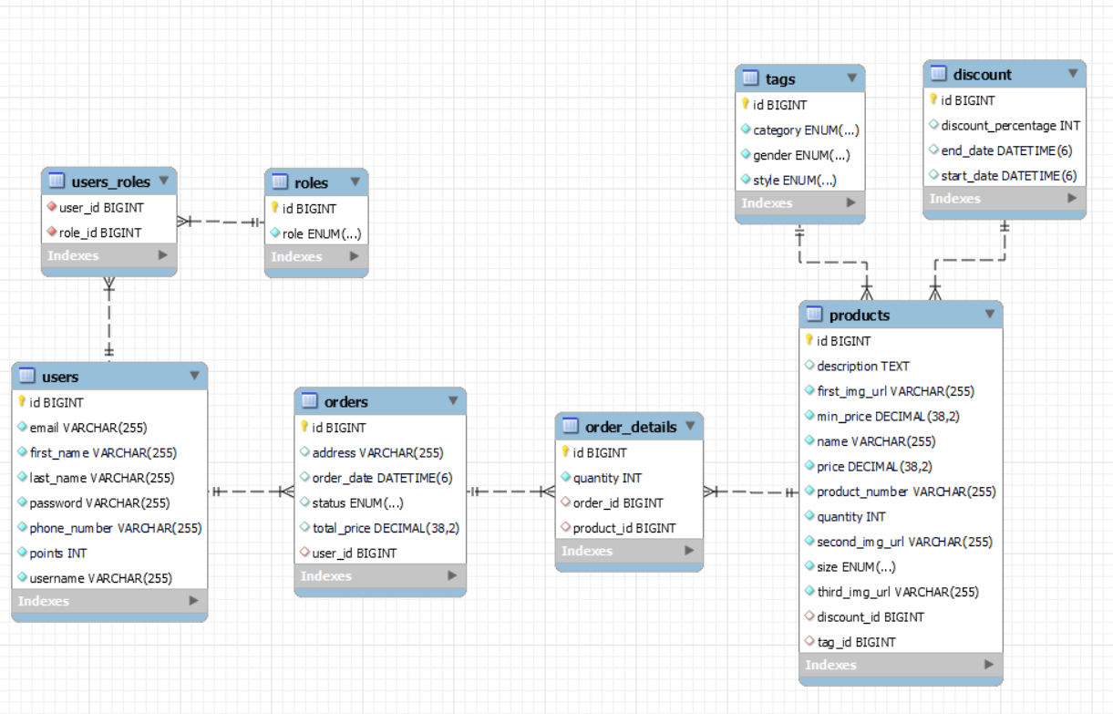

Slide 7
Implementation
Main technologies used:
Spring Boot – the framework we used in order to accelerate development as opposed to using Core Java
Java (obviously) – the backbone to our backend
Thymeleaf - template engine for the frontend
Gradle – our build automation tool of choice
HTML template - CozaStore
Bootstrap – the front-end framework which was bundled with the template we used
HTML, CSS, JS – the template provided us with the foundational components. However, to tailor the solution to our specific needs, we customized and supplemented these ourselves

Slide 8
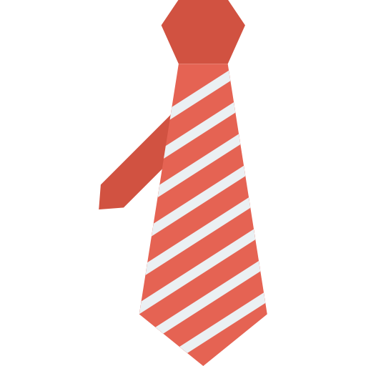

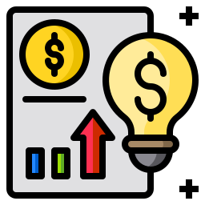
Next up: Business Time

Slide 9


What’s a technically excellent website good for if we have no business idea to make the whole project worthwhile? –
We present to you our Business Model,, carefully crafted and iterated to perfection to maximize profits, while being focused on the consumer and their experience:

Slide 10
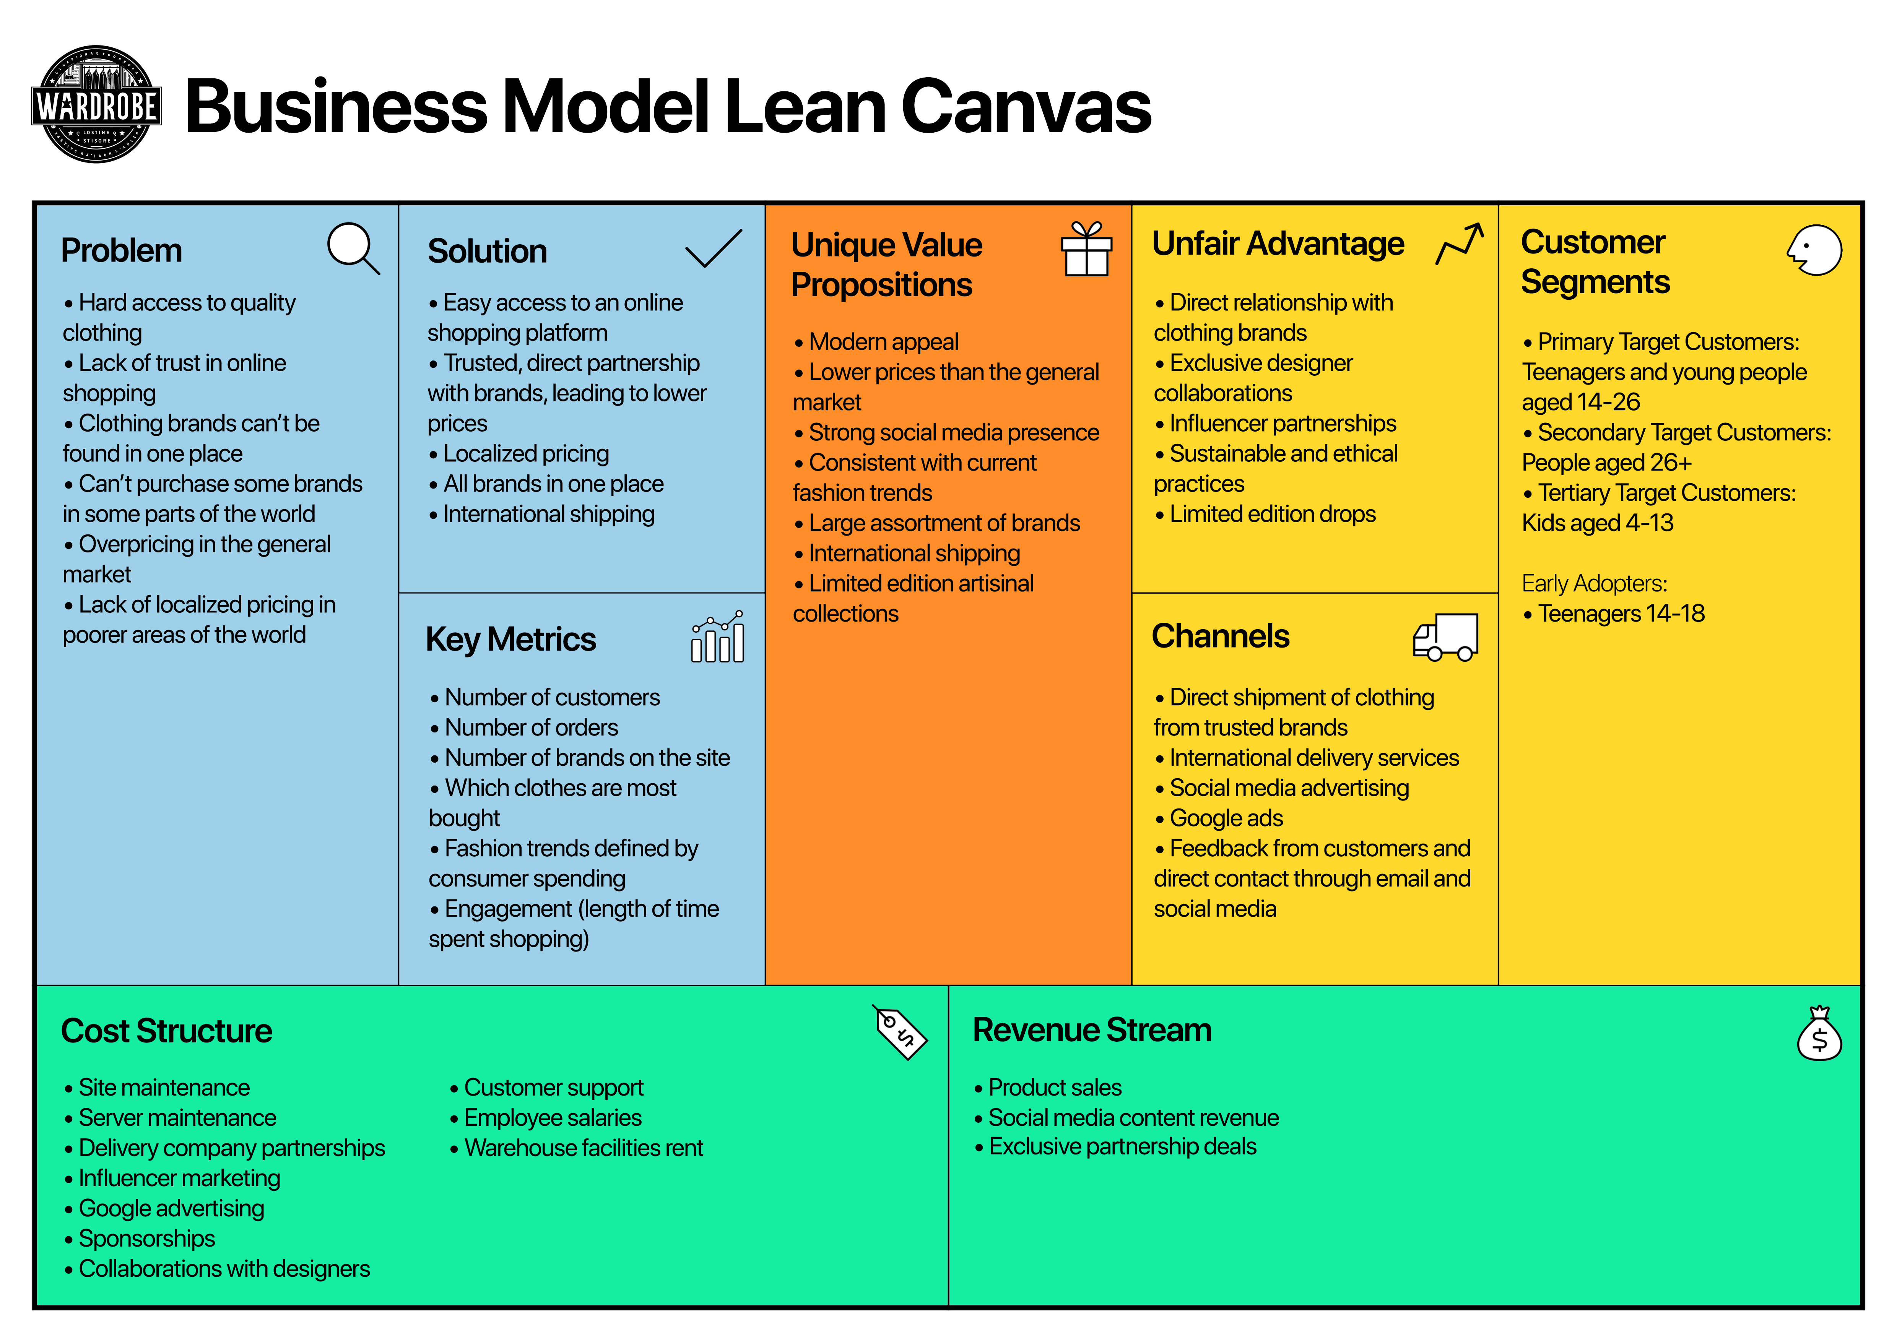

Slide 11
Thank you for your attention!
We are hopeful you would buy something from our site one day :)

