Slide 1
Archipelago – An Open FPGA
Hao Jun Liu

Slide 2
Introduction
Field Programmable Gate Array (FPGA)
Archipelago – OpenFPGA
From RTL Generation to Bitstream Generation
Performance

Slide 3
OpenFPGA Hardware

Slide 4
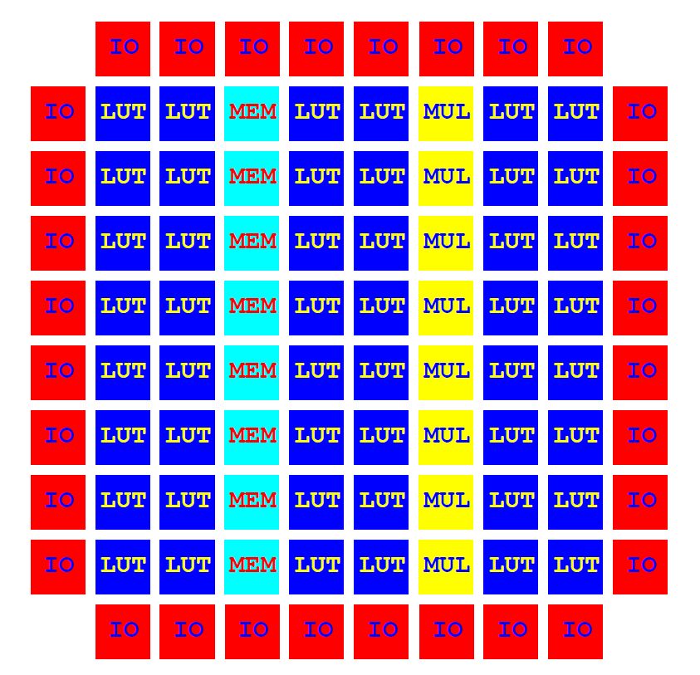
Full Column Based FPGA Arch.

Slide 5
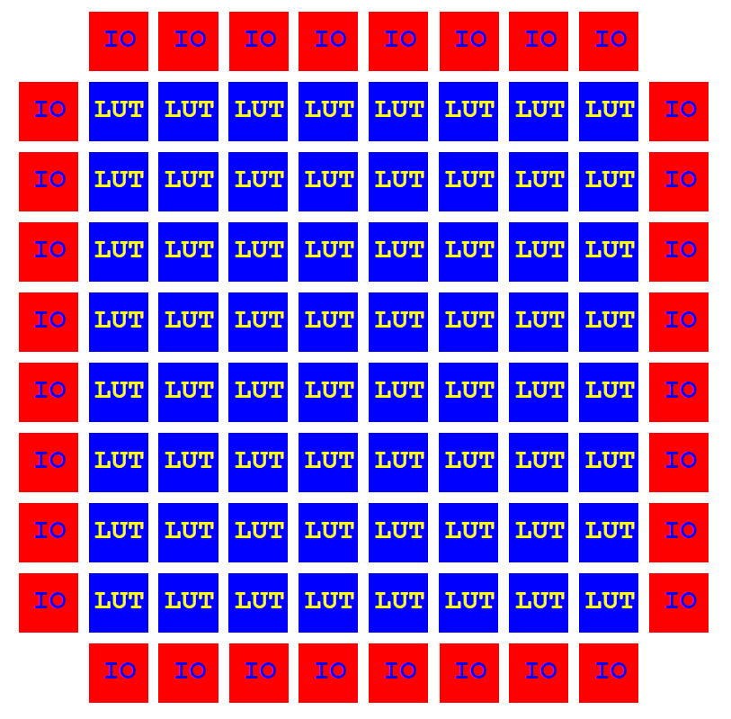
Current Implementation

Slide 6
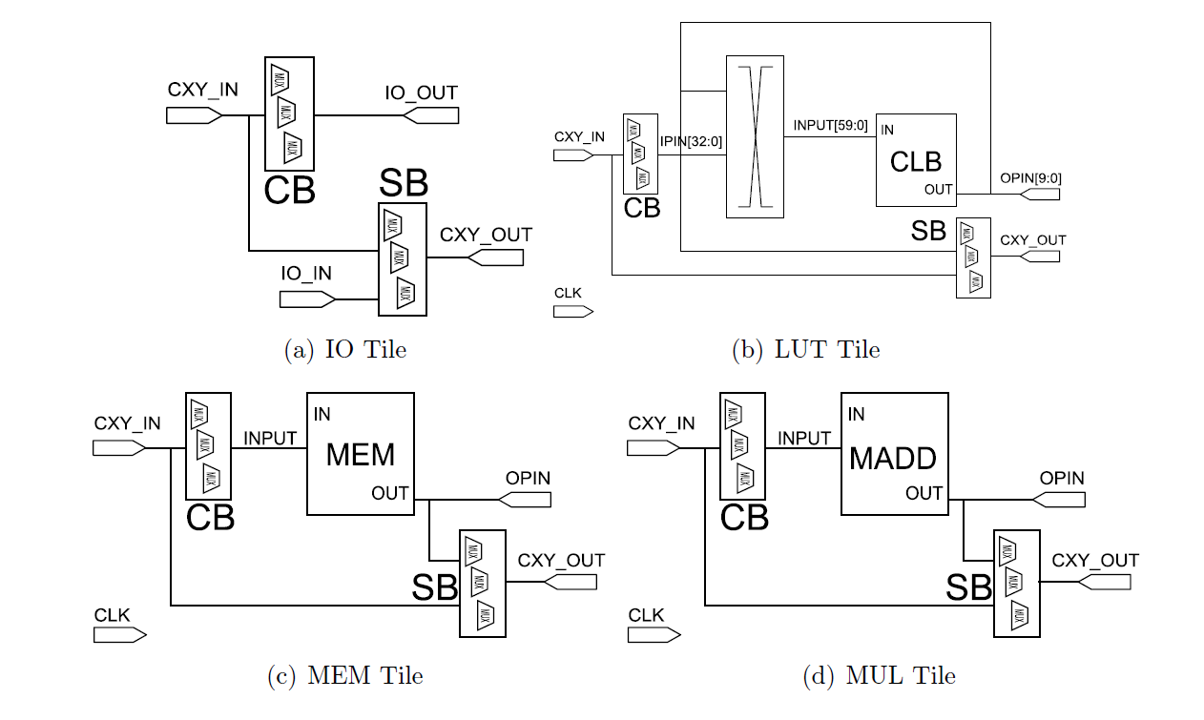
Tile Level Components

Slide 7
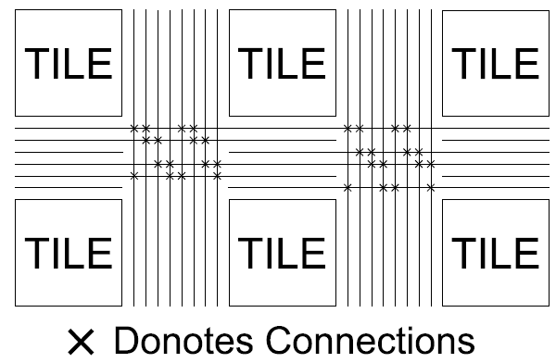
Routing Tracks

Slide 8
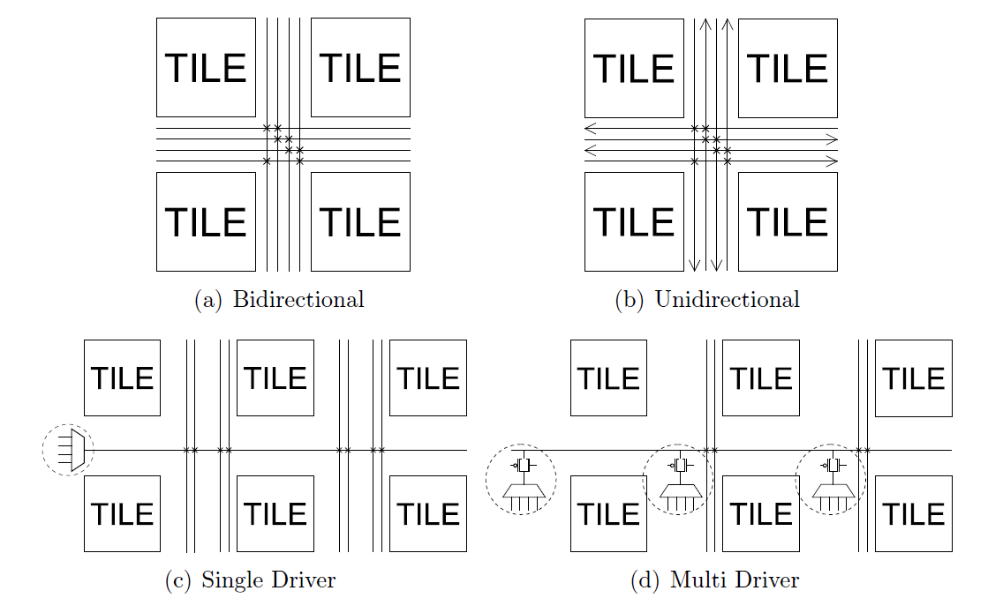
Dir/Driver

Slide 9
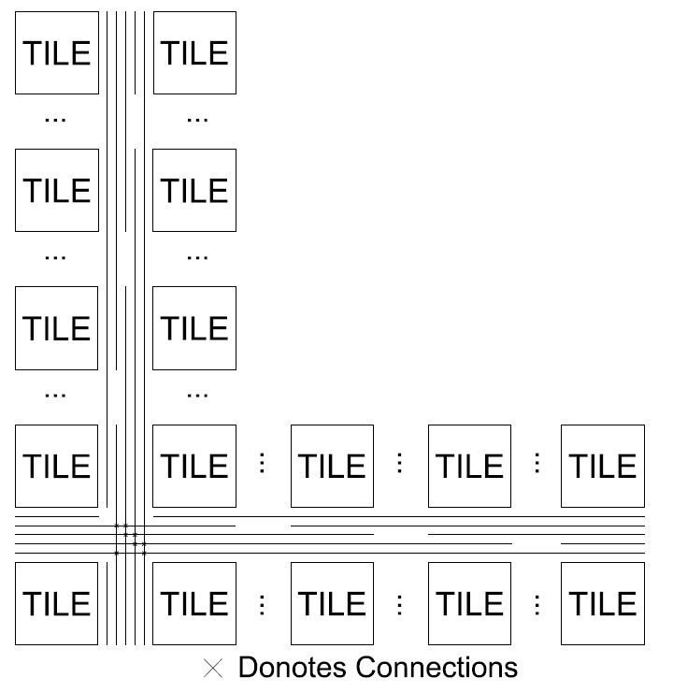
Segmentation

Slide 10
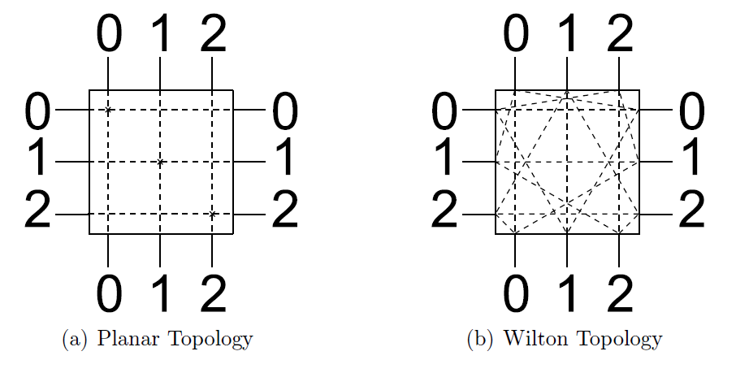
Switch Box Design

Slide 11
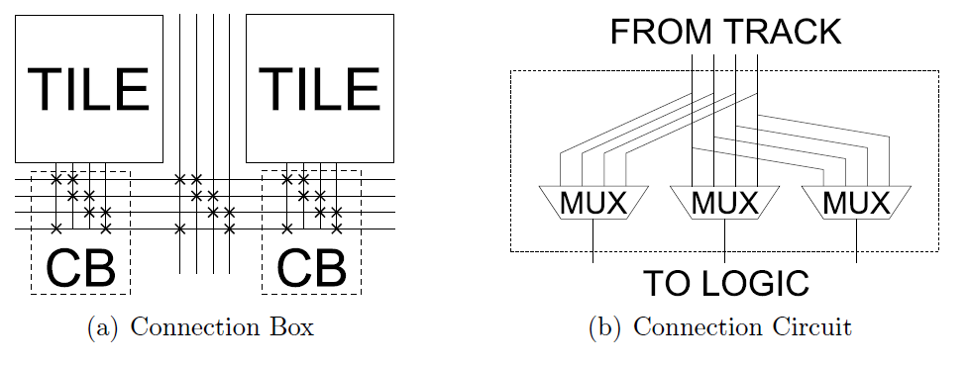
Connection Box Design

Slide 12
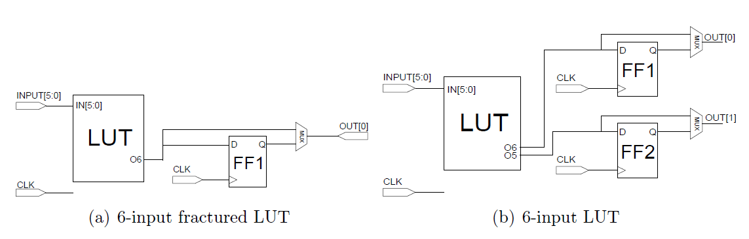
LUTs

Slide 13
CLB and XBAR
LUTs are grouped into CLB (Configuration Logic Block)
XBAR combines output of CLB, output of CB (Connection Box) into CLB inputs

Slide 14
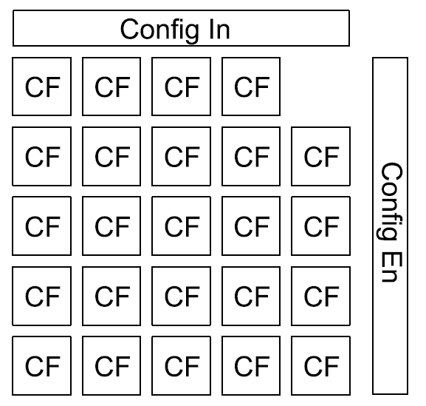
Reconfiguration

Slide 15
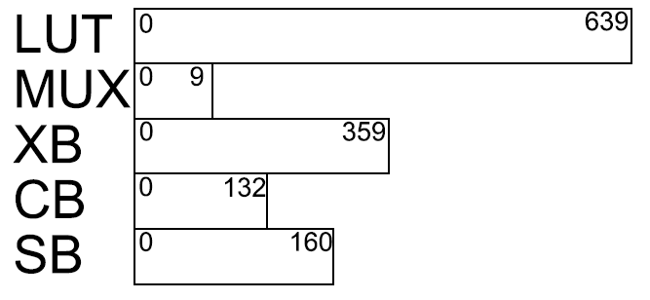
Configuration Frame

Slide 16
Q&A

Slide 17
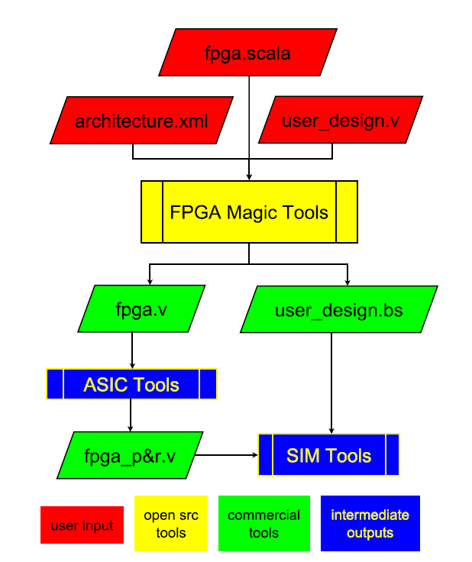
OpenFPGA Tool Flow

Slide 18
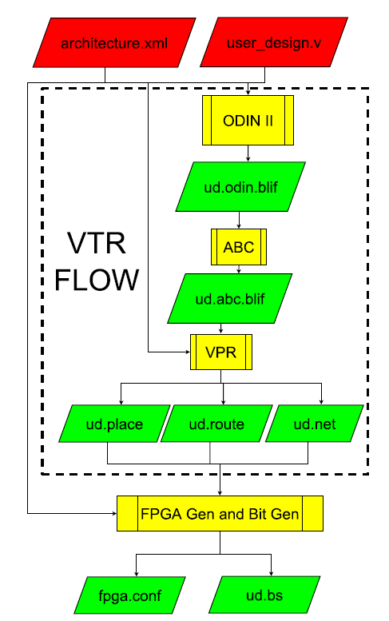
VTR Flow

Slide 19
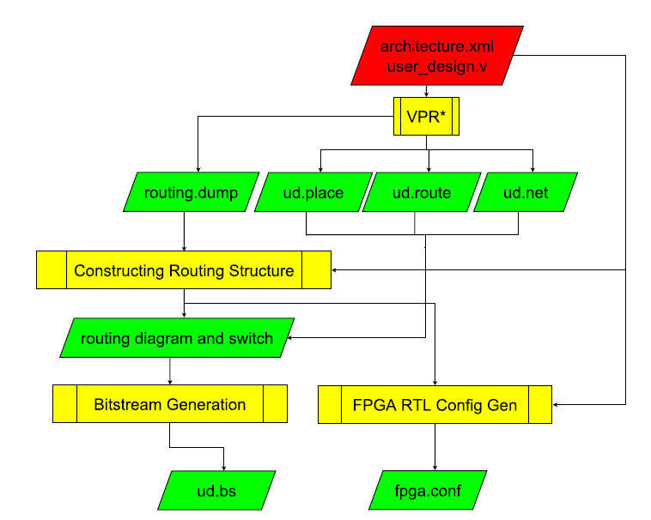
FPGA Generation and Bitstream Generation Flow

Slide 20
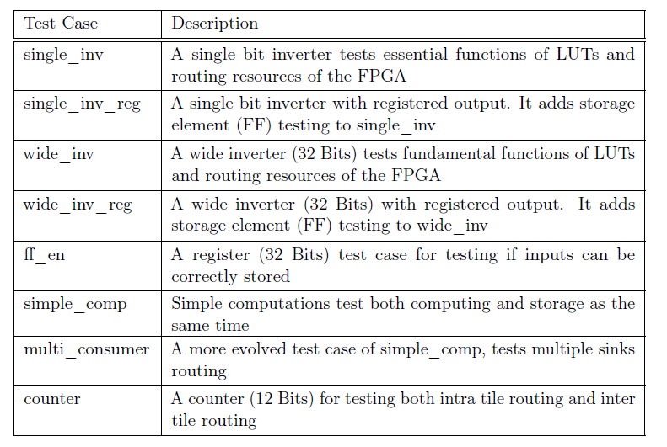
Testing

Slide 21
Q & A

Slide 22
Performance on TSMC 65nm

Slide 23
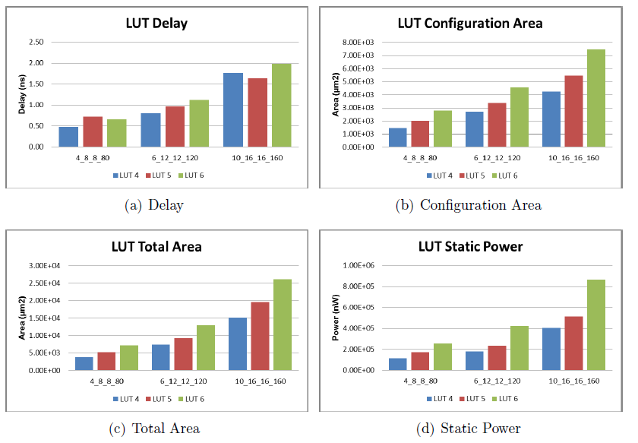
LUT SIZE

Slide 24
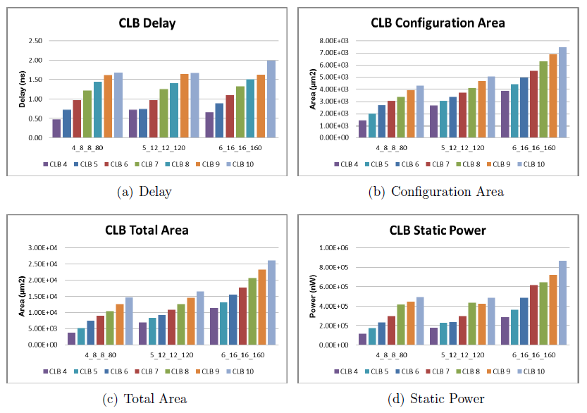
CLB SIZE

Slide 25
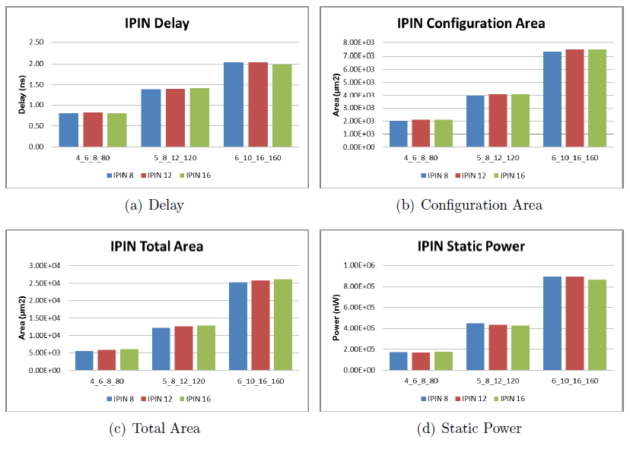
IPIN Width

Slide 26
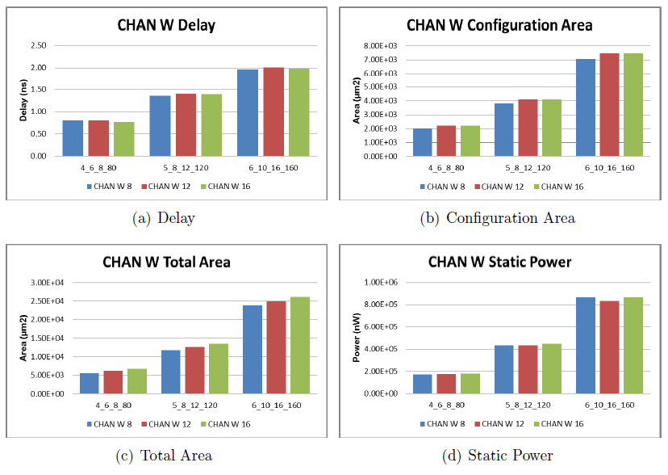
Channel Width

Slide 27
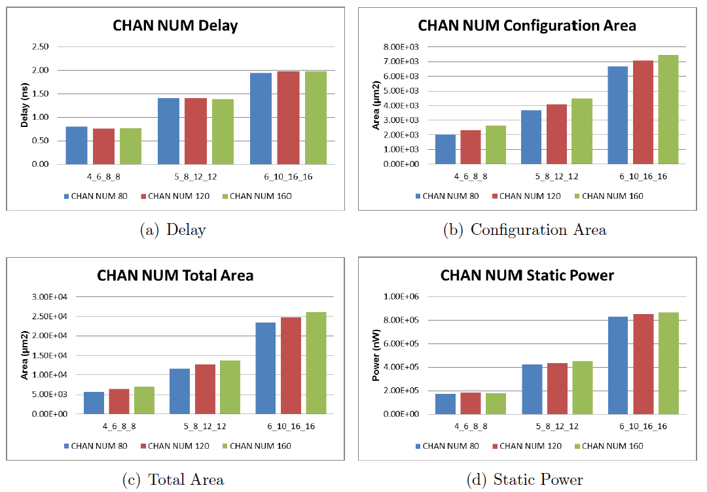
Track Width

Slide 28
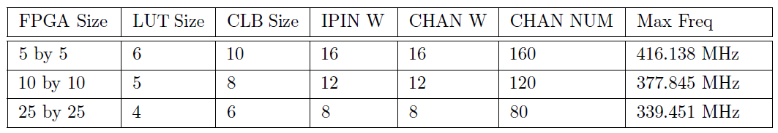
User Circuit Performance

Slide 29
Q & A

