Slide 1
Agenda
1. Modularity
2. Coupling and dependency
3. Control Flow
4. Inversion of control
5. Dependency injection
6. Dependency injection advanced
7. Dependency injection containers

Slide 2

Go further on Dependency Injection (DI)
6

Slide 3
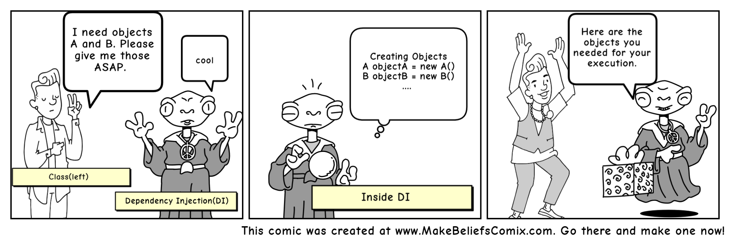
Composition of DI
The client :
Consumer of the dependencies
The dependency :
Component used by the client
The dependencies declaration :
Declaration of the dependencies required by a client
The injector :
Responsible of constructing the dependencies and inject them into the client according to the dependencies declaration. Can create the client sometimes.
Can be called “assembler” because it assembles dependencies

Slide 4
Tell me
How an injector can inject a dependency into a client ?

Slide 5
3 type of DI
Constructor injection (Pico, Guice)
Inject client’s dependencies through it’s constructor parameters
public class BudgetModule { private Bank bank; private CurrencyConverter currencyConverter; public BudgetModule(Bank bank, CurrencyConverter currencyConverter) { this.bank = bank; this.currencyConverter = currencyConverter; } }

Slide 6
3 type of DI
Constructor injection (Pico, Guice)
+ Ensure that all required dependencies have been provided
+ Useful for immutability and so a good choice for distributed environments where code is serialized to be executed on other servers
- Hard to manage optional dependencies
- Hard to change dependencies after construction

Slide 7
3 type of DI
Setter injection
Inject a dependency through a specific setter method
+ Optional dependencies, simpler to manage lot of dependencies
- Mandatory dependencies, unclear required dependencies
public class BudgetModule { private Bank bank; private CurrencyConverter currencyConverter; public void setBank(Bank bank) { this.bank = bank; } public void setCurrencyConverter(CurrencyConverter currencyConverter) { this.currencyConverter = currencyConverter; } }

Slide 8
3 type of DI
public interface BankInjector { void injectBank(Bank bank); } public interface CurrencyConverterInjector { void injectCurrencyConverter(CurrencyConverter currencyConverter); } public class BudgetModule implements BankInjector, CurrencyConverterInjector { private Bank bank; private CurrencyConverter currencyConverter; @Override public void injectBank(Bank bank) { this.bank = bank; } @Override public void injectCurrencyConverter(CurrencyConverter currencyConverter) { this.currencyConverter = currencyConverter; } }
Interface injection
Inject a dependency through a method defined by an Interface

Slide 9
3 type of DI
Interface injection
Same advantage and disadvantage than setter injection
- Heavier because it’s require an interface by dependency and can be complex to read when there are lot of dependencies

Slide 10
Discussion about DI
No best choice, depending on what you want to do
For a Framework creator, it’s often better to choose setter injection
For an application creator, constructor injection is often a good choice
Notes:
Why :
Framework on besoin de beaucoup de valeurs optionelles pour s’adapter a pleins de contexte differents
Application un seul contexte, moins de valeurs optionnelles et on peut bénéficier de l’imuabilité
DI VS CONTAINER DI

Slide 11
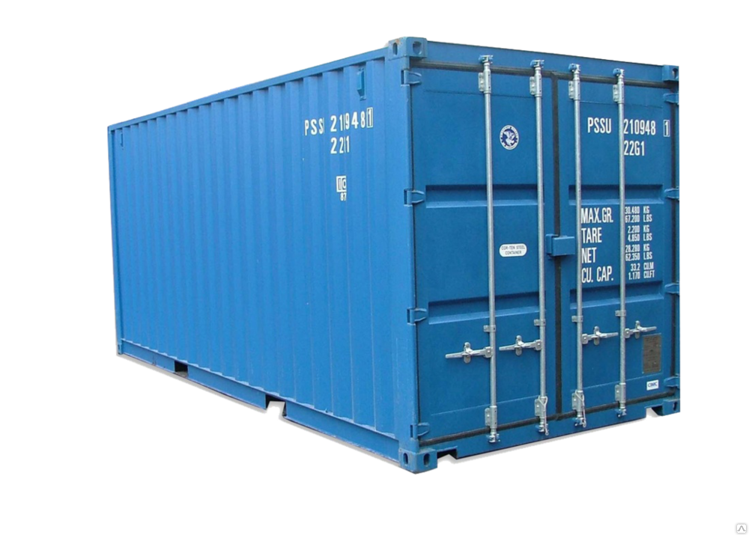
Dependency injection containers
7
DDIY - Don’t Do It Yourself

Slide 12
What is a DI Container ?
A DI Container is responsible of creating and injecting dependencies
Can use Constructor as well as Setter injection
Well known DI Container : Spring, Dagger, Guice…

Slide 13
What is a DI Container ?
Class A
DI Container
Class B
Client
Inject
Create & assemble
Class C

Slide 14
Composition of DI Container
The client :
Consumer of the dependencies
The dependency :
Component used by the client
The dependencies declaration :
Declaration of the dependencies required by a client
The injector :
Responsible of constructing the dependencies and inject them into the client according to the dependencies declaration. Can create the client sometimes.
Can be called “assembler” because it assembles dependencies

Slide 15
Lets build your own DI container
Start with specifications

Slide 16
Credits
Special thanks to all the people who made and released these awesome resources for free:
Presentation template by SlidesCarnival
Photographs by Unsplash
Notes:
https://www.cs.bham.ac.uk/~mdr/teaching/modules04/java2/MyBigJava/Ch07/ch07.html
https://medium.freecodecamp.org/a-quick-intro-to-dependency-injection-what-it-is-and-when-to-use-it-7578c84fa88f
https://spring.io/blog/2007/07/11/setter-injection-versus-constructor-injection-and-the-use-of-required/

