Slide 1
SpringBoot

Slide 2
Spring at the beginning
Created in 2003, Open Source
Lightweight container
Spring container manage your application objects
Use Dependency Injection to instantiate objects
Provide features for enterprise development
high performing, easily testable and reusable code
Most popular framework in java community
Organized in modules

Slide 3
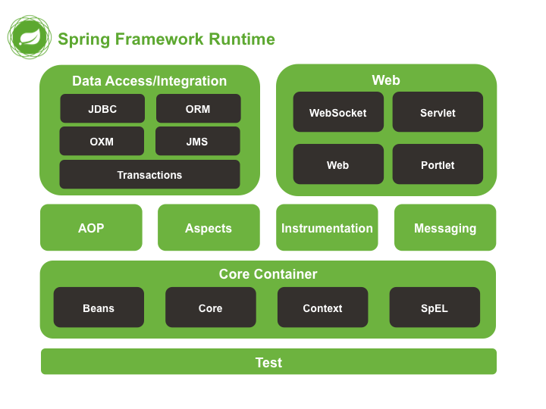
Spring Framework
More than a lightweight container
Spring Framework consists of features organized into about 20 modules
Modules are grouped into Core Container, Data Access/Integration, Web, AOP, Instrumentation, and Test

Slide 4
Spring Framework
Data Access/integration
Module to abstract data access and mapping to business and presentation layer
JDBC : manage connection and transaction with your relational database
ORM : Integrate ORMs like Hibernate with Spring ecosystem
Transaction : manage transaction across transactions API like JTA, Hibernate… Let you manage your transactions in a programmatic way
OXM : Abstraction for Object-XML Mapping (JAXB…)
JMS : Java Messaging Services, simplify messages production and consumption

Slide 5
Spring Framework
Spring Web is made of 4 modules
Spring Web Web general purpose like file uploading, initializing Servlet container…
Spring Servlet Spring’s MVC implementation. Let you create your web app based on MVC pattern with all Spring’s integration

Slide 6
Spring Framework
Spring Core, the heart of Spring
The Core and Beans modules provide Dependency Injection features
The BeanFactory is a sophisticated implementation of the factory pattern
Removes the need for programmatic singletons
Allows to decouple configuration and specification of dependencies from program logic

Slide 7
A word on Spring beans
A Spring bean is a Java bean managed by Spring container : “A bean is an object that is instantiated, assembled, and otherwise managed by Spring IoC container”
Beans are configured through XML files or a Java Code
This configuration is the definition of the bean, ie metadata used by Spring IoC container to create and manage bean lifecycle

Slide 8
A word on Spring beans
<beans>
<bean id="beanOne" class="x.y.ThingOne">
<constructor-arg ref="beanTwo"/>
<constructor-arg ref="beanThree"/>
</bean>
<bean id="beanTwo" class="x.y.ThingTwo"/>
<bean id="beanThree" class="x.y.ThingThree"/>
</beans>
public class ThingOne {
public ThingOne(ThingTwo thingTwo, ThingTwo thingTwoBis) {
// ...
}
}
@Bean
public MongoClient mongoClient() {
MongoClientURI mongoClientURI = new MongoClientURI(mongoUri);
MongoClient mongoClient = new MongoClient(mongoClientURI);
return mongoClient;
}

Slide 9
A word on Spring beans
Beans have a scope used to have more control of the bean instances creation
Scope | Description
singleton | (Default) Scopes a single bean definition to a single object instance per Spring IoC container.
prototype | Scopes a single bean definition to any number of object instances.
request | Scopes a single bean definition to the lifecycle of a single HTTP request; that is, each HTTP request has its own instance of a bean created off the back of a single bean definition. Only valid in the context of a web-aware Spring ApplicationContext.
session | Scopes a single bean definition to the lifecycle of an HTTP Session. Only valid in the context of a web-aware Spring ApplicationContext.
global session | Scopes a single bean definition to the lifecycle of a global HTTP Session. Typically only valid when used in a portlet context. Only valid in the context of a web-aware Spring ApplicationContext.
application | Scopes a single bean definition to the lifecycle of a ServletContext. Only valid in the context of a web-aware Spring ApplicationContext.

Slide 10
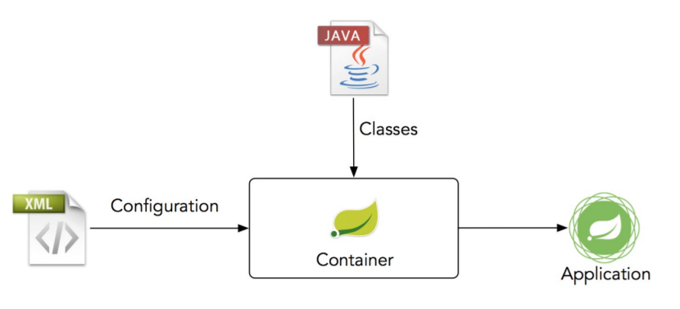

Spring IoC container
Spring IoC container and is responsible for instantiating, configuring, and assembling the beans

Slide 11
Spring Framework
Spring also provide test facilities and mocks to test your app in an effective way
Spring 5 now support Kotlin langage

Slide 12
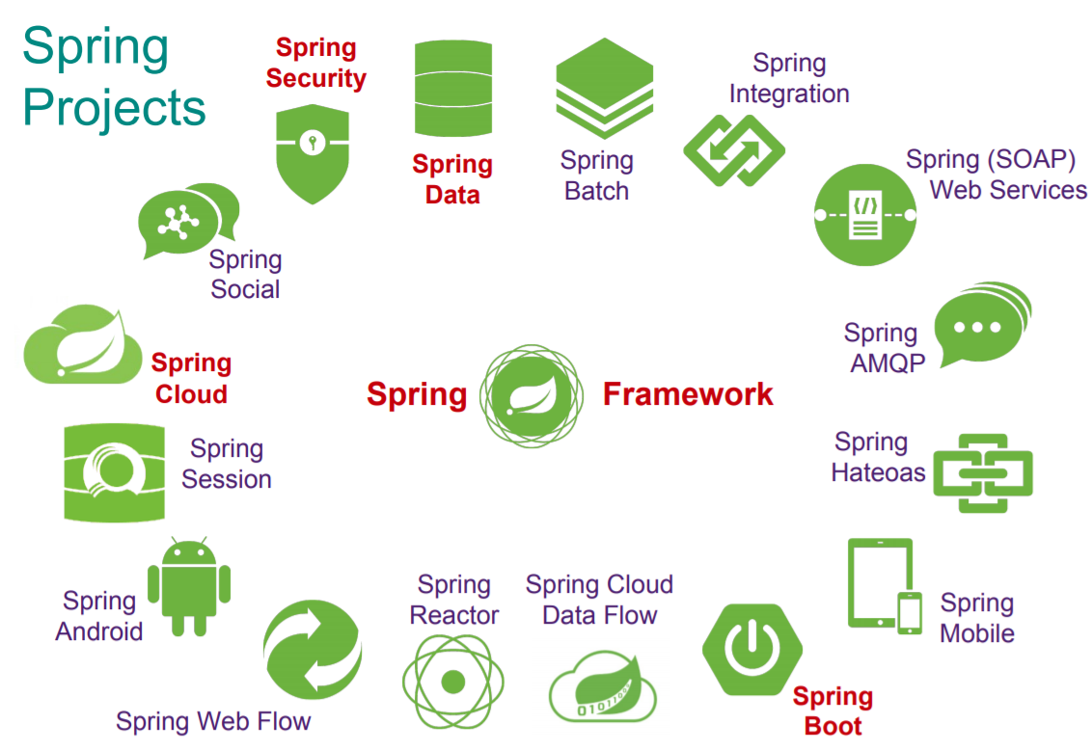
Spring projects
Source : Copyright 2017 Pivotal Software
Spring is now a large ecosystem made of several projects
Always enterprise development oriented
Major projects are Spring Boot, Spring Data, Spring Security and Spring Cloud

Slide 13

Spring problem...

Slide 14
Spring problem...
<beans>
<bean id="beanOne" class="x.y.ThingOne">
<constructor-arg ref="beanTwo"/>
<constructor-arg ref="beanThree"/>
</bean>
<bean id="beanTwo" class="x.y.ThingTwo"/>
<bean id="beanThree" class="x.y.ThingThree"/>
</beans>
<beans>
<bean id="movieLister" class="x.y.SimpleMovieLister">
<property name="moviefinder" ref="awsMovieFinder"/>
</bean>
<bean id="awsMovieFinder" class="x.y.AwesomeMovieFinder"/>
</beans>
<?xml version="1.0" encoding="UTF-8"?>
<beans xmlns="http://www.springframework.org/schema/beans" [...] >
<!-- services -->
<bean id="petStore" class="org.springframework.samples.jpetstore.services.PetStoreServiceImpl">
<property name="accountDao" ref="accountDao"/>
<property name="itemDao" ref="itemDao"/>
<!-- additional collaborators and configuration for this bean go here -->
</bean>
</beans>
<beans>
<bean id="beanOne" class="x.y.ThingOne">
<constructor-arg type="int" value="7500000"/>
<constructor-arg type="java.lang.String" value="42"/>
</bean>
</beans>

Slide 15
Spring boot

Slide 16
Why Spring boot ?
Spring is hard to configure and time consuming
A simple Hello Word require XML configuration to works
Lot of XML configuration files to carefully configure your app (DB, Ldap, beans, web, security…)
Spring brings a high level of control on application configuration, but it has a cost on productivity
Solution ? Spring Boot

Slide 17
What is Spring boot ?
Spring Boot makes it easy to create stand-alone, production-grade Spring based Applications that you can “just run.”
Simplify, improve, accelerate Spring application creation
Use convention over configuration
Use default configuration based on the classpath Oh a mysql dependency ? Maybe you want to connect to a MySQL database
Starters pom to quickly getting started
Standalone app with embedded servlet container (Tomcat or Jetty)

Slide 18
What is Spring boot ?
Main idea is to have a default configuration
Enough to quickly start your project (Ex : Tomcat by default)
But you always have the power ! You can configure your app as you want (Ex: Jetty)

Slide 19
Spring Boot starters
Starters are a set of dependencies
They are skeleton of your project which brings all required dependencies with the right version
You want to build a Spring Boot application ? Use the spring-boot-starter
A web application ? Use spring-boot-starter-web
Need some security ? Use spring-boot-starter-security
You want a beautiful mustache ? Use spring-boot-starter-mustache
https://docs.spring.io/spring-boot/docs/current/reference/htmlsingle/#using-boot-starter

Slide 20
Spring Boot starters
https://start.spring.io

Slide 21
Spring Boot starters
<parent>
<groupId>org.springframework.boot</groupId>
<artifactId>spring-boot-starter-parent</artifactId>
<version>2.6.2</version>
<relativePath/>
</parent>
<dependencies>
<dependency>
<groupId>org.springframework.boot</groupId>
<artifactId>spring-boot-starter</artifactId>
</dependency>
<dependency>
<groupId>org.springframework.boot</groupId>
<artifactId>spring-boot-starter-test</artifactId>
<scope>test</scope>
</dependency>
<dependency>
<groupId>org.springframework.boot</groupId>
<artifactId>spring-boot-starter-web</artifactId>
</dependency>
<dependencies>

Slide 22



Spring Boot : annotations

Slide 23
Spring Boot : First application
@SpringBootApplication
public class BillingserviceApplication {
public static void main(String[] args) {
SpringApplication.run(BillingserviceApplication.class, args);
}
}
@SpringBootApplication : Convenient annotation
@EnableAutoConfiguration : Ask to Spring Boot to scan dependencies to guess the configuration required by your app
@Configuration : Set class as a configuration class (can declare configuration items)
@ComponentScan : Scan sub packages to discover configuration and components of your Application. Spring will detect and register them

Slide 24
Spring Boot : REST API
Presentation layer

Slide 25
Spring IoC container
Spring IoC container and is responsible for instantiating, configuring, and assembling the beans

Slide 26
Spring stereotypes
Spring provides 4 stereotypes used to identified classes roles
Stereotypes are defined by annotations
Classes annotated with a stereotype are registered as beans in Spring container and are injectable
@Component
@Controller
@Service
@Repository

Slide 27
RESTful API
<dependency>
<groupId>org.springframework.boot</groupId>
<artifactId>spring-boot-starter-web</artifactId>
</dependency>
Springs provide annotations to create a RESTful API
The presentation layer is where REST stuff is implemented
Controllers will be the classes responsible of communicating with clients following REST architecture style

Slide 28
@RestController & @ResponseBody
Controllers are the main level of API definition
@RestController is a convenient annotation for @Controller and @ResponseBody
All methods of the controller annotated with @RequestMapping will be automatically annotated with @ResponseBody
@ResponseBody indicate to Spring that return object of the method should be serialized (XML or JSON) and send in body of the response

Slide 29
Handle
Requests

Slide 30
Request Mapping
@RequestMapping indicates a mapping between an HTTP request and a method based on an URI and an HTTP method
Specific annotations for HTTP methods : GetMapping, PostMapping, PutMapping, DeleteMapping, PatchMapping
@GetMapping("/cost")
public ResponseEntity getTotalCost() {
CostResult result = billingService.getTotalCost();
return ResponseEntity.ok(result);
}

Slide 31
Request Mapping : Path pattern
@RequestMapping can pre-parse URI to capture URI variables into method’s parameters
@PathVariable and a placeholder in URI to bound a path element in a variable
@GetMapping("/resourceGroup/{resourceGroup}")
public ResponseEntity getResourceGroupTotalCost(@PathVariable String resourceGroup) {
CostResult result = billingService.getResourceGroupTotalCost(resourceGroup);
return ResponseEntity.ok(result);
}

Slide 32
Request Mapping : Request parameters
It’s also possible to bound URL parameters to method parameters
A method can be mapped on multiple URI but an URI can’t be mapped on multiple methods
Can be set at class level to define a common URI prefix for all methods
// localhost/resourceGroup?name=xxxx
@GetMapping("/resourceGroup")
public ResponseEntity getResourceGroupTotalCost(@RequestParam String name) {
CostResult result = billingService.getResourceGroupTotalCost(name);
return ResponseEntity.ok(result);
}
@RestController
@RequestMapping("/api/billing")
public class BillingController {
}

Slide 33
Request Mapping : RequestBody
With @RequestBody, Spring will automatically deserialize a request’s body to a Java Object
Mapping is done by HttpMessageConverter
You can create and register your own HttpMessageConverter for higher control on mapping
@PostMapping("/user")
public ResponseEntity postUser(@RequestBody User user) {
[...]
}

Slide 34
Handle
Responses

Slide 35
Response : ResponseBody
@RestController is a convenient annotation for @Controller and @ResponseBody
By default, the result of controller’s methods will be the body of the response (serialized in XML or JSON)

Slide 36
Response : ResponseEntity
ResponseEntity represents the whole HTTP response: status code, headers, and body
Provide a full control on the response sent to the client unlike @ResponseBody
Can be useful to send a different status code according to some conditions or adapt it to your API specification
@RestController can be associated with ResponseEntity

Slide 37
Response : ResponseEntity
ResponseEntity has builders to help create a response. Several methods like ok(T) provides a convenient way to create responses
ok(T) creates an HTTP response with status 200 OK and a body with the object serialized
Others methods available : accepted(), badrequest() ...
@GetMapping("/cost/")
public ResponseEntity<CostResult> getTotalCost() {
CostResult result = billingService.getTotalCost();
return ResponseEntity.ok(result);
}

Slide 38
@RestController
@RequestMapping("/api/billing")
public class BillingController {
@Autowired
private BillingService billingService;
@Autowired
UsageDetailsComputeService usageDetailsComputeService;
@GetMapping(value = "/resourceGroup/{resourceGroup}/billingPeriod/{billingPeriod}")
public ResponseEntity getResourceGroupCost(@PathVariable String resourceGroup, @PathVariable String billingPeriod) {
CostResult result = billingService.getResourceGroupCost(resourceGroup, billingPeriod);
return ResponseEntity.ok(result);
}
}

Slide 39
Handle
Errors

Slide 40
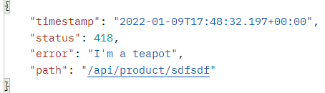
@ResponseStatus
Marks an exception class with the status code and reason that should be returned
Allows to manage errors for custom exceptions
@ResponseStatus(value = HttpStatus.I_AM_A_TEAPOT, reason = "?")
public class DumbException extends RuntimeException {
}

Slide 41
@ExceptionHandler in a Controller
Define a method of the controller to handle exceptions thrown in this controller
Only available for the controller
@GetMapping("/{productCode}")
Product getProduct(@PathVariable String productCode) {
unsafeCode();
return new Product(productCode);
}
@ExceptionHandler(DumbException.class)
@ResponseStatus(HttpStatus.I_AM_A_TEAPOT)
public String handleException(DumbException exception) {
return "Are you a teapot ?";
}

Slide 42
@ControllerAdvice
Allows to centralize the exception management in all Controllers
Intercept all the throwed exceptions in controllers
To combine with basePackages to organize error management
@ControllerAdvice(basePackages = "org.isima.javapro.caillou.product")
public class CustomExceptionAdvice {
@ResponseBody
@ExceptionHandler(DumbException.class)
@ResponseStatus(HttpStatus.I_AM_A_TEAPOT)
String dumbHandler(DumbException dx) {
return "I'm not a teapot !!";
}
}

Slide 43
Injection with Spring boot
Link all these things together !

Slide 44
Spring stereotypes
Spring provides 4 stereotypes used to identified classes roles
Stereotypes are defined by annotations
Classes annotated with a stereotype are registered as beans in Spring container and are injectable
@Component
@Controller
@Service
@Repository

Slide 45
Injection with Spring boot : @Autowired
Injection with Spring Boot is an association of ComponentScan to find and register beans and @Autowired to inject these beans at the right place @Autowired can used on fields, setters and constructors A dependency can be declared optional with @Autowired(required=false)
public class BillingService {
@Autowired
MongoClient mongoClient;
}
public class BillingService {
MongoClient mongoClient;
@Autowired
public void setMongoClient(MongoClient mongoClient) {
this.mongoClient = mongoClient;
}
}
public class BillingService {
MongoClient mongoClient;
@Autowired
public BillingService(MongoClient mongoClient) {
this.mongoClient = mongoClient;
}
}

Slide 46
@Bean
Annotated method produces a bean to be managed by the Spring container
By default, bean’s name is the method’s name. Can be specified explicitly : @bean(“myBean”) @bean({“myBean”, “yourBean”})
A bean can be declared for a specific Spring’s profile and a given scope thanks to @Profile and @Scope :
@Bean
public MongoClient mongoClient() {
return new MongoClient(new MongoClientURI(mongoUri));
}
@Bean
@Profile("integration-test")
@Scope("prototype")
public MongoClient mongoClient() {
return new MongoClient(new MongoClientURI(mongoUri));
}

Slide 47
Injection with Spring boot : bean resolution
By default beans are resolved by type, so in our exemple Spring must find a bean of type MongoClient to inject it
When several beans of the same type are available, you have to provide additional information with @Qualifier
@Bean
public MongoClient mongoCloudClient() {
return new MongoClient(new MongoClientURI(mongoUri));
}
@Service
public class CustomerService {
@Autowired
@Qualifier("mongoCloudClient")
MongoClient mongoClient;
}
@Bean
public MongoClient mongoTestClient() {
return new MongoClient(new MongoClientURI(mongoTestUri));
}

Slide 48
Injection with Spring boot : bean resolution
If it can’t resolve by type, Spring will try to resolve by name If a bean with a name similar to the field annotated with @Autowired is found, Spring will inject this bean It’s a kind of implicit injection
@Bean
public MongoClient mongoClient() {
return new MongoClient(new MongoClientURI(mongoUri));
}
@Service
public class CustomerService {
@Autowired
MongoClient mongoClient;
}
@Bean
public MongoClient mongoTestClient() {
return new MongoClient(new MongoClientURI(mongoTestUri));
}

Slide 49
Injection with Spring boot : @Value
Used for injecting values (not instances) into fields in Spring beans
Can be applied at the field or constructor/method parameter level
@Value("An awesome value")
private String mongoUri;
Used to inject values from configuration file (properties, yaml) into a field or parameter by using a placeholder ${...}
@Value("${mongo.uri}")
private String mongoUri;
A default value can be provided
@Value("${mongo.uri:a_default value}")
private String mongoUri;
Notes:
@PropertySource

Slide 50
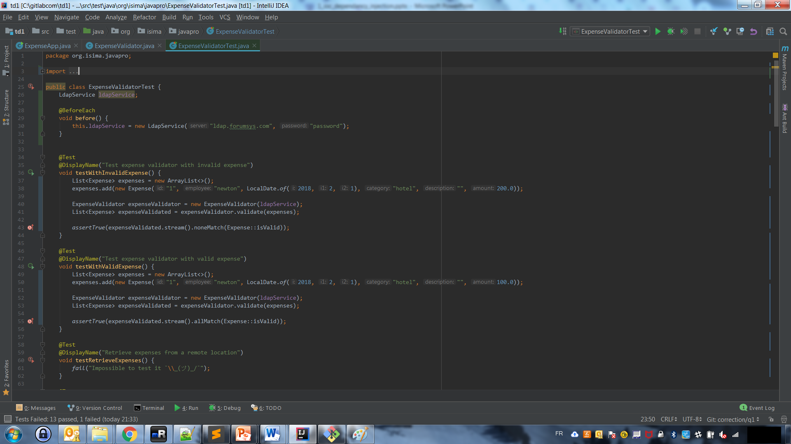
TD Time
Set up your Spring boot application
Caillou

