Slide 1
What is an enterprise application ?

Slide 2
Main characteristics
Long term applications, technology evolve
Business (il)logic rules which evolves
You are not on island ! Integration with multiple other systems
Large applications, few thousand to few millions lines of code

Slide 3
How to design long-term applications, which constantly evolving ?

Slide 4
Enterprise application
Long term applications, technology evolve
-> Modular layout, ready to evolve
Business (il)logic rules which evolves
-> Modular layout, identify actors and use cases
You are not on island ! Integration with multiple other systems
-> Modular layout, ready to use integration blocks
Large applications, few thousand to few millions lines of code
-> Modular layout, clean architecture, layering approach

Slide 5

Enterprise application
Long term applications, technology evolve
Modular layout, ready to evolve
Business (il)logic rules which evolves
Modular layout, identify actors and use cases

Slide 6
Cost of change
Cost of change
Time

Slide 7
Gather into components those classes that change for the same reasons and at the same time. Separate into different components those classes that change at different time and for different reason.
@Robert C. Martin

Slide 8
Single Responsibility Principle
SOLID n°1 SRP : Single Responsibility Principle
A class should have one and only one reason to change
A class should be responsible to one, and only one, actor
Not to be confused with refactoring principle :
A function should do one thing, should do it well and should do it only
Notes:
S - Single-responsiblity Principle
O - Open-closed Principle
L - Liskov Substitution Principle
I - Interface Segregation Principle
D - Dependency Inversion Principle

Slide 9
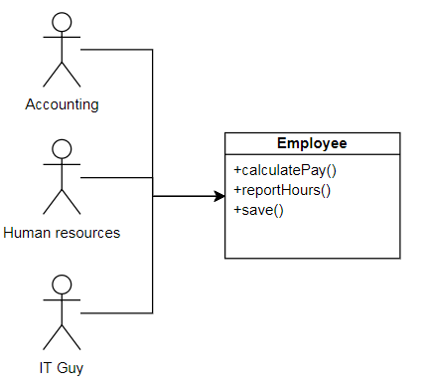
Single Responsibility Principle
3 sources of modification
+archive()

Slide 10
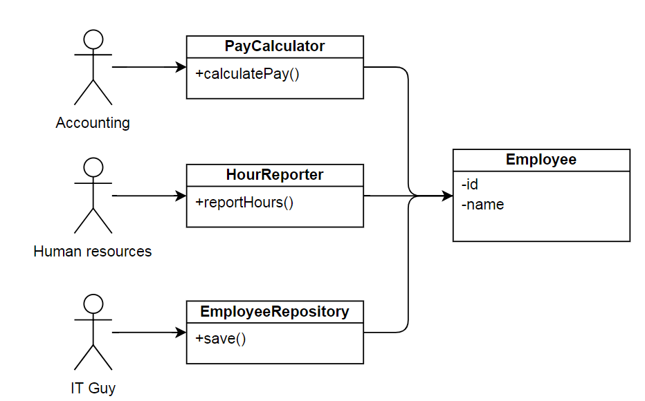
Single Responsibility Principle
1 source of modification
+archive()

Slide 11
CCP principle
CCP : Common Closure Principle
A component should not have multiple reason to change
Limit the propagation of a modification to one place

Slide 12
Common Closure Principle
The SRP applicate to a package, ie a set of cohesive class
Things that change together should be packaged together
A change should not affect multiple packages
More package impacted, the more it will cost

Slide 13
How to do it ?
Identify actors and responsibilities to identify reasons to change
Isolate reasons to change inside a function, a class or a component
And repeat…
Always think about separation of concerns

Slide 14
Enterprise application
Long term applications, technology evolve
-> Modular layout, ready to evolve
Business (il)logic rules which evolves
-> Modular layout, identify actors and use cases
You are not on island ! Integration with multiple other systems
-> Modular layout, ready to use integration blocks
Large applications, few thousand to few millions lines of code
-> Modular layout, clean architecture, layering approach

Slide 15
Enterprise application
You are not on island ! Integration with multiple other systems
Modular layout, ready to use integration blocks
Large applications, few thousand to few millions lines of code
Modular layout, clean architecture, layering approach

Slide 16
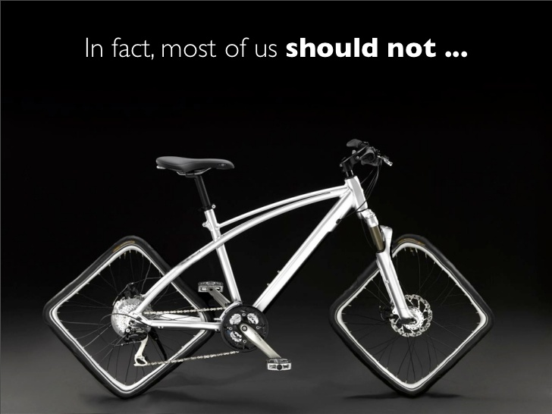
Ready to use integration blocks

Slide 17
Framework
Library 1
Application
code
Application code
Library 2
Application
code
Framework
Flow of control
Flow of control
Library 3
Application
code

Slide 18
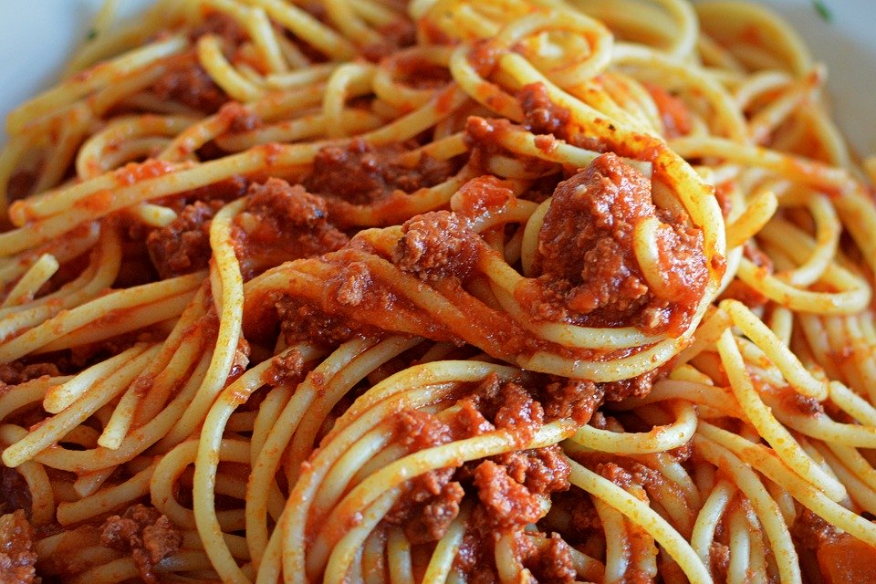
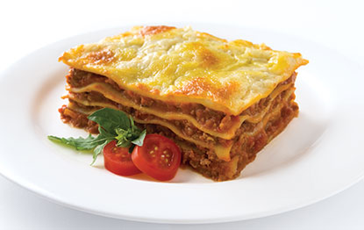
Layering approach

Slide 19
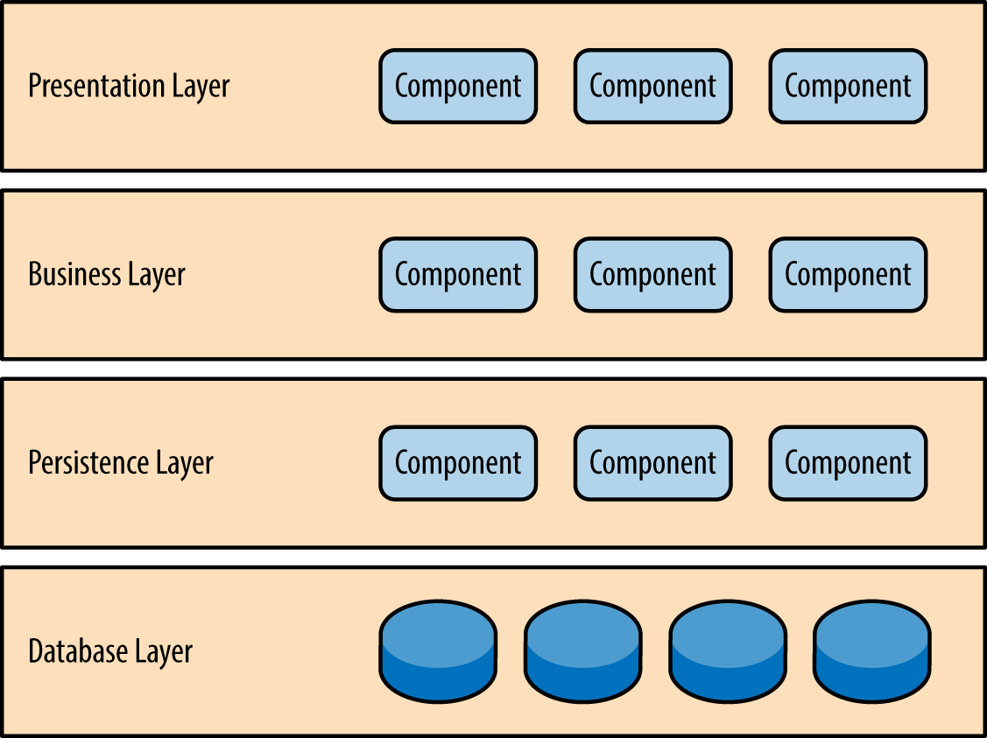
Layering approach

Slide 20
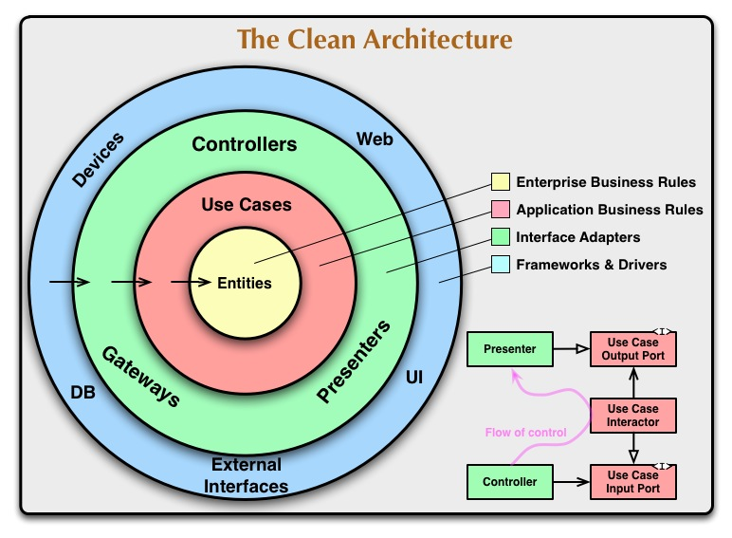
Clean architecture

Slide 21
Credits
Special thanks to all the people who made and released these awesome resources for free:
Presentation template by SlidesCarnival
Photographs by Unsplash

