Slide 1
Spring Data JPA

Slide 2
Spring Data
Provide a consistent, Spring-based programming model for data access while still retaining the special traits of the underlying data store
Provide data access to relational database, NoSQL database, cloud based data services
Keep the same programming model (Repositories, entities…)

Slide 3
Spring Data JPA
JPA : Java Persistence API
Entity persistence model for object-relational mapping (ORM)
Abstract DB access and simplify mapping between Java POJO and relational model
Querying with objects and attribute rather than tables and columns
Type-safe, help fight against SQL injections, transaction management….

Slide 4
Spring Data JPA
<dependency>
<groupId>org.springframework.boot</groupId>
<artifactId>spring-boot-starter-data-jpa</artifactId>
</dependency>

Slide 5
Spring Data JPA: Entities
@Entity
@Table(name = "users")
public class User {
@Id
@Column(name = "id", nullable = false)
private String id;
@Size(max = 300)
@Column(name = "password", length = 300)
private String password;
@Size(max = 100)
@Column(name = "first_name", length = 100)
private String firstName;
@Size(max = 100)
@Column(name = "last_name", length = 100)
private String lastName;
@Size(max = 300)
@Column(name = "email", length = 300, unique = true)
private String email;
@ManyToMany
@JoinTable(name = "users_roles",
joinColumns = @JoinColumn(name = "users_id"),
inverseJoinColumns = @JoinColumn(name = "roles_id")
)
private Set<Role> roles = new HashSet<>();
@OneToMany(mappedBy = "user", cascade = CascadeType.REMOVE)
private List<Token> token = new ArrayList<>();
}
An entity match a SQL table
Your application manipulate entities through Repositories to interact with the Database
To define how an Entity is mapped on a table, use Java annotations

Slide 6
Spring Data JPA : Entities
Annotation | Description
@Entity | Specifies that the class is an entity.
@Table | Specifies the primary table for the annotated entity.
@Column | Specifies the mapped column for a persistent property or field.
@Id | Specifies the primary key of an entity.
@Transient | Specifies that the property or field is not persistent.
@GeneratedValue | Provides for the specification of generation strategies for the values of primary keys.

Slide 7
Spring Data Jpa : Relation
Annotation | Description
@OneToOne | Specifies a single-valued association to another entity that has one-to-one multiplicity.
@OneToMany | Specifies a many-valued association with one-to-many multiplicity.
@ManyToOne | Specifies a single-valued association to another entity class that has many-to-one multiplicity.
@ManyToMany | Specifies a many-valued association with many-to-many multiplicity.

Slide 8
Spring Data JPA : Constraints
Annotation Type | Description
DecimalMax | The annotated element must be a number whose value must be lower or equal to the specified maximum.
DecimalMin | The annotated element must be a number whose value must be higher or equal to the specified minimum.
Digits | The annotated element must be a number within accepted range Supported types are: BigDecimal BigInteger CharSequence byte, short, int, long, and their respective wrapper types null elements are considered valid.
Max | The annotated element must be a number whose value must be lower or equal to the specified maximum.
Min | The annotated element must be a number whose value must be higher or equal to the specified minimum.
NotNull | The annotated element must not be null.
Null | The annotated element must be null.
Past | The annotated element must be a date in the past.
Pattern | The annotated CharSequence must match the specified regular expression.
Size | The annotated element size must be between the specified boundaries (included).

Slide 9
Spring Data JPA : Repositories
No more DAO implementations, lot of boring code replaced by Spring Repositories
Spring Repositories are the DAO interfaces
You define interfaces, Spring manage the implementation
Repositories act as specifications used to querying your entities

Slide 10
Spring Data JPA : Repositories
Repositories are interfaces
@Repository to be able to inject it
Takes the entity type and the Id type as type argument
You define querying specifications as methods (Query methods)
@Repository
public interface RoleRepository extends JpaRepository<Role, Long> {
/**
* Find role by code
*
* @param code the code name
* @return the user role
*/
Role findByCode(String code);
}

Slide 11
Spring Data : Repositories hierarchy
Repository<T, ID extends Serialisable>
CrudRepository<T, ID>
ReactiveCrudRepository<T,ID>
PagingAndSortingRepository<T,ID>
JpaRepository<T,ID>
MongoRepository<T,ID>

Slide 12
Spring Data JPA : Repositories
public interface CrudRepository<T, ID> extends Repository<T, ID> {
<S extends T> S save(S entity);
<S extends T> Iterable<S> saveAll(Iterable<S> entities);
Optional<T> findById(ID id);
boolean existsById(ID id);
Iterable<T> findAll();
Iterable<T> findAllById(Iterable<ID> ids);
long count();
void deleteById(ID id);
void delete(T entity);
void deleteAll(Iterable<? extends T> entities);
void deleteAll();
}
public interface JpaRepository<T, ID> extends PagingAndSortingRepository<T, ID> {
/**
* Flushes all pending changes to the database.
*/
void flush();
/**
* Saves an entity and flushes changes instantly.
*/
<S extends T> S saveAndFlush(S entity);
/**
* Deletes the given entities in a batch which means it will create a single {@link Query}.
*/
void deleteInBatch(Iterable<T> entities);
/**
* Deletes all entities in a batch call.
*/
void deleteAllInBatch();
/**
* Returns a reference to the entity with the given identifier.
*/
T getOne(ID id);
}

Slide 13
Spring Data JPA : Querying
3 ways to query your data through Spring data
Query methods
@Query
Named query
Query methods are a convenient way to create query
But can be ugly when becomes complex

Slide 14
Spring Data JPA : Query methods
public interface UserRepository extends Repository<User, Long> {
List<User> findByEmailAddressAndLastname(String emailAddress, String lastname);
List<User> findByAgeOrderByLastnameDesc(int age);
List<User> findByBirthDateAfter(Date aDate);
}
findBy…, countBy…, deleteBy…
Mix between entity’s properties and operators camel cased
Sort and Date operations
When method become unreadable, prefer @Query (true story)
List<Todo> findByDescriptionContainsOrTitleContainsAllIgnoreCaseOrderByTitleAsc(String descriptionPart, String titlePart);
Notes:
https://docs.spring.io/spring-data/jpa/docs/2.4.2/reference/html/#repository-query-keywords
https://docs.spring.io/spring-data/jpa/docs/2.4.2/reference/html/#repositories.query-methods.details

Slide 15
Spring Data JPA : @Query
public interface UserRepository extends JpaRepository<User, Long> {
@Query("select u from User u where u.emailAddress = ?1")
User findByEmailAddress(String emailAddress);
}
@Query allows to use JPQL (JPA Query language)
JPQL is based on SQL syntax but works with Java entities not relational records
JPQL abstract Database specificities (database platform independent)
Execute the query defined in annotation when the annotated method is called

Slide 16
Spring Data JPA : @Query
List<Todo> findByDescriptionContainsOrTitleContainsAllIgnoreCaseOrderByTitleAsc(String descriptionPart, String titlePart);
@Query("select t from Todo t where t.description like ?1 or UPPER(t.title) like UPPER(?2) order by t.title asc")
List<Todo> findByTodoAttributes(String descriptionPart, String titlePart);

Slide 17
Spring Data JPA : Named Query
@NamedQuery to define a JPQL query in an Entity class
Tell me why it’s bad ?
@Entity
@NamedQuery(name = "User.findByEmailAddress",
query = "select u from User u where u.emailAddress = ?1")
public class User {
}
Notes:
Separation of concern :
Entities define your model and relations
Others classes should be responsible to querying models according to their needs

Slide 18
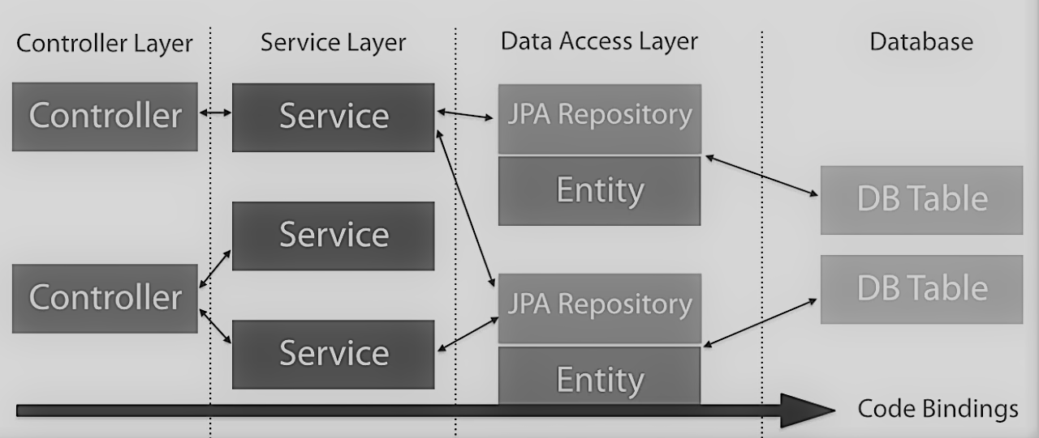
Spring Boot Full exemple

