Slide 1
Test with SpringBoot

Slide 2
Starter
<dependency>
<groupId>org.springframework.boot</groupId>
<artifactId>spring-boot-starter-test</artifactId>
<scope>test</scope>
</dependency>
JUnit, Assertj, Mockito, Hamcrest…

Slide 3
Unit test and integration test
Unit testing : test a piece of code, in much cases a function, without execution environment (database, servlet container, external service…)
@Test
void hasDatabaseIntegration_true() {
IntegrationParameter param = new IntegrationParameter("valid", null, null);
assertTrue(param.hasDatabaseIntegration());
}
Integration testing : test a piece of code with a part or full execution environment
With SpringBoot, it means an ApplicationContext (beans and dependency injection)

Slide 4
Unit testing
Nothing special, use the test starter and rely on JUnit
class IntegrationParameterTest {
@Test
void hasDatabaseIntegration_true() {
assertTrue(new IntegrationParameter("valid", null, null).hasDatabaseIntegration());
}
@Test
void hasDatabaseIntegration_false() {
assertFalse(new IntegrationParameter(null, null, null).hasDatabaseIntegration());
}
}
Use JUnit annotations like @Test, @BeforeEach, @BeforeAll
Use assertion library. You have several assertion libraries available (JUnit, Assert, JHamcrest=)
https://junit.org/junit5/docs/current/user-guide/#writing-tests

Slide 5
Integration testing
Use a Junit Runner or an extension to run your integration tests
For JUnit 4, use SpringRunner and configure it with @RunWith annotation :
@RunWith(SpringRunner.class)
For Junit 5 (default with SpringBoot 2.4), use SpringExtension with @ExtendWith annotation :
@ExtendWith(SpringExtension.class)

Slide 6
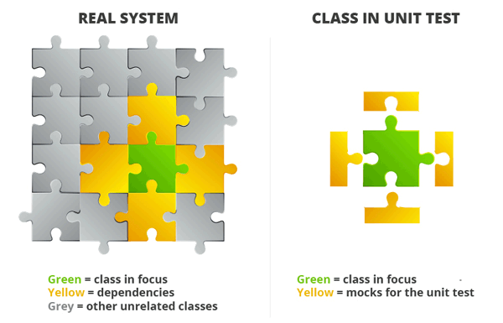
Mock

Slide 7
Integration testing : Repository

Slide 8
Testing Repositories
Use @DataJpaTest annotation :
Scans for entities
Configure your repositories
Configure TestEntityManager class
Configure embedded database if in classpath
@ExtendWith(SpringExtension.class)
@DataJpaTest
public class MyRepositoryTest {

Slide 9
Testing Repositories
Use Spring injection (thanks to integration tests) to inject an instance of your Repository
@ExtendWith(SpringExtension.class)
@DataJpaTest
public class UserRepositoryTest {
@Autowired
private TestEntityManager entityManager;
@Autowired
private UserRepository userRepository;
@Test
public void findAllTest() {
entityManager.persist(new User("Jean Claude"));
entityManager.persist(new User("Jean Paul"));
List<Product> productList = userRepository.findAll();
assertEquals(productList.size(), 2);
}
}
Inject a TestEntityManager to create test data
Create your test data by persisting entities

Slide 10
Integration testing : Services

Slide 11
Testing Services
Services rely on Repositories or/and other Services. They have to be mocked
Use @Mock or @MockBean to mock them
@Mock + @InjectMock for unit testing
@MockBean + @Autowired for integration testing. It mocks your bean (repository or service) and add the mock in the application context

Slide 12
Testing Services
With Mockito, you can easily define value returned by a Mock’s method
@MockBean
private ConfigRepository configurationRepository;
@Autowired
private ConfigurationService configurationService;
@Test
void duplicateTreatmentDate_ThrowException() {
Mockito
.when(configurationRepository.findAll(Mockito.any(Example.class)))
.thenReturn(Lists.list("2020/12/04", "2020/12/04"));
assertThatExceptionOfType(TreatmentDateException.class)
.isThrownBy(configurationService::getTreatmentDate);
}

Slide 13
Integration testing : RestController

Slide 14
Testing RestController
Controllers manage presentation layer of Spring MVC
Use @WebMvcTest annotation
Initialize Spring MVC structure
Scan controllers beans
Autoconfigure MockMvc
@ExtendWith(SpringExtension.class)
@WebMvcTest(ProductController.class)
public class ProductControllerTest {

Slide 15
Testing RestController
Inject a MockMvc instance, an object used to easily test your Controllers without HTTP server
Use MockMvc object to test your controller
import static org.springframework.test.web.servlet.result.MockMvcResultMatchers.*;
import static org.hamcrest.Matchers.*;
@Autowired
private MockMvc mvc;
@Test
public void getResourceShouldReturnResource() throws Exception {
mvc.perform(get("/api/resource/" + id)
.contentType(MediaType.APPLICATION_JSON))
.andExpect(status().isOk())
.andExpect(jsonPath("$.resource.name", is("Bob")))
}

Slide 16
Testing RestController
Controllers always use different services
Services have to be mocked to test your controller
Use the @MockBean annotation
@MockBean
FoodDataService foodDataService;

