Slide 1
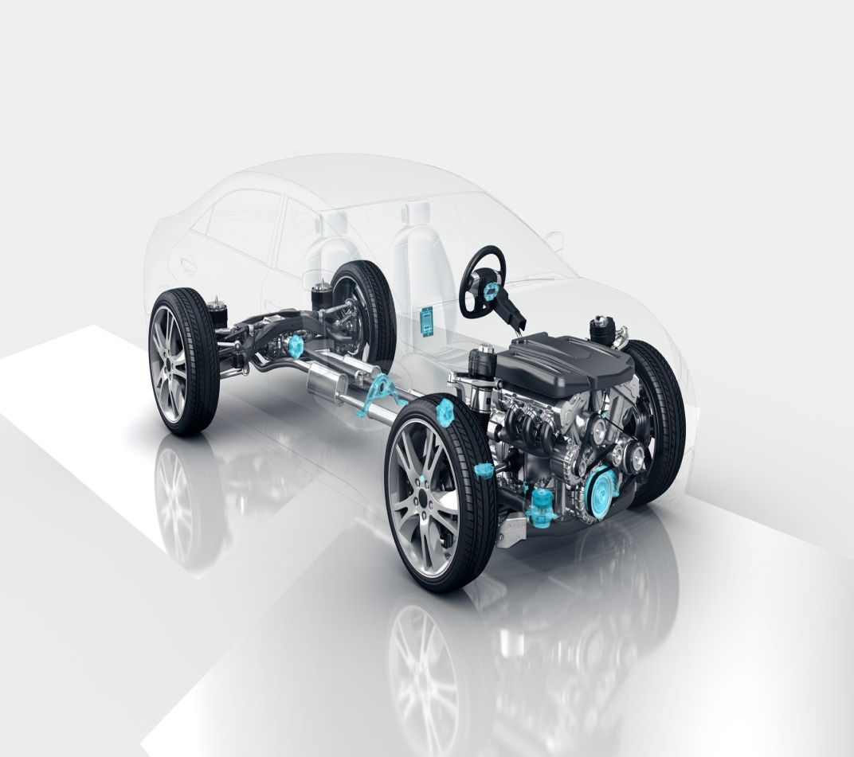

f
Autonomous Vehicle Group
School of ECE
Project Title: Adaptive Cruise Control
Team No: CIM-A 11
Students Details:
1. D. Shreyas USN:01FE20BEC136
2. Shobith .B USN:01FE20BEC047
3.Prajwal .P USN:01FE20BEC218
4.S.Chandu USN:01FE20BEC328
Guide Details:
Prof. Rohit Kalyani

Slide 2
Autonomous Vehicle Group
School of ECE
CONTENTS
INTRODUCTION
PROBLEM STATEMENT
SOCIETIAL CONTEXT
NEED STATEMENT
METHODOLOGY
VEHICLE PLATOONING
BIBLIOGRAPHY

Slide 3

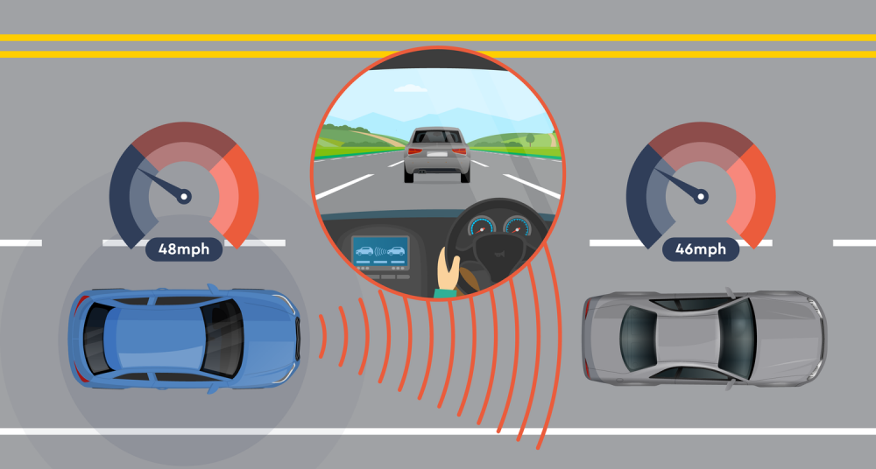
DEFINITION
Autonomous Vehicle Group
School of ECE
Adaptive cruise control (ACC) is an advanced driver assistance system that automatically adjusts the speed of a vehicle to maintain a safe distance from the vehicle in front of it.
The system uses sensors, such as radar or cameras, to detect the distance and speed of the vehicle ahead, and then adjusts the speed of the vehicle accordingly.
Minor Project- 2023

Slide 4
PROBLEM STATEMENT
Autonomous Vehicle Group
School of ECE
Develop adaptive cruise control system and evaluate the performance of the system
Minor Project- 2023

Slide 5
SOCIETIAL CONTEXT
Autonomous Vehicle Group
School of ECE
Improve traffic flow and reduce congestion on roads.
Reduce the frequency and severity of accidents to increase road safety.
Reduce driver fatigue and stress.
Promote sustainable transportation by optimizing vehicle speed and reducing unnecessary fuel consumption.
Improve accessibility for people with disabilities.
Promote responsible driving behaviour.
Improve emergency response times.
Enhance mobility for older adults.
Minor Project- 2023

Slide 6
NEED STATEMENT
Autonomous Vehicle Group
School of ECE
Need for an advanced adaptive cruise control system that can efficiently adapt to real-world driving conditions, reducing the risk of accidents and improving roadway safety.
Minor Project- 2023

Slide 7
METHODOLOGY
Autonomous Vehicle Group
School of ECE
The Adaptive Cruise Control system will have two modes of steady state operation:
Speed control
Vehicle following (i.e. spacing control)
A standard adaptive cruise control system uses the throttle control input to adjust the vehicle's speed to a desired value. There will be an upper level controller and a lower level controller in the hierarchical longitudinal control system architecture for the cruise control vehicle.
Speed set point
Desired acceleration
throttle input
Upper Controller
Lower Controller
Structure of Speed Control System
Minor Project- 2023

Slide 8



Autonomous Vehicle Group
School of ECE
UPPER LEVEL CONTROLLER FOR SPEED CONTROL
A common upper controller algorithm is PI control, which uses speed error as the feedback signal. The mathematical model for controller is given by:
Where, is desired acceleration
is desired velocity
is desired position
Additionally, and are integral and proportional constants respectively.
Mathematical Plant model is given by:
In the model, desired acceleration is given as input and actual velocity is observed at output.
Further, the actual velocity is feed back to calculate the error.
Minor Project- 2023

Slide 9


Autonomous Vehicle Group
School of ECE
Therefore, we get Transfer functions as:
Hence, The Closed loop System is shown below.
+
C
P
-
Minor Project- 2023

Slide 10
Autonomous Vehicle Group
School of ECE
SIMPLE LINEAR EQUATION USED FOR VEHICLE FOLLOWING
We have considered a linear equation in which the speed of the vehicle varies linearly with obstacle distance.
Consider two distances stopping distance and nominal tracking distance. We have two speeds at these distances zero speed at stopping distance and nominal set speed at nominal tracking speed.
Taking these conditions into consideration we derive a linear equation which is as follows:
speed_cmd =nominal_speed/(nominal_tracking_distance-stop_distance)*obstacle_distance- nominal_speed/(nominal_tracking_distance-stop_distance)*stop_distance
From this equation speed_cmd varies linearly with respect to obstacle_distance.
Minor Project- 2023

Slide 11
Autonomous Vehicle Group
School of ECE
ADAPTIVE CRUISE CONTROL BLOCK MODELLING
Image processing is done through CSI camera and depth sense camera.
The image processing data is collected for obstacle distance detection and steering command.
The user control block is used to set nominal speed ,nominal tracking distance and stop distance.
This data is further feed to ACC control block for desired speed calculation and speed reduction during turning.
Minor Project- 2023

Slide 12



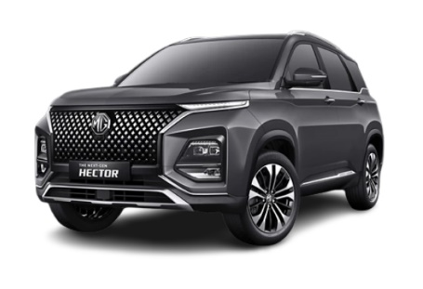
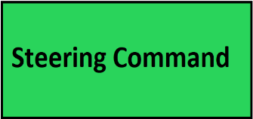
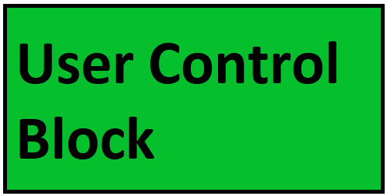
Autonomous Vehicle Group
School of ECE
BLOCK DIAGRAM
DATA PROCESSING BLOCK
Minor Project- 2023

Slide 13
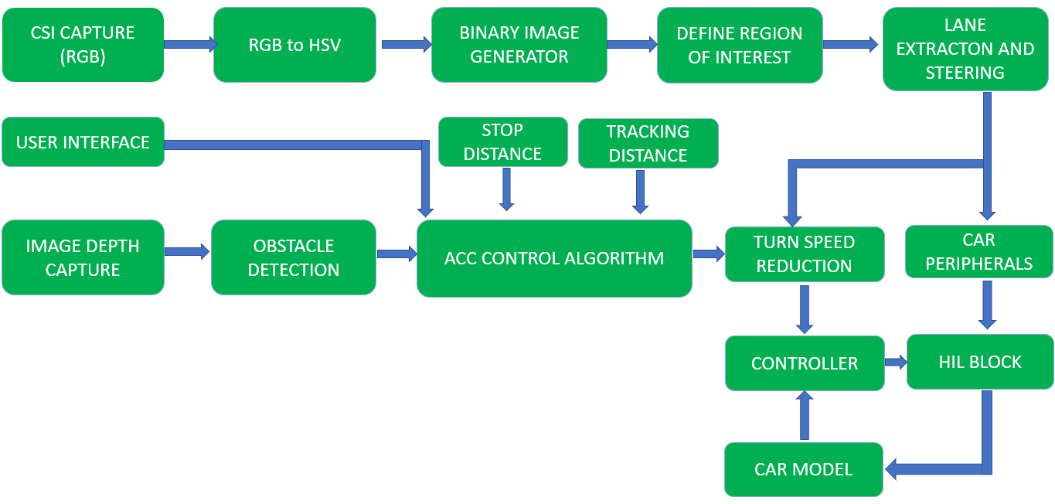



Autonomous Vehicle Group
School of ECE
FLOWCHART
Minor Project- 2023

Slide 14
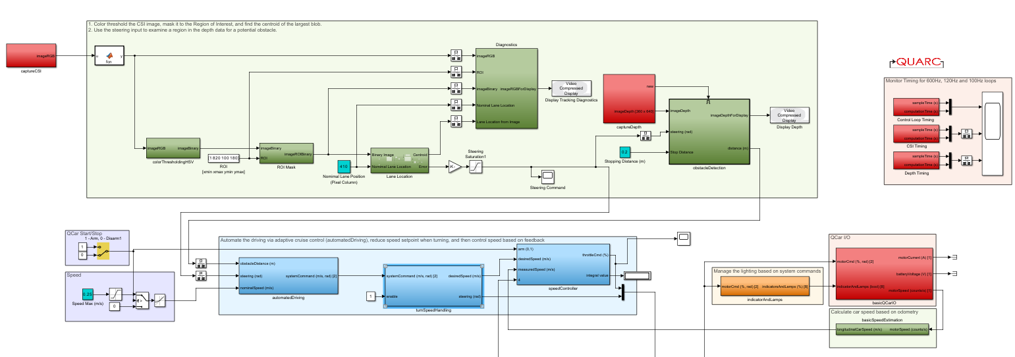
IMPLEMENTATION DETAILS
Autonomous Vehicle Group
School of ECE
SYSTEM ARCHITECTURE
Minor Project- 2023

Slide 15
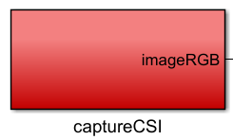
Capture CSI
Autonomous Vehicle Group
School of ECE
INPUTS
Data from CSI Camera
OUTPUTS
RGB Image
Minor Project- 2023

Slide 16
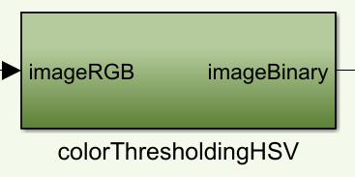
ColourThresholding HSV
Autonomous Vehicle Group
School of ECE
Inputs
RGB Image
Outputs
Binary Image
Minor Project- 2023

Slide 17
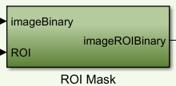
Region of Interest
Autonomous Vehicle Group
School of ECE
INPUTS
Binary Image
ROI
OUTPUTS
ROI Binary Image
Minor Project- 2023

Slide 18
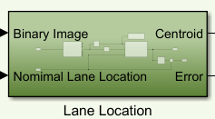
LANE LOCATION
Autonomous Vehicle Group
School of ECE
INPUTS
Binary Image
Nominal Lane Location
OUTPUTS
Centroid
Steering Command Error
Minor Project- 2023

Slide 19
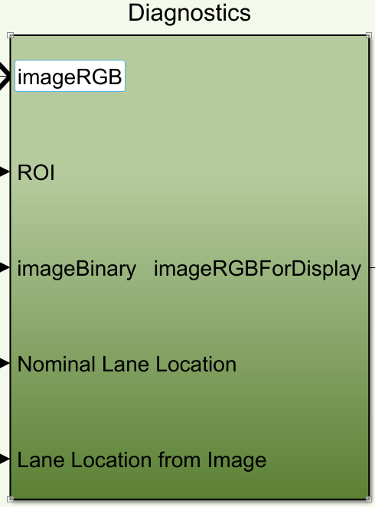
Diagnostics
Autonomous Vehicle Group
School of ECE
Inputs
RGB Image
ROI
Binary Image
Nominal Lane Location
Lane Location from Image
OUTPUTS
RGB Image for Display
Minor Project- 2023

Slide 20

DEPTH SENSOR
Autonomous Vehicle Group
School of ECE
INPUT
RGBD Camera(Intel RealSense)
OUTPUT
RGB Image
Depth Data
Minor Project- 2023

Slide 21
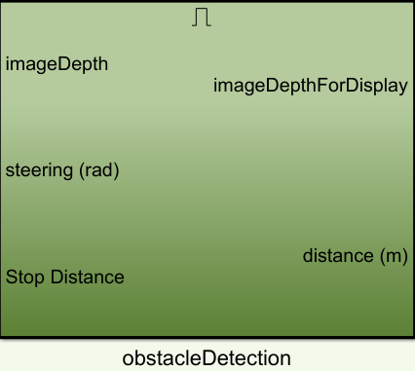
OBSTACLE DETECTION
Autonomous Vehicle Group
School of ECE
INPUT
Image Depth
Stop Distance
OUTPUT
Image Depth
Distance (m)
Minor Project- 2023

Slide 22
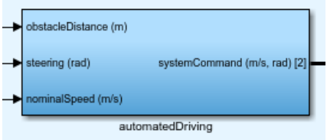
Autonomous Vehicle Group
School of ECE
CONTROL BLOCKS FOR ACC
AUTOMATED DRIVING BLOCK
INPUTS:
obtacleDistance
steering
nominalSpeed
OUTPUTS:
systemCommand
FUNCTIONS:
The input obstacle distance is compared to the nominal tracking distance and stop distance.
If the obstacle distance is smaller than the nominal tracking distance, the nominal set speed will begin to decrease.
When obstacle distance is less than stop distance ,the vehicle speed will scale down to zero.
steering angle calculated using information from image processing.
Accordingly, the desired speed command and steering command is given as output.
Minor Project- 2023

Slide 23
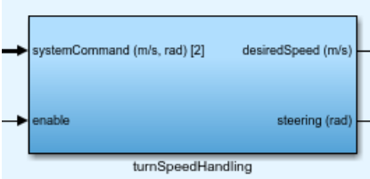
Autonomous Vehicle Group
School of ECE
TURNING SPEED HANDLING BLOCK
INPUTS:
systemCommand
enable
OUTPUTS:
desiredSpeed
steering
FUNCTIONS:
To ignore the speed reduction during turning set enable to zero
When the enable is set to one, the speed reduction takes place depending upon the sharpness of the turning curve.
If the path is straight line then vehicle travels with nominal set speed.
Minor Project- 2023

Slide 24
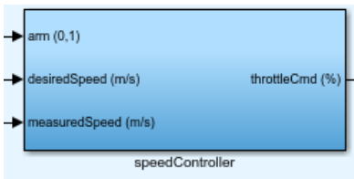
Autonomous Vehicle Group
School of ECE
SPEED CONTROLLER BLOCK
INPUTS:
Arm
DesiredSpeed
measuredSpeed
OUTPUTS:
throttleCmd
FUNCTIONS:
The PI controller tries to obtain the desired speed given as input.
The measured speed is also taken as input for feedforward to map the Desired speed to PWM Duty cycle bias.
Throttle command is then given to the motor.
Minor Project- 2023

Slide 25
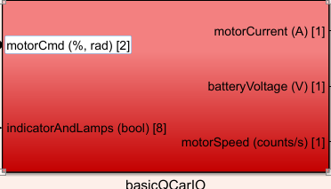
BASIC CAR I/0
Autonomous Vehicle Group
School of ECE
INPUTS
Motor Command(%,rad)
Indicator Lamps
OUTPUTS
Motor Current(A)
Battery Voltage
Motor Speed(count/s)
Minor Project- 2023

Slide 26
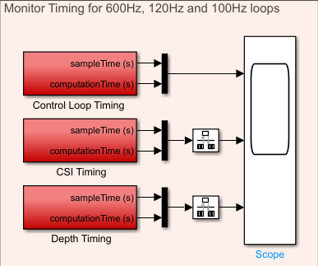
TIMING
Autonomous Vehicle Group
School of ECE
INPUT
Sample Time
Computation Time
OUTPUT
Timing graph of respective block
Minor Project- 2023

Slide 27

INDICATOR AND LAMPS
Autonomous Vehicle Group
School of ECE
INPUT
Motor Command
OUTPUT
Indicator and Lamps command
Minor Project- 2023

Slide 28
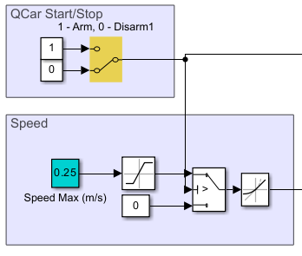
USER CONTROL
Autonomous Vehicle Group
School of ECE
INPUT
Arm(1) or Disarm(0)
Speed[0 to 1.5]
OUTPUT
Arm or Disarm
Speed Command
Minor Project- 2023

Slide 29
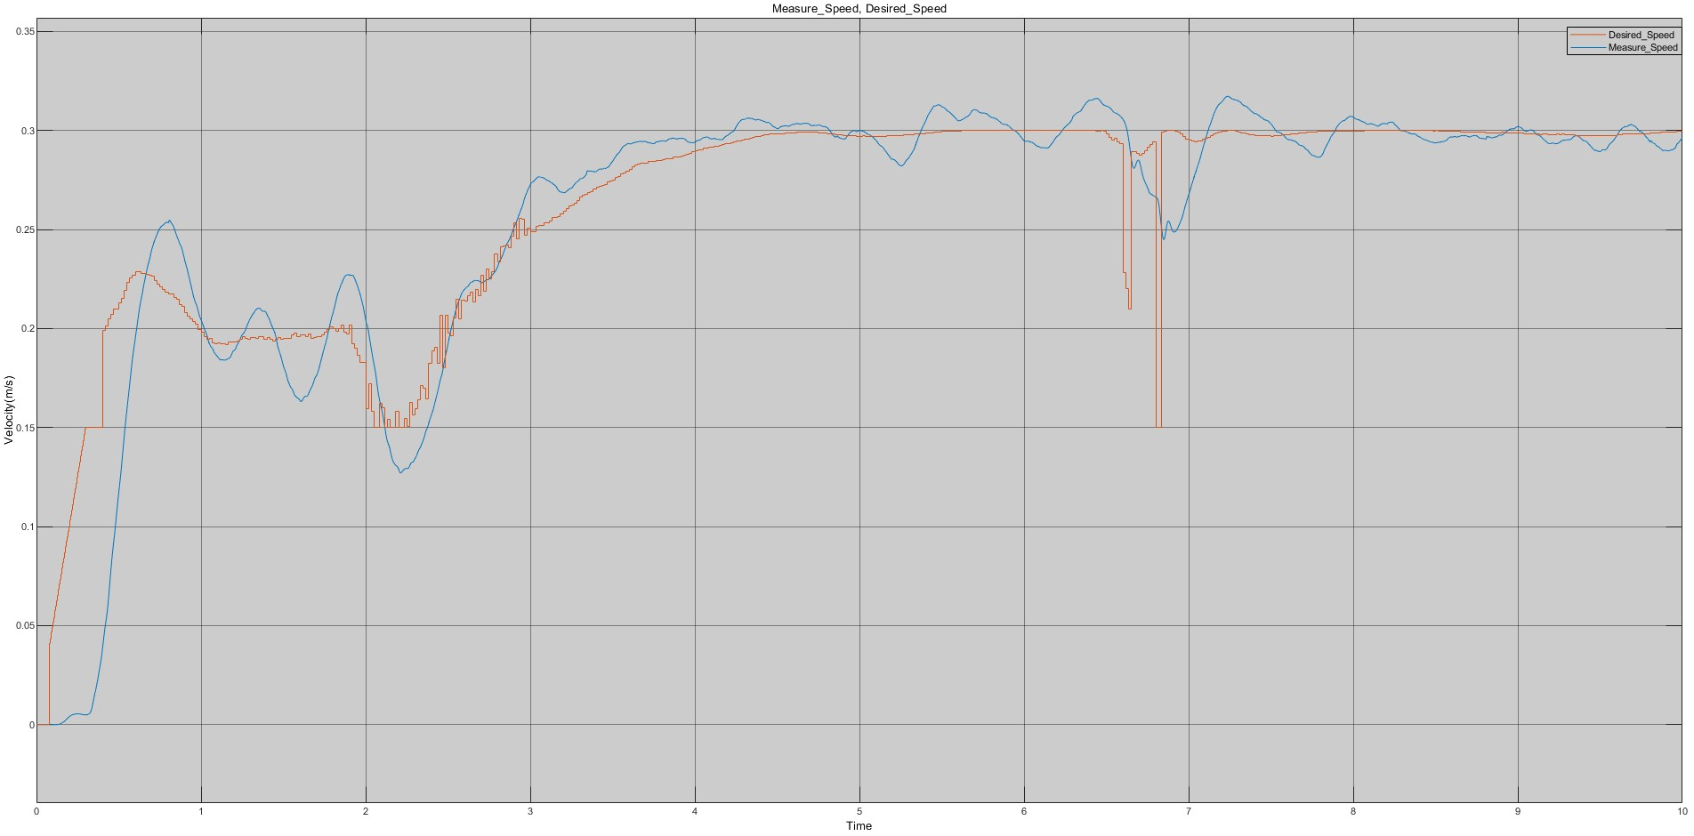
RESULTS
Autonomous Vehicle Group
School of ECE
Graph-1
Desired speed and Actual speed
Minor Project- 2023

Slide 30
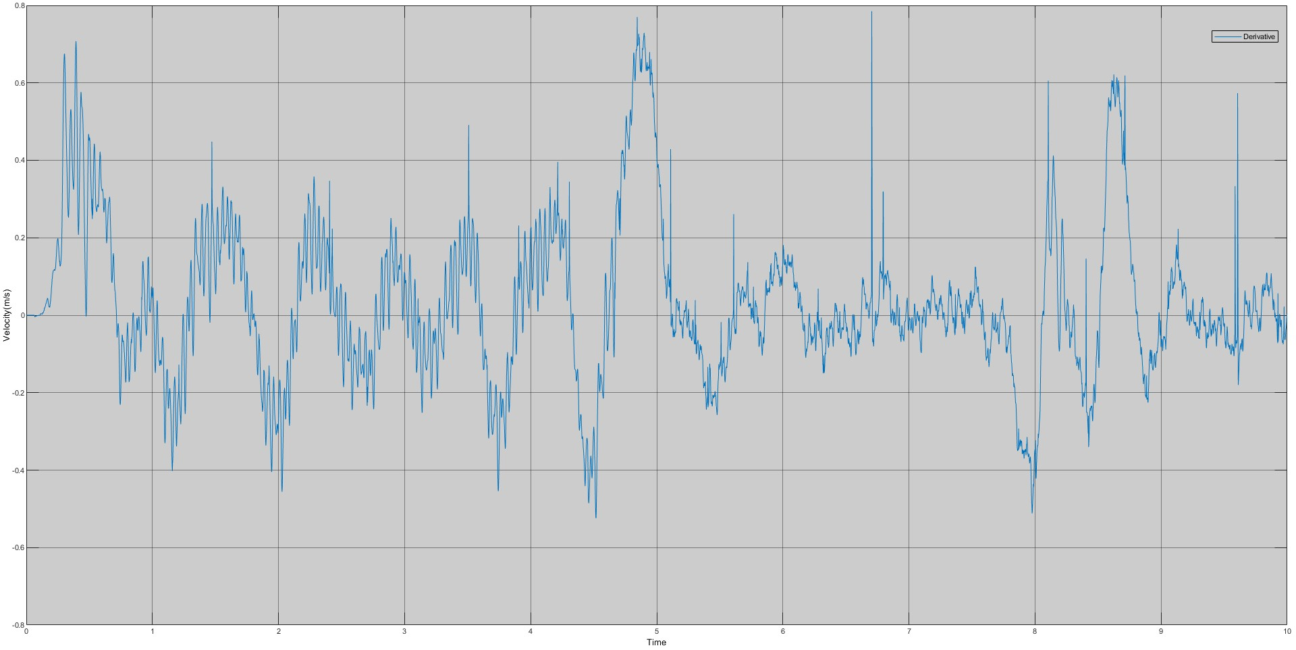
Autonomous Vehicle Group
School of ECE
Graph-2
Acceleration(m/s²)
Fig2. Acceleration v/s Time
Minor Project- 2023

Slide 31
Autonomous Vehicle Group
School of ECE
SIGINIFICANCE OF ACC
Fuel Efficiency
One of the significant advantage of ACC is its potential to improve fuel efficiency. By maintaining a constant speed and avoiding sudden braking and accelerating, the system can help reduce fuel consumption, leading to cost savings and environmental benefits.
Convenience
ACC can make driving more convenient and less stressful, especially during long trips. Drivers can relax and enjoy the ride without constantly adjusting their speed to maintain a safe distance from other vehicles.
Safety
ACC can help reduce the risk of collisions by maintaining a safe following distance, even in stop-and-go traffic. This technology can also help prevent accidents caused by human error, such as tailgating, speeding, and distracted driving.
Traffic flow
ACC can also help improve traffic flow by reducing congestion and smoothing out traffic patterns. When more vehicles are equipped with ACC, the overall traffic flow can be more efficient and safer.
Minor Project- 2023

Slide 32
BIBLIOGRAPHY
Autonomous Vehicle Group
School of ECE
W. Pananurak, S. Thanok and M. Parnichkun, "Adaptive cruise control for an intelligent vehicle," 2008 IEEE International Conference on Robotics and Biomimetics, Bangkok, Thailand, 2009, pp. 1794-1799, doi: 10.1109/ROBIO.2009.4913274.
A. Abdullahi and S. Akkaya, "Adaptive Cruise Control: A Model Reference Adaptive Control Approach," 2020 24th International Conference on System Theory, Control and Computing (ICSTCC), Sinaia, Romania, 2020, pp. 904-908, doi: 10.1109/ICSTCC50638.2020.9259641.
X. Zhang, W. Li, K. Guo, T. Peng and Y. Huang, "Longitudinal acceleration allocation for cooperative adaptive cruise control including platoon kinematics," 2019 IEEE 28th International Symposium on Industrial Electronics (ISIE), Vancouver, BC, Canada, 2019, pp. 1512-1517, doi: 10.1109/ISIE.2019.8781428.
Minor Project- 2023

Slide 33
THANK YOU
Autonomous Vehicle Group
School of ECE

