Slide 1
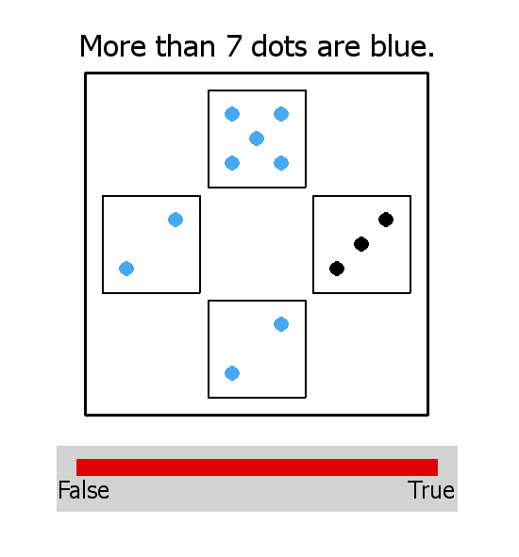
Welcome and thanks for participating in this study,
You will be presented with sentence-picture items. Here is an example of what you will see on the screen:
For each item, your task is to tell us whether the sentence is true or false of the picture it is paired with. For instance, in the example above, the sentence is true.
Important: this is not a math test! In fact, in many cases, the sentence might not be clearly true or clearly false, but describes the picture more or less well. For this reason, you will be able to give a finer jugdment than a simple ‘True’ or ‘False’: you will give your answer along a continuum of answers, by setting with the cursor the right end of a red line going between ‘False’ (to the left) to ‘True’ (to the right). The more the sentence will seem to be a good description of the picture, the more you will move the end of the red line to ‘True’. It should be the case for an example like the one above, and thus your answer should look like what you see. Conversely, if the sentence sounds rather inappropriate, you will move the red line to the left, that is to ‘False’.
Press SPACEBAR to read the rest of the instructions…

Slide 2
To summarize
You might hesitate, but follow your guts and use all the possibilities offered by the red line to represent at best your intuition. Don’t look for a justification to your answer, or for an explanation regarding where your intuition could come from – just answer as you feel it.
This study is not long, but a bit repetitive and you must stay focused. Even though you have to pay attention to every detail, don’t spend too much time on every sentence. Read the sentence in your head and, given what you see on the picture, tell us your intuition using the red answer bar. You will get used to this bar very quickly.
Sentences will sometimes look the same. That doesn’t matter. Answer every time following your intuition, independently of your previous answers.
Press SPACEBAR when you are ready to start…

