Slide 1
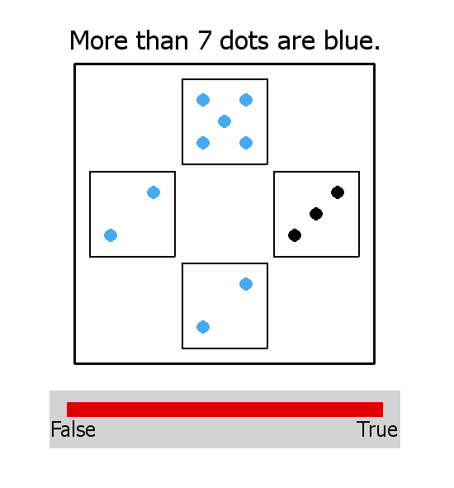
Welcome and thanks for participating in this study,
In this study you will be presented with items containing a picture and a sentence. Here is an example of what you will see on the screen:
For each item, your task is to tell us whether the sentence is true or false as a description of the picture it is paired with. For instance, in the example above, the sentence is true.
Important: this is not a math test! In fact, in many cases, it might not be entirely clear whether the sentence is false, but it may be a better or worse description of the picture. For this reason, you will be able to give more fine-grained judgments than a simple ‘True’ or ‘False’: you will give your answer along a continuum, by using the cursor to set the right end of a red line going between ‘False’ (left) and ‘True’ (right). The more the sentence seems to be a good description of the picture, the more you should move the end of the red line toward ‘True’. For example, this is the case for an example like the one above, and thus the best answer would look like what you see above, with the red bar all the way to the 'True' end. Conversely, if the sentence sounds very inappropriate, you should move the red line all the way to the 'False' end.
Press SPACEBAR to read the rest of the instructions…

Slide 2
Some further notes:
You may hesitate, but it's OK to go with your gut, and to use the full range of the red bar when appropriate. Don’t worry about justifying or explaining your answers: we're interested in finding out precisely what the answer feels like to you.
This study is not long, but it is slightly repetitive and you must maintain concentration. Even though you have to pay attention to detail, don’t spend too much time on each sentence: just read it in your head and tell us your intuition.
Sometimes sentences will sometimes look the same. That's OK – just answer each time according to your feeling, without worrying about what your previous answers were.
Thanks for participating!
Press SPACEBAR when you are ready to start…

