Slide 1
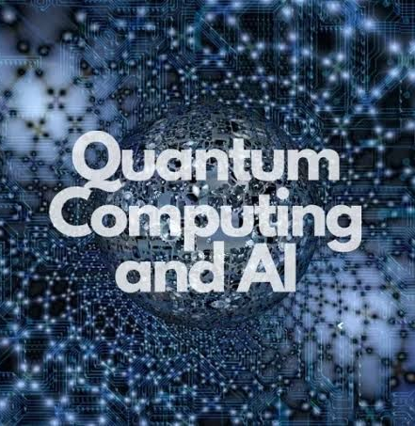
QML For conspicuity Detection

Slide 2
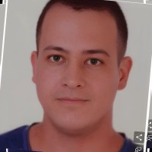

The detection duo team
ML Engineer intern
Graduated from physics major
Currently Computer science undergraduate
Full stack developer
Currently pursuing phd in computer science
Teaches university courses on optimization fundamentals, algorithmic techniques, and quantum algorithms

Slide 3



Outline
Problem
Challenges and future steps
Solution 4 and 5

Slide 4
Problem
1
2
Image classification
Defective/non-defective
Find best accuracy
Predict sine function
sin(x)
Predict more complicated sine function
2*sin(x) + 0.7*sin(3*x)

Slide 5
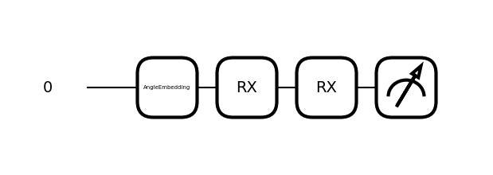
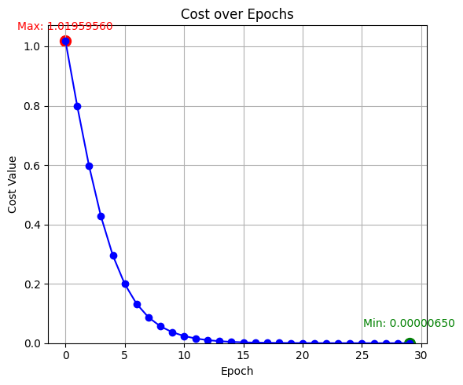
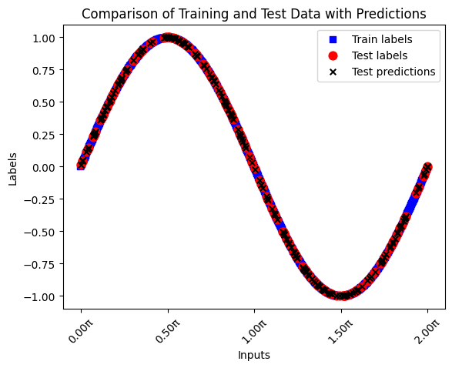
Task 4 Solution part-1
Good Results for simple sine function but not for the complex one

Slide 6
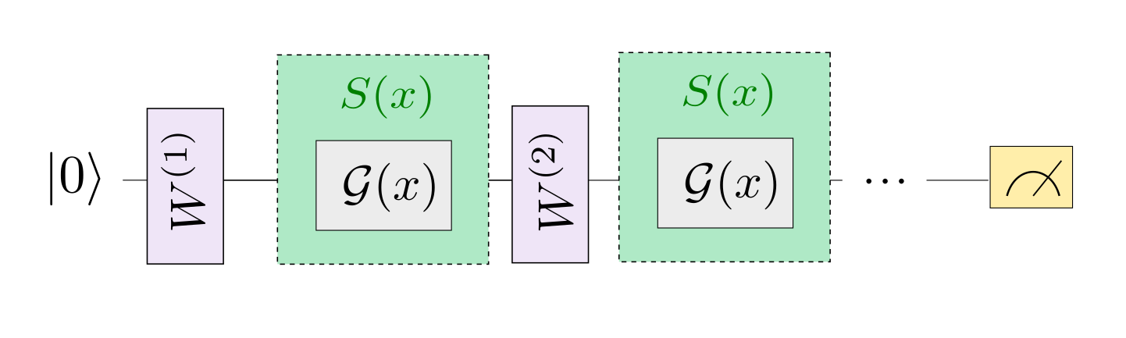
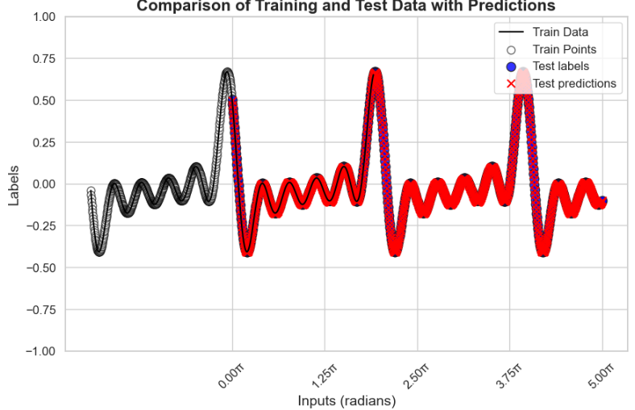
Task4 Solution part-2
We used a different approach to account for low test accuracy in the complicated sine function:
W
Training layer
S(x)
Encoding layer

Slide 7
Task 5 Approach 1
Images crop and resize
Dimensionality reduction using PCA
Train the model comparing different loss functions using 4 qubits.
Find the loss function that gave the highest accuracy
Plot the confusion matrix and calculate the F1-score

Slide 8
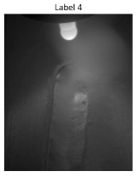
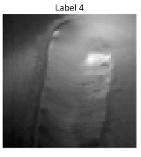
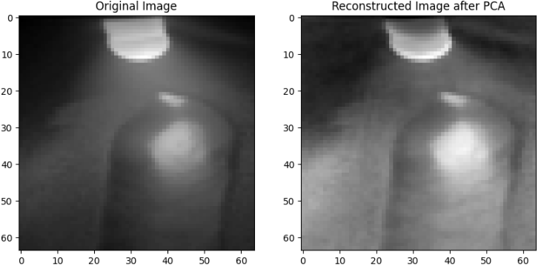
Task 5 Approach 1
Crop and resize
PCA:
Is a technique that can compress the image. So that we have fewer values to encode in our quantum circuit.
The image can be decompressed after encoding or compressing, with minimal loss possible.

Slide 9
Task 5 Approach 2
Images crop and resize
Dimensionality reduction using Autoencoder.
Train the model comparing different loss functions using 8 qubits.
Find the loss function that gave the highest accuracy
Plot the confusion matrix and calculate the F1-score

Slide 10
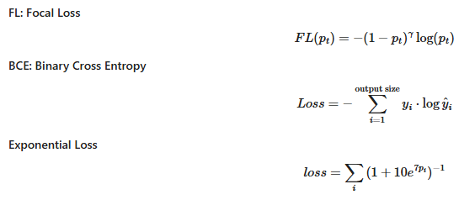
Results for task 5
8 Qubits
+
Exponential loss
+
Autoencoder
Best results achieved:
92.67%
89.83%
Validation Accuracy
Test Accuracy

Slide 11
Challenges and future scope
Challenges
Computational resources
Big images dimensions
Trying to implement a novel approach
Future scope
Comparing with other models
Extending for multiclassification
Find potential speedup

Slide 12
References:
[1] Esther Cruz Carlos A. Riofro Johannes Klepsch Juan Miguel Arrazola Diego Guala, Shaoming Zhang. Practical overview of image classification with tensor-network quantum circuits. Nature Journal, (12):1–12, 3 2023.
[2] Frank Kster Hans-Martin Rieser and Arne Peter Raulf. Tensor networks for quantum machine learning. Royal Society, pages 1–23, 7 2023.
[3] Patrick Holzer and Ivica Turkalj. Spectral invariance and maximality properties of the frequency spectrum of quantum neural networks. Physical Review A, 104(3):032404, 2021.
[4] Enrico Prati Marco Lazzarin, Davide Emilio Galli. Multi-class quantum classifiers with tensor network circuits for quantum phase recognition. Arxiv, pages 1–7, 7 2021.
[5] Mikko Mottonen, Juha J. Vartiainen, Ville Bergholm, and Martti M. Salomaa. Transformation of quantum states using uniformly controlled rotations. arXiv preprint quant-ph/0407010, 2004.
[6] Maria Schuld, Alex Bocharov, Krysta Svore, and Nathan Wiebe. Circuit-centric quantum classifiers. Physical Review A, 101(3):032308, 2020.
[7] Maria Schuld and Francesco Petruccione. Machine Learning with Quantum Computers. Springer International Publishing, 2019.
[8] Maria Schuld, Ryan Sweke, and Johannes Jakob Meyer. The effect of data encoding on the expressive power of varia-tional quantum machine learning models. Physical Review A, 103(3):032430, 2021.

Slide 13

Thank You
https://github.com/Martyna94/The_Detection_Duo

