Slide 1

ENCOUNTER
SWASHBUCKLERS TEAM

Slide 2

INTRODUCTION
Exploring new cities
Not just PokemonGo or Ingress (they’re games)
Meeting restrictions due to pandemic
Know your city better
Know visited city attractions
App leads you all the way to the object

Slide 3
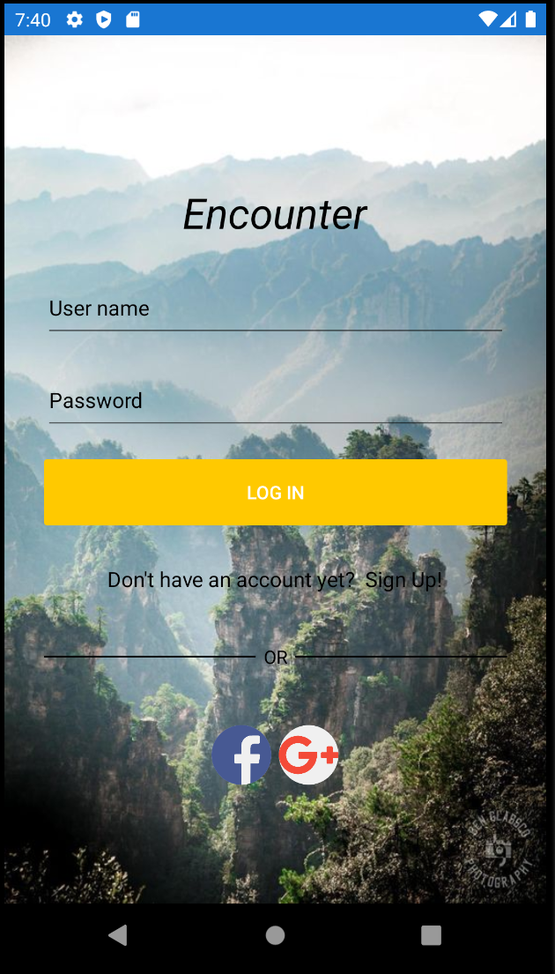
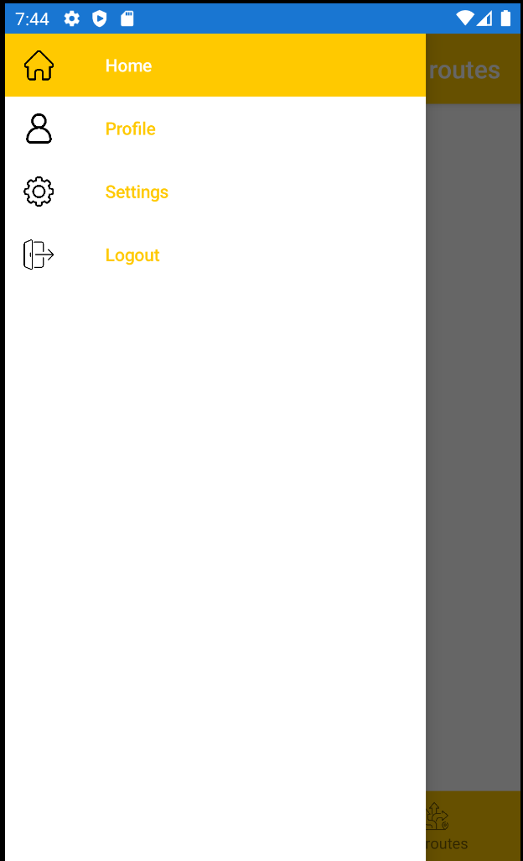
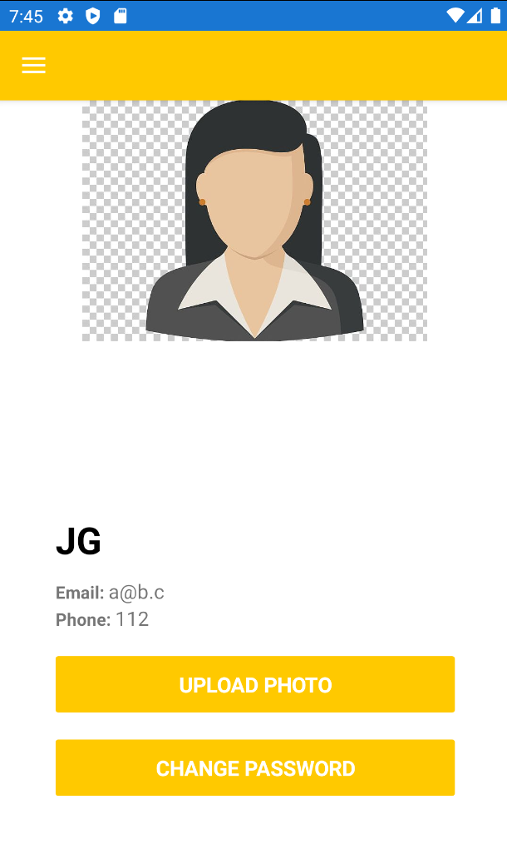
User-friendly design

Slide 4
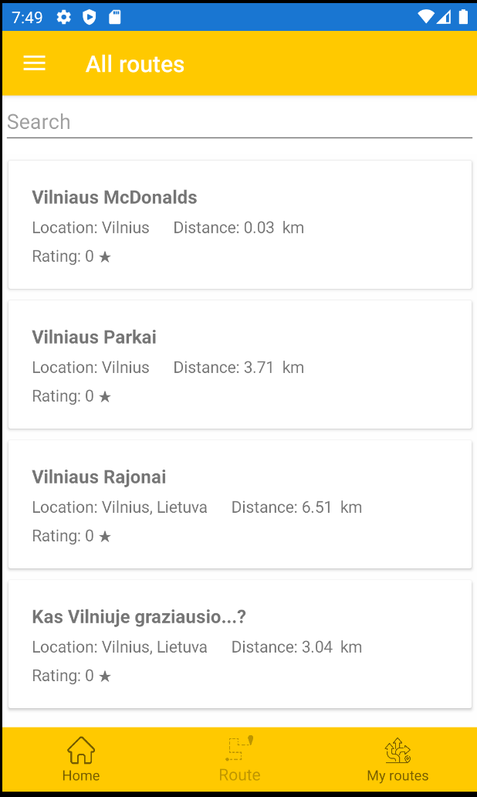
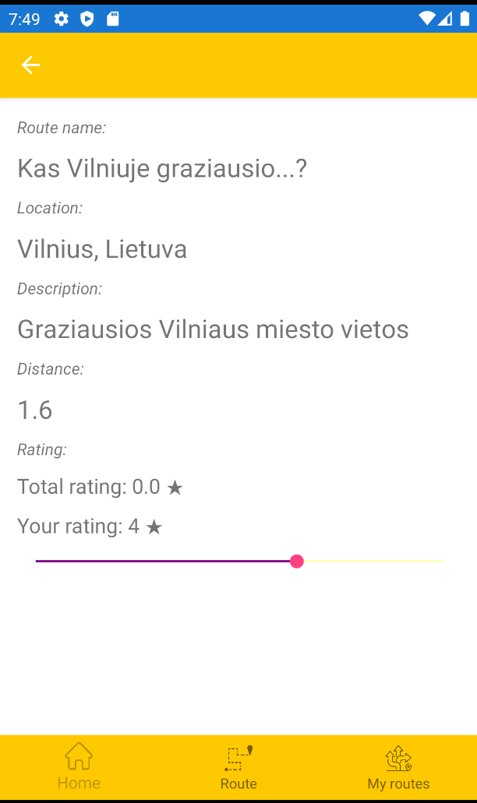
Routes and ratings

Slide 5
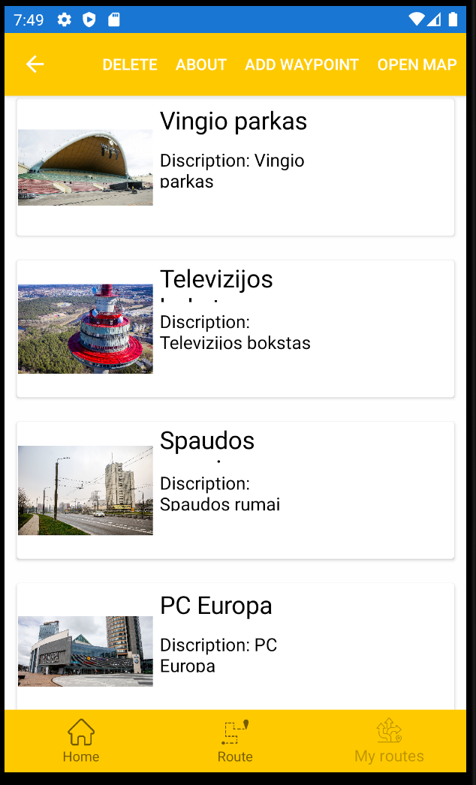
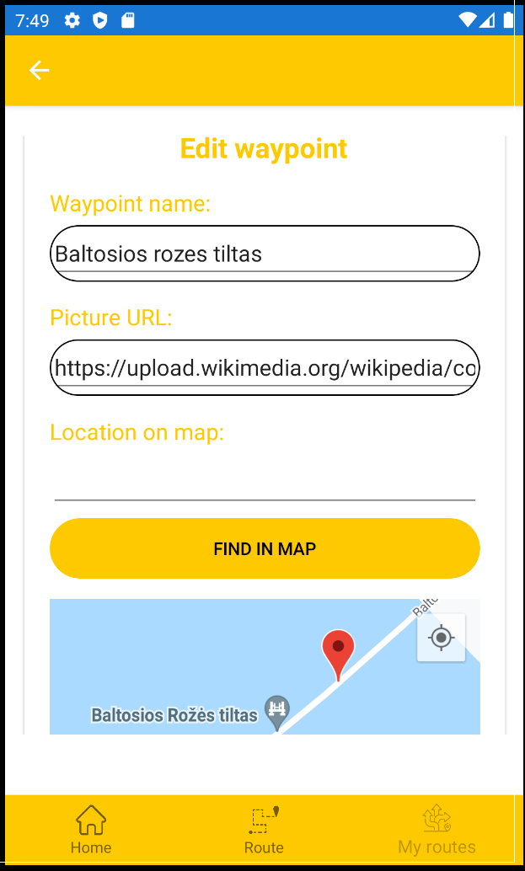
Customizable waypoints
Routes and quizzes are completely customizable too!

Slide 6
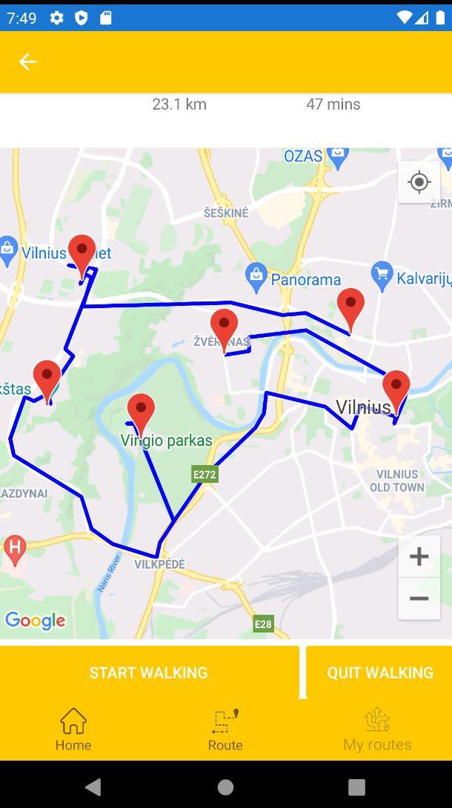
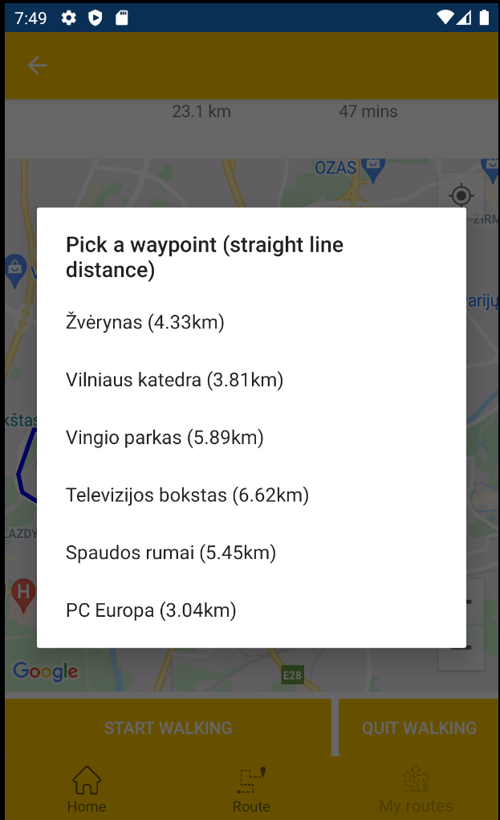
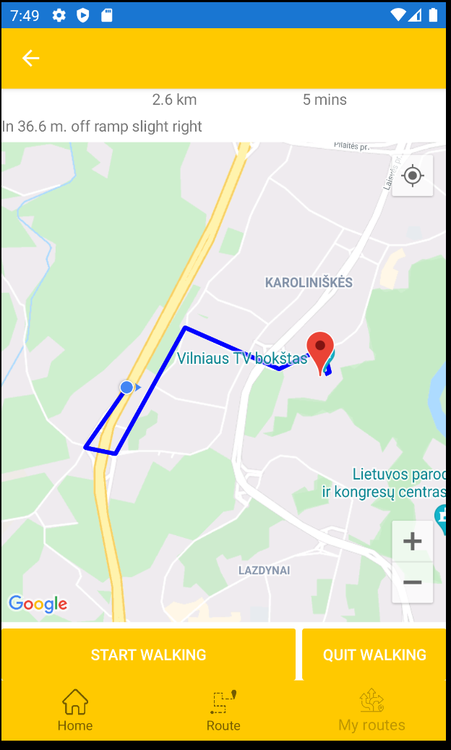
Leading you anywhere you like

Slide 7
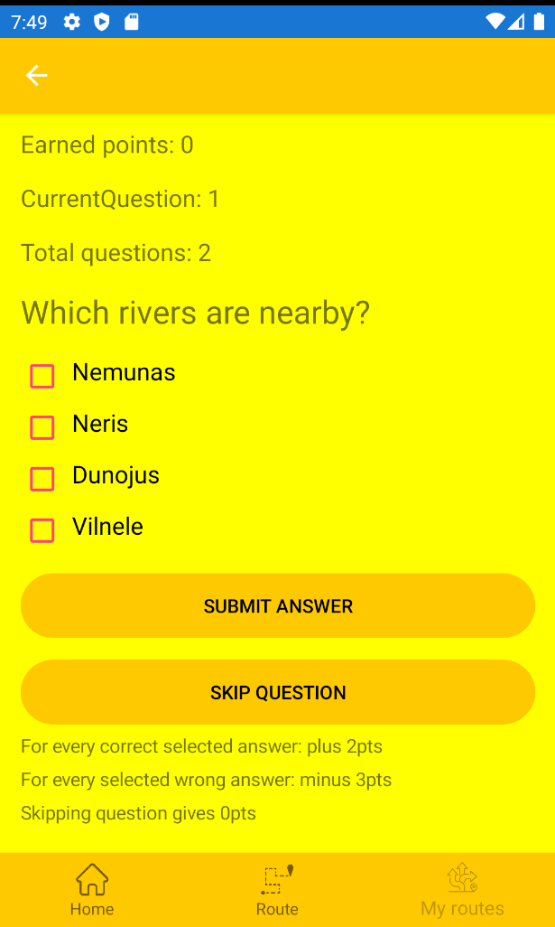
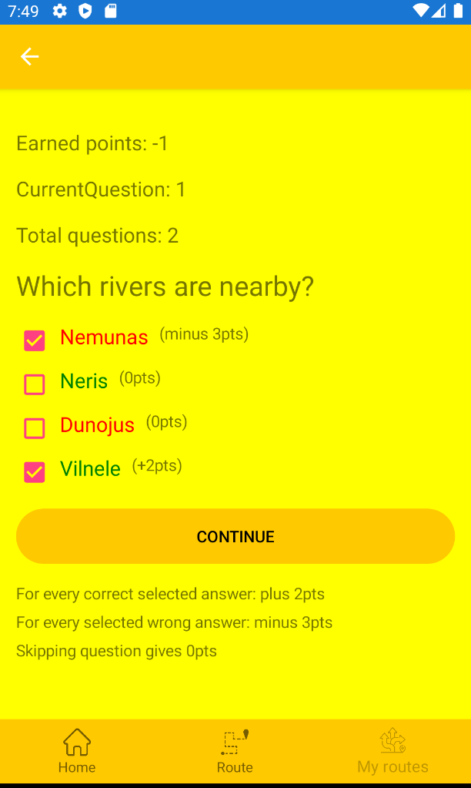
Unexpected entertainment

Slide 8
Time for some DEMO!

Slide 9
Technologies and tools we used
Microsoft Visual Studio
Xamarin
Conveyor
Microsoft Entity Framework
Android Emulator
SQLite database (for testing purposes)

Slide 10
What’s unique
Fully customizable routes
App leads you the whole way from start to finish
You decide which path to take
You can learn things about attractions (in quizzes)
You can stop route anytime you want ant proceed later
Minimalistic design, no unnecessary clutter

