Slide 1

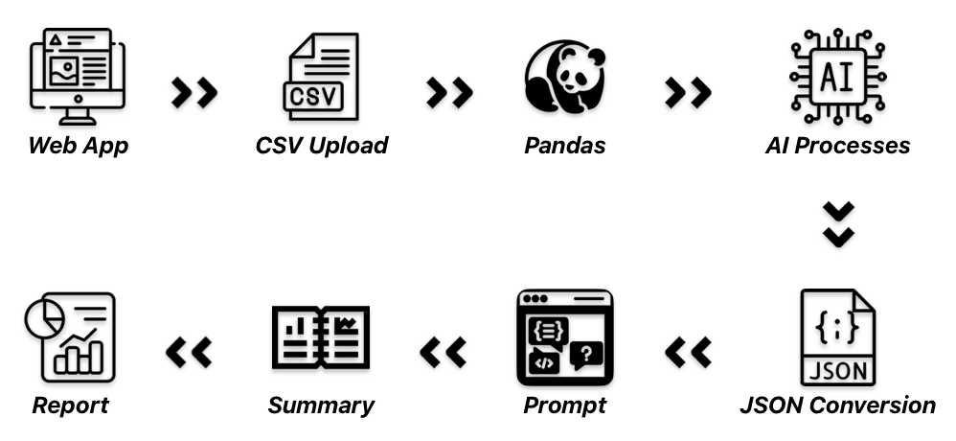
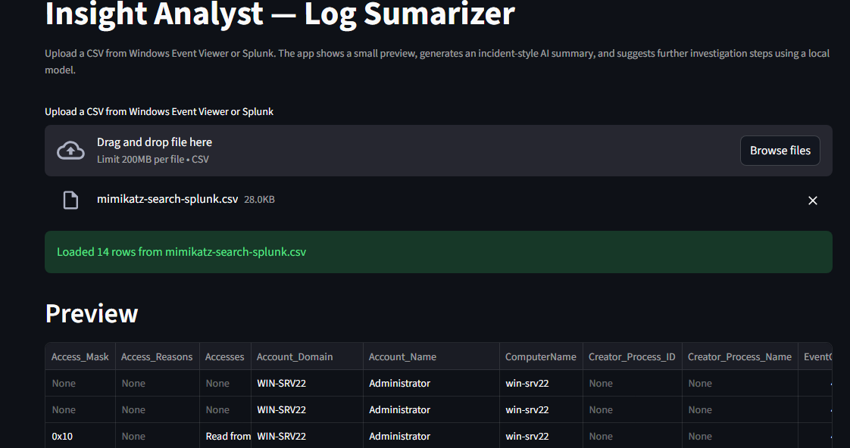
Indiana
Institute of
Technology
Cyber
Security
Martin Quintana
Insight Analyst – AI-Powered Log Summarizer
Abstract
Tools & Technologies
Artificial intelligence has gained significant attention within recent years. Both threat actors and security analysts use it for day-to-day tasks. This project serves as an entry-level learning opportunity on the topic of AI usage within the realm of cybersecurity. Insight analyst will ingest a given CSV file, display the given values, summarize the events, suggest areas to investigate, provide the appropriate next steps and produce a report to download. This will assist SOC analysts with triaging reports and events. In turn, the result is quicker investigation and threat elimination. This will ensure a reduction in possible breaches as this project was designed keeping speed in mind. In conclusion, Insight Analyst will be a valuable asset for cybersecurity professionals who need quick responses to threats.
LM Studio is the chosen platform for hosting a Qwen2.5 7 billion parameter model. Qwen2.5 is an instruct model, which results in task-oriented answers. LM Studio features a built-in API server that can interact with the local system.
A vulnerable Windows Server with Mimikatz.exe produced multiple logs for Windows Event Viewer and Splunk. A Debian host is used as the Splunk indexer, collecting logs and allowing for easy searching. These logs are then fed to Insight Analyst.
Understanding the Design
Python 3.12 is used for the web application that launches when using Insight Analyst. With flexibility kept in mind, Python can handle both the back-end and front-end. Libraries used includes Streamilt, Pyarrow, Wheels, pandas, and dateutil.
A PC containing a GPU with 12 GB of VRAM, 32 GB of DDR4 RAM, a 16-core 3.2 GHz CPU, and a high-speed M.2 NVME for read/write speeds. The web application launches in a virtual PowerShell environment for easy management.
This will begin with the user launching the web app. They will then upload their CSV file. The pandas library will then read the CSV file. This data will be given to the LLM, with respective columns and rows, sent in chunks for optimized processing. This will then be converted to JSON, for formatting and computer readability. This is one of the best ways to prompt AI. This JSON data and the JSON prompt, defined in the code, will then be sent to the LLM using the local API server. Insight Analyst will now begin to analyze and summarize the data. The result is a detailed and easy-to-follow report that can also be downloaded.
Next Steps
There are lots of different avenues that this project can go. Ideally, I would like to design this for Linux systems because of easy package management and lightweight usage of operating system resources. Next will be to add the ability to upload multiple files. Finally, a history of all previously summarized events.

