Slide 1
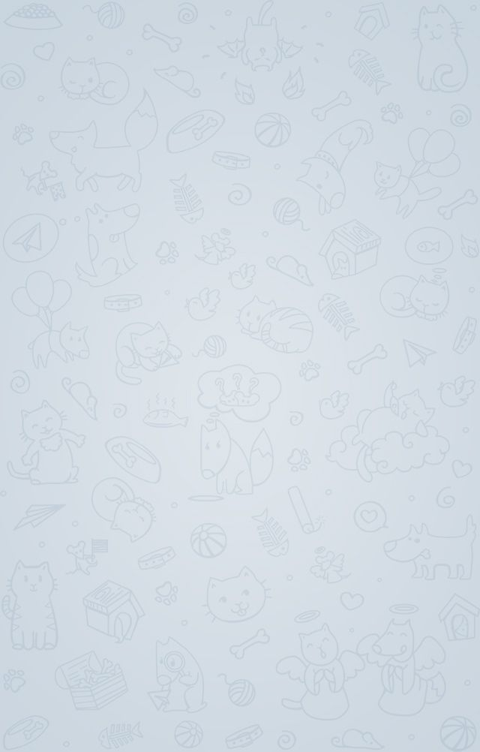
Telegram Bot
Project Report
guide by Pro. Kinjal Raval

Slide 2

Telegram Bot Project
Name :- Maru Bhautik B.
Stream :- BCA SEM-6
Roll No. :-43
Subject :-Python

Slide 3
Topics
What bot
Technology
Screenshot

Slide 4

What is Bot?
robot is a software application that runs automated tasks over the Internet. An Internet bot plays the client role in a client-server model whereas the server role is usually played by web servers.

Slide 5
Why we need Bot?
Chatbot applications streamline interactions between people and services, enhancing customer experience. At the same time, they offer companies new opportunities to improve the customers engagement process and operational efficiency by reducing the typical cost of customer service.

Slide 6
Project requirement
Python 3+ or lover version
Install python modules
telebot
urlshortener

Slide 7
Bot Feature
Url shortener

Slide 8
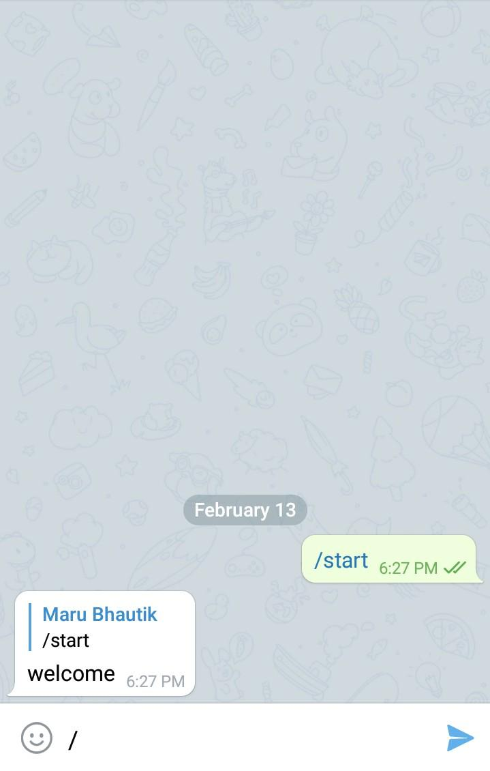

Slide 9
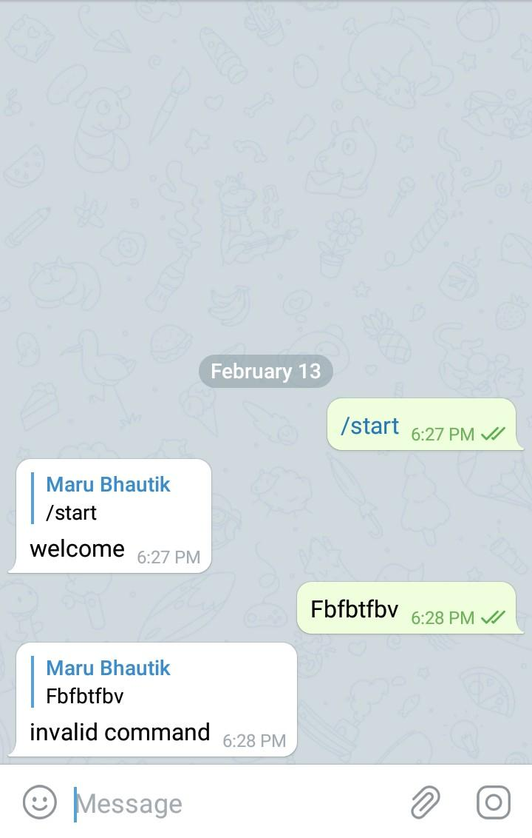

Slide 10
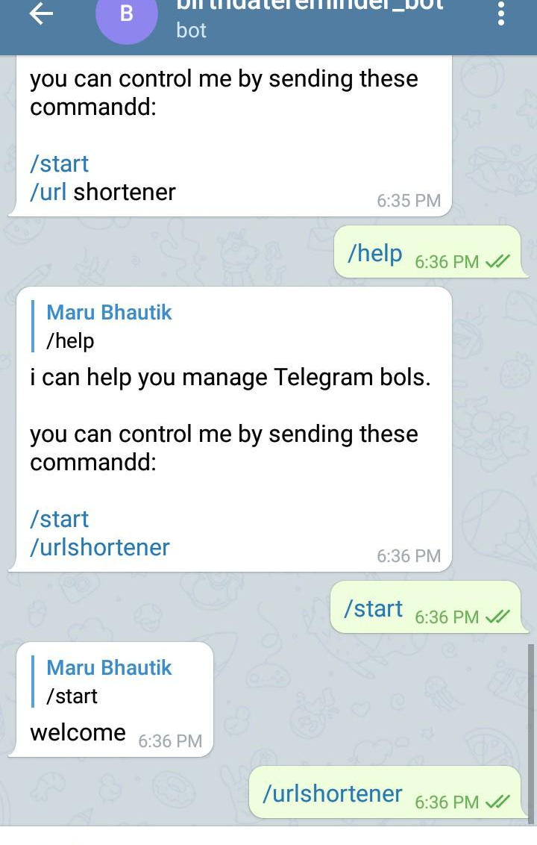

Slide 11
