Slide 1
Linear Search, Bubble Sort, and Insertion Sort
Course Code: CSC 2211
Algorithms(Lab)
Dept. of Computer Science
Faculty of Science and Technology
Lecturer No: | 1 | Week No: | 1 | Semester: | Spring 2020-21
Lecturer: | Name & email

Slide 2
Searching Algorithms
Searching Algorithms are designed to check for an element or retrieve an element from any data structure where it is stored
Based on the type of search operation, these algorithms are generally classified into two categories:
Sequential Search: In this, the list or array is traversed sequentially and every element is checked. For example: Linear Search.
Interval Search: These algorithms are specifically designed for searching in sorted data structures
This type of searching algorithms are much more efficient than Linear Search as they repeatedly target the center of the search structure and divide the search space in half. For Example: Binary Search.

Slide 3
Linear Search
A linear search scans one item at a time, without jumping to any item.
The worst case complexity is O(n), sometimes known an O(n) search
Time taken to search elements keeps increasing as the numbers of elements are increased

Slide 4
Linear Search
5 | 1 | 4 | 2 | 8 | 9
Searching Element=9
Not found

Slide 5
Linear Search
5 | 1 | 4 | 2 | 8 | 9
Searching Element=9
Not found

Slide 6
Linear Search
5 | 1 | 4 | 2 | 8 | 9
Searching Element=9
Not found

Slide 7
Linear Search
5 | 1 | 4 | 2 | 8 | 9
Searching Element=9
Not found

Slide 8
Linear Search
5 | 1 | 4 | 2 | 8 | 9
Searching Element=9
Not found

Slide 9
Linear Search
5 | 1 | 4 | 2 | 8 | 9
Searching Element=9
Found!

Slide 10
Pseudocode for Linear Search
procedure linear_search (list, value) for each item in the list if match item == value return the item's location end if end for end procedure

Slide 11
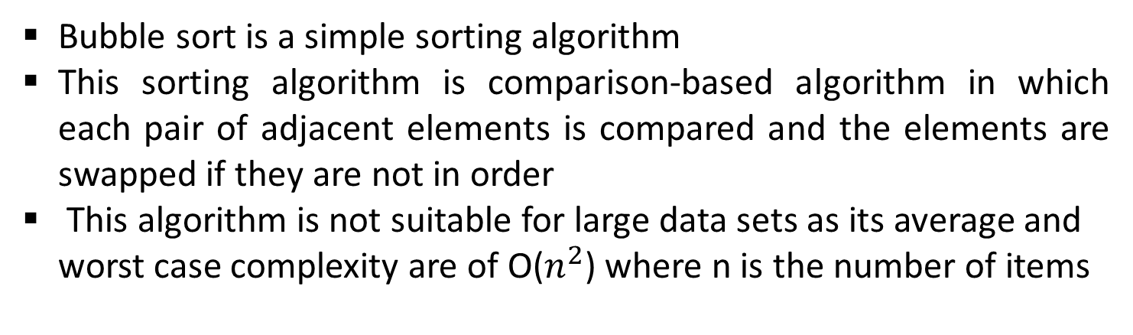
Bubble Sort
Bubble sort is a simple sorting algorithm
This sorting algorithm is comparison-based algorithm in which each pair of adjacent elements is compared and the elements are swapped if they are not in order
This algorithm is not suitable for large data sets as its average and worst case complexity are of Ο($n^{2}$) where n is the number of items

Slide 12
Bubble Sort(First Iteration)
for(int j=0;j<n-i-1;j++) n-0-1=6-0-1=5
5 | 1 | 4 | 2 | 8 | 9
1 | 5 | 4 | 2 | 8 | 9
1 | 4 | 5 | 2 | 8 | 9
1 | 4 | 2 | 5 | 8 | 9
1 | 4 | 2 | 5 | 8 | 9
1 | 4 | 2 | 5 | 8 | 9
Notes:
Pass-1
I=0
J varies from 0 to 5

Slide 13
Bubble Sort(Second Pass)
1 | 4 | 2 | 5 | 8 | 9
1 | 4 | 2 | 5 | 8 | 9
1 | 2 | 4 | 5 | 8 | 9
1 | 2 | 4 | 5 | 8 | 9
1 | 2 | 4 | 5 | 8 | 9
for(int j=0;j<n-i-1;j++) n-1-1=6-0-1=4
Notes:
Pass-2
I=1
J varies from 0 to 4

Slide 14
Bubble Sort(Third Pass)
1 | 2 | 4 | 5 | 8 | 9
1 | 2 | 4 | 5 | 8 | 9
1 | 2 | 4 | 5 | 8 | 9
1 | 2 | 4 | 5 | 8 | 9
for(int j=0;j<n-i-1;j++) n-2-1=6-0-1=3
Notes:
Pass-3
i=2
J=0 to 3

Slide 15
Bubble Sort(Fourth Pass)
1 | 2 | 4 | 5 | 8 | 9
1 | 2 | 4 | 5 | 8 | 9
1 | 2 | 4 | 5 | 8 | 9
for(int j=0;j<n-i-1;j++) n-3-1=6-0-1=2
Notes:
Pass-4
i=3
J=0 to 2

Slide 16
Bubble Sort(Fifth Pass)
1 | 2 | 4 | 5 | 8 | 9
1 | 2 | 4 | 5 | 8 | 9
for(int j=0;j<n-i-1;j++) n-4-1=6-4-1=1
Notes:
Pass-5
i=4
J=0 to 1

Slide 17
Complexity Analysis of Bubble Sort
Problem 5
In Bubble Sort, n-1 comparisons will be done in the 1st pass, n-2 in 2nd pass, n-3 in 3rd pass and so on. So the total number of comparisons will be,
(n-1) + (n-2) + (n-3) + ..... + 3 + 2 + 1
Sum = n(n-1)/2
i.e O(n²) for worst case
O(n) for best case

Slide 18
Pseudocode for Bubble Sort
begin BubbleSort(list)
for all elements of list if list[i] > list[i+1] swap(list[i], list[i+1]) end if end for return list end BubbleSort

Slide 19
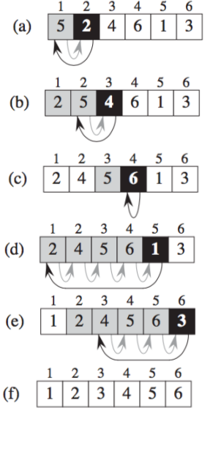
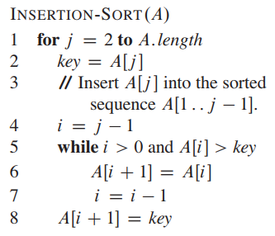
Simulation and Pseudocode of Insertion Sort

Slide 20
Time complexity of Insertion Sort
Input array: 10, 9, 8, 7, 6, 5, 4, 3, 2, 1
1st iteration=>1 comparison( 9, 10, 8, 7, 6, 5, 4, 3, 2, 1)
Second iteration=> 2 comparisons(8,9,10, 7, 6, 5, 4, 3, 2, 1)
9th iteration=>9 comparisons(1,2,3,4,5,6,7,8,9,10)
f(n)=(n-1)+(n-2)+…….+3+2+1=n(n-1)/2
O(n²)
Best case
Input array:1,2,3,4,5,6,7,8,9,10
Total number of comparisons: n-1
Best case time complexity=O(n)

