Slide 1
Binary Search, Selection Sort, and Merge Sort
Course Code: CSC 2211
Algorithms(Lab)
Dept. of Computer Science
Faculty of Science and Technology
Lecturer No: | 2 | Week No: | 2 | Semester: | Spring 2020-21
Lecturer: | Name & email

Slide 2
Binary Search Algorithm
Binary search is a fast search algorithm with run-time complexity of Ο(log n)
This search algorithm works on the principle of divide and conquer
For this algorithm to work properly, the data collection should be in the sorted form
Binary search looks for a particular item by comparing the middle most item of the collection
If a match occurs, then the index of item is returned
If the middle item is greater than the item, then the item is searched in the sub-array to the left of the middle item
Otherwise, the item is searched for in the sub-array to the right of the middle item.
This process continues on the subarray as well until the size of the subarray reduces to zero

Slide 3
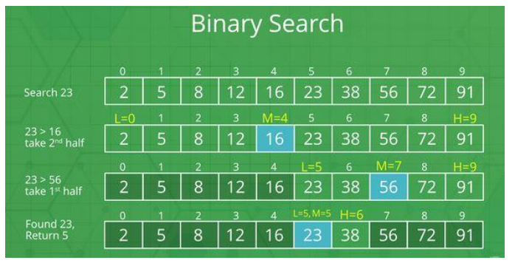

Binary Search Algorithm(cont.)
${O(log}_{2}n$)=${log2}^{3^{2}}=3log2^{2}=3.1=3$

Slide 4
Binary Search Algorithm(cont.)
// initially called with low = 0, high = N – 1 BinarySearch(A[0..N-1], item, low, high) {
while(low<=high){ mid = (low + high) / 2 if (A[mid]==item){ return mid;
}
else if(A[mid]<item){
low=mid+1
}
else{
high=mid-1
} }

Slide 5
Binary Search Algorithm(cont.)
// initially called with low = 0, high = N – 1 BinarySearch_Right(A[0..N-1], value, low, high) { if (high < low) return low mid = (low + high) / 2 if (A[mid] > value) return BinarySearch_Right(A, value, low, mid-1) else return BinarySearch_Right(A, value, mid+1, high) }

Slide 6
Selection sort
9 | 4 | 1 | 7 | 6
1 | 4 | 9 | 7 | 6
1 | 4 | 9 | 7 | 6

Slide 7
Selection sort
1 | 4 | 9 | 7 | 6
1 | 4 | 6 | 7 | 9
1 | 4 | 6 | 7 | 9
1 | 4 | 6 | 7 | 9

Slide 8
Selection Sort Algorithm
void selectionSort(int array[], int n) { int select, minIndex, minValue; for (select = 0; select < (n - 1); select++) { //select the location and find the minimum value minIndex = select; minValue = array[select]; for(int i = select + 1; i < n; i++) { //start from the next of selected one to find minimum if (array[i] < minValue) { minValue = array[i]; minIndex = i; } } array[minIndex] = array[select]; array[select] = minValue; } }

Slide 9
Merge Sort Example
18
26
32
6
43
15
9
1
22
26
19
55
37
43
99
2
18
26
32
6
43
15
9
1
22
26
19
55
37
43
99
2
18
26
32
6
43
15
9
1
22
26
19
55
37
43
99
2
18
26
32
6
43
15
9
1
22
26
19
55
37
43
99
2
18
26
32
6
43
15
9
1
22
26
19
55
37
43
99
2

Slide 10
Merge Sort Example
Original Sequence
Sorted Sequence
18
26
32
6
43
15
9
1
18
26
32
6
43
15
9
1
1
6
9
15
18
26
32
43
18
26
32
6
43
15
9
1
18
26
32
6
43
15
9
1
6
26
32
6
18
26
32
18
1
9
15
43
1
9
15
43
18
26
43
15
9
1
18
26
32
6
43
15
9
1
32
6
18
26
6
32
15
43
18
26
6
32
15
43
1
9
1
9
18
26
32
15
1
15
18
26
32
6
43
15
9
1
18
26
6
43
9
26
32
6
43
15
9
9
1
32
6
43
1
26
32
6
43
15
9
1
26
32
6
43
15
9
1

Slide 11
