Slide 1
Quick Sort and Counting Sort
Course Code: CSC 2211
Algorithms(Lab)
Dept. of Computer Science
Faculty of Science and Technology
Lecturer No: | 3 | Week No: | 3 | Semester: | Spring 2020-21
Lecturer: | Name & email

Slide 2
Quicksort
Pivot
Input array:
2 | 8 | 7 | 1 | 3 | 5 | 6 | 4
2 | 1 | 3 | 4 | 7 | 5 | 6 | 8

Slide 3
Quicksort: Partition
i=p-1
P, j
Pivot
2 | 8 | 7 | 1 | 3 | 5 | 6 | 4

Slide 4
Quicksort: Partition
i=1
j=1
When ith element is smaller than Pivot,
increase the value of i by 1
2<4 – i++
j
Pivot
2 | 8 | 7 | 1 | 3 | 5 | 6 | 4

Slide 5
Quicksort: Partition
i=1
j=2
8>4 – increase j
j
Pivot
2 | 8 | 7 | 1 | 3 | 5 | 6 | 4

Slide 6
Quicksort: Partition
i=1
j=3
7>4 – increase j
j
Pivot
2 | 8 | 7 | 1 | 3 | 5 | 6 | 4

Slide 7
Quicksort: Partition
i=2
j=4
1<4 – increase j and i++
j
Pivot
2 | 8 | 7 | 1 | 3 | 5 | 6 | 4

Slide 8
Quicksort: Partition
i=2
j=4
1<4 – swap
j
Pivot
2 | 1 | 7 | 8 | 3 | 5 | 6 | 4

Slide 9
Quicksort: Partition
i=3
j=5
3<4 – increase j and i++
j
Pivot
2 | 1 | 7 | 8 | 3 | 5 | 6 | 4

Slide 10
Quicksort: Partition
i=3
j=5
3<4 – increase j and i++
j
Pivot
2 | 1 | 7 | 8 | 3 | 5 | 6 | 4

Slide 11
Quicksort: Partition
i=3
j=5
3<4 – swap
j
Pivot
2 | 1 | 3 | 8 | 7 | 5 | 6 | 4

Slide 12
Quicksort: Partition
i=3
j=6
5>4 – increase j
j
Pivot
2 | 1 | 3 | 8 | 7 | 5 | 6 | 4

Slide 13
Quicksort: Partition
i=3
j=7
6>4 – increase j
j
Pivot
2 | 1 | 3 | 8 | 7 | 5 | 6 | 4

Slide 14
Quicksort: Partition
i=3
j=7
6>4 – increase j
j
Pivot
2 | 1 | 3 | 8 | 7 | 5 | 6 | 4

Slide 15
Quicksort: Partition
i=3
j=7
Pivot=i+1
j
Pivot
2 | 1 | 3 | 4 | 7 | 5 | 6 | 8

Slide 16
Quicksort: Partition
Pivot
Pivot
2 | 1 | 3 | 4 | 7 | 5 | 6 | 8

Slide 17
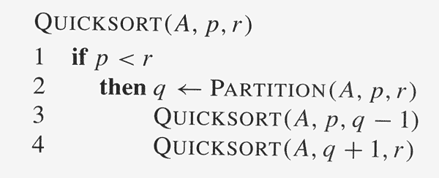
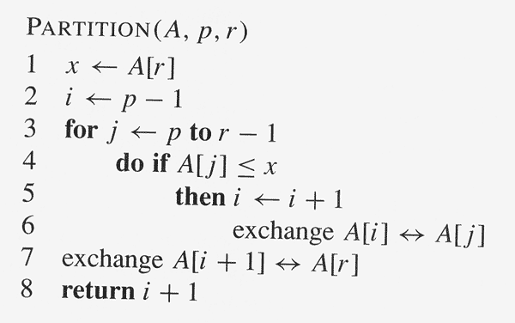

Slide 18
Counting Sort
Counting-Sort(A, B, k)
Let C[0…..k] be a new array
1.
2.
3.
4.
5.
6.
7.
8.
9.
10.
11.
for i=0 to k
C[i]= 0;
for j=1 to A.length or n
C[ A[j] ] = C[ A[j] ] +
for i=1 to k
C[i] = C[i] + C[i-1];
[Loop
1]
[Loop
2]
1;
[Loop
3]
for j=n or A.length down to
B[ C[ A[j] ] ] = A[j];
C[ A[j] ] = C[ A[j] ] - 1;
1
[Loop
4]

Slide 19














Counting-sort
example
1
2
3
4
5
6
7
8
A:
2
5
3
0
2
3
0
3
0
1
2
3
4
5
C:
1
2
3
4
5
6
7
8
B:

Slide 20

Executing
Loop
1
1
2
3
4
5
6
7
8
A:
2
5
3
0
2
3
0
3
0
1
2
3
4
5
0
0
0
0
0
0
C:
1
2
3
4
5
6
7
8
B:

Slide 21




Executing
Loop
2
1
2
2
3
4
5
6
7
8
A:
5
3
0
2
3
0
3
0
1
2
3
4
5
0
0
1
0
0
0
C:
1
2
3
4
5
6
7
8
B:

Slide 22
Executing
Loop
2
1
2
3
4
5
6
7
8
A:
2
5
3
0
2
3
0
3
0
1
2
3
4
5
0
0
1
0
0
1
C:
1
2
3
4
5
6
7
8
B:

Slide 23

Executing
Loop
2
1
2
3
4
5
6
7
8
A:
2
5
3
0
2
3
0
3
0
1
2
3
4
5
0
0
1
1
0
1
C:
1
2
3
4
5
6
7
8
B:

Slide 24
Executing
Loop
2
1
2
3
4
5
6
7
8
A:
2
5
3
0
2
3
0
3
0
1
2
3
4
5
1
0
1
1
0
1
C:
1
2
3
4
5
6
7
8
B:

Slide 25
Executing
Loop
2
1
2
3
4
5
2
6
7
8
A:
2
5
3
0
3
0
3
0
1
2
3
4
5
1
0
2
1
0
1
C:
1
2
3
4
5
6
7
8
B:

Slide 26
Executing
Loop
2
1
2
3
4
5
6
3
7
8
A:
2
5
3
0
2
0
3
0
1
2
3
4
5
1
0
2
2
0
1
C:
1
2
3
4
5
6
7
8
B:

Slide 27
Executing
Loop
2
1
2
3
4
5
6
7
0
8
A:
2
5
3
0
2
3
3
0
1
2
3
4
5
2
0
2
2
0
1
C:
1
2
3
4
5
6
7
8
B:

Slide 28
Executing
Loop
2
1
2
3
4
5
6
7
8
3
A:
2
5
3
0
2
3
0
0
1
2
3
4
5
2
0
2
3
0
1
C:
1
2
3
4
5
6
7
8
B:

Slide 29

End of
Loop
2
1
2
3
4
5
6
7
8
A:
2
5
3
0
2
3
0
3
0
1
2
3
4
5
2
0
2
3
0
1
C:
1
2
3
4
5
6
7
8
B:

Slide 30
























Executing
Loop
4
3
5
1
2
3
6
7
8
A:
2
5
3
2
3
0
3
0
0
2
0
1
0
1
2
2
3
4
5
2
3
0
1
C:
2
3
4
5
2
2
3
0
1
C:
1
2
3
4
5
6
7
8
B:

Slide 31


Executing
Loop
4
3
5
1
2
3
6
7
8
A:
2
5
3
2
3
0
3
0
0
1
2
1
2
2
2
4
3
4
5
2
3
0
1
C:
0
3
4
5
2
2
3
0
1
C:
1
2
3
4
5
6
7
8
B:

Slide 32
Executing
Loop
4
3
5
1
2
3
6
7
8
A:
2
5
3
2
3
0
3
0
0
1
2
4
2
3
3
3
7
4
5
2
2
0
1
C:
0
1
4
5
2
2
4
0
1
C:
1
2
3
4
5
6
7
8
B:

Slide 33

Executing
Loop
4
3
5
1
2
3
6
7
8
A:
2
5
3
2
3
0
3
0
0
1
2
3
7
3
4
0
4
7
5
2
2
4
1
C:
0
1
2
5
2
2
4
7
1
C:
1
2
3
4
5
6
7
8
B:

Slide 34
Executing
Loop
4
3
5
1
2
3
6
7
8
A:
2
5
3
2
3
0
3
0
0
1
2
3
4
7
4
5
1
5
8
2
2
4
7
C:
0
1
2
3
2
2
4
7
7
C:
1
2
3
4
5
6
7
8
B:

Slide 35









End of
Loop
3
7
1
2
3
4
5
6
8
A:
2
5
3
2
3
0
3
0
0
1
2
3
4
5
2
2
4
7
7
8
C:
1
2
3
4
5
6
7
8
B:

Slide 36


Executing
Loop
4
1
2
3
4
5
6
7
8
3
A:
2
5
3
2
3
0
0
0
1
2
3
7
4
5
2
2
4
7
8
C:
1
2
3
4
5
6
7
8
B:

Slide 37
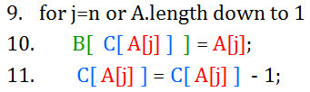

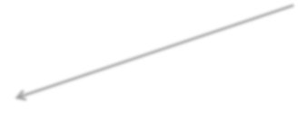

Executing Loop
4
5
1
2
3
4
6
7
8
3
A:
2
5
3
0 2 3 0
J=8, then A[ j ]=A[8]=3
And B[ C[ A[j] ] ]
=B[ C[ 3 ] ]
=B[ 7]
So B[ C[ A[j] ] ] ←A[ j ]
=B[7]←3
0
1
2
3
7
4
5
2
2
4
7
8
C:
1
2
3
4
5
6
7
8
B:

Slide 38

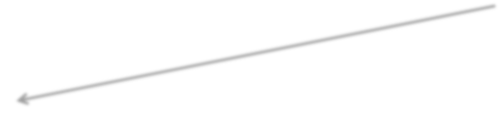








Executing Loop
4
5
1
2
3
4
6
7
0
8
A:
2
5
3
2
3
3
0
J=8, then A[ j ]=A[8]=3
Then C[ A[j] ]
= C[ 3 ]
=7
So C[ A[j] ] = C[ A[j] ] -1
=7-1=6
0
2
1
2
3
4
5
2
4
6
7
8
C:
1
2
3
4
5
6
7
8
3
B:

Slide 39










Executing
Loop
4
1
2
3
4
5
6
3
7
8
A:
2
5
3
0
3
0 2
0
1
2
3
6
4
5
1
2
4
7
8
C:
1
2
3
4
5
6
7
8
0
3
B:

Slide 40







Executing
Loop
4
1
2
3
4
5
2
6
7
8
A:
2
5
3
0
3
3 0
0
1
2
4
3
4
5
1
2
5
7
8
C:
1
2
3
4
5
6
7
8
0
3
3
B:

Slide 41




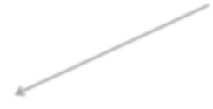







Executing
Loop
4
1
2
3
4
5
6
7
8
A:
0
2
3
0
3
2 5 3
0
1
1
2
3
4
5
2
3
5
7
8
C:
1
2
3
4
5
6
7
8
0
2
3
3
B:

Slide 42












Executing
Loop
4
1
2
3
4
5
6
7
8
A:
2
5
3
0
2
3
0
3
0
1
2
3
5
4
5
0
2
3
7
8
C:
1
2
3
4
5
6
7
8
0
0
2
3
3
B:

Slide 43

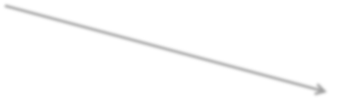






Executing
Loop
4
1
2
5
3
4
5
6
7
8
A:
2
3
0
2
3
0
3
0
1
2
3
4
5
8
0
2
3
4
7
C:
1
2
3
4
5
6
7
8
0
0
2
3
3
3
B:

Slide 44




Executing
Loop
4
1
2
2
3
4
5
6
7
8
:
5
3
0
2
3
0
3
A
0
1
2
3
4
5
0
2
4
7
7
C:
3
1
2
3
4
5
6
7
8
0
0
2
3
3
3
5
B:

Slide 45





End of
Loop
4
7
1
2
3
4
5
6
8
A:
2
5
3
0
2
3
0
3
0
1
2
3
4
5
0
2
2
4
7
7
C:
1
2
3
4
5
6
7
8
0
0
2
2
3
3
3
5
B:
Sorted data
in Array
B

Slide 46
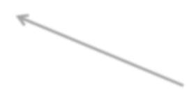
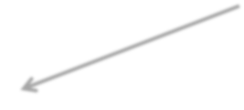
Time Complexity Analysis
Counting-Sort(A, B, k)
Let C[0…..k] be a new array
1.
2.
3.
4.
5.
6.
7.
8.
9.
10.
11.
Loop 1 and 3
takes O(k) time
for i=0 to k
C[i]= 0;
for j=1 to A.length or n
C[ A[j] ] = C[ A[j] ] +
for i=1 to k
C[i] = C[i] + C[i-1];
[Loop
1]
[Loop
2]
3]
1;
[Loop
4]
for j=n or A.length down to
B[ C[ A[j] ] ] = A[j];
C[ A[j] ] = C[ A[j] ] - 1;
1
[Loop
Loop 2 and 4
takes O(n) time

