Slide 1
Lab 4: Greedy Algorithms

Slide 2
Algorithm Design Methods
Algorithm types we will consider include:
Simple recursive algorithms
Backtracking algorithms
Divide and conquer algorithms
Dynamic programming algorithms
Greedy algorithms
Branch and bound algorithms
Brute force algorithms
Randomized algorithms

Slide 3
Optimization problems
An optimization problem is one in which you want to find, not just a solution, but the best solution
A problem in which some functions(called the optimization or objective function) is to be optimized(usually minimized or maximized) subject to some constraints
A “greedy algorithm” sometimes works well for optimization problems
Notes:
2

Slide 4
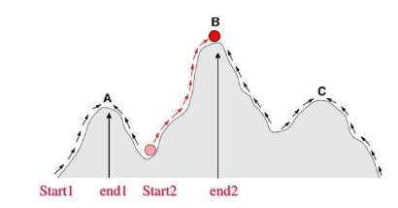
Optimization problems
A greedy algorithm works in phases. At each phase:
You take the best you can get right now, without regard for future consequences
You hope that by choosing a local optimum at each step, you will end up at a global optimum

Slide 5
Knapsack Problem

Slide 6
The Knapsack Problem
The famous knapsack problem:
A thief breaks into a museum. Fabulous paintings, sculptures, and jewels are everywhere. The thief has a good eye for the value of these objects, and knows that each will fetch hundreds or thousands of dollars on the clandestine art collector’s market. But, the thief has only brought a single knapsack to the scene of the robbery, and can take away only what he can carry. What items should the thief take to maximize the haul?

Slide 7
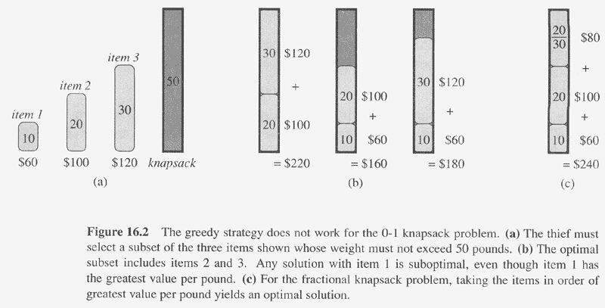
Copyright © The McGraw-Hill Companies, Inc. Permission required for reproduction or display.

Slide 8
Fractional Knapsack Problem
Let us consider that the capacity of the knapsack W = 60 and the list of provided items are shown in the following table −
What will be the maximum profit?
Item | A | B | C | D
Profit | 280 | 100 | 120 | 120
Weight | 40 | 10 | 20 | 24

Slide 9
Fractional Knapsack Problem
Item | A | B | C | D
Profit | 280 | 100 | 120 | 120
Weight | 40 | 10 | 20 | 24
Profit/weight | 7 | 10 | 6 | 5
Item | B | A | C | D
Profit | 100 | 280 | 120 | 120
Weight | 10 | 40 | 20 | 24
Profit/weight | 10 | 7 | 6 | 5

Slide 10
The total weight of the selected items is 10 + 40 + 20 * (10/20) = 60
And the total profit is 100 + 280 + 120 * (10/20) = 380 + 60 = 440
This is the optimal solution. We cannot gain more profit selecting any different combination of items.

Slide 11
The End
Notes:
12

