Slide 1
Lab 5: Greedy Algorithms

Slide 2
Activity-Selection Problem
Problem: get your money’s worth out of a festival
Buy a wristband that lets you onto any ride
Lots of rides, each starting and ending at different times
Your goal: ride as many rides as possible
Another, alternative goal that we don’t solve here: maximize time spent on rides
Welcome to the activity selection problem

Slide 3
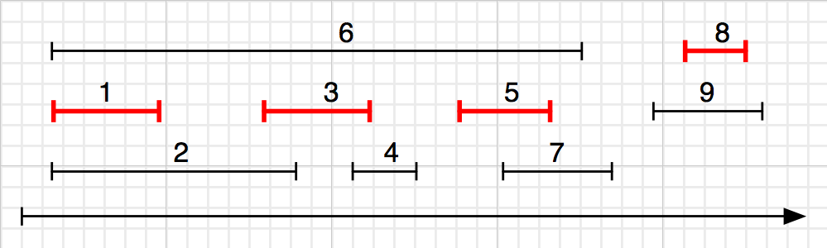
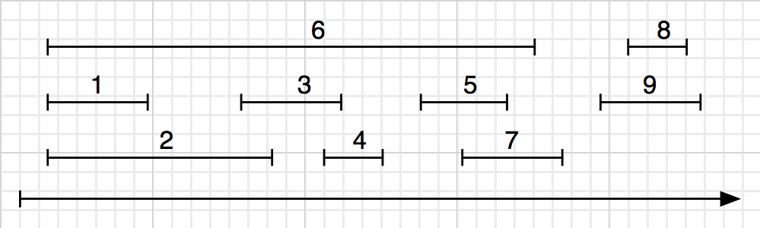
Strategy 1:The idea is to start with finish-first activity.
1. Sort the activities by finishing time, breaking ties arbitally.
2. Pick the first one, removing it from the list along with all the activities that conflict with it.
3. Repeat Step 2, until the list is empty.
|A| =?SE 221: Algorithms
|A| = 4.
CSE 221: Algorithms
This strategy is the one that works.

Slide 4
Example
Here are a set of start and finish times
i | 1 | 2 | 3 | 4 | 5 | 6 | 7 | 8 | 9 | 10 | 11
S_{j} | 1 | 5 | 0 | 3 | 6 | 5 | 3 | 12 | 8 | 2 | 8
f_{j} | 4 | 7 | 6 | 5 | 10 | 9 | 9 | 16 | 12 | 14 | 11
Sorted according to finishing time
i | 1 | 2 | 3 | 4 | 5 | 6 | 7 | 8 | 9 | 10 | 11
S_{j} | 1 | 3 | 0 | 5 | 3 | 5 | 6 | 8 | 8 | 2 | 12
f_{j} | 4 | 5 | 6 | 7 | 9 | 9 | 10 | 11 | 12 | 14 | 16
{1, 4, 8, 11} which is a larger set (an optimal solution)
Solution is not unique, consider {2, 4, 9, 11} (another optimal solution)
1 4
5 7
8 11
12 16

Slide 5
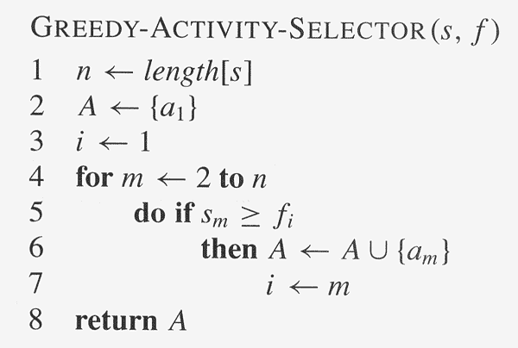
Pseducode

Slide 6
Greedy algorithms
Coin changing problem
Definition
Given coin denominations in {C }, make change for a given amount
A with the minimum number of coins.
Example:
Coin denominations, C = {25,10,5,1} Amount to change, A = 73
Choose 2 25 coins, so remaining is 73 − 2 ∗25 = 23
Choose 2 10 coins, so remaining is 23 − 2 ∗10 = 3
Choose 0 5 coins, so remaining is 3
Choose 3 1 coins, so remaining is 3 − 1 ∗3 = 0
Solution (and it’s optimal): 2 × 25 + 2 × 10 + 3 × 1 = 7 coins
Key Question
Does a greedy approach always produce the optimal solution?
34 / 38

Slide 7
Coin changing problem (continued)
Coin denominations, C = {12, 5, 1} Amount to change, A = 15
Example (using greedy strategy)
Choose 1 12 coins, so remaining is 15 − 1 ∗12 = 3
Choose 3 1 coins, so remaining is 3 − 1 ∗ 3 = 0
Solution: 4 coins.
Example (using optimal strategy)
Choose 0 12 coins, so remaining is 15
Choose 3 5 coins, so remaining is 15 − 3 ∗ 5 = 0
Solution: 3 coins.
Correctness depends on the choice of coins,
so greedy strategy does not provide a general solution to this problem!
35 / 38

Slide 8
The End 1
Notes:
12

