Slide 1
SOFTWARE DEVELOPMENT PROJECT MANAGEMENT (CSC4125)
Lecture 4: Project Evaluation and Program Management

Slide 2
Main topics to be covered
Program Management
Business Case
Portfolio Management
Relations Among Portfolios, Programs and Projects
Benefits Management
Evaluation of Individual Projects
Technical Assessment
Cost benefit analysis
Cash flow forecasting
Risk Evaluation
Managing the Allocation of Resources within Programs

Slide 3
Introduction
New projects do not appear out of thin air. There will be some process –varying in sophistication between organizations – that decides that the project is worth doing.
Sometimes managers justify a commitment to a single project as the benefits will exceed the costs of the implementation and operation of the new application. In other cases, managers would not approve a project on its own, but can see that it enables the fulfillment of strategic objectives when combined with other projects.

Slide 4
Introduction
It might not be possible to measure the benefits of a project in financial terms.
If you create a system which allows the more accurate recording of data concerning the medical condition of patients, it might contribute to the alleviation of pain and the preservation of life, but it would be difficult to put a money value on these.

Slide 5
Introduction
Deciding whether or not to go ahead with a project is really a case of comparing a proposed project with the alternatives and deciding whether to proceed with it.
Projects must be evaluated on strategic, technical and economic grounds.
The risks involved also need to be evaluated.
Managers need some way of deciding which projects to select. This is part of portfolio management.

Slide 6
Business Case
A business case captures the reasoning for initiating a project. It is the information needed for authorization of the project.
It is often presented in a well-structured written document, but may also come in the form of a short verbal argument or presentation.
AKA ==>Feasibility study, or, project justification
A software project needs a Business Case
Business Case is an analysis of the organizational value, feasibility, costs, benefits, and risks of the project.

Slide 7
Contents of a Business Case
Typically a business case document might contain:
Introduction and background to the proposal
The proposed project
The market
Organizational and operational infrastructure
The benefits
Outline implementation plan
Costs
The financial case
Risks
Management plan

Slide 8
Program
A program is a group of related projects managed in a coordinated way to obtain benefits and control not available from managing them individually.
A program is a collection of inter-related projects that all contribute to the same overall organizational goals

Slide 9
Programs may be..
Strategic
Several projects together implement a single strategy. For example, merging two organizations’ computer systems could require several projects each dealing with a particular application area. Each activity could be treated as a distinct project, but would be coordinated as a program.
Business Cycle Programs
A portfolio of projects that are to take place within a certain time frame e.g. the next financial year.
Infrastructure Programs
In an organization there may be many different ICT-based applications which share the same hardware/software infrastructure.
Research and Development Programs
In a very innovative environment where new products are being developed, a range of products could be developed some of which are very speculative and high-risk but potentially very profitable and some will have a lower risk but will return a lower profit. Getting the right balance would be key to the organization’s long term success.
Notes:
Strategic
Several projects together implement a single strategy. For example, merging two organizations will involve many different activities e.g. physical re-organization of offices, redesigning the corporate image, merging ICT systems etc. Each of these activities could be project within an overarching programme.
Business cycle programmes
A portfolio of project that are to take place within a certain time frame e.g. the next financial year
Infrastructure programmes
In an organization there may be many different ICT-based applications which share the same hardware/software infrastructure
Research and development programmes
In a very innovative environment where new products are being developed, a range of products could be developed some of which are very speculative and high-risk but potentially very profitable and some will have a lower risk but will return a lower profit. Getting the right balance would be key to the organization’s long term success
Innovative partnerships
e.g. pre-competitive co-operation to develop new technologies that could be exploited by a whole range of companies

Slide 10
Program Management
Program management is the application of knowledge, skills, and principles to a program to achieve the program objectives and obtain benefits and control not available by managing program components individually. - PMBOK GUIDE
“A group of projects that are managed in a coordinated way to gain benefits that would not be possible were the projects to be managed independently” - D.C. Ferns
Effective program management requires that
There is a well defined program goal
All the organization’s projects are selected & tuned to contribute to this goal

Slide 11
Program Management
A Project must be evaluated according to
How it contributes to the program goal
Viability
Timing
Resourcing
Final worth

Slide 12
Program Management
Value of any project is increased by the fact that it is part of a program.
The whole being greater than sum of the parts
For a successful strategic assessment, there should be a strategic plan clearly defining the organization’s objectives.
Program Director will be responsible for the strategic assessment of a proposed project.

Slide 13
STRATEGIC ASSESSMENT
Strategic assessment consists of
Program Management
Portfolio Management

Slide 14
Program Managers versus Project Managers
Program Manager
Many simultaneous projects
Personal relationship with skilled resources
Need to maximize utilization of resources
Projects tend to be seen as similar
Project Manager
One project at a time
Impersonal relationship with resource type
Need to minimize demand for resources
Projects tend to be dissimilar
Notes:
The programme manager may well have a pool of staff upon which to call. He/she will be concerned with ensuring the best use of staff e.g ensuring that staff have regular work with no periods of enforced idleness between project tasks. The project leader would think in terms of ‘I need a Java programmer for four weeks’ without being concerned which specific person it is (beyond obvious concerns that they are fully capable).

Slide 15
Managing Allocation of Resources within Programs
Resources may have to be shared between concurrent projects within a program. Typically, an IT department has pools of particular types of expertise, e.g. software developers, database designers, network support stuff and these might be called upon to participate in a number of concurrent projects.
In these circumstances, program managers will have concerns about the optimal use of specialist staff

Slide 16
Managing Allocation of Resources within Programs
When a project is planned, at the stage of allocating resources, program management will be involved. Some activities in the project might have to be delayed until the requisite technical staff are freed from work on other projects.
Where expensive technical staff are employed full-time, then you would want to avoid them having short periods of intense activity interspersed with long periods of idleness, during which they are still being paid
It is most economic when the demand for work is evenly spread from month to month

Slide 17
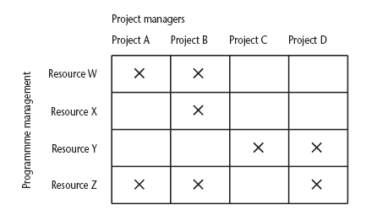
Projects Sharing Resources
Notes:
During the resource allocation phase of project planning – see chapter/lecture 8 on resource allocation – some project activities could be delayed while waiting for a resource to become available.

Slide 18
Portfolio
A portfolio is defined as projects, programs, subsidiary portfolios, and operations managed in a coordinated manner to achieve strategic objectives.
Projects, Programs, sub-portfolios and operations managed as a group to achieve strategic objectives

Slide 19
Portfolio Management
Portfolio Management: The centralized management of one or more portfolios to achieve strategic objectives.
Focuses on ensuring the portfolio is performing consistent with the organization’s objectives and evaluating portfolio components to optimize resource allocation
When an organization is developing a software system, they could be asked to carry out a strategic and operational assessment on behalf of the customer.
The proposed project will form part of a portfolio of ongoing and planned projects and the selection of projects must take account of the possible effects on other projects in the portfolio and overall portfolio profile.

Slide 20
Relationship among Portfolios, Programs and Projects
A portfolio is defined as projects, programs, subsidiary portfolios, and operations managed in a coordinated manner to achieve strategic objectives.
A program is defined as related projects, subsidiary programs, and program activities managed in a coordinated manner to obtain benefits not available from managing them individually.
A project is a temporary endeavor undertaken to create a unique product, service, or result. A project may be managed in three separate scenarios:
Stand-alone (outside a portfolio or program)
Within a program
Within a portfolio
Note: Project management has interactions with portfolio and program
management when a project is within a portfolio or program.

Slide 21
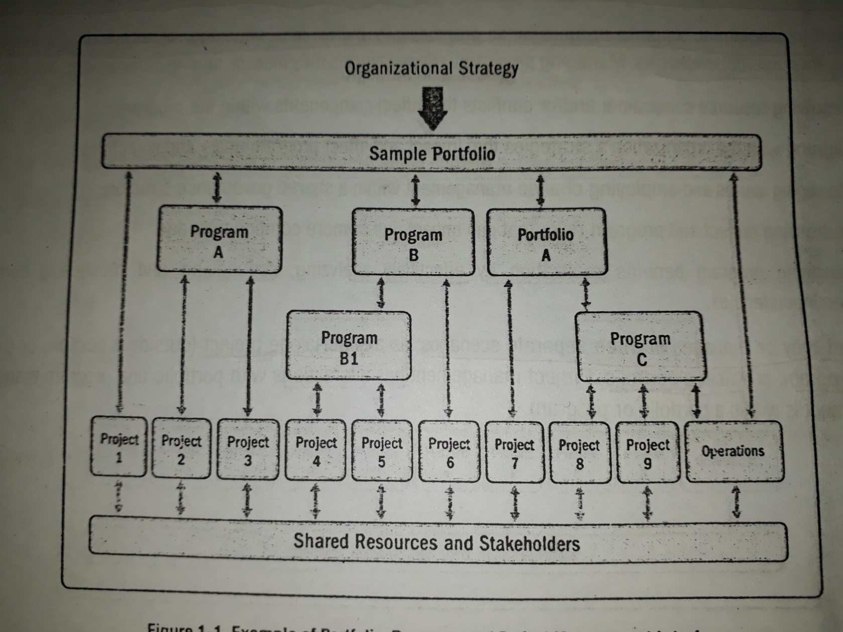
Example of Portfolio, Program and Project Management Interfaces

Slide 22
Benefits Management
Providing an organization with a capability does not guarantee that this will provide benefits envisaged – need for benefits management
This has to be outside the project – project will have been completed
Therefore done at program level
Benefits management encompasses the identification, optimization and tracking of the expected benefits from a business change in order to ensure that they are actually achieved.

Slide 23
Benefits Management
To carry this out, you must:
Define expected benefits
Analyze balance between costs and benefits
Plan how benefits will be achieved & measured
Allocate responsibilities for the successful delivery of the benefits
Monitor achievement of benefits

Slide 24
Benefits
Benefits can be of many different types, including –
Mandatory compliance
Improved quality of service
Increased productivity
More motivated workforce
Internal management benefits (e.g. better decision making)
Risk reduction
Economy
Revenue enhancement/acceleration
Strategic fit

Slide 25
Quantifying Benefits
Benefits can be:
Quantified and valued – e.g. a reduction of x staff saving $y
Quantified but not valued – e.g. a decrease in customer complaints by x%
Identified but not easily quantified – e.g. public approval for a organization in the locality where it is based

Slide 26
Benefits Management
Developers
Users
Organization
use
for
The
Application
Benefits
build
to deliver

Slide 27
Evaluation of Individual Projects
How the feasibility of an individual project can be evaluated?
Technical Assessment
Cost-Benefit Analysis
Cash Flow Forecasting

Slide 28
Technical Assessment
Technical assessment of a proposed system consists of evaluating whether the required functionality can be achieved with current affordable technologies.
Consists of evaluating the required functionality against the hardware and software available
Organizational policy, aimed at providing a consistent hardware/software infrastructure, is likely to limit the technical solutions considered
Costs of the technology adopted must be taken into account in the cost-benefit analysis

Slide 29
Cost-Benefit Analysis
Any project requiring an investment must, as a minimum, provide a greater benefit than putting that investment in, say, a bank.
Assessment is based upon the question of whether the estimated costs are exceeded by the estimated income and other benefits.
It is necessary to ask if the project under consideration is the best of a number of options.
Projects will need to be prioritized so that any scarce resources may be allocated effectively.

Slide 30
Steps of Cost-Benefit Analysis
Cost-Benefit Analysis comprises two steps:
1) Identifying all of the costs and benefits of carrying out the project and operating the delivered application
2) Expressing these costs and benefits in common units

Slide 31
Cost-Benefit Analysis
You need to:
Identify all the Costs which could be:
Development costs
Setup costs
Operational costs
Identify the value of Benefits
Check benefits are greater than costs

Slide 32
Cost Categories
Development Costs
Salaries and other employment costs of the staff involved in the development project and all associated costs
Setup Costs
Costs of putting the system into place
Costs of any new hardware and ancillary equipments
Costs of file conversion
Recruitment and staff training
Operational Costs
Costs of operating the system once it has been installed

Slide 33
Benefits Categories
Direct Benefits
These accrue directly from the operation of the proposed system
Assessable Indirect Benefits
These are generally secondary benefits
Intangible Benefits
Indirect benefits, which are difficult to estimate, are sometimes known as intangible benefits

Slide 34
Cost-Benefit Analysis
If a proposal shows an excess of benefits over costs then it is a candidate for further consideration.
However, cost-benefit analysis is not a sufficient justification for going ahead; the reasons being:
Insufficient fund
Better projects to allocate resources
The project might be too risky

Slide 35
Cash Flow Forecasting
A cash flow forecast indicates when expenditure and income will take place
Funding is required for negative cash flows – until break even
Needs to be done early in the project’s life cycle
Future cash flows are more uncertain
Inflation may be ignored
May be done on an annual, quarterly, or monthly basis
Accurate cash flow forecasting is difficult, as it is done early in the project’s life cycle and many items to be estimated might be some years in the future.

Slide 36
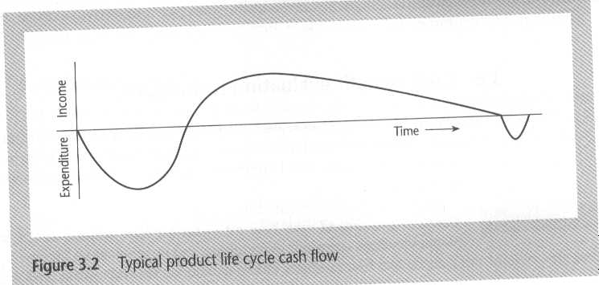
Typical Product life Cycle Cash Flow

Slide 37
Cost-Benefit Evaluation Techniques
Net Profit
Payback Period
Return On Investment (ROI)
Net Present Value (NPV)
Internal Rate of Return (IRR)

Slide 38
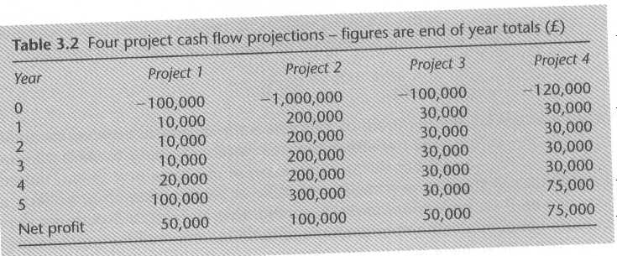
Which is the best among all projects?
Table 2.1 (pg. 29)==> 5th ed.
Note: Cash flows take place at the end of each year. The year 0 represents the
initial investment made at the start of the project.

Slide 39
Net Profit
The net profit of a project is the difference between the total costs and total income over the life of the project
Does not consider investment or risk
Does not consider timing of cash flows
Note: Net Profit for each of the four projects are calculated in the last slide.

Slide 40
Payback Period
Payback Period is the time taken to break even or pay back the initial investment.
This is the time it takes to start generating a surplus of income over outgoings
Simple to calculate and is not particularly sensitive to small forecasting errors
Ignores the overall profitability of the project
Ignores any income/expenditure after break even
Normally, the project with the shortest payback period is chosen
Question: Calculate the payback period for each of the four projects in Table 3.2 [Table 2.1 (pg. 29)==> 5th ed.]

Slide 41
Return On Investment (ROI)
Provides a way of comparing the net profitability to the investment required.
AKA accounting rate of return (ARR)
ROI = (average annual profit/total investment ) X 100
Simple and easy to calculate
Takes no account of the timing of the cash flows
Cannot be compared to interest rates
A project with highest ROI is more beneficial

Slide 42
Calculating Return on Investment (ROI)
Calculate ROI for project 1 (In the previous example)
Average annual profit = 50,000/5 = 10,000
ROI = (average annual profit/total investment ) X 100
= (10,000/100,000 )X 100
= 10%

Slide 43
Net Present Value (NPV)
Calculation of Net Present Value (NPV) is a project evaluation technique that takes into account the profitability of a project and the timing of the cash flows that are produced.
Discounts future cash flows by a percentage known as the discount rate.
NPV for a project is obtained by discounting each cash flow (both negative and positive) and summing the discounted values.
Present Value = Value in year t / (1 + r)^{t}
where r is the discount rate, expressed as a decimal value and t is the number of years into the future that the cash flow occurs

Slide 44
Net Present Value (NPV)
One disadvantage of NPV as a measure of profitability is that, although it may be used to compare projects, it might not be directly comparable with earnings from other investments or the costs of borrowing capital.
Same discount rate should be used in comparisons
Discount rate can be thought of as a target rate of return
Any project that displayed a positive NPV would be considered for selection –perhaps by using an additional set of criteria where candidate projects were competing for resources.

Slide 45
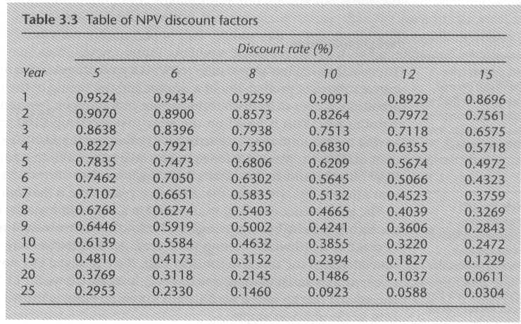
Table of NPV Discount Factors

Slide 46
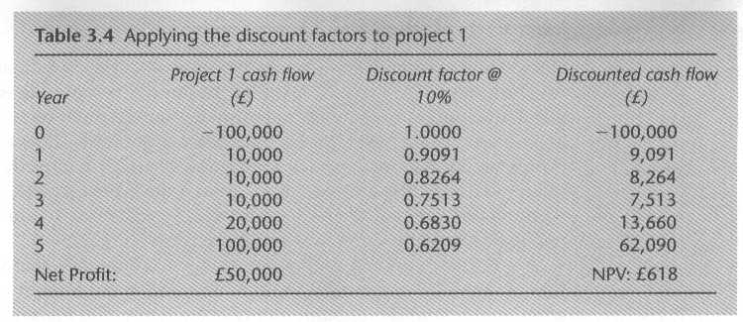
Calculating Net Present Value (NPV) for Project 1 ( Assume Discount rate 10%)

Slide 47
Internal Rate of Return (IRR)
Provides profitability measure as a percentage return that is directly comparable with interest rates
A project that showed an estimated IRR of 10% would be worthwhile if the capital could be borrowed for less than 10% or if the capital could not be invested elsewhere for a return greater than 10%
The IRR is calculated as that percentage discount rate that would produce an NPV of zero.
Generally speaking, the higher a project's internal rate of return, the more desirable it is to undertake the project.

Slide 48
Internal Rate of Return (IRR)
Can be used to compare different investment opportunities.
One deficiency of IRR is that it does not indicate the absolute size of the return
A project with an NPV of $100,000 and an IRR of 15% can be more attractive than one with an NPV of $10,000 and an IRR of 18% - the return on capital is lower but the net benefits greater
Possible to find more than one rate that will produce a zero NPV.
There is a Microsoft Excel function which can be used to calculate

Slide 49
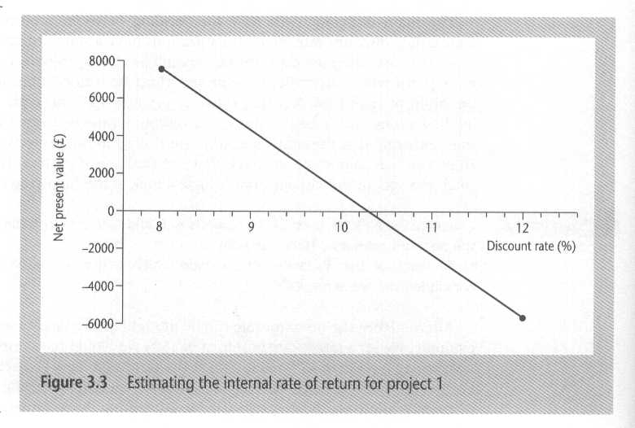
Estimating IRR for Project 1

Slide 50
ROI vs. IRR
ROI
Represents the simple percentage gain over the entire period, not annualized as in the IRR calculation.
Tells an investor about the total growth, start to finish, of the investment.
ROI doesn’t take future value of money while doing the calculations
More common than the IRR
IRR
IRR is annualized percentage return
IRR tells the investor what the annual growth rate is
IRR takes into account the future value of money
Less common than ROI (but modern computers make calculating IRR much easier)

Slide 51
Other Factors to Consider
NPV and IRR are not a complete answer to economic project evaluation.
Other Factors to Consider
Ability to fund
Risk
Overall strategy and framework
Comparison

Slide 52
Risk Evaluation
Every project involves risk
Project risks, which prevent the project from being completed successfully, are different from the business risk that the delivered products are not profitable.
Here we focus on business risk. Project risks will be discussed later.
Project A might appear to give a better return than Project B, but could be riskier
Could draw up a project risk matrix for each project to assess risks (see next slide)
For riskier projects could use higher discount rates

Slide 53
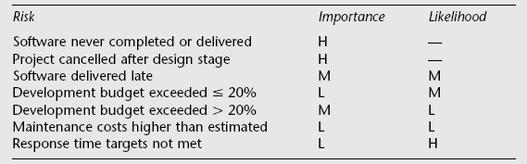
A fragment of a basic project risk matrix
In the table ‘Importance’ relates to the cost of the damage if the risk were to materialize and ‘likelihood’ to the probability that the risk will actual occur. ‘H’ indicates ‘High’, ‘M’ indicates ‘medium’ and ‘L’ indicates ‘low’.

Slide 54
Risk Evaluation
Risk Identification and Ranking
In any project evaluation we should identify the risks and quantify their effects
One approach is to construct a project risk matrix utilizing a checklist of possible risks and classify risks according to relative importance and likelihood
Risk and NPV
Use a higher discount rate to calculate NPV for more risky projects
Cost-Benefit Analysis
Risk Profile Analysis
Using Decision Trees

Slide 55
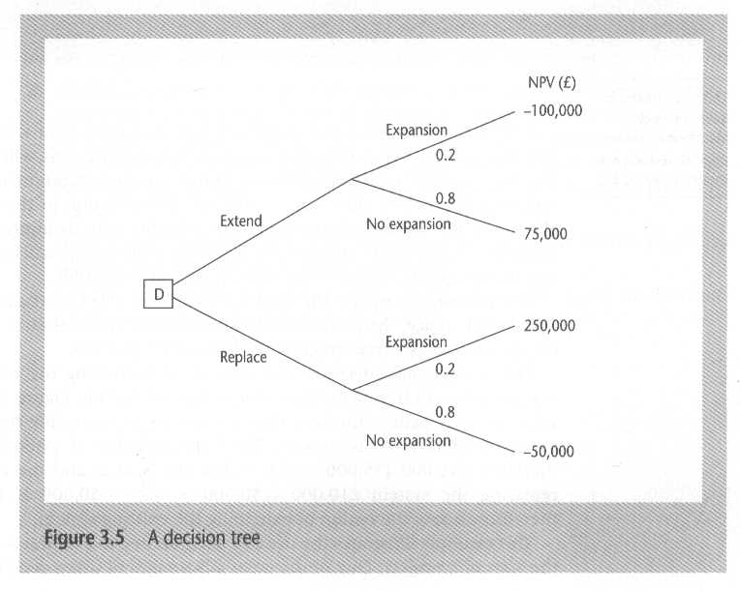
Sample Decision Tree
Figure 2.2 @ page 37 ➔ 5th ed. book
The company should choose the option of Extending the existing system.
Can you explain why?

Slide 56
Remember!
Projects must be evaluated on strategic, technical and economic grounds. Risks involved also need to be considered.
Many projects are not justifiable on their own, but are as part of a broader program of projects that implement an organization’s strategy.
Not all benefits can be precisely quantified in financial value.
Economic assessment involves the identification of all costs and income over the lifetime of the system, including it development and operation and checking that the total value of benefits exceeds total expenditure.

Slide 57
Remember!
Money received in the future is worth less than the same amount of money in hand now, which may be invested to earn interest.
A project may make a profit, but it may be possible to do something else that makes even more profit.
Discounted cash flow techniques may be used to evaluate the present value of future cash flows taking account of interest rates and uncertainty.
Cost-benefit analysis techniques and decision trees provide tools for evaluating expected outcomes and choosing between alternative strategies.

