Slide 1
SYNTHETIC GPR REBAR INVERSION
Recovering rebar geometry from radar waveforms
By Abdullah Maruf – Inframind Labs
A mature FDTD / full-waveform-inversion pipeline that recovers a 3-rebar variable-depth, variable-radius scene under noise, source mismatch and ringdown stress — with confidence reporting.
425/425
740–1218
synthetic
exact geometry recovered
experiments presented
not yet field-validated

Slide 2



THE PROBLEM
Find hidden rebar from a single radar trace
Ground-penetrating radar sees concrete from the surface. We want each rebar's horizontal position (x), depth (z) and radius (r) — but the only measurement is the reflected waveform.
THE OPTIMIZER LOOP
1
Propose a candidate scene
guess x, z, r in bounded windows
Forward model: FDTD
Finite-difference time-domain simulation turns any candidate concrete/rebar scene into a synthetic radar waveform.
2
Simulate its waveform
run FDTD forward
Inverse model: FWI
Score the misfit
3
The optimizer never sees the truth. It proposes scenes and keeps the one whose simulated waveform best matches the reference.
candidate vs reference (lower is better)
4
Pick the best, report margin
Three synthetic rebars
best radius vs runner-up radius
target0 (150, 80, r5) · target1 (250, 100, r6) · target2 (350, 120, r8), in millimetres.
loops until the misfit stops improving
Synthetic GPR-FDTD-FWI rebar inversion · status as of June 2026
2

Slide 3
HOW IT WORKS
Forward simulation and inverse recovery
Synthetic GPR-FDTD-FWI rebar inversion · status as of June 2026
3

Slide 4
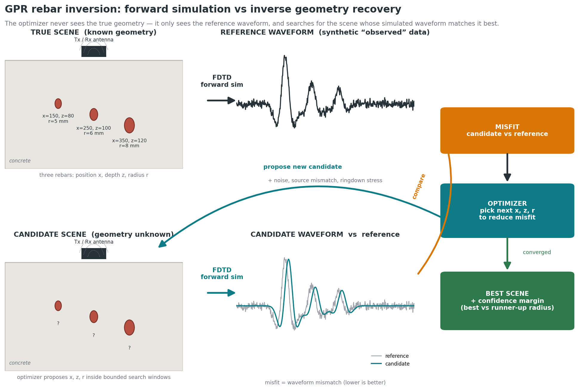
HOW IT WORKS
Forward simulation and inverse recovery
Synthetic GPR-FDTD-FWI rebar inversion · status as of June 2026
3

Slide 5
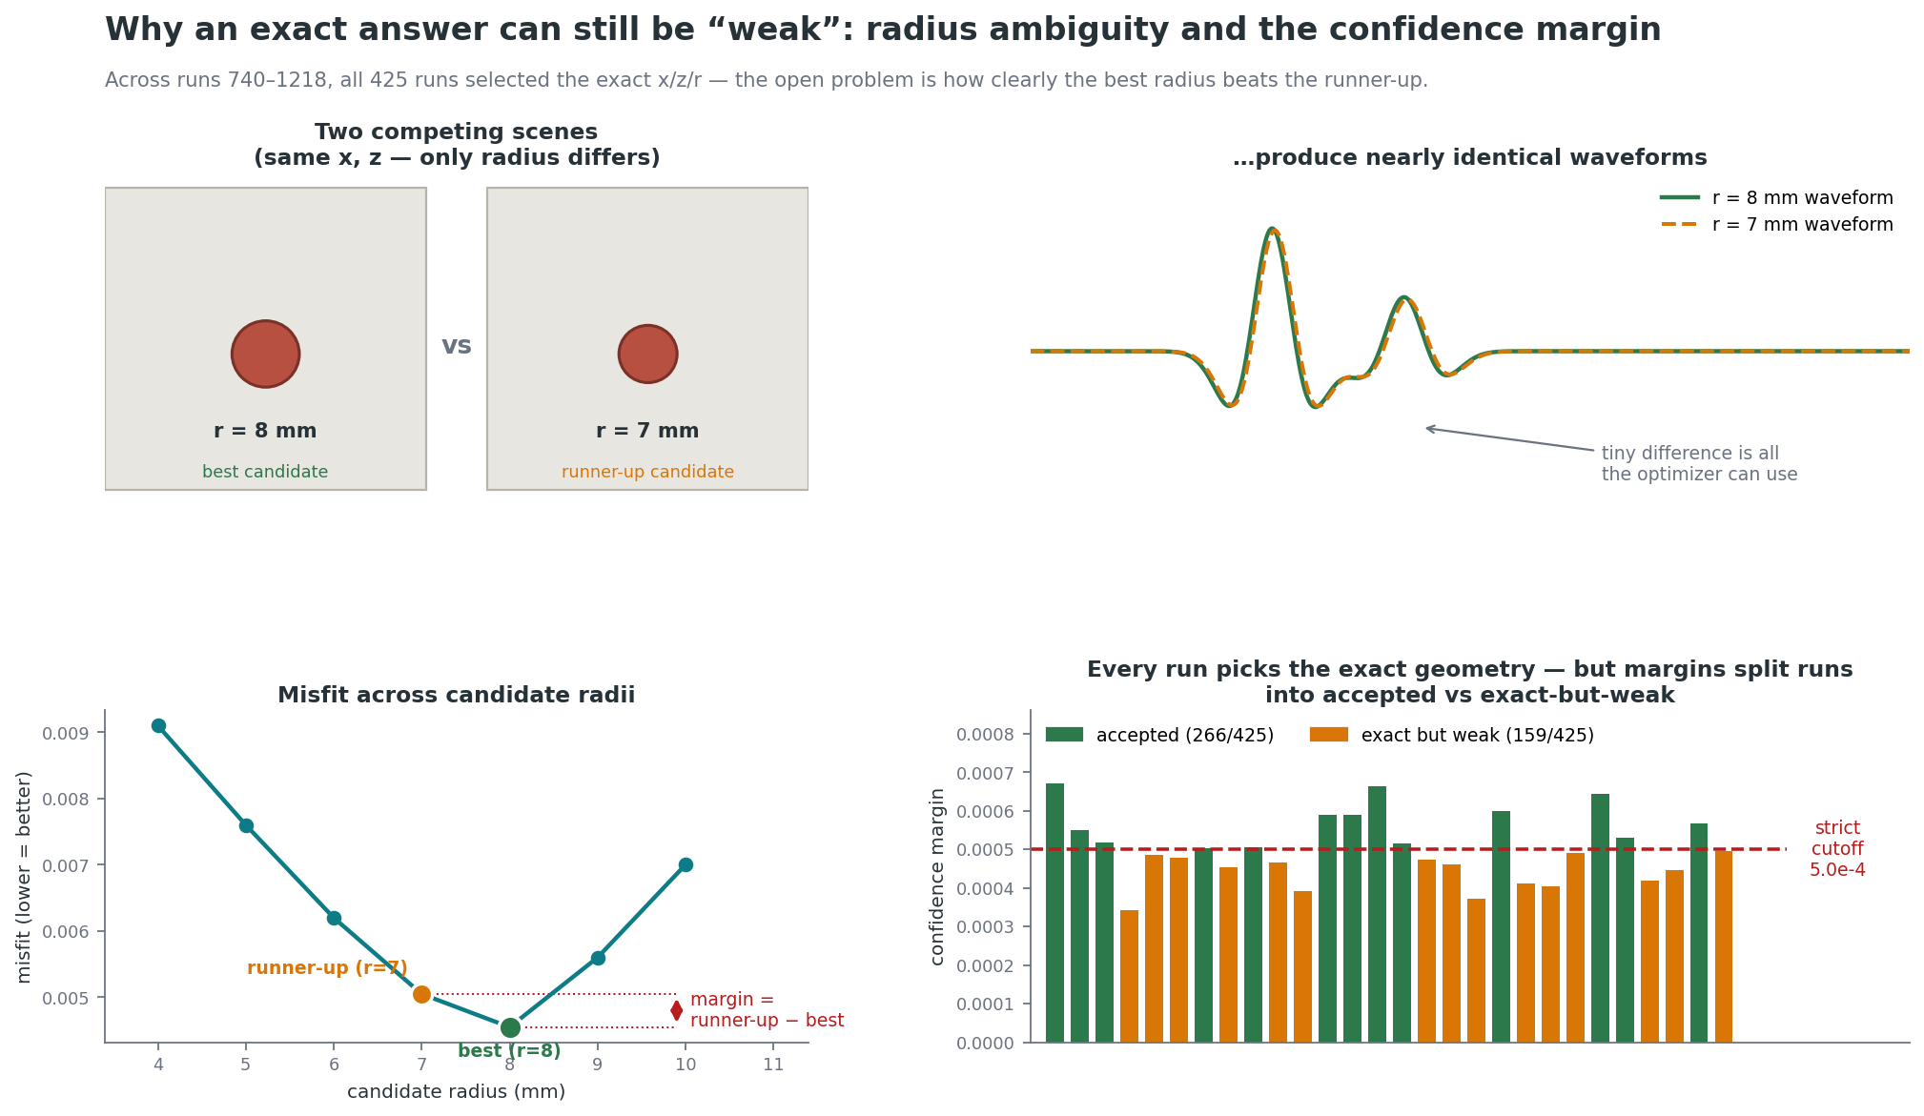
HOW IT WORKS
Radius ambiguity & confidence margin
Synthetic GPR-FDTD-FWI rebar inversion · status as of June 2026
3

Slide 6



THE PIPELINE TODAY
Three workflow levels, one mature core
1 · Single-rebar
2 · Multi-rebar
3 · Field-data QC
Detector-seeded local sizing
Coordinate optimizer (the core)
Real GSSI data — import only
Detects one rebar, seeds an x/z/r refinement
Handles synthetic noise & source mismatch
Mature for local sizing — not a field claim
3-rebar variable depth & radius
Bounded x/z/r search vs reference waveform
Reports geometry, radius, margin, diagnostics
DZT import, metadata audit, sanity checks
Kept separate from synthetic experiments
No validated field inversion yet
MATURE (LOCAL)
MATURE CORE
QC STAGE ONLY
Synthetic GPR-FDTD-FWI rebar inversion · status as of June 2026
4

Slide 7
STRONGEST RESULT
Exact geometry every time, across 425 runs
425
425/425
266/425
coordinate-optimizer runs parsed
selected the exact x / z / r
also cleared the strict cutoff
Acceptance fraction by target
What the numbers mean
Localization is solved.
Every run picked the correct rebar geometry in the tested windows.
target2 is the most fragile
by confidence (51.8% accepted) even though its geometry is still exact.
Synthetic GPR-FDTD-FWI rebar inversion · status as of June 2026
5

Slide 8


THE OPEN PROBLEM
The issue isn't location — it's confidence
159 of 425 exact-geometry runs stayed below the strict 5.0e-4 margin. The right rebar is found, but the best radius is sometimes only slightly better than the next competing radius.
Exact-geometry runs
Why it happens
Two scenes that differ only slightly in radius can produce almost identical waveforms. The optimizer must separate them on a tiny misfit difference.
Why it's good practice
Confidence reporting flags the 159 weak rows instead of overstating certainty — it distinguishes exact-and-clear from exact-but-ambiguous.
Where it bites most
target2 (deeper, larger) is the most acceptance-fragile; target1 has exact-but-weak branches that resist simple escalation.
Synthetic GPR-FDTD-FWI rebar inversion · status as of June 2026
6

Slide 9
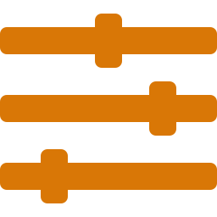


RESCUE INTERVENTIONS
What rescues a weak run — and what doesn't
117 multi-run series tested three intervention families. The lesson: rescues are real but not monotonic — more is not always better.
Source-density
Tx / Rx offset
Ringdown tuning
62 series
33 series
22 series
Often helps target2, but more sources can also worsen the margin.
Bracketing rescues acquisition-sensitive cases, especially target0.
Stable when already in the right regime — not a universal rescue.
CONCRETE EXAMPLE · target2 source-density rescue (runs 1207–1209)
5 sources
→
7 sources
→
9 sources
margin 4.24e-4 weak
margin 4.94e-4 near cutoff
margin 5.60e-4 accepted
Synthetic GPR-FDTD-FWI rebar inversion · status as of June 2026
7

Slide 10

STATUS
Confirmed, partial, and still open
CONFIRMED
PARTIAL
UNRESOLVED
Synthetic FDTD forward modeling
Single-rebar local refinement
3-rebar bounded coordinate optimization
Meaningful confidence reporting
Objective-variant diagnostics
Source-density rescue policies
Tx/Rx-offset rescue policies
Ringdown050 replication near cutoff
target1 exact-but-weak handling
Real GSSI field-data inversion
3D FDTD / FWI & 3D acquisition
Universal global optimizer
Synthetic → field threshold transfer
Coverage of older special cases
Synthetic GPR-FDTD-FWI rebar inversion · status as of June 2026
8

Slide 11

RECOMMENDED NEXT STEP
A narrow decision pass — not another long marathon
The project is at a genuine stop-and-evaluate point. The next GPU run should answer one specific policy question, not broadly continue replication.
target1 weak branches
target2 near-misses
Decide when to use Tx/Rx bracketing instead of adding sources.
Decide when to escalate 5 → 7 → 9 source density.
Two cutoffs
Keep field data apart
Separate strict research confidence from practical reporting confidence.
Field-data experiments and trackers stay separate from synthetic.
Strongest result today: a mature synthetic inversion-and-reporting pipeline — not yet field-validated, not yet 3D.

Slide 12
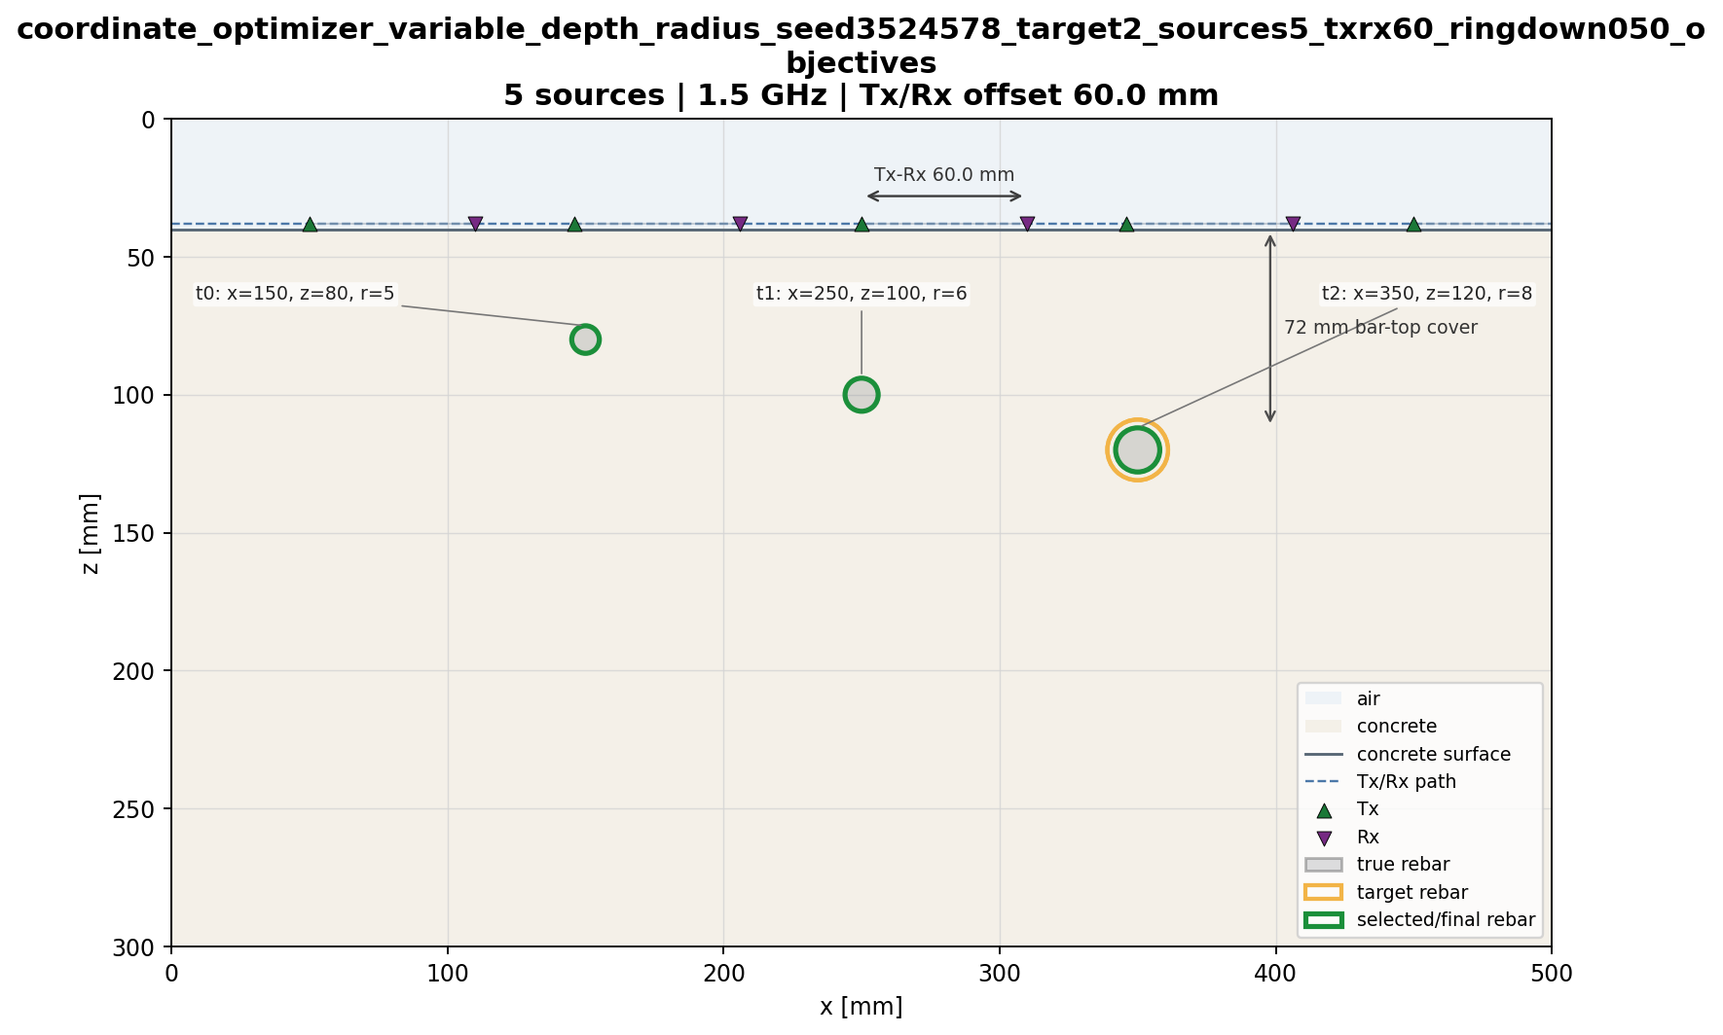

Slide 13
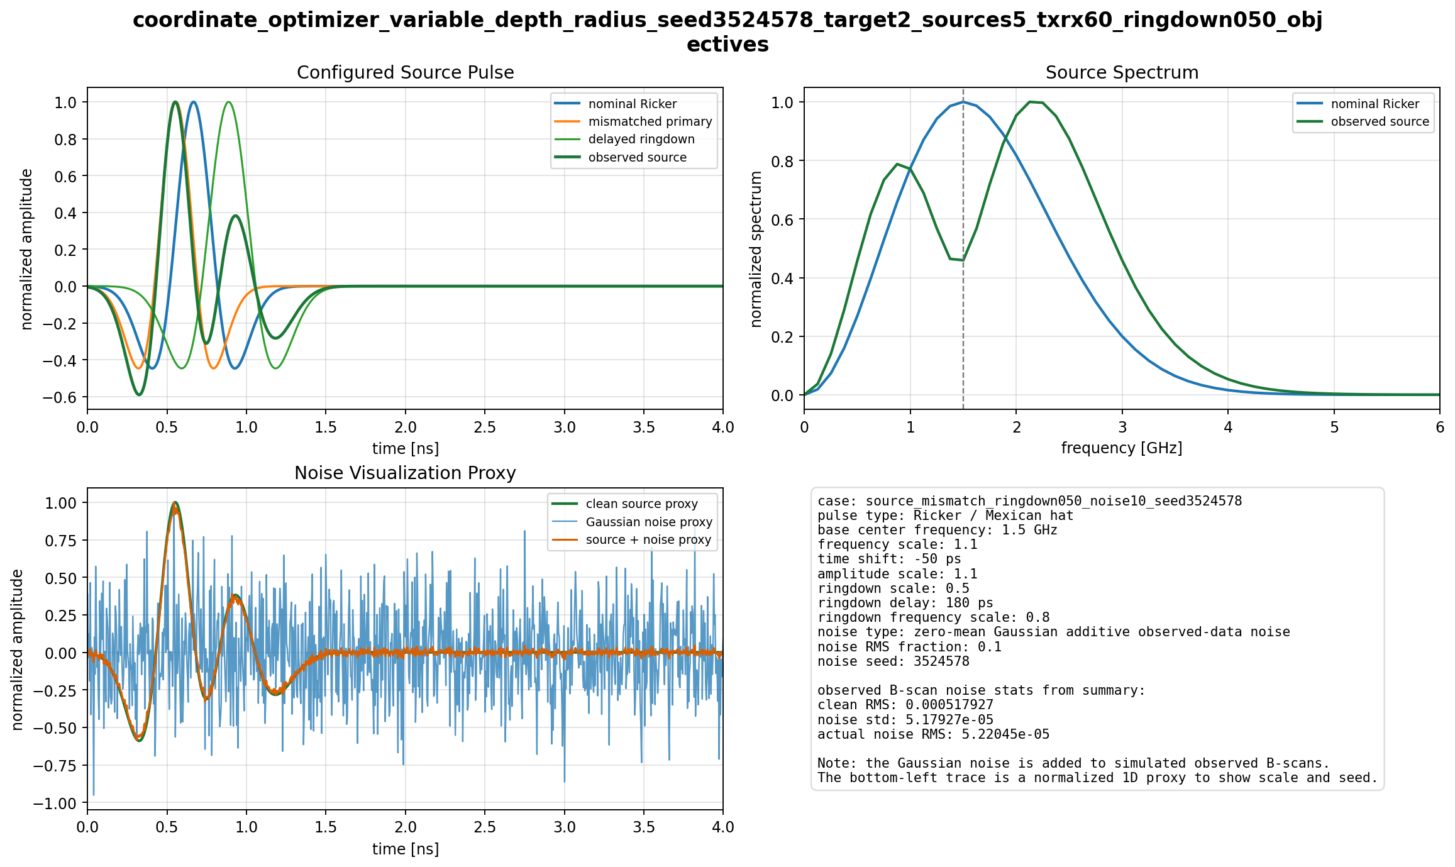

Slide 14
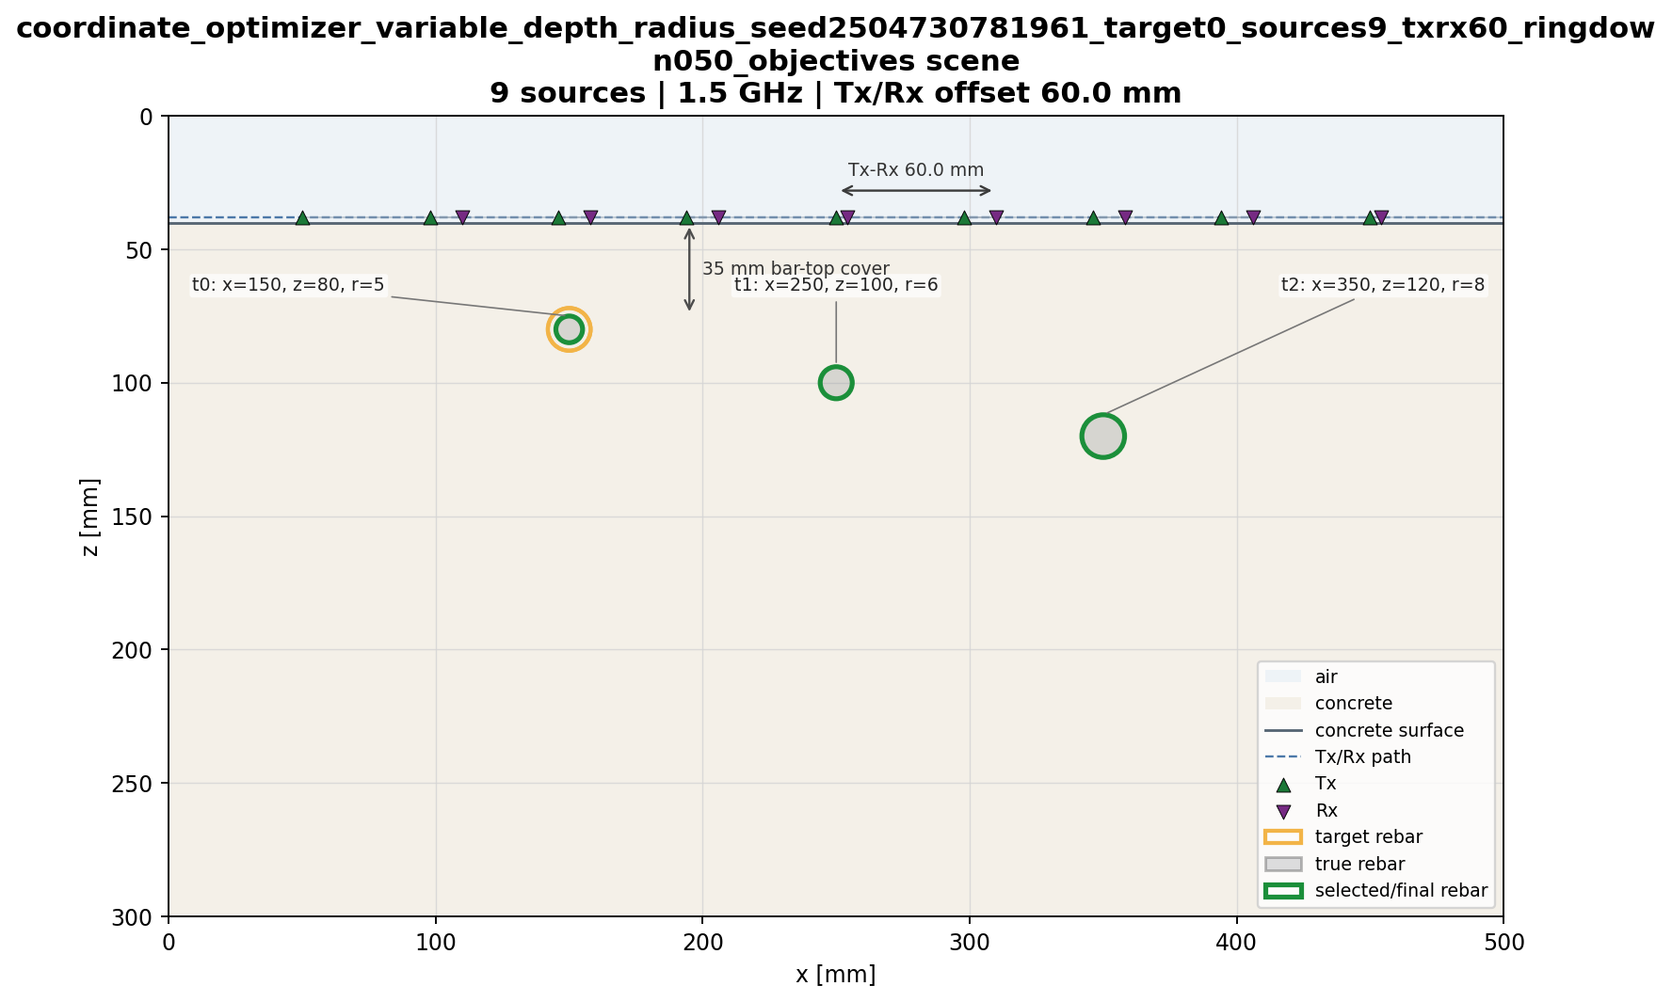
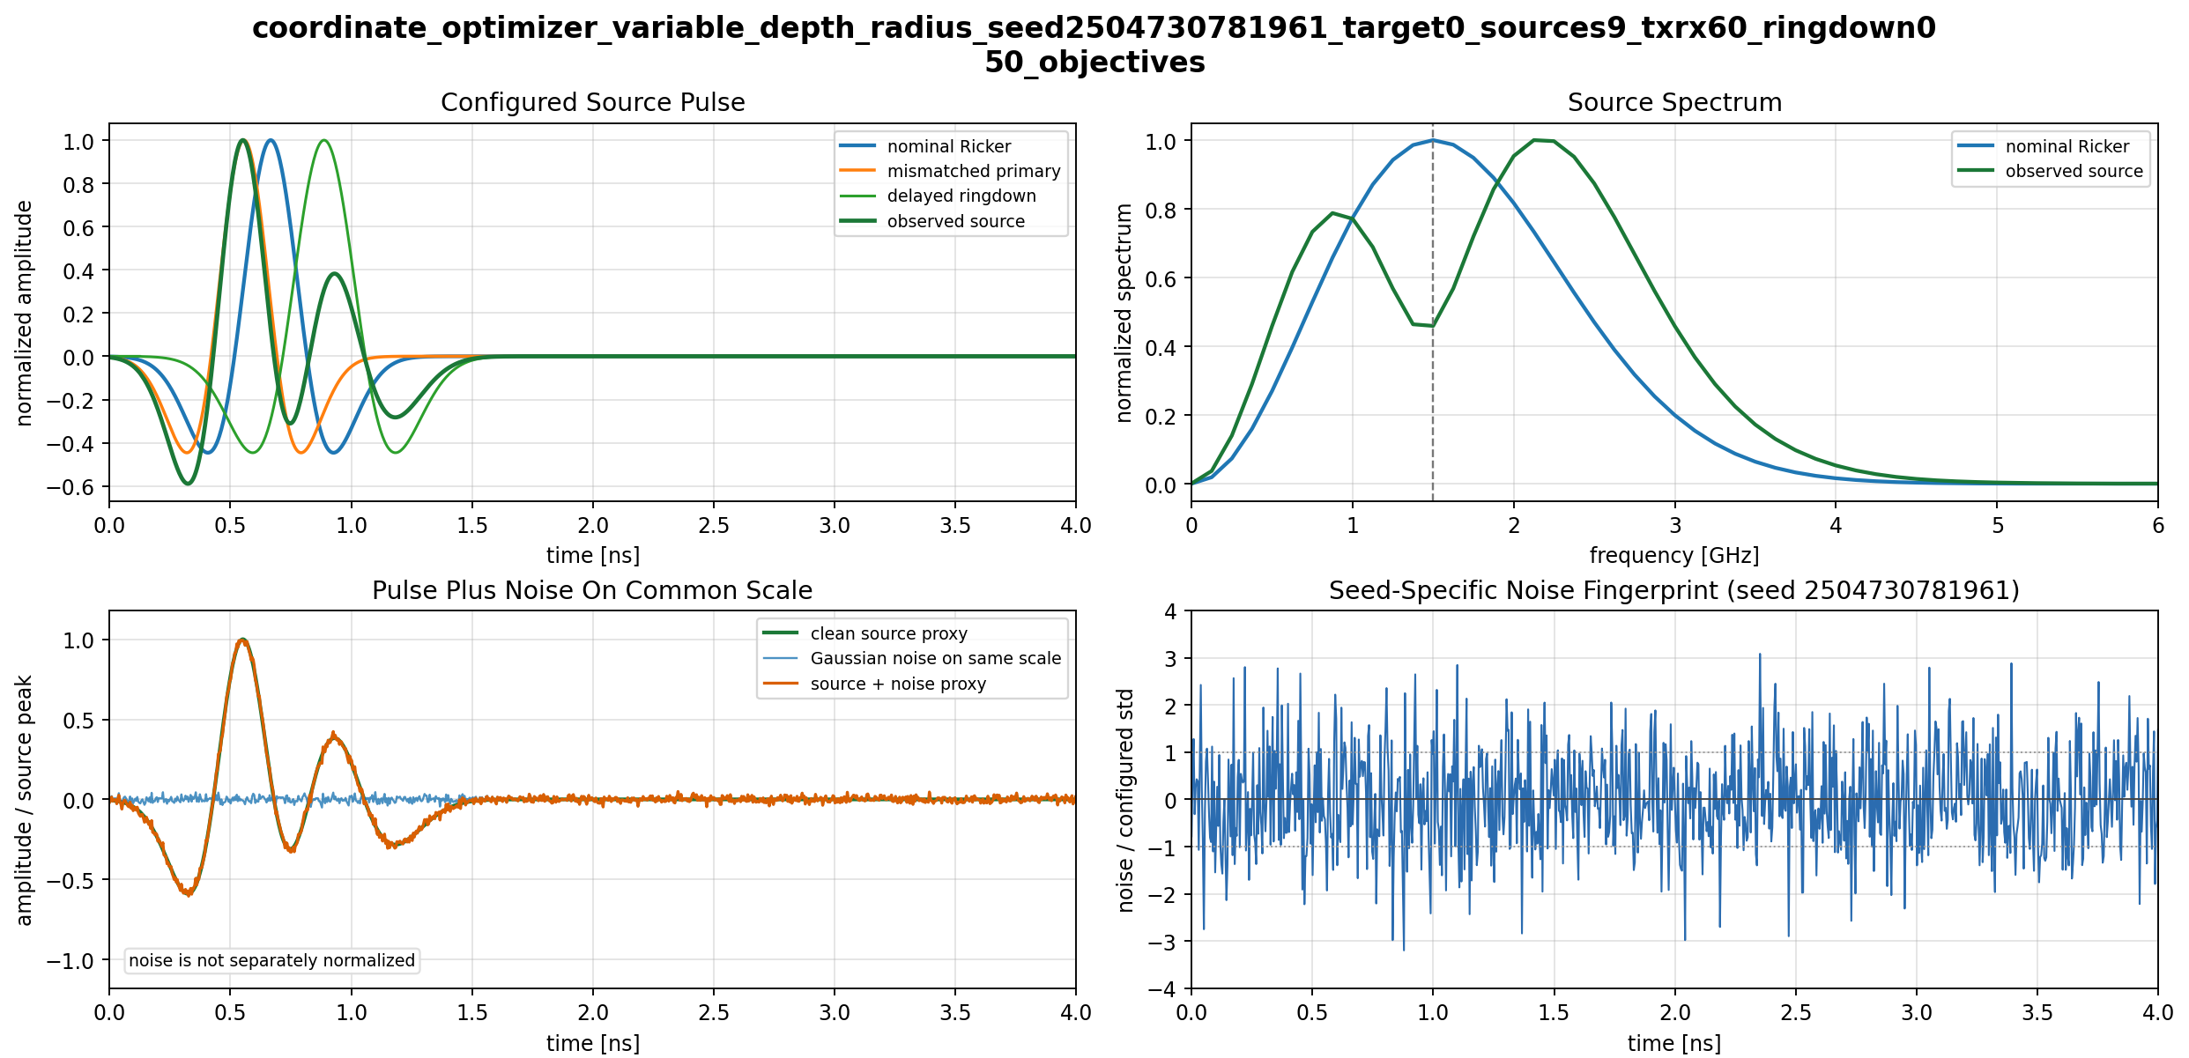

Slide 15
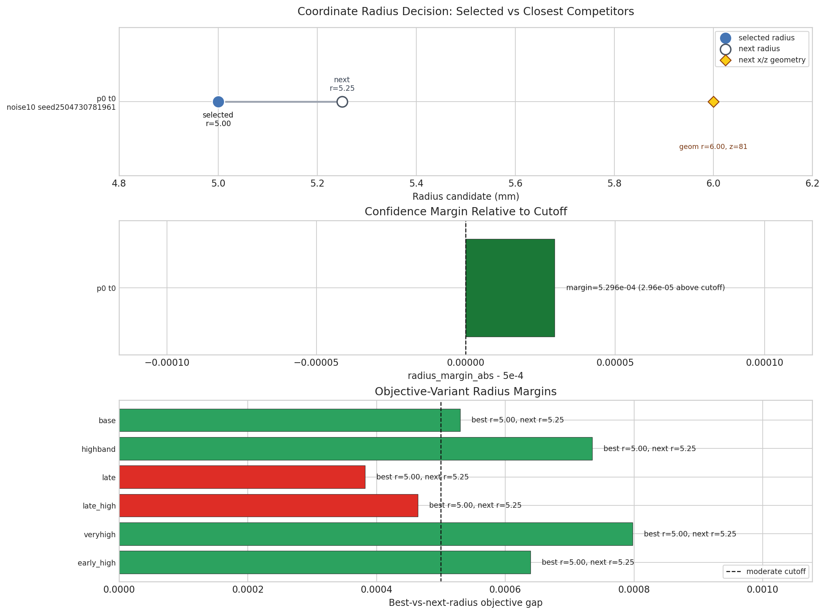

Slide 16
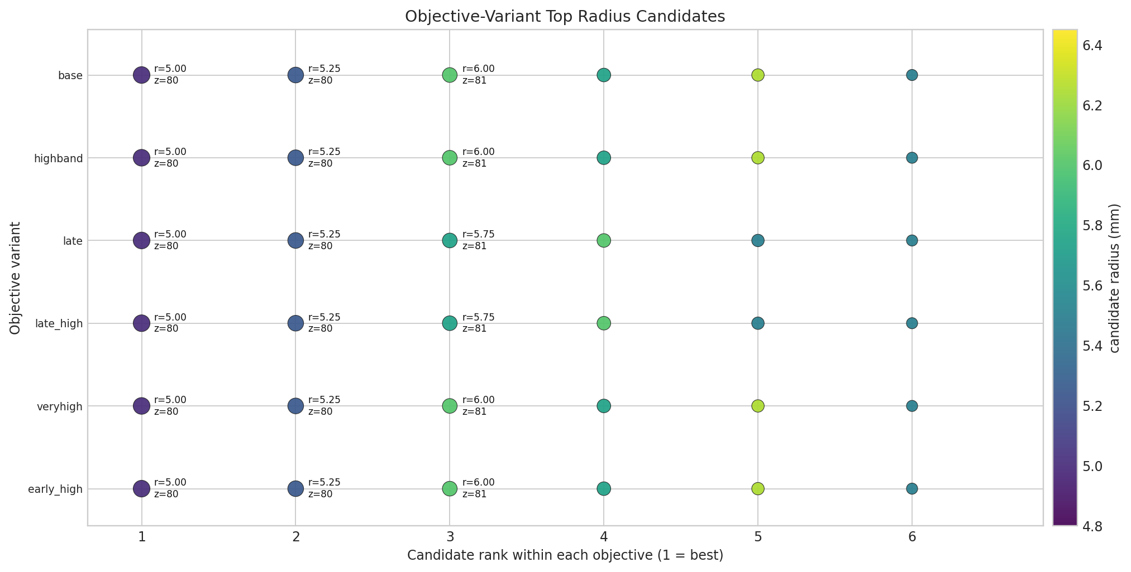

Slide 17
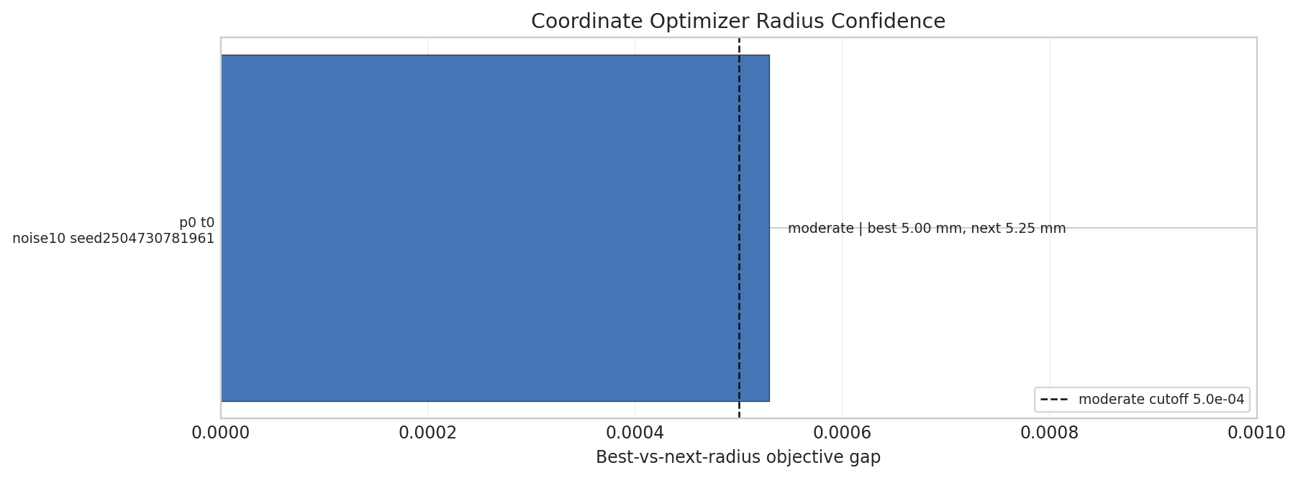

Slide 18
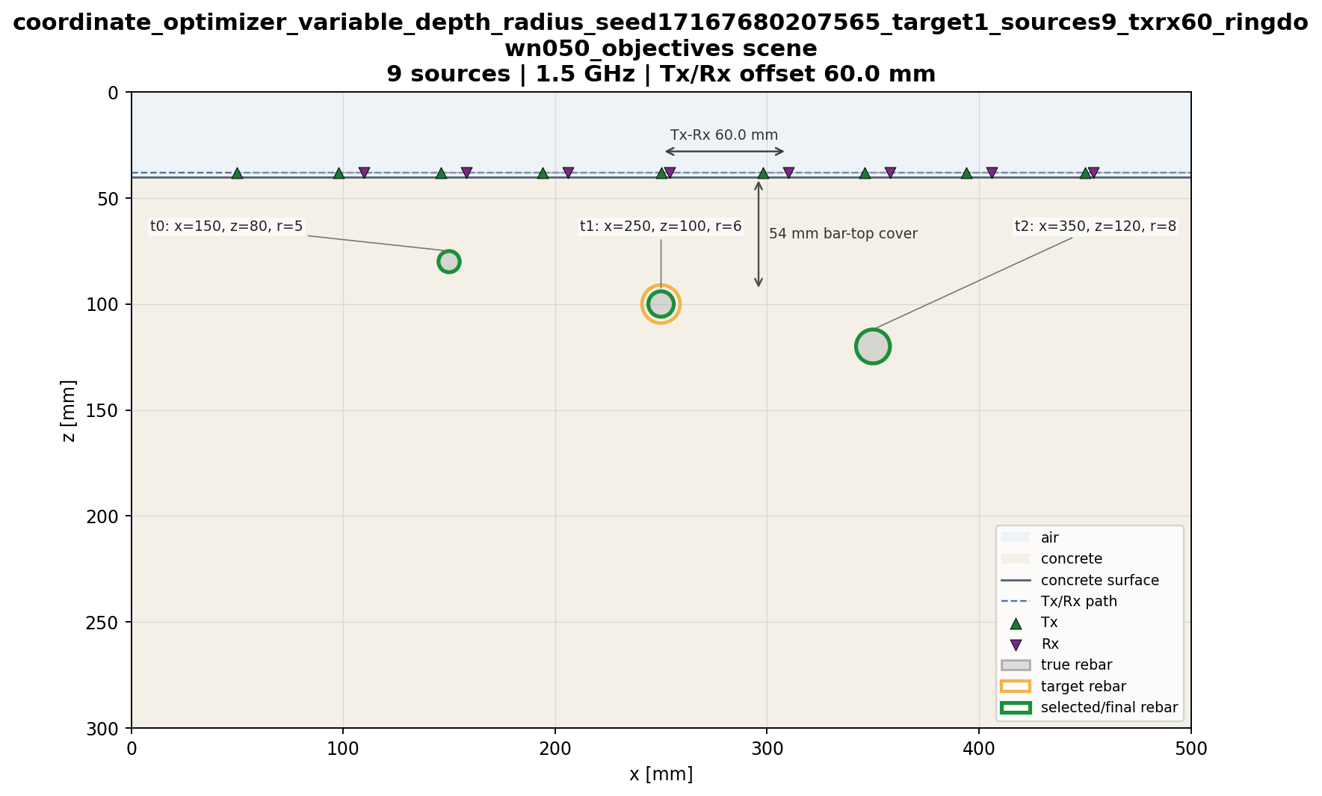
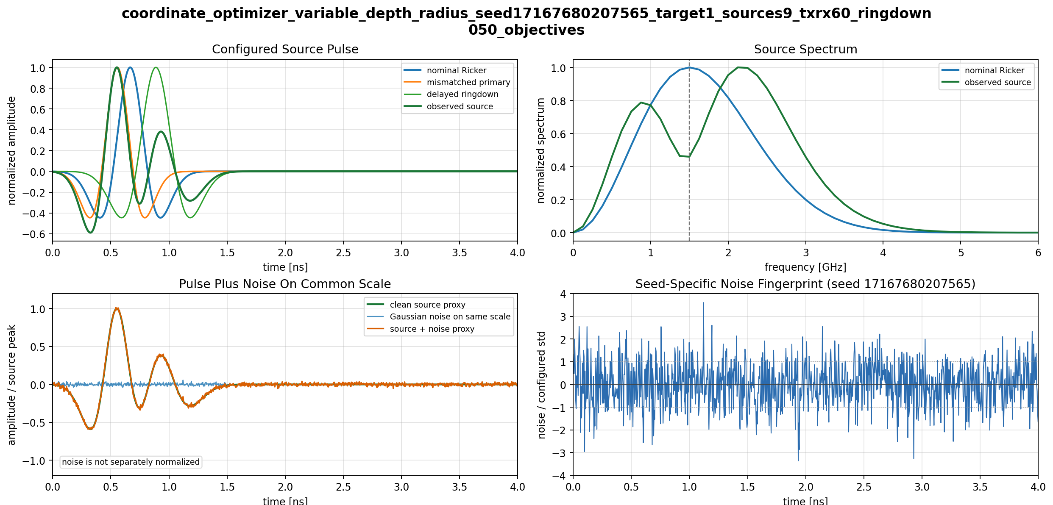

Slide 19
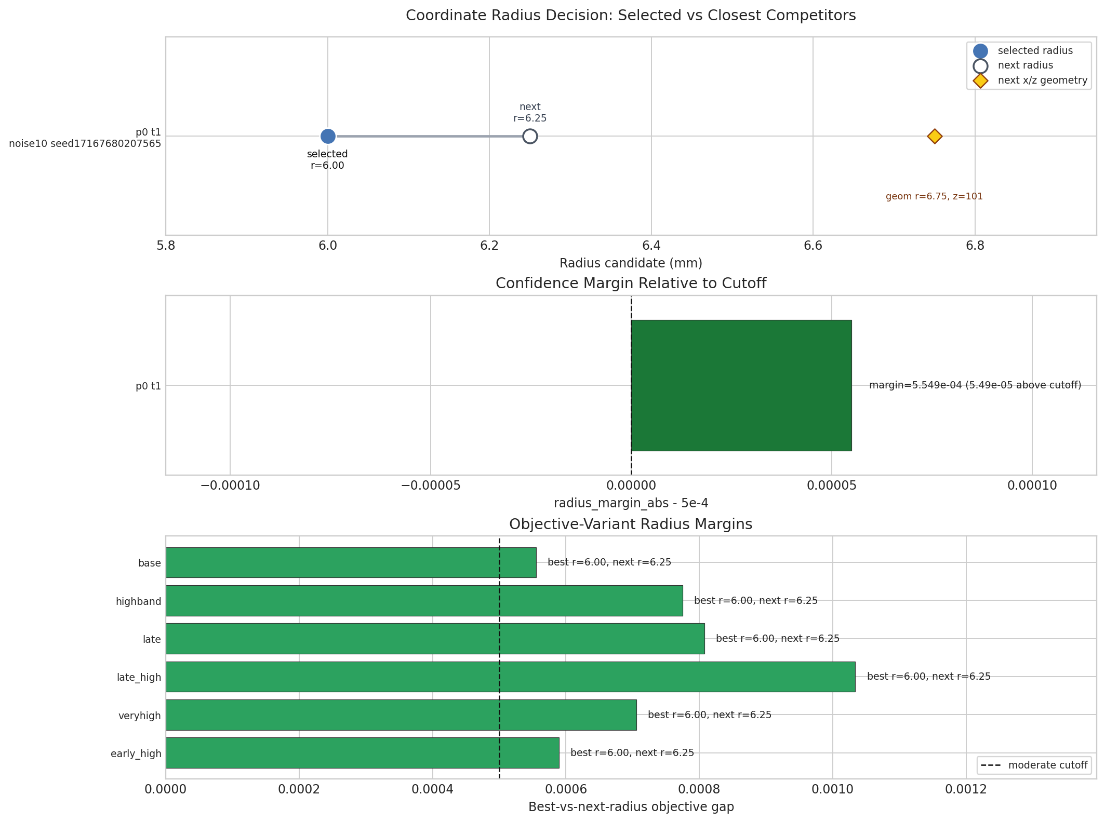

Slide 20


Slide 21
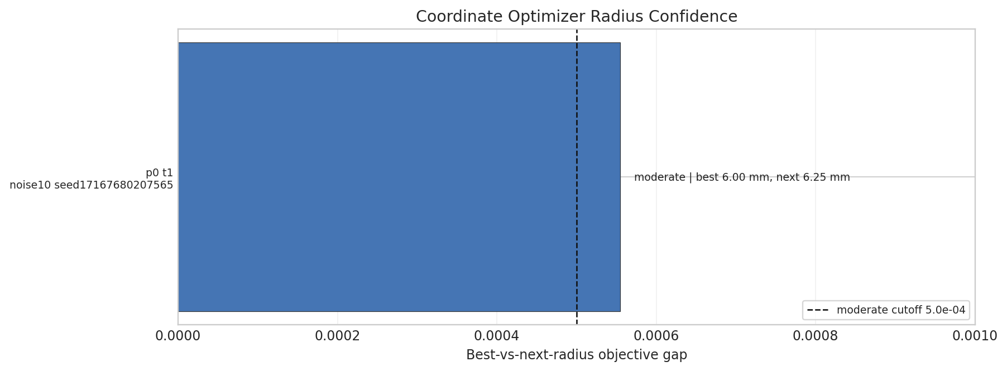

Slide 22
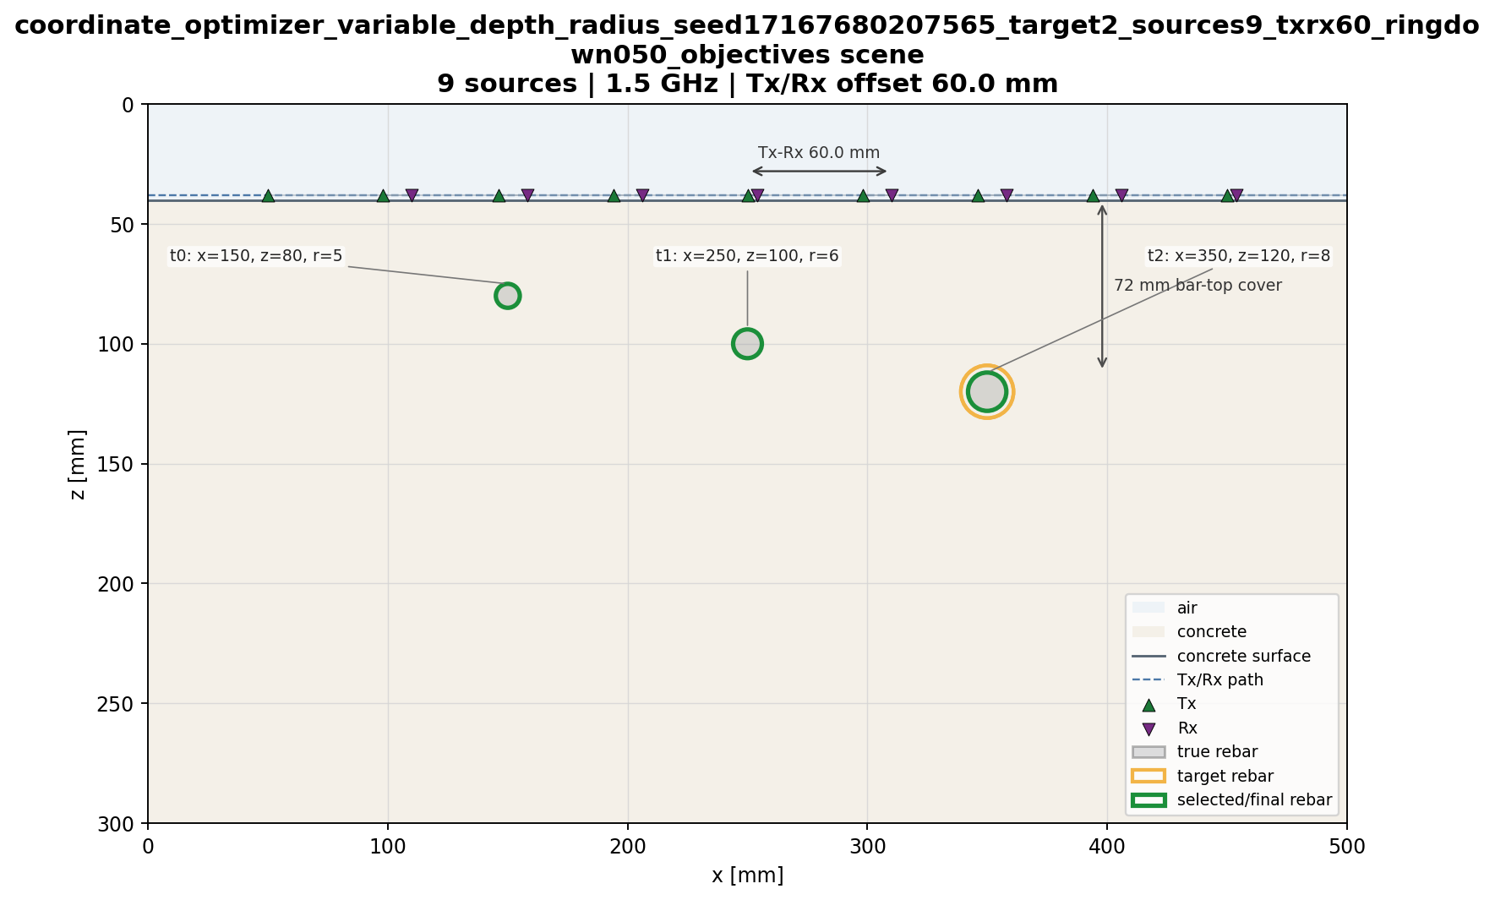


Slide 23


Slide 24
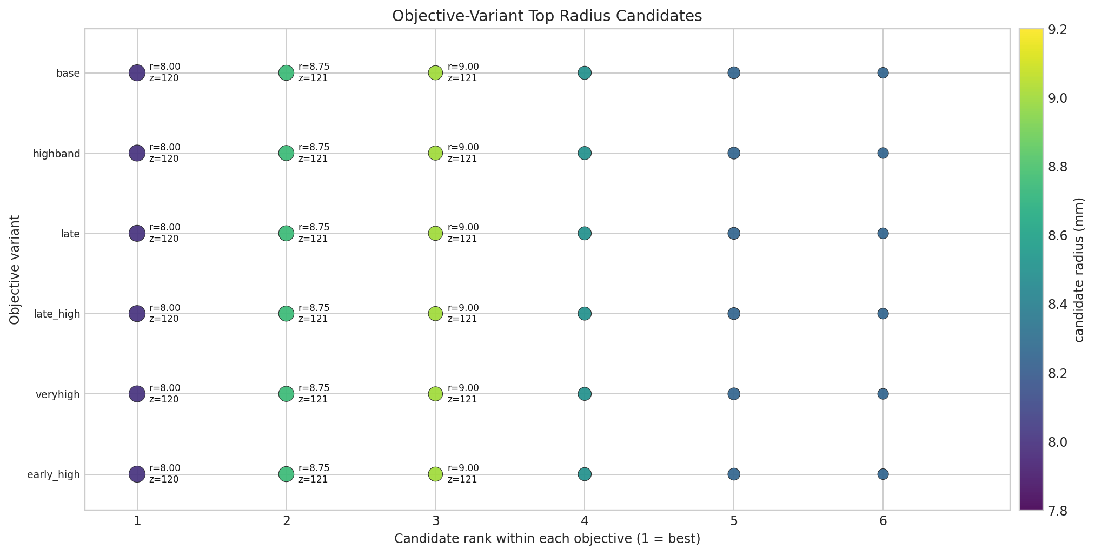

Slide 25
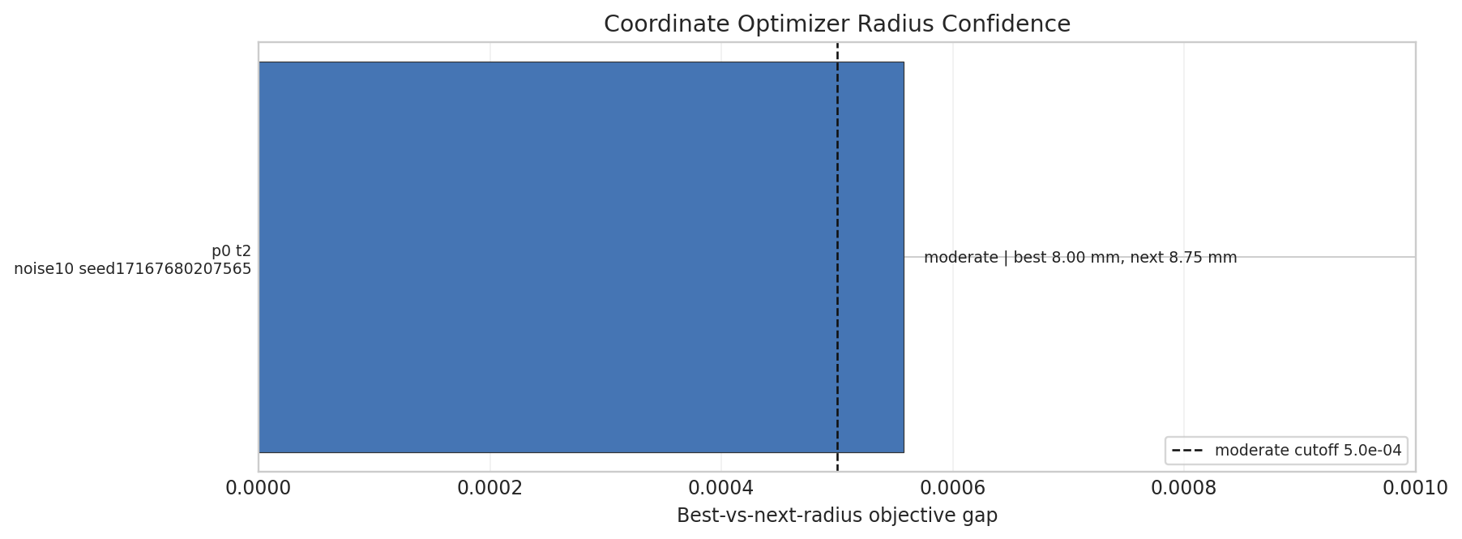

Slide 26
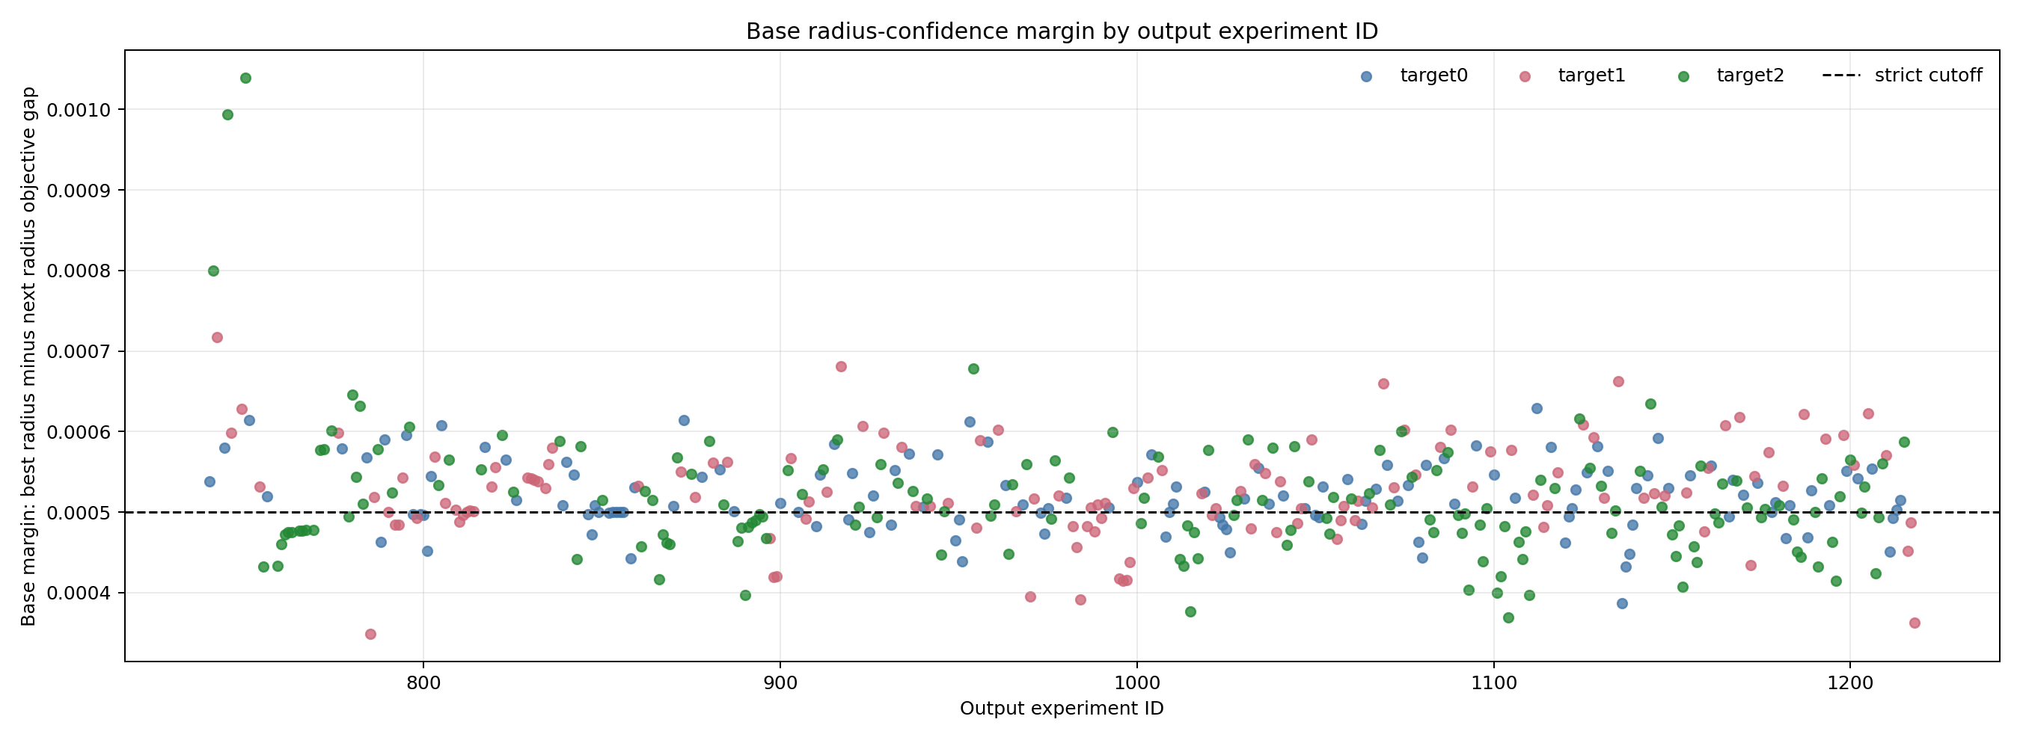

Slide 27
