Slide 1
SECOND RESEARCH ARC
Stress-testing the single-rebar pipeline
What assumption, if broken, actually moves radius?
Five published FWI strategies as the menu of hypotheses
Source profiling
Frequency weighting
Polish, not Powell
Amplitude + time-shift + center-frequency scale
Lower bands for basin, 1.5 GHz for radius
Local grid polish remains the radius selector
GPR-FDTD-FWI • experiments 024–058
1
Notes:
The first deck ended at exact-synthetic recovery on the 1 mm grid. This deck is the systematic stress test that follows, organised around five published FWI strategies. The deck order mirrors what we learned: rule out the OT hypothesis (cycle skipping), test bandwidth scheduling (helpful for seeding, not for radius), test frequency weighting (use 1.5 GHz-only or carry_low_25), test W2 (rejected as a radius objective), find the dominant new failure mode (source wavelet mismatch), and assemble a production source-profiled polish that recovers radius and source jointly.

Slide 2
Abbreviations and shorthand
reference
Used throughout the deck — refer back as needed
FWI — Full-Waveform Inversion — fit a wave-equation forward model to observed traces.
WRI — Wavefield Reconstruction Inversion — paper 1 (Feng et al. 2022).
GPR — Ground-Penetrating Radar.
PEBDD — Progressively Expanded Bandwidths of the Data — paper 2 (Zhou et al. 2021).
FDTD — Finite-Difference Time-Domain — the wave-equation solver this project uses.
OT — Optimal Transport — a family of distances between distributions.
CPML — Convolutional Perfectly Matched Layer — the absorbing boundary used by the FDTD solver.
OT-LS — OT-then-LS hybrid objective — paper 3 (Hunziker et al. 2025).
B-scan — GPR data array: lateral scan position × two-way time.
W2 — Quadratic Wasserstein distance — a specific OT-based objective (paper 4, Lu et al. 2024).
LS / L2 — Least squares — the standard waveform misfit (sum of squared point-wise residuals).
IFWI — Implicit FWI — paper 5 (Sun et al. 2025).
NRMS — Normalised Root-Mean-Square misfit between two B-scans (or between two models).
Sinkhorn — Entropy-regularised algorithm for cheap W2 computation.
εr — Relative permittivity (dielectric constant).
Softplus — log(1+e^(βx)) — turns a signed oscillating trace into a non-negative mass distribution.
σ — Electrical conductivity, in S/m.
β (W2) — Softplus scale — larger β preserves more signed-shape information.
PEC — Perfect Electric Conductor — the steel-rebar idealisation in our forward model.
ε (W2) — Sinkhorn entropy regularisation — smaller is more accurate, less numerically stable.
Tx / Rx — Transmitter / receiver antenna positions on the scan line.
ds (W2) — Sinkhorn downsample factor for trace length (cost control).
fc — Source-wavelet centre frequency.
RCCC — Relative Cross-Correlation Criterion = |trace shift| / dominant period (per trace pair).
Ricker wavelet — The time-domain pulse used as our source (the negative second derivative of a Gaussian).
NRCCC — Normalised RCCC = fraction of traces with RCCC < 0.5 (half-period gate from the OT-LS paper).
ps / mm — Picoseconds (10⁻¹² s) and millimetres — units we report time-shift and geometry in.
carry_low_25 — Weighting scheme: 0.25 × 1.0 GHz + 1.0 × 1.5 GHz (radius-friendly multi-frequency).
2
Notes:
This is a reference slide; we will not dwell on it. The rest of the deck uses these acronyms freely, so jump back here if anything is unclear. The left column has general FWI, GPR, and FDTD terms. The right column has paper-specific and numerical terms, including the five paper methods and the two W2 hyperparameters. The name carry_low_25 is one we coined for the frequency-weighting scheme that puts 25 percent weight on the 1 GHz residual and full weight on the 1.5 GHz residual; it shows up in the frequency-weighting section later.

Slide 3
Key terms and jargon
reference
Plain-language gloss for the rest of the deck
Powell — Derivative-free local optimiser available in SciPy; explores along directions, not gradients. Our default for the continuous local refinement stage.
Cycle skipping — When a modelled trace is more than half a period out of phase with the observed one, least-squares can settle into the wrong cycle. This is the classical failure mode the OT family of methods targets.
Basin — The local valley in the objective landscape where an optimiser settles.
Variable projection (WRI) — Solve a fast subproblem for the wavefield first (with the model fixed), then reduce the optimisation to just the material model.
High-radius basin — The specific wrong local minimum at r ≈ 6.95 mm that continuous Powell consistently finds in our setup.
Matched filter (PEBDD) — Apply the same band-pass to both observed and modelled traces inside the objective — the distinguishing detail vs older bandwidth methods.
Depth-radius coupling — Near the true minimum, a slightly deeper rebar (z+) trades against a slightly larger radius (r+) and produces an almost identical waveform — this is what causes the high-radius basin.
Source-wavelet mismatch — The observed source wavelet differs from the modelled one (amplitude / time-zero / centre-frequency).
Grid polish — A deterministic small local (z, r) grid search after Powell. Corrects radius bias because rasterised geometry is piecewise-constant in physical coordinates, so smooth-tolerance optimisers cannot find the exact rasterised cell.
Source profile — A small set of nuisance parameters (amplitude scalar + time-shift grid + fc-scale grid) fit per candidate to absorb wavelet mismatch.
Top-k candidates — Instead of one best (x, z, r), the polish reports the K best candidates and their misfits — the next-best alternative is auditable.
Distinct-radius margin — Objective gap between the best radius and the best next-distinct-radius candidate — our standard confidence measure.
Twin experiment — Both the 'observed' and the candidate B-scans come from the same FDTD solver, so any failure is in the inverse pipeline, not in the physics model.
Residual spectrum — FFT amplitude of (synthetic − observed) for a specific candidate; shows which frequencies that candidate fails to fit.
3
Notes:
Two entries on the left matter more than the others. 'High-radius basin' is the wrong local minimum at about 6.95 mm radius that Powell consistently finds — it will come up on most of the later slides. 'Depth-radius coupling' is the physical reason that basin exists: a deeper rebar trades against a larger radius and produces an almost identical waveform. The grid-polish entry is a carry-over from the first deck but central enough to repeat here. The right column lists features of the production source-profiled polish later in the deck — when 'source profile' and 'distinct-radius margin' appear, the definitions are on this slide.

Slide 4
Five papers as the menu of hypotheses
setup
What this section is and how it lands in the deck
The first deck ended at exact-synthetic recovery on the 1 mm grid. That left a sharper question:
what assumption, if broken, actually moves radius?
We did not invent a new objective. Instead, the recent FWI literature already proposes five distinct strategies for the failure modes we might run into. Each paper is a hypothesis about which assumption matters:
Paper 1 (WRI): the wave equation is too tight a constraint
Paper 2 (PEBDD): the data bandwidth is too wide too soon
Paper 3 (OT-LS): the objective traps on cycle skips
Paper 4 (W2): least squares is the wrong distance
Paper 5 (IFWI): the model representation is too rigid
Each paper was tested through a controlled landscape gate before any optimizer integration. Some were kept, some were rejected, some were deferred — with reasons.
Paper 1 · WRI 2022 (Feng et al.)
Frequency-domain wavefield reconstruction + cumulative frequency strategy.
Paper 2 · PEBDD 2021 (Zhou et al.)
Progressively expanded bandwidth, matched filter on both d_obs and d_syn.
Paper 3 · OT-LS 2025 (Hunziker et al.)
Hybrid OT-then-LS with an NRCCC switching criterion.
Paper 4 · W2 GPR 2024 (Lu et al.)
Quadratic Wasserstein objective via Softplus normalisation + Sinkhorn.
Paper 5 · IFWI 2025 (Sun et al.)
Implicit neural representation (x, z) → (εr, σ) with frequency-principle prior.
4
Notes:
The framing of this whole arc is deliberate. We did not pick a single paper and try to apply it; we collected five distinct strategies for FWI failure modes and tested each as a hypothesis. The pattern was the same every time: build the smallest reusable piece of the paper's machinery, put it through a controlled landscape gate, and only decide whether to adopt it based on what the landscape says — before any optimiser integration. That order matters. If we had wired W2 into Powell first, we would have burned compute to learn the same lesson the landscape test delivered cheaply.

Slide 5
Wavefield Reconstruction Inversion (WRI)
paper 1 / WRI
Feng et al., Remote Sensing 2022 — frequency-domain GPR-FWI for underground pipeline imaging
PROBLEM IT ATTACKS
METHOD / ARCHITECTURE
Standard FWI for GPR pipeline imaging is brittle: enforcing the wave equation exactly each iteration makes the objective highly nonlinear, so an inaccurate starting model creates cycle skipping and trapped local minima. Multiparameter inversion (permittivity and conductivity together) amplifies this; high-frequency content amplifies it further.
Frequency-domain wavefield reconstruction inversion (WRI). The wave equation is no longer enforced exactly — it becomes a penalty term, so wavefield and model are co-updated. Variable projection: solve a least-squares problem for the reconstructed wavefield given the model, substitute back into a reduced objective over the model, optimize with L-BFGS over relative permittivity and conductivity. Pair this with a multi-scale cumulative frequency strategy: stages B1..B5 add 1, 2, 3, 4, or 6 new frequencies per step while keeping previous ones; inverse-frequency-squared weighting prevents the high band from dominating the objective.
KEY FINDINGS REPORTED
OUR ADAPTATION
Two synthetic pipeline cases and one field-style case. Cumulative schedules beat the simultaneous baseline in every test. Reported error reductions: 7–11% (permittivity) and 7–15% (conductivity) on case 1; 20–40% and 17–24% on case 2. Smaller cumulative batches were more accurate but cost more PDE solves. Permittivity reconstructed better than conductivity. Field case recovered plausible pipeline locations even with imperfect starts.
Kept: the cumulative-frequency philosophy, adapted as time-domain per-frequency objective contributions and a --frequency-weights CLI. This is what enables the carry_low_25 scheme we use for radius. Deferred: full WRI itself. Faithful implementation needs a new frequency-domain Helmholtz/Maxwell operator, complex sparse solves, frequency-domain adjoint, and penalty continuation — its own project. The current radius bias is already well explained by source handling and weighted LS, so the cost is not justified. Documented in docs/experiments/28_wri_feasibility.md.
5
Notes:
Three points to land from this slide. First, the WRI relaxation is a structural change to the optimisation — the wave equation is no longer a hard constraint enforced exactly each iteration, it is a penalty term, so the wavefield can be slightly inconsistent with the model in exchange for better basin behaviour. Second, the cumulative-frequency idea is independent of WRI itself, and that is the part we actually adopted — we added per-frequency objective contributions and a frequency-weight CLI flag, which is what makes the carry_low_25 scheme possible later in the deck. Third, our deferral of full WRI is conditional, not categorical. If a future setup creates an initial-model failure that source handling cannot fix, WRI moves back onto the table; the docs/experiments/28 tracker has the design notes.

Slide 6
Progressively Expanded Bandwidth FWI (PEBDD)
paper 2 / PEBDD
Zhou, Klotzsche, Vereecken, NSG 2021 — crosshole GPR FWI with bandwidth scheduling + source-wavelet update
PROBLEM IT ATTACKS
METHOD / ARCHITECTURE
Crosshole GPR FWI requires the modeled and observed traces to be within roughly half a wavelength or half a period at every position for least-squares to be safe. Ray-based starting models often violate this in high-contrast media. The visible failure mode is the optimizer settling into a depth/contrast tradeoff that fits the B-scan well but is physically wrong.
PEBDD = Progressively Expanded Bandwidths of the Data. Apply the SAME tapered bandpass to both observed and modeled traces — that is the differentiator from older bandwidth-expansion methods, which filtered only the modeled side through the source wavelet. Algorithm: estimate an effective source wavelet; build a tapered filter; fix a low cut; start with a low high cut; run a small number of FWI iterations; expand the high cut by a fixed increment; repeat. After the staged build-up, use the recovered model as the starting model for full-band FWI, then update the source wavelet by deconvolution and run full-band FWI again.
KEY FINDINGS REPORTED
OUR ADAPTATION
Synthetic case I with a good ray-based start: permittivity MAE 2.0 → 1.7 with PEBDD; data RMS roughly halved. Synthetic case II with a deliberately bad start outside the half-wavelength criterion: standard FWI MAE 3.6 → PEBDD MAE 2.1; standard FWI was trapped, PEBDD was not. Field-data RMS improved in all four crosshole sections tested; CPT comparisons mostly better, not uniformly.
Kept: the matched-filter design (FFT bandpass applied to both d_obs and d_syn) as inversion/trace_filters.py, plus a new spectrum-design tool so the band edges come from real residual spectra instead of guesses. Used as the seed-building stage of the staged inversion. Adapted: the source-wavelet update is replaced in our pipeline by the explicit source profiling described later in the deck (amplitude / time-shift / center-frequency-scale).
6
Notes:
The single most important detail in PEBDD is that the same band-pass filter is applied to both observed and modelled traces inside the objective. Older bandwidth methods filtered only the modelled side through the source wavelet, and they did not survive on field data. PEBDD did. Our adoption is faithful to that detail — the matched-filter band-pass lives in inversion/trace_filters.py and is applied identically to both d_obs and d_syn before the residual is computed. The schedule itself we re-derived from actual residual spectra after seeing that our first-pass guessed bands did not carry radius information; that story takes up the next several slides.

Slide 7
Optimal-Transport / Least-Squares Hybrid (OT-LS)
paper 3 / OT-LS
Hunziker, Meles, Linde, JAG 2025 — get into the basin with OT, refine with LS, switch via NRCCC
PROBLEM IT ATTACKS
METHOD / ARCHITECTURE
Crosshole GPR FWI is cycle-skipping-prone with L2 because the objective has multiple local minima along trace shifts. When the wavelet's main lobe moves past truth, pointwise amplitude cancellation creates a misleading local decrease and the optimizer slides into the wrong basin. The proposed fix is a hybrid objective, not just a different optimizer.
Two-stage objective. OT first: convert each trace into a 'fingerprint' — a 2D pseudo probability density over (time, amplitude), take its two 1D marginals, compute Wasserstein distances on those marginals. The fingerprint OT objective has a broad global basin that is shift-monotonic. Then switch to LS for sharpness once trace pairs are aligned. Switching is governed by the cross-correlation criterion RCCC = |trace shift| / dominant period; NRCCC is the fraction of traces with RCCC < 0.5; switch when NRCCC > Cs ≈ 0.7. Gradients computed sparsely at random master points away from antennas, then interpolated — implicit regularization plus runtime.
KEY FINDINGS REPORTED
OUR ADAPTATION
Synthetic crosshole with a large circular anomaly and a deliberately poor homogeneous starting model. Pure LS converged to bad local minima. Pure OT moved toward the right structure but did not resolve details. Hybrid OT → LS recovered good models for switching thresholds Cs ≈ 0.7–0.75. Runs that ended with NRCCC = 1 and weighted RMS close to 1 were reliable; runs that did not were not.
Kept: the NRCCC trace-shift diagnostic, implemented in inversion/trace_distances.py and saved in every run summary. We use it as a safety report — does the model live in a least-squares-safe basin? Deferred: the OT objective itself. Across exact / 5% / 10% noise, NRCCC = 1.0 for our wrong-radius candidates — they are already in the LS-safe basin. The OT machinery would be solving a problem we do not have.
7
Notes:
Two design points on this slide deserve unpacking. First, the trace fingerprint — converting each trace to a 2D pseudo probability density over time and amplitude and then taking marginals — is what lets optimal transport work on signed oscillatory data without a heavy normalisation. That is a different approach from the W2 / Softplus method in the next paper, which transforms the trace itself into a non-negative mass distribution. Second, the sparse-gradient idea using random master points away from the antennas is a regularisation choice with a side benefit — gradients become independent of the specific distance measure, so swapping in a new objective does not require deriving a new adjoint. That property makes the OT-LS framework unusually flexible for trying objectives quickly.

Slide 8
Quadratic Wasserstein GPR-FWI (W2)
paper 4 / W2
Lu et al., Remote Sensing 2024 — two-parameter GPR-FWI with W2 as a direct L2 replacement
PROBLEM IT ATTACKS
METHOD / ARCHITECTURE
Two-parameter GPR FWI (relative permittivity and conductivity) is unstable under standard L2: high parameter sensitivity, weak conductivity recovery, noise vulnerability, strong initial-model dependence. The paper proposes a single objective change rather than a new optimization framework, so the rest of the FWI stack stays the same.
Replace L2 with the quadratic Wasserstein distance W2. Three implementation pieces matter. (1) Softplus normalisation: raw signed GPR traces oscillate around zero, but optimal transport needs non-negative distributions with equal mass; softplus(b·x) / Σsoftplus turns the trace into a usable distribution. The scale b controls how aggressive the transform is. (2) Sinkhorn entropy regularisation: exact OT is too expensive for repeated FWI evaluations; ε trades transport accuracy for numerical stability. (3) Wrap in multi-scale frequency-domain FWI with L-BFGS over εr and σ, frequencies added in batches (e.g. 15 batches of 4 frequencies, 10 iterations each).
KEY FINDINGS REPORTED
OUR ADAPTATION
Three numerical examples. W2-FWI depends less on the initial model than L2-FWI. W2-FWI is more robust to additive noise. W2-FWI improves conductivity recovery more strongly than permittivity recovery (the opposite ordering from L2-based work). L2-FWI can generate high-frequency artifacts and obscure targets when the starting model is poor. Adding higher frequencies did not always improve W2 results.
Built: a standalone Softplus / Sinkhorn W2 module with unit tests (inversion/trace_wasserstein.py). Ran it through two gates before any optimizer integration. Gate 1 (shifted Ricker, paper claim): passed. Gate 2 (rebar landscape): failed. Softplus normalisation removes the amplitude content radius depends on; W2 margin collapses by four orders of magnitude vs LS. Decision: reject W2 as the final radius objective for this problem. Kept available as a basin diagnostic for future poor-initial-model / field-data scenarios.
8
Notes:
The two-gate structure of our W2 evaluation is important — we did not dismiss W2 from theoretical arguments alone. We replicated the paper's positive claim about shift convexity on shifted Ricker pulses, and only then ran the same machinery on the actual rebar landscape. The negative result on the rebar landscape is specific to this single-rebar radius problem; it is not a general judgement on W2 for FWI. Two more things to keep in mind: β, the Softplus scale, and ε, the Sinkhorn entropy regularisation, are hyperparameters that must be chosen, and Sinkhorn cost grows with trace length. Both of these are reasons to test in a controlled landscape gate before wiring W2 into an optimiser.

Slide 9
Implicit Multiparameter GPR-FWI (IFWI)
paper 5 / IFWI
Sun et al., GJI 2025 — neural implicit representation of the subsurface material model
PROBLEM IT ATTACKS
METHOD / ARCHITECTURE
Standard FWI stores material parameters on a dense grid. That makes multiparameter inversion brittle: huge model dimensionality, manual parameter weighting between permittivity and conductivity, strong initial-model dependence, ad-hoc multi-scale schedules. The paper proposes a fundamentally different model representation rather than a new objective.
Implicit FWI. Replace the grid with a small neural network: coordinates (x, z) → N_θ(x, z) → (εr, σ). The forward solver is still Maxwell / FDTD, the loss is still waveform mismatch — only the model parameterization changes. Optimize the network weights with Adam. Architecture details matter: SIREN / sinusoidal activations with a frequency scale ω₀ that controls detail sensitivity; too small ω₀ misses fine structure, too large ω₀ produces high-frequency noise. Dropout helps in some configurations. The paper also describes an RNN-style differentiable FDTD framing so AD gives gradients consistent with adjoint-state methods.
KEY FINDINGS REPORTED
OUR ADAPTATION
The 'frequency principle' of neural networks acts as an automatic multiscale prior: broad/low-frequency structure is learned before fine detail. IFWI reconstructed useful subsurface structure from poorer initial models than standard FWI. Permittivity and conductivity inverted simultaneously without the manual parameter weighting that classical multiparameter FWI relies on. Network architecture (depth, width, ω₀, dropout) materially affects results — these are tuning choices, not free parameters.
Deferred. Two concrete reasons: (1) our parameter vector is [x, z, radius] — three numbers; an implicit field is overkill. (2) a flexible neural residual would risk absorbing radius bias into a 'background correction' instead of revealing it, which would make the radius estimate less meaningful, not more. The frequency-principle lesson is already implicit in our staged pipeline (basin first, detail later). Reserved for multi-rebar or field-data stages where explicit nuisance parameters become insufficient. See docs/experiments/29_ifwi_feasibility.md for the design of a constrained future prototype.
9
Notes:
The IFWI deferral is the most subtle one in the deck. The risk is not that IFWI does not work — it does, in the paper's own results. The risk is what it can be made to fit. A free neural residual field around the rebar could match observed data perfectly while leaving the radius estimate wrong, because the radius error would be absorbed into the residual field as a small material perturbation. That would make our radius confidence number meaningless. The future-prototype design in tracker 29 is intentionally constrained for exactly this reason: explicit geometry stays the primary unknown, the neural residual is small, smooth, and regularised, and held-out scan positions validate that the residual generalises rather than absorbs errors. That constrained version is what we would build first if we did revisit IFWI.

Slide 10
From papers to experiments — the mapping
roadmap
Which experiments tested each paper's claim, and the verdict
Source | Hypothesis tested | Experiments | Gate result | Verdict
OT-LS | Cycle skipping drives radius bias | 024–027 | NRCCC = 1.0 for every candidate, including the wrong-radius one | ruled out for this problem; diagnostic kept
PEBDD | Bandwidth scheduling fixes the radius bias | 028–037, 043–045 | Powell stops in the high-radius basin at every stage; polish stays the radius selector | kept as seed builder; spectrum-design tool added
WRI | Cumulative-frequency / weighted multi-frequency helps radius | 038–041, 046–049 | 1.0 GHz weak; unweighted averaging dilutes margin; carry_low_25 best compromise | kept as time-domain weighted LS; WRI solver deferred
W2 | Softplus / Sinkhorn beats LS for radius selection | 048, 050, 051 | Shift convexity ✓ (gate 1); rebar margin collapses ×10⁴ (gate 2) | rejected as radius objective; module kept as diagnostic
PEBDD risk | Source-wavelet mismatch (field-data flag) shifts radius | 052–055 | Raw mismatch pegs r to grid bound; structured source profile recovers truth | amplitude + time + freq profile fixes all tested cases
(geometry) | Material parameters can hide a wrong radius | 056 | εr identified; σ saturates above 1e5; distinct-radius margin preserved | no material params in the radius optimizer yet
all 5 | Production runner combines surviving ideas | 057, 058 | Radius + source profile co-recovered under injected mismatch | recommended pipeline going forward
IFWI | Neural implicit field needed for radius | doc 29 only | Flexible residual would absorb radius bias | deferred to multi-rebar / field-data stage
Acronym key: OT-LS = optimal-transport / least-squares hybrid · PEBDD = progressively expanded bandwidths of the data · WRI = wavefield reconstruction inversion · W2 = quadratic Wasserstein · IFWI = implicit full-waveform inversion · NRCCC = fraction of trace pairs within half a period · LS = least squares.
10
Notes:
This is the deck roadmap. The order of the rest of the presentation follows the rows of this table top to bottom. First we rule out OT as a radius solver and keep its diagnostic. Then we test bandwidth scheduling and keep it only as a seed builder. Then frequency weighting, where we discover unweighted multi-frequency dilutes radius margin and carry_low_25 is the best compromise. Then W2, where we run two gates — the shift-convexity test passes, the rebar landscape fails, and W2 gets rejected as a final radius objective. Then material parameters, which turn out not to explain the radius bias. Then the wavelet-mismatch finding, which is the new contribution from this arc. And finally the production runner that synthesises the surviving ideas. The OT-LS paper actually appears twice — once directly for the cycle-skipping hypothesis, and once indirectly because it shares PEBDD's concern about source-wavelet handling on field data.

Slide 11
01
Was it cycle skipping?
OT diagnostic on the existing high-radius candidate
11

Slide 12
OT-style trace-shift diagnostic
exp 024–027
Rule out the OT branch before committing to a new objective
Hypothesis
If the high-radius Powell basin is a cycle-skipping failure, the OT-LS paper's NRCCC criterion should flag it as unsafe for least-squares.
What we did
We implemented RCCC = |trace shift| / dominant period and NRCCC = fraction with RCCC < 0.5. Ran it post-hoc on the known high-radius Powell candidate, the polished true candidate, and the top-k polish candidates under 5% and 10% noise.
What we'll see
If NRCCC < 1 for the wrong-radius case, the OT branch is worth pursuing.
If NRCCC = 1 for every candidate, this problem is not a transport problem.
12
Notes:
Module: inversion/trace_distances.py. Runner: run_single_rebar_trace_diagnostics.py. We added per-frequency trace_shift_by_frequency to every new single_rebar_summary. The design point of mentioning this on the slide is *not* that OT is bad — it is that the diagnostic itself ruled out the branch for the current problem before any expensive optimizer integration. Even at 10% noise the wrong-radius candidate still passes the half-period gate.

Slide 13
NRCCC results across the candidate set
exp 024–026
Does the half-period gate flag the wrong-radius candidates as unsafe?
RCCC (Relative Cross-Correlation Criterion) = |trace shift| / dominant period, computed for each (observed, synthetic) trace pair.
NRCCC (Normalised RCCC) = fraction of traces with RCCC < 0.5 — the half-period gate the OT-LS paper uses to decide a trace is least-squares-safe.
Paper's switching rule: when NRCCC > ~0.7, switch from the OT objective to LS. If a candidate is already at NRCCC = 1.0, OT brings no extra basin-finding benefit.
Candidate | Misfit J | NRCCC | med RCCC | max RCCC | Radius | Note
polished true (014 / 015) | 0 | 1.000 | 0.000 | 0.000 | 6.000 mm | exact recovery
Powell high-radius | 2.08e-3 | 1.000 | 0.003 | 0.003 | 6.955 mm | wrong radius, but phase-safe
noise 10% top 1 (023) | 1.99e-1 | 1.000 | 0.000 | 0.003 | 6.000 mm | recovered
noise 10% top 2 | 1.99e-1 | 1.000 | 0.000 | 0.003 | 6.000 mm | alternative cell
noise 10% high-radius | 2.01e-1 | 1.000 | 0.003 | 0.006 | 6.991 mm | wrong radius, phase-safe
noise 5% recovered | 5.86e-2 | 1.000 | 0.000 | 0.000 | 6.000 mm | recovered
noise 5% optimizer-end | 6.09e-2 | 1.000 | 0.003 | 0.006 | 6.973 mm | wrong radius, phase-safe
What this means
Every candidate — including the wrong-radius Powell solutions at all noise levels — already sits at NRCCC = 1.0. The wrong-radius rows have a tiny non-zero median RCCC (≈ 0.003, i.e. 0.3% of a dominant period), but that is far below the 0.5 half-period gate. So the radius failure is not a phase / cycle-skipping problem; an OT objective designed for cycle skips cannot help here. Decision: rule the OT branch out for this problem; keep the NRCCC diagnostic for field-data use.
13
Notes:
The result on this slide is what rules out the OT branch for our specific problem. Three observations to land. First, the OT-LS paper's whole motivation is cycle skipping at scale — the trigger condition for using OT is NRCCC less than 1, meaning some traces are out of phase by more than half a period. Second, every one of our wrong-radius candidates already sits at NRCCC equal to 1, including under 5% and 10% noise; the paper itself would say 'use least squares here'. Third, the wrong-radius rows do have very slightly higher RCCC than the polished true rows, but the absolute value — about 0.003 of a period — is two orders of magnitude below the 0.5 gate. So the radius issue is an amplitude and detail issue, not a transport issue. That observation drives the next section on PEBDD bandwidth and eventually motivates the source-profiling work that closes the deck. We keep the NRCCC diagnostic available because field data may still have basin-finding problems that this synthetic case does not.

Slide 14
02
Bandwidth scheduling
PEBDD first pass, then a spectrum-driven re-design
14

Slide 15
First PEBDD attempt with guessed bands
exp 028–033
Same band-pass filter applied to observed and synthetic traces (matched-filter design)
Hypothesis
A staged objective that starts in a low frequency band and expands the high cut should reduce the high-radius Powell bias (the wrong local minimum at r ≈ 6.95 mm that the derivative-free SciPy Powell optimiser keeps finding) before the polish stage.
What we did
Built a trace-filter helper and a staged runner. First schedule used 0.2–0.8 then 0.2–1.1 then full band, with a final coarse polish. Also ran controls without polish and a polish-only path from the low-band seed.
What we'll see
Exact data: low-band Powell did move radius closer to the truth, but full-band Powell pulled it back.
Noise: the low-band stage stayed in the high-radius basin.
Polish remained the reliable radius selector in every variant.
15
Notes:
At this stage the bands were chosen by inspection: 0.2 to 0.8 GHz, then 0.2 to 1.1, then 0.2 to 1.5, then the full band. The matched band-pass filter lives in inversion/trace_filters.py and is exposed through the --objective-bandpass-ghz CLI flag with a taper width. The fact that this first-pass schedule did not move radius is what motivated the spectrum-driven design on the next few slides; we will see that the residual energy that actually distinguishes nearby radii does not live in the 0.2–0.8 GHz band at all.

Slide 16
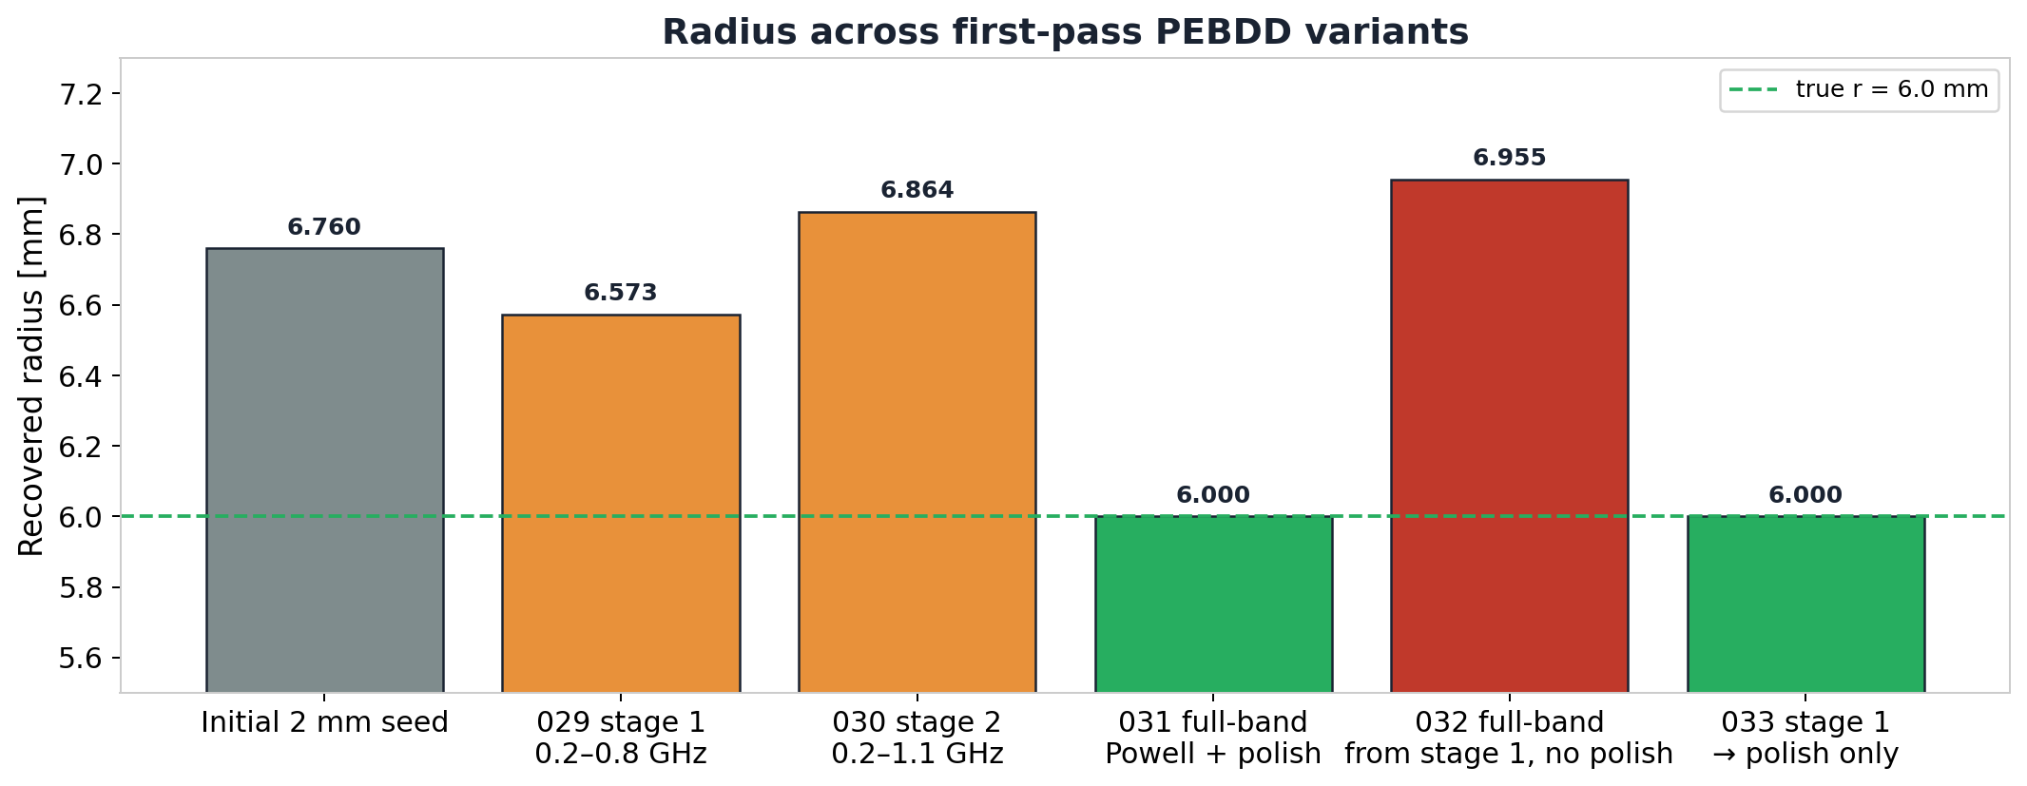
Radius across first-pass PEBDD variants
exp 029–033
Single-frequency 1.5 GHz, 5 scan positions (PEBDD = progressively expanded bandwidths of the data)
Each bar is the recovered radius at the end of one run. 'Powell' is SciPy's derivative-free local optimiser; 'polish' is a deterministic small (z, r) grid search after Powell. Polish is the only step that lands on 6.0 mm; full-band Powell without polish returns to the high-radius basin (r ≈ 6.95 mm) — the wrong local minimum it consistently finds.
16
Notes:
The bars go in chronological order. The grey bar on the left is the initial seed at radius 6.76 mm. Stage 1 with the low band brings radius down to 6.57 — that is a real improvement. Stage 2, which expands the band to 1.1 GHz, drifts back up to 6.86. The red bar in the middle is the control: stage 1 seed followed by a full-band Powell run without polish — it returns to the same 6.955 mm wrong basin as the original first-arc Powell result, which tells us the regression is caused by the full-band Powell objective itself, not by any particular staging choice. The two green bars are the only ones that land at the true 6.0 mm, and both of them used the polish stage.

Slide 17
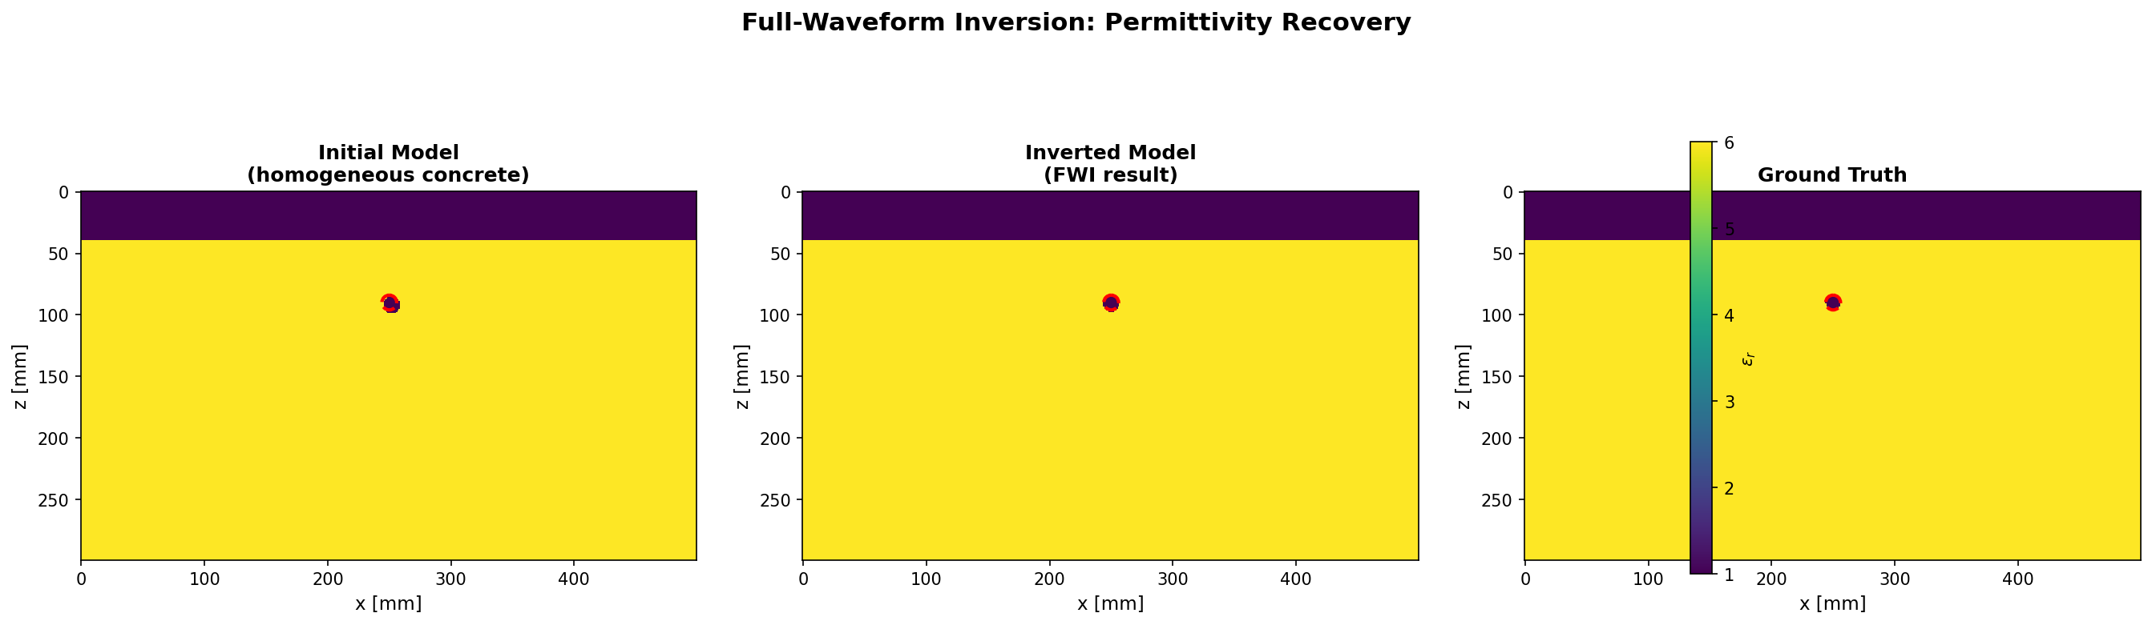
Stage 1: low-band Powell
exp 029
0.2–0.8 GHz objective; full unfiltered traces still used for NRMS
Stage-1 recovered r = 6.573 mm at x ≈ 249.8, z ≈ 90.6 mm. The low band moved radius toward the truth but did not reach it.
17
Notes:
The filtered objective at the end of this stage is about 1e-4 and the full-data NRMS is about 1.07 percent — both small numbers. But the recovered model still has the rebar slightly off in depth and at the wrong radius. The PEBDD-faithful detail here is that the observed and synthetic traces are filtered through the same band-pass before the residual is computed; older bandwidth-expansion methods filtered only the modelled side through the source wavelet, and that is the difference that made PEBDD survive on field data.

Slide 18

Stage 2: expanded to 0.2–1.1 GHz
exp 030
Bandwidth expansion from the stage-1 seed (same band-pass on observed and synthetic)
Recovered r drifts back up to 6.864 mm. Expanding the band re-introduces the depth–radius coupling (a slightly deeper rebar trades against a slightly larger radius to produce a near-identical waveform).
18
Notes:
Full-data NRMS (normalised RMS over the unfiltered traces) actually improves to about 0.79%, but the recovered radius worsens from 6.57 mm back toward 6.86 mm. This is the single most important lesson from the PEBDD-first-pass section: data fit and radius fidelity can move in opposite directions when the objective expansion reactivates the depth-radius tradeoff. The expanded band lets the optimiser explore amplitude detail the low band could not see, but the dominant valley in that detail is the high-radius basin, not the true r = 6.0 mm minimum. This behaviour was not predictable from the paper's claims alone — it is specific to our rasterised-geometry setting and is what motivates the polish stage that follows.

Slide 19

Stage 3: full band + polish
exp 031
Full-band Powell from stage 2, then a deterministic coarse grid polish
Polish recovers r = 6.000 mm (NRMS model = 0). Powell alone reverts to r = 6.955 mm before polish takes over — same wrong basin as the no-PEBDD path.
19
Notes:
The top polish candidates here are radius 6.0 mm with misfit zero, radius 6.2 with misfit 1.04e-3, and radius 6.8 with misfit 2.08e-3. That is exactly the same ranking the simpler single-frequency polish produced in the first deck. The implication is unambiguous: even with the multi-stage bandwidth schedule wrapped around it, the polish stage is what does the radius work. PEBDD as we have implemented it has not added to radius accuracy; it has only added compute cost. This is the first hard evidence that PEBDD on its own cannot solve radius, and it sets up the spectrum-design section that asks whether the band choices themselves were wrong. One caveat: this is the exact-synthetic case. Under noise the same conclusion holds, but the polish stage starts to need careful early-stop thresholds to avoid following noise instead of geometry.

Slide 20
Control: full-band Powell, no polish
exp 032
Same stage-1 seed, run full-band Powell without polish — isolates the bandwidth role
Final r = 6.955 mm. Confirms the regression we saw in stage 2 is the full-band Powell objective itself, not a specific staging choice.
20
Notes:
This run isolates blame between two suspects. Either the staged path itself is unstable — maybe stage 2 destabilised something — or the full-band Powell objective is the cause because of the depth-radius valley we discussed earlier. If the staged path were at fault, removing the polish step would still leave us at a moderate radius. If the full-band objective were at fault, we would land back at the original wrong basin. The result is unambiguous: r = 6.955 mm, exactly the same as the original first-arc Powell result. The full-band Powell objective is the cause, not the staging. That conclusion lets us promote the 'stage 1 seed → polish only' variant on the next slide, which removes the full-band Powell step entirely.

Slide 21

Pragmatic path: stage 1 seed → polish only
exp 033
Skip full-band Powell; use low-band seed to enter the polish window
Recovered r = 6.000 mm. The low-band seed plus polish is the cleanest staged path on exact data.
21
Notes:
This is the variant we promote on exact data: low-band Powell to land in the right basin, then full-band polish to select radius. It is faster than the full Powell-plus-polish path because we skip the most expensive Powell stage. The caveat is that this only works on exact data — under noise the low-band stage does not move radius much, and the next slide shows the noise variant explicitly.

Slide 22
Noise variant: PEBDD seed + polish under noise
exp 034–037
Experiments 034–037
Under noise, the low-band Powell stage stops in the high-radius basin. The polish stage still recovers r = 6.0 mm.
experiment noise powell r polish r NRMS data
------------------------------------------------------------------------------------------
034 stage 1, 5% noise 5% 6.999 mm - 5.09%
035 polish from stage 1, 5% noise 5% - 6.000 mm 5.02%
036 stage 1, 10% noise 10% 6.927 mm - 10.05%
037 polish from stage 1, 10% noise 10% - 6.000 mm 10.01%
Bandwidth scheduling helps move rough seeds; the polish is the radius selector.
22
Notes:
Two additive-noise seeds, 5 percent and 10 percent RMS. The low-band Powell stage stays near r = 7.0 mm in both cases — it does not move radius under noise. The polish stage is what recovers the true 6.0 mm. So under noise the low-band stage is a seed-builder, not a radius corrector, and the headline is the same as the exact-data case: bandwidth scheduling moves rough seeds into the right window, but the polish stage is the radius selector.

Slide 23
Cumulative frequency — first try
exp 038–041
Add a 1.0 GHz source carrier alongside the 1.5 GHz one, average the two
Hypothesis
Adding a complementary source carrier frequency should help radius, in the spirit of WRI's cumulative-frequency strategy (low frequencies kept while higher ones are added).
What we did
Added per-frequency objective contributions (the residual misfit split by source centre frequency, not just the average) to the summary, and ran a coarse grid polish at the known high-radius seed using two source frequencies (1.0 + 1.5 GHz).
What we'll see
Polish still recovers r = 6.0 mm in this exact case.
But the per-frequency split shows that 1.0 GHz is a much weaker radius discriminator than 1.5 GHz.
Equal averaging dilutes the useful radius evidence.
23
Notes:
Two new pieces of plumbing were added here. First, per-frequency reporting in the summary JSON, so we can see which source band a candidate's misfit actually came from. Second, a --frequency-weights CLI flag for weighted averaging across frequencies. These two together set up the frequency-weighting matrix that we will see in the next section.

Slide 24
Two-frequency polish
exp 040
1.0 + 1.5 GHz objective, coarse polish from the high-radius seed
Polished r = 6.000 mm. Per-frequency margins: 1.0 GHz = 3.56e-5, 1.5 GHz = 1.04e-3. The average dilutes the 1.5 GHz evidence by roughly half.
24
Notes:
The recovered model panel looks the same as the earlier polish results because the true model has zero misfit at both frequencies. The interesting information is in the margin numbers. At r = 6.2 mm, the 1.0 GHz objective gives a misfit of 3.56e-5, while the 1.5 GHz objective gives 1.04e-3 — roughly a thirty-times ratio. When we average the two equally, the effective margin drops to about 5.4e-4, roughly halfway between. The conclusion to take away when designing multi-frequency objectives: equal weighting is not neutral. It dilutes the most informative frequency.

Slide 25
Designing PEBDD bands from real spectra
exp 043–044
Choose band edges from what the data actually contains
Hypothesis
The guessed low band (0.2–0.8 GHz) may have contained almost none of the energy that distinguishes nearby radii. Choose bands from real signal/residual spectra instead.
What we did
Built a spectrum-design runner. Saved source, observed and candidate-residual spectra for the true model, a near-radius (r = 6.2) candidate, and the known high-radius Powell candidate, with and without 10% noise.
What we'll see
Radius-discriminating residual energy lives mostly above 1 GHz, peaking near 2 GHz.
The earlier 0.2–0.8 GHz band contained ≈ 2% of that energy.
Noise residual is broadband — useful as a stress test, not as a faithful field-noise model.
25
Notes:
The implementation lives in two files: inversion/spectrum_analysis.py for the core logic, and run_single_rebar_spectrum_design.py for the experiment runner. The three spectra — source, observed, and candidate residual — are all saved as a single CSV so we can re-render at any zoom level. The figures on the next three slides are re-rendered with the x-axis cropped to 0–4 GHz, because the original saved figures extend to about 250 GHz Nyquist and the relevant content is invisible at that scale.

Slide 26
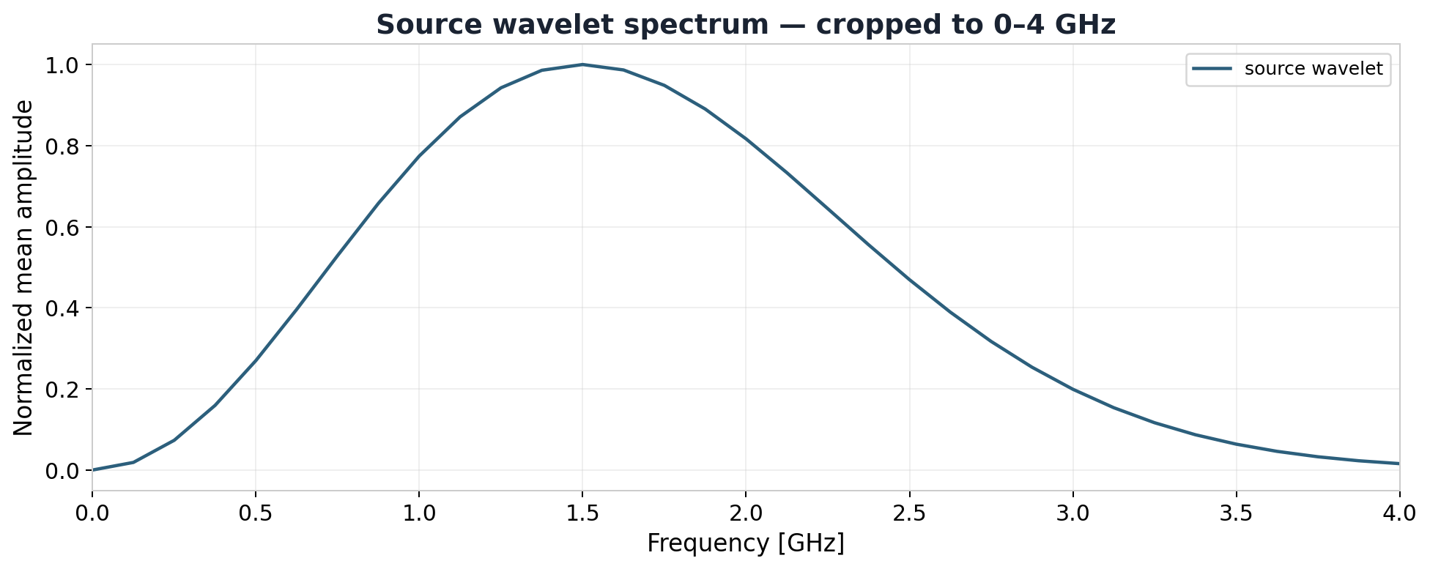
Source wavelet spectrum
exp 043
1.5 GHz Ricker pulse, FFT amplitude (Ricker = negative second derivative of a Gaussian)
Useful source band is roughly 0.75–2.5 GHz with peak at 1.5 GHz. x-axis cropped to 0–4 GHz for readability; the FDTD sampling rate (~250 GHz Nyquist) sets the figure's untrimmed extent.
26
Notes:
The runner reports the 5-to-95 percent source-energy band as 0.75 to 2.5 GHz, with peak at 1.5 GHz, which matches the nominal centre frequency of the Ricker pulse. This sets a hard upper limit for any band design that comes next: anything we ask the inversion objective to fit above about 2.5 GHz is fitting noise or numerical content, not real source content. It also explains why the W2 / Sinkhorn experiments later in the deck need to downsample along the time axis — the source band is narrow compared to the trace sampling rate, so most of the trace samples carry no source information and are pure simulator overhead from Sinkhorn's perspective.

Slide 27
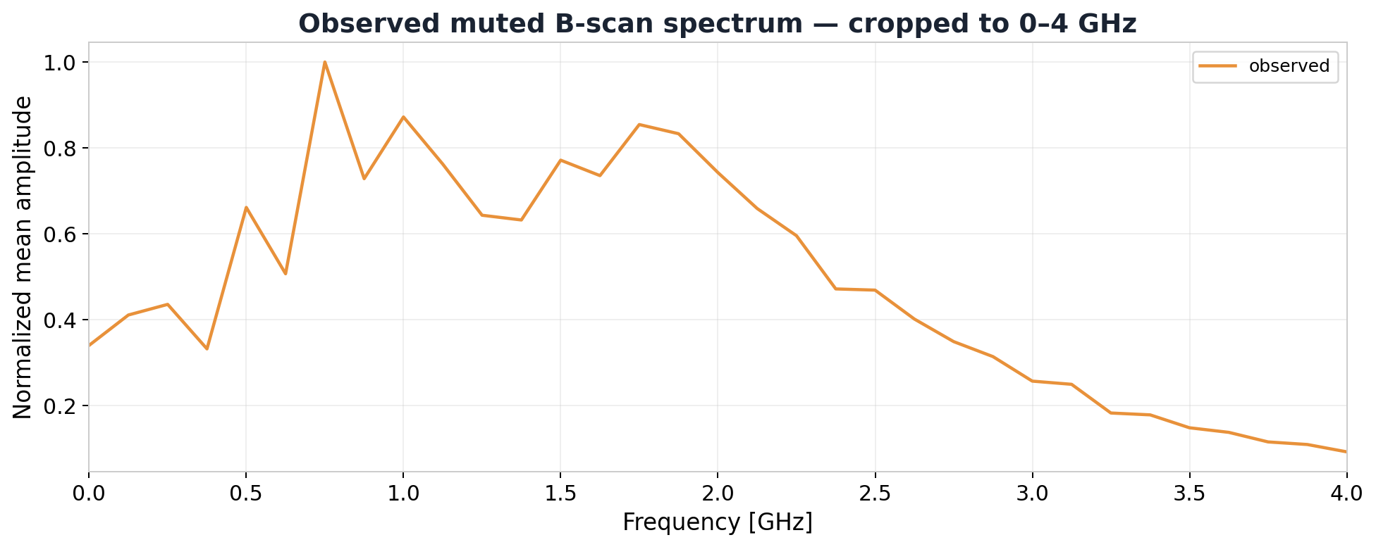
Observed muted B-scan spectrum
exp 043
Spectrum of the synthetic observed traces
Observed energy band 0.375–2.75 GHz, peak at 0.75 GHz. The medium and antenna geometry have shifted energy downward relative to the source spectrum.
27
Notes:
Notice that the observed spectrum peak is at 0.75 GHz, not 1.5 GHz. That can surprise the audience: the source carrier is 1.5 GHz, but by the time the wave has propagated through air, crossed the air-concrete interface, scattered off the rebar, and returned through the Tx–Rx geometry, the energy distribution has shifted downward. The important caveat is that this does not mean the radius information lives at 0.75 GHz. The radius-discriminating part is in the residual, not in the observed trace itself — and the next slide shows the residual spectra explicitly.

Slide 28
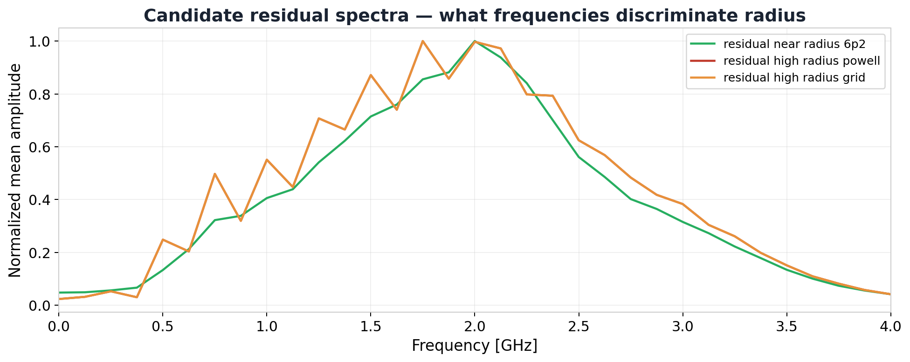
Candidate residual spectra — the headline plot
exp 043
What frequencies actually distinguish nearby radii (residual = synthetic − observed, then FFT amplitude)
Residual energy from a near-radius candidate (r = 6.2 mm) and the known high-radius Powell candidate (r ≈ 6.95 mm — Powell is SciPy's derivative-free local optimiser that consistently lands here) both peak near 2 GHz. Bands below 1 GHz carry almost none of the radius evidence.
This is why the first-pass 0.2–0.8 GHz schedule could not fix radius.
28
Notes:
The numerical context behind this chart: for the r = 6.2 mm near-radius candidate, the residual energy captured by progressively wider bands is 2.1 percent in 0.2–0.8 GHz, 5.5 percent in 0.35–1.10, 22.5 percent in 0.35–1.50, 60.4 percent in 0.35–2.00, and 89.7 percent in 0.35–2.50. So the difference between r = 6.0 and r = 6.2 lives almost entirely above 1 GHz, with the peak near 2 GHz. This single chart is what justified the spectrum-derived schedule on the next slides.

Slide 29
Faithful spectrum-derived PEBDD schedule
exp 045
Run the new bands as a staged Powell + polish
Hypothesis
If the band edges were the problem, the spectrum-derived schedule should land Powell closer to the true radius before polish.
What we did
Built a staged runner using the bands 0.35–1.10 → 0.35–1.50 → 0.35–2.00 → 0.35–2.50 GHz, then a final full-band coarse polish. Exact data, 5 sources, 1 mm grid.
What we'll see
x and z stay on target throughout.
Each Powell stage stops in the high-radius basin (r ≈ 6.86–6.93 mm).
Final full-band polish recovers r = 6.000 mm exactly.
29
Notes:
The runner is run_single_rebar_bandwidth_schedule.py. Each stage's outputs are saved as a nested directory inside the experiment directory — stage01_0.35_1.10GHz, stage02_0.35_1.50GHz, and so on, ending with a final_fullband_coarse_polish stage. This run is the controlled comparison to the first-pass PEBDD: the same staged shape, but with bands chosen by the spectrum tool rather than by guesswork.

Slide 30
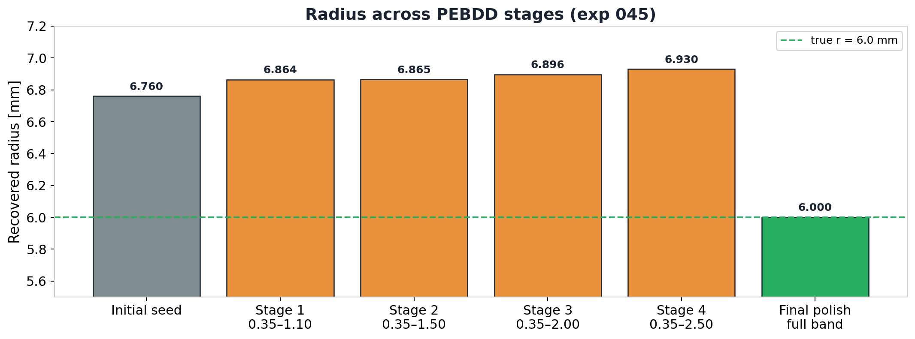
Stage-by-stage recovered radius
exp 045
Spectrum-derived PEBDD schedule
Powell stages stay in the high-radius basin even as the band widens to 2.5 GHz. The final polish is the step that lands radius on truth.
30
Notes:
The Powell stages move slightly away from truth as the band widens — from 6.864 in stage 1 up to 6.930 in stage 4. The right interpretation is that radius is already as well determined as Powell can make it in the lowest band, and the wider bands reactivate the depth-radius valley rather than adding new constraints. Polish is what removes the bias. The headline of this section is the same as the first-pass section: bandwidth scheduling helps with seed building, not with radius selection.

Slide 31
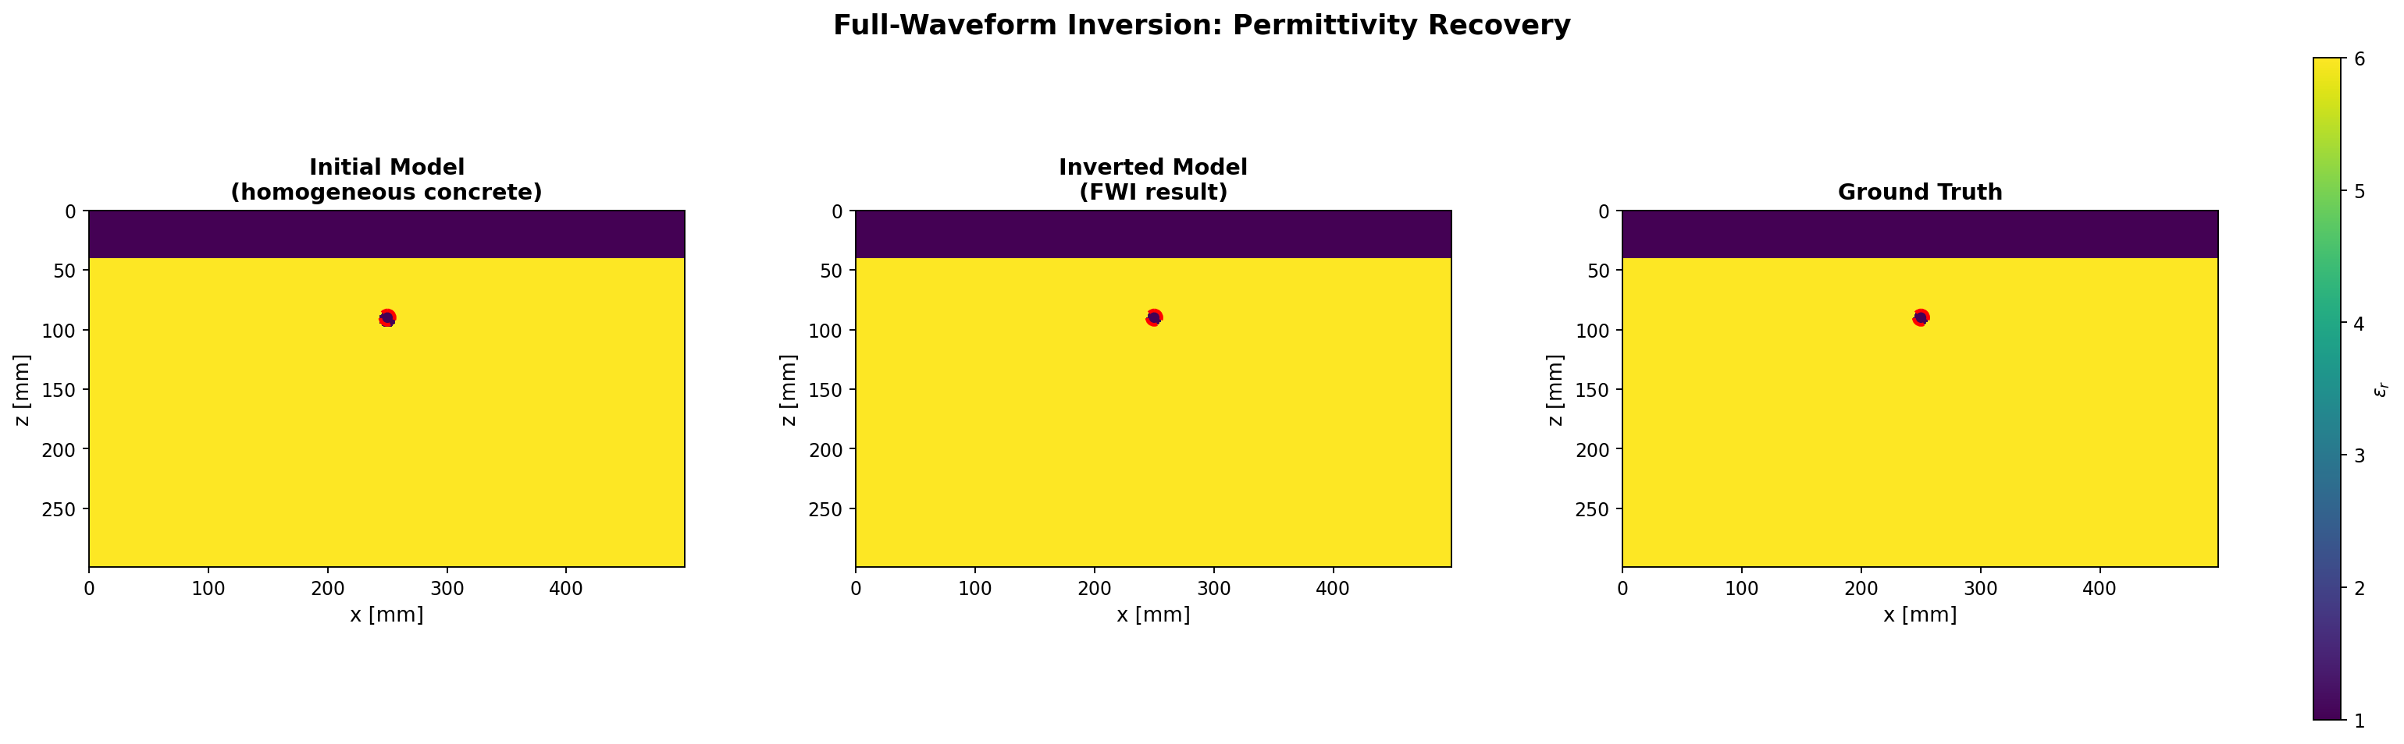
Final full-band coarse polish — model comparison
exp 045
Final stage of the faithful PEBDD schedule (NRMS = normalised root-mean-square misfit)
Recovered geometry matches truth on the 1 mm grid (NRMS model = 0, NRMS data = 0). Top polish candidates (J = least-squares waveform misfit; lower is better): r = 6.0 mm (J = 0), r = 6.2 mm (J = 1.04 × 10⁻³), r = 6.8 mm (J = 2.08 × 10⁻³).
31
Notes:
Normalised root-mean-square misfit is zero on both the model and the data. The polish margin — the objective gap between the chosen r = 6.0 mm and the next-best r = 6.2 mm — is about 1.04e-3, identical to the simpler polish from the first arc. So the bandwidth schedule did not change the radius evidence the polish stage operates on; it only ensured the polish started inside the right (x, z) window.

Slide 32
03
Frequency weighting and W2
Where to put the spectral evidence weight, and when not to
32

Slide 33
Frequency-weighted radius margins
exp 046–049
Five weight schemes evaluated on the same local x / z / r candidate grid
Hypothesis
If multi-frequency information is genuinely useful for radius, some weighted combination should beat single-frequency LS (least squares).
What we did
Built a frequency-weight matrix runner. Swept radius 5.4–7.8 mm at four depths under five weight schemes: low_only (1.0 GHz alone), onepointfive_only (1.5 GHz alone), unweighted (equal average), carry_low_25 (0.25 × 1.0 GHz + 1.0 × 1.5 GHz), carry_low_50 (0.5 × 1.0 GHz + 1.0 × 1.5 GHz). Ran exact, 5% noise, and 10% noise versions.
What we'll see
low_only has the weakest radius margin (30x smaller than 1.5 GHz alone).
Unweighted averaging cuts the radius margin nearly in half.
carry_low_25 preserves most of the 1.5 GHz margin while keeping low-frequency carry.
33
Notes:
The runner is run_single_rebar_frequency_weight_matrix.py. Weight schemes are specified as comma-separated lists — for example, '0.25,1' means 25 percent weight on the 1.0 GHz residual and full weight on the 1.5 GHz residual. The runner reports the best-radius-versus-next-radius margin per scheme, so the schemes can be ranked at a glance from a single output table.

Slide 34
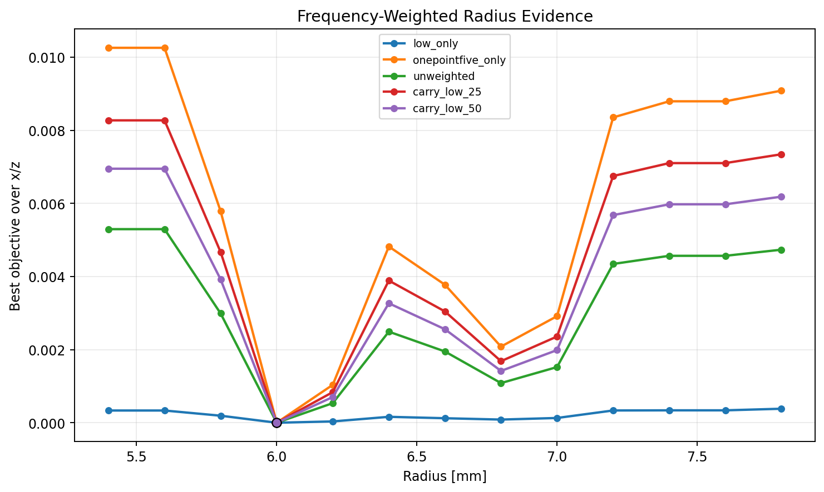
Exact-data radius margin under five weight schemes
exp 046
Common local x / z / r candidate grid evaluated for each scheme
Scheme legend — low_only: 1.0 GHz alone; onepointfive_only: 1.5 GHz alone; unweighted: equal 1.0 + 1.5 GHz average; carry_low_25 / carry_low_50: 0.25 (or 0.50) weight on 1.0 GHz plus full weight on 1.5 GHz. The deepest valley at r = 6.0 mm wins on radius discrimination; flatter curves are weaker.
34
Notes:
The distinct-radius margins between r = 6.0 and r = 6.2 are: 3.56e-5 for low_only, 1.04e-3 for onepointfive_only, 5.36e-4 for unweighted, 8.37e-4 for carry_low_25, and 7.03e-4 for carry_low_50. The pattern is intuitive once we have seen the spectrum-design slide: 1.0 GHz is below the residual-energy band that distinguishes nearby radii, so it carries little radius information, and equal averaging just dilutes the useful evidence from 1.5 GHz.

Slide 35
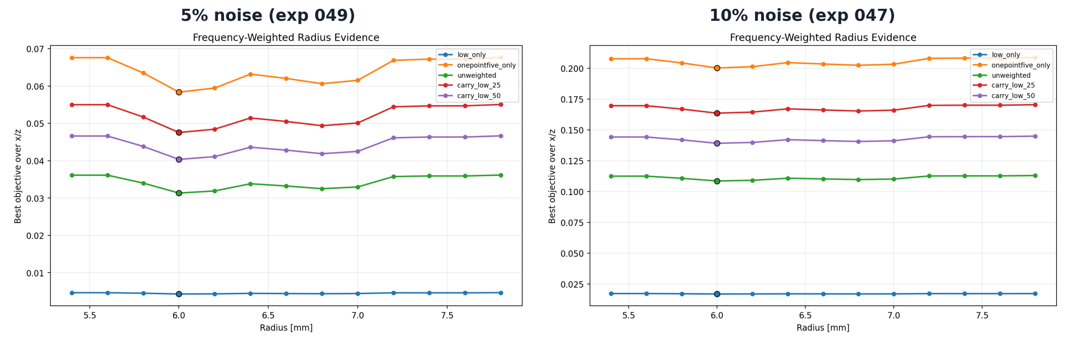
Same conclusion under noise — 5% and 10%
exp 047 + 049
Side-by-side: 5% additive trace-RMS noise on the left, 10% on the right
Margin = objective value at r = 6.2 mm minus value at r = 6.0 mm (larger margin → stronger radius discrimination). The headline numbers at 10% noise: 1.04 × 10⁻³ (1.5 GHz only), 8.4 × 10⁻⁴ (carry_low_25 = 0.25 × 1.0 GHz + 1.0 × 1.5 GHz), 5.4 × 10⁻⁴ (unweighted average), 3.1 × 10⁻⁵ (1.0 GHz only). Ranking is identical at 5%.
35
Notes:
The two panels are nearly identical, which is the point: the ranking is robust to the noise level. The practical recommendation from this whole matrix is: use 1.5 GHz-only least squares for the final radius decision; use carry_low_25 if a low-frequency contribution is needed for basin continuity — for example, when the initial seed is poorer and we still need some sensitivity to broad-scale features. Never use the unweighted equal average for radius selection; the margin loss is consistent across noise levels.

Slide 36
W2 / Optimal Transport — gate 1
exp 048
Replicate the paper's shift-convexity claim on shifted Ricker pulses
Hypothesis
The W2 paper claims that quadratic Wasserstein with Softplus normalisation (log(1+e^(βx)) — turns a signed trace into a non-negative mass distribution) and Sinkhorn iterations (entropy-regularised cheap OT) is monotonic over time shifts where standard L2 has spurious local minima from oscillatory cancellation.
What we did
Built a standalone Softplus / Sinkhorn W2 module. Computed both L2 and W2 over a −28 … +28 sample shift range for a Ricker pulse, with β ∈ {4, 8, 12} (Softplus scale) and ε = 0.02 (Sinkhorn entropy).
What we'll see
L2 has 24 monotonicity violations across the tested shift range.
W2 is smoothly monotonic for every tested β.
Paper claim reproduced — but on shifted Ricker traces, not on the rebar problem.
36
Notes:
The W2 module lives in inversion/trace_wasserstein.py as a standalone object with unit tests. The Softplus scale β controls how strongly the signed waveform is transformed before being normalised to a mass distribution; the Sinkhorn entropy regularisation ε trades transport accuracy for numerical stability. We test three β values — 4, 8, and 12 — as a small sensitivity sweep. We call this gate 1 because passing the trace-shift test is necessary but not sufficient for W2 to be useful on the actual radius problem; gate 2 is the rebar landscape three slides from now.

Slide 37
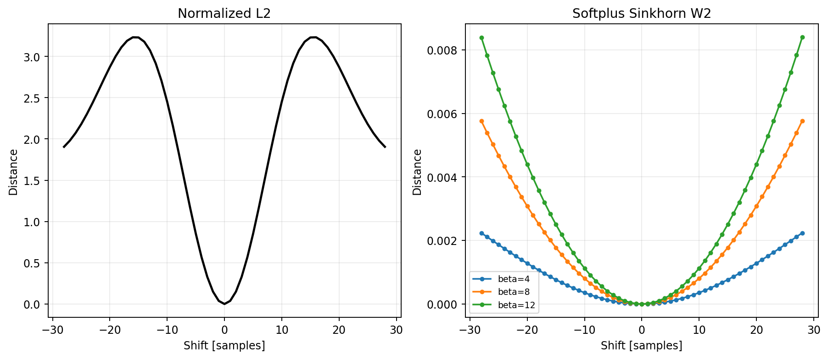
W2 trace convexity — paper claim holds
exp 048
Softplus / Sinkhorn quadratic Wasserstein (W2) vs least-squares (L2) over shifted Ricker pulses
L2 (left) shows the classical cycle-skip pattern: zero only at shift = 0, with a second 'mountain' that traps optimisers. W2 (right) is smooth and monotonic on both sides of zero for all three Softplus scales (β = 4 / 8 / 12) — the larger β, the sharper the curvature near zero.
37
Notes:
The L2 panel on the left hits zero only at the shift-equals-zero point, but it rises and then falls again on each side — that second mountain is the cycle-skip trap that misleads optimisers. The W2 panel on the right is U-shaped and monotonic on both sides of zero for all three β values. β = 12 has the sharpest curvature near the minimum, which would matter for an optimiser. We use β = 8 on the next slide for the rebar landscape as a balance between sharpness and numerical stability.

Slide 38
W2 — gate 2 on the actual rebar landscape
exp 050–051
Move quadratic Wasserstein (W2) from the shift smoke test to the radius problem
Hypothesis
If W2's better convexity transfers to the rebar landscape, its margin (objective gap) between r = 6.0 mm and r = 6.2 mm should be comparable to or better than the standard least-squares (LS) margin.
What we did
Evaluated the same Softplus / Sinkhorn W2 on the same local x / z / r candidate grid as the LS landscape (β = 8 = Softplus scale, ε = 0.02 = Sinkhorn entropy regularisation, ds = 8 / 16 = downsample factor for trace length; ds reduces the Sinkhorn cost by taking every nth sample of the trace).
What we'll see
LS margin (r=6.0 vs r=6.2): 1.04e-3.
W2 margin: 1.06e-7 (downsample 16); 1.03e-7 (downsample 8).
Softplus normalisation removes the amplitude content that radius depends on.
38
Notes:
The runner is run_single_rebar_w2_landscape.py. The downsample parameter is needed because Sinkhorn on the full trace length is expensive — ds = 16 means we take every sixteenth sample of the muted trace before computing W2. The key story to land here is that the W2 paper's claim about shifts genuinely holds — we just saw that in gate 1 — but the radius problem in our setup is not a shift problem, so W2's advantage does not transfer.

Slide 39
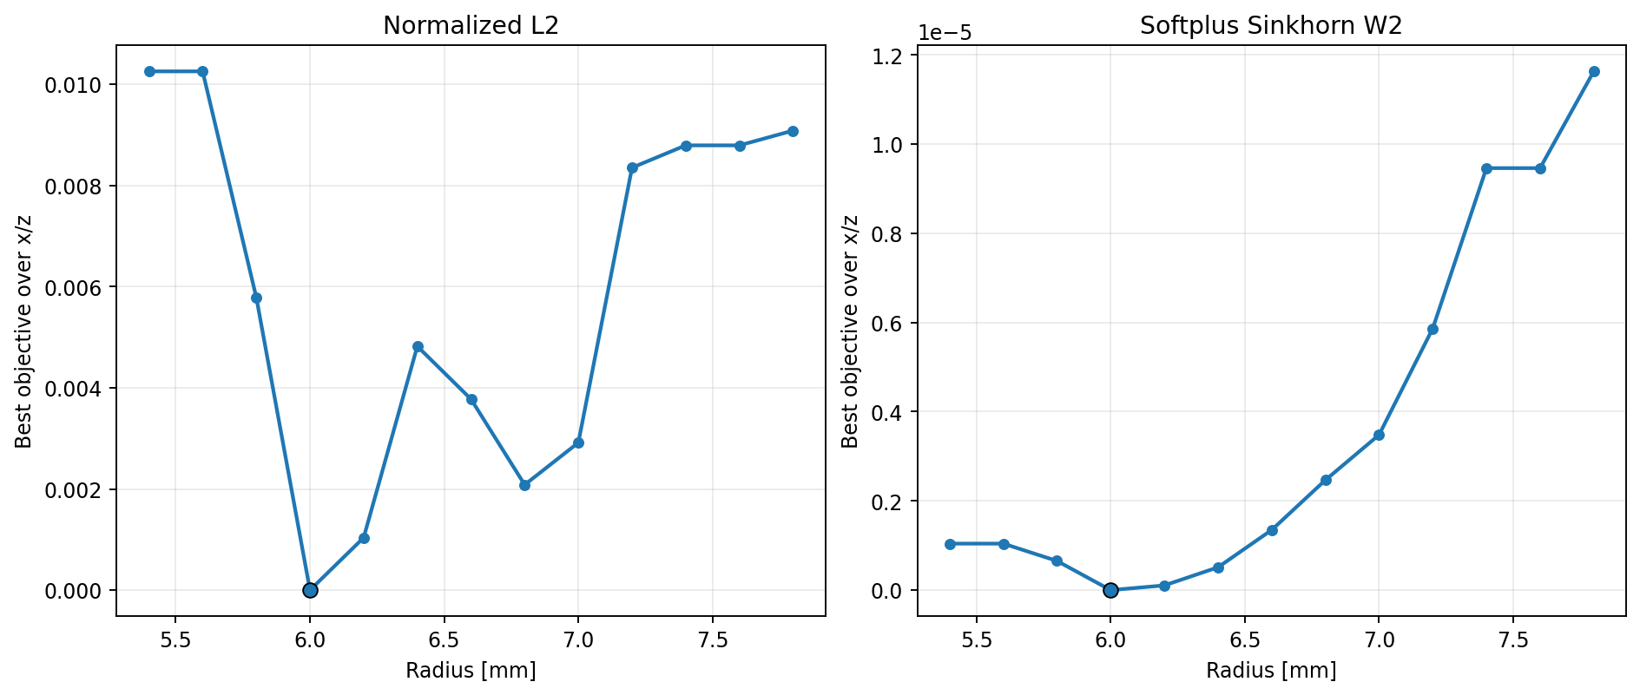
W2 radius margin collapses on the rebar problem
exp 050
Note the W2 y-axis is in units of 1 × 10⁻⁵
L2 = least squares (left): the familiar deep V at the true radius r = 6.0 mm. W2 = quadratic Wasserstein with Softplus normalisation (right): nearly flat — radius margin is 1.06 × 10⁻⁷ vs 1.04 × 10⁻³ for L2 (≈ 10 000× smaller). Softplus removed the amplitude content that radius depends on.
Decision: reject W2 as the final radius objective. Keep it as a basin diagnostic for field data.
39
Notes:
Both panels reach zero at r = 6.0 mm, but the L2 plot on the left has wings on the order of 1e-3, while the W2 plot on the right has wings on the order of 1e-7. The downsample-equals-8 version in experiment 051 is qualitatively identical, so this is not a numerical artefact of how we set up Sinkhorn. The decision is to reject W2 as the final radius objective for this problem. We keep the module available because it may still be useful as a basin diagnostic for future poor initial models or field data, but for radius selection we stay with least squares.

Slide 40
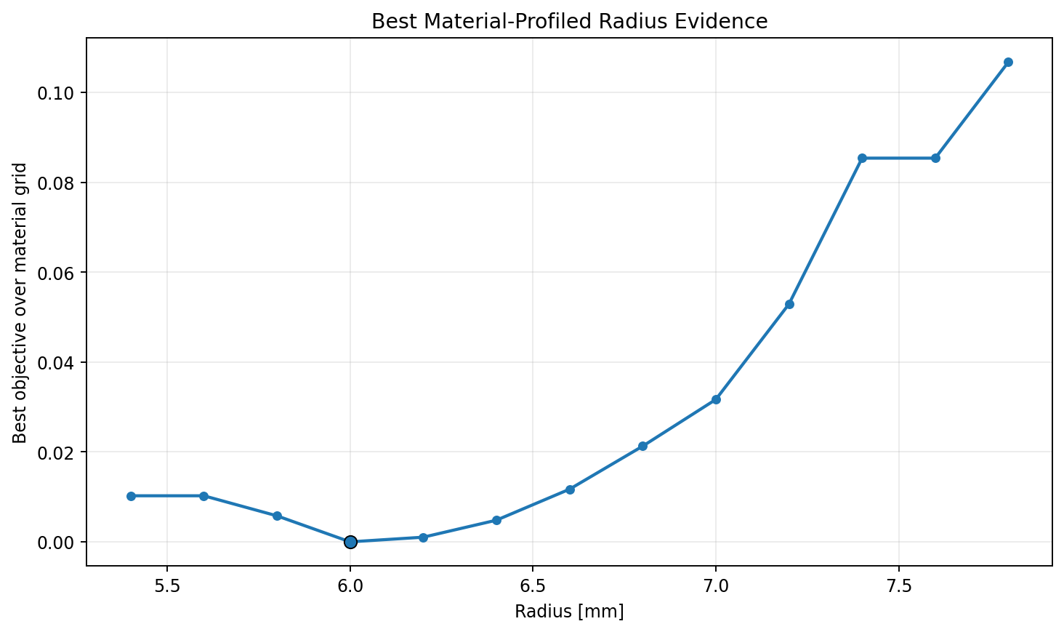
Material tradeoff — does material explain radius?
exp 056
Fixed x = 250, z = 90 mm; sweep radius × εr × σ (εr = relative permittivity / dielectric constant; σ = electrical conductivity, S/m)
Hypothesis: at the correct (x, z) location, free material parameters could let a wrong radius still fit the data.
Sweep: r = 5.4–7.8 mm × εr ∈ {5.5, 6.0, 6.5} × log10 σ ∈ {5, 6, 7} S/m.
Result:
• Best material set is the true one (εr = 6.0).
• Rebar σ saturates above ≈ 10⁵ S/m (1e5, 1e6, 1e7 all behave the same — the rebar already acts as a perfect conductor).
• Best radius is 6.0 mm; distinct-radius margin against r = 6.2 mm is J = 1.04 × 10⁻³ (J = least-squares misfit).
Decision: do not add material parameters to the radius optimiser at this stage.
40
Notes:
The runner is run_single_rebar_material_tradeoff.py. The top four candidates in the saved summary tell the whole story. Rank 1 is the true model: r = 6.0, εr = 6.0, σ = 1e7, misfit zero. Ranks 2 and 3 are also r = 6.0 with εr = 6.0, but with σ values of 1e6 and 1e5 — and the misfit values are tiny, 3.18e-10 and 3.85e-8. That is the saturation: once σ is high enough for the rebar to behave as a perfect conductor, the exact value stops mattering. Rank 4 is r = 6.2 with the true εr, and the misfit is 1.04e-3 — the familiar radius margin. The εr value is genuinely identified; the σ value is saturated above 1e5 S/m. That tells us we do not need to introduce free material parameters into the radius optimiser at this stage.

Slide 41
04
Wavelet mismatch — the key new finding
What breaks the pipeline first when we leave the synthetic comfort zone
41

Slide 42
Source-wavelet mismatch — does radius survive?
exp 052–055
Perturb only the observed source pulse; modelled source stays nominal
Hypothesis
Real data don't have a perfectly known source pulse. If the observed source differs from the modelled one in amplitude, time-zero, or centre frequency (fc), does the radius selection still hold?
What we did
Built a wavelet-mismatch runner. Held the modelled source at nominal 1.5 GHz Ricker; perturbed only the observed source across seven cases. Case-code legend: nominal = no change; fc_low10 / fc_high10 = source centre frequency ×0.9 or ×1.1; delay_±50 ps = observed source shifted later (+50 ps) or earlier (−50 ps); amp_low10 / amp_high10 = observed source scaled by 0.9 or 1.1. Same local radius grid as the frequency-weighting matrix.
What we'll see
Pure amplitude mismatch shifts the best radius by one grid step.
Pure centre-frequency or time-delay mismatch can peg the best radius to the grid bound (5.4 or 7.8 mm).
Adding source profiling one nuisance parameter at a time (amplitude → + time → + frequency-scale) recovers the true radius.
42
Notes:
The runner is run_single_rebar_wavelet_mismatch.py. The modelled source wavelet stays at the nominal 1.5 GHz Ricker; only the observed truth changes from case to case. This is the first experiment series in the deck where we allow any aspect of the source to be wrong, and it is where the most important new finding of this arc comes from. The fix unfolds across four slides — each slide adds one nuisance parameter to the objective and shows which mismatch cases recover and which do not.

Slide 43
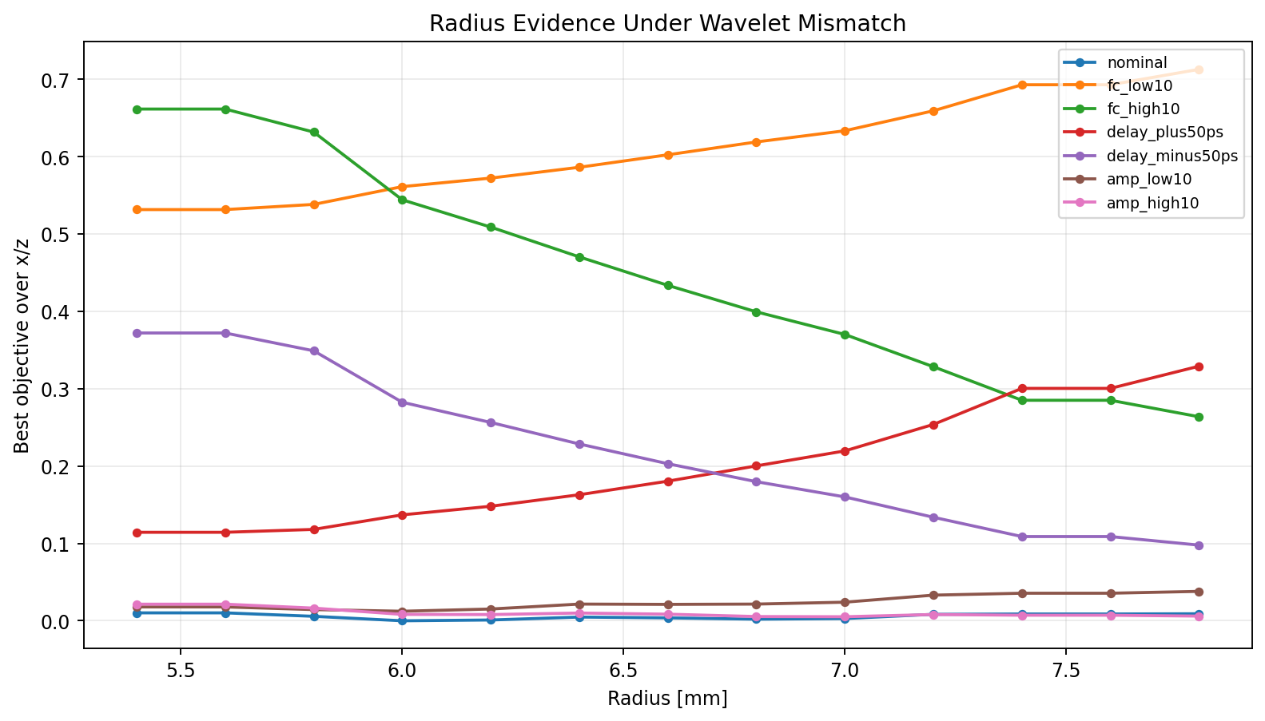
Raw mismatch — radius pegged to the grid bound
exp 052
Fixed-source least-squares (LS) with no nuisance parameters fit per candidate
Case codes: fc_low10 / fc_high10 = observed centre frequency ×0.9 / ×1.1; delay_±50 ps = observed source shifted later / earlier by 50 ps; amp_low10 / amp_high10 = observed amplitude ×0.9 / ×1.1. Only the nominal and amp_low10 curves keep their minimum at r = 6.0 mm — the four fc / delay cases push the minimum to the lower (5.4 mm) or upper (7.8 mm) radius bound.
43
Notes:
The best-radius per case tells the story. Nominal recovers 6.0 mm, fc_low10 pegs to the lower grid bound at 5.4, fc_high10 pegs to the upper bound at 7.8, delay_+50 ps goes to 5.4, delay_−50 ps goes to 7.8, amp_low10 stays at 6.0, and amp_high10 moves to 7.0. The asymmetry is real: pegging to the lower bound corresponds to a slower observed wavelet — later arrival, longer period — while pegging to the upper bound corresponds to a faster one. This is the kind of failure that would only show up after moving to real data. It is the motivation for the three nuisance-parameter slides that follow, which fix the cases one at a time.

Slide 44
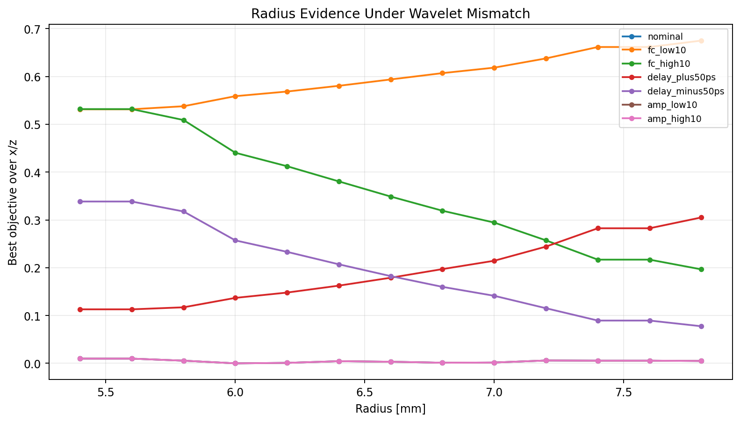
+ amplitude scalar fit
exp 053
Fix amplitude mismatch first — fit one scalar amplitude per candidate (closed form, essentially free)
Amplitude mismatch is cleanly separated from radius. amp_high10 (observed amplitude ×1.1) returns to r = 6.0 mm; the four fc / delay cases (centre-frequency and time-shift perturbations) are unchanged.
44
Notes:
The optimal scalar amplitude for each candidate has a closed form — it is the standard inner-product over norm-squared ratio, the dot product of d_obs and d_syn divided by the dot product of d_syn with itself. That makes it essentially free compared to the cost of a forward solve. The amp_high10 line, where the observed source was scaled by 1.1, now sits on top of the nominal line. The fc_low10, fc_high10, delay_+50, and delay_-50 lines are unchanged because amplitude fitting cannot absorb phase or bandwidth differences. The takeaway is that amplitude is the smallest, cheapest nuisance parameter that meaningfully reduces source-mismatch bias — if the budget only allows one, this is the one to add.

Slide 45
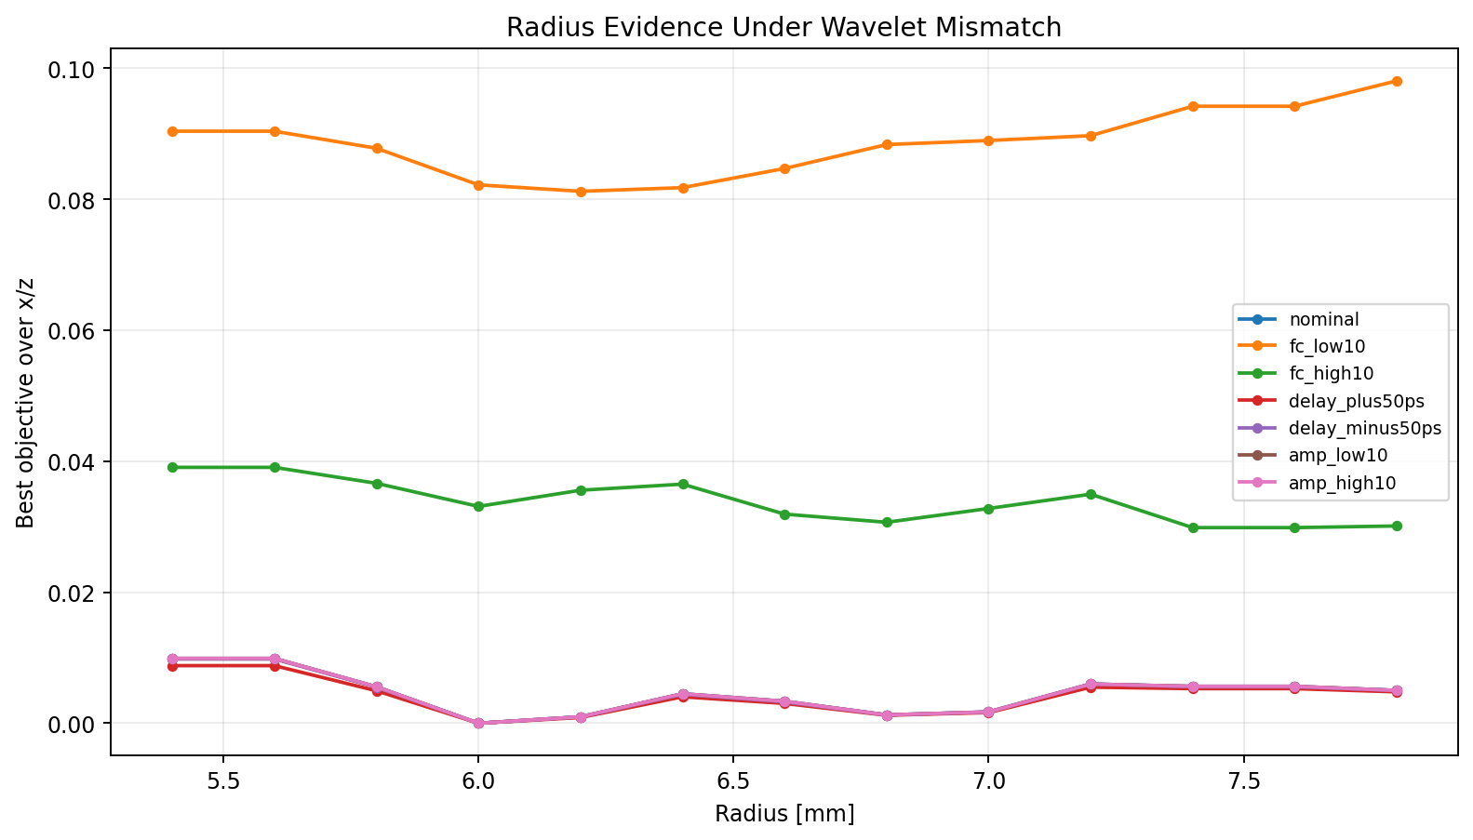
+ global time-shift grid
exp 054
Add a small ±80 ps time-shift profile to the nuisance fit
Time-shift grid: {−80, −50, −25, 0, +25, +50, +80} ps applied globally per scan position (not per candidate). delay_±50 ps cases land back at r = 6.0 mm. The remaining failure is the fc_low10 / fc_high10 pair (centre-frequency ×0.9 / ×1.1) — bandwidth mismatch is not yet absorbed.
45
Notes:
The time-shift grid is small on purpose — minus 80, minus 50, minus 25, zero, plus 25, plus 50, plus 80 picoseconds. The shift is global per scan position, meaning one value per (scan, candidate) pair, not a free per-trace parameter; that keeps the nuisance space small enough to enumerate exhaustively. The delay-plus-50 and delay-minus-50 cases now land back at r = 6.0 mm because a global plus 50 picosecond shift in the modelled trace fully absorbs a minus 50 picosecond observed mismatch. The fc_low10 case partially recovers — the best radius moves from the lower grid bound at 5.4 mm up to 6.2 mm — because a time shift can partially compensate for a longer-period observed pulse, but fc_high10 still fails. Bandwidth mismatch is fundamentally different from a pure time shift and needs its own nuisance parameter, which the next slide adds.

Slide 46
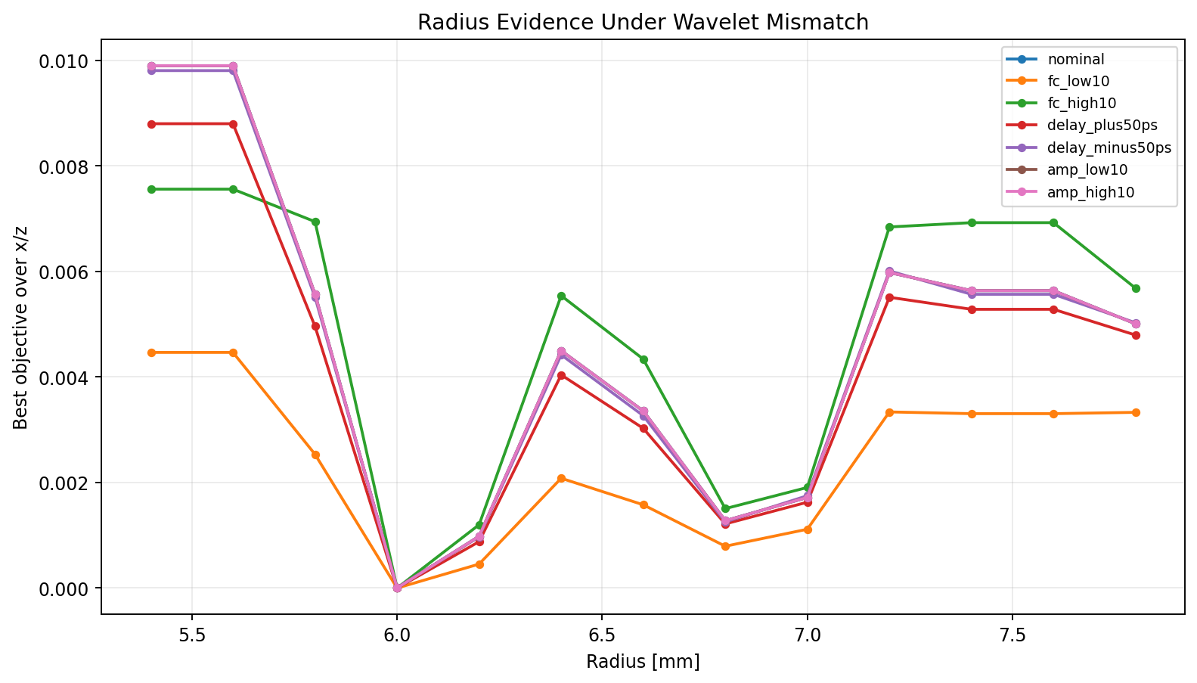
+ frequency-scale profile — all cases recover
exp 055
Add a small centre-frequency scale grid (fc_scale ∈ {0.9, 1.0, 1.1}) to the source profile
Per-candidate nuisance fit is now: amplitude scalar + global time-shift + centre-frequency scale. All seven mismatch cases collapse onto a clean V at the true r = 6.0 mm. Distinct-radius margin (objective gap to r = 6.2 mm) ranges from 4.55 × 10⁻⁴ (fc_low10) to 1.20 × 10⁻³ (fc_high10).
This is the most important new contribution of this arc.
46
Notes:
The frequency-scale grid is small on purpose — just three values, 0.9, 1.0, and 1.1 — because each value needs its own FDTD forward solve, so the grid is the expensive part of the nuisance fit. All seven mismatch cases now land at r = 6.0 mm. This slide is the diagnostic matrix that tells us the three-piece source profile — amplitude scalar, time-shift grid, and frequency-scale grid — is sufficient to absorb the kinds of mismatch we tested. The next section packages the same three pieces into a reusable production polish runner.

Slide 47
05
Source-profiled polish — synthesis
Every surviving idea assembled into one runner
47

Slide 48
Production source-profiled radius polish
exp 057–058
What the recommended pipeline actually runs at the final stage
Hypothesis
If the surviving ideas are right, a single runner that does (a) local x/z/r grid, (b) per-candidate amplitude + time-shift + frequency-scale source profile, and (c) top-k reporting should recover the true radius in both nominal and mismatched cases.
What we did
Built run_single_rebar_source_profiled_polish.py. Validated it on a nominal smoke run and a combined-mismatch run with injected fc = 1.1, shift = -50 ps, amplitude = 1.1.
What we'll see
Nominal case: best r = 6.0 mm, margin 9.815e-4. Source profile recovers truth (fc=1.0, shift=0, amp=1.0).
Combined mismatch: best r = 6.0 mm, margin 1.146e-3. Source profile recovers fc=1.1, shift=-50 ps, amp=1.1.
Confidence is reported as top-k candidates and distinct-radius margin, not a single point estimate.
48
Notes:
The source-profile module lives in inversion/source_profile.py and the runner is Stage 1 of the post-summary plan in tracker 31. It exists so that the next stage, which replicates results across noise and source-mismatch seeds, has a clean validated entry point. One design choice on this slide worth noting: the confidence reporting — top-k candidates plus distinct-radius margin — is part of the runner interface, not a separate analysis step. The pipeline does not produce a single point estimate; it produces a list.

Slide 49
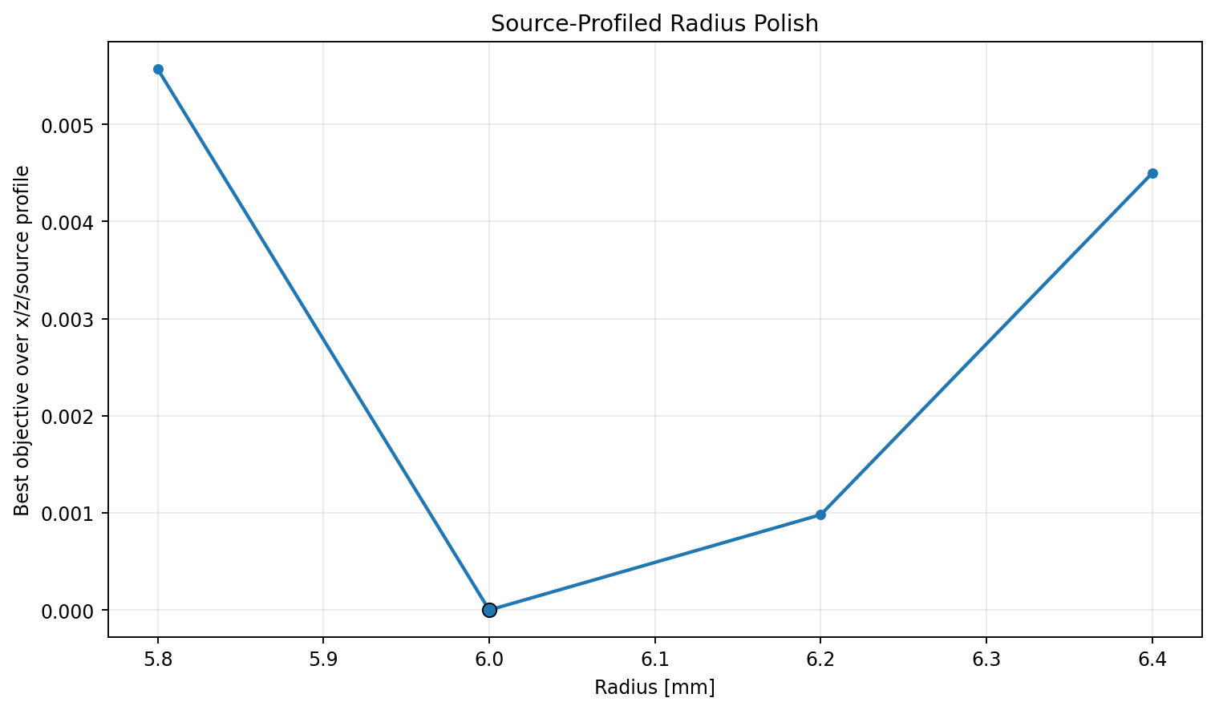
Nominal source-profiled polish
exp 057
No injected source mismatch — confirms the runner reproduces the exact-synthetic case
Best r = 6.0 mm at (x = 250.0 mm, z = 90.0 mm). Recovered source profile lands at (fc_scale = 1.0 = unchanged centre frequency, shift = 0 ps, amp = 1.000 = unchanged amplitude). Next-distinct radius is r = 6.2 mm with objective gap 9.815 × 10⁻⁴.
49
Notes:
This is the nominal smoke run: 12 geometry candidates evaluated with no injected source mismatch. The source-profile parameters land at exactly the nominal values — frequency scale 1.0, shift 0 picoseconds, amplitude 1.000 — which is the right behaviour. The runner should not introduce drift when there is no mismatch to fit. The distinct-radius margin — the objective gap between the best radius and the best next-distinct radius — matches the earlier polish result at about 9.815e-4. The runner is conservative: it does not inflate margins or pull the source profile away from truth when no mismatch is present. That property is important because we want this runner to be safe to use as the default final stage, not just as an opt-in audit step.

Slide 50
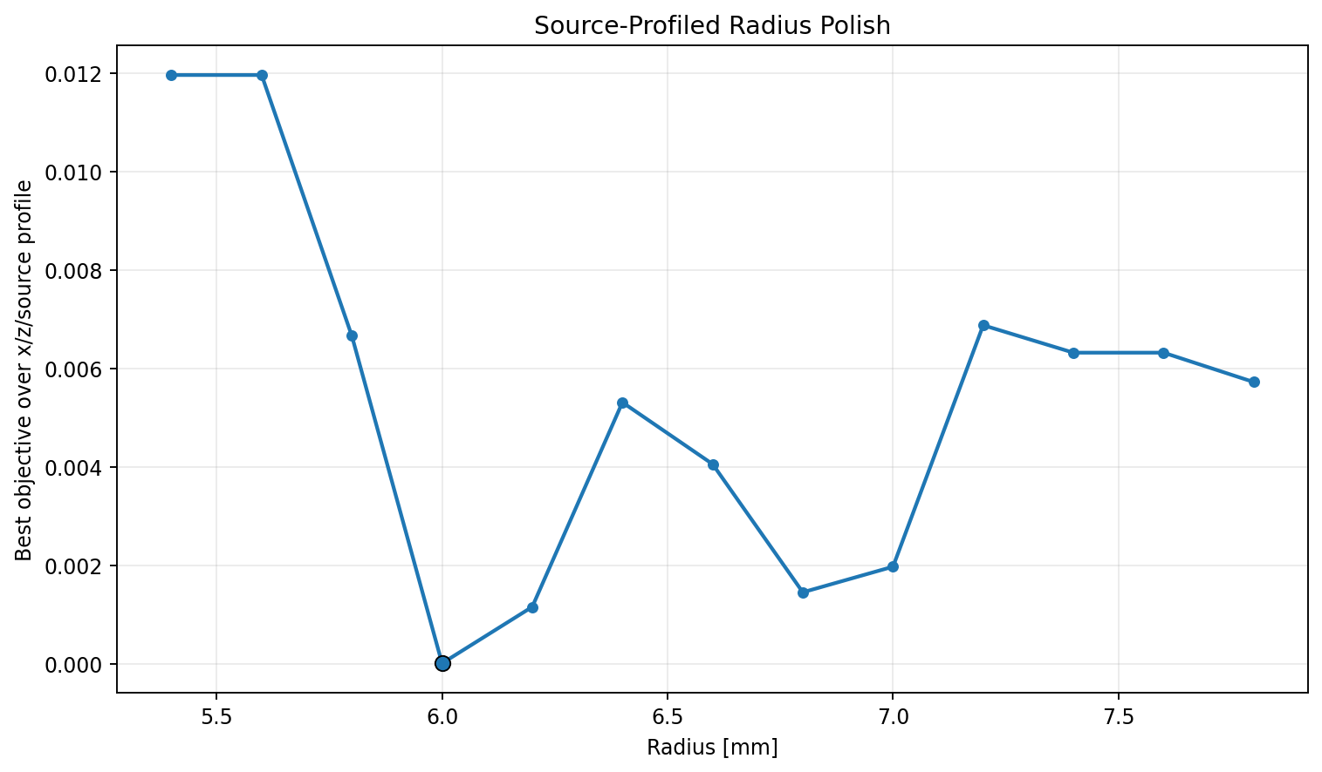
Combined mismatch — joint recovery
exp 058
Injected fc_scale = 1.1, time shift = −50 ps, amp scale = 1.1 in the observed source
Best r = 6.0 mm at (x = 250.0 mm, z = 90.0 mm). Recovered source profile matches the injected one exactly: (fc_scale = 1.1, shift = −50 ps, amp = 1.100). Distinct-radius margin (J = least-squares misfit gap to next radius r = 6.2 mm) is 1.146 × 10⁻³.
50
Notes:
This run evaluates 52 geometry candidates with three modelled source-frequency scales each. The observed source was deliberately mismatched in three ways at once — centre frequency scaled by 1.1, time shifted by minus 50 picoseconds, and amplitude scaled by 1.1. The recovered source profile matches the injected one exactly: fc scale 1.1, shift minus 50 picoseconds, amplitude 1.100. This is the headline result of the whole arc — the production runner recovers both the geometry and the injected nuisance source parameters at the same time. Looking at the sub-ranks, a few r = 6.2 mm candidates also prefer a minus 25 picosecond shift, which is exactly the kind of competing explanation top-k reporting is meant to surface.

Slide 51
Verdict by paper — what worked and what did not
conclusion
Concrete adoption / rejection per paper, with the experiment that justifies it
Paper / method | What worked ✓ | What did not work / deferred ✗
Paper 1 — WRI (Feng et al. 2022) | Cumulative-frequency philosophy adopted as time-domain weighted LS. carry_low_25 (25% × 1.0 GHz + 1.0 × 1.5 GHz) preserves ~80% of the 1.5 GHz-only radius margin while keeping a low-frequency contribution. [exp 046–049] | Full WRI solver itself — would require a new frequency-domain Helmholtz/Maxwell operator, complex sparse solves, and a new adjoint. Deferred; the current radius bias is already explained by source handling. [doc 28]
Paper 2 — PEBDD (Zhou et al. 2021) | Matched-filter trace band-pass (same filter on observed and synthetic) as the seed-builder stage. Spectrum-design tool to choose band edges from real residual spectra rather than guesses. [exp 028–045] | PEBDD did not fix radius on its own. Every Powell stage stopped in the high-radius basin (r ≈ 6.86–6.93 mm). The polish stage was still the radius selector. Use PEBDD as a seed-builder only. [exp 031, 045]
Paper 3 — OT-LS (Hunziker et al. 2025) | NRCCC trace-shift diagnostic implemented and saved in every run summary. Useful as a safety check for future field-data and poor-initial-model scenarios. [exp 024–027] | OT objective inside the optimiser was ruled out. Every wrong-radius candidate, including under 10% noise, already had NRCCC = 1.0 — the radius problem is not cycle skipping. OT brings no benefit here. [exp 024–026]
Paper 4 — W2 (Lu et al. 2024) | Standalone Softplus / Sinkhorn W2 module with tests, used as a landscape gate. Paper's shift-convexity claim reproduced on shifted Ricker pulses (gate 1 passed). [exp 048] | W2 as the final radius objective. On the rebar landscape the margin collapsed from 1.04 × 10⁻³ (LS) to 1.06 × 10⁻⁷ (W2) — Softplus removes the amplitude content radius depends on. Rejected. [exp 050, 051]
Paper 5 — IFWI (Sun et al. 2025) | Frequency-principle thinking — smooth structure before detail — already implicit in our staged pipeline (coarse → fine → polish). [design] | Full neural implicit field — flexible neural residual would risk absorbing radius bias into a 'background correction', making radius less meaningful, not more. Deferred to multi-rebar / field data. [doc 29]
Additional finding (beyond the 5 papers) | Source-wavelet profiling — per-candidate amplitude scalar + global time-shift + centre-frequency scale grid. Recovers radius even when the modelled source differs from the observed one (all seven mismatch cases land at r = 6.0 mm). [exp 052–055, productionised in 057, 058] | Fixed-source LS alone — bias to the radius grid bound under modest fc or time-zero mismatch. Cannot be relied on for field data without the source profile. [exp 052]
51
Notes:
This is the single-slide summary of the whole arc, organised by paper. The headline sits in the bottom row — the additional finding that was not in any of the five papers: source-wavelet profiling with a small structured nuisance fit per candidate. That is the most important new contribution of this arc, and it is the recipe the recommended pipeline is built around. Above that, the five papers each gave us something we kept — frequency weighting from WRI, the matched-filter band-pass from PEBDD, the trace-shift diagnostic from OT-LS, the W2 module as a landscape gate, and the frequency-principle staging idea from IFWI. Each paper also had a piece we ruled out for this specific problem, and each rejection is justified by a specific experiment number in the table. Two of the rejections are conditional, not categorical. WRI moves back onto the table if a future setup creates an initial-model failure source handling cannot fix. IFWI moves back onto the table when explicit nuisance parameters become insufficient for multi-rebar or field data.

Slide 52
06
Deferred branches and what's next
What we are explicitly not building next, and what we are doing instead
52

Slide 53
What we deferred
docs 28 + 29
Documented in 28 / 29 trackers; reserved for later stages
WRI (full)
IFWI (neural implicit field)
Needs a new frequency-domain Helmholtz / Maxwell operator
Complex sparse solves at large grid
Frequency-domain adjoint and penalty continuation
Defer reason: radius is already well explained by source handling and weighted LS
Flexible neural residual can absorb radius bias
Needs differentiable FDTD, held-out source validation, regularisation guardrails
Defer reason: not the right tool while explicit nuisance parameters still suffice
Reserved for multi-rebar / field-data stages
53
Notes:
Both deferrals are conditional, not categorical. WRI becomes worth revisiting if a future use case creates a poor initial model where time-domain FDTD optimisation reliably fails. IFWI becomes worth revisiting when explicit nuisance parameters can no longer absorb material or background residuals — most likely with multi-rebar geometry or field data. Both tracker documents lay out a constrained design for a future prototype if either of those conditions is met.

Slide 54
Recommended pipeline
tracker 30 summary
For controlled single-rebar synthetic data; transferable to field data with the source profile
What the pipeline does
What we are explicitly not doing next
1. Bring x/z into the basin (staged or PEBDD path).
2. Final radius from 1.5 GHz-only LS or carry_low_25.
3. Local radius profiling / grid polish, not continuous Powell.
4. Profile source amplitude + time-shift + center-frequency scale at the final stage.
5. Report top-k candidates and distinct-radius margin.
Another broad global search.
W2 inside the optimizer for radius.
Free rebar conductivity in the radius optimizer.
Full WRI or full IFWI at this stage.
54
Notes:
The five-step pipeline is the production recipe distilled from this whole arc. Walking through the steps: first, use the existing staged or PEBDD path only to bring x and z into the right basin — we should not expect it to fix radius. Second, evaluate the final radius with 1.5 GHz-only or carry_low_25 — never use unweighted multi-frequency, because it dilutes margin. Third, the radius decision is a local grid polish — a small enumeration over (z, r) — not Powell; continuous Powell sits in the depth-radius valley. Fourth, a per-candidate source profile combining amplitude, time-shift, and frequency-scale is mandatory before trusting any radius decision on data where the source may differ from nominal. Fifth, confidence is the distinct-radius margin and the top-k candidate list, not a single point estimate. The right column matters just as much — each 'not doing' item is a specific branch we tested and chose not to spend the next iteration on, with reasons in the relevant tracker documents.

Slide 55
Next experiments
post-058 plan
Direct follow-ons that reuse the source-profiled polish runner
Replication matrix
Scaling out
Run source-profiled polish across several noise seeds.
Run across several source-mismatch combinations (fc, shift, amp).
Stress with offset x/z/r seeds to map the basin where the polish still works.
Extend to two then three rebars: same forward model, same polish stage; the global stage becomes the load-bearing piece.
Introduce a hyperbola or migration baseline for a non-FWI cross-check.
Move toward field-style data with the source profile in place.
55
Notes:
This is the closing slide. The choice here is deliberate: stay narrow, with a focused replication matrix and a scaling-out path, rather than opening another menu of new research branches. The hyperbola baseline on the right is intentionally non-FWI — having an independent method available makes the FWI result credible when we get to field-data validation.

