Slide 1
SINGLE REBAR • TWIN EXPERIMENT
Single-Rebar Geometry Inversion
Recovering position, depth, and radius from synthetic GPR B-scans
GPU FDTD
Staged solver
Verified
2D TMz + CPML, batched
Coarse → fine → polish
Exact recovery, robust to 10% noise
GPR-FDTD-FWI • DGX Spark • 2026
1

Slide 2
The problem
What we are estimating and what is actually hard
Unknown parameter vector: [x, z, radius] for a single circular rebar in concrete.
Observed data: a 2D B-scan (depth-time × lateral position) from common-offset GPR.
Twin experiment: synthetic-to-synthetic. The 'observed' B-scan and the candidate B-scans share the same forward operator, so any failure is in the inverse pipeline, not the physics.
Identifiability hierarchy (literature-consistent):
  Lateral position: easy, set by hyperbola apex.
  Cover depth: easy once velocity is known.
  Radius / diameter: weakly identified; nuisance-coupled and grid-sensitive.
Synthetic truth
x = 250.0 mm z = 90.0 mm r = 6.0 mm
Initial guess (intentionally wrong)
x = 235.0 mm z = 80.0 mm r = 8.0 mm
Acquisition
1.5 GHz Ricker source
5–9 scan positions, 20 mm Tx–Rx offset
Concrete εr = 6.0, σ = 0.01 S/m
Air layer above slab
2
Notes:
The unknowns are intentionally tiny. We're not estimating a full image — we are estimating three numbers from a B-scan. That keeps the inverse problem clean enough to diagnose identifiability.

Slide 3
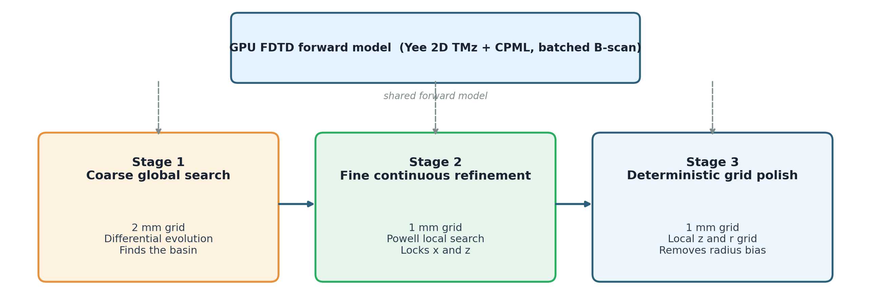
Pipeline architecture
Same forward model, three optimizers staged from coarse to fine
Each stage hands its best estimate to the next. The forward model is identical; what changes is the resolution and the search strategy.
3
Notes:
Stage 1 finds the basin globally on a cheap grid. Stage 2 refines continuously on the production grid. Stage 3 is deterministic and small, and is the part that actually closes the radius gap by accepting that the geometry is rasterized.

Slide 4
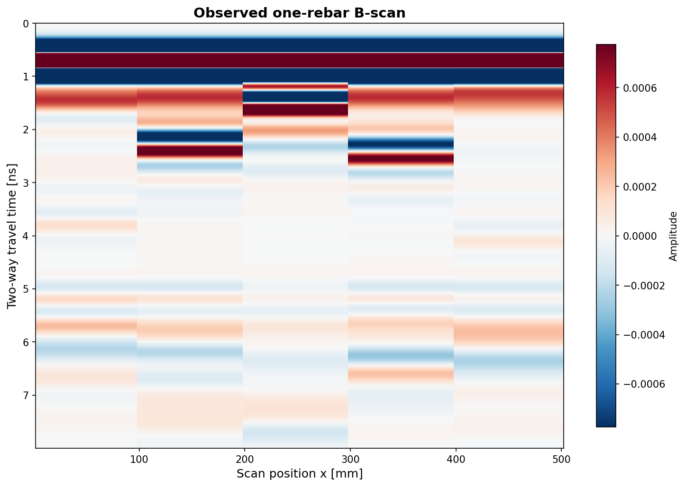
Forward model
GPU-batched 2D TMz FDTD with CPML; parity-tested against the CPU reference
Solver: 2D transverse-magnetic (TMz) Yee-grid FDTD with CPML boundaries.
Backend: CuPy on the DGX Spark GB10. Batched B-scan support advances every scan position in one GPU launch.
Parity tests cover the single-trace and the batched paths against the CPU CPML solver, so changes in CuPy or kernels can be caught.
Numbered-run convention: every diagnostic and inversion writes a run_manifest.json with the command, git commit, backend, and summary path.
Synthetic 'observed' B-scan: rebar hyperbola near 2 ns, 5 scan positions, 1.5 GHz.
4
Notes:
The forward model is the same one used in the previous geometry-inversion runs. The presentation point is that the GPU batched solver makes one objective evaluation as cheap as a single FDTD run for moderate scan counts.

Slide 5
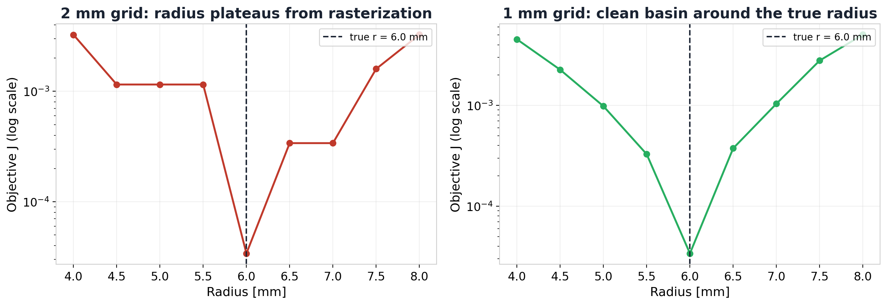
Why radius is hard
Hard-grid rasterization, not lack of signal
Same waveform objective, same scan, same true radius — only the grid step changed. The 2 mm grid produces flat plateaus where nearby radii rasterize to the same material mask. The 1 mm grid breaks the plateaus and reveals a clean basin at r = 6.0 mm.
Significance: radius identifiability in this code is dominated by geometry discretization. Multi-frequency stacking did not fix it; a finer grid did.
5
Notes:
Both axes are log-J. On the 2 mm grid the optimizer literally cannot distinguish r=4.5, 5.0, 5.5 because the cell mask is identical. On the 1 mm grid we recover a V-shape with the true radius at the bottom.

Slide 6
Depth–radius coupling
Why the continuous optimizer still drifts after the grid is fine enough
At Powell's stop (run 010)
Same x, true depth (run 011)
More sources, same z bias (run 013)
x = 249.5 mm z = 90.65 mm
best radius ≈ 6.80 mm
J ≈ 2.1e-3
x = 249.5 mm z = 90.00 mm
best radius = 6.00 mm
J ≈ 0
9 sources, x = 249.5 mm, z = 90.65 mm
best radius ≈ 6.80 mm
9-src didn't move the radius
Continuous Powell stops in a low-misfit valley where a slightly deeper rebar trades against a slightly larger radius.
Profiling at the true depth recovers r = 6 mm exactly — so the signal carries radius information.
Adding scan positions narrows the valley but does not move its radius minimum. The fix has to come from the search strategy, not from more data.
6
Notes:
This is the central technical insight. Radius bias is not 'optimizer failure', it is a real coupling between depth and radius in the waveform objective near the minimum. The remedy is the grid polish in stage 3.

Slide 7
Stage 3 — the grid polish
Accepting that geometry is piecewise constant on the grid
Powell's continuous step doesn't help past a point: rasterized geometry is piecewise constant in physical coordinates.
Polish takes the Powell seed and evaluates a small set of (z, r) candidates on an absolute millimeter grid.
Defaults: 40-candidate coarse grid (z step 0.5 mm, r step 0.2 mm). A 160-candidate fine preset is kept for audit runs.
Polish exposes the next-best candidates, so the margin between the chosen rebar and its competitors is auditable.
Powell hand-off
x = 249.5 mm z = 90.65 mm
r = 6.96 mm J = 2.08e-3
After polish (run 015)
x = 250.0 mm z = 89.75 mm
r = 6.00 mm J = 0
7
Notes:
Polish is the single most important step for radius in this pipeline. The 0.25 mm z difference is a hard-grid equivalence — multiple sub-mm z values produce the same rasterized circle.

Slide 8
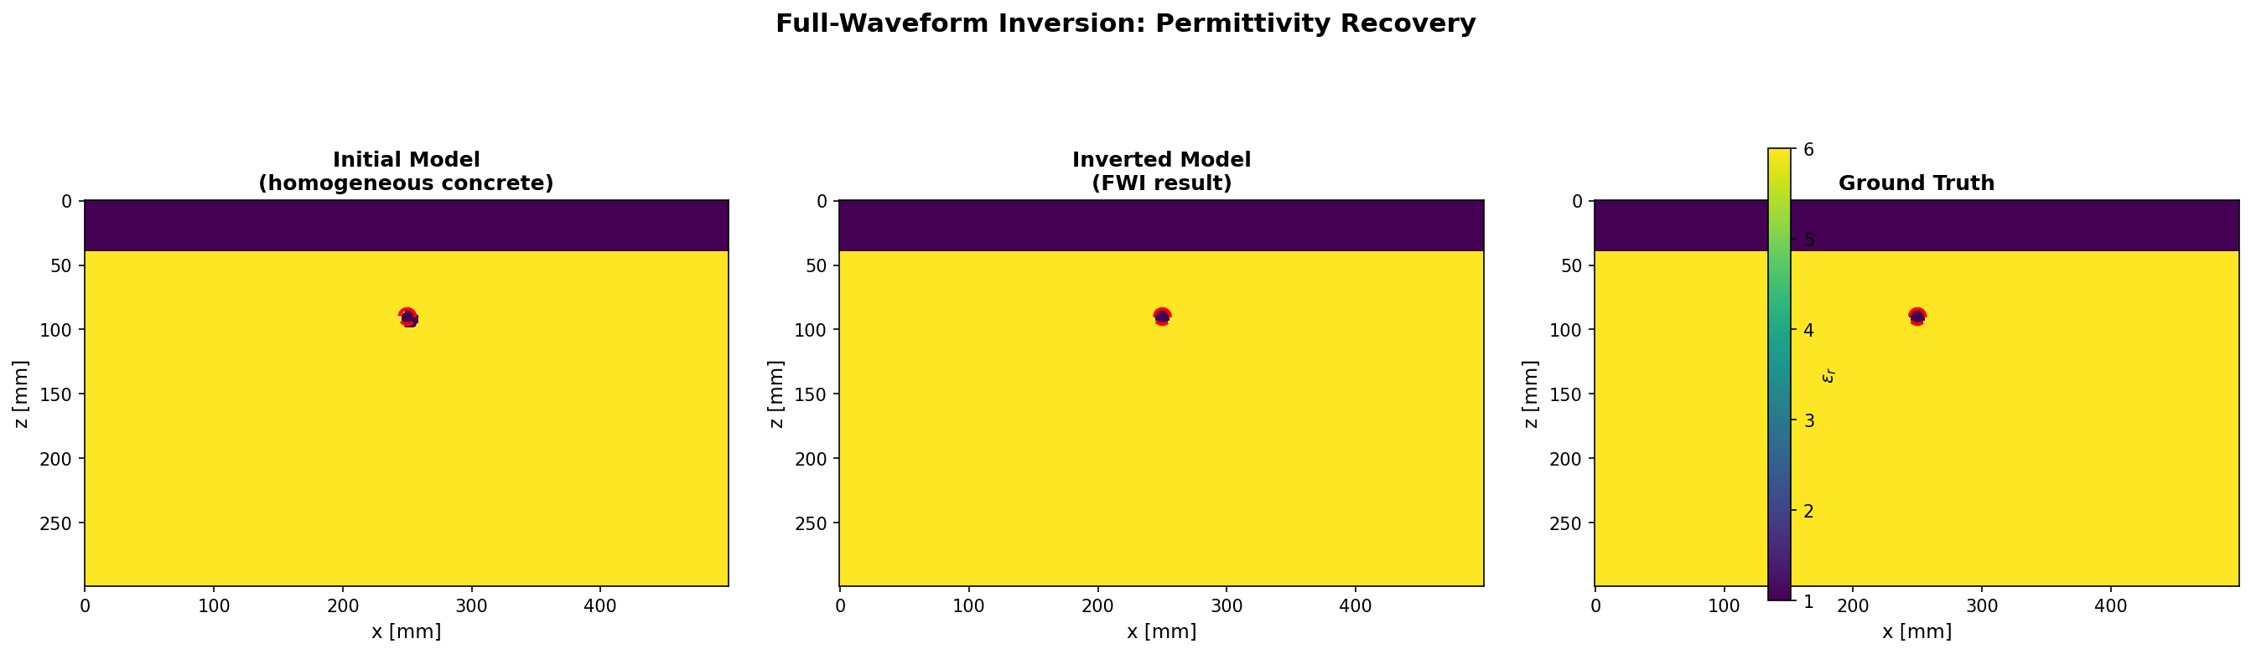
Final inversion (exact synthetic)
Truth = recovered on the 1 mm grid; model and data misfit both zero
250.0 mm
89.75 mm
6.00 mm
0 / 0
x recovery
z recovery
radius
NRMS (model / data)
8
Notes:
z reads 89.75 because the 1 mm hard-grid circle is identical at z=89.75 and z=90.0 — both produce the same material mask and the same B-scan. That is a representation detail, not a science result.

Slide 9

Observed vs recovered B-scans
The recovered geometry reproduces the data trace-for-trace
Observed B-scan (synthetic truth, 5 sources, 1.5 GHz Ricker).
Recovered B-scan from inverted geometry (run 015).
Difference is below the floating-point floor: NRMS data = 0. The recovered model is not just a close fit; on the 1 mm grid it is the same model.
9
Notes:
Both panels show the same direct-wave band and rebar diffraction. Zero misfit is the strongest possible synthetic-recovery signal.

Slide 10
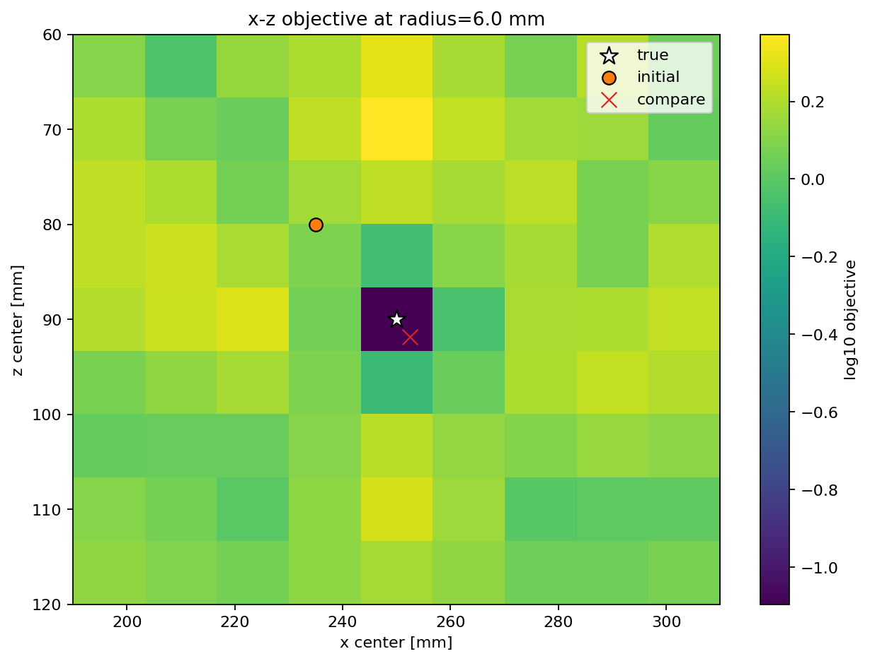
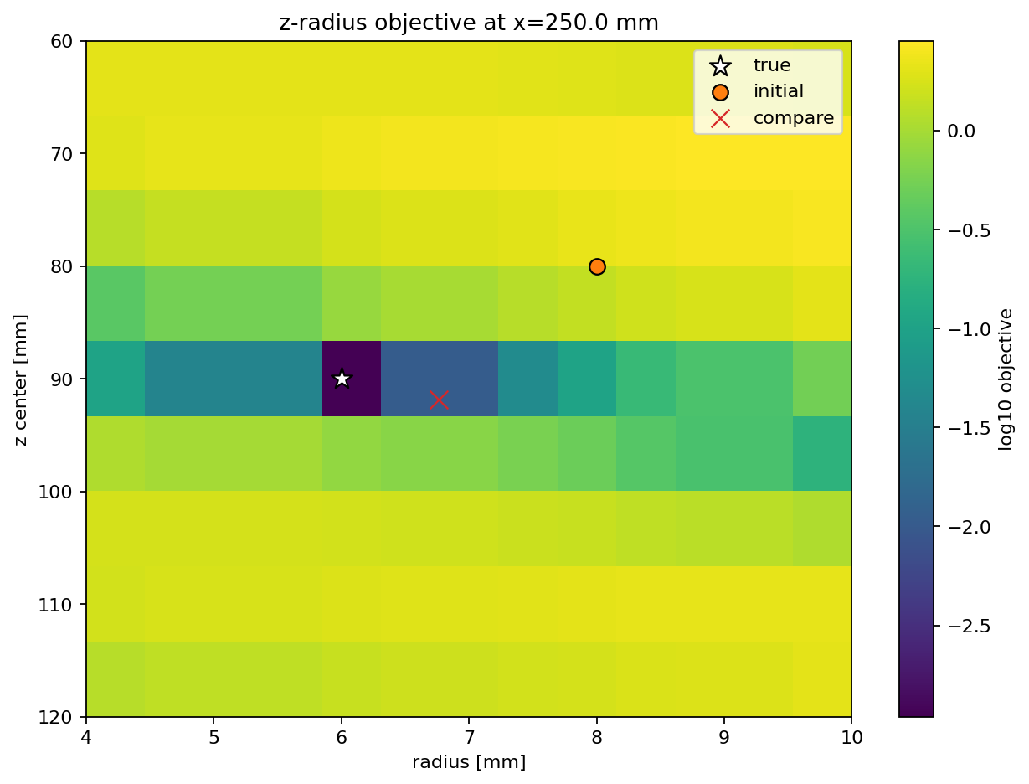
Objective landscape diagnostics
The optimizers are working on a well-behaved local landscape
x–z slice at the true radius: unimodal, true position at the dark minimum.
z–radius slice at the true x: the coupled valley discussed in the previous slide.
The local landscape has the expected shape: position is convex around truth, but the z–radius slice shows the elongated valley that causes continuous optimizers to stop slightly off-radius. That valley is exactly what the grid polish steps over.
10

Slide 11
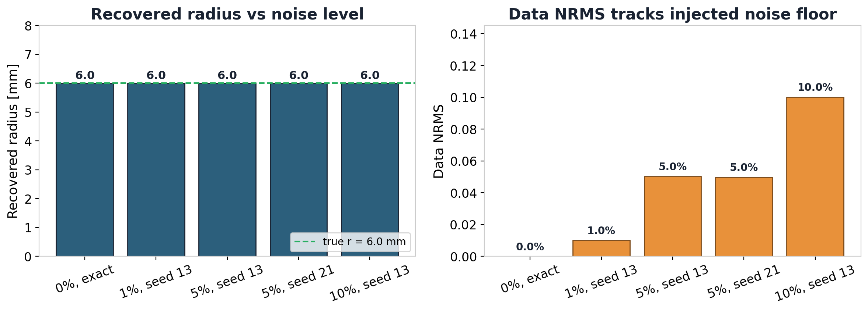
Noise robustness
Recovery stays correct under 1–10% additive observed-data noise
Across two seeds and four noise levels, the polished radius is exactly 6.0 mm and the data NRMS matches the injected noise. Model NRMS stays at zero, meaning the rasterized geometry is unchanged.
11
Notes:
The point isn't that the misfit is small; it is that the recovered geometry doesn't move. The data residual is fully explained by the noise we added.

Slide 12
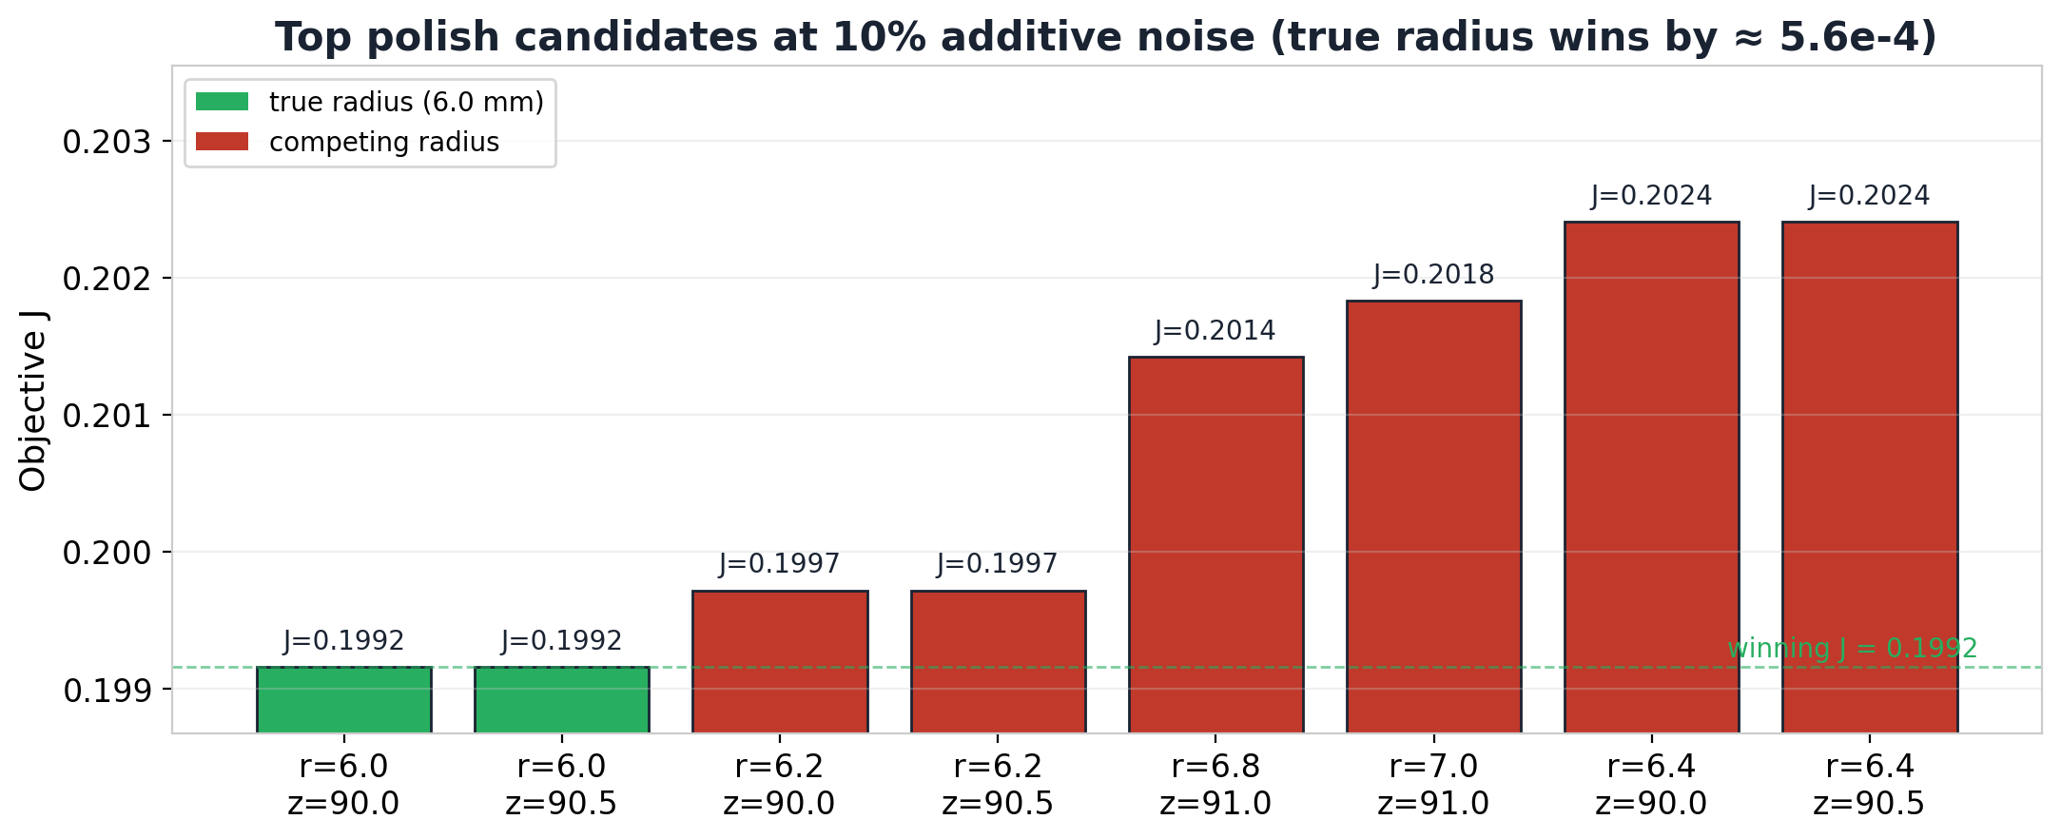
Margin at the 10% stress level
Where the radius would start being ambiguous
At 10% noise, r = 6.0 mm still wins, but by only ≈ 5.6e-4 over r = 6.2 mm. Beyond this point we should treat radius as a distribution rather than a single value, and use the top-k candidates list directly.
12
Notes:
This slide is the calibration of where the pipeline starts to lose discrimination. It also justifies why we save top-k candidates and why noisy field data should not use --polish-stop-misfit 0.

Slide 13
What comes next
Lift the twin-experiment assumptions one at a time
Multi-rebar
Nuisance parameters
Field-style validation
Re-introduce 2-3 rebars with shared global x search and per-rebar polish. The polish stage and identifiability hierarchy stay; the global stage gets harder.
Let concrete εr, conductivity, time-zero, and source wavelet float. This is the Jazayeri-style realism gap — radius identifiability depends on calibrating them.
Add a hyperbola/migration baseline (RGPR-style) to quantify what FWI buys over geometry-only methods, and cross-check the forward against gprMax.
Each direction is supported by the existing pipeline: the forward model, numbered-run convention, and grid-polish stage transfer directly. The work is in the search strategy and in mapping which parameters the data actually supports.
13

