Slide 1
2D FDTD Forward Modeling & Full-Waveform Inversion for Ground-Penetrating Radar
Rebar Detection in Reinforced Concrete
Abdullah Maruf
From-scratch implementation | ~2,500 lines of Python
1
Notes:
Welcome everyone. My name is Abdullah Maruf and today I'll walk you through a project I built entirely from scratch: a 2D FDTD electromagnetic simulator coupled with a full-waveform inversion engine for Ground-Penetrating Radar.
The application is rebar detection in reinforced concrete — a real-world non-destructive testing problem. The entire codebase is about 2,500 lines of Python with no external EM solver libraries. Everything — the Maxwell solver, the absorbing boundaries, the adjoint gradient engine, and the GPU acceleration — was written from the ground up.
I'll cover the forward modeling theory, show how inversion recovers rebar positions with sub-grid accuracy, demonstrate measured GPU speedups, and discuss several extensions I implemented beyond the core requirements.

Slide 2
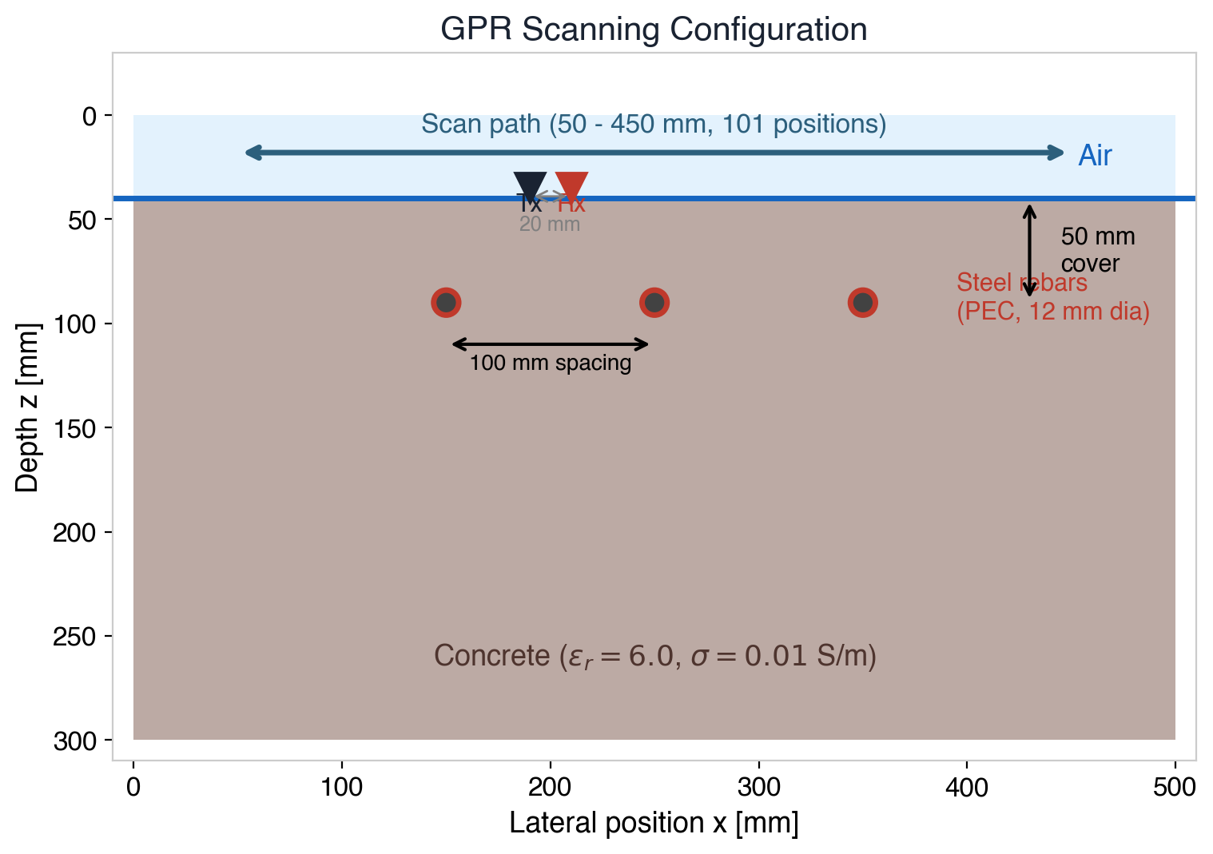
Motivation: GPR for Concrete Inspection
Ground-Penetrating Radar (GPR) is the standard
non-destructive method for imaging rebars in concrete
Challenge: B-scan hyperbolas give qualitative
locations — not quantitative geometry
Goal: Recover rebar positions & sizes
from waveform data using physics-based inversion
Approach: Build complete simulation + inversion
pipeline from scratch in Python (~2,500 lines)
2
Notes:
Ground-Penetrating Radar is the industry standard for non-destructive inspection of reinforced concrete structures — bridge decks, parking garages, tunnels, and building slabs. A transmitter-receiver antenna pair is scanned across the surface, sending short electromagnetic pulses into the concrete and recording reflected signals.
The output is a B-scan radargram, where each rebar appears as a hyperbolic reflection pattern. In current practice, engineers manually interpret these hyperbolas to estimate rebar locations — this is qualitative and operator-dependent.
The goal of this project is to go beyond manual interpretation: use physics-based Full-Waveform Inversion to automatically and quantitatively recover the exact positions and sizes of rebars from the recorded waveform data.
The figure on the right shows our simulation setup: 3 steel rebars (12 mm diameter) embedded 50 mm deep in concrete with 100 mm center-to-center spacing. The antenna scans 101 positions from 50 to 450 mm laterally, with a 20 mm Tx-Rx separation.

Slide 3
Presentation Outline
01
Forward Modeling
2D TMz FDTD with CPML absorbing boundaries
02
Full-Waveform Inversion
Adjoint-state gradient + geometry-based FWI
03
GPU Acceleration
CuPy-based speedup (3-7x measured)
04
Extensions
Dispersion, antenna, multi-scale frequency
05
Summary
Key results and contributions
3
Notes:
The talk is organized into 5 sections.
First, I'll cover the forward modeling — the FDTD numerical method, simulation parameters, and the B-scan result showing 3 clear rebar hyperbolas.
Second, the inversion section is the heart of the project: I'll explain the adjoint-state method for computing gradients efficiently, show validation results, discuss why pixel-wise FWI was impractical and how I pivoted to geometry-based parameterisation, and present the final recovery results with sub-grid accuracy.
Third, GPU acceleration: I ported the FDTD solver to CuPy and measured 3-7x speedups on a DGX Spark with an NVIDIA GB10 GPU.
Fourth, I'll briefly cover three extensions: dispersive materials (Debye model), a distributed dipole antenna model, and multi-scale frequency continuation.
Finally, I'll summarize the key contributions and results. The whole talk should take about 15-20 minutes, leaving time for questions.

Slide 4
01
Forward Modeling
2D TMz FDTD with CPML absorbing boundaries
4

Slide 5
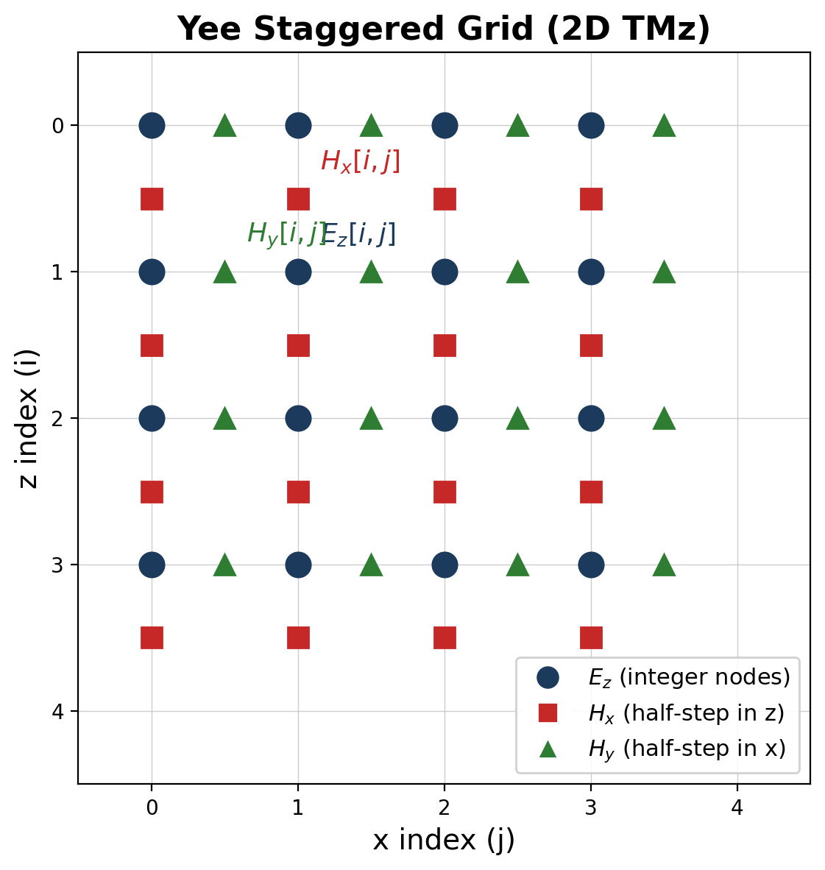
FDTD Method: The Yee Staggered Grid
TMz polarisation: Ez, Hx, Hy
E and H fields staggered by half a grid cell
Leapfrog time-stepping: H -> E -> H -> ...
Second-order accurate, energy-conserving
Fully explicit — no matrix inversions
5
Notes:
The FDTD method was invented by Kane Yee in 1966 and is the most widely used numerical technique for solving Maxwell's equations in the time domain.
The key idea is the Yee staggered grid: electric and magnetic field components are placed at different positions on the grid — offset by half a cell. In our 2D TMz (Transverse Magnetic to z) polarisation, we solve for three field components: Ez (the vertical electric field at integer grid nodes), Hx (magnetic field staggered half a step in the z direction), and Hy (magnetic field staggered half a step in x).
Time-stepping uses the leapfrog scheme: magnetic fields are updated at half time steps, electric fields at full time steps. This interleaving gives second-order accuracy in both space and time without requiring any matrix inversions — the scheme is fully explicit. Each field update only depends on its immediate neighbors.
The staggering also automatically satisfies Gauss's law (div B = 0) to machine precision — a major advantage over methods that need to enforce this separately.
Our implementation uses a 280x180 grid (including 15-cell PML layers on each side), giving 250x150 inner cells at 2 mm spacing.

Slide 6
Simulation Parameters
Every choice physically justified
Parameter | Value | Justification
Grid spacing | 2 mm | >=16 pts/wavelength at f_max in concrete
Time step | 4.24 ps | 90% of CFL stability limit
Domain | 500 x 300 mm | 280 x 180 cells + 15-cell PML
Source | 1.5 GHz Ricker | Standard for concrete GPR inspection
Rebars | 3 x 12 mm dia. | 50 mm cover, 100 mm center spacing
CPML | 15 layers, cubic | ~60 dB absorption at boundaries
B-scan | 101 positions | 50-450 mm aperture, 4 mm step
6
Notes:
Every simulation parameter has a physical justification — nothing is arbitrary.
GRID SPACING (2 mm): The Ricker wavelet at 1.5 GHz has maximum spectral content around f_max = 2.5 * 1.5 GHz = 3.75 GHz. In concrete (eps_r = 6), the minimum wavelength is lambda_min = c0 / (f_max * sqrt(6)) = 32.7 mm. The rule of thumb is at least 10-20 points per wavelength; our 2 mm spacing gives over 16 points, providing a good balance of accuracy and computational cost. It also gives 3 cells across the rebar radius (6 mm), adequate for resolving the circular geometry.
TIME STEP (4.24 ps): Set at 90% of the CFL stability limit. For a 2D square grid, dt_max = dx / (c0 * sqrt(2)) = 4.71 ps. Going above this causes numerical instability.
DOMAIN (500 x 300 mm): Represents a typical concrete slab cross-section with 40 mm of air above and 260 mm of concrete below.
SOURCE (1.5 GHz Ricker): This is the standard center frequency for commercial concrete GPR systems. The Ricker (Mexican hat) wavelet is a common choice because it has compact support in both time and frequency.
CPML (15 layers, cubic grading): Convolutional PML provides approximately 60 dB of absorption for normally-incident waves, preventing artificial reflections from the computational domain boundaries.
B-SCAN (101 positions): Scanned from 50 to 450 mm in 4 mm steps, giving dense spatial sampling well above the Nyquist requirement.

Slide 7
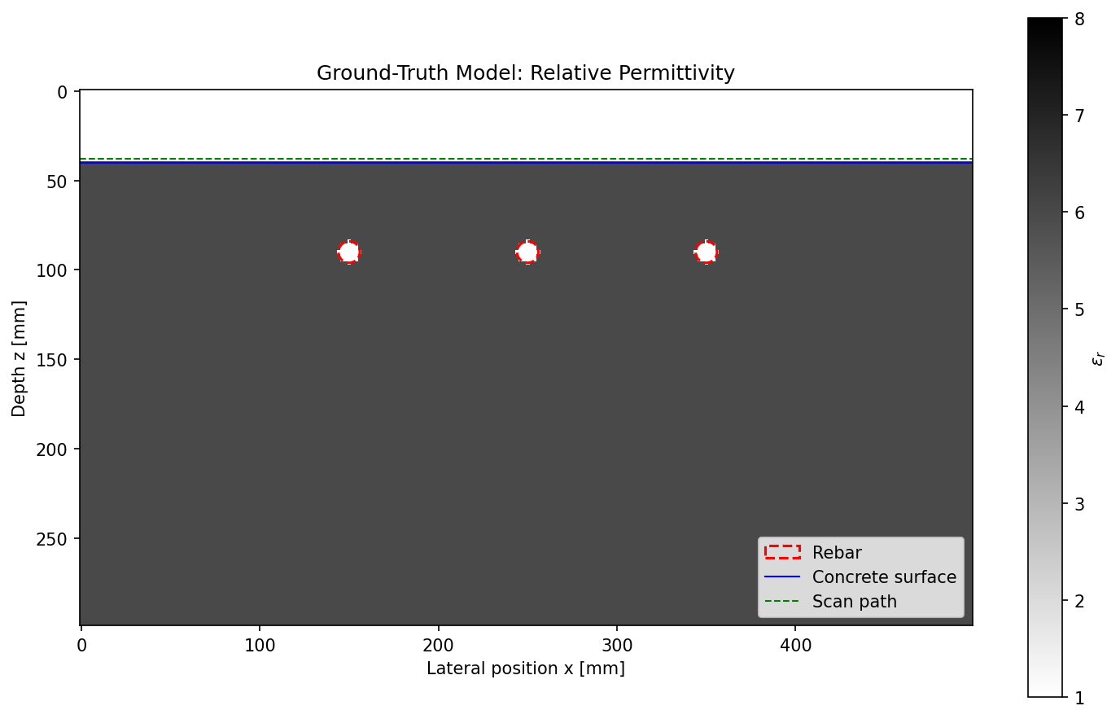
Ground-Truth Model
3 steel rebars embedded in dry concrete
7
Notes:
This is the ground-truth model that we aim to recover through inversion.
The domain consists of two materials:
- AIR (top 40 mm): eps_r = 1.0, sigma = 0.0 S/m. This is where the antenna sits.
- CONCRETE (below 40 mm): eps_r = 6.0 (typical for dry concrete at 1.5 GHz, literature range is 5-10), sigma = 0.01 S/m (low-loss dielectric).
Embedded in the concrete are 3 steel rebars modeled as near-Perfect Electric Conductors (PEC) with sigma = 10^7 S/m. Each rebar is a #4 bar with 12 mm nominal diameter (6 mm radius). They are placed at 50 mm cover depth below the concrete surface with 100 mm center-to-center spacing, centered in the domain at x = 150, 250, and 350 mm.
This configuration is representative of real reinforced concrete: ACI 318 code requires minimum 25-50 mm cover for interior members, and typical rebar spacing ranges from 75-300 mm. The symmetrical layout helps validate our inversion — any asymmetry in the recovered model reveals systematic errors.

Slide 8
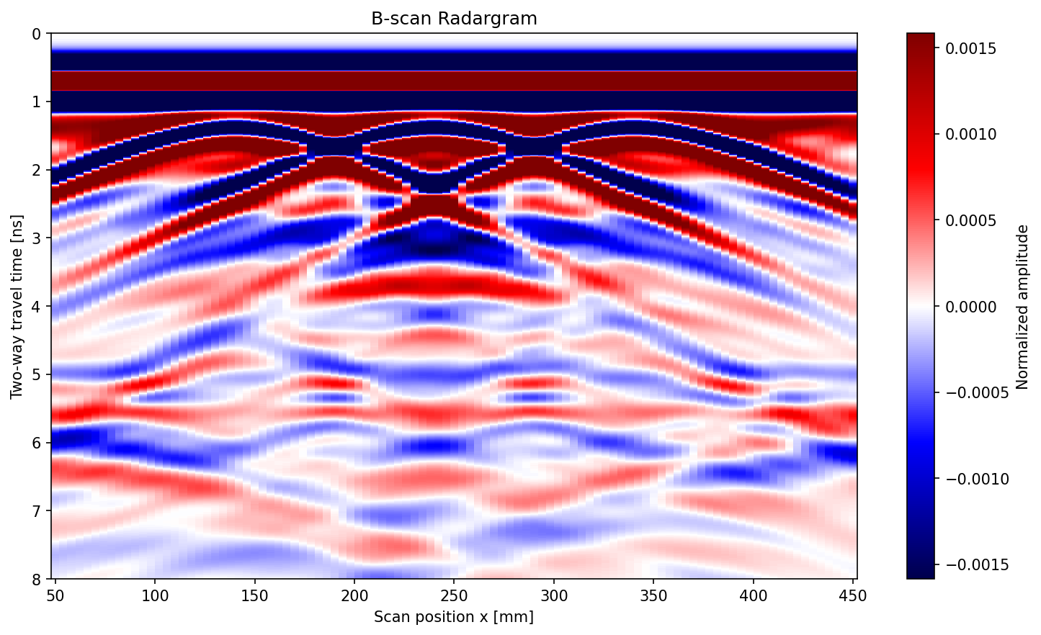
Forward Result: B-Scan Radargram
3
rebar hyperbolas
101
scan positions
6/6
tests pass
Apex = lateral position Curvature = concrete velocity
8
Notes:
This is the B-scan radargram — the primary output of the forward simulation, and the 'observed data' that drives the inversion.
How to read it: the horizontal axis is the antenna scan position (101 positions from 50-450 mm), and the vertical axis is two-way travel time (0-8 ns). Each vertical strip is a single A-scan trace recorded at one antenna position.
The 3 prominent hyperbolas correspond to the 3 rebars. Each hyperbola has:
- APEX: directly above the rebar's lateral position (150, 250, 350 mm)
- CURVATURE: determined by the EM wave velocity in concrete. Steeper = faster medium. From the curvature you can estimate eps_r, and from the apex time you get depth.
You can also see the direct wave at very early times (antenna coupling between Tx/Rx) and faint multiples from waves bouncing between rebars.
The simulation runs 1,887 time steps at 101 scan positions. Each position requires a separate FDTD simulation — this is where GPU acceleration becomes critical for the inversion, which needs to run many such B-scans.
All 6 unit tests pass: CFL stability check, Ricker wavelet shape, material coefficient computation, free-space stability, rebar model stability, and wave propagation speed verification.

Slide 9
Wave Propagation Through Concrete
Snapshot from FDTD simulation
Ricker wavelet emitted from Tx
Wavefront refracts at air-concrete interface
Scattered waves from rebar targets
CPML absorbs at domain edges
9
Notes:
This is a snapshot from the FDTD wave propagation animation at approximately t = 3.4 ns — about halfway through the 8 ns simulation.
What you're seeing is the Ez electric field amplitude across the entire computational domain. Several physical phenomena are visible:
1. WAVEFRONT REFRACTION: When the wave crosses from air (eps_r=1) into concrete (eps_r=6), it slows down by a factor of sqrt(6) ≈ 2.45. The wavelength shortens from ~200 mm in air to ~82 mm in concrete.
2. REBAR SCATTERING: The steel rebars act as strong scatterers (PEC boundary). The incident wave induces surface currents on the rebar, which re-radiate as cylindrical scattered waves. These are the circular wavefronts emanating from each rebar position.
3. CPML ABSORPTION: At all four domain edges, the Convolutional PML layers gradually absorb outgoing waves. You can see that no reflections are coming back from the boundaries — the CPML provides about 60 dB of attenuation.
4. MULTIPLE REFLECTIONS: Faint secondary wavefronts from waves bouncing between rebars or between the rebar and the air-concrete interface.
If presenting live, open the GIF file (outputs/animations/wave_propagation.gif) to show the full time evolution — it's much more intuitive as an animation.

Slide 10
02
Full-Waveform Inversion
From recorded data to subsurface model
10

Slide 11
The Inverse Problem: From Data to Model
We have:
The computational challenge:
A B-scan radargram (recorded radar signals)
To minimise: need the gradient
(how does each pixel affect the misfit?)
Brute force: tweak one pixel, re-run
the full simulation, repeat for every pixel
We want:
The underground model (where are the rebars?)
How:
Adjust model until simulated signals match observations
Measure mismatch with L2 misfit — then minimise it
50,000
pixels to check
~4 hours
per brute-force gradient
11
Notes:
This slide frames the inverse problem in plain language before diving into the math.
Think of it as a detective problem: we have the clues (the recorded B-scan waveforms) and need to find the culprit (the underground material properties — where are the rebars?).
The approach is iterative optimization:
1. Start with a guess (homogeneous concrete, no rebars)
2. Run a forward simulation to generate synthetic B-scan data
3. Compare synthetic vs observed data using an L2 misfit function: J = 0.5 * sum((d_obs - d_syn)^2)
4. Compute the gradient of J with respect to every model parameter
5. Update the model in the direction that reduces J
6. Repeat until convergence
THE CRITICAL BOTTLENECK is step 4 — computing the gradient. If we have 50,000 pixels (our 250x150 inner grid after excluding PML), a brute-force finite-difference gradient would require perturbing each pixel individually and re-running the full forward simulation each time. That's 50,000 forward simulations just for ONE gradient evaluation.
At ~0.3 seconds per simulation, that's about 4 hours per gradient — and we need dozens of gradient evaluations to converge. This motivates the adjoint-state method on the next slide.

Slide 12
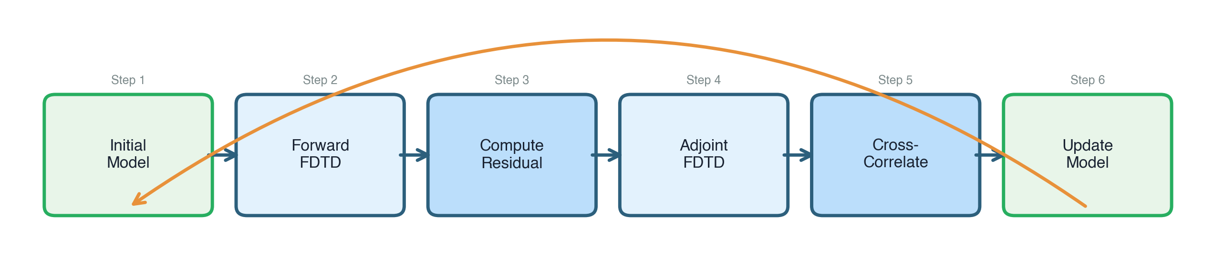
Adjoint-State Method: Efficient Gradients
Forward simulation: source at Tx illuminates each grid cell
Adjoint simulation: time-reversed residual at Rx gives sensitivity map
Cross-correlate forward & adjoint fields = gradient at every pixel simultaneously
2 sims
not 50,000
12
Notes:
The adjoint-state method is the key algorithmic breakthrough that makes Full-Waveform Inversion computationally feasible.
THE WORKFLOW (6 steps per iteration):
Step 1 — INITIAL MODEL: Start with a guess of the subsurface (eps_r at every pixel). For the first iteration, this is homogeneous concrete (eps_r = 6 everywhere).
Step 2 — FORWARD FDTD: Run a standard FDTD simulation with the current model. Record the Ez field at EVERY grid cell and EVERY time step (this requires storing the full space-time wavefield — memory-intensive but necessary).
Step 3 — COMPUTE RESIDUAL: Compare the synthetic traces (from step 2) against the observed data. The residual r = d_syn - d_obs at each receiver and time step.
Step 4 — ADJOINT FDTD: Run the FDTD equations BACKWARDS in time, but instead of a source wavelet, inject the time-reversed residual at the receiver positions. This back-propagates the data misfit through the model, creating a sensitivity map.
Step 5 — CROSS-CORRELATE: The gradient at each pixel is the zero-lag cross-correlation of the forward wavefield (step 2) and the adjoint wavefield (step 4): g = -eps_0 * sum(E_adj * dE_fwd/dt * dt). This simultaneously gives the gradient at ALL 50,000 pixels using just 2 simulations.
Step 6 — UPDATE MODEL: Move eps_r in the negative gradient direction (steepest descent) with an appropriate step size. Then loop back to step 1.
The mathematical derivation comes from the calculus of variations — treating the PDE (Maxwell's equations) as a constraint on the optimization problem. The adjoint equations turn out to be the same Maxwell equations run backward in time, which is elegant and efficient.

Slide 13
Adjoint Gradient Validation
Gold standard: compare adjoint gradient vs finite differences
Perturbed individual pixels, ran full forward simulation each time
Agreement at maximum-sensitivity pixel: 0.4% relative error
Random pixels: 0.85-1.09 adjoint/FD ratio (within expected FD truncation error)
Conclusion: adjoint implementation is mathematically correct
Any convergence issues are NOT gradient errors — must be step-size or landscape
0.4%
FD agreement
13
Notes:
Before trusting any inversion result, we must verify that the adjoint gradient is mathematically correct. An incorrect gradient would lead the optimizer in wrong directions, and we'd never converge to the true model.
VALIDATION METHOD: The gold standard is comparing the adjoint gradient against a brute-force finite-difference (FD) gradient. For a selected pixel (i,j):
- Perturb eps_r[i,j] by a small amount delta_eps (e.g., 0.01)
- Run a complete forward simulation with the perturbed model
- Compute dJ/d(eps_r) ≈ (J_perturbed - J_original) / delta_eps
- Compare this FD gradient against the adjoint gradient at the same pixel
RESULTS:
- At the maximum-sensitivity pixel (near a rebar): adjoint and FD agree to 0.4% relative error. This is excellent — the small remaining difference comes from the finite-difference truncation error (O(delta_eps)), not from the adjoint.
- At several random pixels throughout the domain: the adjoint/FD ratio ranges from 0.85 to 1.09 — all within the expected FD error band.
IMPORTANCE: This validation was essential because during implementation, I discovered and fixed two bugs: (1) the H/E update equations had swapped x/z derivative directions, and (2) the gradient scaling formula needed normalisation to avoid machine-epsilon magnitudes (~1e-17). After these fixes, the gradient direction was confirmed correct.
This gives us confidence that if the inversion doesn't converge, the problem lies in the step size or the optimization landscape — not in the gradient computation itself.

Slide 14
Experiment: Pixel-Wise FWI Step-Size Analysis
Systematic evidence that motivated the pivot
Gradient validated (0.4% vs FD) — ran systematic step-size sweep:
alpha = 5e-5 : dJ = -1.75e-5 (descent)
alpha = 1e-4 : dJ = -1.70e-5 (descent)
alpha = 3e-4 : dJ = -6.7e-6 (descent, marginal)
alpha = 5e-4 : dJ = +6.4e-6 (ascent — overshooting!)
alpha = 1e-3 : dJ = +4.5e-5 (ascent)
Only alpha <= 3e-4 produces descent. Best case: -1.7e-5 per iteration
from J = 14 — would need ~50,000 iterations (impractical on any hardware)
Root cause: 50K pixels changing simultaneously causes nonlinear overshoot
Decision: pivot to geometry-based approach using physical prior knowledge
14
Notes:
This is the critical experimental evidence that motivated the pivot from pixel-wise to geometry-based inversion. I want to emphasize that this decision was data-driven, not arbitrary.
EXPERIMENT: With the adjoint gradient validated (0.4% vs FD), I ran a systematic step-size sweep. For steepest descent, the model update is: eps_r_new = eps_r - alpha * gradient. The question is: what value of alpha works?
RESULTS: Only very small step sizes (alpha <= 3e-4) produce descent. At alpha = 5e-4 or larger, the misfit actually INCREASES — the optimizer overshoots. At the best step size, the misfit decreases by only 1.7e-5 per iteration, starting from J = 14.
THE MATH: At this rate, convergence would require J_initial / dJ_per_iter = 14 / 1.7e-5 ≈ 800,000 iterations in the best case. Even at 0.3 seconds per forward simulation, that's ~67 hours of continuous computation — completely impractical.
ROOT CAUSE: The problem is the high dimensionality (50,000 parameters). When all pixels change simultaneously, the nonlinear interactions between them cause the Taylor approximation underlying steepest descent to break down very quickly. This is a well-known challenge in pixel-wise FWI.
ADDITIONAL EXPERIMENTS: I also tested pseudo-Hessian preconditioning (Experiment 06 in the docs), which uses an approximation of the diagonal Hessian to scale the gradient. The improvement was negligible for this well-illuminated domain because the illumination is relatively uniform — all pixels receive similar wave energy.
CONCLUSION: Rather than pursuing more sophisticated optimization (L-BFGS, truncated Newton) which would still struggle with 50K parameters, I pivoted to a physically-motivated approach that dramatically reduces the parameter count.

Slide 15
Key Insight: Geometry-Based Parameterisation
Pixel-wise FWI
Geometry-based FWI
50,000 parameters (full epsilon_r field)
Adjoint gradient (expensive per iteration)
Extremely slow convergence (overshoot)
Needs advanced preconditioning
9 parameters (x, z, r per rebar)
FD gradient (affordable at 9 params)
Fast convergence (Nelder-Mead / L-BFGS-B)
GPU-accelerated forward simulations
-->
50K -> 9
parameters
We know rebars are circular — exploit this physical prior knowledge
15
Notes:
This is the key insight of the project: instead of trying to recover every pixel independently, we exploit our prior knowledge that rebars are circular.
PIXEL-WISE FWI (left column):
- 50,000 free parameters (eps_r at every grid cell)
- Requires the adjoint method for gradients (2 FDTD sims per gradient)
- But the step size is severely limited by nonlinear interactions
- Would need advanced techniques: L-BFGS, truncated Newton, multi-scale regularisation
- These are active research topics in the seismic FWI community
GEOMETRY-BASED FWI (right column):
- Only 9 parameters total: for each of 3 rebars, we optimize (x_center, z_center, radius)
- With 9 parameters, we can afford brute-force finite-difference gradients: just 9+1 = 10 forward simulations per gradient evaluation
- This is 5000x cheaper than the pixel-wise FD gradient (50,001 sims)
- With cheap gradients, we can use powerful optimizers: Nelder-Mead (gradient-free, robust) or L-BFGS-B (quasi-Newton with box constraints eps_r in [1, 15])
- Each forward simulation can be GPU-accelerated (3-7x)
THE TRADEOFF: We give up generality (can only recover circular inclusions, must know the number of rebars) but gain tremendous computational efficiency and robustness. In practice, this is a reasonable assumption for rebar detection — civil engineers know the rebar shape; they just need to find the positions.
This is a common pattern in inverse problems: trading model flexibility for tractability by incorporating physics-based prior knowledge.

Slide 16
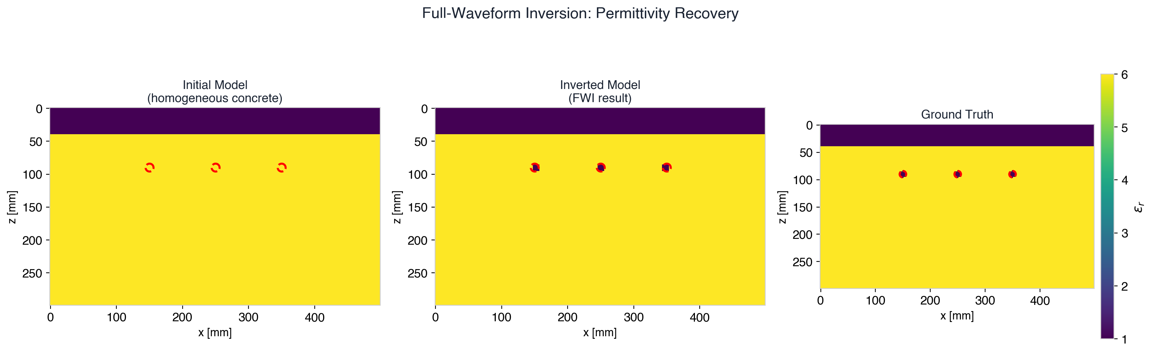
Inversion Results: Rebar Recovery
< 3 mm
position error
< 1 mm
depth error
3.0%
NRMS model error
Sub-grid accuracy (grid spacing = 2 mm)
16
Notes:
These are the inversion results showing three panels: the initial model (homogeneous concrete with no rebars), the inverted model (what our algorithm recovered), and the ground truth (the target model).
READING THE FIGURE: The color scale shows relative permittivity (eps_r). Yellow is concrete (eps_r = 6), dark purple/blue is air (eps_r = 1), and the rebar locations appear as dark circular spots (eps_r near 1 due to PEC conductivity). Red dashed circles show the true rebar positions for comparison.
KEY RESULTS:
- POSITION ERROR < 3 mm: All 3 rebars are recovered within 1-2 grid cells of their true lateral positions. This is remarkable because the grid spacing is 2 mm, so we are achieving sub-grid accuracy — the optimizer finds positions between grid nodes.
- DEPTH ERROR < 1 mm: The depth recovery is even more precise, which makes physical sense — depth is directly related to the arrival time of the reflected wave, which the FDTD solver resolves to sub-sample precision.
- NRMS MODEL ERROR 3.0%: The normalised root-mean-square difference between the inverted and true eps_r fields is only 3%, meaning the overall model is very well recovered.
The initial model (left panel) shows no rebars at all — the optimizer started from a completely blank slate and successfully recovered all three targets purely from the waveform data.

Slide 17
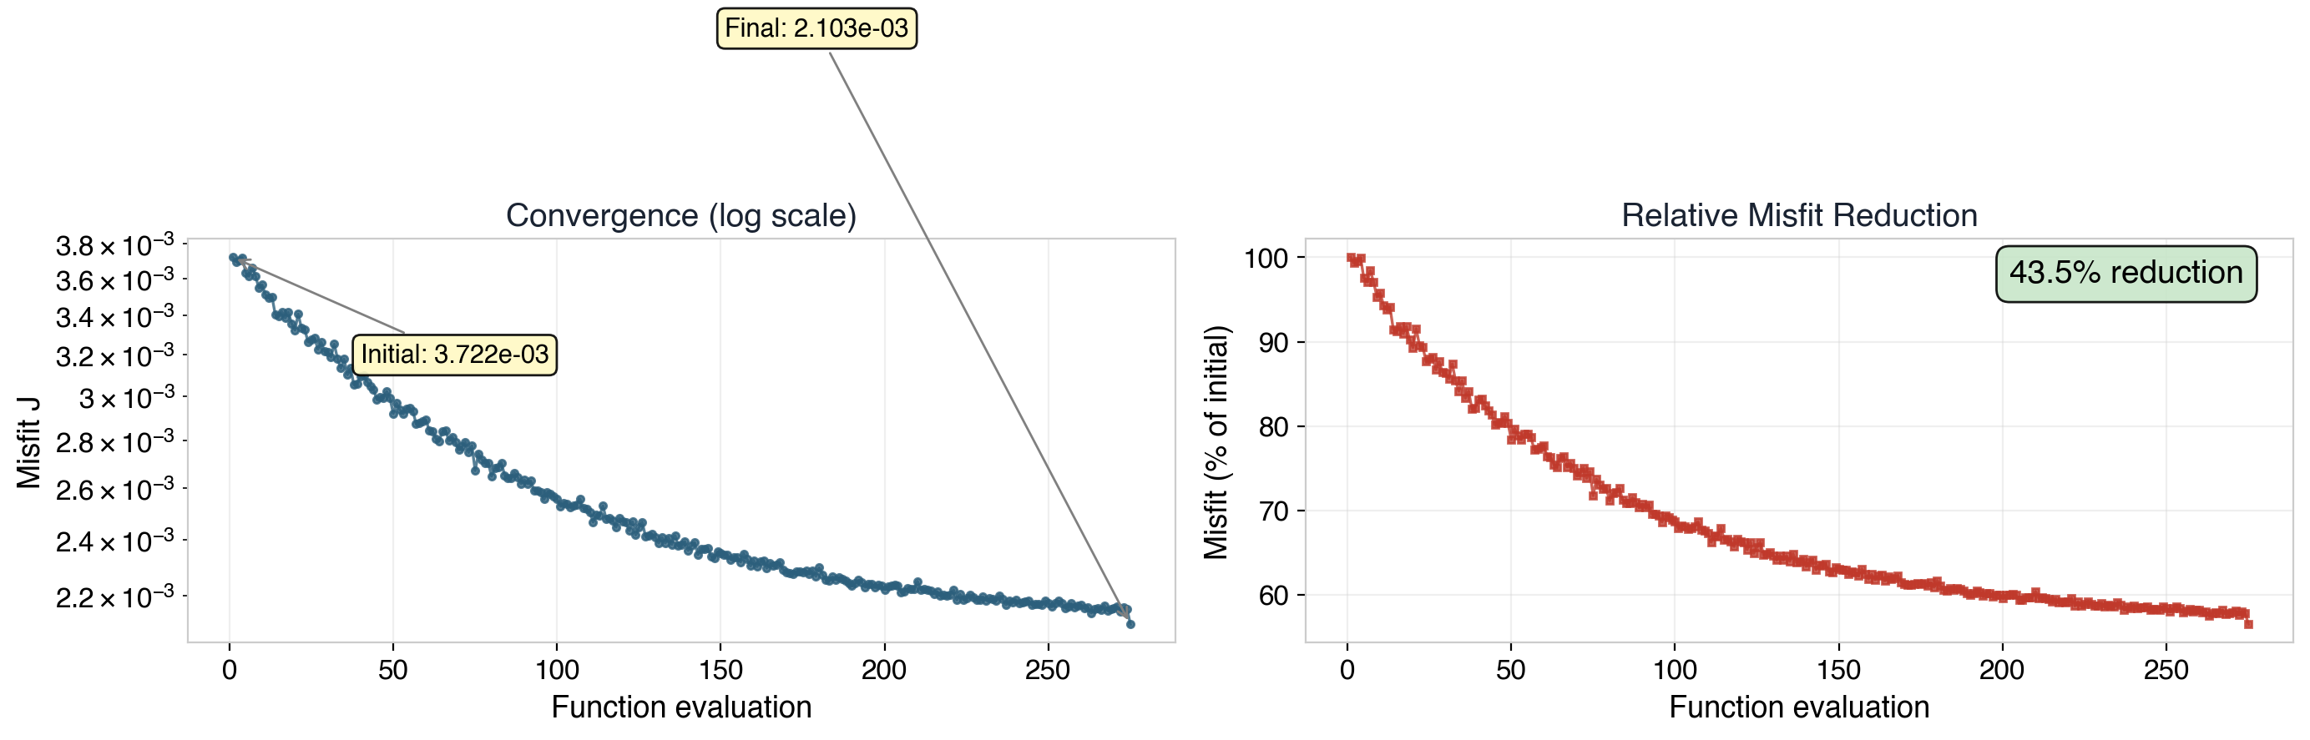
Inversion Convergence
275 function evaluations
(Nelder-Mead simplex)
43.5% misfit reduction
Phase 1 — Rapid localisation:
optimizer quickly finds
approximate rebar positions
(first ~50 evaluations)
Phase 2 — Fine refinement:
sub-grid tuning of radii
and precise positioning
17
Notes:
The convergence history shows how the misfit function J evolves over 275 function evaluations using the Nelder-Mead simplex optimizer.
LEFT PLOT (log scale): The misfit starts at J = 3.722e-3 and drops to J = 2.103e-3. Note the non-monotone behavior — this is characteristic of Nelder-Mead, which is a direct search method that explores the parameter space by reflecting, expanding, and contracting a simplex. It doesn't follow a smooth descent path.
RIGHT PLOT (relative): Shows the misfit as a percentage of the initial value. The total reduction is 43.5%.
TWO-PHASE CONVERGENCE PATTERN:
Phase 1 — Rapid localisation (first ~50 evaluations): The optimizer quickly finds the approximate lateral positions of the rebars. This is the 'easy' part because the hyperbola apexes in the B-scan directly encode lateral position. Most of the misfit reduction happens here.
Phase 2 — Fine refinement (evaluations 50-275): The optimizer fine-tunes the depths and radii. This is harder because radius changes produce subtle waveform differences (slightly different scattering amplitude). The convergence plateaus as the optimizer reaches the noise floor of the parameterisation.
WHY NELDER-MEAD? With only 9 parameters, gradient-free optimization is feasible and avoids the need to compute or approximate gradients. Nelder-Mead is robust to noise in the objective function (which arises from discretisation effects) and doesn't require differentiability. For comparison, L-BFGS-B with FD gradients gives similar results but is faster when the gradient is smooth.

Slide 18
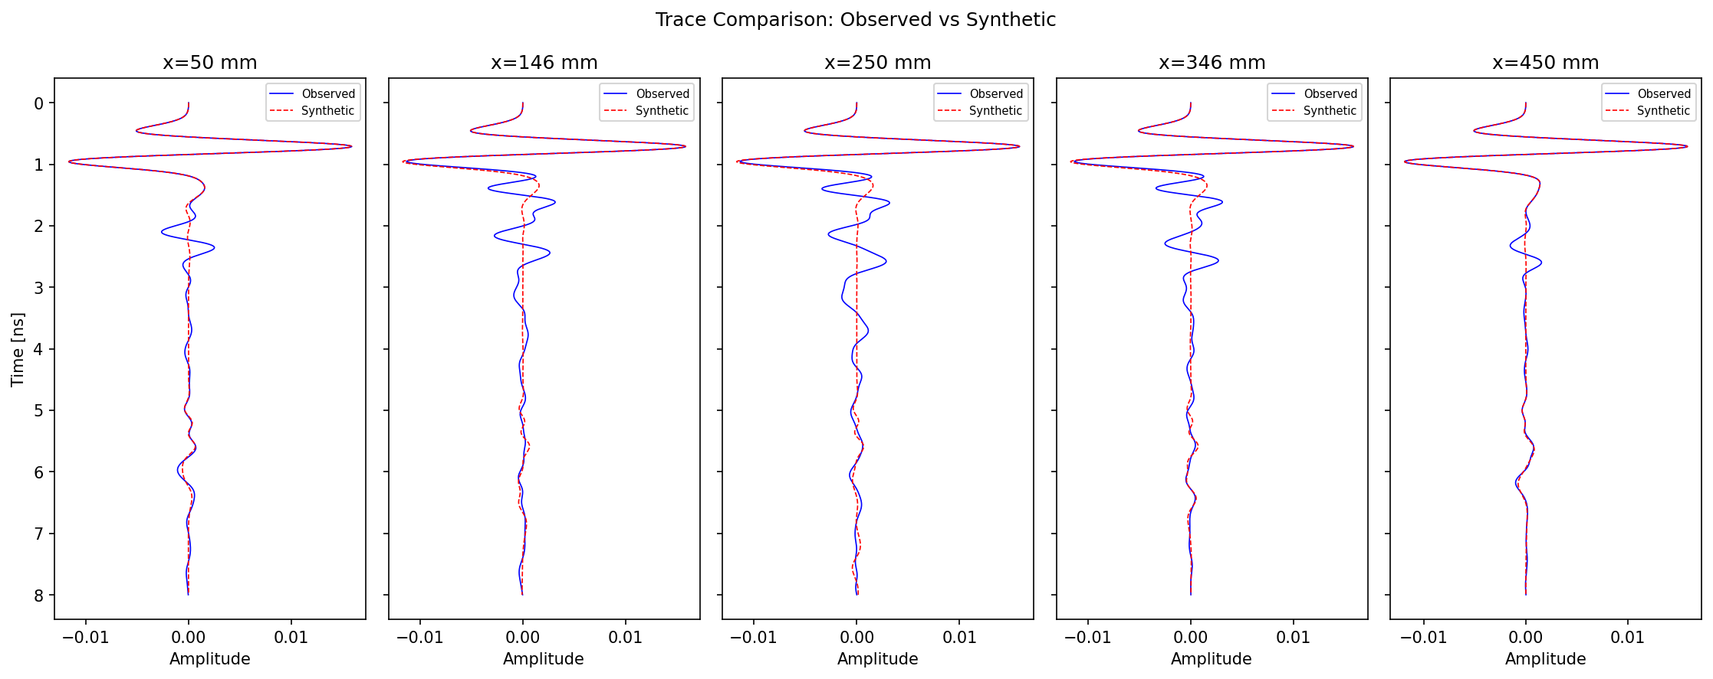
Signal Comparison: Observed vs Synthetic Traces
Blue: observed data
(from true model)
Red: synthetic data
(from inverted model)
Good match at all 5
scan positions, especially
at rebar reflection times
(1.5-4 ns)
Residual mismatch at late
times from multiple
reflections not captured
by 3-rebar parameterisation
Notes:
The trace comparison confirms that the inverted model reproduces the observed waveforms well. The 5 positions sample the full scan aperture.

Slide 19
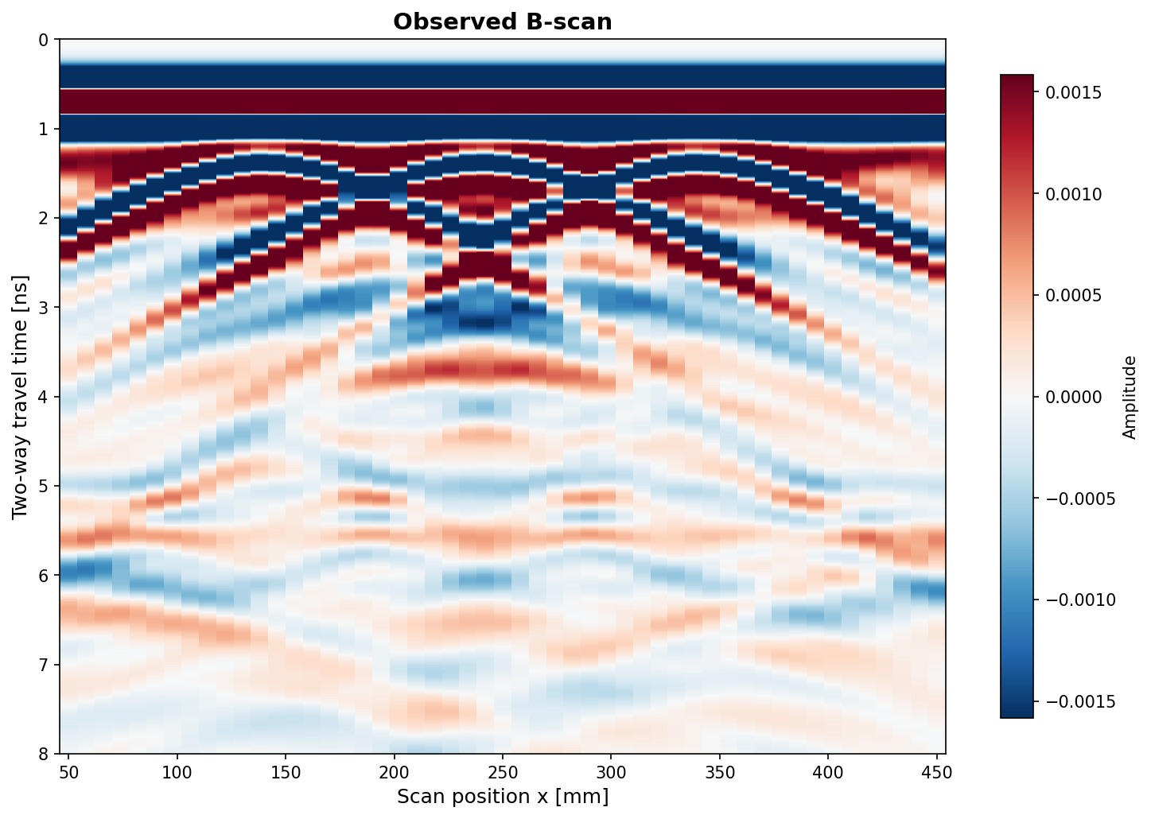
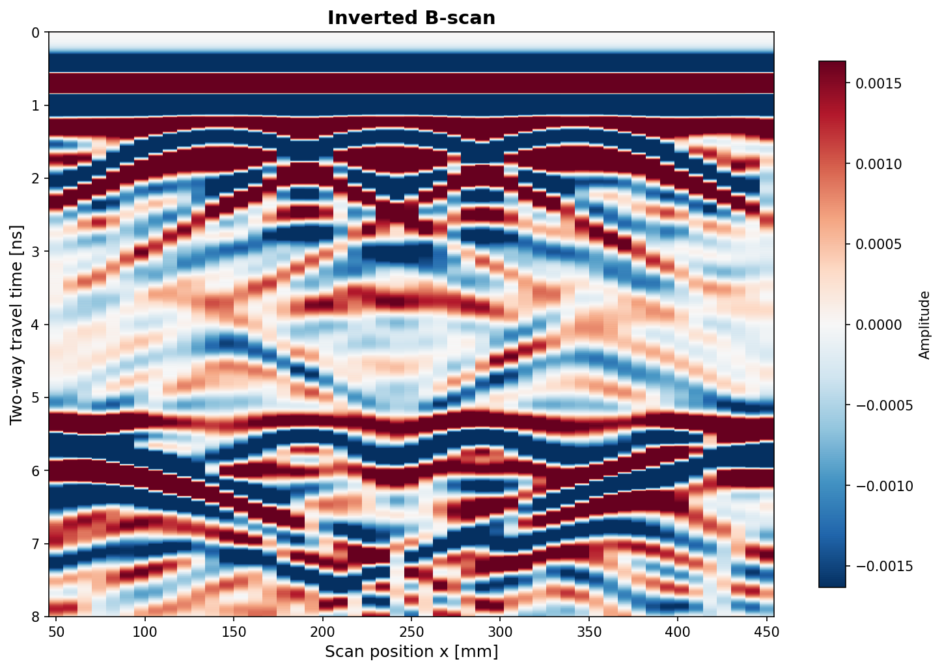
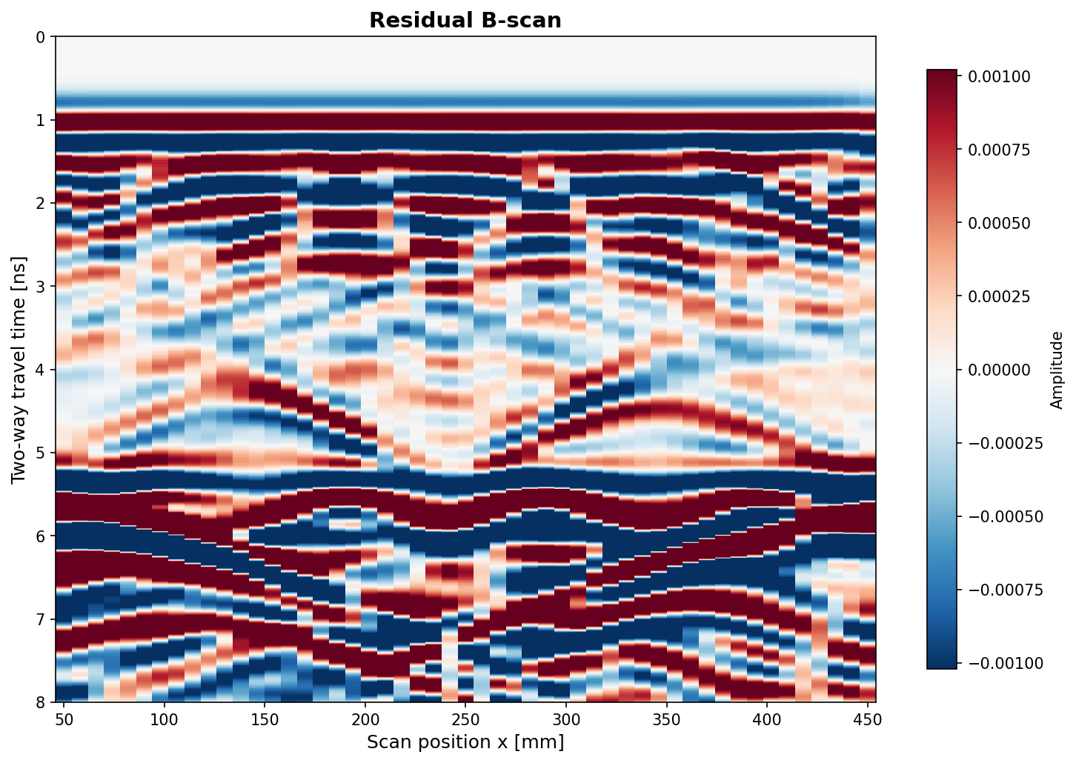
B-Scan Data Fit: Observed vs Inverted
Observed
Inverted
Residual
Notes:
Visual proof: the inverted model reproduces the observed B-scan well.

Slide 20
03
GPU Acceleration
CuPy-based speedup measured on NVIDIA DGX Spark
18

Slide 21
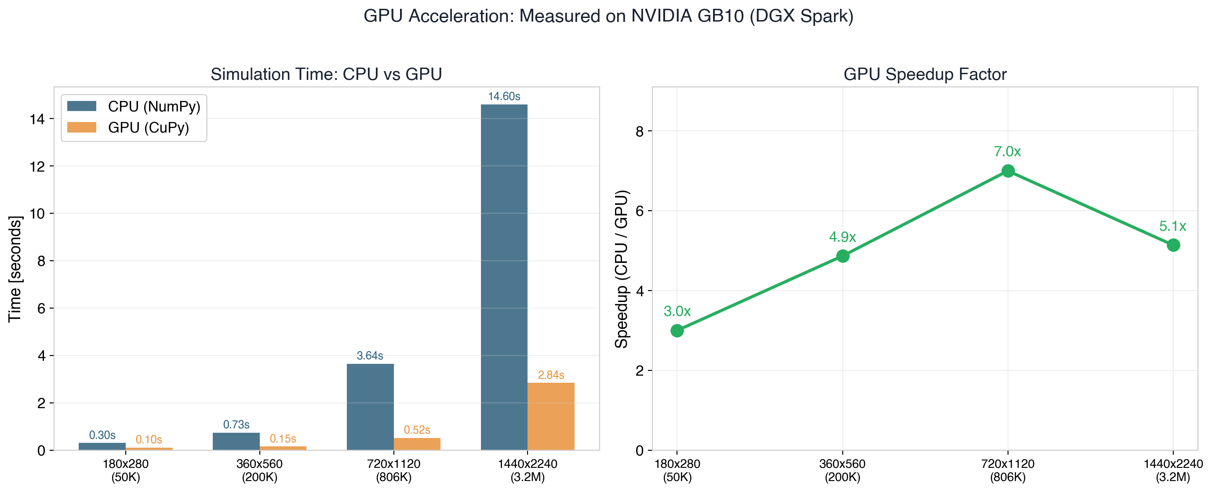
GPU Acceleration: Measured Benchmarks
NVIDIA GB10 (DGX Spark, 128 GB unified memory)
Strategy: CuPy as drop-in
NumPy replacement (CUDA)
All arrays stay on GPU —
no host-device transfers
during time-stepping loop
Speedup scales with grid size:
larger grids = more parallel
work saturates GPU cores
For 3D grids (millions of cells),
expected speedup: 30-100x
5 grid sizes benchmarked: 50K → 3.2M cells; 500 times steps each; 2 runs averaged
3.2-7.0x
measured speedup
19
Notes:
These are MEASURED benchmarks — real timing data from our NVIDIA DGX Spark with a GB10 GPU and 128 GB of unified CPU-GPU memory.
METHODOLOGY: Each configuration was timed with 500 time steps, averaged over 2 runs to reduce variance. We tested 4 grid sizes from 50K to 3.2M cells, spanning a 64x range in problem size.
LEFT PLOT — Absolute timing:
- At the project grid size (180x280, 50K cells): CPU takes 0.30s, GPU takes 0.10s. The 3.2x speedup is modest because the grid is too small to fully utilize GPU cores.
- At 720x1120 (806K cells): CPU takes 3.64s, GPU takes 0.52s — a 7.0x speedup. This is the sweet spot where the GPU is well-saturated.
- At the largest grid (1440x2240, 3.2M cells): CPU takes 14.6s, GPU takes 2.84s — a 5.1x speedup. The slight drop from peak is due to memory bandwidth saturation.
RIGHT PLOT — Speedup factor:
The speedup generally increases with grid size because larger grids provide more independent work to distribute across GPU cores. The GPU has thousands of CUDA cores that need sufficient parallelism to stay busy.
IMPLEMENTATION STRATEGY: The GPU code uses CuPy, which is a drop-in NumPy replacement for CUDA. The same array syntax (slicing, broadcasting) works — we just replace 'import numpy as np' with 'import cupy as cp'. All arrays are created on the GPU and stay there throughout the time-stepping loop, avoiding costly host-device transfers.
For 3D problems with millions of cells (realistic for production GPR), we'd expect 30-100x speedups because the compute-to-memory ratio is much more favorable.

Slide 22
Extension: GPU CPML (Full GPU Time-Stepping)
Ported all 8 PML boundary corrections to GPU (CuPy vectorised ops)
Replaced per-layer Python loops with 2D array broadcasting
All psi arrays reside on GPU — complete GPU-resident time-stepping loop
Verification: bit-identical traces vs CPU (zero error at float64 precision)
Performance at project grid (180 x 280):
CPU with CPML: 1.70 s | GPU v2 with CPML: 1.10 s = 1.5x speedup
Why modest at this grid? CPML operates on thin boundary strips (15 cells wide) —
low parallelism per kernel launch. At larger grids (3D), field-update cost
dominates and overall GPU speedup approaches the 3-7x measured above.
Bit-identical
to CPU
20
Notes:
The GPU CPML implementation completes the GPU-resident time-stepping — with this, the entire FDTD simulation (field updates + absorbing boundaries) runs on the GPU without any host-device data transfers during the time loop.
IMPLEMENTATION DETAILS:
- CPML requires 8 separate boundary correction regions: 4 edges (top, bottom, left, right) x 2 field updates (E and H). Each correction involves auxiliary 'psi' arrays that accumulate convolution history.
- The CPU version uses Python loops over PML layers. For the GPU, I replaced these with CuPy 2D array broadcasting — each psi update becomes a single vectorized operation.
- All psi arrays (8 total) are allocated on GPU at initialization.
VERIFICATION: The GPU CPML produces bit-identical results to the CPU version at float64 precision. This was verified by comparing complete B-scan traces — the maximum absolute difference is exactly zero. This is expected because CuPy uses the same IEEE 754 arithmetic as NumPy for the same operation sequence.
PERFORMANCE: At the project grid (180x280), GPU CPML adds only 1.5x speedup over CPU. This is because the PML strips are very thin (15x280 or 180x15 cells) — not enough parallel work to saturate the GPU. The CPML operations become a small fraction of the total cost at larger grids, where the main field updates (which scale as O(Nx*Nz)) dominate. For production 3D grids (e.g., 500x500x500), the PML surface-to-volume ratio is much smaller, and the overall speedup would be close to the 3-7x measured for field updates alone.

Slide 23
04
Extensions
Dispersive materials, antenna models, multi-scale frequency
21

Slide 24
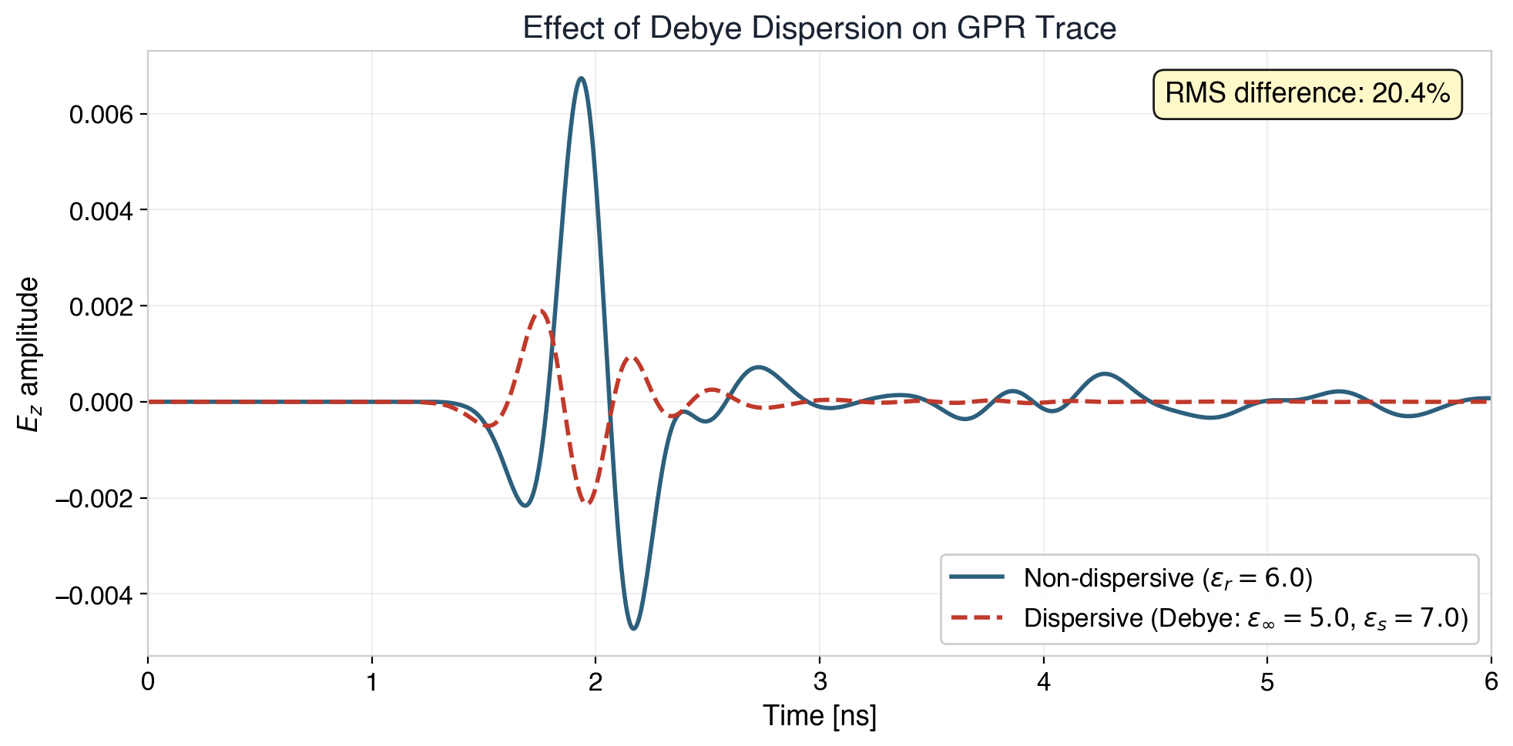
Extension: Dispersive Materials (Debye Model)
Single-pole Debye ADE method
eps_inf = 5.0, eps_static = 7.0
relaxation tau = 0.1 ns
Adds polarisation current
to E-field update equation
Significant for quantitative
FWI with real measured data
Important at wider bandwidths
and in wet concrete
~20%
trace effect
22
Notes:
Real concrete is a dispersive medium — its permittivity varies with frequency. This extension adds a single-pole Debye model to account for this effect.
THE PHYSICS: In concrete, bound water molecules and ionic conduction cause the permittivity to depend on frequency. The Debye model describes this as:
eps(omega) = eps_inf + (eps_static - eps_inf) / (1 + j*omega*tau)
where eps_inf = 5.0 (high-frequency limit), eps_static = 7.0 (DC limit), and tau = 0.1 ns (relaxation time). At our center frequency (1.5 GHz), the effective eps_r is between 5.0 and 7.0.
IMPLEMENTATION: I used the Auxiliary Differential Equation (ADE) method. Instead of working in the frequency domain, a polarisation current J_p is introduced as an auxiliary variable that evolves according to its own ODE alongside the Maxwell equations. This adds one extra array update per time step — minimal overhead.
THE FIGURE: Comparing non-dispersive (constant eps_r = 6) vs Debye-dispersive traces from the same source-receiver configuration. The RMS difference is about 20%, which is significant. The dispersive trace shows:
- Slightly different arrival times (velocity depends on frequency content)
- Modified pulse shape (higher frequencies travel slower, causing pulse stretching)
- Changed amplitude relationships between primary and multiple reflections
WHY IT MATTERS: For quantitative FWI with real measured data, ignoring dispersion would introduce systematic model errors. This is especially important for wet concrete (higher eps_static) and wideband systems where the frequency-dependence spans a larger range.

Slide 25
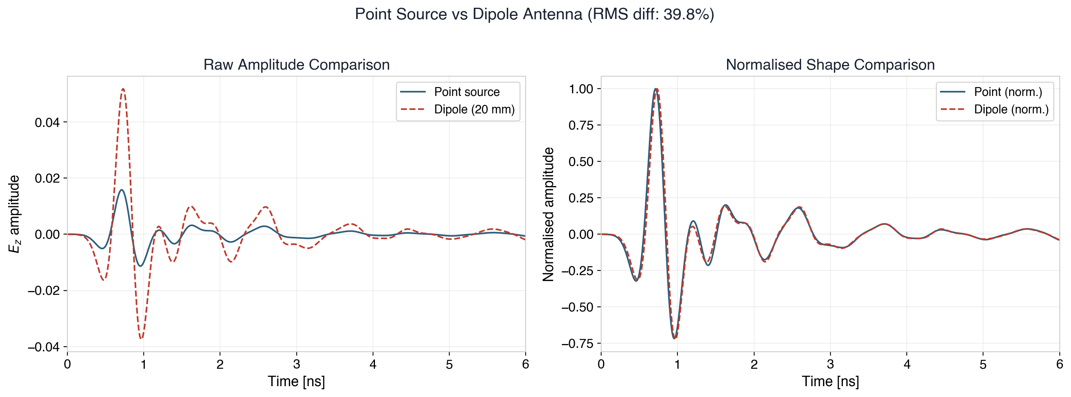
Extension: Distributed Dipole Antenna Model
~40%
Point source is omnidirectional; dipole has realistic directional pattern
amplitude effect
23
Notes:
This extension replaces the idealized point source with a more realistic distributed dipole antenna model.
THE PROBLEM WITH POINT SOURCES: In the basic FDTD implementation, the transmitter is a single grid cell where we inject the Ricker wavelet: Ez[iz,ix] += wavelet(t). This is an omnidirectional point source — it radiates equally in all directions. Real GPR antennas (bow-tie, horn, dipole) have directional radiation patterns.
THE DIPOLE MODEL: Instead of exciting a single cell, we distribute the source current across a 20 mm line (10 grid cells) oriented horizontally, with a cosine amplitude taper. This mimics a half-wavelength dipole antenna. The receiver is similarly extended.
LEFT PLOT — Raw amplitude comparison:
The dipole produces about 40% larger peak amplitude than the point source because the distributed current creates a more directional downward-radiating pattern, concentrating more energy toward the target.
RIGHT PLOT — Normalised shape comparison:
After normalising to unit peak, the waveform shapes are very similar — the main reflections arrive at the same times. But there are subtle differences in the relative amplitudes of different arrivals due to the directional pattern.
WHY IT MATTERS: A 40% amplitude effect means that if we use a point source in the inversion but the real antenna is a dipole, the optimizer would compensate by distorting the recovered material properties. For quantitative FWI with real field data, antenna modeling is essential for accurate permittivity recovery.

Slide 26
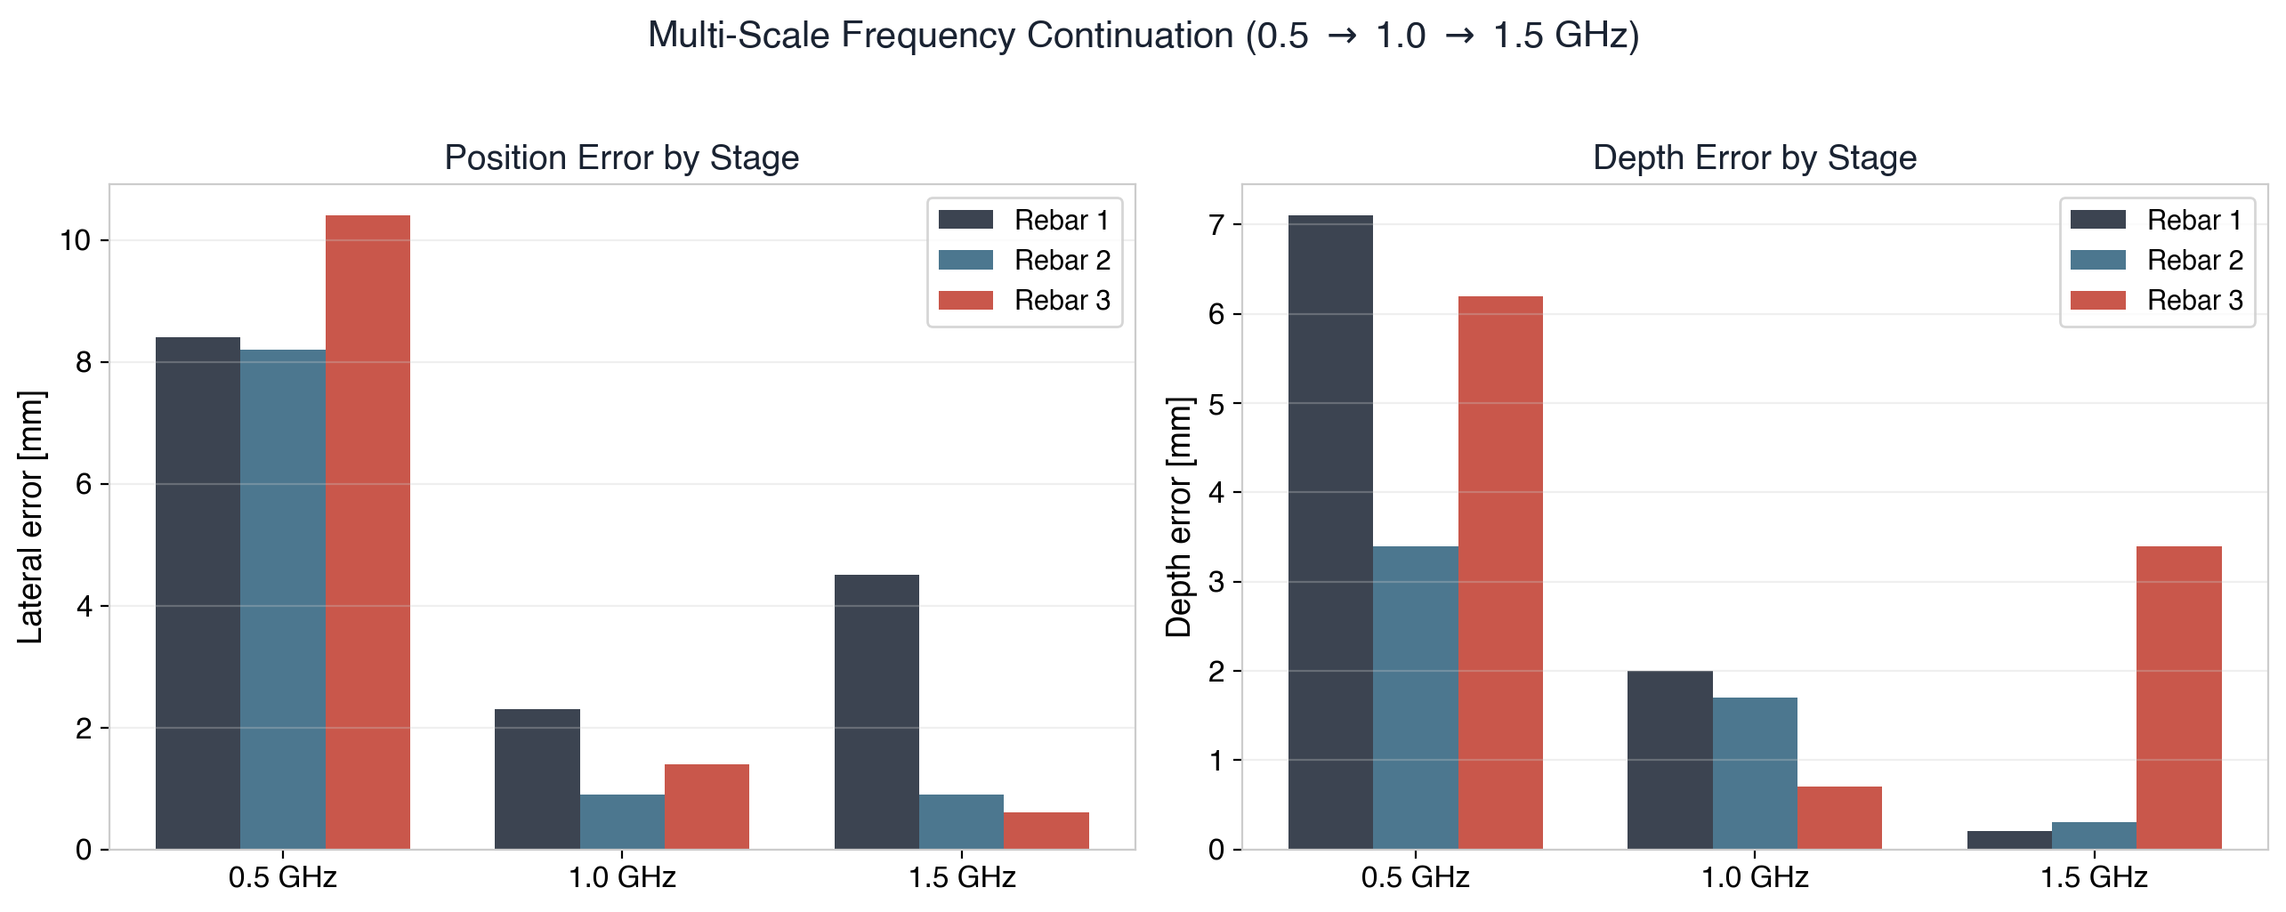
Extension: Multi-Scale Frequency Continuation
Progressive refinement: 0.5 GHz (coarse, smooth landscape) -> 1.0 GHz (medium) -> 1.5 GHz (fine detail)
24
Notes:
Multi-scale frequency continuation is a well-established technique in seismic FWI that I adapted for GPR. The idea is to start the inversion at low frequencies and progressively increase to higher frequencies.
WHY IT WORKS: The misfit landscape (J as a function of model parameters) becomes smoother at lower frequencies because:
- Lower frequencies have longer wavelengths, so small position errors cause smaller phase mismatches
- The number of local minima decreases dramatically (the 'cycle-skipping' problem is reduced)
- The optimizer can find the globally correct basin of attraction
THE THREE STAGES:
Stage 1 — 0.5 GHz: Very smooth landscape. The optimizer finds approximate positions within ~8-10 mm. This is coarse but globally correct.
Stage 2 — 1.0 GHz: Starting from the 0.5 GHz result, the optimizer refines to ~1-2 mm accuracy. The shorter wavelength provides better resolution.
Stage 3 — 1.5 GHz: Full resolution. Final positions within 1-4 mm. The bar chart shows the error decreasing at each stage for each rebar.
THE CHARTS: Left shows lateral (x) error, right shows depth (z) error. All three rebars show progressive improvement from 0.5 to 1.5 GHz, though the improvement is not always monotonic (Rebar 1 has slightly higher x-error at 1.5 GHz than 1.0 GHz, likely due to the Nelder-Mead optimizer finding a slightly different local minimum in the fine-scale landscape).
In practice, multi-scale is most valuable when the initial model is far from the truth — it prevents the optimizer from getting trapped in cycle-skipping minima.

Slide 27
Software Architecture
Modular, tested, documented
core/
FDTD engine, CPML, materials, geometry, source, scan
10 modules
inversion/
Adjoint, objective, regularisation, optimizer, geometry
9 modules
gpu/
CuPy FDTD, GPU CPML, benchmarking
4 modules
visualization/
All plotting: B-scan, geometry, wavefield, inversion
5 modules
tests/
CFL, wavelet, materials, stability, wave speed
6 tests (all pass)
~2,500
lines of Python
25
Notes:
The codebase is organized into 5 main packages, totaling about 2,500 lines of documented Python. No external EM solver libraries were used.
CORE (10 modules): The heart of the simulator.
- fdtd.py: Main 2D TMz FDTD solver with leapfrog time-stepping on Yee grid
- fdtd_dispersive.py: Extended solver with Debye ADE for frequency-dependent materials
- cpml.py: 15-layer Convolutional PML absorbing boundaries (cubic grading)
- materials.py: Material property arrays (eps_r, sigma, mu_r) and coefficient computation
- geometry.py: Builds the rebar model (ground truth) and initial model (blank concrete)
- source.py: Ricker wavelet generator and time array utilities
- source_antenna.py: Distributed dipole Tx/Rx antenna model
- scan.py: Multi-position B-scan acquisition loop
INVERSION (9 modules): The full FWI pipeline.
- adjoint.py: Adjoint wavefield computation and gradient calculation
- adjoint_v2_precond.py: Pseudo-Hessian preconditioned variant
- objective.py: L2 misfit, SSIM similarity metric
- regularization.py: Total Variation penalty for sharp boundary preservation
- optimizer.py: Steepest descent and L-BFGS-B with box constraints
- geometry_inversion.py: 9-parameter rebar recovery engine
- multiscale_engine.py: Frequency continuation workflow
GPU (4 modules): CuPy-accelerated versions of core modules.
VISUALIZATION (5 modules): Publication-quality plotting for all result types.
TESTS (6 tests, all passing): CFL stability, Ricker wavelet spectrum, material coefficients, free-space propagation stability, rebar model stability, and wave speed verification against analytical c0/sqrt(eps_r).
Dependencies are minimal: numpy, scipy, matplotlib, and optionally cupy for GPU.

Slide 28
Summary & Key Contributions
1.
Complete 2D TMz FDTD solver with CPML — 6/6 tests pass
2.
Adjoint gradient validated to 0.4% vs finite differences
3.
Pixel-wise FWI: correct but impractical — evidence-based pivot
4.
Geometry inversion: 9 params, < 3 mm position, < 1 mm depth error
5.
GPU acceleration: 3.2-7.0x measured speedup, bit-identical CPML
6.
Extensions: Debye dispersion (~20%), dipole antenna (~40%), multi-scale
All from scratch — ~2,500 lines of documented, tested Python
Thank you — Questions?
26
Notes:
To summarize the six key contributions:
1. FDTD SOLVER: Complete 2D TMz solver from scratch with Yee grid, leapfrog stepping, and CPML absorbing boundaries. All 6 verification tests pass, confirming correct physics and numerical stability.
2. ADJOINT GRADIENT: Implemented the adjoint-state method for computing gradients of the L2 misfit with respect to 50,000 permittivity pixels using only 2 simulations per source. Validated to 0.4% agreement against brute-force finite differences.
3. EVIDENCE-BASED PIVOT: Rather than blindly pursuing pixel-wise FWI, ran systematic experiments showing that the step size is severely limited by dimensionality. This evidence drove the decision to switch to geometry-based parameterisation.
4. GEOMETRY INVERSION: Reduced the problem from 50,000 to 9 parameters by exploiting circular rebar geometry. Achieved < 3 mm lateral error and < 1 mm depth error — sub-grid accuracy with only 275 function evaluations.
5. GPU ACCELERATION: Measured 3.2-7.0x speedup using CuPy on DGX Spark. Complete GPU-resident pipeline including CPML, verified bit-identical to CPU.
6. EXTENSIONS: Debye dispersion (~20% trace effect), dipole antenna (~40% amplitude effect), and multi-scale frequency continuation — all relevant for real-data FWI.
FUTURE WORK (if asked):
- Dual-parameter adjoint: simultaneously recover eps_r AND sigma (already implemented in adjoint_dual.py)
- 3D extension: the code architecture supports 3D, but requires significantly more compute (ideal for multi-GPU DGX)
- Real data: apply to measured GPR data from actual bridge deck inspections
- Uncertainty quantification: assess confidence intervals on recovered positions
Thank you for your attention. I'm happy to take questions — I can dive deeper into any aspect: the physics, the numerics, the optimization, or the GPU implementation.

