Slide 1
SECOND RESEARCH ARC
Stress-testing the single-rebar pipeline
What assumption, if broken, actually moves radius?
Five published FWI strategies as the menu of hypotheses
Source profiling
Frequency weighting
Polish, not Powell
Amplitude + time-shift + center-frequency scale
Lower bands for basin, 1.5 GHz for radius
Local grid polish remains the radius selector
GPR-FDTD-FWI • experiments 024–058
1
Notes:
The first deck ended at exact-synthetic recovery on the 1 mm grid. This deck is the systematic stress test that follows, organised around five published FWI strategies. The deck order mirrors what we learned: rule out the OT hypothesis (cycle skipping), test bandwidth scheduling (helpful for seeding, not for radius), test frequency weighting (use 1.5 GHz-only or carry_low_25), test W2 (rejected as a radius objective), find the dominant new failure mode (source wavelet mismatch), and assemble a production source-profiled polish that recovers radius and source jointly.

Slide 2
Abbreviations and shorthand
reference
Used throughout the deck — refer back as needed
FWI — Full-Waveform Inversion — fit a wave-equation forward model to observed traces.
WRI — Wavefield Reconstruction Inversion — paper 1 (Feng et al. 2022).
GPR — Ground-Penetrating Radar.
PEBDD — Progressively Expanded Bandwidths of the Data — paper 2 (Zhou et al. 2021).
FDTD — Finite-Difference Time-Domain — the wave-equation solver this project uses.
OT — Optimal Transport — a family of distances between distributions.
CPML — Convolutional Perfectly Matched Layer — the absorbing boundary used by the FDTD solver.
OT-LS — OT-then-LS hybrid objective — paper 3 (Hunziker et al. 2025).
B-scan — GPR data array: lateral scan position × two-way time.
W2 — Quadratic Wasserstein distance — a specific OT-based objective (paper 4, Lu et al. 2024).
LS / L2 — Least squares — the standard waveform misfit (sum of squared point-wise residuals).
IFWI — Implicit FWI — paper 5 (Sun et al. 2025).
NRMS — Normalised Root-Mean-Square misfit between two B-scans (or between two models).
Sinkhorn — Entropy-regularised algorithm for cheap W2 computation.
εr — Relative permittivity (dielectric constant).
Softplus — log(1+e^(βx)) — turns a signed oscillating trace into a non-negative mass distribution.
σ — Electrical conductivity, in S/m.
β (W2) — Softplus scale — larger β preserves more signed-shape information.
PEC — Perfect Electric Conductor — the steel-rebar idealisation in our forward model.
ε (W2) — Sinkhorn entropy regularisation — smaller is more accurate, less numerically stable.
Tx / Rx — Transmitter / receiver antenna positions on the scan line.
ds (W2) — Sinkhorn downsample factor for trace length (cost control).
fc — Source-wavelet centre frequency.
RCCC — Relative Cross-Correlation Criterion = |trace shift| / dominant period (per trace pair).
Ricker wavelet — The time-domain pulse used as our source (the negative second derivative of a Gaussian).
2
NRCCC — Normalised RCCC = fraction of traces with RCCC < 0.5 (half-period gate from the OT-LS paper).
ps / mm — Picoseconds (10⁻¹² s) and millimetres — units we report time-shift and geometry in.
carry_low_25 — Weighting scheme: 0.25 × 1.0 GHz + 1.0 × 1.5 GHz (radius-friendly multi-frequency).
Notes:
This is intentionally a reference slide, not a slide to dwell on. Mention that the rest of the deck uses these acronyms freely, and audiences can jump back here if anything is unclear. The two columns are organised by category: general FWI / GPR / FDTD terms on the left, and paper-specific / W2 / OT-LS terms on the right. carry_low_25 in particular is a name we coined for one of our frequency-weighting schemes.

Slide 3
Key terms and jargon
reference
Plain-language gloss for the rest of the deck
Powell — Derivative-free local optimiser available in SciPy; explores along directions, not gradients. Our default for the continuous local refinement stage.
Cycle skipping — When a modelled trace is more than half a period out of phase with the observed one, least-squares can settle into the wrong cycle. This is the classical failure mode the OT family of methods targets.
Basin — The local valley in the objective landscape where an optimiser settles.
Variable projection (WRI) — Solve a fast subproblem for the wavefield first (with the model fixed), then reduce the optimisation to just the material model.
High-radius basin — The specific wrong local minimum at r ≈ 6.95 mm that continuous Powell consistently finds in our setup.
Matched filter (PEBDD) — Apply the same band-pass to both observed and modelled traces inside the objective — the distinguishing detail vs older bandwidth methods.
Depth-radius coupling — Near the true minimum, a slightly deeper rebar (z+) trades against a slightly larger radius (r+) and produces an almost identical waveform — this is what causes the high-radius basin.
Source-wavelet mismatch — The observed source wavelet differs from the modelled one (amplitude / time-zero / centre-frequency).
Grid polish — A deterministic small local (z, r) grid search after Powell. Corrects radius bias because rasterised geometry is piecewise-constant in physical coordinates, so smooth-tolerance optimisers cannot find the exact rasterised cell.
Source profile — A small set of nuisance parameters (amplitude scalar + time-shift grid + fc-scale grid) fit per candidate to absorb wavelet mismatch.
Top-k candidates — Instead of one best (x, z, r), the polish reports the K best candidates and their misfits — the next-best alternative is auditable.
Distinct-radius margin — Objective gap between the best radius and the best next-distinct-radius candidate — our standard confidence measure.
Twin experiment — Both the 'observed' and the candidate B-scans come from the same FDTD solver, so any failure is in the inverse pipeline, not in the physics model.
Residual spectrum — FFT amplitude of (synthetic − observed) for a specific candidate; shows which frequencies that candidate fails to fit.
3
Notes:
The two most important entries to land verbally are 'high-radius basin' and 'depth-radius coupling' — these come up on most of the later slides. 'Grid polish' is the carry-over from the first deck but is so central to the story that it gets a slot here too. The right column's entries are all features of the production source-profiled polish later in the deck — they give the audience a heads-up on what 'source profile' and 'distinct-radius margin' will mean when those appear.

Slide 4
Five papers as the menu of hypotheses
setup
What this section is and how it lands in the deck
The first deck ended at exact-synthetic recovery on the 1 mm grid. That left a sharper question:
what assumption, if broken, actually moves radius?
We did not invent a new objective. Instead, the recent FWI literature already proposes five distinct strategies for the failure modes we might run into. Each paper is a hypothesis about which assumption matters:
Paper 1 (WRI): the wave equation is too tight a constraint
Paper 2 (PEBDD): the data bandwidth is too wide too soon
Paper 3 (OT-LS): the objective traps on cycle skips
Paper 4 (W2): least squares is the wrong distance
Paper 5 (IFWI): the model representation is too rigid
Each paper was tested through a controlled landscape gate before any optimizer integration. Some were kept, some were rejected, some were deferred — with reasons.
Paper 1 · WRI 2022 (Feng et al.)
Frequency-domain wavefield reconstruction + cumulative frequency strategy.
Paper 2 · PEBDD 2021 (Zhou et al.)
Progressively expanded bandwidth, matched filter on both d_obs and d_syn.
Paper 3 · OT-LS 2025 (Hunziker et al.)
Hybrid OT-then-LS with an NRCCC switching criterion.
Paper 4 · W2 GPR 2024 (Lu et al.)
Quadratic Wasserstein objective via Softplus normalisation + Sinkhorn.
Paper 5 · IFWI 2025 (Sun et al.)
Implicit neural representation (x, z) → (εr, σ) with frequency-principle prior.
4
Notes:
The framing is deliberate. We did not pick a paper and try to apply it; we collected five distinct strategies for FWI failure modes and tested each as a hypothesis. The pattern was the same every time: build the smallest reusable piece of the paper's machinery, put it through a controlled landscape gate, decide adoption based on what the landscape says before any optimizer integration. That order matters — if we had wired W2 into Powell first, we would have burned compute to learn the same lesson the landscape test delivered cheaply.

Slide 5
Wavefield Reconstruction Inversion (WRI)
paper 1 / WRI
Feng et al., Remote Sensing 2022 — frequency-domain GPR-FWI for underground pipeline imaging
PROBLEM IT ATTACKS
METHOD / ARCHITECTURE
Standard FWI for GPR pipeline imaging is brittle: enforcing the wave equation exactly each iteration makes the objective highly nonlinear, so an inaccurate starting model creates cycle skipping and trapped local minima. Multiparameter inversion (permittivity and conductivity together) amplifies this; high-frequency content amplifies it further.
Frequency-domain wavefield reconstruction inversion (WRI). The wave equation is no longer enforced exactly — it becomes a penalty term, so wavefield and model are co-updated. Variable projection: solve a least-squares problem for the reconstructed wavefield given the model, substitute back into a reduced objective over the model, optimize with L-BFGS over relative permittivity and conductivity. Pair this with a multi-scale cumulative frequency strategy: stages B1..B5 add 1, 2, 3, 4, or 6 new frequencies per step while keeping previous ones; inverse-frequency-squared weighting prevents the high band from dominating the objective.
KEY FINDINGS REPORTED
OUR ADAPTATION
Two synthetic pipeline cases and one field-style case. Cumulative schedules beat the simultaneous baseline in every test. Reported error reductions: 7–11% (permittivity) and 7–15% (conductivity) on case 1; 20–40% and 17–24% on case 2. Smaller cumulative batches were more accurate but cost more PDE solves. Permittivity reconstructed better than conductivity. Field case recovered plausible pipeline locations even with imperfect starts.
Kept: the cumulative-frequency philosophy, adapted as time-domain per-frequency objective contributions and a --frequency-weights CLI. This is what enables the carry_low_25 scheme we use for radius. Deferred: full WRI itself. Faithful implementation needs a new frequency-domain Helmholtz/Maxwell operator, complex sparse solves, frequency-domain adjoint, and penalty continuation — its own project. The current radius bias is already well explained by source handling and weighted LS, so the cost is not justified. Documented in docs/experiments/28_wri_feasibility.md.
5
Notes:
When walking through this slide, the order to emphasize is: (1) the WRI relaxation is a *structural* change to the optimization (penalty instead of constraint), not just a different solver step; (2) the cumulative-frequency idea is independent of WRI and is what we actually adopted; (3) the deferral is conditional, not categorical — if a future setup creates an initial-model failure that source handling cannot fix, WRI moves back onto the table.

Slide 6
Progressively Expanded Bandwidth FWI (PEBDD)
paper 2 / PEBDD
Zhou, Klotzsche, Vereecken, NSG 2021 — crosshole GPR FWI with bandwidth scheduling + source-wavelet update
PROBLEM IT ATTACKS
METHOD / ARCHITECTURE
Crosshole GPR FWI requires the modeled and observed traces to be within roughly half a wavelength or half a period at every position for least-squares to be safe. Ray-based starting models often violate this in high-contrast media. The visible failure mode is the optimizer settling into a depth/contrast tradeoff that fits the B-scan well but is physically wrong.
PEBDD = Progressively Expanded Bandwidths of the Data. Apply the SAME tapered bandpass to both observed and modeled traces — that is the differentiator from older bandwidth-expansion methods, which filtered only the modeled side through the source wavelet. Algorithm: estimate an effective source wavelet; build a tapered filter; fix a low cut; start with a low high cut; run a small number of FWI iterations; expand the high cut by a fixed increment; repeat. After the staged build-up, use the recovered model as the starting model for full-band FWI, then update the source wavelet by deconvolution and run full-band FWI again.
KEY FINDINGS REPORTED
OUR ADAPTATION
Synthetic case I with a good ray-based start: permittivity MAE 2.0 → 1.7 with PEBDD; data RMS roughly halved. Synthetic case II with a deliberately bad start outside the half-wavelength criterion: standard FWI MAE 3.6 → PEBDD MAE 2.1; standard FWI was trapped, PEBDD was not. Field-data RMS improved in all four crosshole sections tested; CPT comparisons mostly better, not uniformly.
Kept: the matched-filter design (FFT bandpass applied to both d_obs and d_syn) as inversion/trace_filters.py, plus a new spectrum-design tool so the band edges come from real residual spectra instead of guesses. Used as the seed-building stage of the staged inversion. Adapted: the source-wavelet update is replaced in our pipeline by the explicit source profiling described later in the deck (amplitude / time-shift / center-frequency-scale).
6
Notes:
The most important sentence to deliver: 'the differentiator from older bandwidth methods is filtering both sides the same way'. This is what made PEBDD survive on field data in the paper. Our adoption is faithful to that detail; the schedule itself we re-derived from actual residual spectra after seeing that the guessed bands did not carry radius information.

Slide 7
Optimal-Transport / Least-Squares Hybrid (OT-LS)
paper 3 / OT-LS
Hunziker, Meles, Linde, JAG 2025 — get into the basin with OT, refine with LS, switch via NRCCC
PROBLEM IT ATTACKS
METHOD / ARCHITECTURE
Crosshole GPR FWI is cycle-skipping-prone with L2 because the objective has multiple local minima along trace shifts. When the wavelet's main lobe moves past truth, pointwise amplitude cancellation creates a misleading local decrease and the optimizer slides into the wrong basin. The proposed fix is a hybrid objective, not just a different optimizer.
Two-stage objective. OT first: convert each trace into a 'fingerprint' — a 2D pseudo probability density over (time, amplitude), take its two 1D marginals, compute Wasserstein distances on those marginals. The fingerprint OT objective has a broad global basin that is shift-monotonic. Then switch to LS for sharpness once trace pairs are aligned. Switching is governed by the cross-correlation criterion RCCC = |trace shift| / dominant period; NRCCC is the fraction of traces with RCCC < 0.5; switch when NRCCC > Cs ≈ 0.7. Gradients computed sparsely at random master points away from antennas, then interpolated — implicit regularization plus runtime.
KEY FINDINGS REPORTED
OUR ADAPTATION
Synthetic crosshole with a large circular anomaly and a deliberately poor homogeneous starting model. Pure LS converged to bad local minima. Pure OT moved toward the right structure but did not resolve details. Hybrid OT → LS recovered good models for switching thresholds Cs ≈ 0.7–0.75. Runs that ended with NRCCC = 1 and weighted RMS close to 1 were reliable; runs that did not were not.
Kept: the NRCCC trace-shift diagnostic, implemented in inversion/trace_distances.py and saved in every run summary. We use it as a safety report — does the model live in a least-squares-safe basin? Deferred: the OT objective itself. Across exact / 5% / 10% noise, NRCCC = 1.0 for our wrong-radius candidates — they are already in the LS-safe basin. The OT machinery would be solving a problem we do not have.
7
Notes:
Stress two design points the slide names but does not unpack: (1) the trace fingerprint is the part that lets OT work on signed oscillatory data without a heavy normalization; this is different from the W2 / Softplus approach we will see next paper; (2) the sparse-gradient idea (master points) is a regularization choice with a side effect — it makes it cheaper to swap in new distance measures because we are not derivative-tied to any one objective.

Slide 8
Quadratic Wasserstein GPR-FWI (W2)
paper 4 / W2
Lu et al., Remote Sensing 2024 — two-parameter GPR-FWI with W2 as a direct L2 replacement
PROBLEM IT ATTACKS
METHOD / ARCHITECTURE
Two-parameter GPR FWI (relative permittivity and conductivity) is unstable under standard L2: high parameter sensitivity, weak conductivity recovery, noise vulnerability, strong initial-model dependence. The paper proposes a single objective change rather than a new optimization framework, so the rest of the FWI stack stays the same.
Replace L2 with the quadratic Wasserstein distance W2. Three implementation pieces matter. (1) Softplus normalisation: raw signed GPR traces oscillate around zero, but optimal transport needs non-negative distributions with equal mass; softplus(b·x) / Σsoftplus turns the trace into a usable distribution. The scale b controls how aggressive the transform is. (2) Sinkhorn entropy regularisation: exact OT is too expensive for repeated FWI evaluations; ε trades transport accuracy for numerical stability. (3) Wrap in multi-scale frequency-domain FWI with L-BFGS over εr and σ, frequencies added in batches (e.g. 15 batches of 4 frequencies, 10 iterations each).
KEY FINDINGS REPORTED
OUR ADAPTATION
Three numerical examples. W2-FWI depends less on the initial model than L2-FWI. W2-FWI is more robust to additive noise. W2-FWI improves conductivity recovery more strongly than permittivity recovery (the opposite ordering from L2-based work). L2-FWI can generate high-frequency artifacts and obscure targets when the starting model is poor. Adding higher frequencies did not always improve W2 results.
Built: a standalone Softplus / Sinkhorn W2 module with unit tests (inversion/trace_wasserstein.py). Ran it through two gates before any optimizer integration. Gate 1 (shifted Ricker, paper claim): passed. Gate 2 (rebar landscape): failed. Softplus normalisation removes the amplitude content radius depends on; W2 margin collapses by four orders of magnitude vs LS. Decision: reject W2 as the final radius objective for this problem. Kept available as a basin diagnostic for future poor-initial-model / field-data scenarios.
8
Notes:
When presenting, emphasize the two-gate structure of our test — we did not just dismiss W2 from theoretical arguments. We replicated the paper's positive claim (shift convexity) and then put the same method on the actual rebar problem. The negative result on the rebar landscape is *specific to single-rebar radius*, not a general judgment on W2. Mention also that β (Softplus scale) and ε (Sinkhorn entropy) are hyperparameters that need to be set, and Sinkhorn cost grows with trace length — both are reasons to test in a controlled landscape gate, not directly inside an optimizer.

Slide 9
Implicit Multiparameter GPR-FWI (IFWI)
paper 5 / IFWI
Sun et al., GJI 2025 — neural implicit representation of the subsurface material model
PROBLEM IT ATTACKS
METHOD / ARCHITECTURE
Standard FWI stores material parameters on a dense grid. That makes multiparameter inversion brittle: huge model dimensionality, manual parameter weighting between permittivity and conductivity, strong initial-model dependence, ad-hoc multi-scale schedules. The paper proposes a fundamentally different model representation rather than a new objective.
Implicit FWI. Replace the grid with a small neural network: coordinates (x, z) → N_θ(x, z) → (εr, σ). The forward solver is still Maxwell / FDTD, the loss is still waveform mismatch — only the model parameterization changes. Optimize the network weights with Adam. Architecture details matter: SIREN / sinusoidal activations with a frequency scale ω₀ that controls detail sensitivity; too small ω₀ misses fine structure, too large ω₀ produces high-frequency noise. Dropout helps in some configurations. The paper also describes an RNN-style differentiable FDTD framing so AD gives gradients consistent with adjoint-state methods.
KEY FINDINGS REPORTED
OUR ADAPTATION
The 'frequency principle' of neural networks acts as an automatic multiscale prior: broad/low-frequency structure is learned before fine detail. IFWI reconstructed useful subsurface structure from poorer initial models than standard FWI. Permittivity and conductivity inverted simultaneously without the manual parameter weighting that classical multiparameter FWI relies on. Network architecture (depth, width, ω₀, dropout) materially affects results — these are tuning choices, not free parameters.
Deferred. Two concrete reasons: (1) our parameter vector is [x, z, radius] — three numbers; an implicit field is overkill. (2) a flexible neural residual would risk absorbing radius bias into a 'background correction' instead of revealing it, which would make the radius estimate less meaningful, not more. The frequency-principle lesson is already implicit in our staged pipeline (basin first, detail later). Reserved for multi-rebar or field-data stages where explicit nuisance parameters become insufficient. See docs/experiments/29_ifwi_feasibility.md for the design of a constrained future prototype.
9
Notes:
The deferral here is the most subtle in the deck. The risk is not that IFWI does not work — it does. The risk is *what* it can be made to fit. A free neural residual field around the rebar could match data while leaving radius wrong; the radius error would be absorbed into the field. The future-prototype design in tracker 29 is intentionally constrained: explicit geometry stays primary, the neural residual is small, smooth, regularised, and held-out scan positions check generalisation. Mention this caveat if anyone asks why we didn't just try it.

Slide 10
From papers to experiments — the mapping
roadmap
Which experiments tested each paper's claim, and the verdict
Source | Hypothesis tested | Experiments | Gate result | Verdict
OT-LS | Cycle skipping drives radius bias | 024–027 | NRCCC = 1.0 for every candidate, including the wrong-radius one | ruled out for this problem; diagnostic kept
PEBDD | Bandwidth scheduling fixes the radius bias | 028–037, 043–045 | Powell stops in the high-radius basin at every stage; polish stays the radius selector | kept as seed builder; spectrum-design tool added
WRI | Cumulative-frequency / weighted multi-frequency helps radius | 038–041, 046–049 | 1.0 GHz weak; unweighted averaging dilutes margin; carry_low_25 best compromise | kept as time-domain weighted LS; WRI solver deferred
W2 | Softplus / Sinkhorn beats LS for radius selection | 048, 050, 051 | Shift convexity ✓ (gate 1); rebar margin collapses ×10⁴ (gate 2) | rejected as radius objective; module kept as diagnostic
PEBDD risk | Source-wavelet mismatch (field-data flag) shifts radius | 052–055 | Raw mismatch pegs r to grid bound; structured source profile recovers truth | amplitude + time + freq profile fixes all tested cases
(geometry) | Material parameters can hide a wrong radius | 056 | εr identified; σ saturates above 1e5; distinct-radius margin preserved | no material params in the radius optimizer yet
all 5 | Production runner combines surviving ideas | 057, 058 | Radius + source profile co-recovered under injected mismatch | recommended pipeline going forward
IFWI | Neural implicit field needed for radius | doc 29 only | Flexible residual would absorb radius bias | deferred to multi-rebar / field-data stage
Acronym key: OT-LS = optimal-transport / least-squares hybrid · PEBDD = progressively expanded bandwidths of the data · WRI = wavefield reconstruction inversion · W2 = quadratic Wasserstein · IFWI = implicit full-waveform inversion · NRCCC = fraction of trace pairs within half a period · LS = least squares.
10
Notes:
This is the roadmap. The deck order after this slide follows the rows in this table top-to-bottom: rule out OT (kept as a diagnostic), then bandwidth scheduling (kept as a seed builder), then frequency weighting (kept), then W2 (rejected, with both gates shown), then material (no parameters added), then the wavelet-mismatch finding (the new contribution), then the synthesis runner. The two-week summary tracker (doc 30) is the source of these verdicts. Mention that the OT-LS paper is actually used twice in our work — once for the cycle-skipping hypothesis (ruled out) and once indirectly via the PEBDD source-wavelet risk it shares.

Slide 11
01
Was it cycle skipping?
OT diagnostic on the existing high-radius candidate
11

Slide 12
OT-style trace-shift diagnostic
exp 024–027
Rule out the OT branch before committing to a new objective
Hypothesis
If the high-radius Powell basin is a cycle-skipping failure, the OT-LS paper's NRCCC criterion should flag it as unsafe for least-squares.
What we did
We implemented RCCC = |trace shift| / dominant period and NRCCC = fraction with RCCC < 0.5. Ran it post-hoc on the known high-radius Powell candidate, the polished true candidate, and the top-k polish candidates under 5% and 10% noise.
What we'll see
If NRCCC < 1 for the wrong-radius case, the OT branch is worth pursuing.
If NRCCC = 1 for every candidate, this problem is not a transport problem.
12
Notes:
Module: inversion/trace_distances.py. Runner: run_single_rebar_trace_diagnostics.py. We added per-frequency trace_shift_by_frequency to every new single_rebar_summary. The design point of mentioning this on the slide is *not* that OT is bad — it is that the diagnostic itself ruled out the branch for the current problem before any expensive optimizer integration. Even at 10% noise the wrong-radius candidate still passes the half-period gate.

Slide 13
NRCCC results across the candidate set
exp 024–026
Does the half-period gate flag the wrong-radius candidates as unsafe?
RCCC (Relative Cross-Correlation Criterion) = |trace shift| / dominant period, computed for each (observed, synthetic) trace pair.
NRCCC (Normalised RCCC) = fraction of traces with RCCC < 0.5 — the half-period gate the OT-LS paper uses to decide a trace is least-squares-safe.
Paper's switching rule: when NRCCC > ~0.7, switch from the OT objective to LS. If a candidate is already at NRCCC = 1.0, OT brings no extra basin-finding benefit.
Candidate | Misfit J | NRCCC | med RCCC | max RCCC | Radius | Note
polished true (014 / 015) | 0 | 1.000 | 0.000 | 0.000 | 6.000 mm | exact recovery
Powell high-radius | 2.08e-3 | 1.000 | 0.003 | 0.003 | 6.955 mm | wrong radius, but phase-safe
noise 10% top 1 (023) | 1.99e-1 | 1.000 | 0.000 | 0.003 | 6.000 mm | recovered
noise 10% top 2 | 1.99e-1 | 1.000 | 0.000 | 0.003 | 6.000 mm | alternative cell
noise 10% high-radius | 2.01e-1 | 1.000 | 0.003 | 0.006 | 6.991 mm | wrong radius, phase-safe
noise 5% recovered | 5.86e-2 | 1.000 | 0.000 | 0.000 | 6.000 mm | recovered
noise 5% optimizer-end | 6.09e-2 | 1.000 | 0.003 | 0.006 | 6.973 mm | wrong radius, phase-safe
What this means
Every candidate — including the wrong-radius Powell solutions at all noise levels — already sits at NRCCC = 1.0. The wrong-radius rows have a tiny non-zero median RCCC (≈ 0.003, i.e. 0.3% of a dominant period), but that is far below the 0.5 half-period gate. So the radius failure is not a phase / cycle-skipping problem; an OT objective designed for cycle skips cannot help here. Decision: rule the OT branch out for this problem; keep the NRCCC diagnostic for field-data use.
13
Notes:
The slide intentionally shows the diagnostic outcome before the decision, so the audience can see *why* we rule the OT branch out rather than just reading the verdict. Key points to deliver: (1) the OT-LS paper's whole motivation is cycle skipping at scale, with NRCCC < 1.0 being the trigger to use OT; (2) our wrong-radius candidates already have NRCCC = 1.0, so they are in the LS-safe basin — the paper itself would say 'use LS here'; (3) the wrong-radius rows have very slightly higher RCCC than the polished true rows, but the absolute value (0.003 of a period) is two orders of magnitude below the gate. The radius issue is therefore an amplitude / detail issue, not a transport issue. That observation drives the next section (PEBDD bandwidth) and ultimately motivates the source-profiling work that closes the deck. We keep the NRCCC diagnostic available for field data where the basin-finding question is still open.

Slide 14
02
Bandwidth scheduling
PEBDD first pass, then a spectrum-driven re-design
14

Slide 15
First PEBDD attempt with guessed bands
exp 028–033
Same band-pass filter applied to observed and synthetic traces (matched-filter design)
Hypothesis
A staged objective that starts in a low frequency band and expands the high cut should reduce the high-radius Powell bias (the wrong local minimum at r ≈ 6.95 mm that the derivative-free SciPy Powell optimiser keeps finding) before the polish stage.
What we did
Built a trace-filter helper and a staged runner. First schedule used 0.2–0.8 then 0.2–1.1 then full band, with a final coarse polish. Also ran controls without polish and a polish-only path from the low-band seed.
What we'll see
Exact data: low-band Powell did move radius closer to the truth, but full-band Powell pulled it back.
Noise: the low-band stage stayed in the high-radius basin.
Polish remained the reliable radius selector in every variant.
15
Notes:
Bands chosen by inspection at this point: 0.2–0.8 → 0.2–1.1 → 0.2–1.5 → full. Code lives in inversion/trace_filters.py. The CLI flag is --objective-bandpass-ghz LOW,HIGH with a taper width. Important storytelling point: the first-pass result is the reason the next slide (spectrum-driven design) happens at all.

Slide 16
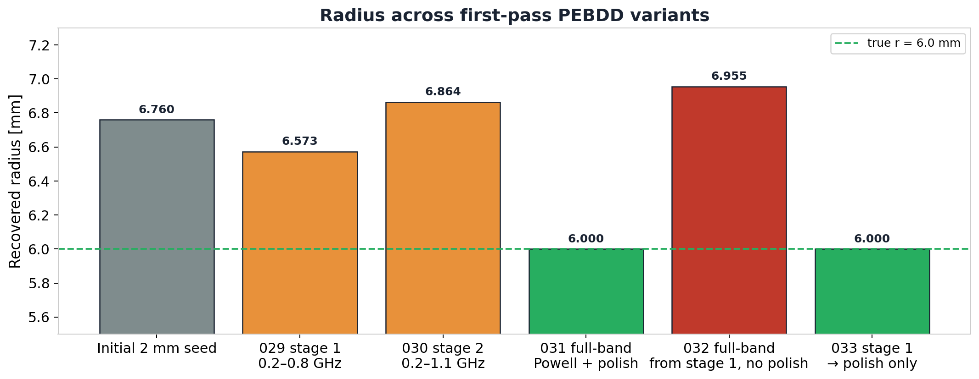
Radius across first-pass PEBDD variants
exp 029–033
Single-frequency 1.5 GHz, 5 scan positions (PEBDD = progressively expanded bandwidths of the data)
Each bar is the recovered radius at the end of one run. 'Powell' is SciPy's derivative-free local optimiser; 'polish' is a deterministic small (z, r) grid search after Powell. Polish is the only step that lands on 6.0 mm; full-band Powell without polish returns to the high-radius basin (r ≈ 6.95 mm) — the wrong local minimum it consistently finds.
16
Notes:
Walk through the bars in order. Initial seed at r=6.76. Stage 1 (low band) brings radius to 6.57 — a real improvement. Stage 2 (expansion) drifts back to 6.86. The full-band run from stage 1 without polish (exp 032) confirms the regression is caused by the full-band Powell objective itself, not by any particular stage. The two green bars are the only ones that land at truth: both used the polish stage.

Slide 17
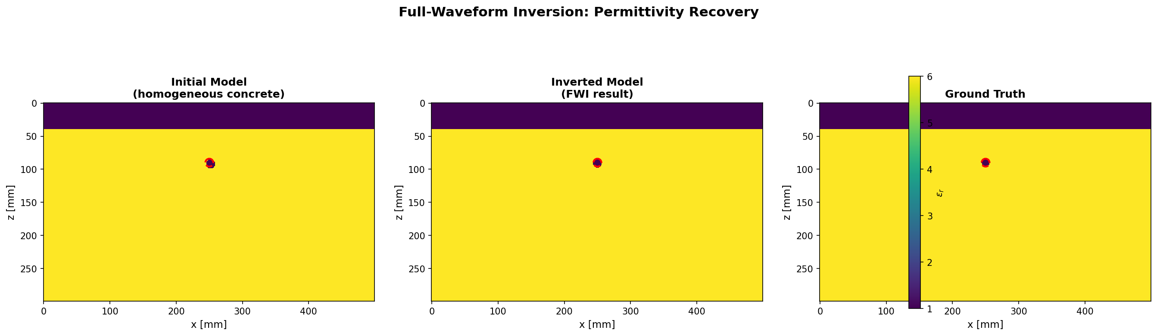
Stage 1: low-band Powell
exp 029
0.2–0.8 GHz objective; full unfiltered traces still used for NRMS
Stage-1 recovered r = 6.573 mm at x ≈ 249.8, z ≈ 90.6 mm. The low band moved radius toward the truth but did not reach it.
17
Notes:
Filtered objective at the end was about 1.0e-4. Full-data NRMS is about 1.07%, which is fine — but the recovered model still has the rebar slightly off and not at the right radius. Mention here that the observed and synthetic traces are filtered the same way; this is the PEBDD detail that differentiates it from older bandwidth-expansion methods.

Slide 18

Stage 2: expanded to 0.2–1.1 GHz
exp 030
Bandwidth expansion from the stage-1 seed (same band-pass on observed and synthetic)
Recovered r drifts back up to 6.864 mm. Expanding the band re-introduces the depth–radius coupling (a slightly deeper rebar trades against a slightly larger radius to produce a near-identical waveform).
18
Notes:
Full-data NRMS (normalised RMS over the unfiltered traces) actually improves to about 0.79%, but the recovered radius worsens from 6.57 mm back toward 6.86 mm. This is the single most important lesson from the PEBDD-first-pass section: data fit and radius fidelity can move in opposite directions when the objective expansion reactivates the depth-radius tradeoff. The expanded band lets the optimiser explore amplitude detail the low band could not see, but the dominant valley in that detail is the high-radius basin, not the true r = 6.0 mm minimum. This behaviour was not predictable from the paper's claims alone — it is specific to our rasterised-geometry setting and is what motivates the polish stage that follows.

Slide 19

Stage 3: full band + polish
exp 031
Full-band Powell from stage 2, then a deterministic coarse grid polish
Polish recovers r = 6.000 mm (NRMS model = 0). Powell alone reverts to r = 6.955 mm before polish takes over — same wrong basin as the no-PEBDD path.
19
Notes:
Top polish candidates here: r = 6.0 mm (J = 0), r = 6.2 mm (J = 1.04e-3), r = 6.8 mm (J = 2.08e-3). Same ranking as the simpler single-frequency polish from the first arc. The implication is unambiguous: even with the multi-stage bandwidth schedule wrapped around it, the polish stage is what is doing the radius work. PEBDD has not added to radius accuracy; it has only added cost. This is the first hard evidence that PEBDD as written cannot solve radius on its own — and it sets up the spectrum-design section, which asks whether the band choices themselves were wrong. Important caveat to mention: this is the exact-synthetic case; under noise the conclusion is the same but the polish stage starts to need careful early-stop thresholds to avoid following noise.

Slide 20
Control: full-band Powell, no polish
exp 032
Same stage-1 seed, run full-band Powell without polish — isolates the bandwidth role
Final r = 6.955 mm. Confirms the regression we saw in stage 2 is the full-band Powell objective itself, not a specific staging choice.
20
Notes:
This slide is the diagnostic that isolates blame between two suspects: (a) the staged path itself (maybe stage 2 destabilised something), or (b) the full-band Powell objective (which has the depth-radius valley). If (a), removing polish would still leave us at a moderate radius. If (b), we should return to the original wrong basin. Result: we are back at r = 6.955 mm, identical to the original Powell result from the first arc. Verdict: (b) is the cause. This is the kind of controlled experiment that lets us reject one design hypothesis (staging is the problem) and keep another (the polish stage is doing the load-bearing work). It also justifies the 'stage 1 seed → polish only' variant on the next slide, which removes the full-band Powell step entirely.

Slide 21

Pragmatic path: stage 1 seed → polish only
exp 033
Skip full-band Powell; use low-band seed to enter the polish window
Recovered r = 6.000 mm. The low-band seed plus polish is the cleanest staged path on exact data.
21
Notes:
This is the variant we promote: low-band Powell to land in the basin, then full-band polish to select radius. Faster than the full Powell + polish path because we skip the most expensive Powell stage. Caveat: works on exact data — under noise the low-band stage does not move radius much, as we will see next.

Slide 22
Noise variant: PEBDD seed + polish under noise
exp 034–037
Experiments 034–037
Under noise, the low-band Powell stage stops in the high-radius basin. The polish stage still recovers r = 6.0 mm.
experiment noise powell r polish r NRMS data
------------------------------------------------------------------------------------------
034 stage 1, 5% noise 5% 6.999 mm - 5.09%
035 polish from stage 1, 5% noise 5% - 6.000 mm 5.02%
036 stage 1, 10% noise 10% 6.927 mm - 10.05%
037 polish from stage 1, 10% noise 10% - 6.000 mm 10.01%
Bandwidth scheduling helps move rough seeds; the polish is the radius selector.
22
Notes:
Two seeds (5% and 10% RMS). The low-band Powell stage stays near r = 7.0 mm — it does not move radius under noise. The polish stage is what recovers truth. So under noise the low-band stage is essentially a seed-builder, not a radius corrector, and the headline is the same as the exact-data case.

Slide 23
Cumulative frequency — first try
exp 038–041
Add a 1.0 GHz source carrier alongside the 1.5 GHz one, average the two
Hypothesis
Adding a complementary source carrier frequency should help radius, in the spirit of WRI's cumulative-frequency strategy (low frequencies kept while higher ones are added).
What we did
Added per-frequency objective contributions (the residual misfit split by source centre frequency, not just the average) to the summary, and ran a coarse grid polish at the known high-radius seed using two source frequencies (1.0 + 1.5 GHz).
What we'll see
Polish still recovers r = 6.0 mm in this exact case.
But the per-frequency split shows that 1.0 GHz is a much weaker radius discriminator than 1.5 GHz.
Equal averaging dilutes the useful radius evidence.
23
Notes:
Two new pieces of code: per-frequency reporting in the summary JSON (so we can see which band a candidate's misfit came from) and a --frequency-weights CLI flag for weighted averaging. The slide is setup for the frequency-weighting matrix that comes later in the deck.

Slide 24
Two-frequency polish
exp 040
1.0 + 1.5 GHz objective, coarse polish from the high-radius seed
Polished r = 6.000 mm. Per-frequency margins: 1.0 GHz = 3.56e-5, 1.5 GHz = 1.04e-3. The average dilutes the 1.5 GHz evidence by roughly half.
24
Notes:
The model recovery looks the same as the earlier polish runs because the true model has zero misfit at both frequencies. The information that *should* worry us is in the margin numbers. r=6.2 has 1.0 GHz misfit 3.56e-5 vs 1.5 GHz misfit 1.04e-3 — a roughly 30x ratio. Averaging the two equally drops the effective margin to ~5.4e-4 (roughly halfway). Take this point seriously when designing multi-frequency objectives — equal weighting is not neutral.

Slide 25
Designing PEBDD bands from real spectra
exp 043–044
Choose band edges from what the data actually contains
Hypothesis
The guessed low band (0.2–0.8 GHz) may have contained almost none of the energy that distinguishes nearby radii. Choose bands from real signal/residual spectra instead.
What we did
Built a spectrum-design runner. Saved source, observed and candidate-residual spectra for the true model, a near-radius (r = 6.2) candidate, and the known high-radius Powell candidate, with and without 10% noise.
What we'll see
Radius-discriminating residual energy lives mostly above 1 GHz, peaking near 2 GHz.
The earlier 0.2–0.8 GHz band contained ≈ 2% of that energy.
Noise residual is broadband — useful as a stress test, not as a faithful field-noise model.
25
Notes:
Implementation in inversion/spectrum_analysis.py and run_single_rebar_spectrum_design.py. The three spectra (source, observed, residual) are saved as a single CSV. The figures on the next three slides were re-rendered with x-axis cropped to 0–4 GHz; the original saved figures extend to ~250 GHz because the FDTD sampling rate is high, which made them hard to read.

Slide 26
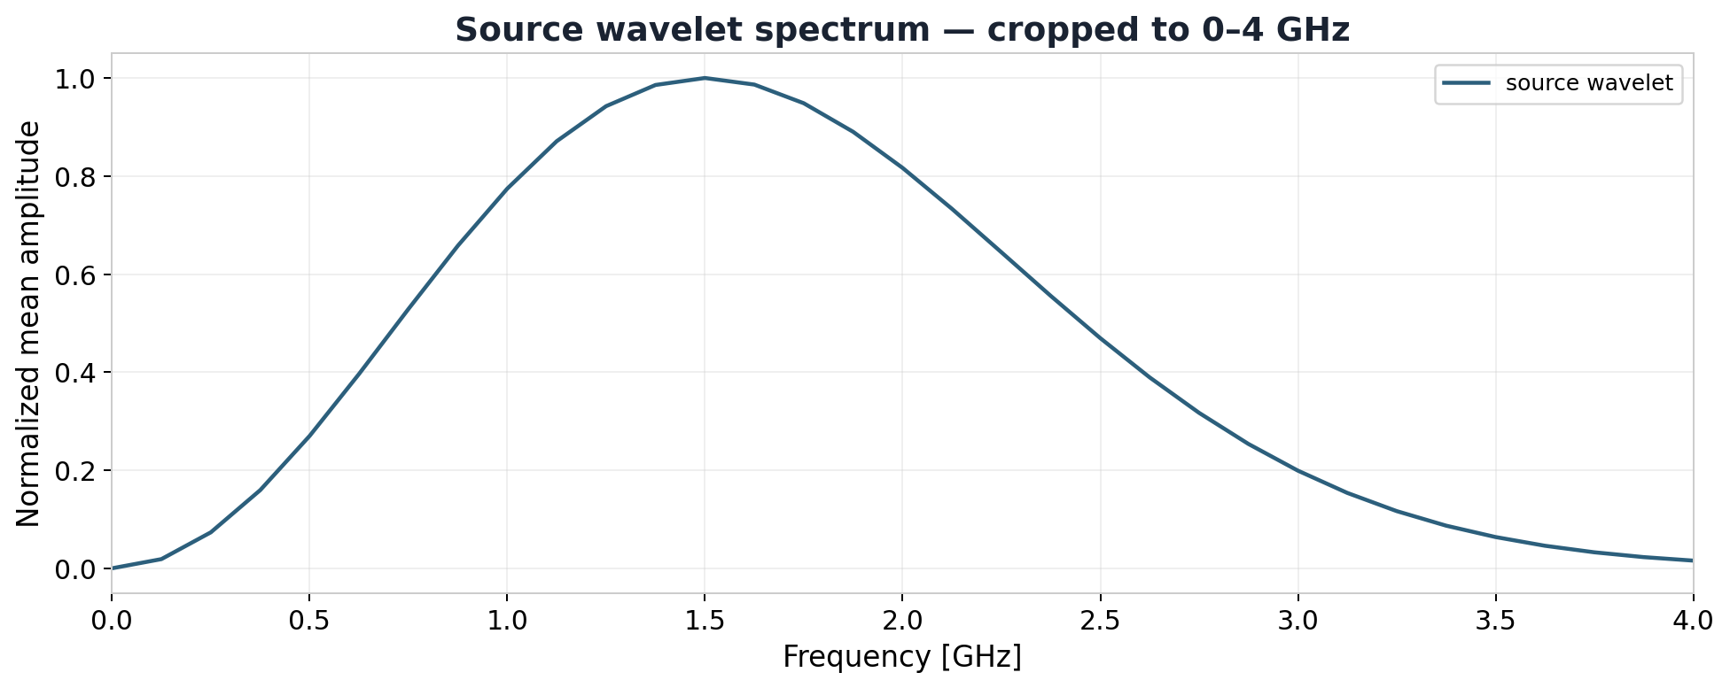
Source wavelet spectrum
exp 043
1.5 GHz Ricker pulse, FFT amplitude (Ricker = negative second derivative of a Gaussian)
Useful source band is roughly 0.75–2.5 GHz with peak at 1.5 GHz. x-axis cropped to 0–4 GHz for readability; the FDTD sampling rate (~250 GHz Nyquist) sets the figure's untrimmed extent.
26
Notes:
The runner reports the 5%–95% source-energy band as 0.750–2.500 GHz, peak at 1.500 GHz (matching the nominal centre frequency of the Ricker pulse). The implication for the next two slides: anything we ask the inversion objective to fit above about 2.5 GHz is fitting noise or numerical content, not real source content. This is the upper limit that *any* PEBDD band design must respect. It also explains why the W2 / Sinkhorn experiments need downsampling along the time axis — the source band is narrow compared to the time-sampling rate, so most of the trace samples carry no source information and are pure simulator overhead.

Slide 27
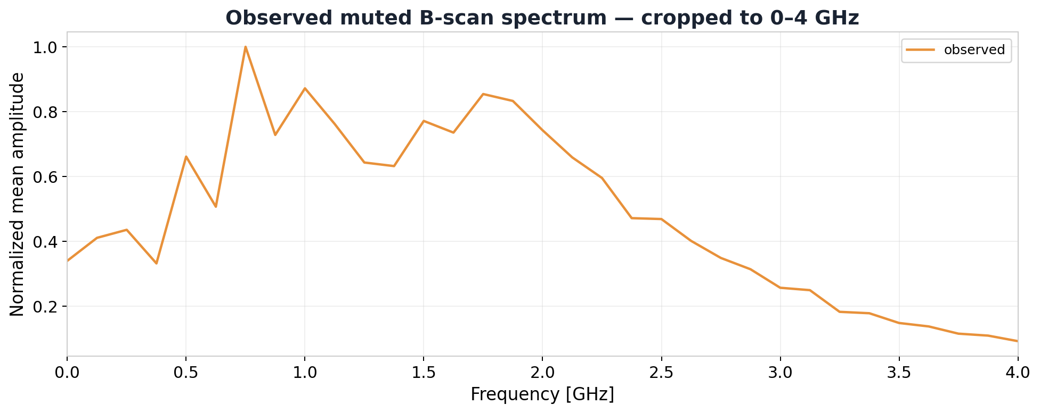
Observed muted B-scan spectrum
exp 043
Spectrum of the synthetic observed traces
Observed energy band 0.375–2.75 GHz, peak at 0.75 GHz. The medium and antenna geometry have shifted energy downward relative to the source spectrum.
27
Notes:
The observed spectrum peak is at 0.75 GHz, not 1.5 GHz — this is the kind of detail that catches people off guard. Wave propagation, the air/concrete interface, rebar scattering, and the Tx–Rx geometry all reshape the energy distribution. It does not mean radius information lives at 0.75 GHz — that is what the next slide answers.

Slide 28
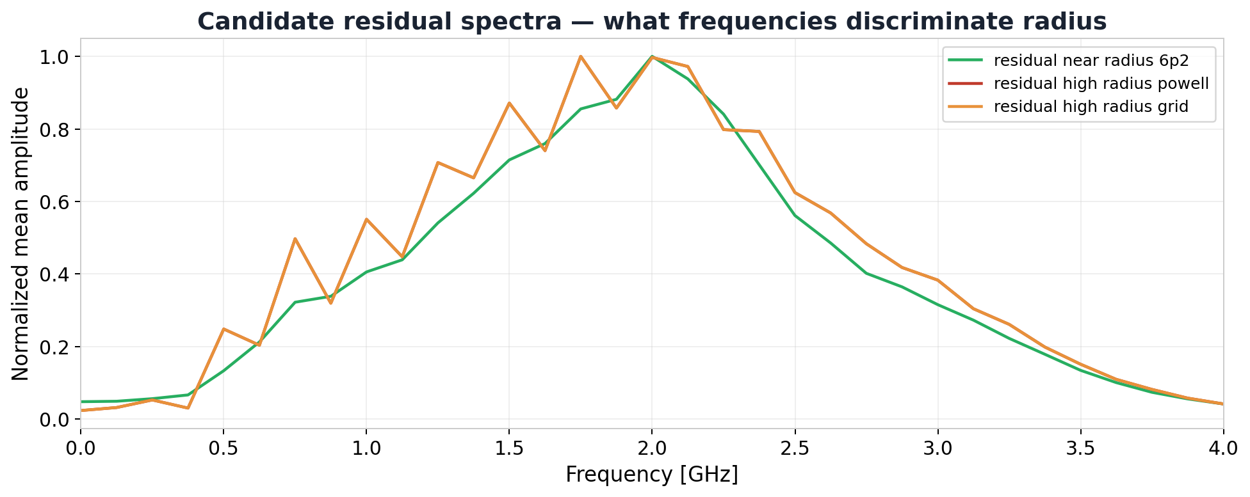
Candidate residual spectra — the headline plot
exp 043
What frequencies actually distinguish nearby radii (residual = synthetic − observed, then FFT amplitude)
Residual energy from a near-radius candidate (r = 6.2 mm) and the known high-radius Powell candidate (r ≈ 6.95 mm — Powell is SciPy's derivative-free local optimiser that consistently lands here) both peak near 2 GHz. Bands below 1 GHz carry almost none of the radius evidence.
This is why the first-pass 0.2–0.8 GHz schedule could not fix radius.
28
Notes:
Numerical context the slide does not show: residual energy captured by candidate bands for the r=6.2 case is 2.1% (0.2–0.8 GHz), 5.5% (0.35–1.10), 22.5% (0.35–1.50), 60.4% (0.35–2.00), 89.7% (0.35–2.50). So the difference between r=6.0 and r=6.2 lives almost entirely above 1 GHz with peak near 2 GHz. This single chart is what justified the spectrum-derived schedule on the next slides.

Slide 29
Faithful spectrum-derived PEBDD schedule
exp 045
Run the new bands as a staged Powell + polish
Hypothesis
If the band edges were the problem, the spectrum-derived schedule should land Powell closer to the true radius before polish.
What we did
Built a staged runner using the bands 0.35–1.10 → 0.35–1.50 → 0.35–2.00 → 0.35–2.50 GHz, then a final full-band coarse polish. Exact data, 5 sources, 1 mm grid.
What we'll see
x and z stay on target throughout.
Each Powell stage stops in the high-radius basin (r ≈ 6.86–6.93 mm).
Final full-band polish recovers r = 6.000 mm exactly.
29
Notes:
Runner: run_single_rebar_bandwidth_schedule.py. The stage outputs are organised as nested directories per stage (stage01_0.35_1.10GHz, etc.) inside the experiment dir, with a final_fullband_coarse_polish stage. The slide is the controlled comparison: same staged shape as the first pass, but with bands chosen by the spectrum tool.

Slide 30
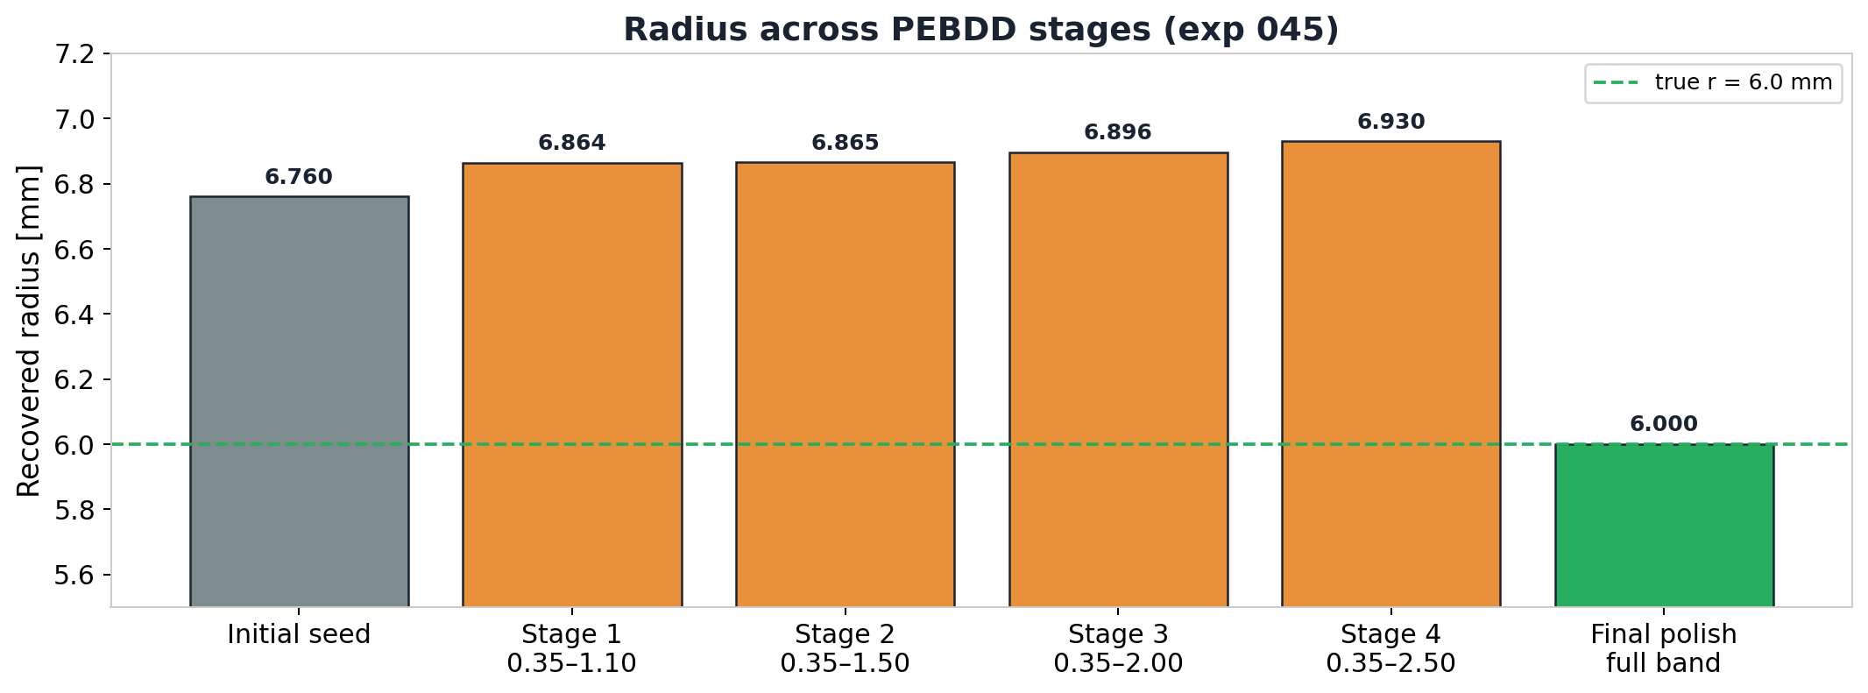
Stage-by-stage recovered radius
exp 045
Spectrum-derived PEBDD schedule
Powell stages stay in the high-radius basin even as the band widens to 2.5 GHz. The final polish is the step that lands radius on truth.
30
Notes:
The Powell stages move slightly *away* from truth as the band widens (6.864 → 6.865 → 6.896 → 6.930). The right interpretation is that radius is *already* well-determined in the lower band, but the wider band reactivates the depth/radius valley. Polish is what removes the bias. The headline of this section is the same as the first-pass section: bandwidth scheduling helps seed-building, not radius selection.

Slide 31
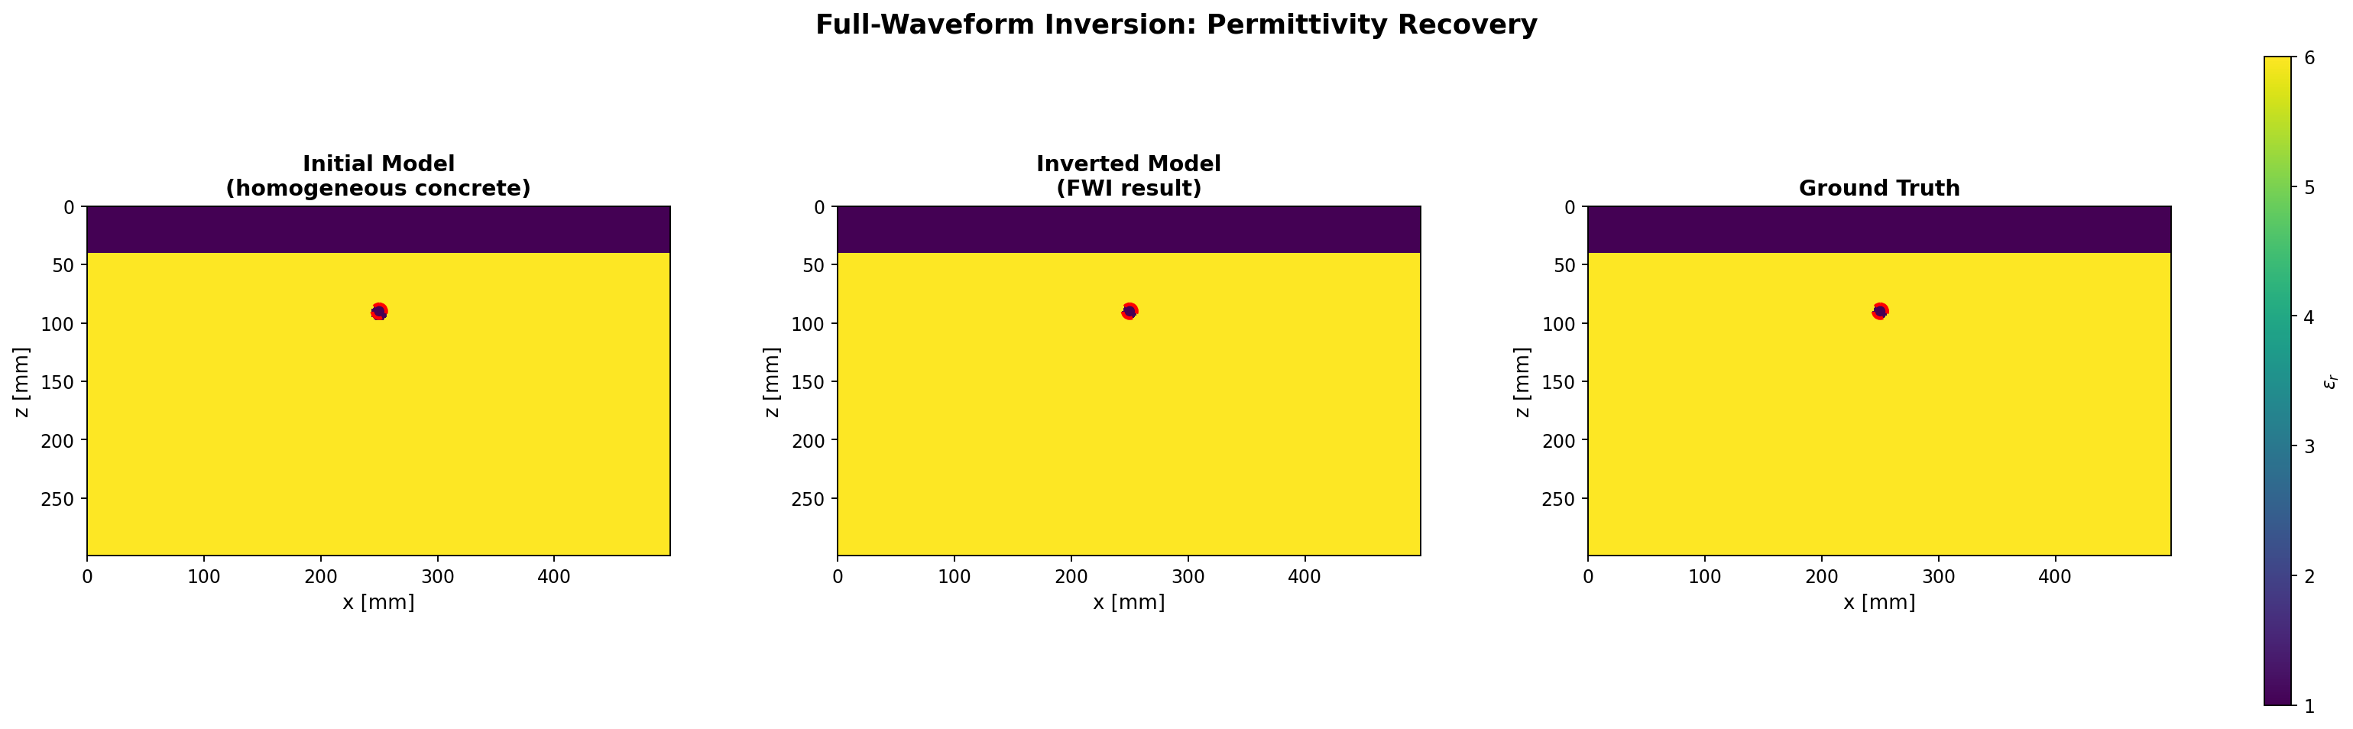
Final full-band coarse polish — model comparison
exp 045
Final stage of the faithful PEBDD schedule (NRMS = normalised root-mean-square misfit)
Recovered geometry matches truth on the 1 mm grid (NRMS model = 0, NRMS data = 0). Top polish candidates (J = least-squares waveform misfit; lower is better): r = 6.0 mm (J = 0), r = 6.2 mm (J = 1.04 × 10⁻³), r = 6.8 mm (J = 2.08 × 10⁻³).
31
Notes:
NRMS model = 0 and NRMS data = 0. The polish margin (r=6.0 over r=6.2 ≈ 1.04e-3) is identical to the simpler polish from the first arc — meaning the bandwidth schedule did not change the radius evidence in the polish stage, it only ensured the polish started inside the right window.

Slide 32
03
Frequency weighting and W2
Where to put the spectral evidence weight, and when not to
32

Slide 33
Frequency-weighted radius margins
exp 046–049
Five weight schemes evaluated on the same local x / z / r candidate grid
Hypothesis
If multi-frequency information is genuinely useful for radius, some weighted combination should beat single-frequency LS (least squares).
What we did
Built a frequency-weight matrix runner. Swept radius 5.4–7.8 mm at four depths under five weight schemes: low_only (1.0 GHz alone), onepointfive_only (1.5 GHz alone), unweighted (equal average), carry_low_25 (0.25 × 1.0 GHz + 1.0 × 1.5 GHz), carry_low_50 (0.5 × 1.0 GHz + 1.0 × 1.5 GHz). Ran exact, 5% noise, and 10% noise versions.
What we'll see
low_only has the weakest radius margin (30x smaller than 1.5 GHz alone).
Unweighted averaging cuts the radius margin nearly in half.
carry_low_25 preserves most of the 1.5 GHz margin while keeping low-frequency carry.
33
Notes:
Runner: run_single_rebar_frequency_weight_matrix.py. Weight schemes are specified as comma-separated lists like '0.25,1' meaning 25% weight on 1.0 GHz and full weight on 1.5 GHz. The runner reports the best-radius-vs-next-radius margin per scheme so the schemes can be ranked at a glance.

Slide 34
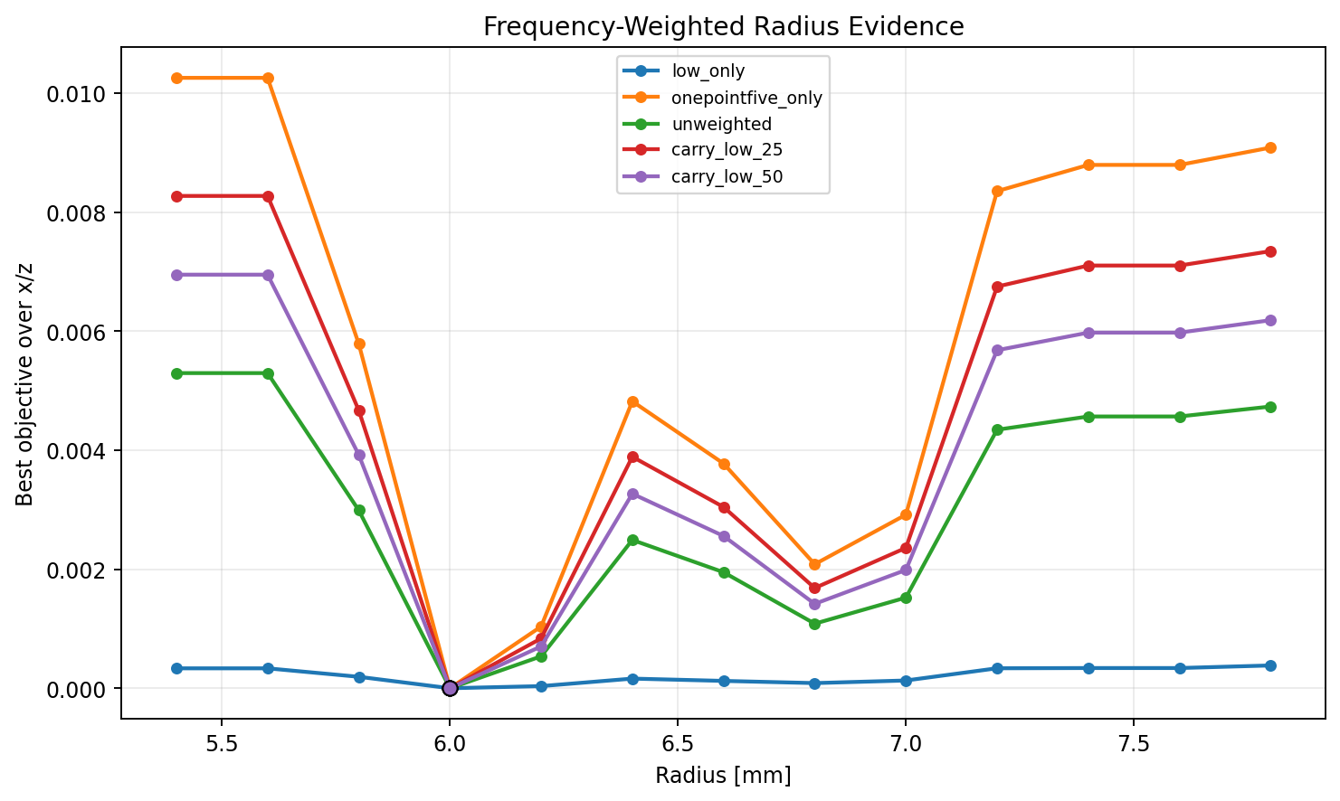
Exact-data radius margin under five weight schemes
exp 046
Common local x / z / r candidate grid evaluated for each scheme
Scheme legend — low_only: 1.0 GHz alone; onepointfive_only: 1.5 GHz alone; unweighted: equal 1.0 + 1.5 GHz average; carry_low_25 / carry_low_50: 0.25 (or 0.50) weight on 1.0 GHz plus full weight on 1.5 GHz. The deepest valley at r = 6.0 mm wins on radius discrimination; flatter curves are weaker.
34
Notes:
Margins at r=6.0 vs r=6.2: 3.56e-5 (low_only), 1.04e-3 (onepointfive_only), 5.36e-4 (unweighted), 8.37e-4 (carry_low_25), 7.03e-4 (carry_low_50). The pattern is intuitive in retrospect: 1.0 GHz is below the residual-energy band we saw in the spectrum design slide, so it carries little radius information; equal averaging just dilutes the useful evidence.

Slide 35
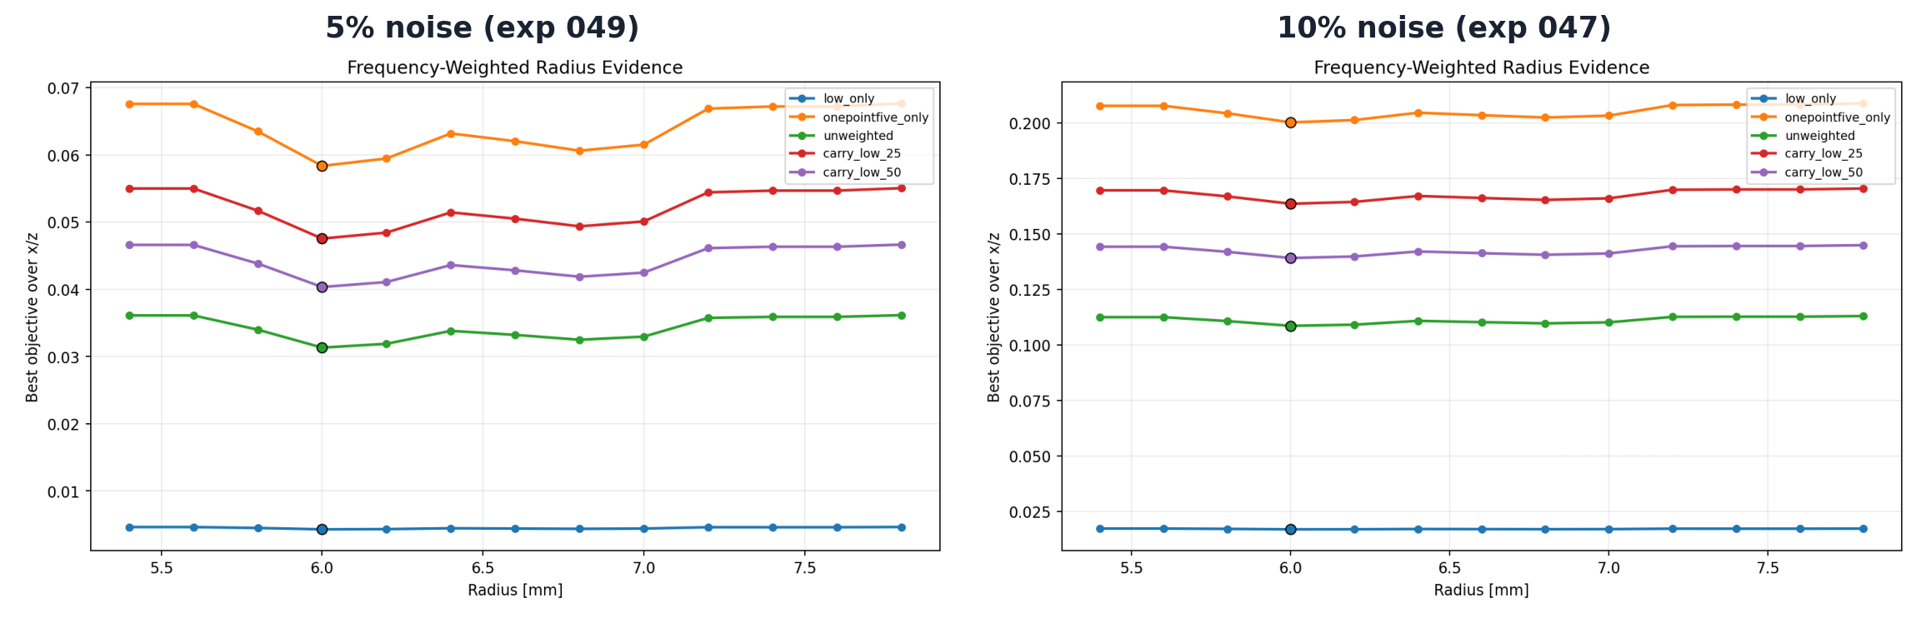
Same conclusion under noise — 5% and 10%
exp 047 + 049
Side-by-side: 5% additive trace-RMS noise on the left, 10% on the right
Margin = objective value at r = 6.2 mm minus value at r = 6.0 mm (larger margin → stronger radius discrimination). The headline numbers at 10% noise: 1.04 × 10⁻³ (1.5 GHz only), 8.4 × 10⁻⁴ (carry_low_25 = 0.25 × 1.0 GHz + 1.0 × 1.5 GHz), 5.4 × 10⁻⁴ (unweighted average), 3.1 × 10⁻⁵ (1.0 GHz only). Ranking is identical at 5%.
35
Notes:
The two panels are nearly identical, which is the point: the ranking is robust to the noise level we tested. Practical recommendation that comes out of this matrix: use 1.5 GHz-only LS for the *final* radius decision; carry_low_25 is the best compromise if a low-frequency carry is needed for basin continuity (e.g. for a poorer initial seed).

Slide 36
W2 / Optimal Transport — gate 1
exp 048
Replicate the paper's shift-convexity claim on shifted Ricker pulses
Hypothesis
The W2 paper claims that quadratic Wasserstein with Softplus normalisation (log(1+e^(βx)) — turns a signed trace into a non-negative mass distribution) and Sinkhorn iterations (entropy-regularised cheap OT) is monotonic over time shifts where standard L2 has spurious local minima from oscillatory cancellation.
What we did
Built a standalone Softplus / Sinkhorn W2 module. Computed both L2 and W2 over a −28 … +28 sample shift range for a Ricker pulse, with β ∈ {4, 8, 12} (Softplus scale) and ε = 0.02 (Sinkhorn entropy).
What we'll see
L2 has 24 monotonicity violations across the tested shift range.
W2 is smoothly monotonic for every tested β.
Paper claim reproduced — but on shifted Ricker traces, not on the rebar problem.
36
Notes:
Module: inversion/trace_wasserstein.py. The Softplus scale β controls how strongly signed waveforms are transformed before normalisation; the Sinkhorn entropy regularisation ε trades accuracy for numerical stability. We test β ∈ {4, 8, 12} as a small sensitivity sweep. This is gate 1 because passing the trace shift test is necessary, but not sufficient, for W2 to be useful on the actual radius problem.

Slide 37
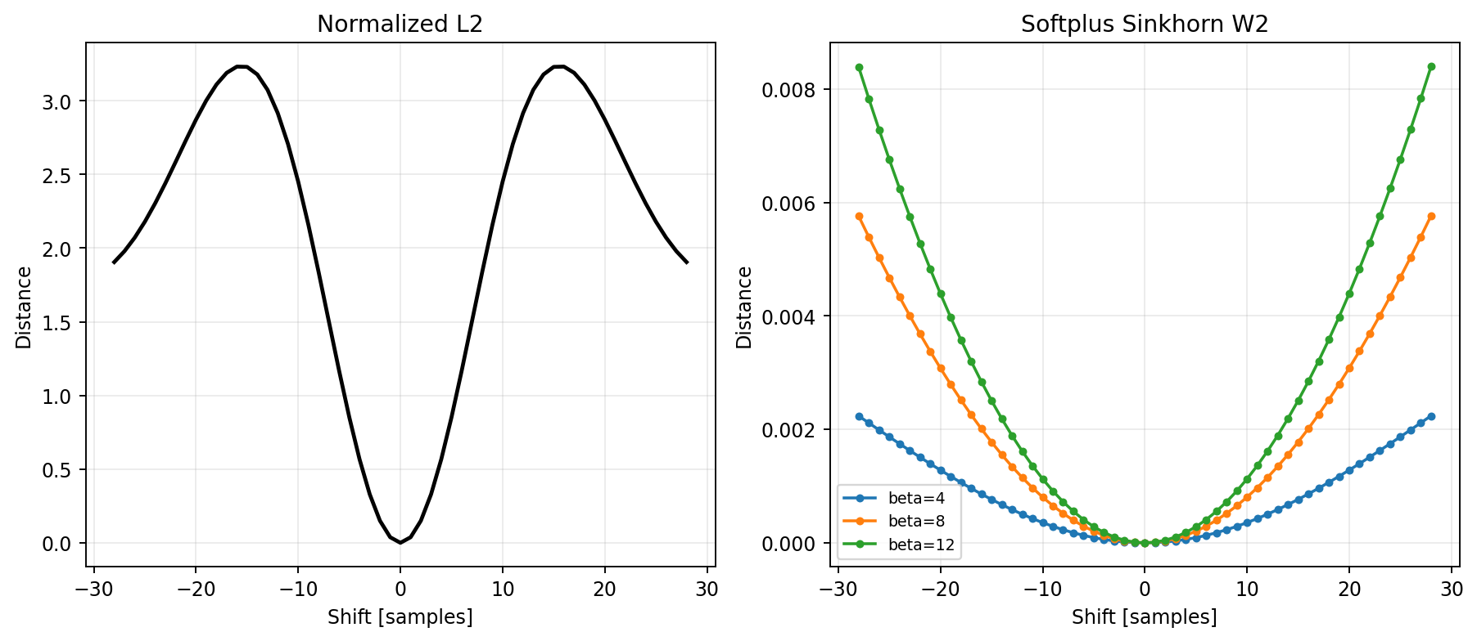
W2 trace convexity — paper claim holds
exp 048
Softplus / Sinkhorn quadratic Wasserstein (W2) vs least-squares (L2) over shifted Ricker pulses
L2 (left) shows the classical cycle-skip pattern: zero only at shift = 0, with a second 'mountain' that traps optimisers. W2 (right) is smooth and monotonic on both sides of zero for all three Softplus scales (β = 4 / 8 / 12) — the larger β, the sharper the curvature near zero.
37
Notes:
The L2 panel hits zero only at shift = 0 but rises and falls again — the second 'mountain' is the cycle-skip trap. The W2 panel is U-shaped on both sides of zero for all β. β = 12 has the sharpest curvature near zero, which would matter for an optimiser; we use β = 8 in the rebar landscape on the next slide as a balance.

Slide 38
W2 — gate 2 on the actual rebar landscape
exp 050–051
Move quadratic Wasserstein (W2) from the shift smoke test to the radius problem
Hypothesis
If W2's better convexity transfers to the rebar landscape, its margin (objective gap) between r = 6.0 mm and r = 6.2 mm should be comparable to or better than the standard least-squares (LS) margin.
What we did
Evaluated the same Softplus / Sinkhorn W2 on the same local x / z / r candidate grid as the LS landscape (β = 8 = Softplus scale, ε = 0.02 = Sinkhorn entropy regularisation, ds = 8 / 16 = downsample factor for trace length; ds reduces the Sinkhorn cost by taking every nth sample of the trace).
What we'll see
LS margin (r=6.0 vs r=6.2): 1.04e-3.
W2 margin: 1.06e-7 (downsample 16); 1.03e-7 (downsample 8).
Softplus normalisation removes the amplitude content that radius depends on.
38
Notes:
Runner: run_single_rebar_w2_landscape.py. The downsample parameter is needed because Sinkhorn on the full trace length is expensive; ds=16 means we take every 16th sample. The story to deliver clearly: the W2 paper's claim about *shifts* genuinely holds (gate 1), but the *radius* problem is not a shift problem, so W2's advantage does not transfer.

Slide 39
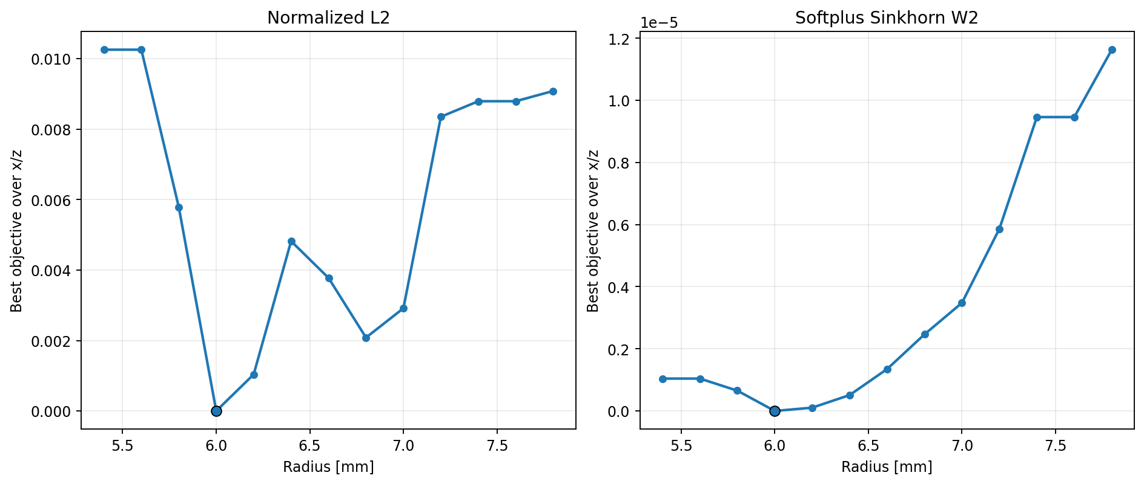
W2 radius margin collapses on the rebar problem
exp 050
Note the W2 y-axis is in units of 1 × 10⁻⁵
L2 = least squares (left): the familiar deep V at the true radius r = 6.0 mm. W2 = quadratic Wasserstein with Softplus normalisation (right): nearly flat — radius margin is 1.06 × 10⁻⁷ vs 1.04 × 10⁻³ for L2 (≈ 10 000× smaller). Softplus removed the amplitude content that radius depends on.
Decision: reject W2 as the final radius objective. Keep it as a basin diagnostic for field data.
39
Notes:
Both panels share the same y-axis behaviour at r = 6.0 (zero misfit) but the LS plot has order-1e-3 wings while the W2 plot has order-1e-7 wings. The downsample = 8 version (exp 051) is qualitatively identical. The decision is to reject W2 as the final radius objective. We keep the module available because it may still be useful as a *basin* diagnostic for poor initial models or field data — a use case we have not tested yet.

Slide 40
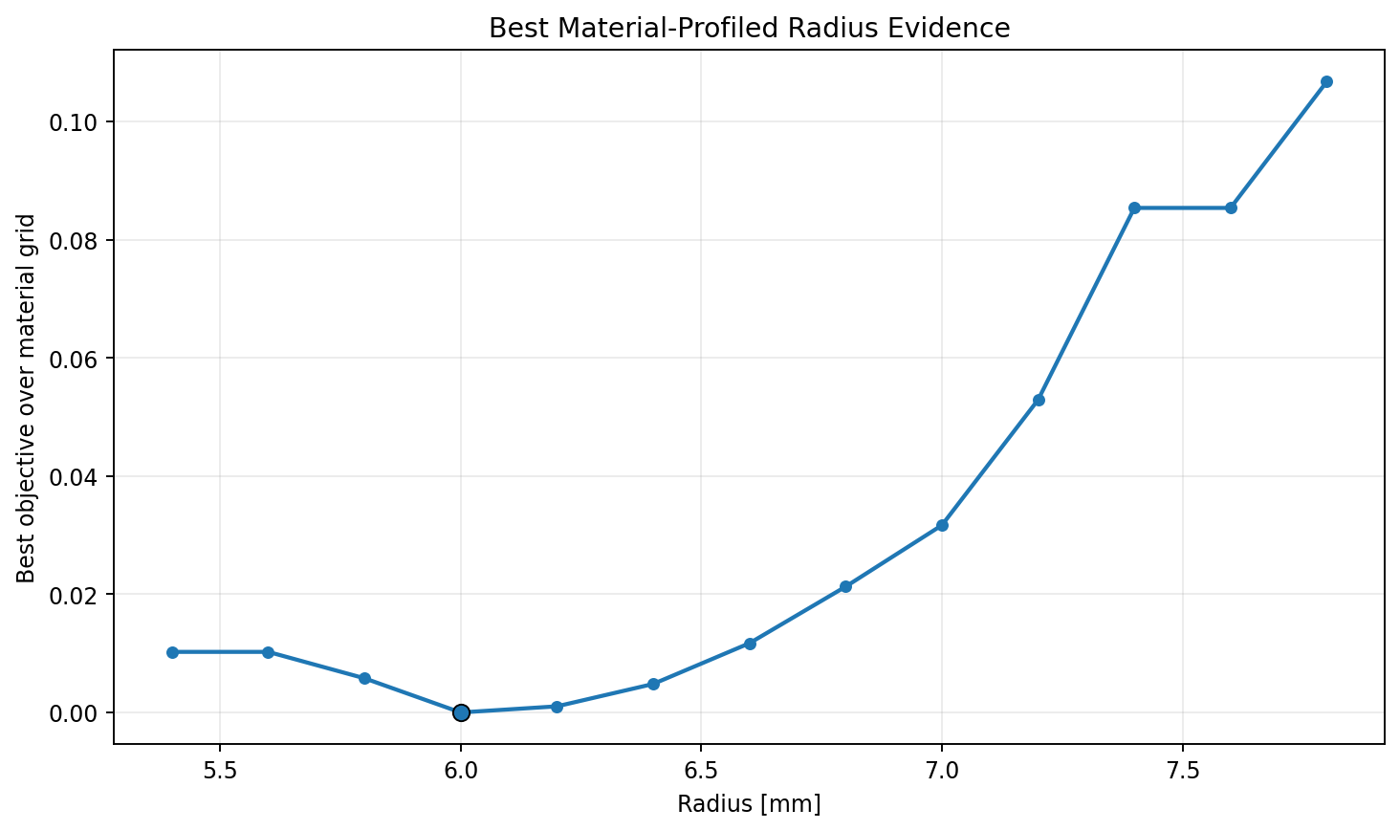
Material tradeoff — does material explain radius?
exp 056
Fixed x = 250, z = 90 mm; sweep radius × εr × σ (εr = relative permittivity / dielectric constant; σ = electrical conductivity, S/m)
Hypothesis: at the correct (x, z) location, free material parameters could let a wrong radius still fit the data.
Sweep: r = 5.4–7.8 mm × εr ∈ {5.5, 6.0, 6.5} × log10 σ ∈ {5, 6, 7} S/m.
Result:
• Best material set is the true one (εr = 6.0).
• Rebar σ saturates above ≈ 10⁵ S/m (1e5, 1e6, 1e7 all behave the same — the rebar already acts as a perfect conductor).
• Best radius is 6.0 mm; distinct-radius margin against r = 6.2 mm is J = 1.04 × 10⁻³ (J = least-squares misfit).
Decision: do not add material parameters to the radius optimiser at this stage.
40
Notes:
Runner: run_single_rebar_material_tradeoff.py. The top four candidates in the saved summary are: rank 1 r=6.0 εr=6.0 σ=1e7 J=0; rank 2 r=6.0 εr=6.0 σ=1e6 J=3.18e-10; rank 3 r=6.0 εr=6.0 σ=1e5 J=3.85e-8; rank 4 r=6.2 εr=6.0 any σ J=1.04e-3. The σ ladder is what shows the saturation — once σ is high enough for the rebar to behave like a perfect conductor, the exact value stops mattering. The εr saturation does not happen — the value is genuinely identified.

Slide 41
04
Wavelet mismatch — the key new finding
What breaks the pipeline first when we leave the synthetic comfort zone
41

Slide 42
Source-wavelet mismatch — does radius survive?
exp 052–055
Perturb only the observed source pulse; modelled source stays nominal
Hypothesis
Real data don't have a perfectly known source pulse. If the observed source differs from the modelled one in amplitude, time-zero, or centre frequency (fc), does the radius selection still hold?
What we did
Built a wavelet-mismatch runner. Held the modelled source at nominal 1.5 GHz Ricker; perturbed only the observed source across seven cases. Case-code legend: nominal = no change; fc_low10 / fc_high10 = source centre frequency ×0.9 or ×1.1; delay_±50 ps = observed source shifted later (+50 ps) or earlier (−50 ps); amp_low10 / amp_high10 = observed source scaled by 0.9 or 1.1. Same local radius grid as the frequency-weighting matrix.
What we'll see
Pure amplitude mismatch shifts the best radius by one grid step.
Pure centre-frequency or time-delay mismatch can peg the best radius to the grid bound (5.4 or 7.8 mm).
Adding source profiling one nuisance parameter at a time (amplitude → + time → + frequency-scale) recovers the true radius.
42
Notes:
Runner: run_single_rebar_wavelet_mismatch.py. The modeled wavelet is held at the nominal 1.5 GHz Ricker; only the observed truth changes per case. This is the first experiment series where we let any *aspect* of the source be wrong. The fix unfolds across four slides — each adds one nuisance parameter to the objective and shows which mismatch cases recover.

Slide 43
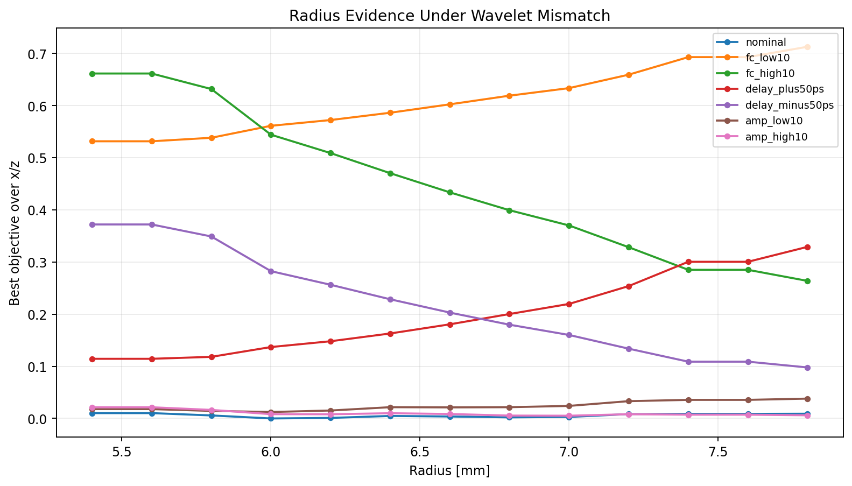
Raw mismatch — radius pegged to the grid bound
exp 052
Fixed-source least-squares (LS) with no nuisance parameters fit per candidate
Case codes: fc_low10 / fc_high10 = observed centre frequency ×0.9 / ×1.1; delay_±50 ps = observed source shifted later / earlier by 50 ps; amp_low10 / amp_high10 = observed amplitude ×0.9 / ×1.1. Only the nominal and amp_low10 curves keep their minimum at r = 6.0 mm — the four fc / delay cases push the minimum to the lower (5.4 mm) or upper (7.8 mm) radius bound.
43
Notes:
Best radius per case: nominal 6.0 (✓), fc_low10 5.4 (grid bound), fc_high10 7.8 (grid bound), delay_+50 ps 5.4, delay_-50 ps 7.8, amp_low10 6.0, amp_high10 7.0. The asymmetry is real: pegging to the *lower* bound corresponds to slowing the wavelet (later arrival, longer period), and to the *upper* bound corresponds to speeding it up. This is the kind of failure that would only show up after moving to real data — worth dwelling on as a motivation for the slides that follow.

Slide 44
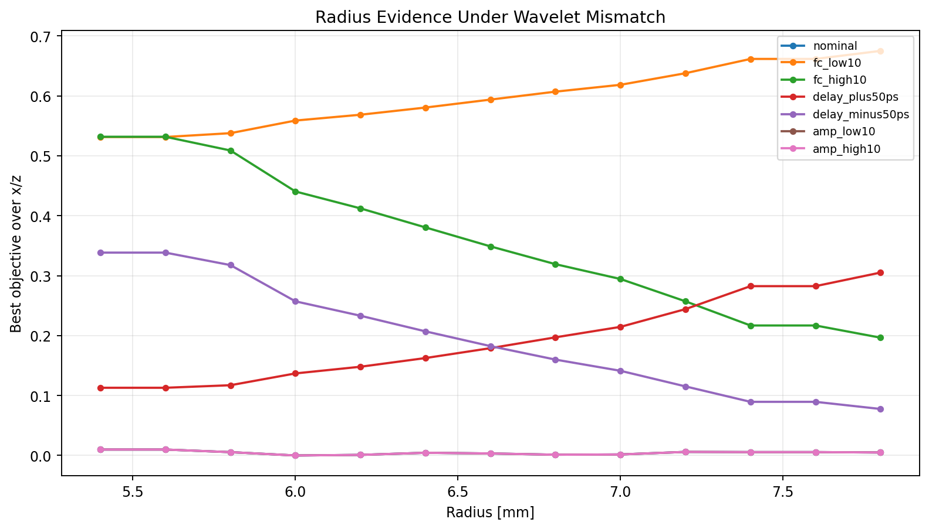
+ amplitude scalar fit
exp 053
Fix amplitude mismatch first — fit one scalar amplitude per candidate (closed form, essentially free)
Amplitude mismatch is cleanly separated from radius. amp_high10 (observed amplitude ×1.1) returns to r = 6.0 mm; the four fc / delay cases (centre-frequency and time-shift perturbations) are unchanged.
44
Notes:
Closed form: for each candidate, the optimal scalar amplitude is the standard inner-product / norm-squared ratio, ⟨d_obs, d_syn⟩ / ⟨d_syn, d_syn⟩. It is essentially free relative to the forward solve cost. The amp_high10 line (observed source ×1.1) now sits on top of the nominal line; the fc_low10, fc_high10, delay_+50, delay_-50 lines are unchanged because amplitude fitting cannot absorb phase or bandwidth differences. The presenter point: this is the smallest, cheapest nuisance parameter that meaningfully reduces source-mismatch bias — if you only have budget for one, do this one.

Slide 45
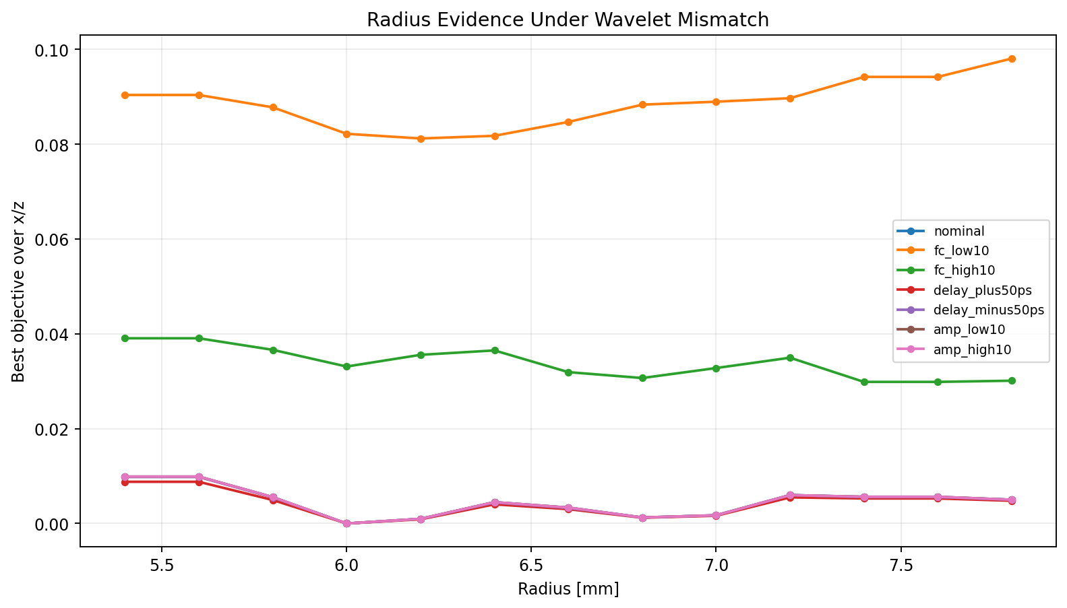
+ global time-shift grid
exp 054
Add a small ±80 ps time-shift profile to the nuisance fit
Time-shift grid: {−80, −50, −25, 0, +25, +50, +80} ps applied globally per scan position (not per candidate). delay_±50 ps cases land back at r = 6.0 mm. The remaining failure is the fc_low10 / fc_high10 pair (centre-frequency ×0.9 / ×1.1) — bandwidth mismatch is not yet absorbed.
45
Notes:
Time-shift grid here is {−80, −50, −25, 0, +25, +50, +80} ps. The shift is *global* per scan position (one value per (scan, candidate) pair), not a free per-trace parameter — that keeps the nuisance space small enough to enumerate. delay_±50 ps cases land back on r = 6.0 mm because a global +50 ps shift in the modelled trace fully absorbs a −50 ps observed mismatch. fc_low10 partially recovers (best r moves from the lower grid bound at 5.4 mm to r = 6.2 mm) because a time shift can partially compensate for a longer-period observed pulse, but fc_high10 still fails — bandwidth mismatch is fundamentally different from a pure time shift and needs its own nuisance parameter, which the next slide adds.

Slide 46
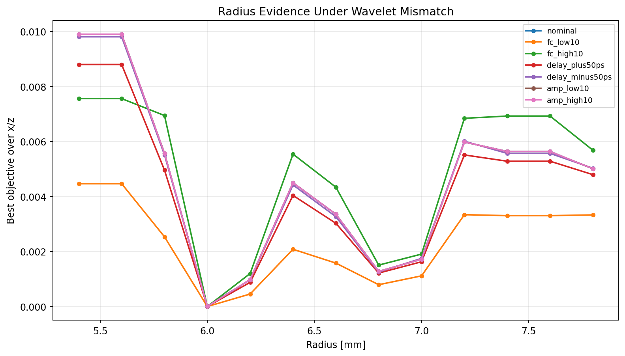
+ frequency-scale profile — all cases recover
exp 055
Add a small centre-frequency scale grid (fc_scale ∈ {0.9, 1.0, 1.1}) to the source profile
Per-candidate nuisance fit is now: amplitude scalar + global time-shift + centre-frequency scale. All seven mismatch cases collapse onto a clean V at the true r = 6.0 mm. Distinct-radius margin (objective gap to r = 6.2 mm) ranges from 4.55 × 10⁻⁴ (fc_low10) to 1.20 × 10⁻³ (fc_high10).
This is the most important new contribution of this arc.
46
Notes:
Frequency-scale grid is small ({0.9, 1.0, 1.1}) on purpose: each value needs its own FDTD forward, so the grid is the expensive part. All seven cases recover r = 6.0 mm. Note that this is the diagnostic matrix — the production runner (next section) is what packages the three-piece source profile into a reusable polish stage.

Slide 47
05
Source-profiled polish — synthesis
Every surviving idea assembled into one runner
47

Slide 48
Production source-profiled radius polish
exp 057–058
What the recommended pipeline actually runs at the final stage
Hypothesis
If the surviving ideas are right, a single runner that does (a) local x/z/r grid, (b) per-candidate amplitude + time-shift + frequency-scale source profile, and (c) top-k reporting should recover the true radius in both nominal and mismatched cases.
What we did
Built run_single_rebar_source_profiled_polish.py. Validated it on a nominal smoke run and a combined-mismatch run with injected fc = 1.1, shift = -50 ps, amplitude = 1.1.
What we'll see
Nominal case: best r = 6.0 mm, margin 9.815e-4. Source profile recovers truth (fc=1.0, shift=0, amp=1.0).
Combined mismatch: best r = 6.0 mm, margin 1.146e-3. Source profile recovers fc=1.1, shift=-50 ps, amp=1.1.
Confidence is reported as top-k candidates and distinct-radius margin, not a single point estimate.
48
Notes:
Module: inversion/source_profile.py. The runner is Stage 1 of the post-summary plan in tracker 31: it exists so Stage 2 (replication across noise and source-mismatch seeds) has a clean, validated entry point. The design call to make on the slide: confidence reporting (top-k + distinct-radius margin) is part of the runner interface, not a separate analysis step.

Slide 49
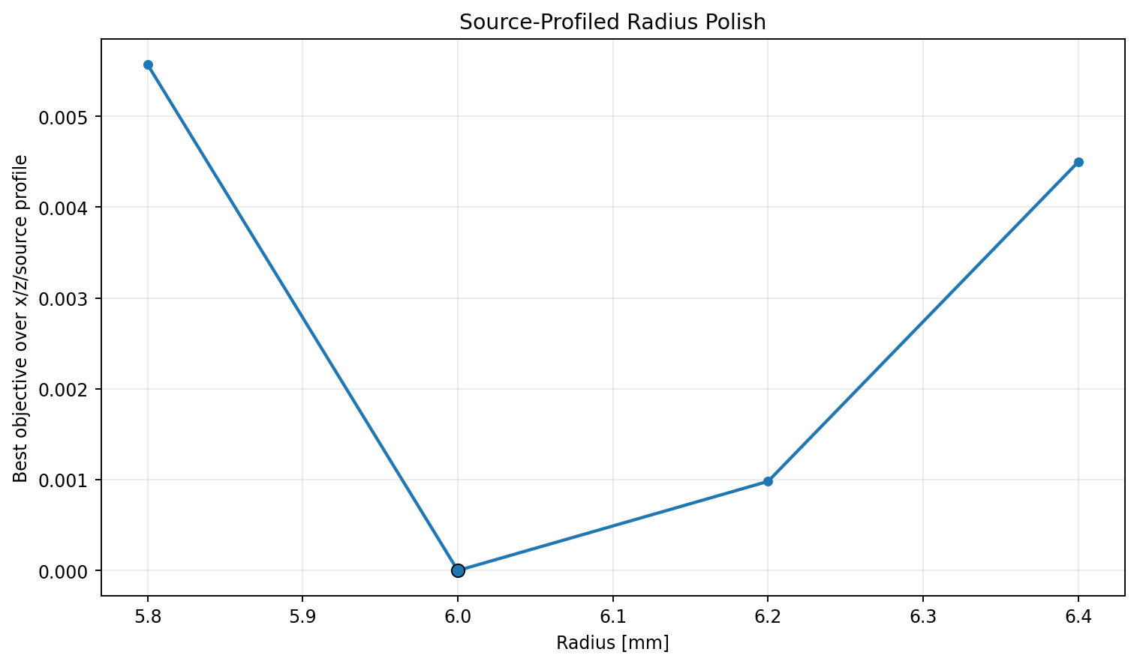
Nominal source-profiled polish
exp 057
No injected source mismatch — confirms the runner reproduces the exact-synthetic case
Best r = 6.0 mm at (x = 250.0 mm, z = 90.0 mm). Recovered source profile lands at (fc_scale = 1.0 = unchanged centre frequency, shift = 0 ps, amp = 1.000 = unchanged amplitude). Next-distinct radius is r = 6.2 mm with objective gap 9.815 × 10⁻⁴.
49
Notes:
Nominal smoke run: 12 geometry candidates evaluated. The source-profile parameters land at exactly the nominal values (fc_scale = 1.0, shift = 0 ps, amp = 1.000), which is the right behaviour — the runner should *not* introduce drift when there is no mismatch to fit. Distinct-radius margin (objective gap between best radius and best next-distinct radius) matches the earlier polish result (9.815 × 10⁻⁴). The implication: the production runner is conservative — it does not inflate margins or pull the source profile away from truth when no mismatch is present. That property is important because we want the runner to be safe to use as the default final stage, not just an opt-in audit.

Slide 50
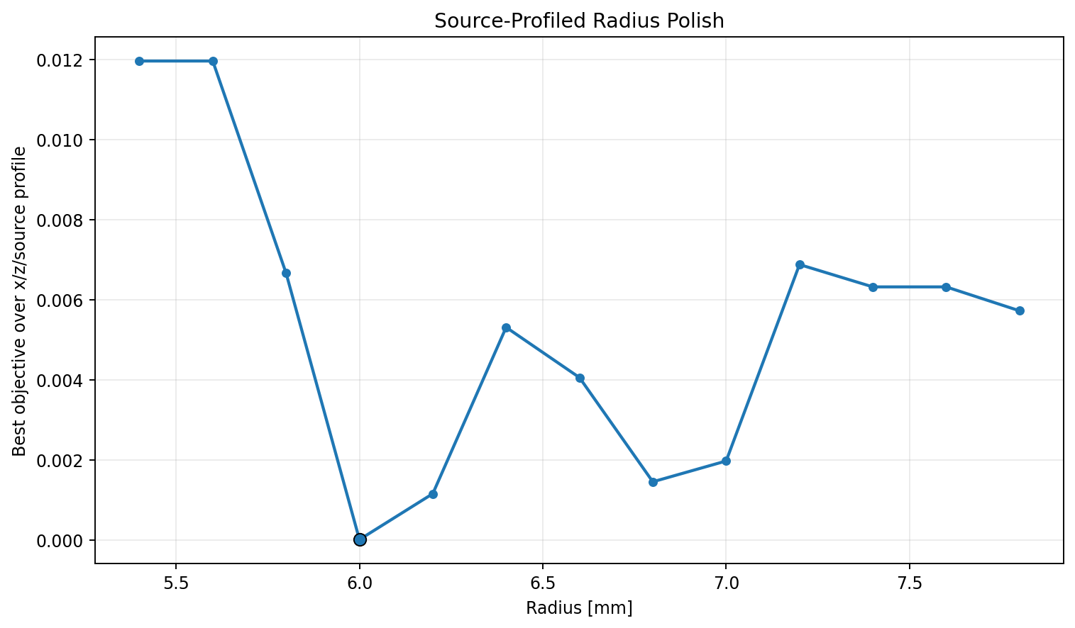
Combined mismatch — joint recovery
exp 058
Injected fc_scale = 1.1, time shift = −50 ps, amp scale = 1.1 in the observed source
Best r = 6.0 mm at (x = 250.0 mm, z = 90.0 mm). Recovered source profile matches the injected one exactly: (fc_scale = 1.1, shift = −50 ps, amp = 1.100). Distinct-radius margin (J = least-squares misfit gap to next radius r = 6.2 mm) is 1.146 × 10⁻³.
50
Notes:
52 geometry candidates × 3 modeled source-frequency scales each. The recovered source profile matches the injected one exactly: fc_scale = 1.1, shift = -50 ps, amp = 1.100. This is the headline result of the arc: the production runner recovers both the geometry and the injected nuisance source parameters together. Sub-ranks show a few r = 6.2 candidates also preferring a -25 ps shift, which is exactly the kind of competing explanation top-k reporting is meant to surface.

Slide 51
06
Deferred branches and what's next
What we are explicitly not building next, and what we are doing instead
51

Slide 52
What we deferred
docs 28 + 29
Documented in 28 / 29 trackers; reserved for later stages
WRI (full)
IFWI (neural implicit field)
Needs a new frequency-domain Helmholtz / Maxwell operator
Complex sparse solves at large grid
Frequency-domain adjoint and penalty continuation
Defer reason: radius is already well explained by source handling and weighted LS
Flexible neural residual can absorb radius bias
Needs differentiable FDTD, held-out source validation, regularisation guardrails
Defer reason: not the right tool while explicit nuisance parameters still suffice
Reserved for multi-rebar / field-data stages
52
Notes:
Both deferrals are conditional, not categorical. WRI becomes worth revisiting if a future use case creates a poor initial model where time-domain FDTD optimisation reliably fails. IFWI becomes worth revisiting when explicit nuisance parameters can no longer absorb material / background residuals — likely either with multi-rebar geometry or field data.

Slide 53
Planned pipeline
tracker 30 summary
For controlled single-rebar synthetic data; transferable to field data with the source profile
What the pipeline does
What we are explicitly not doing next
1. Bring x/z into the basin (staged or PEBDD path).
2. Final radius from 1.5 GHz-only LS or carry_low_25.
3. Local radius profiling / grid polish, not continuous Powell.
4. Profile source amplitude + time-shift + center-frequency scale at the final stage.
5. Report top-k candidates and distinct-radius margin.
Another broad global search.
W2 inside the optimizer for radius.
Free rebar conductivity in the radius optimizer.
Full WRI or full IFWI at this stage.
53
Notes:
The five-step pipeline is the production recipe distilled from this whole arc. Steps to land verbally: (1) use the existing staged / PEBDD path only to bring x and z into the right basin — don't expect it to fix radius; (2) evaluate the final radius with 1.5 GHz only or carry_low_25 (25% × 1.0 GHz + 1.0 × 1.5 GHz) — never unweighted multi-frequency, which dilutes margin; (3) the radius decision is a local grid polish (small enumeration over (z, r)), not Powell — continuous Powell sits in the depth-radius valley; (4) per-candidate source profile (amplitude + time-shift + fc-scale) is mandatory before trusting any radius decision on data where the source may differ from nominal; (5) confidence is the distinct-radius margin and the top-k candidate list, not a single point estimate. The 'not doing' column is just as important — each item is a specific branch we tested and chose not to spend the next iteration on (with reasons documented in the relevant tracker docs).

Slide 54
Next experiments
post-058 plan
Direct follow-ons that reuse the source-profiled polish runner
Replication matrix
Scaling out
Run source-profiled polish across several noise seeds.
Run across several source-mismatch combinations (fc, shift, amp).
Stress with offset x/z/r seeds to map the basin where the polish still works.
Extend to two then three rebars: same forward model, same polish stage; the global stage becomes the load-bearing piece.
Introduce a hyperbola or migration baseline for a non-FWI cross-check.
Move toward field-style data with the source profile in place.
54
Notes:
Closing slide. The deliberate choice here is to stay narrow: a focused replication matrix and a scaling-out path, rather than another menu of new branches. The hyperbola baseline is intentionally non-FWI — having an independent method makes the FWI result credible at field-data validation time.

