Slide 1
2D FDTD Forward Modeling & Full-Waveform Inversion for Ground-Penetrating Radar
Rebar Detection in Reinforced Concrete
Abdullah Maruf
Notes:
Introduce yourself. This is a complete from-scratch implementation in Python — no external EM solvers used.

Slide 2
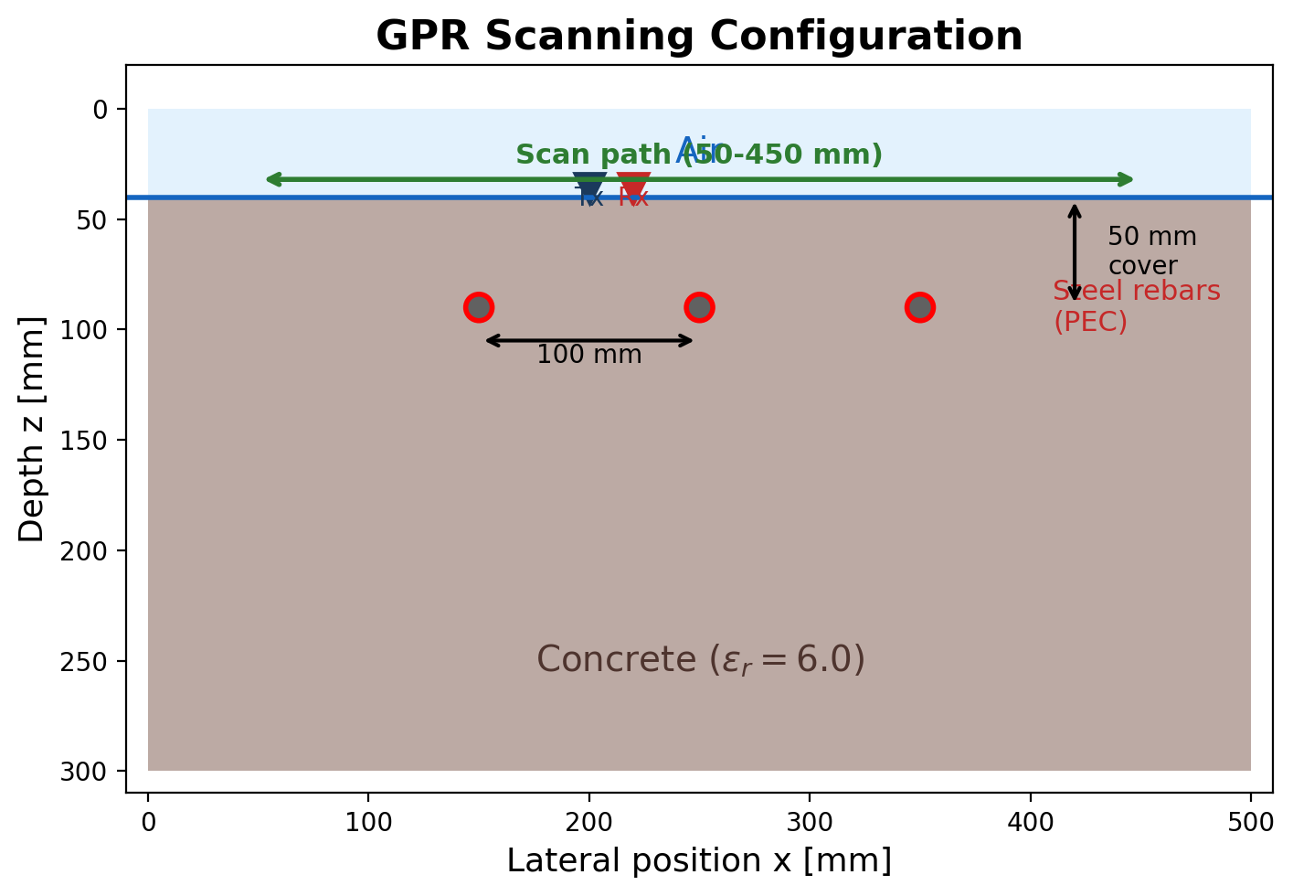
Motivation: GPR for Concrete Inspection
Ground-Penetrating Radar (GPR) is the standard
non-destructive method for imaging rebars
Challenge: B-scan hyperbolas give qualitative
locations — not quantitative geometry
Goal: Recover rebar positions & sizes from
waveform data using physics-based inversion
From scratch: ~2,500 lines of Python
Notes:
GPR used in bridge deck inspection, concrete assessment. Current practice relies on manual interpretation. FWI automates this.

Slide 3
Outline
1.
Forward Modeling
2D TMz FDTD with CPML boundaries
2.
Inversion
Adjoint-state gradient + geometry-based FWI
3.
GPU Acceleration
CuPy-based speedup (3-7x)
4.
Extensions
Dispersion, antenna, multi-scale
5.
Conclusions
Key results and future work
Notes:
5 sections, ~20 min talk.

Slide 4
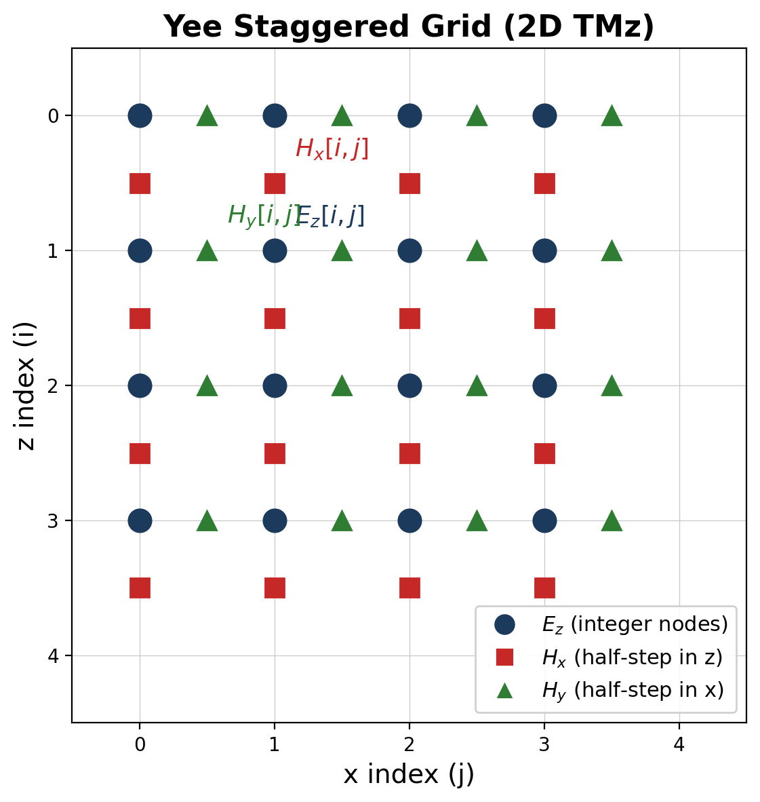
FDTD Method: The Yee Staggered Grid
TMz polarisation: Ez, Hx, Hy
E and H staggered by half a grid cell
Leapfrog time-stepping: H → E → H → ...
Second-order accurate, energy-conserving
No matrix inversions (fully explicit)
Notes:
Yee's 1966 innovation. Staggering gives 2nd-order accuracy for free and automatically satisfies div B = 0.

Slide 5
Simulation Parameters
Parameter | Value | Justification
Grid spacing | 2 mm | >=16 pts/wavelength
Time step | 4.24 ps | 90% of CFL limit
Domain | 500 x 300 mm | 280 x 180 cells + PML
Source | 1.5 GHz Ricker | Standard for concrete GPR
Rebars | 3 x 12 mm dia | 50 mm cover, 100 mm spacing
CPML | 15 layers, cubic | ~60 dB absorption
Scan | 101 positions | 50-450 mm, 4 mm step
Notes:
Every parameter has a physical justification. 2mm grid = 16 pts/wavelength at max Ricker frequency in concrete.

Slide 6
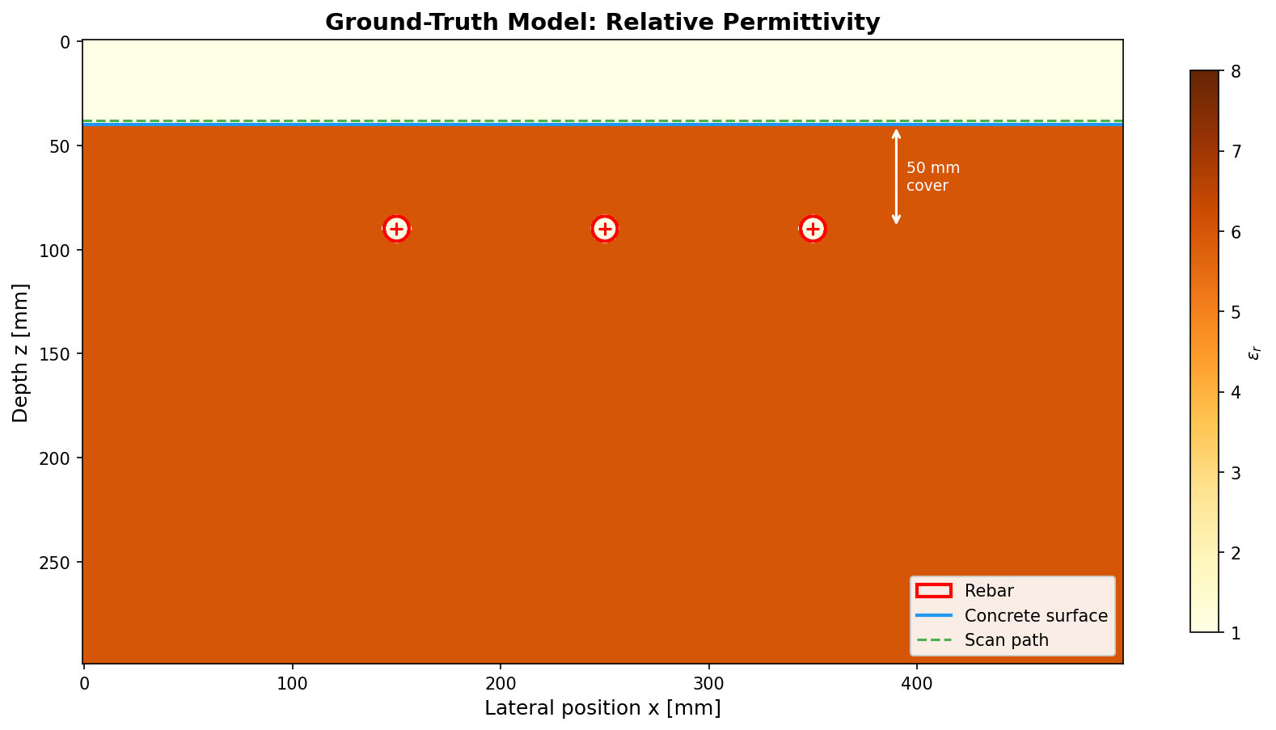
Ground-Truth Model
Notes:
The model we aim to recover. Concrete eps_r=6, rebar PEC (sigma=1e7). 3 rebars at 50mm cover, 100mm spacing.

Slide 7
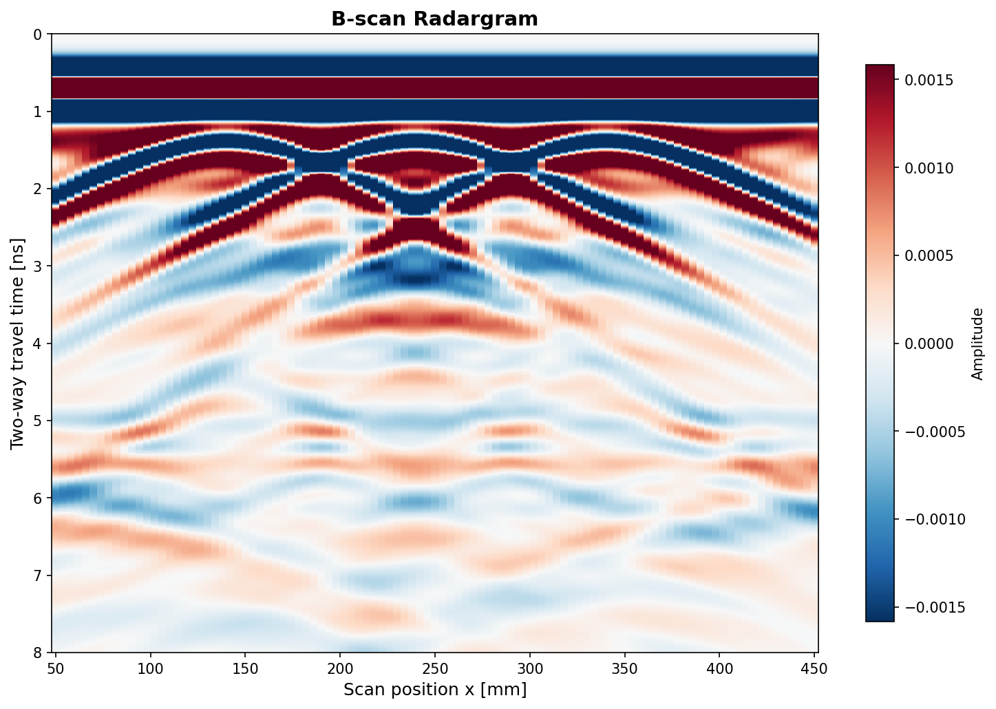
Forward Result: B-Scan Radargram
3
rebar hyperbolas
6/6
tests pass
Notes:
Each rebar produces a characteristic hyperbola. Apex = lateral position, curvature = concrete velocity.

Slide 8
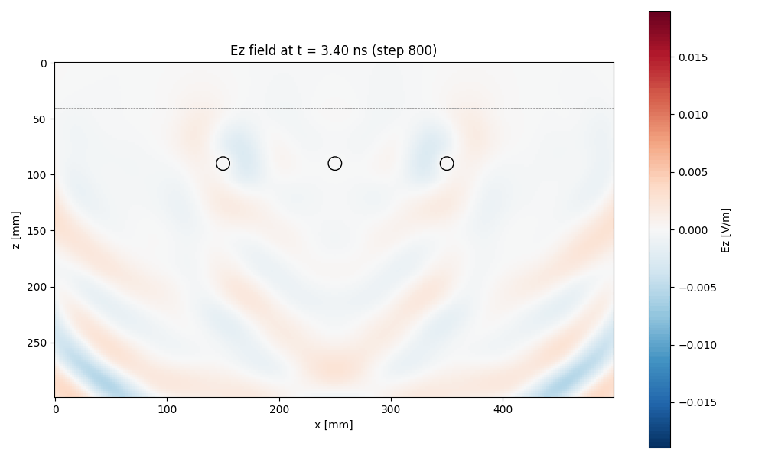
Wave Propagation Through Concrete
Full animation available: outputs/animations/wave_propagation.gif
Notes:
Show the GIF animation live if possible. Wavefront refracts at air-concrete, reflects off rebars, CPML absorbs at edges.

Slide 9
The Inverse Problem: From Data to Model
We have:
The cost problem:
A B-scan radargram (recorded radar signals)
To know which direction to adjust,
we need a "gradient" — how does each
pixel affect the misfit?
Brute force: tweak one pixel, re-run
the simulation, repeat for every pixel
We want:
The underground model (where are the rebars?)
How:
50,000
pixels to check
Adjust the model until simulated signals match observed ones
Measure mismatch with a "misfit" score — then minimise it
~4 hours
per brute-force gradient
Notes:
Frame this as a detective problem: we have the clues (B-scan) and want to find the culprit (rebar positions). The challenge is that checking every possible change is prohibitively expensive — 50K forward simulations just to know which direction to step.

Slide 10
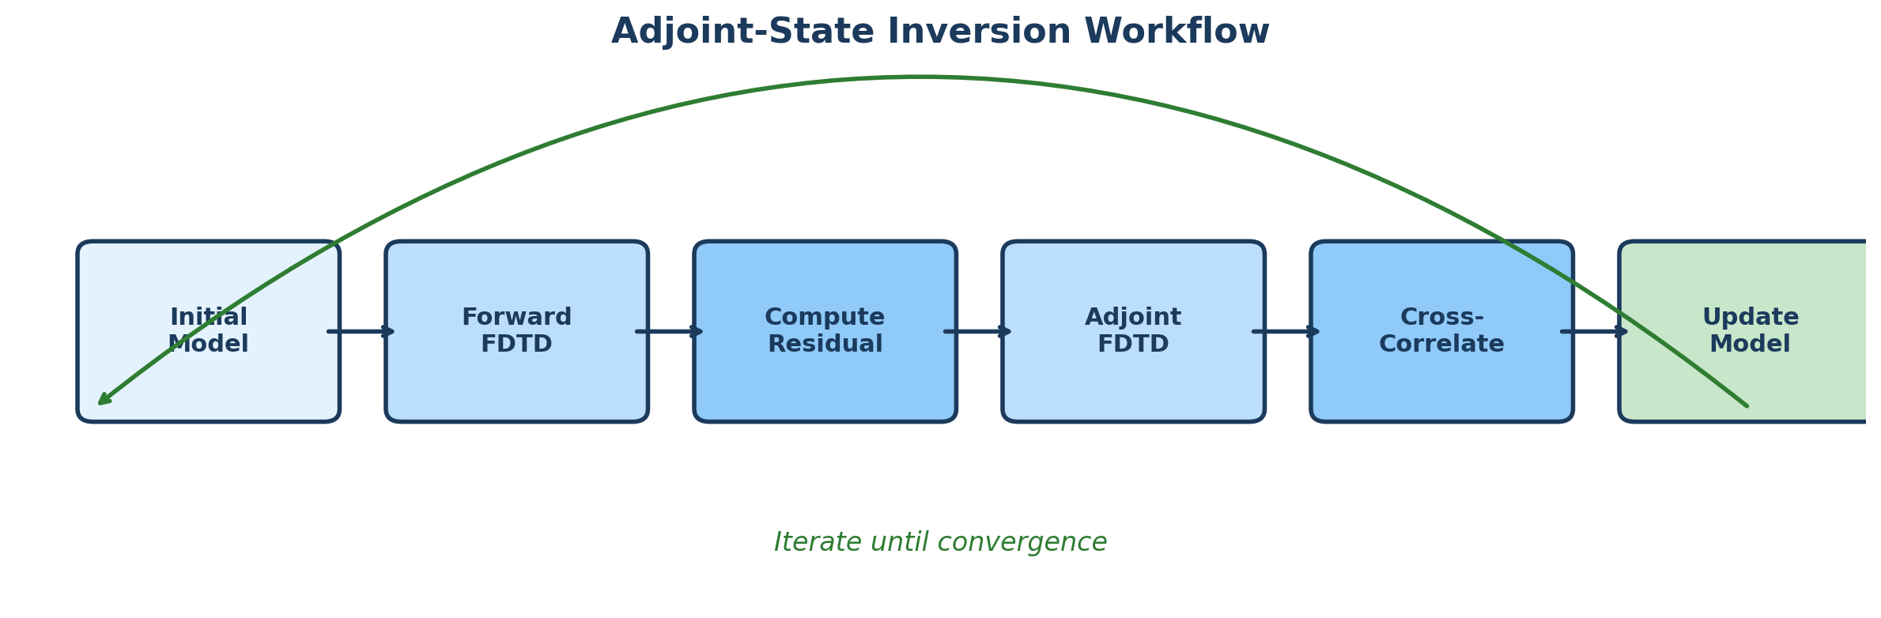
Adjoint-State Method: Efficient Gradients
Forward: source at Tx → illumination of each grid cell
Adjoint: time-reversed residual at Rx → sensitivity map
Cross-correlate → gradient at every pixel simultaneously
2 sims
not 50,000
Notes:
The adjoint method computes the full gradient with only 2 simulations per source: one forward, one adjoint.

Slide 11
Adjoint Gradient Validation
Gold standard: compare adjoint gradient vs finite differences
Perturbed individual pixels, ran forward simulation
Agreement at max-sensitivity pixel: 0.4% relative error
Random pixels: 0.85-1.09 ratio (expected FD truncation error)
Conclusion: adjoint implementation is mathematically correct
Any convergence issues are NOT gradient errors
0.4%
FD agreement
Notes:
This is critical for trusting inversion results.

Slide 12
Experiment: Pixel-Wise FWI Step-Size Analysis
Gradient validated (0.4% vs FD) → ran systematic step-size sweep:
alpha = 5e-5 : dJ = -1.75e-5 (descent)
alpha = 1e-4 : dJ = -1.70e-5 (descent)
alpha = 3e-4 : dJ = -6.7e-6 (descent, marginal)
alpha = 5e-4 : dJ = +6.4e-6 (ascent — overshooting!)
alpha = 1e-3 : dJ = +4.5e-5 (ascent)
Only alpha <= 3e-4 produces descent. At best step: -1.7e-5 per iter
from J = 14 — would need ~50,000 iterations (impractical)
Root cause: 50K pixels changing simultaneously causes nonlinear overshoot
Decision: pivot to geometry-based approach using prior knowledge
Notes:
This is the evidence that motivated the pivot. The gradient is correct but the step size is severely limited by the dimensionality. We also tested pseudo-Hessian preconditioning (Experiment 06) — negligible improvement for this well-illuminated domain.

Slide 13
Key Insight: Geometry-Based Parameterisation
Pixel-wise FWI
Geometry-based FWI
50,000 parameters
Adjoint gradient (expensive)
Extremely slow convergence
Needs advanced preconditioning
9 parameters (x, z, r per rebar)
FD gradient (affordable at 9 params)
Fast convergence (Nelder-Mead)
GPU-accelerated forward sims
50K → 9
parameters
Notes:
We know rebars are circular. Exploit this prior knowledge.

Slide 14
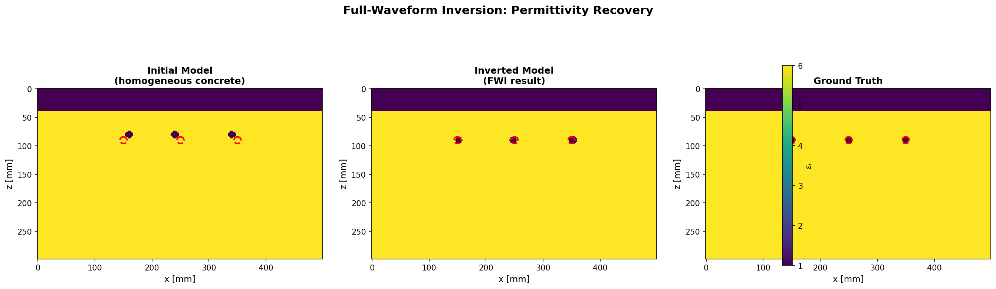
Inversion Results: Rebar Recovery
< 3 mm
position error
< 1 mm
depth error
3.0%
NRMS model error
Notes:
All 3 rebars recovered with sub-grid accuracy. Grid spacing is 2mm, so <3mm error is within 1-2 cells.

Slide 15
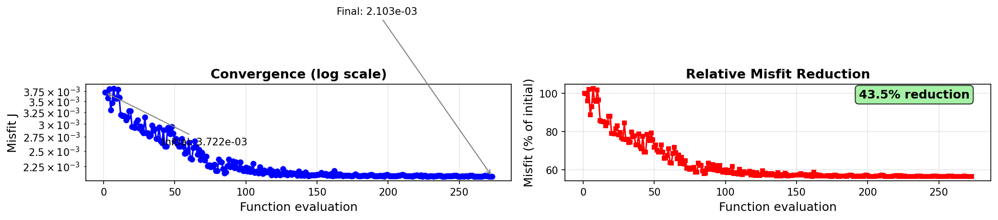
Inversion Convergence
275 function evaluations
(Nelder-Mead simplex)
43.5% misfit reduction
Rapid initial decrease:
optimizer quickly finds
approximate rebar positions
Gradual refinement:
fine-tuning radii and
sub-grid positioning
Notes:
The convergence shows two phases: rapid coarse localisation in the first ~50 evaluations, then gradual refinement of positions and radii.

Slide 16
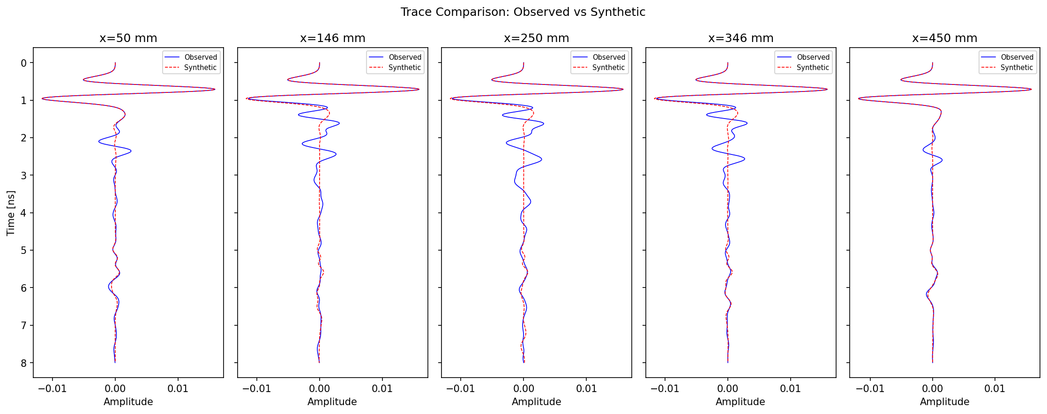
Signal Comparison: Observed vs Synthetic Traces
Blue: observed data
(from true model)
Red: synthetic data
(from inverted model)
Good match at all 5
scan positions, especially
at rebar reflection times
(1.5-4 ns)
Residual mismatch at late
times from multiple
reflections not captured
by 3-rebar parameterisation
Notes:
The trace comparison confirms that the inverted model reproduces the observed waveforms well. The 5 positions sample the full scan aperture.

Slide 17
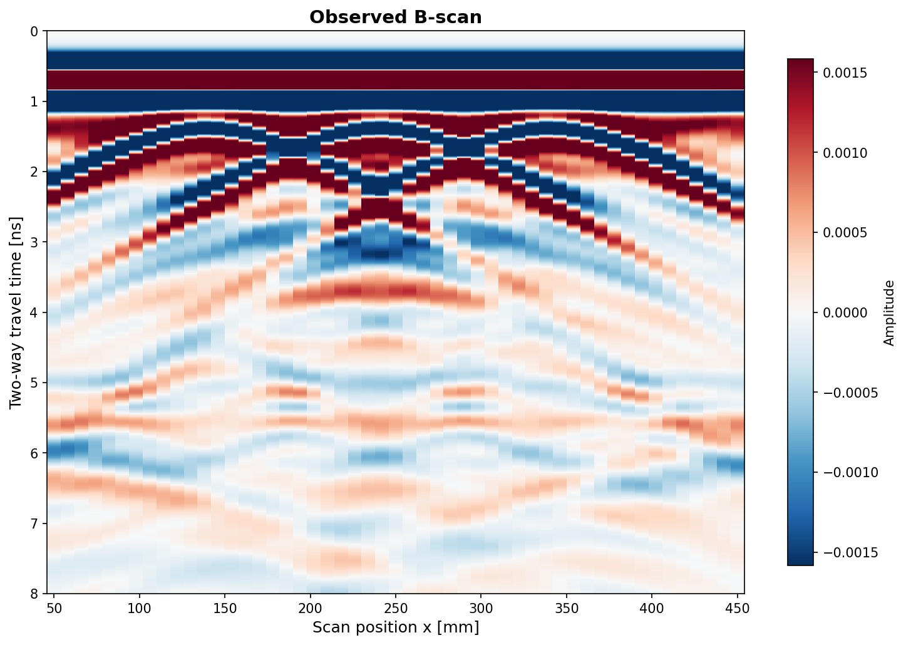
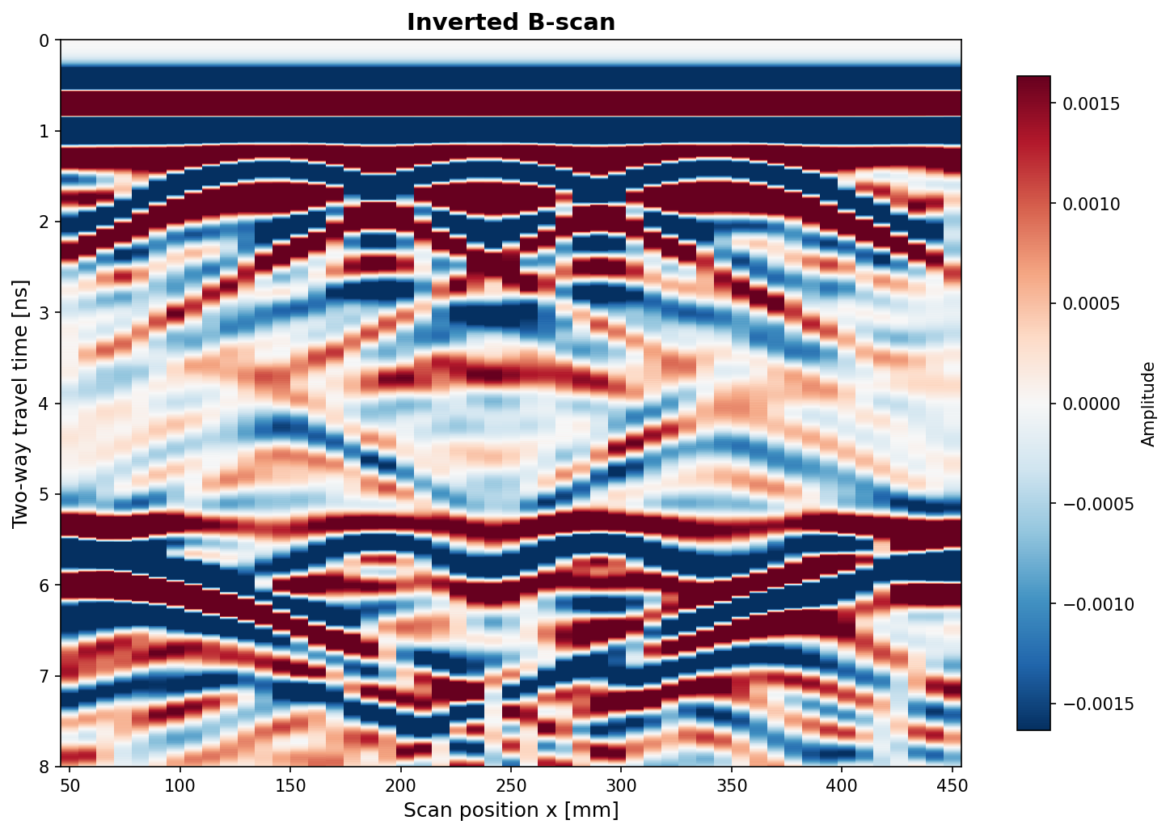
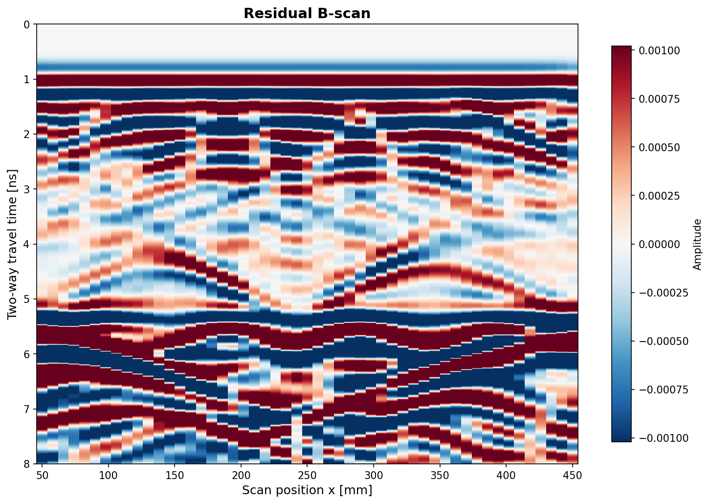
B-Scan Data Fit: Observed vs Inverted
Observed
Inverted
Residual
Notes:
Visual proof: the inverted model reproduces the observed B-scan well.

Slide 18
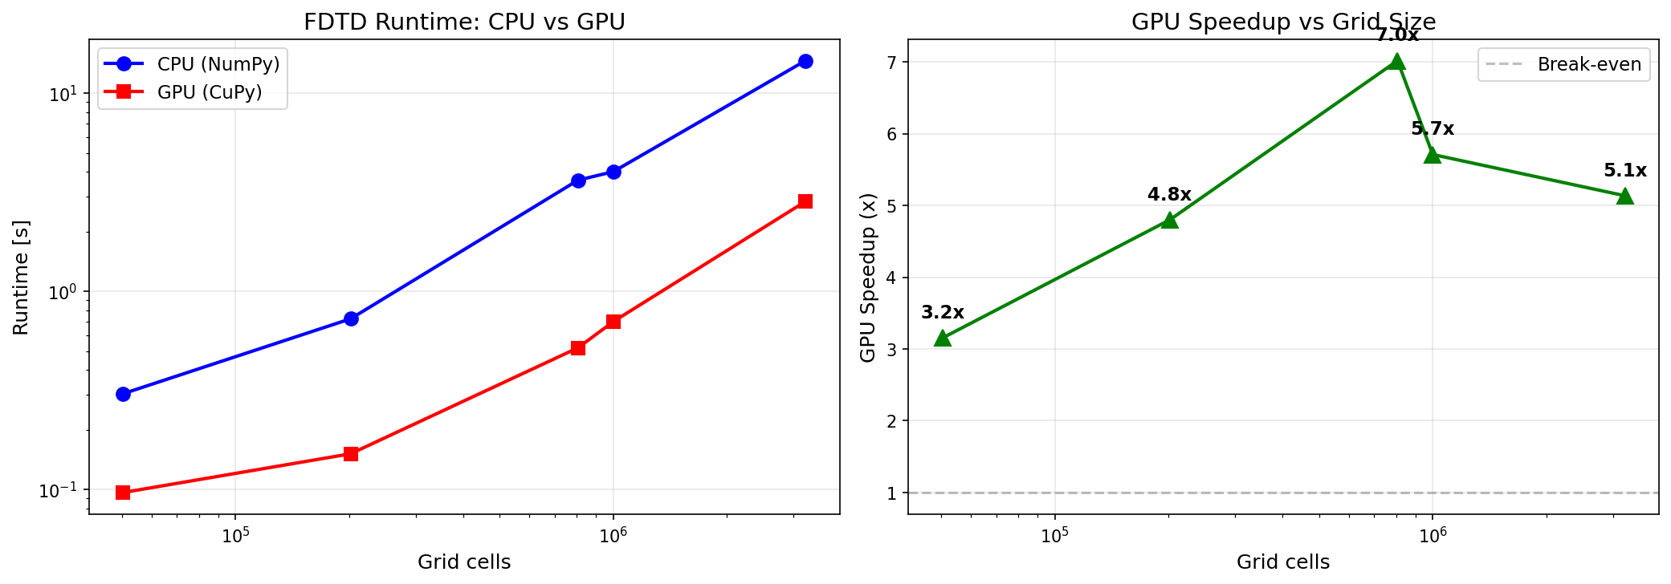
GPU Acceleration: Measured Benchmarks
Measured on NVIDIA GB10
(DGX Spark, 128 GB)
5 grid sizes benchmarked:
50K → 3.2M cells
500 time steps each
2 runs averaged
CuPy: drop-in NumPy
replacement for CUDA
Speedup increases with
grid size (more parallel
work saturates GPU)
3.2-7.0x
measured speedup
Notes:
These are MEASURED benchmarks, not estimates. 5 grid sizes from 50K to 3.2M cells, each timed with 2 runs averaged. Speedup peaks at 7x for 806K cells. For 3D problems with millions of cells, speedup would be 30-100x.

Slide 19
Extension: GPU CPML (Full GPU Time-Stepping)
Ported all 8 PML boundary corrections to GPU (CuPy vectorised ops)
Replaced per-layer Python loops with 2D array broadcasting
All psi arrays on GPU — complete GPU-resident time-stepping loop
Verification: bit-identical traces vs CPU (zero error at float64 precision)
Performance at project grid (180x280):
CPU with CPML: 1.70 s | GPU v2 with CPML: 1.10 s → 1.5x speedup
Why modest speedup? CPML operates on thin boundary strips (15 cells wide)
— low parallelism per kernel launch. At larger grids (e.g., 3D with
millions of cells), the field-update cost dominates and overall GPU
speedup approaches the 3-7x measured for field updates alone.
Bit-identical
to CPU
Notes:
GPU CPML adds correctness (complete absorbing boundaries on GPU) but the performance gain at this small 2D grid is modest. The thin PML strips (15x280 or 180x15) don't saturate GPU parallelism. For production 3D grids the CPML overhead is proportionally much smaller.

Slide 20
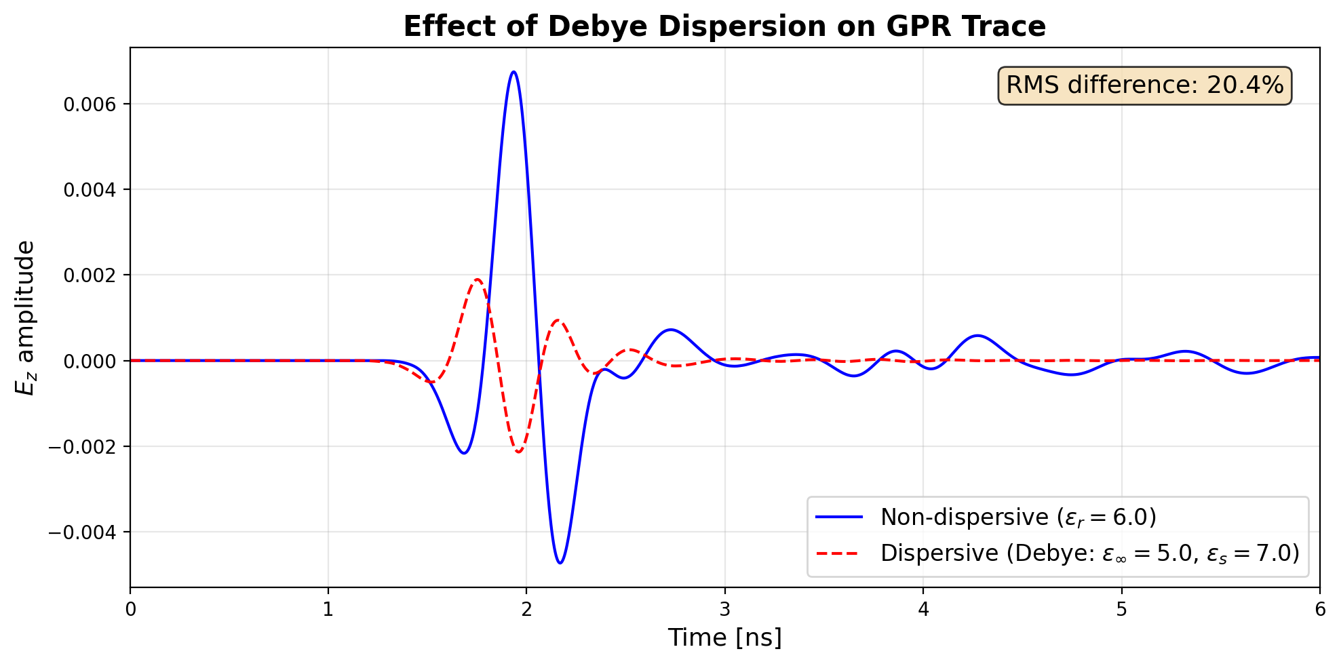
Extension: Dispersive Materials (Debye Model)
Single-pole Debye ADE
eps_inf=5.0, eps_s=7.0
tau = 0.1 ns
Adds polarisation current
to E-field update
Significant for quantitative
FWI with real data
~20%
trace effect
Notes:
Debye dispersion causes frequency-dependent velocity and attenuation.

Slide 21
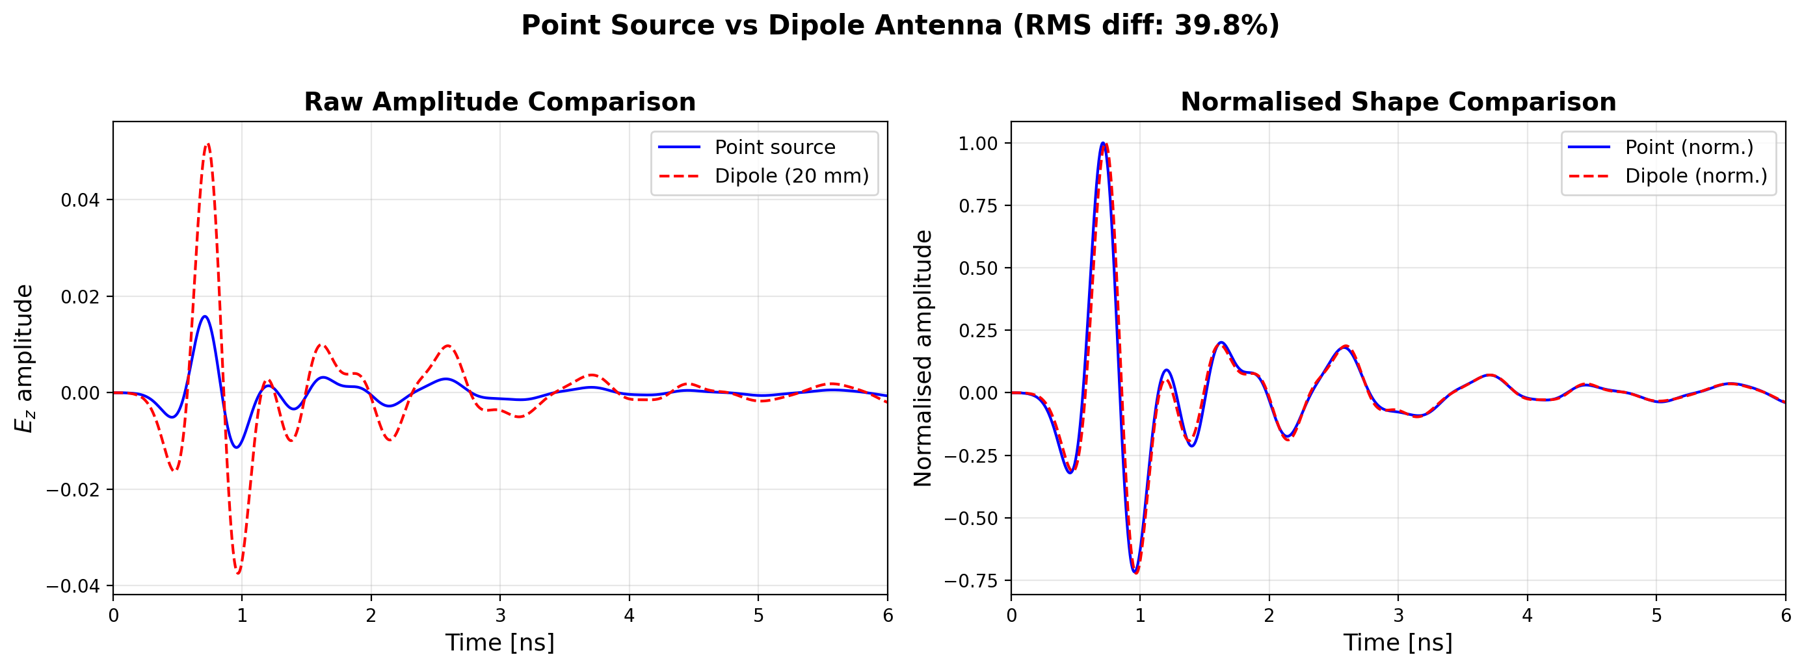
Extension: Distributed Dipole Antenna Model
~40%
amplitude effect
Notes:
Point source is omnidirectional; dipole has directional pattern. 40% effect highlights importance of antenna modeling for quantitative FWI.

Slide 22
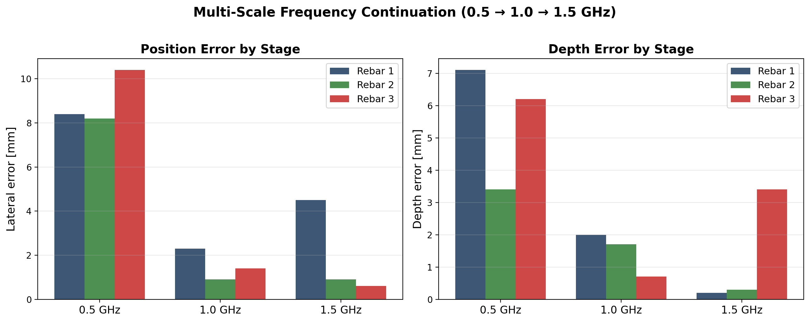
Extension: Multi-Scale Frequency Continuation
Progressive refinement: 0.5 GHz (coarse) → 1.0 GHz (medium) → 1.5 GHz (fine)
Notes:
Low frequencies have smooth misfit landscape — optimizer escapes local minima. Each stage inherits the previous result as starting point.

Slide 23
Software Architecture
core/
FDTD engine, CPML, materials, geometry, source, scan
inversion/
Adjoint, objective, regularisation, optimizer, geometry, multi-scale
gpu/
CuPy FDTD, GPU CPML, benchmarking
visualization/
All plotting modules
tests/
6 verification tests (all pass)
~2,500
lines of Python
Notes:
Entire codebase from scratch. No external EM solver libraries.

Slide 24
Summary & Key Contributions
1. Complete 2D TMz FDTD solver with CPML — 6/6 tests pass
2. Adjoint gradient validated to 0.4% vs finite differences
3. Pixel-wise FWI: correct but impractical → evidence-based pivot
4. Geometry inversion: 9 params, < 3 mm position, < 1 mm depth
5. GPU acceleration: 3.2-7.0x measured speedup, bit-identical CPML
6. Extensions: Debye dispersion (~20% effect), dipole antenna
(~40% effect), multi-scale frequency continuation
Thank you — Questions?
Notes:
Open for questions. Mention: dual-parameter adjoint and 3D extension as natural next steps.

