Slide 1
e-Learning
Group 6:
1005062
1005065
1005071
1005072
1005074
one more step towards future world

Slide 2
Scope of our system
Define the system

Slide 3
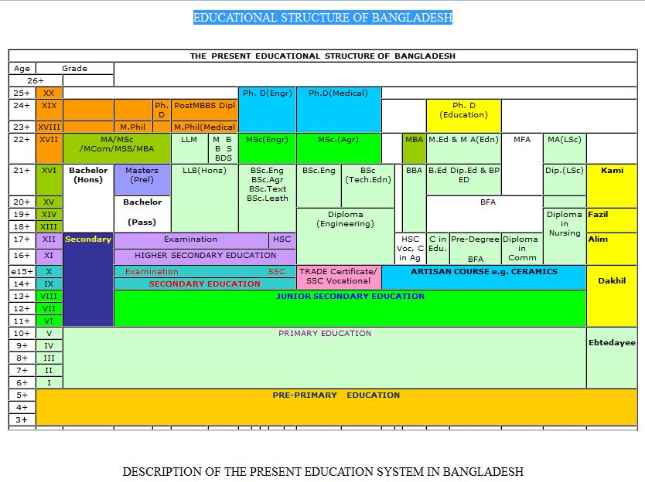

Slide 4
Scope of our system
Define the system
Define our scope

Slide 5
Problems
There is no such system connecting teachers students countrywide
People all over the country aren’t getting all the information equally

Slide 6
Problems
All the information is not well organized in a place
Students have to travel for only form fill up, for collecting books or collecting information
There is no such complete system serving all the purposes

Slide 7
Discussing Scope
ACTORS
Processes
DATA

Slide 8
Actors
Teachers
Guardians
Students
Experts
Moderators

Slide 9
Actors
Admins
Anonymus

Slide 10
Worthiness of our system

Slide 11
Estimated Schedule, plan and budget
A preliminary plan
Estimated Schedule and budget

Slide 12
Registration
Experts
Others
Students
Teachers
Study
Exam
Statistics
Information
Forum
Moderators/Admins

Slide 13
Implementation
Ministry of education
Ministry of IT & Ministry of planning
Funding Sponsors
Users
Project team
Vendors
Researchers

Slide 14
Project team
Management
Development
Deployment
Operation

Slide 15
Thank You

