Slide 1
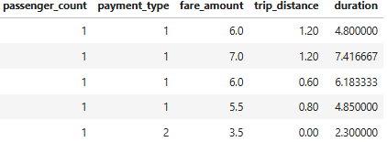
Data Overview
For this analysis, we utilized the comprehensive dataset of NYC Taxi Trip records, used data cleaning and feature engineering procedures to concentrate solely on relevant columns essential for our investigation
Relevant columns used for this research:
passenger_count (1 to 5)
payment_type (card or cash)
fare_amount
trip_distance (miles)
duratrion (minutes)

Slide 2
Methodology
Step | Description
Descriptive Analysis | Performed statistical analysis to summarize key aspect of the data, focusing on fare amounts and payment types.
Hypothesis Testing | Conducted a T-test to evaluate the relationship between payment type and fare amount, testing the hypothesis that different payment methods influence fare amounts.
Regression Analysis | Implemented linear regression to explore the relationship between trip duration (calculated from pickup and dropoff times) and fare amount.

Slide 3
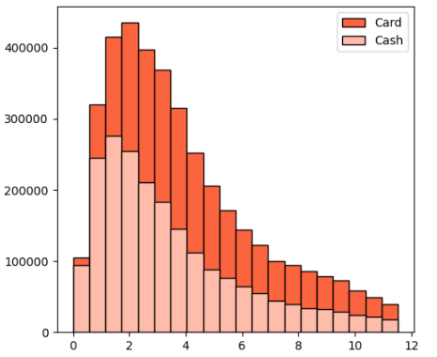
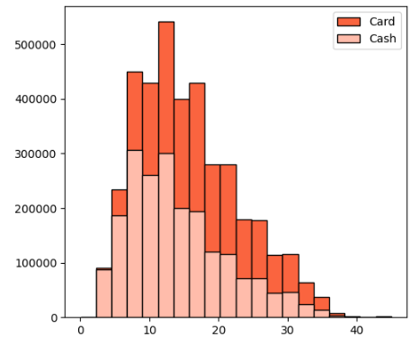
Fare Amount
Journey Insights
Customers paying with cards tend to have a slightly higher average trip distance and fare amount compared to those paying with cash.
Indicates that customers prefers to pay more with cards when they have high fare amount and long distance.
Trip Distance
 | Payment Type | Mean | Standard Deviation
Fare Amount | Card | 15.78 | 7.34
 | Cash | 14.14 | 7.14
Trip Distance | Card | 3.93 | 2.63
 | Cash | 3.45 | 2.56

Slide 4
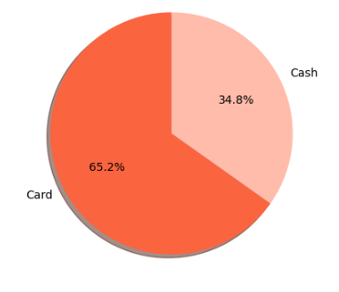
Preference Of Payment Types
The proportion if customers paying with card is significantly higher than those paying with cash, card payment accounting for 65.2% of all transactions compared to cash payments at 34.8%.
This indicates a strong preference among customers for using card payments over cash , potentially due to convenience, security or incentives offered for card transactions.

Slide 5
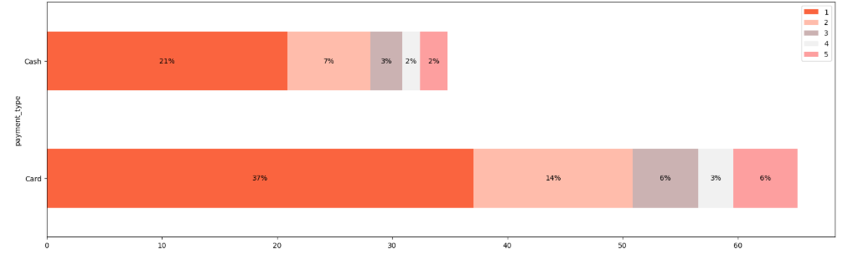
Passenger Count Analysis
Among card payments, rides with a single passenger (passenger_count = 1) comprise the largest proportion, constituting 65.2% of all card transactions.
Similarly, cash payments are predominantly associates with single-passenger rides, making up 34.8% of all cash trasactions.
There is a noticeable decrease in the percentage of transactions as the passenger_count increases, suggesting that larger groups are less likely to use taxis or may opt for alternate payment methods.
These insights emphasize the importance of the considering both payment method and passenger count_count when analyzing transaction data as they provide valuable insights into customers behavior and preferences.

Slide 6
Hypothesis Testing
Null Hypothesis: There is no difference in average fare between customers who use credit cards and customers who use cash.
Alternative Hypothesis: There is a difference in average fare between fare between customers who use credit cards and customers who use cash.
With a T-statistic of 262.64 and a P-value of less than 0.0, we reject the null hypothesis, suggesting that there is indeed a significant difference in average fare between the two payment methods.

Slide 7
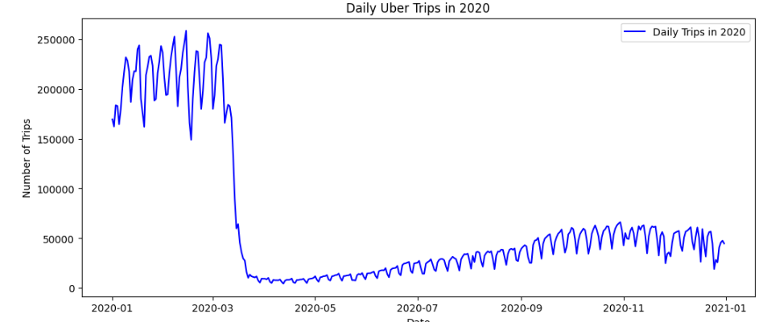
Daily Trip Analysis
Trip counts dropped sharply mid-March due to COVID-19 restrictions.
From March to May, trip volume remained consistently low.
Weekly seasonality remained consistent throughout the year.
A gradual recovery started from June onward.
Weekly seasonality remained consistent throughout the year.

Slide 8
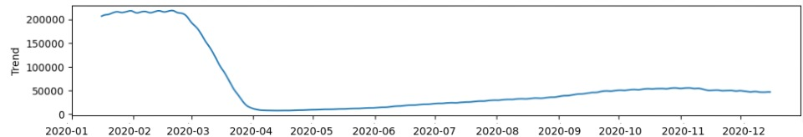
Trip Trend Analysis
Trip volumes remained steady around 200,000 during January and February 2020.
A rapid, sharp decline occurred in March 2020, dropping over 80% as pandemic restrictions took effect.
Growth stalled and slightly dipped, likely due to seasonal factors and pandemic resurgence.
The upward trend plateaued and decreased slightly through November and December of 2020, likely because of changes in the season and pandemic healing.

Slide 9
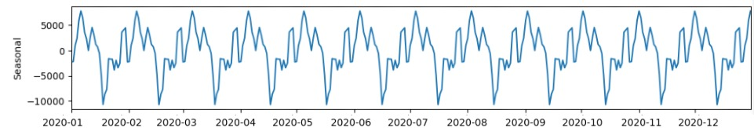
Seasonal Pattern Analysis
Distinct, consistent cyclical pattern repeating approximately every 7 days, suggesting strong weekly seasonality in the number of trips.
Patterns of peaks and troughs remain constant in shape and frequency throughout the year, even though overall trip patterns fluctuate.
Positive seasonal effects (peaks) tend to be on specific days of the week, and negative effects (troughs) on other likely reflecting predictable weekday vs. weekend or workweek vs. leisure travel behaviors.
The amplitude of seasonal swings (~±10,000 trips) remains relatively constant before, during, and after major trend shifts — indicating that while total trip volumes dropped, relative intra-week patterns continue.

Slide 10
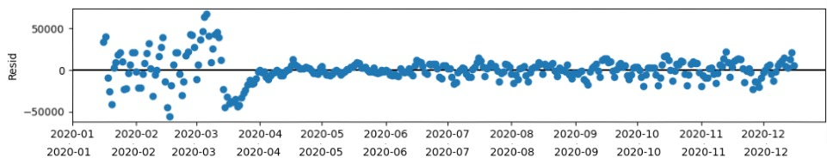
Seasonal Pattern Analysis
Unprecedented volatility in residuals in Jan–Mar 2020, reflecting extreme unexplained departures from trend and seasonality early in the year.
Residual values sharply stabilize after March 2020, reflecting a more stable trend after trip activity fell and mobility restrictions normalized behavior.
Post-April residuals oscillate repeatedly in a narrower range (~±20,000 trips), reflecting less random fluctuation and improved model fit during the pandemic's restrictive phases.
No extreme outliers observed post-March, pointing to effective decomposition where most variation is captured by trend and seasonality components.

Slide 11
Seasonal Pattern Analysis
R² Score: 0.971
The model explains 97.1% of the variance in fare amount, showing an excellent fit to the data and strong predictive power.
Mean Absolute Error (MAE): 0.578
On average, the model’s predictions are off by just $0.58, demonstrating high accuracy and reliability.

Slide 12
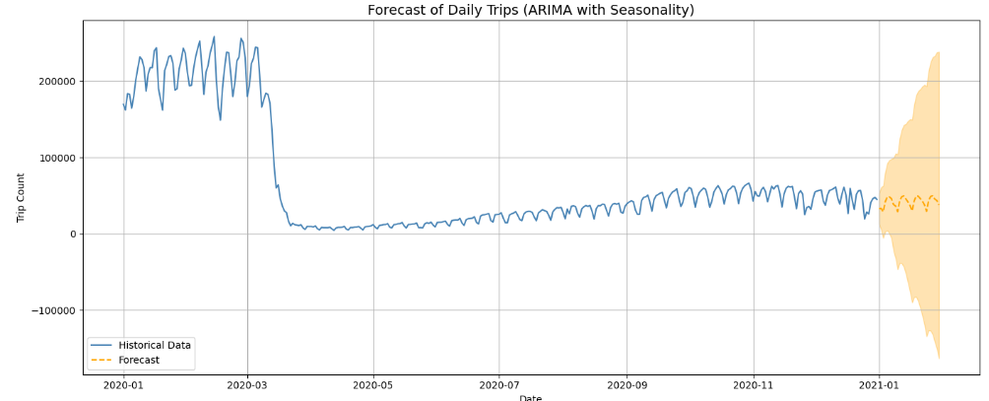
Forecasting Trip
The forecast gives a slow-down recovery. The orange line forecast shows sustained recovery to the more typical pattern of mobility with seasonals held constant as normal.
The forecasting reveals normal week-to-week cycles (peaks and troughs), indicating while overall trip levels fell, trips' cyclical pattern (likely weekday vs. weekend behaviors) remained intact during the epidemic.

Slide 13
Recommendations
Encourage customers to pay with credit cards to capitalize on the potential for generating more revenue for taxi cab drivers.
Implement strategies such as offering incentives or discounts for credit card transactions to incentivize to choose this payment method
Provide seamless and secure credit card payment options enhance customer convenience and encourage adoption of this payment method.

