Slide 1
Assignment 2: Group Recommendations
Md Maruf Rayhan
maruf.rayhan@tuni.fi
Finy Mercialie Linjaya
finy.linjaya@tuni.fi

Slide 2
Group Recommendation
The motivation and usefulness of group recommendations naturally arises in situations where a group of users shares a common activity, service, task, or device.
Group-oriented recommendations are helpful in everyday situations like selecting a restaurant or organizing a trip.
There are numerous techniques for preference aggregation that is generally divided into three categories:
Majority-based strategies
Consensus-based strategies
Borderline strategies

Slide 3
Disagreements between the users in a group
Disagreement describes the satisfaction bias among the group members.
We must count disagreement if we're going to improve the user experience with the final recommended items.

Slide 4
Proposed Method
Most pleasure strategy: It works as the least misery strategy, but instead of considering for an item the smallest ratings of the users, it selects the greatest ones. It belongs to the Borderline strategies method. Below is an example:
Considers the maximum rating of an item. Group rating for item will be 8 since it’s the largest amongst(5,8,7)
 | Item 1 | Item 2 | Item 3
MD | 2 | 5 | 5
Maruf | 4 | 8 | 7
Rayhan | 6 | 7 | 1

Slide 5
Proposed Method Cont.
We calculate the absolute differences between each user's individual rating weight and the Aggregated Maximum rating .
We considered threshold value of 3.5
Any group member whose sum of weight rating difference is less than the threshold point (3.5) is regarded as disagreement and is removed from the final list of recommendations. Hence, added in the disagreement recommendation list.

Slide 6
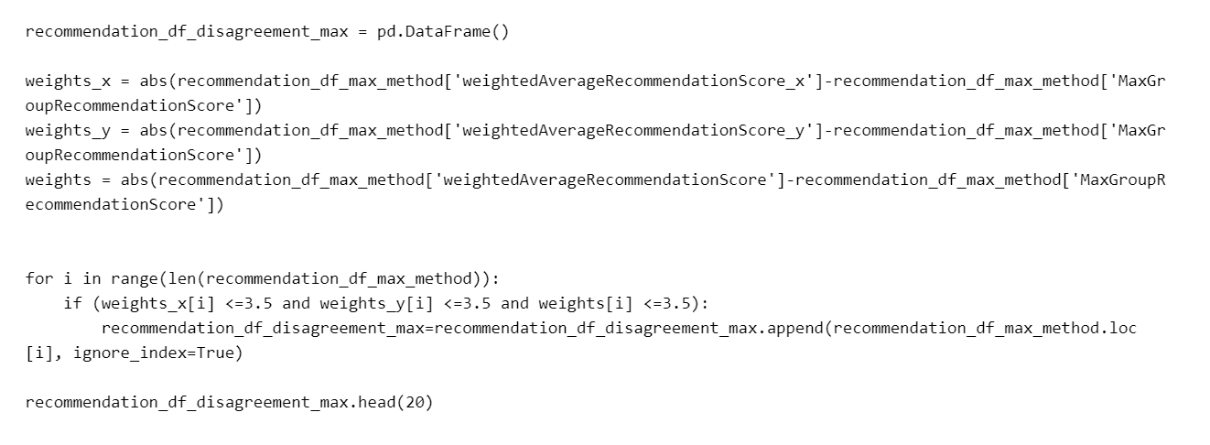
Code Snippet

Slide 7


Any Question?

