Slide 1

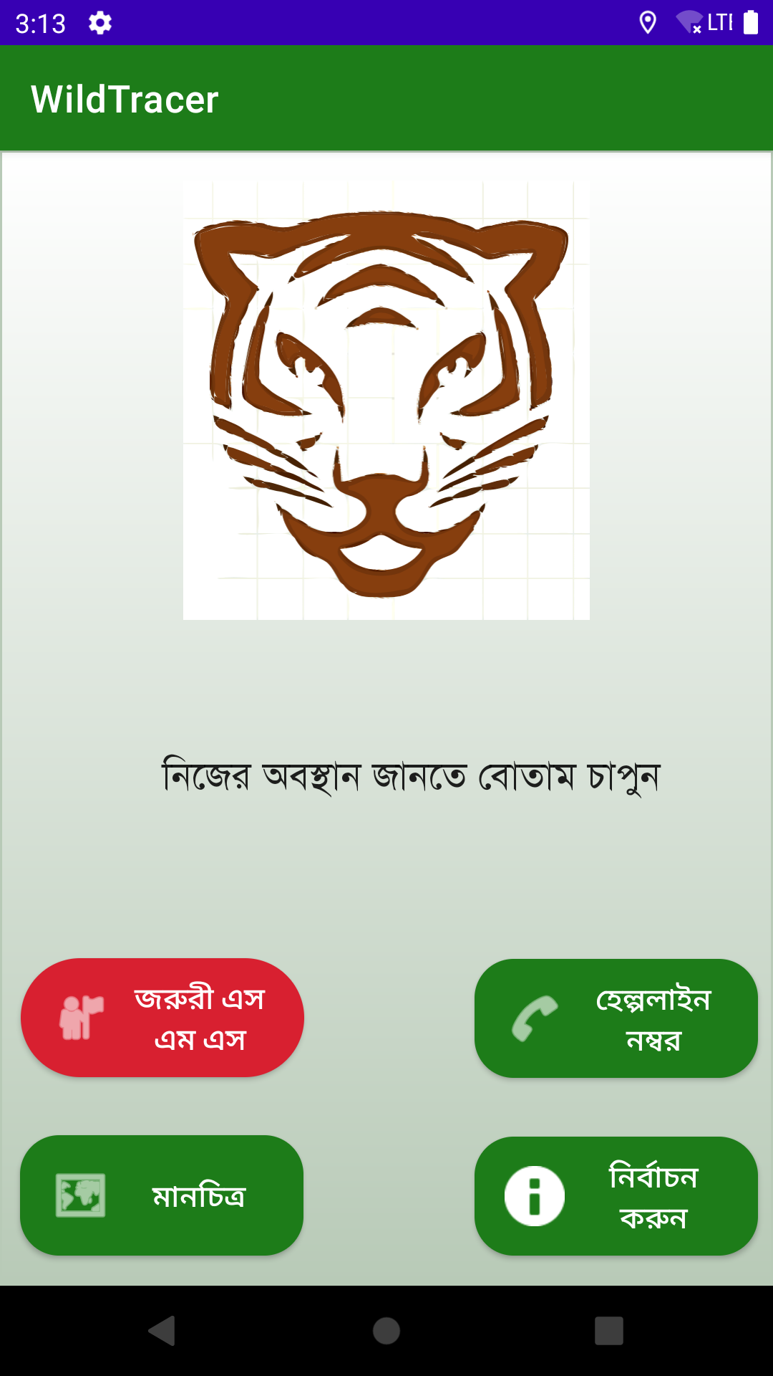
WildTracer App
WildTracer App for preventing wildlife trafficking
WildTracer

Slide 2
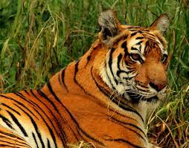
WildTracer
There is no app for emergency wildlife trafficking in
Bengali in Bangladesh!
WildTracer app is an app that is created to send emergency call and sms to the emergency response team in case of wildlife trafficking. It is the only wildlife trafficking prevention app which also imlements ML, in the world.

Slide 3

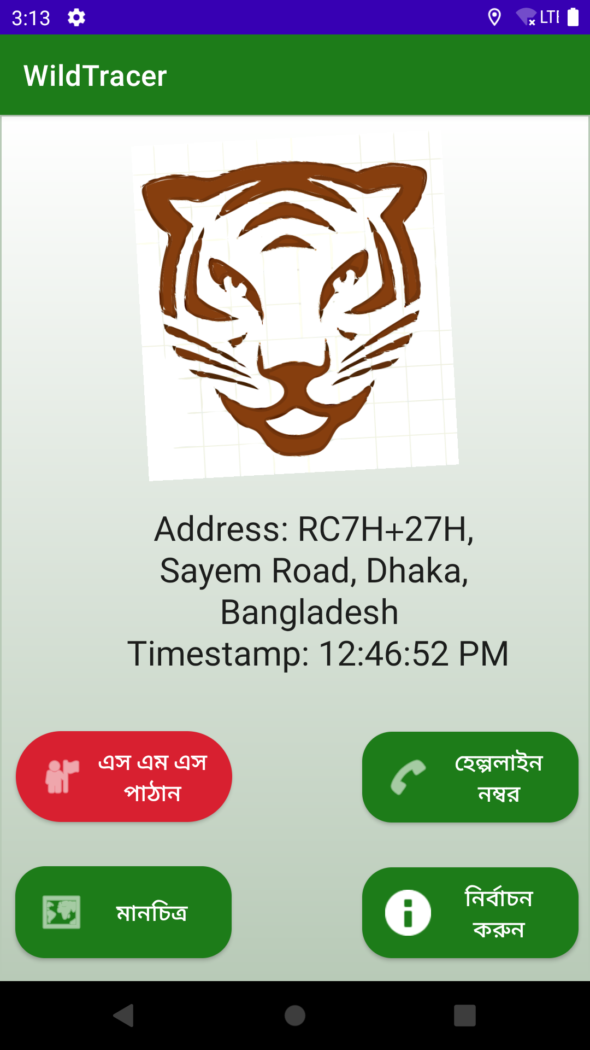
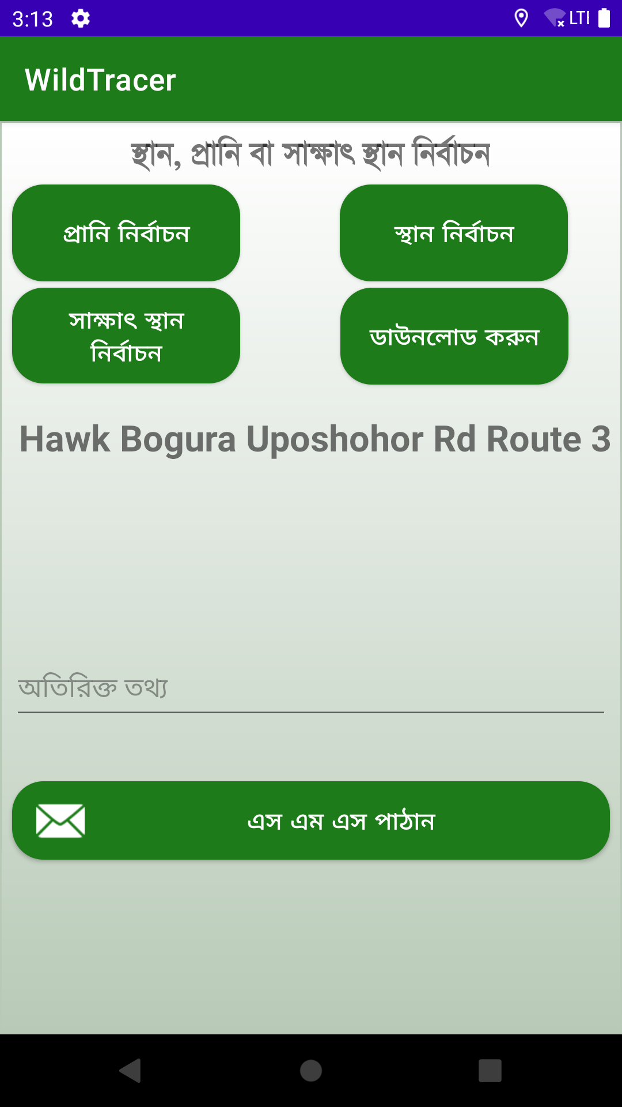
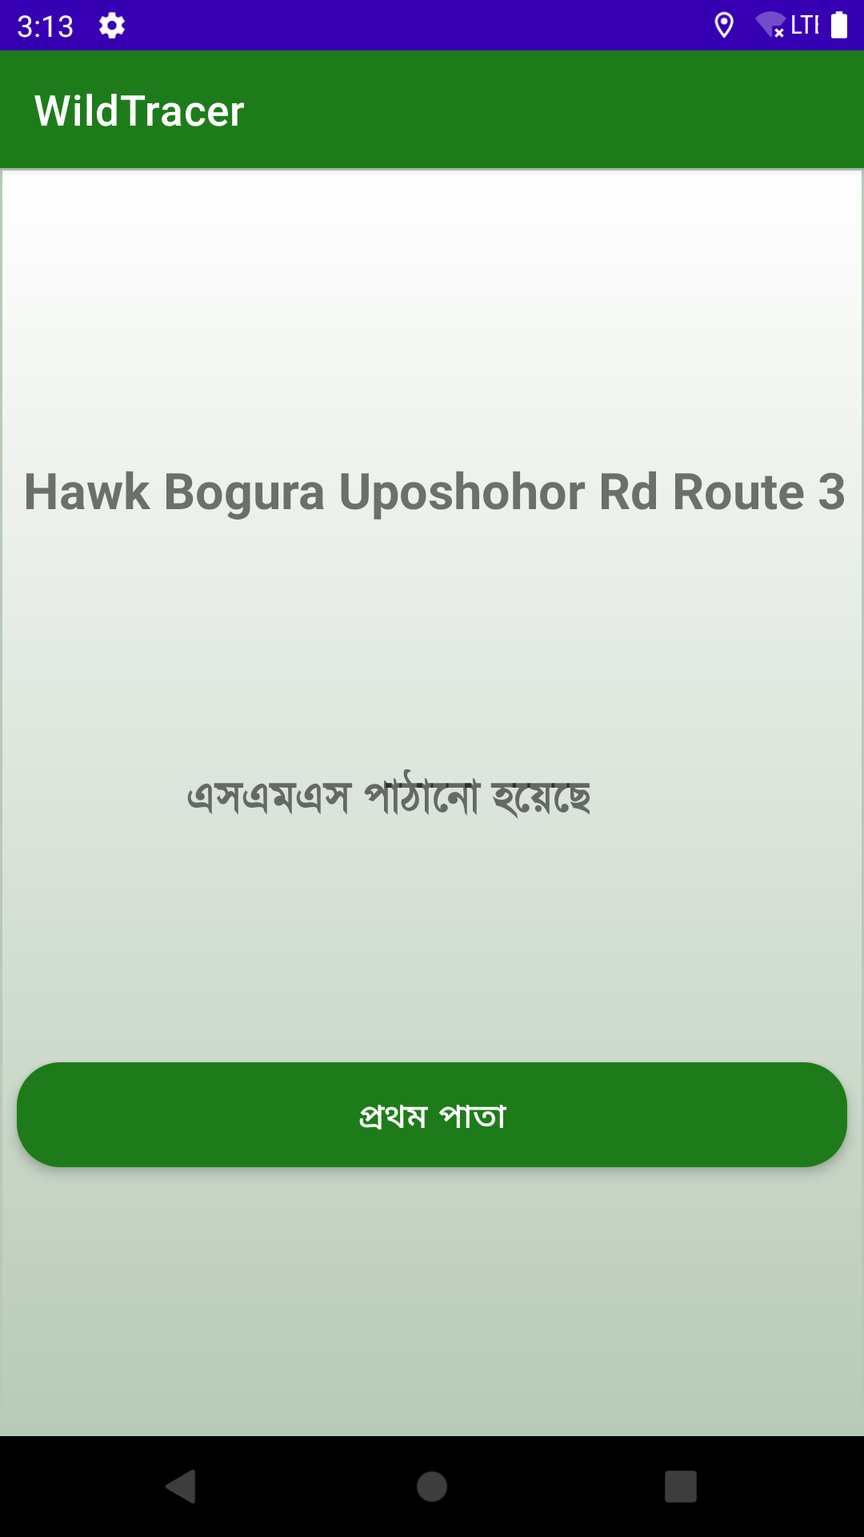
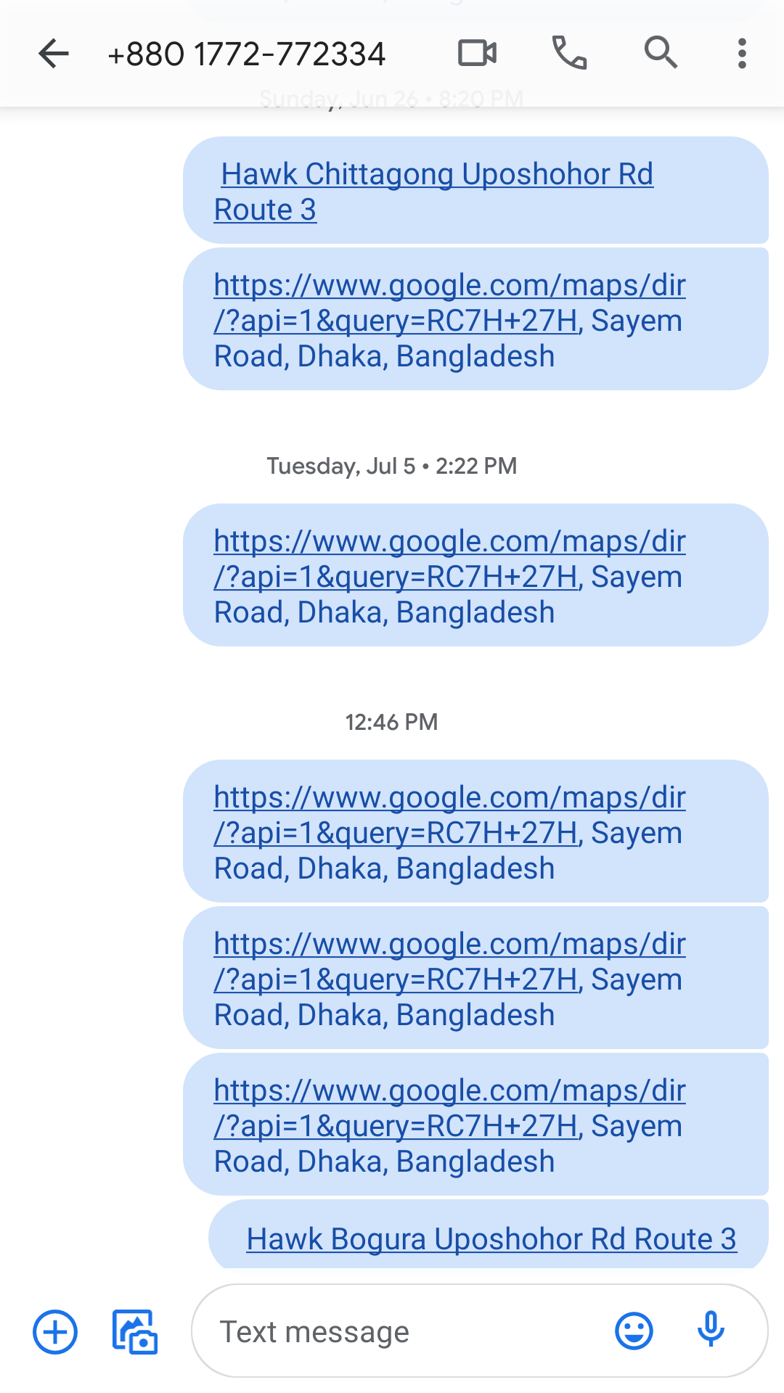
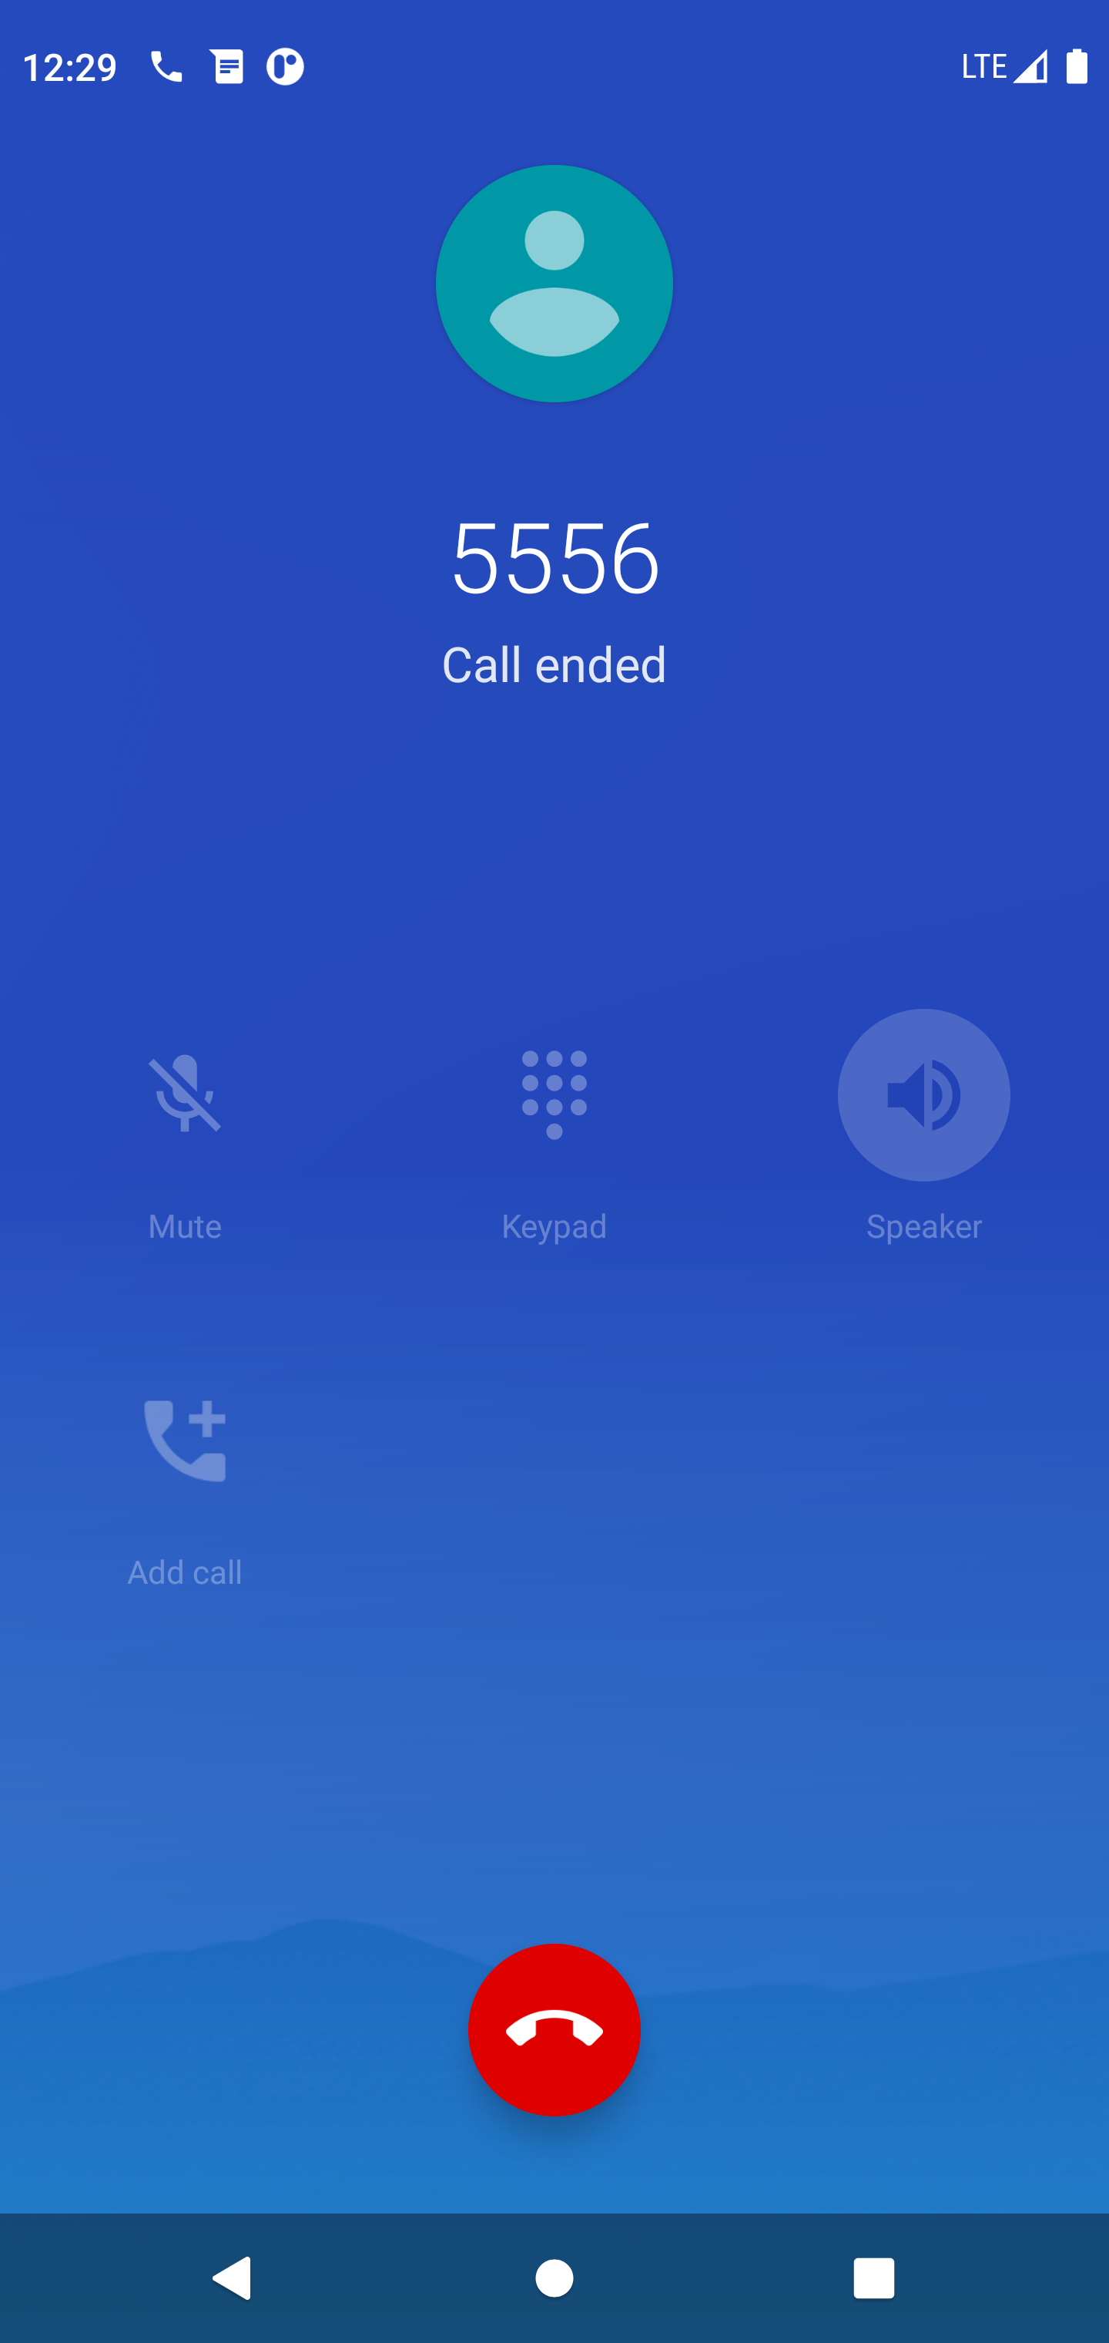
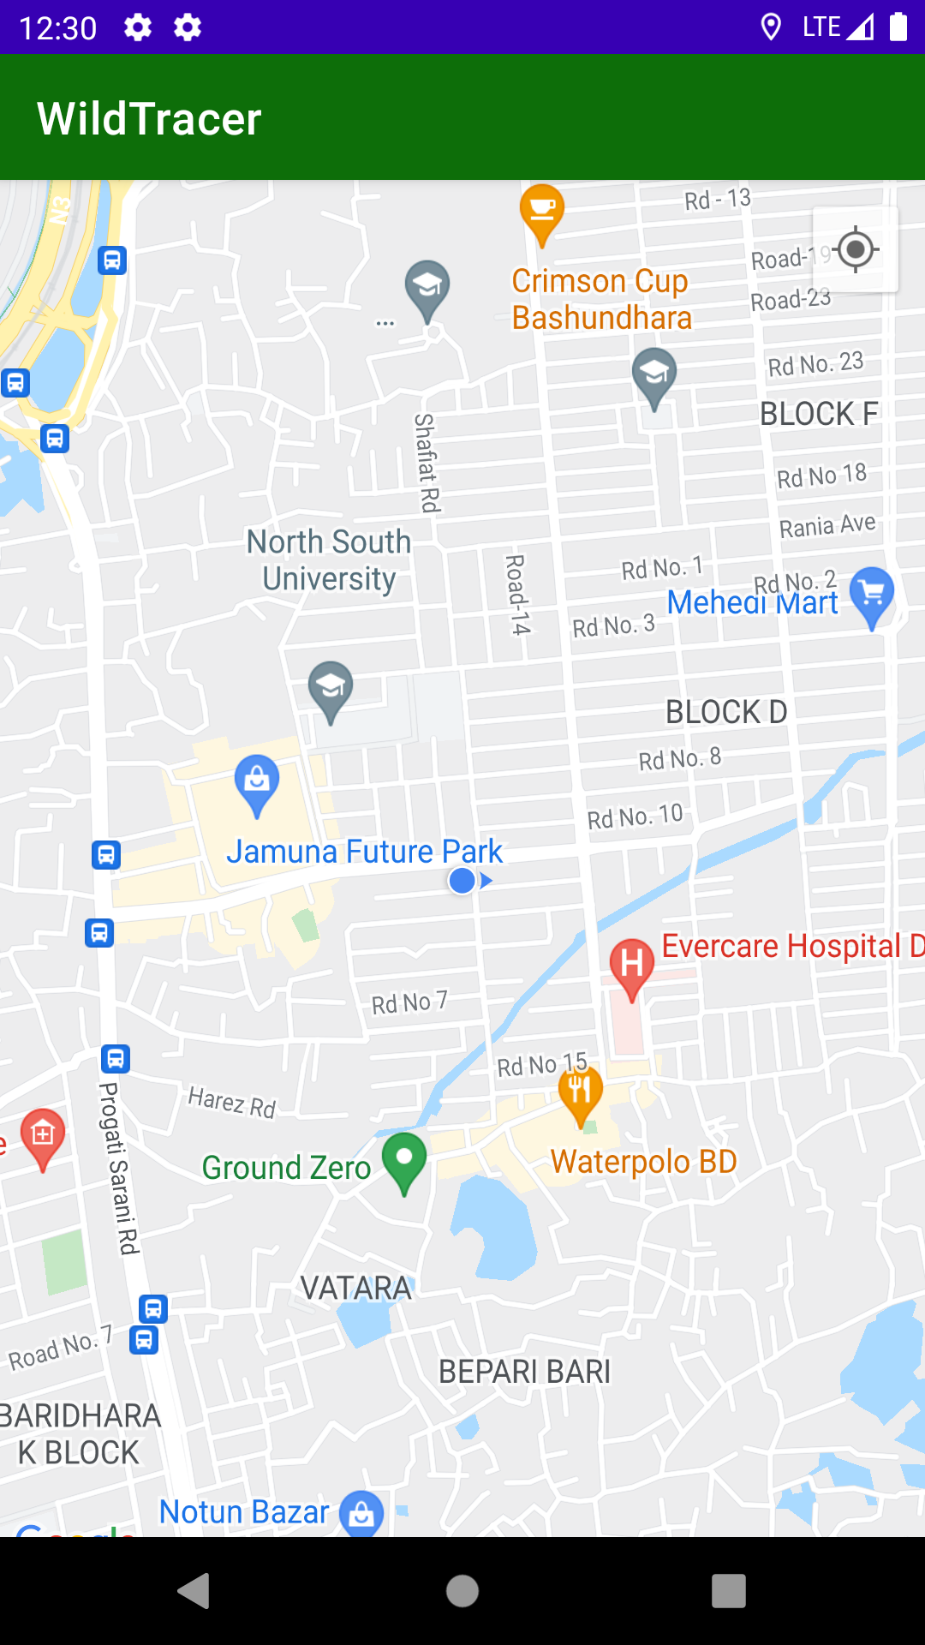
WildTracer App Tour
Current Location
Choose Options
Send SMS
Instant SMS
Instant Call
Map Location
SMS current location with the internet and location access.
Select option from preloaded data.
Confirm the SMS content and send to the receiver with a tap of the button.
Receiver receive the SMS instantly.
Receiver receive the call instantly.
View current location on map

Slide 4
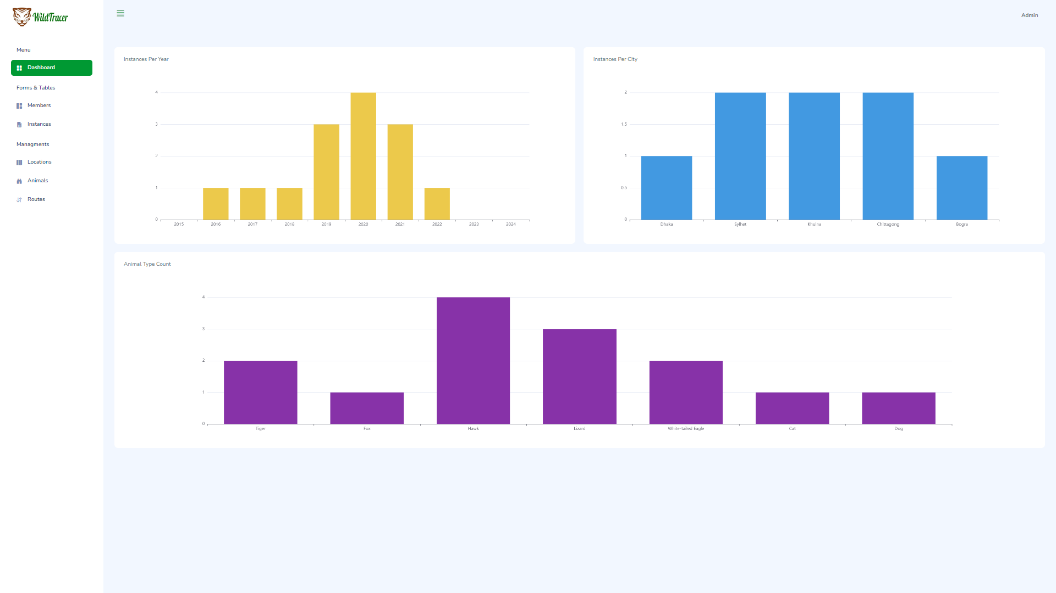
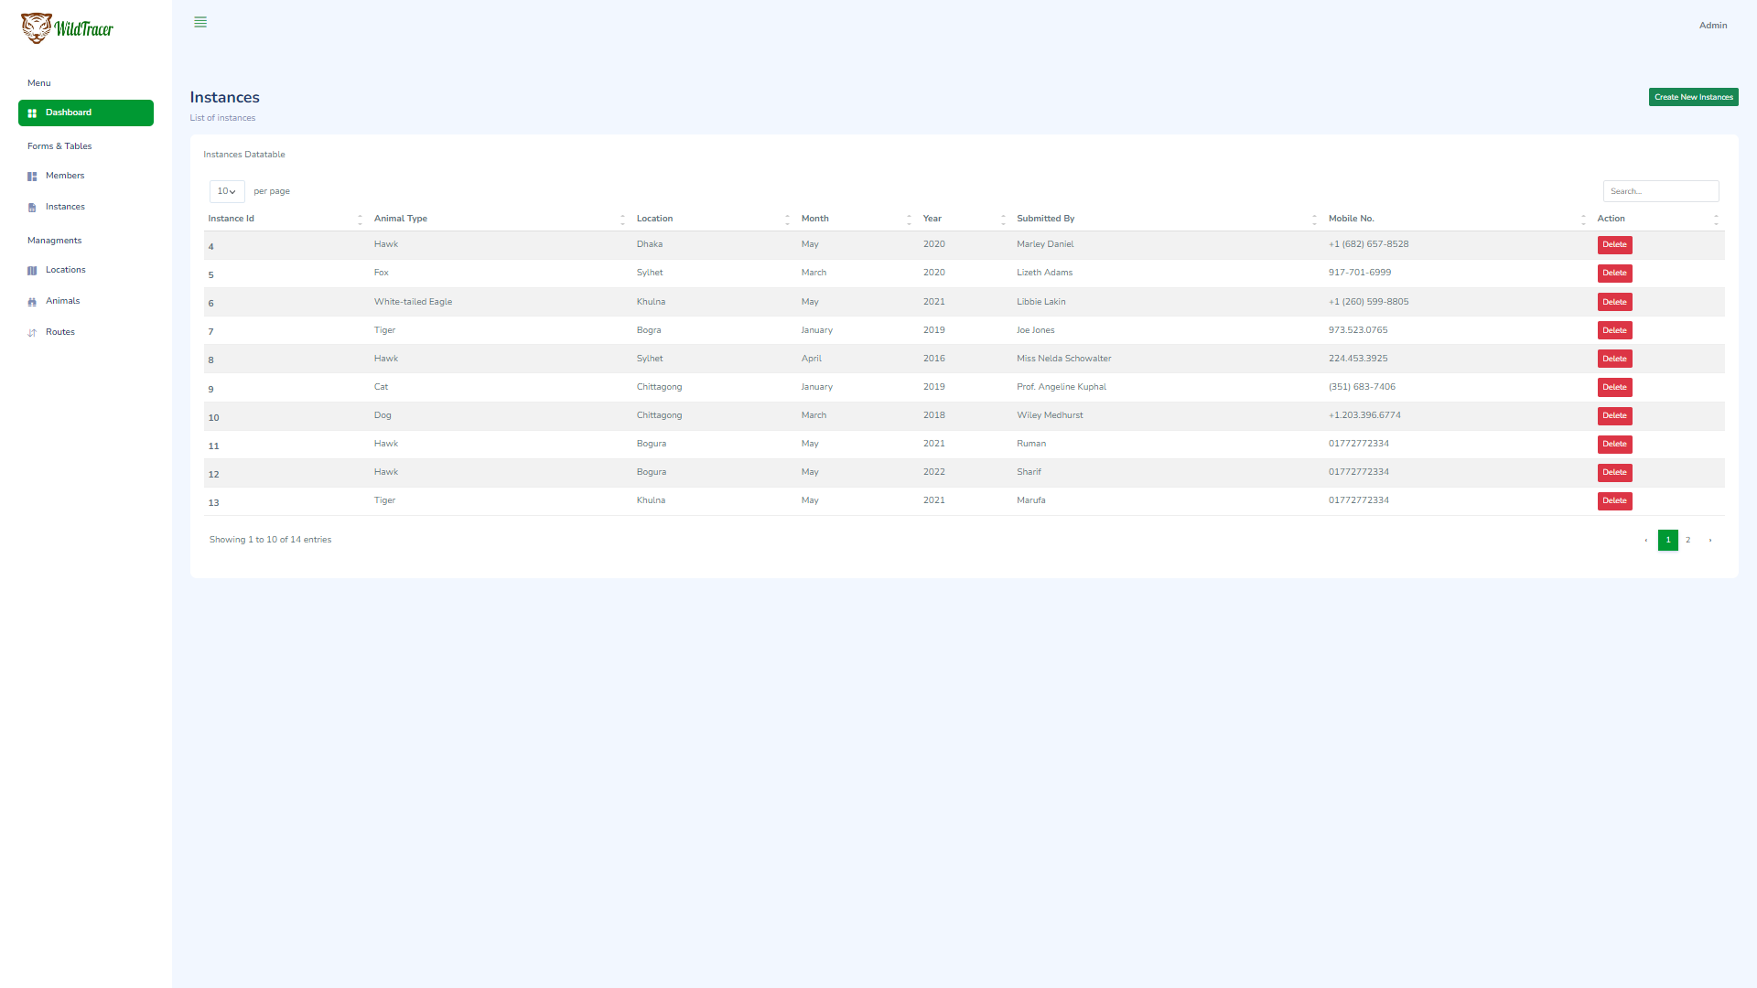
Dashboard

Slide 5
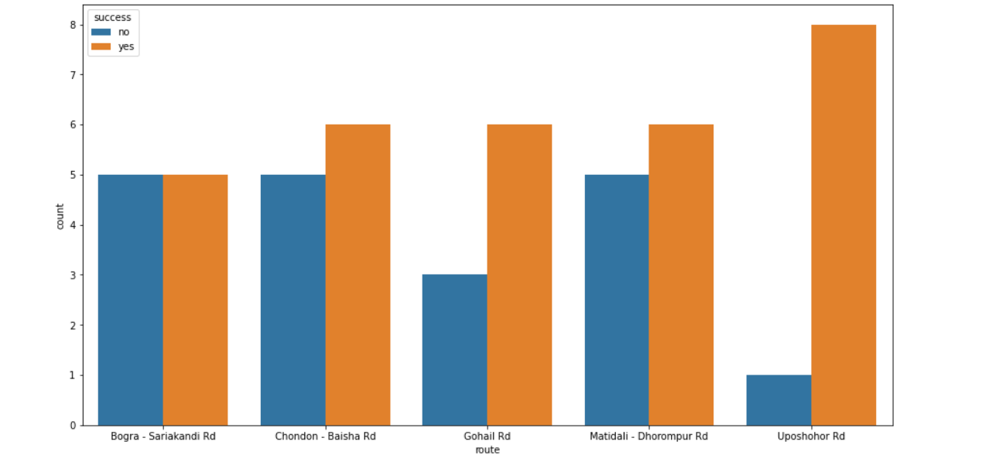
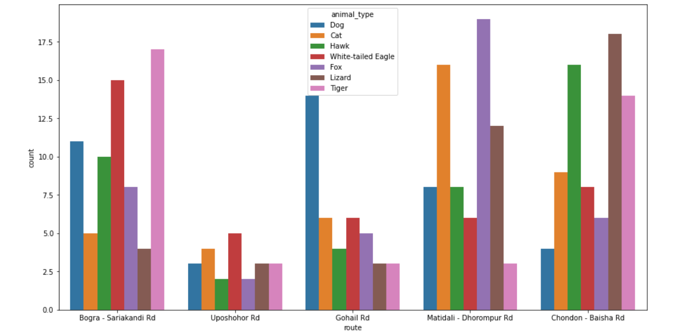
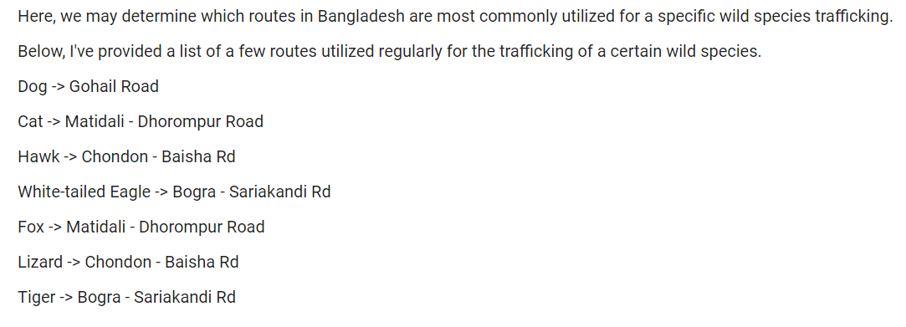
Machine Learning
Predicts which animals are more vulnerable and which routes are mostly used.

Slide 6
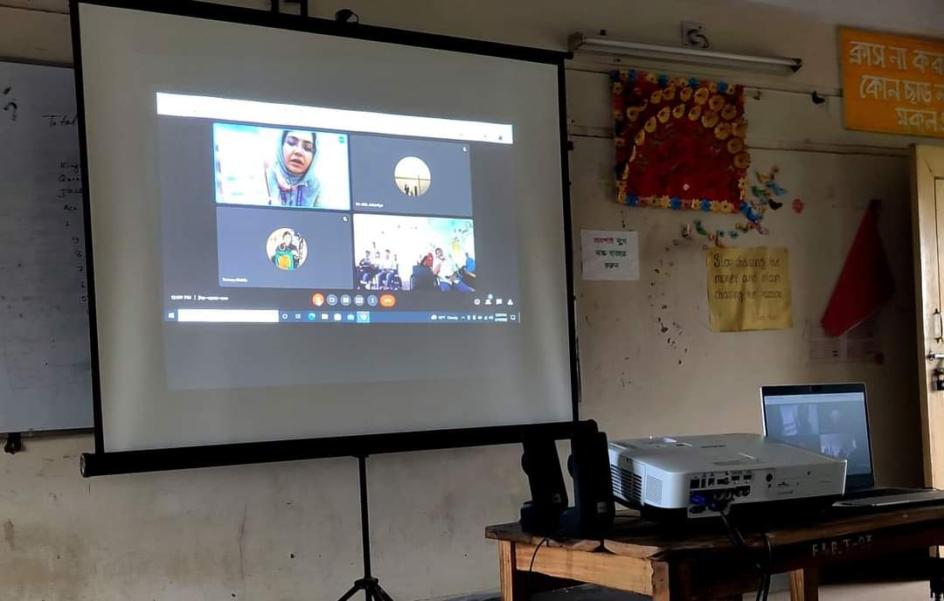
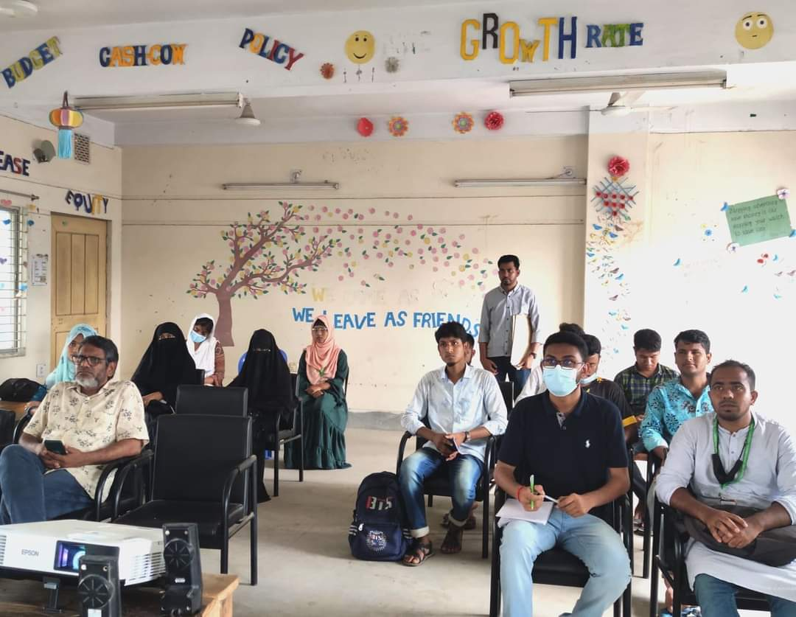
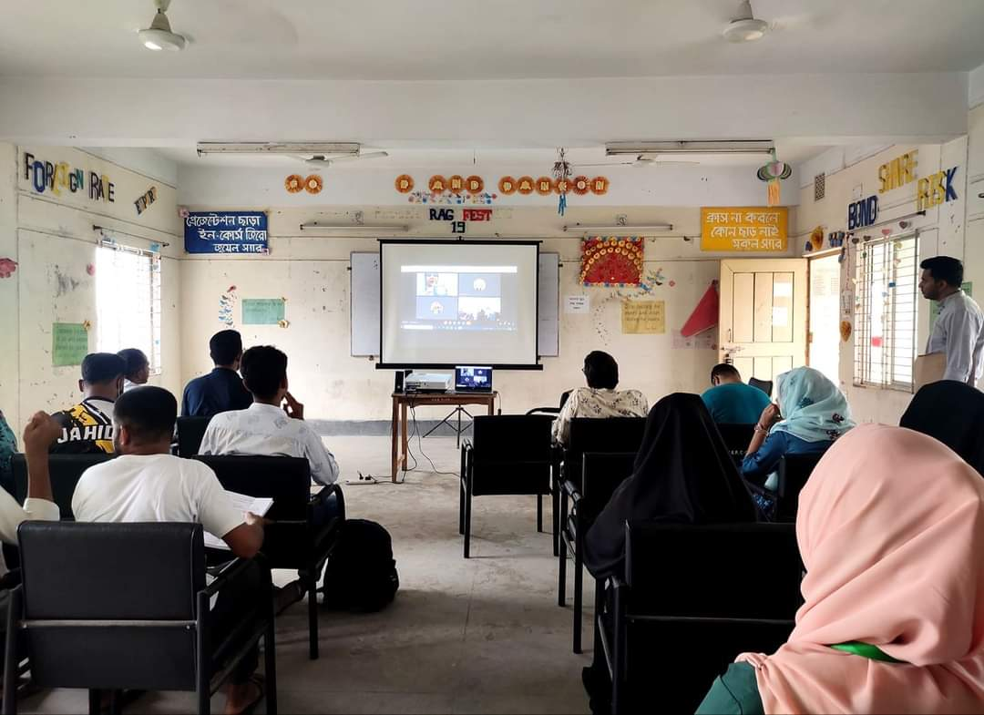
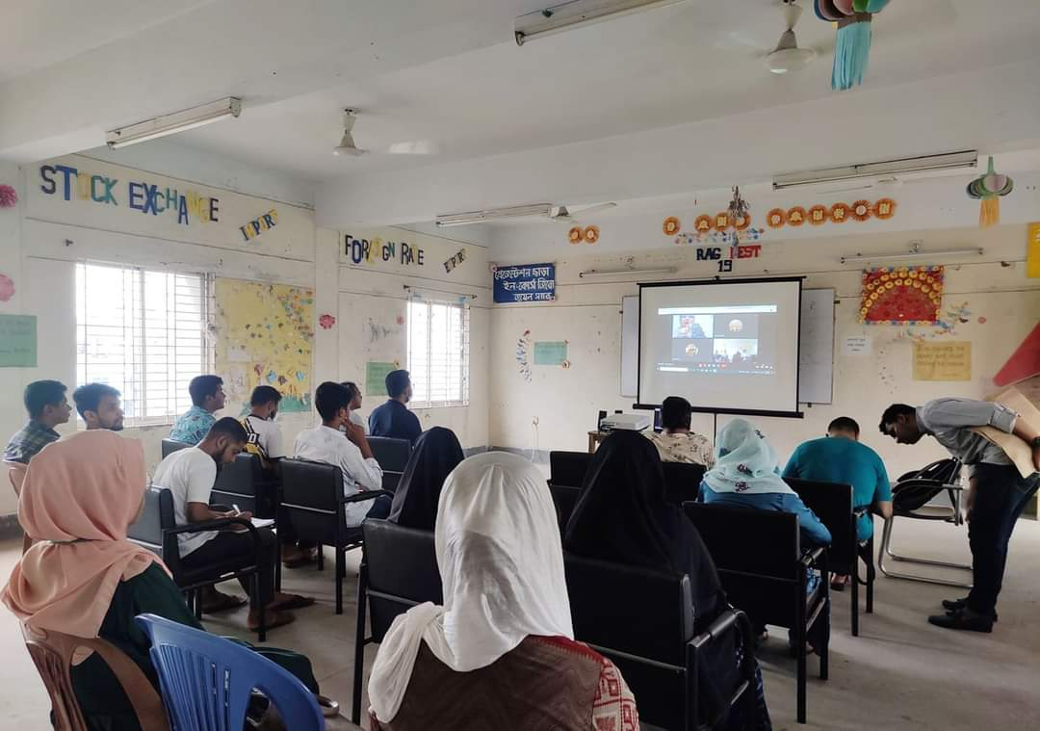
Survey

Slide 7
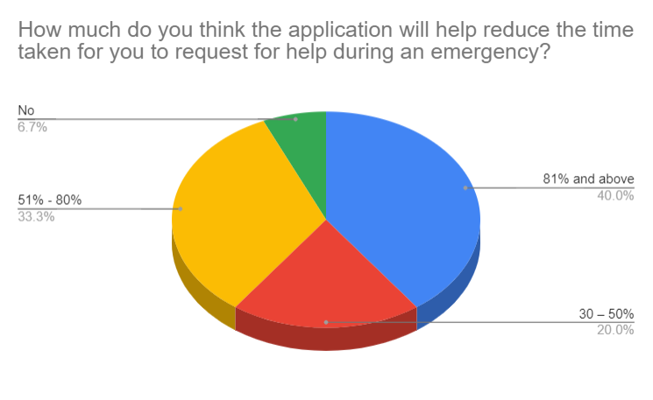
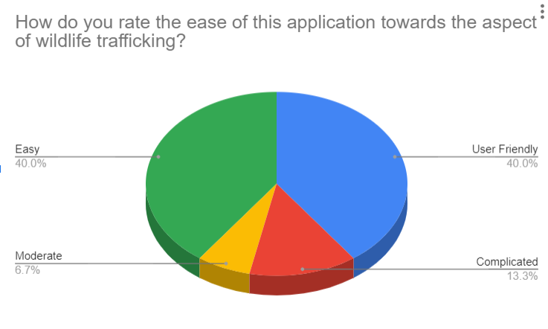
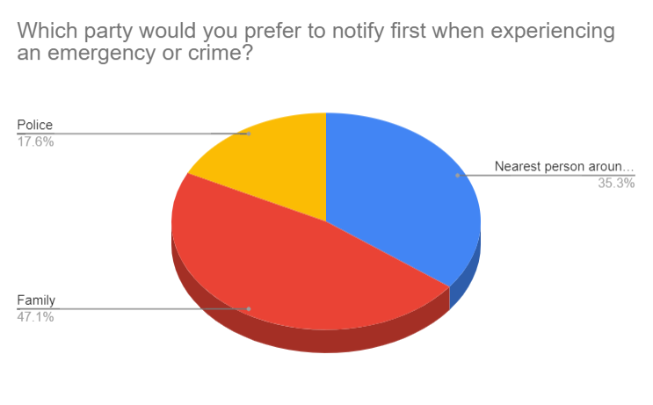
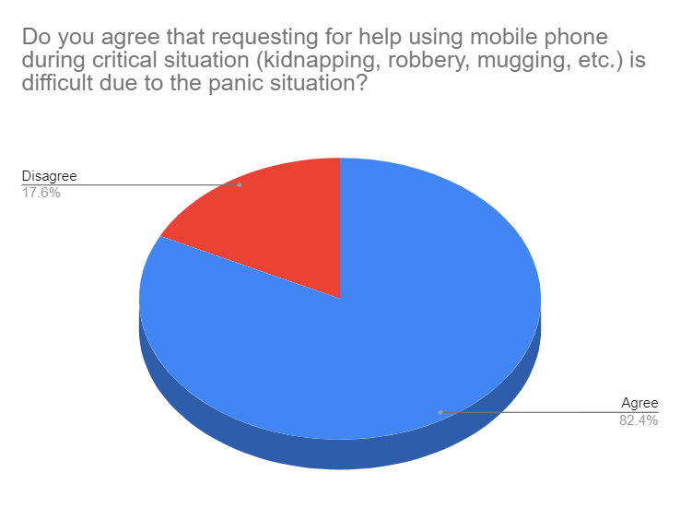
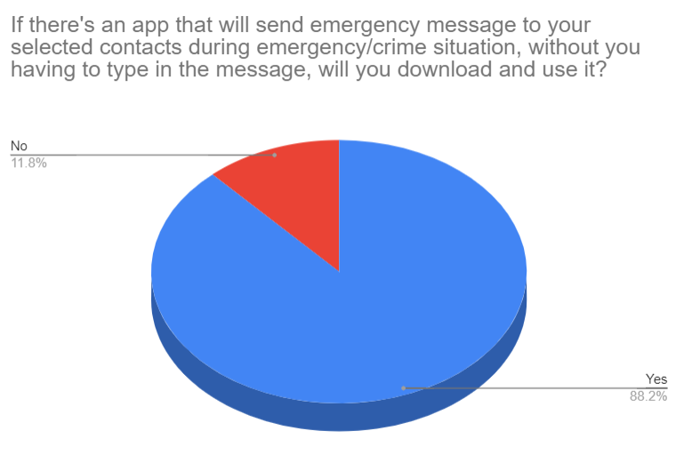
Results

Slide 8
APK of the App
APK of the app:
https://drive.google.com/file/d/1o505BFl3-tc_GcSgbSmtWcAMsNa8W6cc/view?usp=sharing

