Slide 1

PROJECT REVIEW - 2
Interactive Hand Sign Detection and Learning Platform
DEPARTMENT OF INFORMATION TECHNOLOGY
UNIVERSITY COLLEGE OF ENGINEERING SCIENCE AND TECHNOLOGY, HYDERABAD
MOMULA MARUTHI
21031F0006
Master of Computer Applications
Under The Guidance of :
K. GOVINDA RAO
Assistant professor

Slide 2
CONTENTS
Abstract
Introduction
Objectives
Model details
Achieved Till Now
Results
To be Achieved

Slide 3
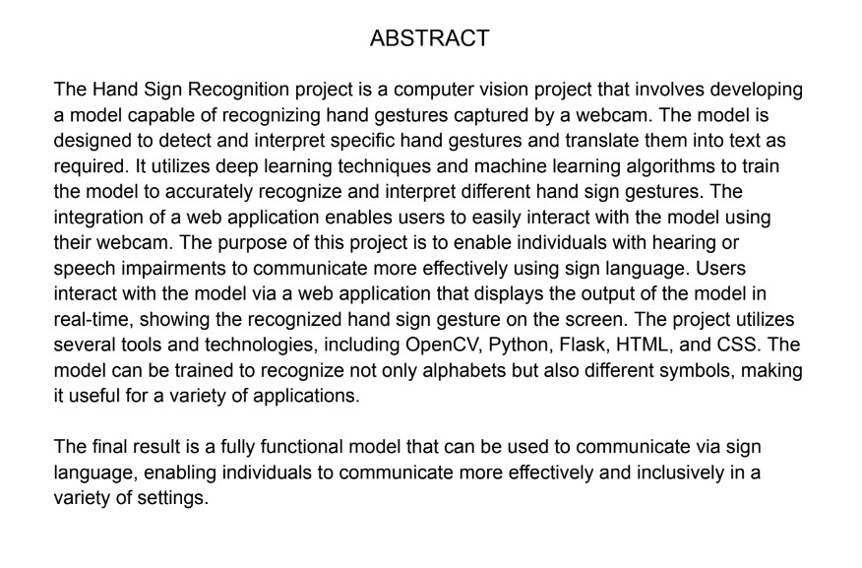

Slide 4
INTRODUCTION
As We Know There Are Many Languages To Communicate Our Needs, But When It Comes To Deaf And Hard Of Hearing Community , They Depend On Actions. These Actions Help Them In Effective Communication. As The Part Of Improvement This Platform Is Designed To Provide With A Unique And Engaging Way To Learn And Explore The Sign Language. It Is Useful For Both Deaf Community Or Any Individual , To Enhance These Skills.
Through Advanced Computing Of Hand Detection Technology, You’ll Be Able To See Your Gestures And Signs Of Communication.
There Are Many Sign Languages Around The World , In This Project I’ve Used Chinese Sign Language , Which Is Most Used Sign Language In The World Since 1950’s.

Slide 5
OBJECTIVES
The objective of the project is to Develop a hand recognition Platform that accurately detects a wide range of hand gestures like Chinese Hand Sign (used in this project).
Create a user-friendly interface for the learning platform.
Integrate feedback (Alert) feature to improve users’ signing skills to accurately represent the sign.
Ensure that the system is intuitive and sequential learning for the users.
Empower users to communicate more effectively with the deaf and hard-of-hearing community.

Slide 6
Model Details
The Model that I have used here was generated from Teachable Machine which was developed by Google Inc., that uses pre-trained CNN algorithm called MobileNet V2 to create classification model that are specifically designed for image recognition.
The MobileNet V2 consists of Input layer, convolutional layers, Depth wise separable convolutions, Inception modules and Classification layer.
The use of depth wise separable convolutions and inception modules allows MobileNet V2 to achieve better accuracy.

Slide 7
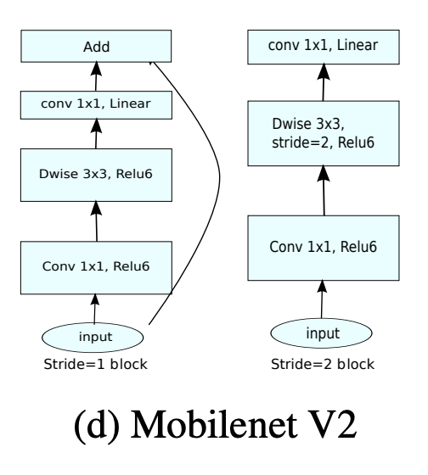
Contd…
SAMPLE WORKING:
MobileNet V2 takes an image as input.
It extracts features from the image using convolutional layers.
It reduces the computational cost of the network using depth wise separable convolutions.
It improves the accuracy of the network using inception modules.
It classifies the input image into a category, such as a cat, dog, or car.

Slide 8
ACHIEVED TILL NOW
Recognizing Hand Image in Full webcam feed, and marking required dimensions.
Developed a Classification Model , through Input of Hand sign images(partially completed).
Tested the model’s accuracy and its results for consistency in use
Achieved Maximum Accuracy , with Minimal loss for the generated classification model.
Generated Sequential flow of lesson , as such user cannot skip current hand sign until program recognizes it in live feed from webcam.
Giving Alerts to the user to maintain smooth flow of program.
Manual navigation to finish page after completion of course.

Slide 9
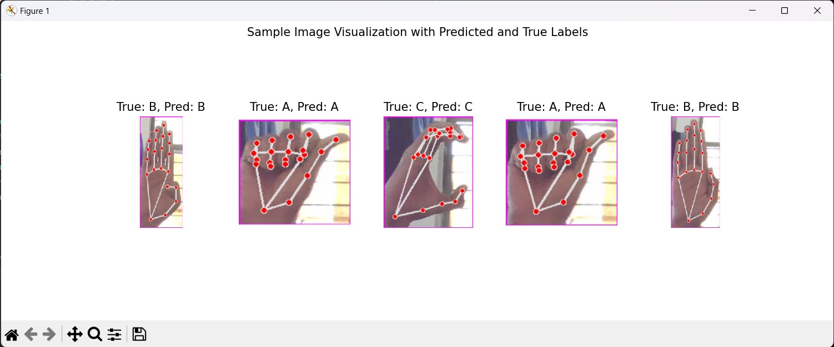
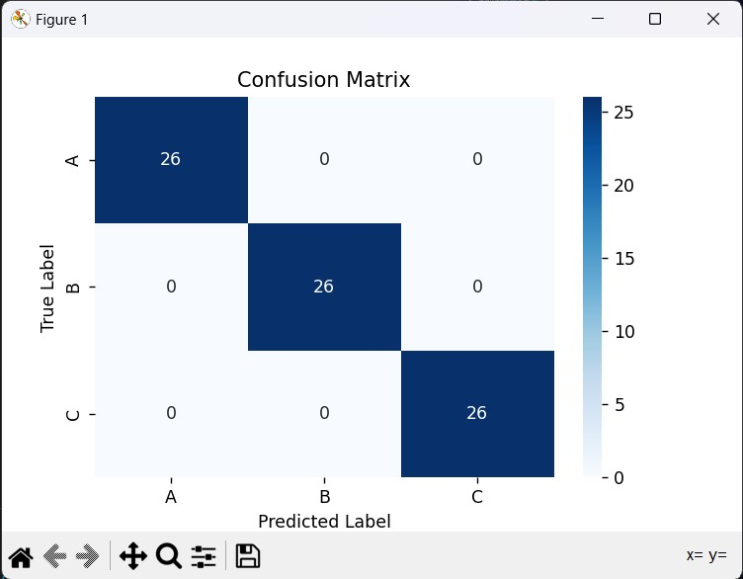
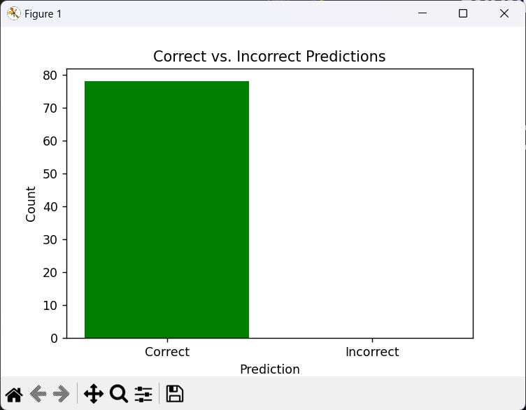
RESULTS

Slide 10
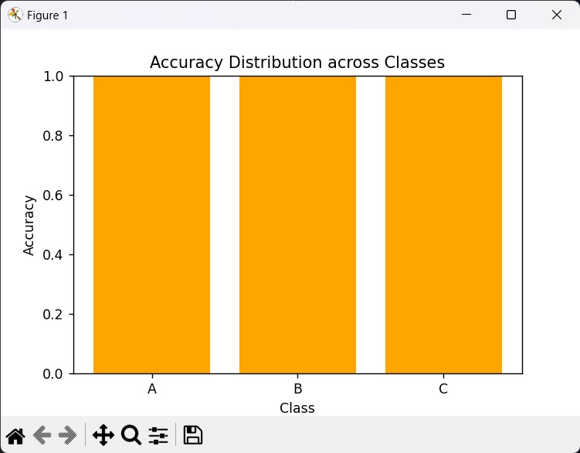
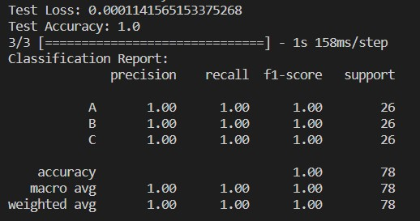
RESULTS (cont..)

Slide 11
TO BE ACHIEVED…
To Develop More Complex Solving Image Model.
Complete Classification Model, With Maximum Accuracy And Minimum Loss.
Automatic Redirection To Completion Page After User Successfully Learns All Hand Signs.

Slide 12
THANK YOU

