Slide 1
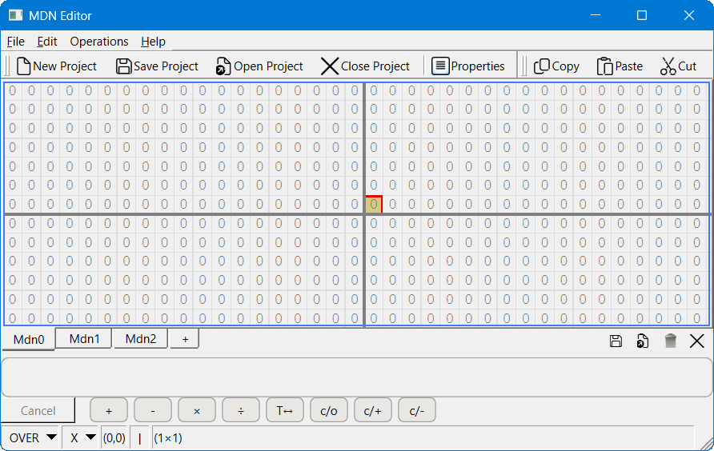
Menu bar
Project toolbar
Edit toolbar
Number Display Grid
Number Selection (Tabs)
(Hover to peek)
Number (Tab) toolbar
Operations toolbar
Status bar

