Slide 1
EXPLORATORY DATA ANALYSIS
HOTEL BOOKING DATA ANALYSIS
PART-1,PART-2
MENTOR: MUNNA PANDEY
SUBMITTED BY :
M.PRIYANKA

Slide 2
HOTEL BOOKING DATA ANALYSIS PART-1
DATA CLEANING
Perform the necessary data cleaning steps to convert messy , unclean data into clean data.
CODE:
df=pd.read_csv(r"Downloads/DS1_C5_S5_Hotel Dataset.csv") #loading the dataset
df.isnull().sum() #Finding the missing values
#Handling Missing Values
df['agent'].fillna(0, inplace=True)
df['company'].fillna(0, inplace=True)
INTERPRETATION:The missing values found in agent and company . And filling with zero.
df.dtypes #Finding the data type
#Correcting Data Types: Convert 'reservation_status_date' to datetime format

Slide 3
df['reservation_status_date'] = pd.to_datetime(df['reservation_status_date’],
format='%d-%m-%Y’)
Handle Duplicate Rows: Drop duplicate rows, if any
df.drop_duplicates(inplace=True)
Standardize Text Data: Standardize the 'meal' column (e.g., replace variations like 'BB' with 'Bed & Breakfast’)
df['meal'] = df['meal'].replace({'BB': 'Bed & Breakfast', 'FB': 'Full Board', 'HB': 'Half Board', 'SC': 'Self Catering', 'Undefined': 'No Meal’})
Displaying the cleaned dataset's information
df.info()
df.head()
INTERPRETATION: From the above determined the data cleaning on dataset.

Slide 4
Booking Pattern Analysis
What are the peak booking periods for the hotel.
CODE:
booking_counts=df.groupby(['arrival_date_year','arrival_date_month']).size().reset_index(name='booking_count’)
month_order = ['January', 'February', 'March', 'April', 'May', 'June','July', 'August', 'September', 'October', 'November', 'December’]
booking_counts['arrival_date_month’]=pd.Categorical(booking_counts['arrival_
date_month'], categories=month_order, ordered=True)
booking_counts=booking_counts.sort_values(['arrival_date_year','arrival_date_month’])
sns.lineplot(data=booking_counts, x='arrival_date_month', y='booking_count', hue='arrival_date_year', marker='o’)
plt.title('Peak Booking Periods by Month and Year', fontsize=14)

Slide 5
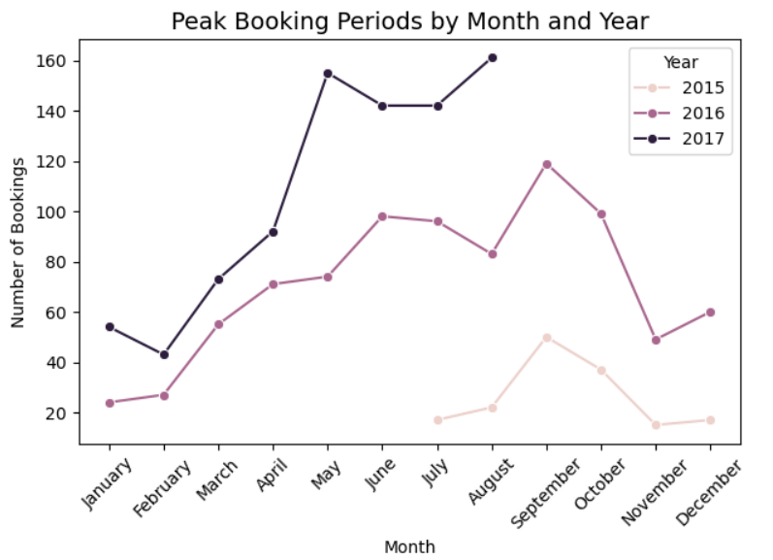
plt.xlabel('Month’) OUTPUT
plt.ylabel('Number of Bookings’)
plt.xticks(rotation=45)
plt.legend(title='Year’)
plt.tight_layout()
plt.show()
INTERPRETATION: From the task analysed the booking columns like arrival_date_year and arrival_date_month to find peak booking periods. And sorted the month to visualize and then I used advanced lineplot for visualization.Peak booking period at the year of 2015 was in the month of May, at the year of 2016 peak booking period was in the month of September and finally at the year of 2017 peak booking period was in the month of September.

Slide 6
Is there a relationship between lead time and the likelihood of a booking being cancelled?
CODE:
plt.figure(figsize=(10, 6))
sns.boxplot(data=df, x='is_canceled', y='lead_time’)
plt.title('Relationship Between Lead Time and Booking Cancellation', fontsize=14)
plt.xlabel('Booking Canceled (0 = No, 1 = Yes)’)
plt.ylabel('Lead Time (Days)’)
plt.tight_layout()
plt.show()
# Calculate the correlation between lead time and booking cancellation
correlation = df['lead_time'].corr(df['is_canceled’])
print(f"Correlation between Lead Time and Cancellation: {correlation:.2f}")

Slide 7
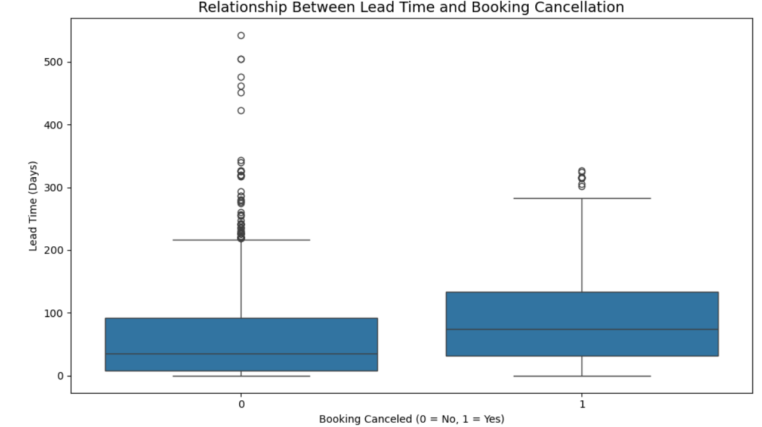
OUTPUT:
Correlation between Lead time and cancellation :0.17
INTERPRETATION:In this task to find the relationship between leadtime and likelihood first I has used both the columns and then I has used corr function to find the relationship and visualized using boxplot.

Slide 8
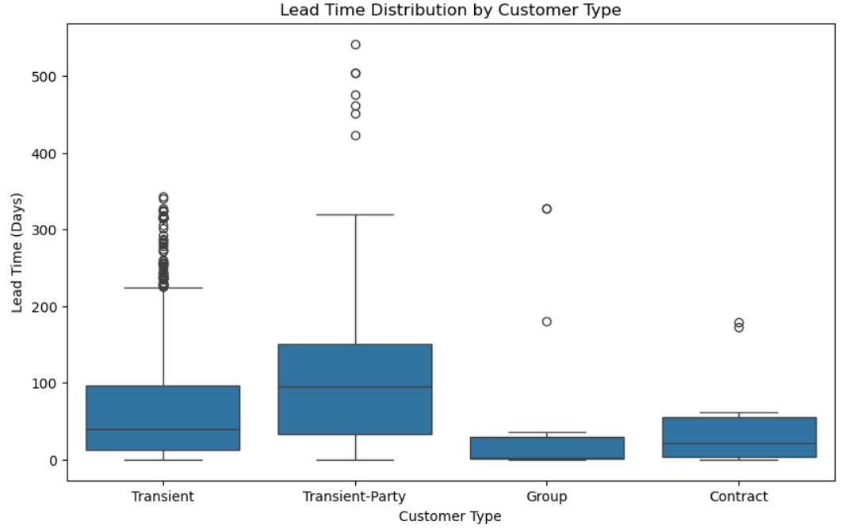
Customer Behavioral Segmentation
Are there distinct patterns in the lead time, special requests, or room preferences for different customer segments?
CODE:
grouped_data=df.groupby('customer_type')[['lead_time','total_of_special_requests']].describe()
# Visualize lead time distribution
plt.figure(figsize=(10, 6))
sns.boxplot(x='customer_type', y='lead_time', data=df)
plt.title('Lead Time Distribution by Customer Type’)
plt.xlabel('Customer Type’)
plt.ylabel('Lead Time (Days)’)
plt.show()

Slide 9
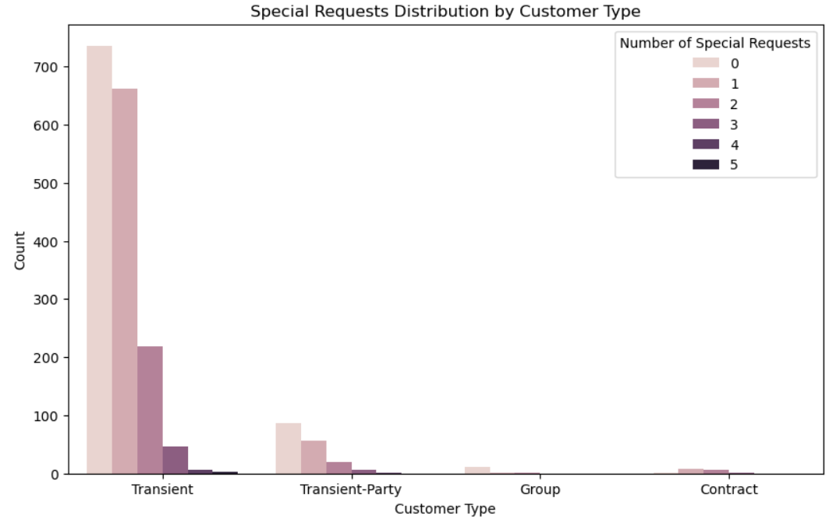
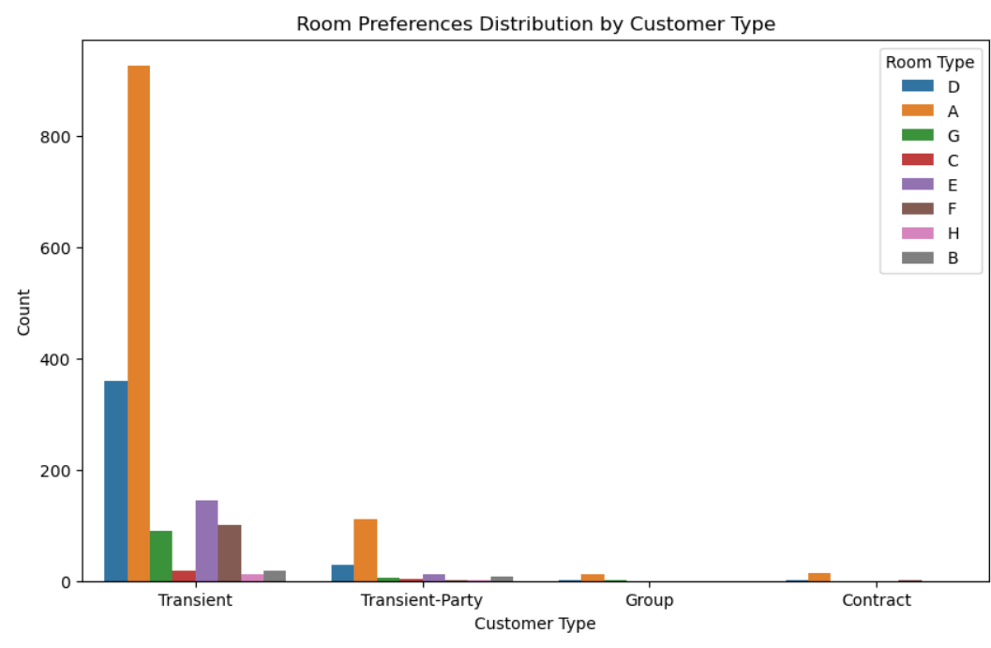
# Visualize special requests distribution
plt.figure(figsize=(10, 6))
sns.countplot(x='customer_type', hue='total_of_special_requests’,
data=df)
plt.title('Special Requests Distribution by Customer Type’)
plt.xlabel('Customer Type’)
plt.ylabel('Count’)
plt.legend(title='Number of Special Requests’)
plt.show()
# Visualize room preferences distribution
sns.countplot(x='customer_type', hue='reserved_room_type’,
data=df)
plt.title('Room Preferences Distribution by Customer Type’)
plt.xlabel('Customer Type’)
plt.ylabel('Count’)
plt.legend(title='Room Type')plt.show()

Slide 10
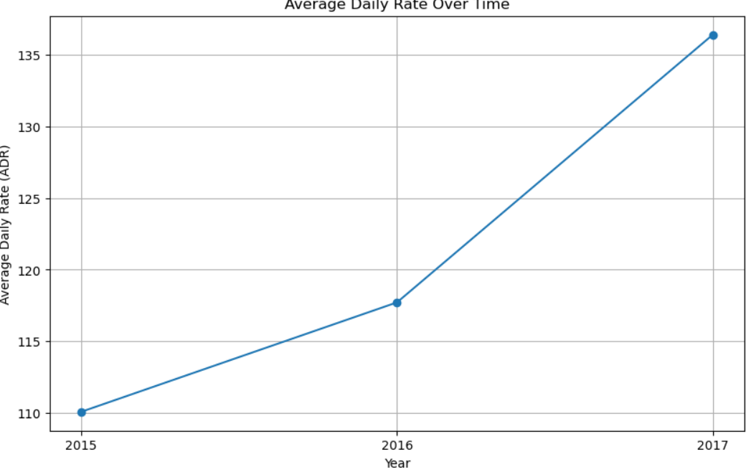
Revenue Management
How does the Average Daily Rate (ADR) vary over time?
CODE:
avg_adr_per_year = df.groupby('arrival_date_year')['adr'].mean()
plt.figure(figsize=(10, 6))
plt.plot(avg_adr_per_year.index, avg_adr_per_year.values)
plt.xlabel('Year’)
plt.ylabel('Average Daily Rate (ADR)’)
plt.title('Average Daily Rate Over Time’)
# Setting x-axis to show only integer year values plt.xticks(avg_adr_per_year.index.astype(int))
Plt.grid(True)plt.show()
INTERPRETATION:In the year 2017 it shows upward trend of average daily rate .

Slide 11
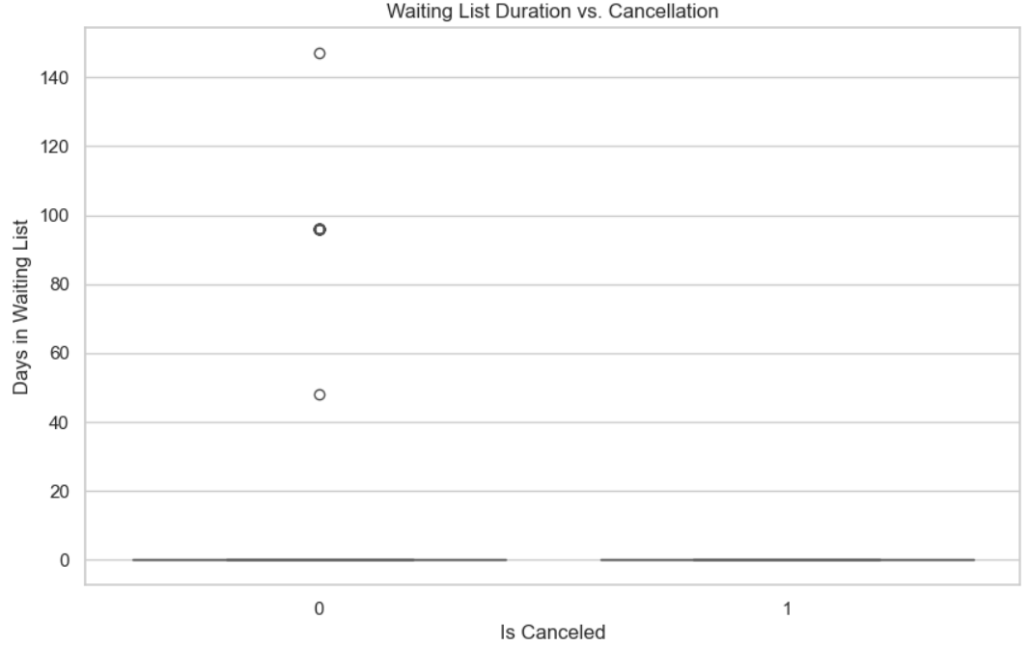
Operational Efficiency
Is there a correlation between the duration a booking remains on the waiting list and the likelihood of cancellation?
CODE:
waiting_list_duration = df['days_in_waiting_list’]
correlation = df[['days_in_waiting_list', 'is_canceled’]]
.corr().iloc[0,1]]
plt.figure(figsize=(10,6))
sns.boxplot(x='is_canceled', y='days_in_waiting_list’,
data=df)
plt.title('Waiting List Duration vs. Cancellation’)
plt.xlabel('Is Canceled')plt.ylabel('Days in Waiting List')plt.show()
# Output the correlation value
Correlation
INTERPRETATION:To find the correlation between duration of booking remains on the waiting list and likelihood of cancellation it shows high negative correlation(-0.06089201752421644).

Slide 12
HOTEL BOOKING DATA ANALYSIS --PART-2
Marketing and Sales Optimization
Which marketing channels and market segments contribute the most to successful bookings?
CODE:
distribution_channel_counts = df['distribution_channel'].value_counts()
market_segment_counts = df['market_segment'].value_counts()
# Plot distribution of bookings by distribution channel
plt.figure(figsize=(10, 6))
sns.barplot(x=distribution_channel_counts.index,y=distribution_channel_counts.values, palette='viridis’)
plt.title('Number of Bookings by Distribution Channel’)
plt.xlabel('Distribution Channel’)
plt.ylabel('Number of Bookings’)
plt.xticks(rotation=45)
plt.show

Slide 13
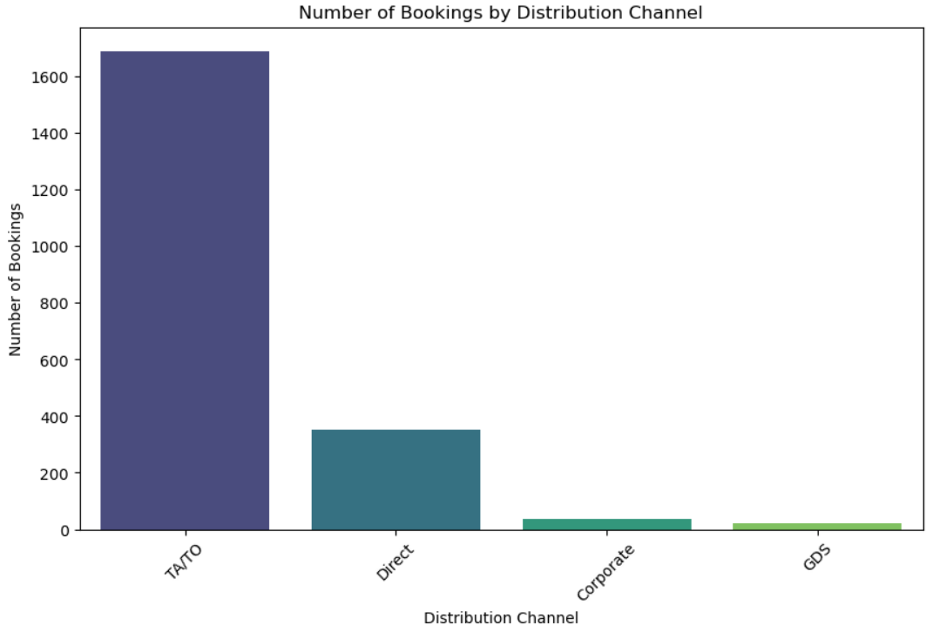
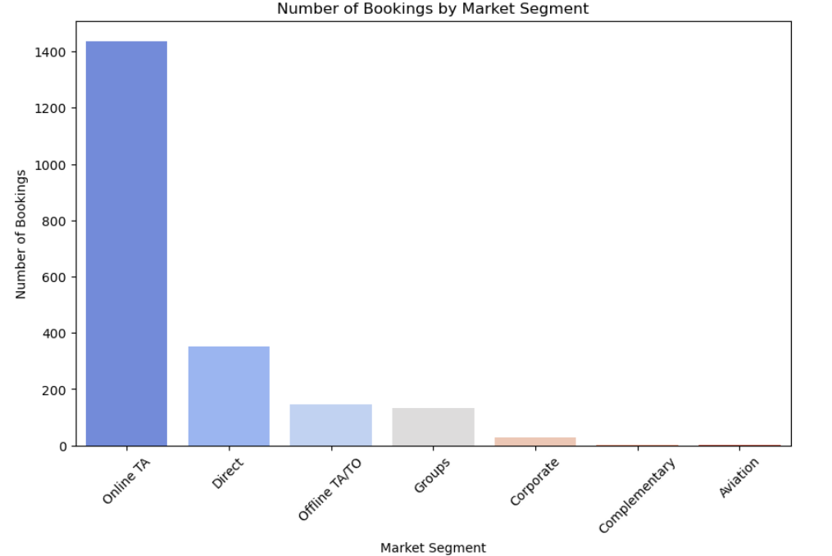
# Plot distribution of bookings by market segment
plt.figure(figsize=(10, 6))
sns.barplot(x=market_segment_counts.index,
y=market_segment_counts.values,)
plt.title('Number of Bookings by Market Segment’)
plt.xlabel('Market Segment’)
plt.ylabel('Number of Bookings’)
plt.xticks(rotation=45)plt.show()
INTERPRETATION: In market channel the TA/TO
has highest bookings . And in market segment the
ONLINE TA has highest successful bokkings.

Slide 14
Conclusion:
In Project Part 1,analyzed the hotel data focusing on booking patterns, booking cancellation rates, and customer behavioral segmentation, revenue management, operational efficiency, loyalty programs, and repeat business.
And performed the data cleaning on the dataset and peak booking periods for hotel and correlation and relationship between the lead time and booking cancellation.
In project part 2 ,analyzed the hotel data focusing on the marketing and sales optimization . And determined the market channel and market segment of highest successful bookings .

Slide 15
THANK YOU

