Slide 1


SIGN LANGUAGE DETECTION
AND
VOICE ASSISTANCE SYSTEM
Course: Machine Learning
Presented by:
Hamza Ali Ahmed
Maruthi V Kamath
Manjushree M R
Prajwal

Slide 2
Introduction
Communication is difficult for people who cannot speak or see.
Mute individuals use hand signs, but most people do not understand them.
Visually impaired people cannot see hand signs at all.
Our system uses a camera + machine learning model to recognize hand signs.
The output is shown as text and also spoken using Text-to-Speech (TTS)

Slide 3
Problem Statement
People who cannot speak use hand signs to communicate, but most people do not understand sign language. Blind people also cannot see these signs. Because of this, it becomes difficult for us to understand mute individuals language. So, we need a device that can look at a hand sign, understand it, and convert it into text and speech to make communication easier for everyone.

Slide 4
GOAL
The main goal of this project is to create an application that can understand hand signs shown to a camera and convert them into text and speech so that everyone can communicate with a person who has disability with speaking so that any disabilities can’t stop communication.

Slide 5
Objectives
To detect hand signs in real time using a camera.
To convert the detected sign into English text so others can understand the message.
To convert the text into speech using Text-to-Speech so visually impaired users can hear the output.
To reduce communication barriers for mute, deaf, and visually impaired individuals.
To provide a low-cost system using open-source tools.
To make communication faster, easier, and more inclusive using machine learning.

Slide 6
Data Collection and its Description
Data Collection & Dataset Description
Collected two ASL datasets from Kaggle
3000 real-world images with variations in lighting, backgrounds, angles, and skin tones.
70 clean black-background images with clear gesture boundaries.
Reduced the larger dataset to 1500 diverse images per category by removing duplicates and low-quality samples.
Combined both datasets to form a balanced, diverse, and representative final dataset suitable for real-world ASL recognition.
The collected dataset included ASL hand signs for all letters A–Z, along with Space and Delete gestures, enabling proper word and sentence formation.

Slide 7
Feature Extraction
Images were passed through Mediapipe, which detects and normalizes hand landmarks.
Ensured only valid frames with clear hand detection were included..
Mediapipe extracted 21 hand landmarks per image.
Each landmark contains x, y, z coordinates.
Total features per image → 63 numerical values.
These features capture hand geometry, finger orientation, and gesture structure.
All extracted features were stored in a CSV file used for training our ML models.

Slide 8
Model Training:
Used 63 landmark features extracted from Mediapipe.
Created a structured CSV dataset for training.
Chose Support Vector Machine (SVM) as the classification model.
Trained using the RBF kernel for handling complex gesture patterns.
Tuned key hyperparameters (C and Gamma) for best accuracy.
Enabled probability=True for confidence scores.
Saved the final trained model as svm_mediapipe.pkl.
Model used for real-time webcam detection.

Slide 9
MODELS TESTED (MODEL SELECTION)
1. KNN
Simple algorithm based on nearest neighbors.
Slow prediction time for large datasets.
Low accuracy due to 63-dimensional feature space.
2. Random Forest
Better accuracy compared to KNN.
Showed signs of overfitting on training data.
Inconsistent predictions for visually similar gestures.
3. SVM (Selected Model)
Best performance among all tested models.
Excellent with numerical, landmark-based datasets.
Strong at separating gestures with small differences.
Fast and stable for real-time webcam detection.

Slide 10
Justification For SVM Selection
Delivered the highest accuracy in our experiments.
Performed consistently across all ASL hand signs.
RBF kernel efficiently handled non-linear hand shapes.
Did not overfit, unlike Random Forest.
More stable and faster than KNN for real-time prediction.
Ideal for structured feature vectors (63 points).
Maintained accuracy even when gestures had minor variations.

Slide 11
Evaluation and Metrics
Model Evaluation
Tested on unseen ASL images to check generalization.
Evaluated with accuracy, confusion matrix, and class-wise performance.
Key Observations
High overall testing accuracy.
Strong stability in real-time webcam inference.
Misclassifications mainly occurred between M and N (very similar landmarks).
Performance Metrics Used
Accuracy Score
Confusion Matrix
Real-Time Responsiveness

Slide 12
Results:
SVM achieved high accuracy in ASL recognition.
Real-time webcam detection worked smoothly.
System produced correct text & speech output
Mediapipe provided consistent and clean landmark features.
System worked reliably under good lighting conditions.
Predicted signs were shown as text on the interface.
Text-to-Speech (TTS) produced clear and correct audio output.

Slide 13
Future Enchancements
Add support for two-hand ASL gestures.
Improve robustness: handle low light, cluttered background, and varied camera angles.
Improve real-time speed & stability.
Build a mobile app (Android/iOS) for easier daily use.
Provide multilingual TTS (Kannada, Hindi, English, etc.).
Train on a larger, more diverse dataset (different skin tones, hand sizes, lighting).
Edge deployment & optimization for small devices

Slide 14
Conclusion
Successfully built a real-time webcam-based ASL sign detection interface.
Used Mediapipe landmarks and SVM for accurate and stable recognition.
System converts detected signs into text and speech for accessibility.
Helps visually impaired users by providing clear audio output.
Works smoothly in real time and is simple, low-cost, and user-friendly.
Provides a strong base for future development into a full ASL translation system.
Overall, the system shows strong potential to reduce communication barriers for hearing, speech, and visually impaired individuals.

Slide 15
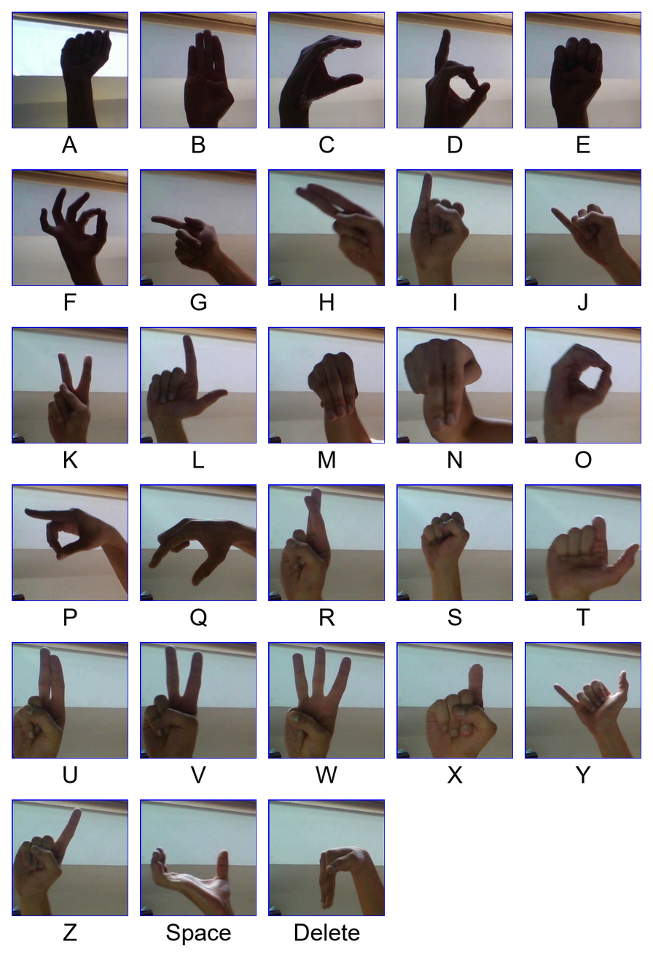

Slide 16
THANK YOU

