Slide 1

Retrieval-Augmented Generation (RAG)
Integrating Retrieval with Generative AI for Accurate and Reliable Systems
Vaishnavi Kompella

Slide 2
Retrieval-Augmented Generation (RAG)
Introduction to RAG
The Necessity of RAG in Modern AI
Understanding RAG Architecture and Components
Diving into RAG's Step-by-Step Workflow
Comparing RAG with Traditional Approaches
Advantages, Limitations, and Security Considerations
RAG vs Finetuning
Real-World Applications and Future Outlook

Slide 3
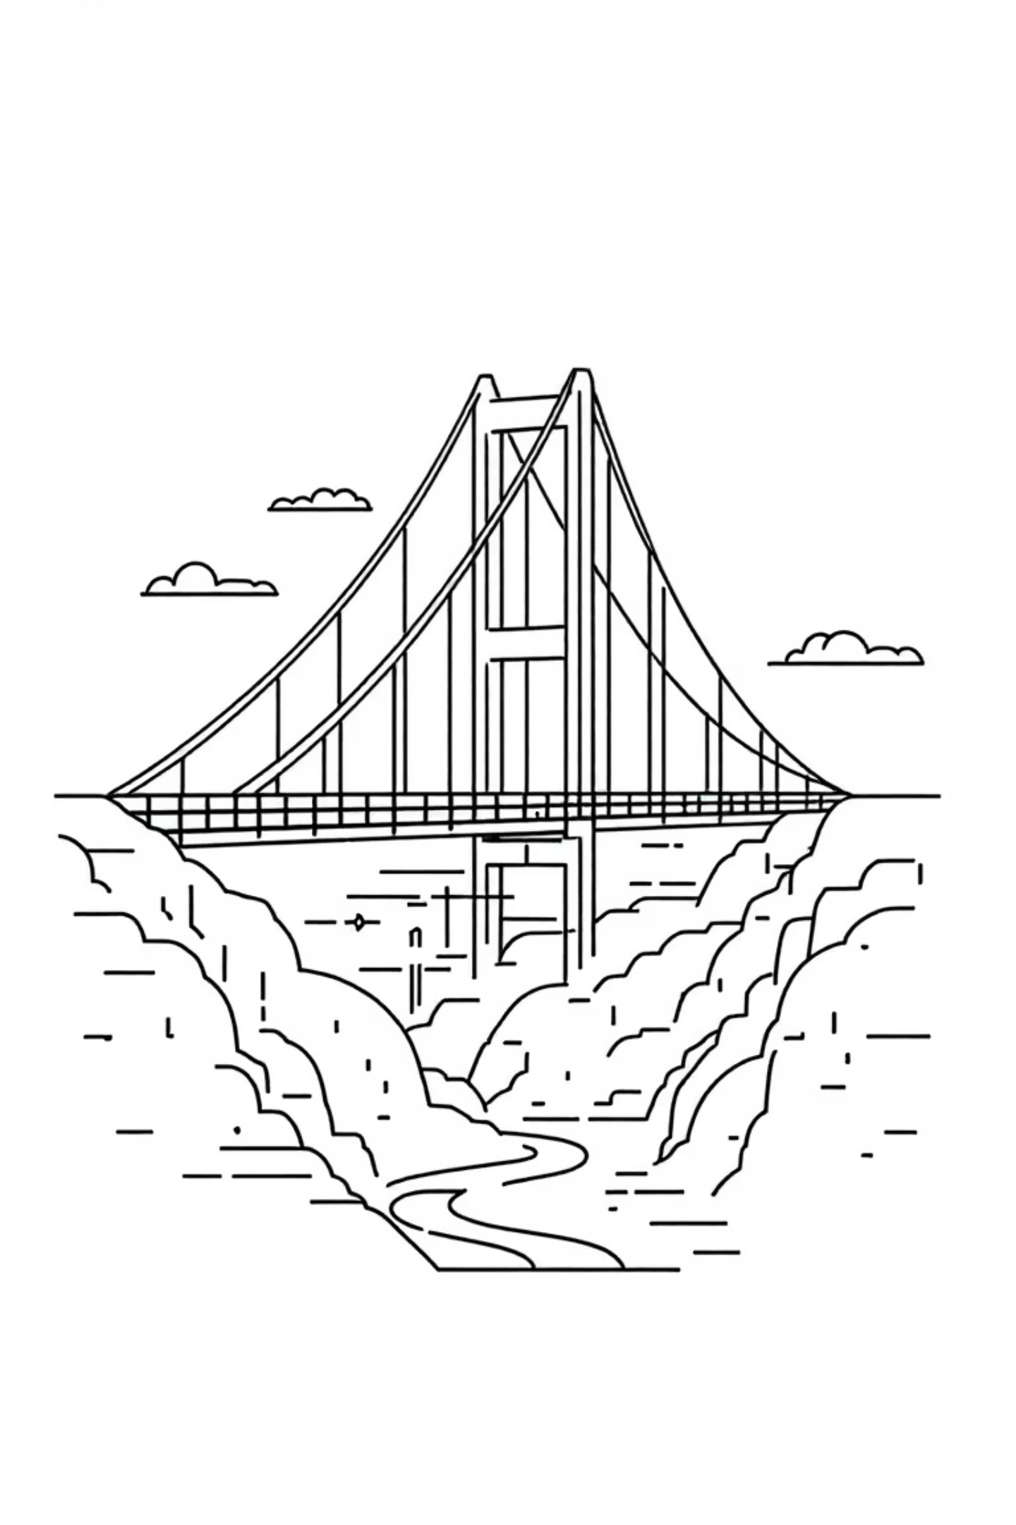
Introduction to Retrieval-Augmented Generation (RAG)
RAG is a ground-breaking hybrid AI architecture that synergizes the power of information retrieval with advanced generative models. Unlike traditional Large Language Models (LLMs) that rely solely on their pre-trained, static internal knowledge, RAG dynamically fetches updated and contextually relevant information from external knowledge bases in real-time.
This innovative approach addresses critical limitations of standalone LLMs, such as hallucinations (generating plausible but incorrect information), outdated knowledge, and a general lack of domain-specific accuracy. RAG effectively acts as a sophisticated bridge between the vast, dynamic world of search engines and the creative, interpretive capabilities of language models.

Slide 4
The Critical Need for RAG
Traditional LLM Challenges
Why RAG is Essential
Static knowledge, quickly outdated.
Provides real-time knowledge access.
High cost and complexity of retraining.
Significantly improves factual accuracy.
Prone to generating fabricated information (hallucinations).
Enables customization with proprietary data.
Difficulty with domain-specific accuracy.
Reduces reliance on expensive, frequent fine-tuning.
RAG emerges as a vital solution, ensuring that AI-generated responses are not only coherent but also factually robust and current, making them invaluable for enterprise-level applications where accuracy is paramount.

Slide 5
The Core Architecture of RAG
RAG’s strength lies in its modular yet integrated design, fundamentally comprising two primary components: the Retriever and the Generator. This dual-system approach allows for context-rich and accurate responses.
The Retriever Module
The Generator Module
This component is responsible for intelligently searching and fetching the most relevant knowledge chunks or documents from a vast external knowledge base. This knowledge base can be anything from internal enterprise documents to publicly available web data, structured databases, or even specialized APIs.
Typically a Large Language Model (LLM), the Generator takes the user's original query and the contextually relevant information provided by the Retriever. It then synthesizes this combined input to formulate a coherent, context-aware, and factually grounded response.
This end-to-end pipeline ensures that the generated output is not only fluent but also highly informed by external, verifiable data sources.

Slide 6
RAG in Action: A Step-by-Step Workflow
Understanding the sequence of operations within RAG clarifies how it delivers superior responses. Each step is crucial for ensuring accuracy and relevance.
01
02
03
User Query Input
Retriever Searches Knowledge Base
Generator Synthesizes Information
The process begins when a user submits a query or prompt to the RAG system.
The Retriever module processes the query and searches a vast vector database to identify and extract the top-k most relevant documents or knowledge chunks.
The Generator (LLM) receives both the original user query and the retrieved relevant documents. It uses this combined context to formulate its response.
04
05
Response Creation
Output Delivery
The LLM generates a coherent, factually checked, and contextually appropriate answer, significantly reducing the risk of hallucinations.
The final, enhanced response is then delivered back to the user.

Slide 7
Key Components Defining RAG
The effectiveness of a RAG system hinges on the robust integration and performance of its core constituent parts.
Retriever: Utilizes advanced techniques like embedding vectors and similarity search, primarily leveraging vector databases (e.g., FAISS, Milvus, Pinecone) to efficiently find relevant information from the knowledge base.
Generator: A pre-trained Large Language Model (LLM), such as variants of GPT, BERT, or T5. Its role is to process the retrieved context alongside the user's query and generate a human-like, coherent, and informed response.
Knowledge Base: A critical repository containing all the external information RAG can draw upon. This can be diverse, encompassing structured data, unstructured text (PDFs, research papers), websites, customer records, or any other relevant enterprise data sources.
End-to-End Pipeline: The seamless integration of these components, orchestrating the flow from query to retrieval, context injection, and final response generation, ensuring a cohesive and high-quality output.

Slide 8


Deep Dive: The Retriever Module
The Retriever is the "search engine" within RAG, crucial for ensuring the quality and relevance of the information fed to the Generator. Its efficiency directly impacts the factual accuracy of the output.
Embedding Vectors
Similarity Search
Knowledge Storage
Converts the user's query into numerical vector representations.
Searches a vector database to find documents with the most similar embeddings.
Knowledge base chunks are also pre-converted to embeddings for rapid search.
Retrieval Techniques:
Dense Retrieval: Relies on deep learning models to create embeddings. Examples include FAISS, Milvus, and Pinecone for efficient similarity search.
Sparse Retrieval: Uses traditional keyword-based methods like BM25 (Best Match 25) or TF-IDF (Term Frequency-Inverse Document Frequency). While less context-aware, they can be highly effective for specific query types.
An efficient Retriever is paramount, reducing the likelihood of irrelevant results and enhancing the overall quality of RAG's output.

Slide 9

Deep Dive: The Generator Module
The Generator acts as the intelligent synthesiser of information, taking the retrieved context and crafting a final, coherent response.
This module is essentially a pre-trained Large Language Model (LLM) that has been fine-tuned for context conditioning. It receives the user's original query and the relevant text chunks retrieved by the Retriever, then combines them to generate the final output.
Key Functions:
Contextual Fluency: Ensures the generated text is natural, coherent, and integrates the retrieved information seamlessly.
Reduced Hallucination: By grounding responses in external data, the Generator significantly minimizes the tendency of LLMs to fabricate information.
Real-time Data Integration: Allows for the inclusion of the most current and specific information available in the knowledge base.
Examples of Generators: Models like T5, BART, and various GPT-based architectures are commonly employed as Generators in RAG systems, each bringing their unique strengths in language understanding and generation.

Slide 10
RAG vs. Traditional LLMs: A Paradigm Shift
Understanding the fundamental differences between RAG and traditional LLMs highlights why RAG represents a significant leap forward in AI capabilities.
Traditional LLMs
Retrieval-Augmented Generation (RAG)
Static Knowledge: Knowledge is fixed at the time of training. Cannot access new information post-training.
Dynamic Knowledge: Accesses and integrates real-time, external information from knowledge bases.
Hallucination Risk: Prone to generating factually incorrect or fabricated information.
Enhanced Accuracy: Significantly improves factual reliability by grounding responses in verifiable sources.
Costly Updates: Requires expensive and time-consuming retraining to incorporate new data.
Efficient Updates: Knowledge updates are as simple as updating the external database, not retraining the entire model.
General Purpose: Often lacks depth for highly specific, domain-centric queries without extensive fine-tuning.
Domain Adaptability: Easily customized to specific industries or proprietary data without full model retraining.
RAG combines the generative power of LLMs with the factual precision of search engines, offering the best of both worlds for robust and reliable AI systems.

Slide 11
RAG Use Cases
Retrieval-Augmented Generation (RAG) is transforming various sectors by enabling AI systems to deliver precise, contextually relevant, and up-to-date information.
Enhanced Customer Support
Internal Knowledge Management
Provides accurate, real-time answers from product manuals, FAQs, and customer data, significantly improving resolution rates and customer satisfaction.
Empowers employees with intelligent search over internal documents, reports, and policies, streamlining operations and boosting organisational productivity.
Scientific & Medical Research
Financial Analysis & Reporting
Facilitates rapid access to the latest research papers, clinical guidelines, and drug information, aiding researchers and healthcare practitioners in critical decision-making.
Offers real-time insights by querying vast repositories of market data, company reports, and financial news, supporting informed investment strategies and compliance.

Slide 12
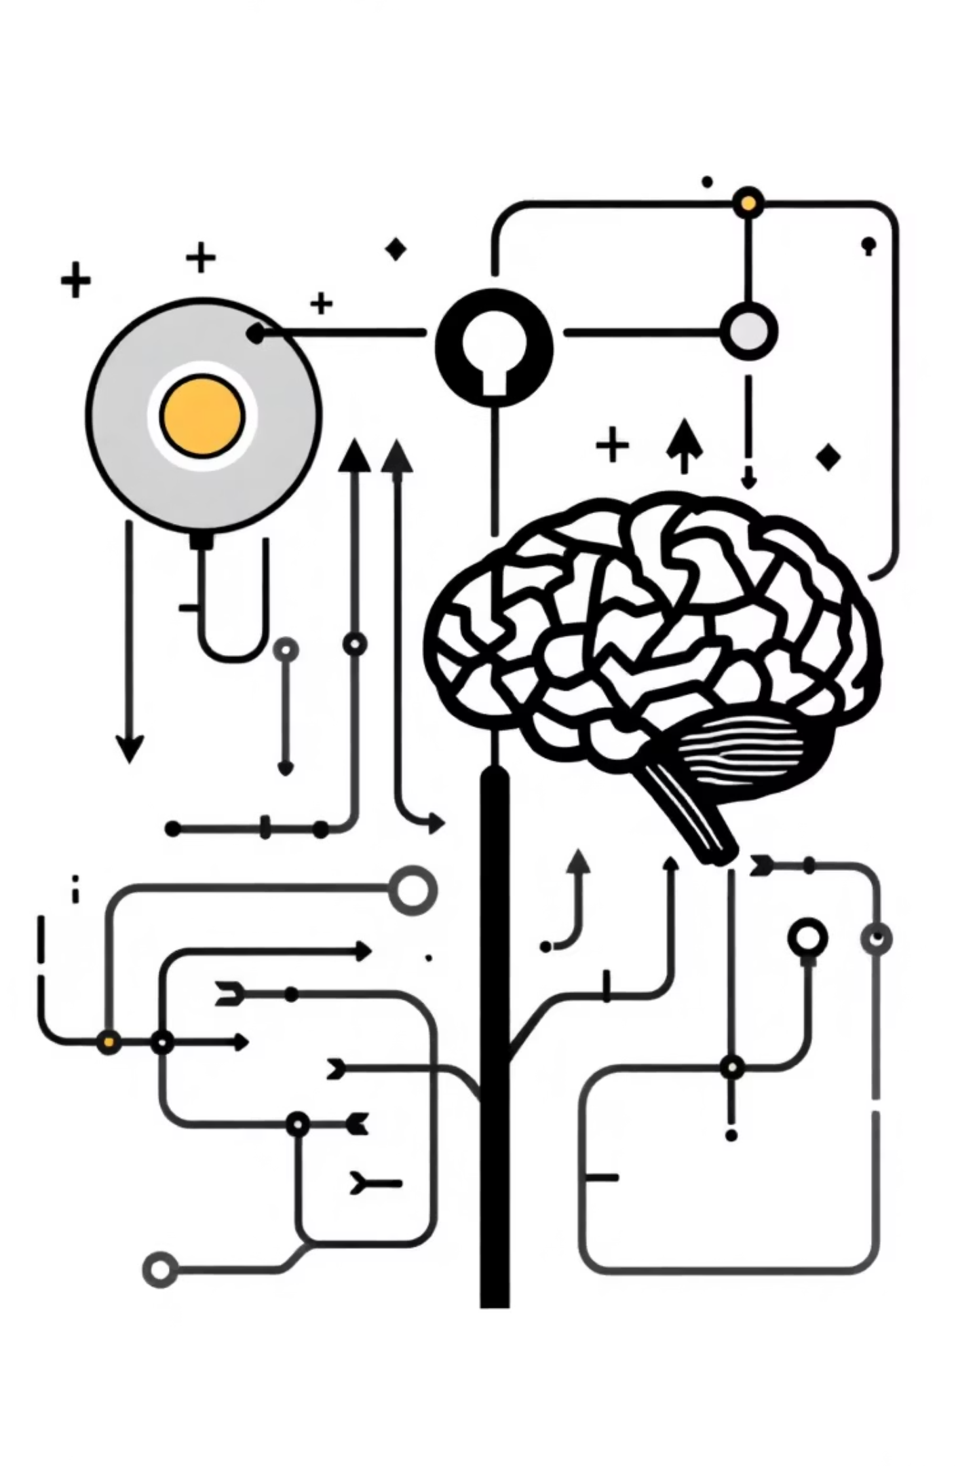
RAG vs. Fine-tuning: A Strategic Comparison
While both Retrieval-Augmented Generation (RAG) and fine-tuning enhance Large Language Models (LLMs), they serve different purposes and offer unique advantages.
Retrieval-Augmented Generation (RAG)
Fine-tuning
Deep Domain Understanding: Adapts the model's internal weights for specific data and tasks.
Dynamic Knowledge: Integrates external, up-to-date information at inference time.
Style & Tone: Teaches the model to adopt a particular voice or format.
Reduced Hallucinations: Grounds responses in verifiable external sources.
Efficiency: No external retrieval step during inference once trained.
Cost-Effective Updates: Knowledge base updates don't require model retraining.
Task Specificity: Excels in highly specialised tasks with limited external context.
Traceability: Provides clear citations for generated content.
Choosing between RAG and fine-tuning, or combining both, depends on the specific application's need for real-time data, factual accuracy, and domain specialisation.

Slide 13
Security Concerns of RAG
While Retrieval-Augmented Generation (RAG) significantly enhances LLM capabilities, it also introduces unique security challenges that demand careful consideration and robust mitigation strategies.
Data Privacy & Leakage
Data Poisoning & Integrity
RAG systems retrieve information from diverse data sources, increasing the risk of inadvertently exposing sensitive or proprietary data if not properly secured, leading to potential compliance and privacy breaches.
The external knowledge base, if compromised, can be poisoned with malicious or inaccurate information. This directly impacts the RAG system's output, leading to false, biased, or harmful generations.
Prompt Injection Vulnerabilities
Source Veracity & Misinformation
Malicious users can craft prompts designed to manipulate both the retrieval and generation components, forcing the RAG system to bypass safeguards, reveal confidential data, or generate unintended responses.
If the RAG system retrieves information from unreliable or unverified sources, it can inadvertently propagate misinformation, fake news, or unscientific claims, undermining trust and factual accuracy.
Addressing these concerns is paramount to ensure the responsible and secure deployment of RAG systems in critical applications.

Slide 14
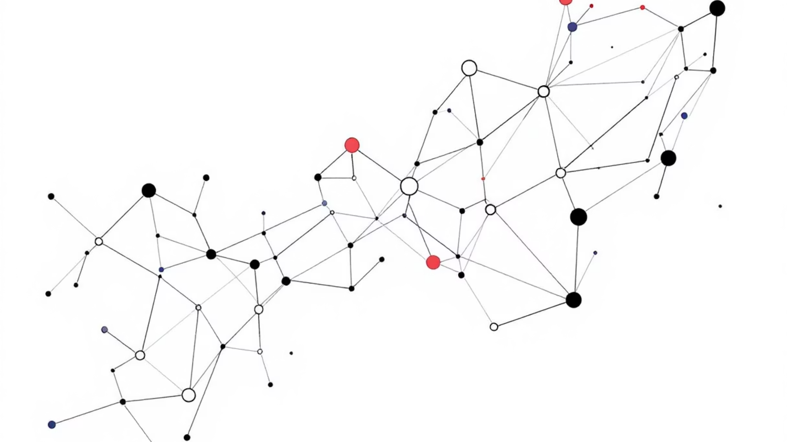
Thank You

