Slide 1

SIDDAGANGA INSTITUTE OF TECHNOLOGY
Department of Computer Science
Project title: Mapping Co's to po’s using nlp
Batch id: b7
Project associates: L Maruthi Kiran (1si20cs052)
Raghavendra urs H R (1si20cs086)
Yoganandini J (1si20cs138)
Guide : Dr. Srinivasa k ph.D.

Slide 2
AGENDA
1. Introduction to the project
2. Motivation for the project
3. Literature Survey
4. Problem Statement
5. Objectives
6.System architecture
7. High Level Design
8. Tools and Platform
9. Implementation
10. Result, comparison study and snapshots
11. Conclusion
12. References

Slide 3
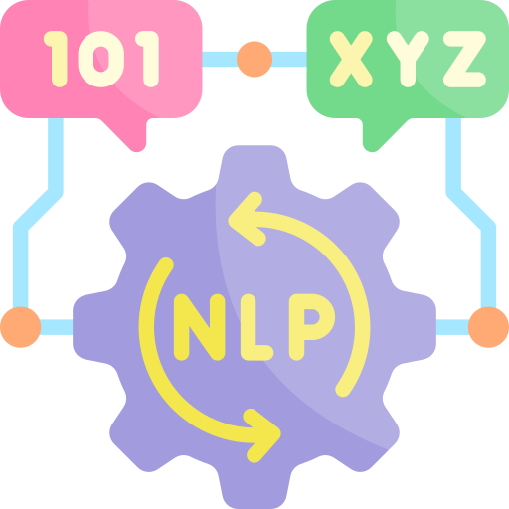
INTRODUCTION
Mapping Of Course Outcome (CO) to Program Outcome (PO) using NLP.
This process can facilitate the identification of overlapping or missing content, the assessment of program effectiveness, and the improvement of learning outcomes.
Makes the Curriculum design Easier.
Provide a framework for curriculum development and evaluation, as well as support the accreditation and quality assurance processes.
0, 1 and 2 indicates the level of matching.
Efficiency of the Model.

Slide 4
MOTIVATION
Curriculum design: By mapping course outcomes to program outcomes, it can help to ensure that the curriculum is aligned with the overall goals and objectives of the program.
Assessment and evaluation: By aligning course outcomes with program outcomes, it can help to assess student performance and evaluate the effectiveness of the program.
Accreditation: Many accreditation bodies require that institutions demonstrate alignment between course outcomes and program outcomes as part of the accreditation process.
Program improvement: By mapping course outcomes to program outcomes, it can help to identify areas where the program may need improvement and make changes accordingly. • Automation: Currently mapping is done manually but it can be automated using NLP.

Slide 5
LITERARY SURVEY
Study | Focus | Method | Key Findings
Study1 | Comparing the Performance with other popular NLP Libraries | spaCy | Spacy outperformed the other libraries on most of the tasks.
Study2 | Sentence Detection | spaCy | Sentence detection allows you to divide a text into linguistically meaningful units.
Study3 | Strength and Efficiency | spaCy | Spacy's strengths as its efficiency, ease of use, and support for multiple languages.
Study4 | Next Sentence Predictions | BERT/Word Embeddings | Model receives pairs of sentences as input and learns to predict if the second sentence in the pair is the subsequent sentence in the original document.
Study5 | Distributional approach | BERT/Word Embeddings | This can be useful for identifying related words and topics in a text, as words that appear in similar contexts will have similar vector representations.

Slide 6

PROBLEM STATEMENT
To implement a system that can automatically map course outcomes to program outcomes , analyze the language used in both the course and program outcomes and identify the most relevant keywords and concepts as well as to improve the time efficiency , consistency and accuracy.

Slide 7

OBJECTIVES
The project has the following specific objectives:
OBJECTIVE 1:
Develop an NLP model that can accurately map course outcomes to program outcomes: The model should be able to process large volumes of textual data and identify the most relevant concepts and keywords that indicate the relationship between the course outcomes and program outcomes.
OBJECTIVE 2:
Assess the generalizability and scalability of the proposed approach : The developed NLP model will be evaluated on a range of courses and programs from different disciplines to assess its ability to be generalized across different domains. The scalability of the model will also be examined to evaluate its ability to handle a large volume of data and support a wide range of educational programs as well as improves time efficiency and accuracy of Mapping Process.

Slide 8
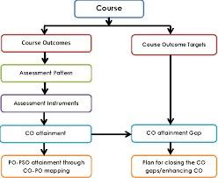
System Architecture

Slide 9
HIGH LEVEL DESIGN
Mapping course outcomes to program outcomes is an important process in designing an effective curriculum. The goal of this process is to ensure that individual courses align with the overall goals of the program and that students are adequately prepared for the workforce or further education.
Here are the high-level steps for mapping course outcomes to program outcomes:
Identify program outcomes: Start by identifying the desired outcomes for the program as a whole. These might include skills, knowledge, and competencies that students should have upon completion of the program.
Identify course outcomes: For each course in the program, identify the specific outcomes that students should achieve. These outcomes should be based on the content and objectives of the course.
Evaluate course outcomes: Once we have identified course outcomes, evaluate each one to determine how it aligns with the program outcomes. Look for areas of overlap and identify any gaps that need to be addressed

Slide 10
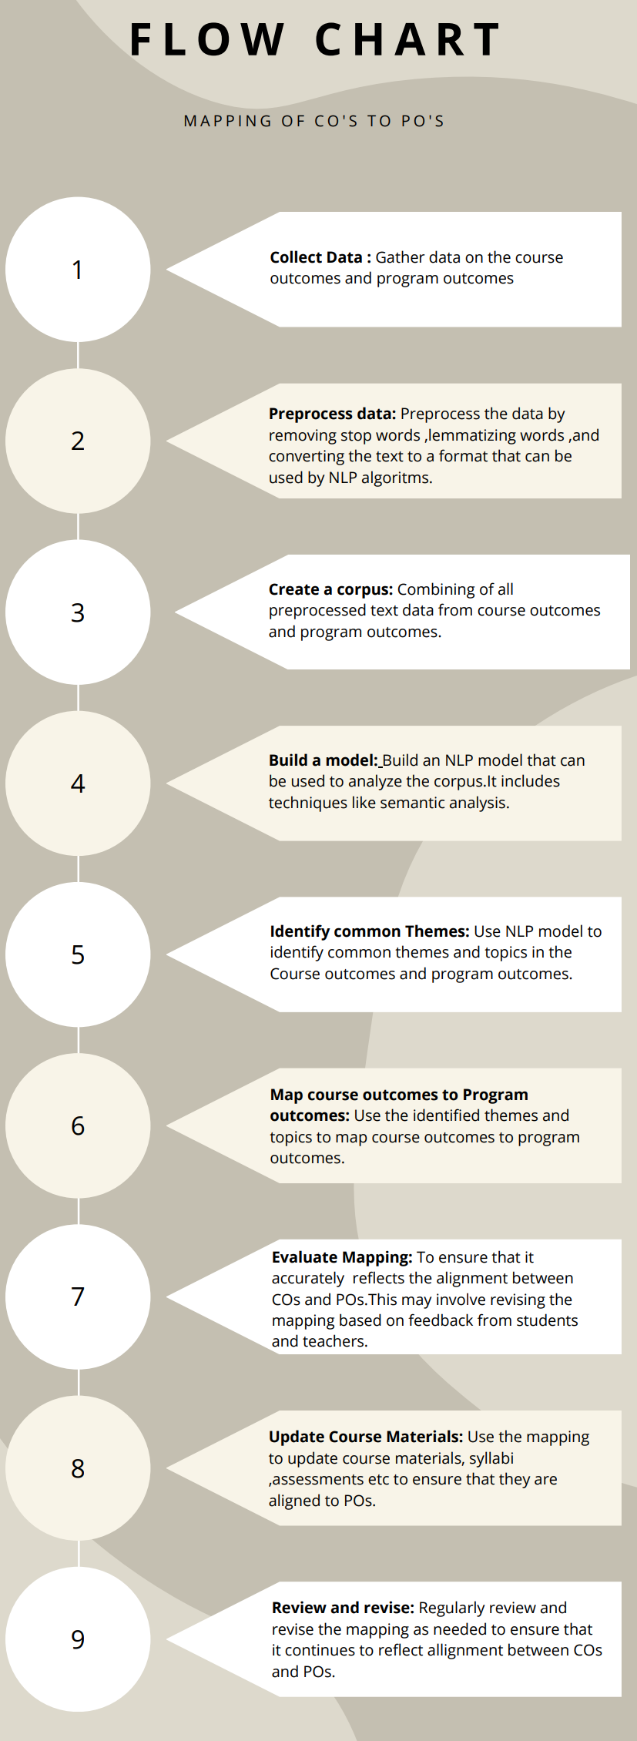
Revise course outcomes: If necessary, revise the course outcomes to better align with the program outcomes. This may involve modifying the course content or objectives.
Develop assessments: Develop assessments that measure the achievement of both course outcomes and program outcomes. These assessments should be aligned with the course content and objectives and should provide evidence of student learning.
Implement and evaluate: Implement the revised course outcomes and assessments, and evaluate their effectiveness. Use the results to make further revisions as necessary.
By following these steps, we can ensure that each course in the program contributes to the overall goals of the program, and that students are adequately prepared for their future endeavors.

Slide 11


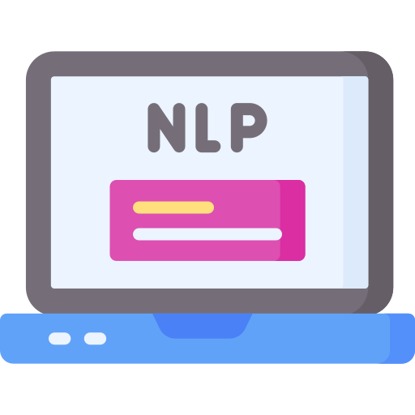
TOOLS AND PLATFORM
spaCy is a free open-source library for Natural Language Processing in Python.
Among the plethora of NLP libraries these days, spaCy really does stand out on its own.
The factors that work in the favor of spaCy are the set of features it offers, the ease of use, and the fact that the library is always kept up
to date.
Language modeling techniques like BERT/Word Embeddings.
BERT (Bidirectional Encoder Representations from Transformers) is a powerful natural language processing (NLP) model that can be
used for a wide range of tasks, including text classification, question answering, and sentiment analysis, among others.
Anaconda:
Anaconda is a distribution of the Python and R programming languages for scientific computing (data science, machine learning
applications, large-scale data processing, predictive analytics, etc.), that aims to simplify package management and deployment.

Slide 12
Implementation
Word Doc
Doc2txt lib
Preprocessing
Count Vectorizer
Cosine Similarity
Thresholding
Accuracy

Slide 13
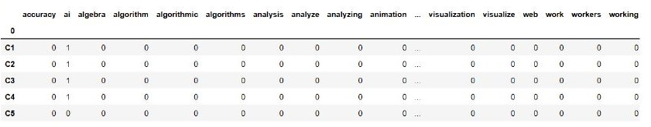
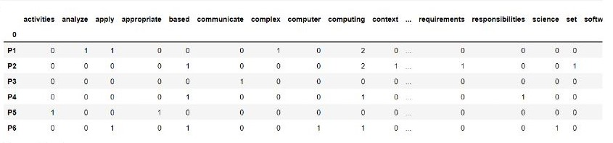
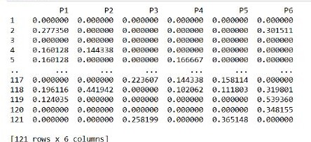
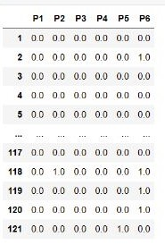
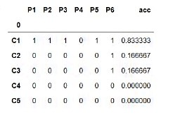
Results and snapshots

Slide 14

CONCLUSION
Mapping course outcomes to program outcomes using natural language processing is a valuable tool that can help to enhance the alignment, assessment, and improvement of learning outcomes. By utilizing natural language processing, this process can facilitate the identification of areas for improvement, provide a framework for curriculum development and evaluation, and support accreditation and quality assurance processes. The study's findings will be valuable for universities and educational institutions, as it will provide a new and innovative approach to curriculum design and assessment. Overall, this approach can lead to more effective and efficient educational programs that better meet the needs of students and society.

Slide 15
References
Alshanqiti, A., Tanweer A., Mohamed B., Abdallah, N., and Ahmad T. (2020). A Rule based Approach toward Automating the Assessments of Academic Curriculum Mapping. International Journal of Advanced Computer Science and Applications (IJACSA), 11, 12.
Shafi, A., et al. (2019). Student Outcomes Assessment Methodology for ABET Accreditation: A Case Study of Computer Science and Computer Information Systems Programs. IEEE Access, 7, 13653- 13667.
Ujkani, B., Minkovska, D., and Stoyanova, L. (2021). Using Natural Language Processing for Quality Assurance Purposes in Higher Education. IV International Conference on High Technology for Sustainable Development (HiTech), (pp. 01-04). doi:10.1109/HiTech53072.2021.961420.
Vajjala, S., Majumder, B., Gupta, A., and Surana H. (2020). Practical Natural Language Processing. O’Reilly Media, Inc. Watson, S., Steketee, C., Mansfield, K., Moore, M., Dalziel, B., Damodaran, A., Walker, B., Duvivier, RJ., and Hu, W. (2020). Curriculum mapping for health pro fissions education: A typology. Focus on Health Professional Education, 21(1), 91-113.
Winkler, W. E. (1990). String Comparator Metrics and Enhanced Decision Rules in the FellegiSunter Model of Record Linkage. Proceedings of the Section on Survey Research Methods, (pp. 354–359).
Plaza, C. M. , Draugalis, J. R. , Slack, M. K., Skrepnek, G. H., and Sauer, K. A. (2007). Curriculum mapping in program assessment and evaluation. American Journal of Pharmaceutical Education, 71(2). scikit learn Machine Learning in Python. (n.d.). Retrieved July 16, 2022, from https://scikit-learn.org/stable/.
Devlin, J., Chang, M., Lee, K., and Toutanova, K. (2018). BERT: Pre training of Deep Bidirectional Transformers for Language Understanding. arXiv.
Automating the Mapping of Course Learning Outcomes to Program Learning Outcomes using Natural Language Processing for Accurate Educational Program Evaluation. Posted Date: October 24th, 2022

Slide 16
THANK YOU

