Slide 1

CS5242 Tutorial 1
Introduction to PyTorch

Slide 2
What is Pytorch
PyTorch is a Python-based scientific computing package serving two broad purposes:
A replacement for NumPy to use the power of GPUs and other accelerators.
An automatic differentiation library that is useful to implement neural networks.

Slide 3

Before Installing PyTorch
If you are using servers or you own PC:
Virtual environment with conda highly recommended.
Easier package management (avoiding conflict).
Easier for others to build the environment of your projects.

Slide 4
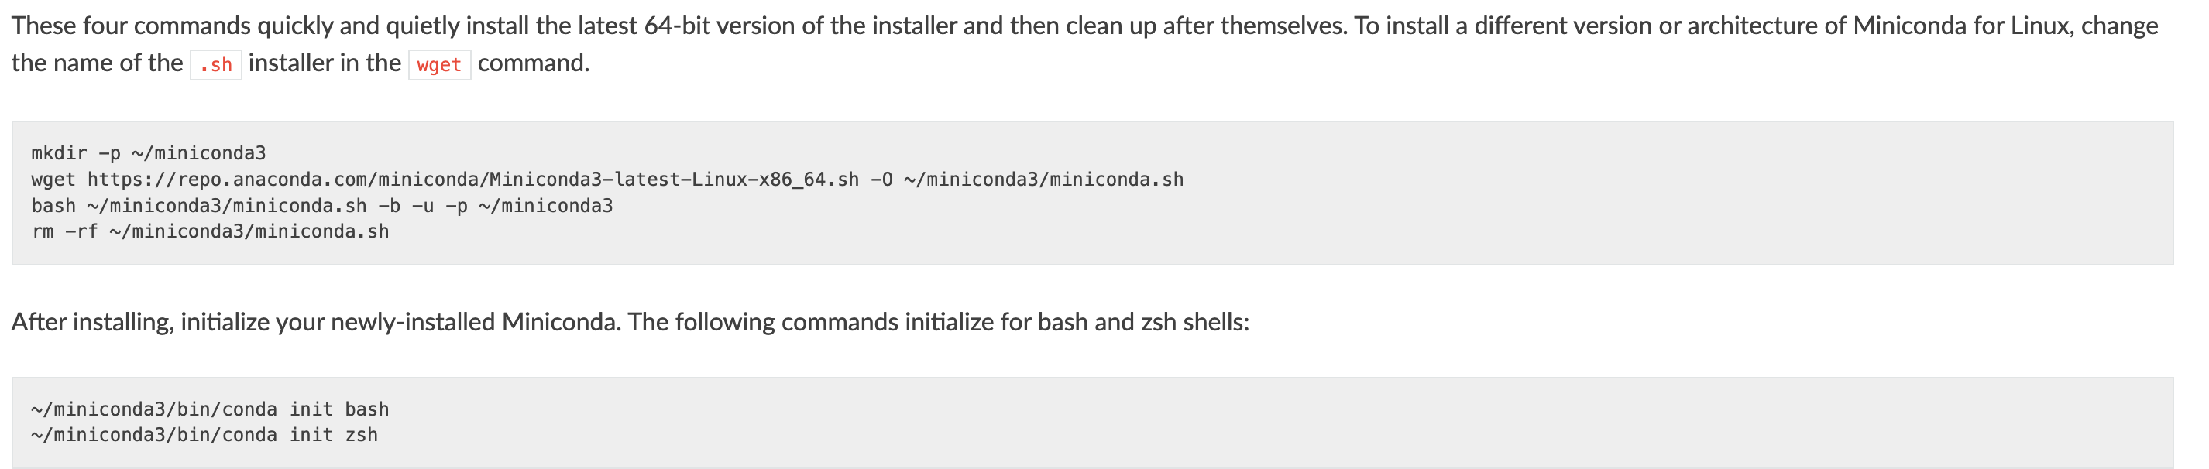
Installing Miniconda
Miniconda is a minimal installer provided by Anaconda.
Lighter, need to install most packages yourself.

Slide 5
Using Miniconda
Create an environment:
conda create -n CS5242 python=3.8
Activate your environment:
conda activate CS5242
Exit the environment:
conda deactivate

Slide 6
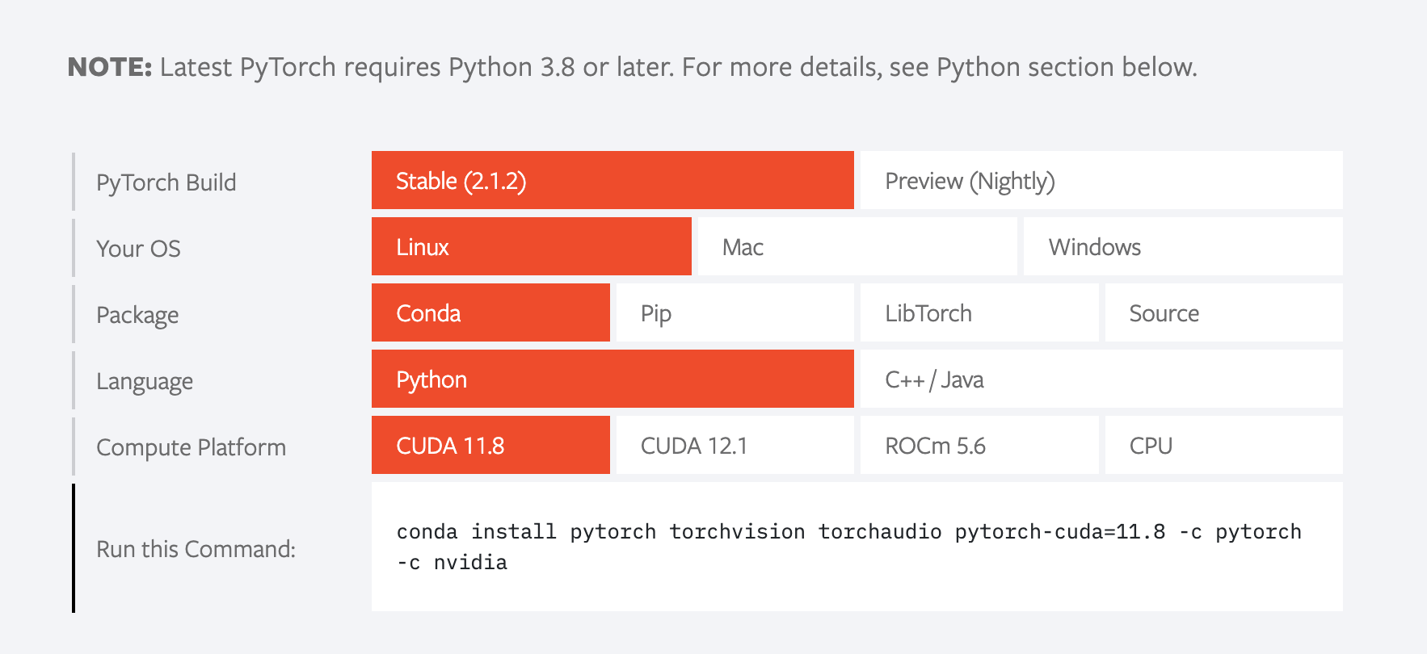
Installing PyTorch
Install using the command on Torch Website:

