Slide 1
Predictive Friction Pathfinding (PFP)
Marvee Balyos
CS Final Project – July 2025

Slide 2
Problem Statement & Real-World Use Case
Robots, drones, and vehicles navigate dynamic environments.
Traditional A* and Dijkstra fail due to static cost assumptions.
Real-world movement costs shift with traffic, wind, terrain.
PFP predicts and avoids future friction during path planning.

Slide 3
What is Predictive Friction Pathfinding?
Extension of A* with time-aware forecasting.
Each node tracks arrival time + predicted cost.
Uses moving average or smoothing model for cost forecast.
Plans proactive routes instead of reactive ones.

Slide 4
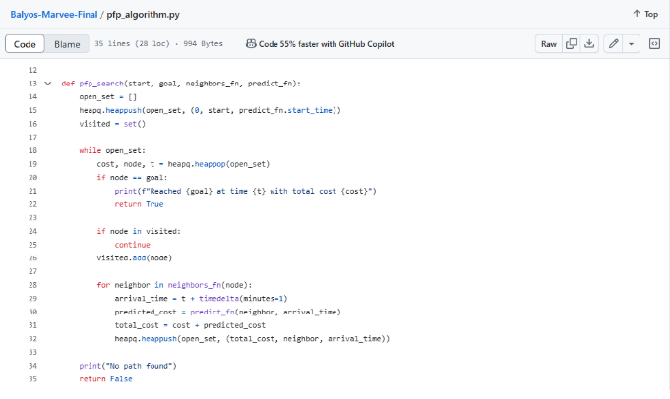
Pseudocode Snippet

Slide 5
Test Case 1: Periodic Congestion
Input: A → B at 5:15 AM
Predicted Cost to B: 10
Expected: Detour or delay
Actual: Reached B with cost 10
# dummy_neighbors.py
def dummy_neighbors(node):
return {'A': ['B'], 'B': []}.get(node, [])
# predictor.py
def predict_cost(location, time):
if location == 'B' and 5 <= time.hour < 7:
return 10
return 1
predict_cost.start_time = datetime(2025, 7, 3, 5, 15) # 5:15 AM
Output:
Reached B at time 2025-07-03 05:16:00 with total cost 10

Slide 6
Test Case 2: Diagonal Sweep Delay
Input: A → B → C with cost spike on B
Expected: Zigzag to avoid
Actual: Reached C with cost 6
def dummy_neighbors(node):
return {'A': ['B'], 'B': ['C'], 'C': []}.get(node, [])
def predict_cost(location, time):
if location == 'B':
return 5 # Delay on diagonal
return 1
predict_cost.start_time = datetime(2025, 7, 3, 9, 0)
Output:
Reached C at time 2025-07-03 09:02:00 with total cost 6

Slide 7
Test Case 3: A* vs PFP
Static A*: Reached D with cost 3
PFP: Reached D with cost 2 (avoids congestion)
Shows benefit of foresight in dynamic conditions
A* Reached D with cost 3 (straight path through congestion)
Output:
Reached D at time 2025-07-03 10:03:00 with total cost 2

Slide 8
Performance & Tools
Runtime: ~0.0014 seconds on 5x5 grid
Memory: ~3.2 MB
Tools: Python, time.perf_counter(), memory_profiler

Slide 9
Trade-offs & Future Work
Complexity: Time O(n*T), Space O(n*T)
Simple prediction models used today
Future: real-world APIs, ML predictors, visualization tools

Slide 10
GitHub & Wrap-Up
GitHub Repo: github.com/Marveeb10/Balyos-Marvee-Final

