Slide 1






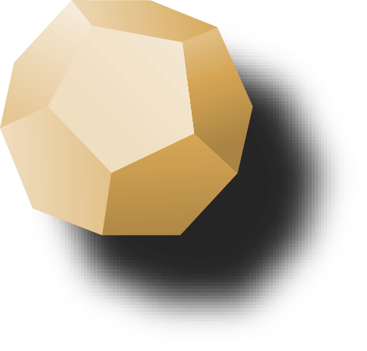
Final Talks Week 12: By Oracle

Slide 2
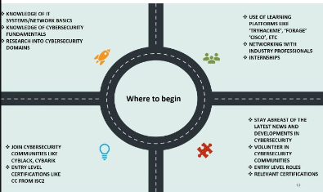
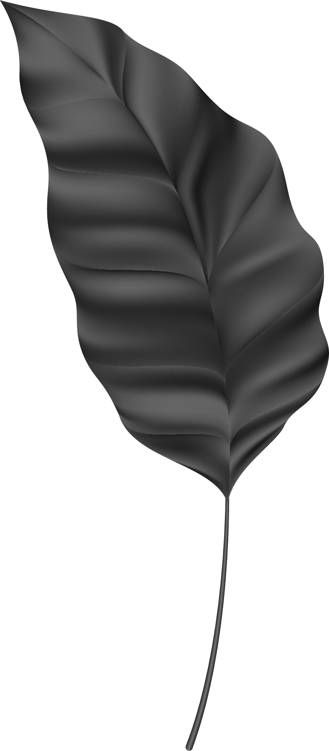
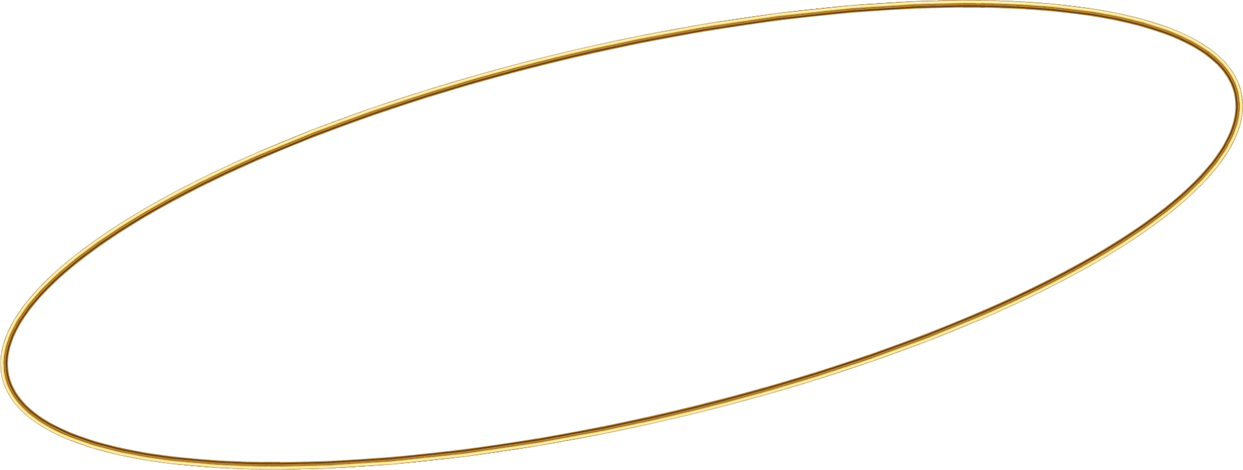


How do applications work?
Applications are collections of code that allow users to perform specific tasks, interact with data, and connect with other systems.

Slide 3
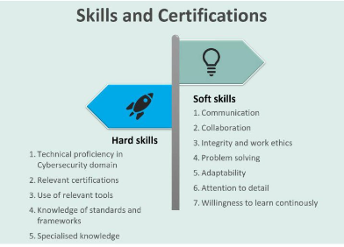

Slide 4
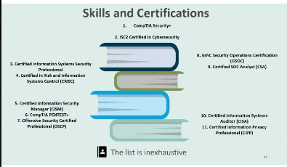
How do applications work?
Applications are collections of code that allow users to perform specific tasks, interact with data, and connect with other systems.

Slide 5
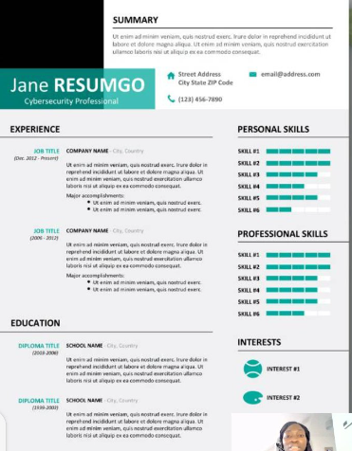

Slide 6


Slide 7
Thanks!
Do you have any questions?
amosmarvellous48@gmail.com
+234 702 625 4613

