Slide 1
Essential Tools and programming languages
Week 3: What have you learnt so far?

Slide 2
?
Last weeks review

Slide 3
Team Divisions
MERCURY
MARS
JUPITER
VENUS
SATURN
Back Wing
Left Wing
Center Wing
Right Wing
Forward Wing

Slide 4
As a group, formulate one scenario for technical (A, B) and administrative (D, E) controls
Oracle’s Group Assignment Review

Slide 5
At the end, you should:
CYBER
Demonstrate a basic understanding of programming concepts commonly used in cybersecurity.
Write simple scripts in Python to perform basic cybersecurity tasks
Analyse the advantages and limitations of different tools and propose the most appropriate tool for a given task.
CYBER
FUTURISTIC
SECURITY

Slide 6
Programning Languages
01

Slide 7
Python
Python is considered to be a general-purpose language.
This means that it can create a variety of different programs, and it is not limited to a specialized in any particular problem in fields such as web development and artificial intelligence.
Python is typically used to build websites and perform data analysis
In security, the main reason we use Python is to automate tasks

Slide 8
Python
Automation is the use of technology to reduce human and manual effort to perform common and repetitive tasks.
Python is generally best for automating short, simple tasks.
For example, an analyst might use Python to manage an access control list, the list that controls who can access the system and its resources. It would be potentially less consistent if the analysts had to manually remove an employee's access every time they left the company. However, a Python program can periodically monitor this instead.

Slide 9
Advantages
Readability and Simplicity: Python's clean syntax and easy-to-understand structure make it accessible to security professionals, even those without a strong programming background.
Extensive Libraries and Frameworks: Python offers a vast ecosystem of libraries and frameworks specifically designed for security tasks, such as Scapy for network packet manipulation, nmap for network scanning, and Beautiful Soup for web scraping.
Community and Support: Python has a large and active community, providing ample resources, tutorials, and forums for learning and troubleshooting.
Versatility: Python can be used for various security tasks, from vulnerability scanning and penetration testing to malware analysis and incident response.

Slide 10
Programming with Purpose
02
Python Syntax Overview

Slide 11
Python
Programming involves a lot of design decisions
In Python, it's good practice to start with a comment.
A comment is a note programmers make about the intention behind their code.

Slide 12
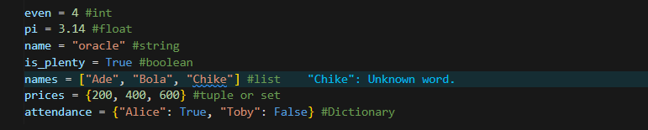
Python
A data type is a category for a particular type of data item

Slide 13
Best Practices
You can name a variable almost anything you want, but there are a few guidelines you should follow to ensure correct syntax and prevent errors:
Use only letters, numbers, and underscores in variable names.
E.g. date_3, username, interval2
Start a variable name with a letter or underscore. Do not start it with a number.
E.g. time, _login
Remember that variable names in Python are case-sensitive.
E.g. time, Time, TIME, timE.
Don't use Python’s built-in keywords or functions for variable names.
Variables shouldn't be named True, False, or if.

Slide 14
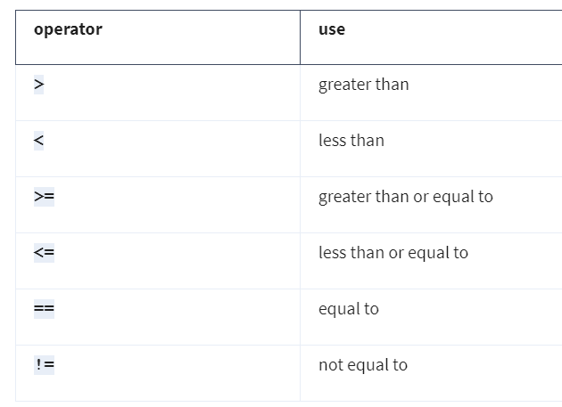
Conditionals
A conditional statement is that which checks code to determine whether it meets a specific set of conditions.
When a condition is met, it evaluates to a Boolean value of True.
When the condition isn’t met, it evaluates a Boolean value of False.

Slide 15
Conditionals
The keyword if starts a conditional statement
The keyword else is used only when all conditions preceding it within the conditional statement are evaluated as False.
The elif keyword precedes a condition that is only evaluated when previous conditions evaluate as False.

Slide 16
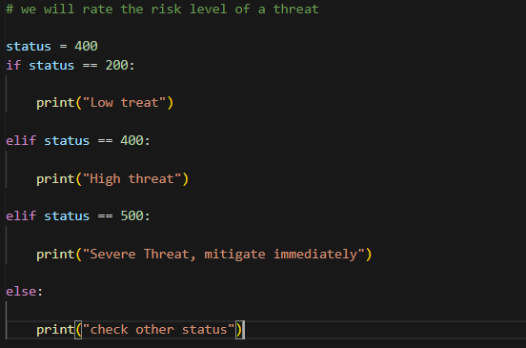
Conditionals

Slide 17
Iterations
An iterative statement is code that repeatedly executes a set of instructions.
Depending on the criteria, iterative statements execute zero or more times.
We iterated through code using both for loops and while loops.

Slide 18
For Loop Interation
If you need to iterate through a specified sequence, you should use a for loop.

Slide 19
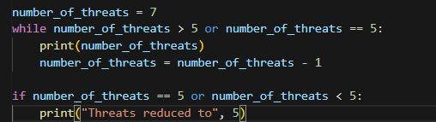
While Loop Interation
If you want a loop to iterate based on a condition, you should use a while loop.

Slide 20

Fun fact!!!
Strings are also lists and can be iterated through.

Slide 21
Functions
A function is a section of code that can be reused in a program.
Functions are important in Python because they allow you to automate repetitive parts of your code. In cybersecurity, you will likely adopt some processes that you will often repeat.
When working with security logs, you will often encounter tasks that need to be repeated.
For example, if you were responsible for finding malicious login activity based on failed login attempts, you might have to repeat the process for multiple logs.
To work around that, you could define a function that takes a log as its input and returns all potentially malicious logins.
It would be easy to apply this function to different logs.

Slide 22

Functions
The def keyword is placed before a function name to define a function.
Tip: When naming a function, give it a name that indicates what it does.

Slide 23
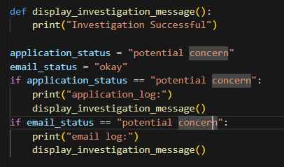
Calling a function
Using a function after defining it is referred to as calling a function.

Slide 24
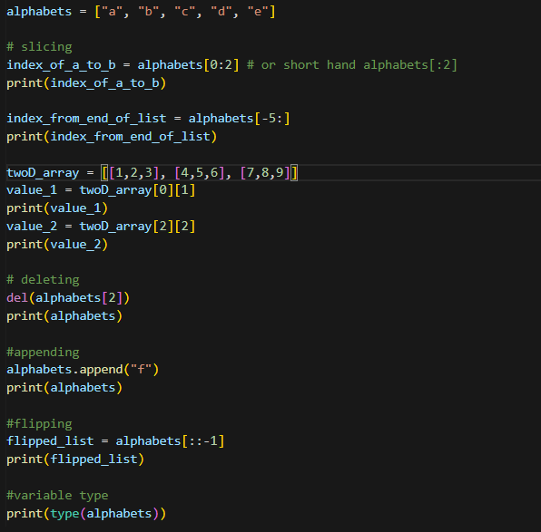
Working With Lists

Slide 25
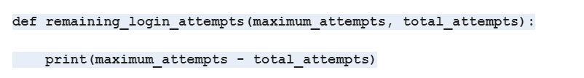
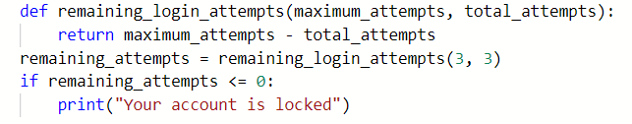
Working with variables in functions
Parameter: A parameter is an object that is included in a function definition for use in that function
Augments: In Python, an argument is the data brought into a function when it is called.
Return: The return keyword is used to return information from a function.

Slide 26
Develop an algorithm that only allows login of 3MTT fellows in your Team.
Class Task 1

Slide 27
Programming with Purpose
03
Python for Automation

Slide 28
Working with files in cybersecurity
Security analysts may need to access a variety of files when working in Python. Many of these files will be logs.
A log is a record of events that occur within an organization's systems.
For instance, there may be a log containing information on login attempts. This might be used to identify unusual activity that signals attempts made by a malicious actor to access the system.
As another example, malicious actors that have breached the system might be capable of attacking software applications. An analyst might need to access a log that contains information on software applications that are experiencing issues.

Slide 29
Opening Files in python
Create a file named update_log.txt
Open the file on python using
with open("update_log.txt", "r") as file
with
The keyword with handles errors and manages external resources when used with other functions.
In this case, it will then manage the resources by closing the file opened by the open() after exiting the with statement.
open()
The open() function opens a file in Python.

Slide 30
Your organisation has a list of approved members in a text file named allow_list.txt. Develop an algorithm that only allows login of members of your organization.
Class Task 2

Slide 31
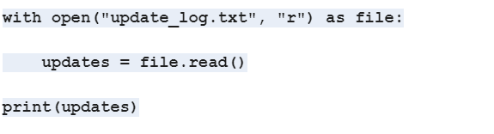
Reading Files in python

Slide 32
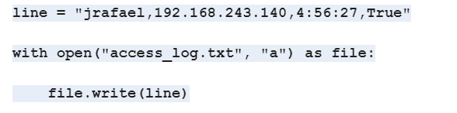
Writing Files in python

Slide 33
At your organization, access to restricted content is controlled with an allow list of IP addresses. The "allow_list.txt" file identifies these IP addresses. A separate remove list identifies IP addresses that should no longer have access to this content.
Class Task 2

Slide 34
Create an algorithm to automate updating the "allow_list.txt" file and remove these IP addresses that should no longer have access.

Slide 35
Build an algorithm for a passphrase generator of 3MTT fellows
Assignment

Slide 36
04
Overview of Kali Linux

Slide 37
Kali Linux
This open-source operating system made specifically with penetration testing and digital forensics in mind.
There are many tools pre-installed into KALI LINUX
It's important to note that KALI LINUX should be used on a virtual machine.
This prevents damage to your system in the event its tools are used improperly.
An additional benefit is that using a virtual machine gives you the ability to revert to a previous state.

Slide 38
Kali Linux for Penetration testing
Security professionals advance in their careers, some specialize in penetration testing.
A penetration test is a simulated attack that helps identify systems, networks, websites, applications, and processes vulnerabilities.
KALI LINUX has numerous tools that are useful during penetration testing. Let's look at a few examples.

Slide 39
Kali Linux tools for Pen. testing
Metasploit can be used to look for and exploit vulnerabilities on machines.
Burp Suite is another tool that helps to test for weaknesses in web applications.
John the Ripper is a tool used to guess passwords.
If you choose to specialize in penetration testing, you will be exposed to how these tools can aid you in your exploits.

Slide 40
Kali Linux application in Digital Forensics
Digital forensics is the process of collecting and analyzing data to determine what has happened after an attack.
As a security analyst, your work might involve digital forensics where you might be tasked with investigating data related to network activity.
KALI LINUX is also a useful distribution for security professionals who are involved in digital forensic work.

Slide 41
Kali Linux tool in Digital Forensics
Tcpdump: this is a command-line packet analyzer used to capture network traffic.
Wireshark: This tool has a graphical user interface that can be used to analyze live and captured network traffic.
Autopsy: Autopsy is a forensic tool used to analyze hard drives and smartphones.

Slide 42
Thanks!
Do you have any questions?
amosmarvellous48@gmail.com
+234 702 625 4613

