Slide 1
Understanding Networks and Network scanning
Week 4: What have you learnt so far?

Slide 2
?
Last weeks review

Slide 3
Team Divisions
MERCURY
MARS
JUPITER
VENUS
SATURN
Back Wing
Left Wing
Center Wing
Right Wing
Forward Wing

Slide 4
At your organization, access to restricted content is controlled with an allow list of IP addresses. The "allow_list.txt" file identifies these IP addresses. A separate remove list identifies IP addresses that should no longer have access to this content.
Task 1 Review

Slide 5
Create an algorithm to automate updating the "allow_list.txt" file and remove these IP addresses that should no longer have access.

Slide 6
Build an algorithm for a passphrase generator of 3MTT fellows
Assignment Review

Slide 7
At the end, you should:
CYBER
Identify and label common network components
Analyze network architecture and operations to identify vulnerabilities and potential points of compromise.
Navigate the Linux terminal
Understand the use network scanning
Perform basic network scans using Nmap and identify used protocols.
CYBER
FUTURISTIC
SECURITY

Slide 8
01
Overview of Kali Linux

Slide 9
Kali Linux
This open-source operating system made specifically with penetration testing and digital forensics in mind.
There are many tools pre-installed into KALI LINUX
It's important to note that KALI LINUX should be used on a virtual machine.
This prevents damage to your system in the event its tools are used improperly.
An additional benefit is that using a virtual machine gives you the ability to revert to a previous state.

Slide 10
Kali Linux for Penetration testing
Security professionals advance in their careers, some specialize in penetration testing.
A penetration test is a simulated attack that helps identify systems, networks, websites, applications, and processes vulnerabilities.
KALI LINUX has numerous tools that are useful during penetration testing. Let's look at a few examples.

Slide 11
Kali Linux tools for Pen. testing
Metasploit can be used to look for and exploit vulnerabilities on machines.
Burp Suite is another tool that helps to test for weaknesses in web applications.
John the Ripper is a tool used to guess passwords.
If you choose to specialize in penetration testing, you will be exposed to how these tools can aid you in your exploits.

Slide 12
Kali Linux application in Digital Forensics
Digital forensics is the process of collecting and analyzing data to determine what has happened after an attack.
As a security analyst, your work might involve digital forensics where you might be tasked with investigating data related to network activity.
KALI LINUX is also a useful distribution for security professionals who are involved in digital forensic work.

Slide 13
Kali Linux tool in Digital Forensics
Tcpdump: this is a command-line packet analyzer used to capture network traffic.
Wireshark: This tool has a graphical user interface that can be used to analyze live and captured network traffic.
Autopsy: Autopsy is a forensic tool used to analyze hard drives and smartphones.

Slide 14
Networks Understanding what networks are and why we are scanning them is important before diving into the how.
02

Slide 15
What is a Network
A network is a group of connected devices.
The devices on a network can communicate with each other over network cables or wireless connections.
Devices need to find each other on a network to establish communications.
These devices will use unique addresses, or identifiers, to locate each other. These are called the IP and MAC addresses.
Devices can communicate on two types of networks: a local area network, also known as a LAN, and a wide area network, also known as a WAN.

Slide 16
Network Security
Network security is important because we want to ensure that our network systems are safe and resilient to defend against malicious hackers and that we can protect our user data.
Working with network security allows us to see the overview of the whole company's network systems.
When working in network security, there are often going to be requests that come from network teams and security teams that have specific requirements on certain platforms or on a feature that they need in one of the network policies, which you may need to escalate or try to work on a fix for.

Slide 17
Network Security Applications
An entry-level cybersecurity analyst would look at using command lines, log parsing, and network traffic analysis in their everyday scope of work.
The command line allows you to interact with various levels of your operating system.
Logs in log parsing help and support you in finding out and debugging what is going on in your program or application.
Network traffic analysis is looking at networks across various application and network layers and seeing what that traffic is doing, how it can be secured as well as identify any vulnerabilities and concerns.

Slide 18
03
Network Scanning

Slide 19
What is Nmap
Nmap is a tool used to check computer networks and see what's there. It can find out which computers are connected and what programs they're running. It can even figure out what type of computer it's talking to.
Uses of Nmap
To check if a network is safe.
To test how secure a network is.
To see if firewalls and security systems are set up correctly.
Nmap has different ways to do its job:
It can find computers on the network.
It can check what ports are open on a computer.
It can figure out what services are running on those ports.
It can even guess what type of computer it's talking to.

Slide 20
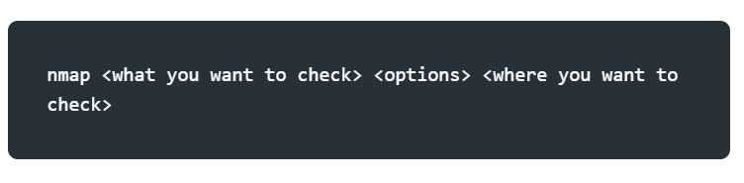
A Typical Nmap command

Slide 21
An Example
Lets perform a basic network scan on your local machine
On your terminal type ‘ifconfig’ or ‘ip addr’
Copy your ip address
Type nmap <machine_ip>
Another site we are authorized to scan is scanme.nmap.org
Type nmap scanme.nmap.org

Slide 22
Key terms in Networking
Ports: A port is like a door on your computer or device that allows different kinds of internet traffic to come in and go out. Different doors (ports) are used for different things, like browsing the web or sending emails.
Host: A host is any device, like your computer or phone, that is connected to a network (like the internet) and can send or receive information.
Service: A service is a specific job or function that a computer or server performs over a network, like hosting a website, handling emails, or running an online game.
Flags: Flags are signals used in network communication to control or manage how data is sent and received between devices. Think of them as markers that indicate what should happen next.

Slide 23
Key terms in Nmap
Subnet Mask: A subnet mask helps divide an IP address into two parts: the part that tells which network a device is on and the part that tells which specific device it is. It’s like dividing an address into the street name (network) and house number (device).
Switch: A switch is a device that helps connect multiple computers or devices in the same building (local network). It directs data only to the device that needs it, making everything work faster.
Router: A router connects different networks, like your home network and the internet, and makes sure data gets to the right place.

Slide 24
04
Subnets

Slide 25
Network segment
A network segment is a group of computers connected using a shared medium.
This medium can be the Ethernet switch or WiFi access point.
In an IP network, a subnetwork is usually the equivalent of one or more network segments connected and configured to use the same router.
The network segment refers to a physical connection, while a subnetwork refers to a logical connection.

Slide 26
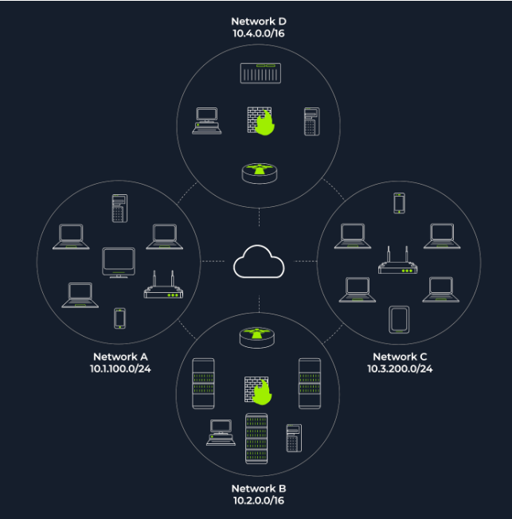
Network segment
In this network diagram, we have four network segments or subnetworks.
A subnetwork, or simply a subnet, has its IP address range and is connected to a more extensive network via a router.
N/B: a firewall might enforce security policies depending on each network.

Slide 27
Network segment
This figure shows two types of subnets:
Subnets with /16, which means that the subnet mask can be written as 255.255.0.0. This subnet can have around 65 thousand hosts.
Subnets with /24 indicate that the subnet mask can be expressed as 255.255.255.0. This subnet can have around 250 hosts

Slide 28
Network segment
Nmap relies on different approaches to discover live hosts, including:
ARP scan: This uses ARP requests. An Address Resolution Protocol is responsible for finding the MAC (hardware) address related to a specific IP address. It works by broadcasting an ARP query, and receiving the response to discover live hosts.
TCP/UDP ping scan: This scan sends packets to TCP ports and UDP ports to determine live hosts.

Slide 29
Note
If you are connected to the same subnet, you would expect your scanner to rely on ARP (Address Resolution Protocol) queries to discover live hosts.
If you are in Network A, you can use ARP only to discover the devices within that subnet (10.1.100.0/24).
Suppose you are connected to a subnet different from the subnet of the target system(s). In that case, all packets generated by your scanner will be routed via the default gateway (router) to reach the systems on another subnet; however, the ARP queries won’t be routed and hence cannot cross the subnet router.
ARP packets are bound to their subnet.

Slide 30
Note
To perform an ARP host detection scan using Nmap:
Run the command sudo nmap -PR -sn <machine_ip>/24,
where -PR indicates that you only want an ARP scan and the –sn indicates you are not port-scanning the live systems.
N/B: An ARP scan is possible only if you are on the same subnet as the target systems(Wifi, ethernet, etc)

Slide 31
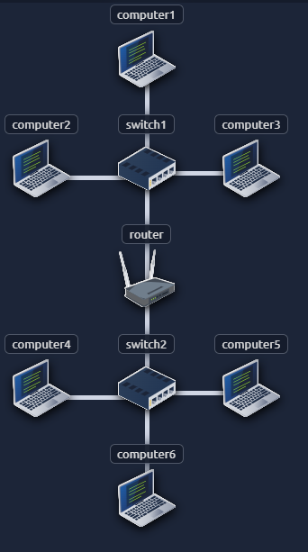
Task 1
If a packet is sent from computer1 to computer3 as a broadcast using ARP:
How many devices can see the ARP Request?
Did computer4 get the request?

Slide 32
05
Nmap Enumeration

Slide 33
Enumeration
Enumeration is the process of gathering information about a system, such as usernames, machine names, network resources, shares, and services
Enumeration is the process of gathering information about a system, such as usernames, machine names, network resources, shares, and services
To a security analyst, this step is critical in the reconnaissance phase of ethical hacking or penetration testing where you aim to find out some of the weaknesses/vulnerabilities within the target.

Slide 34
Nmap Enumeration
We need to specify the targets we want to scan. This can be done by providing a list, a range, or a subnet.
Examples of target specifications are:
list: MACHINE_IP scanme.nmap.org example.com will scan 3 IP addresses.
range: 10.11.12.15-20 will scan 6 IP addresses: 10.11.12.15, 10.11.12.16,… and 10.11.12.20.
subnet: MACHINE_IP/30 will scan 4 IP addresses.
N/B: We will focus on using subnets for this lecture.

Slide 35
Task 1
What is the first IP address Nmap would scan if you provided <your_ip>/30 as your target?
What is the first IP address Nmap would scan if you provided <your_ip>/24 as your target?

Slide 36
Fingerprinting and OS detection.
06

Slide 37
Fingerprinting
OS fingerprinting is a technique used to determine the type and version of the operating system running on a remote host.
Here we’ll be checking the operating system and the system version being used on the available hosts.
Run the command:
sudo nmap –O –sV <machine_ip>/24
N/B fingerprinting requires administrative permission, hence, the sudo flag
The –O represents operating system and the –sV represents system version.

Slide 38
Quiz
What can an attacker do with knowledge of a host’s OS and system version?

Slide 39
07
Vulnerability scanning

Slide 40
Script
Nmap includes a powerful scripting engine (NSE) that allows you to scan for specific vulnerabilities. Use the following command to run common vulnerability checks:
nmap --script vuln <machine_ip>/24
N/B: This data can be save to a file by adding the flag –oN <name_of_file.txt>

Slide 41
Task
Scan for vulnerabilities in the site scannme.nmap.org and save the report in a txt file named output.txt.

Slide 42
1. Review Network protocols. 2. Draft a report on the vulnerabilities found on the scanme.nmap.org web site detailing how they can be leveraged, their attack surface area, ways to mitigate them and other relevant details.
Assignment

Slide 43
Thanks!
Do you have any questions?
amosmarvellous48@gmail.com
+234 702 625 4613

