Slide 1
Java Programming, 9e Chapter 4
More Object Concepts

Slide 2
Objectives
Understand blocks and scope
Overload a method
Avoid ambiguity
Create and call constructors with parameters
Use the this reference
Use static fields
Use automatically imported, prewritten constants and methods
Use composition and nest classes

Slide 3
Understanding Blocks and Scope (1 of 7)
Blocks
Use opening and closing curly braces
Can exist entirely within another block or entirely outside of and separate from another block
Cannot overlap
Types:
Outside block (or outer block)
Inside block (or inner block)
Nested (contained entirely within the outside block)

Slide 4
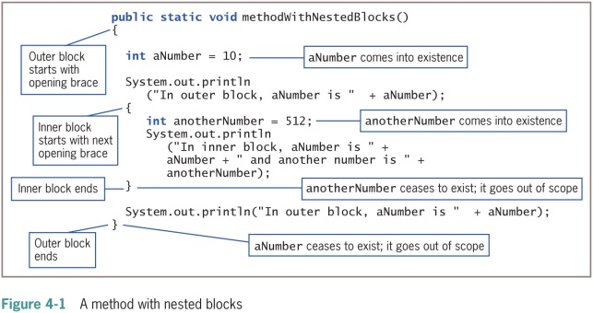
Understanding Blocks and Scope (2 of 7)

Slide 5
Understanding Blocks and Scope (3 of 7)
Scope
The portion of a program within which you can refer to a variable
Comes into scope
Variable comes into existence
Goes out of scope
Variable ceases to exist
Redeclare the variable
You cannot declare the same variable name more than once within a block
An illegal action

Slide 6
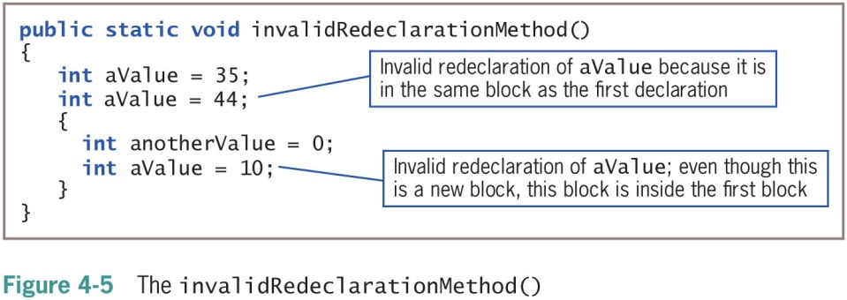
Understanding Blocks and Scope (4 of 7)

Slide 7
Understanding Blocks and Scope (5 of 7)
Override
Occurs when you use the variable’s name within the method in which it is declared
The variable takes precedence over any other variable with the same name in another method
Shadowing: locally declared variables always mask or hide other variables with the same name elsewhere in the class

Slide 8
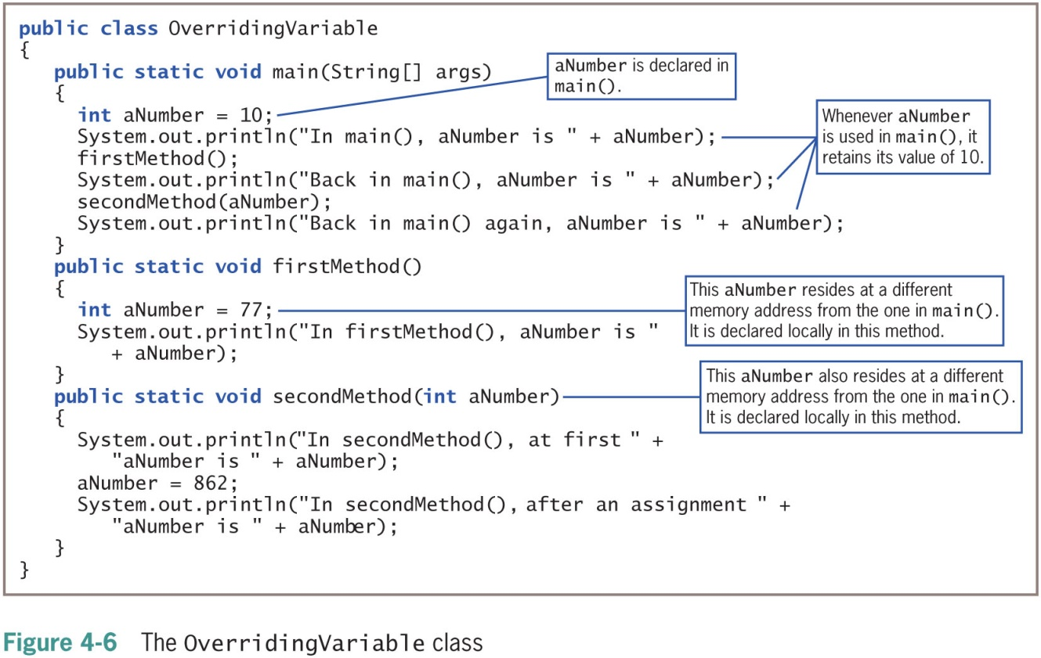
Understanding Blocks and Scope (6 of 7)

Slide 9
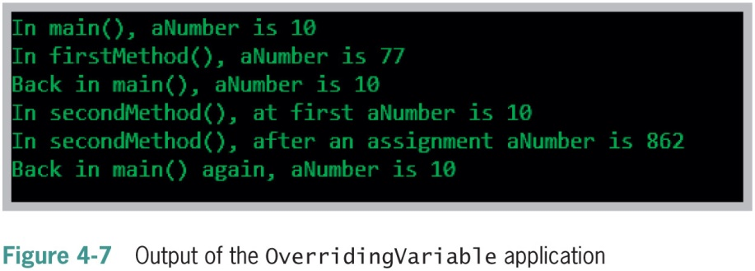
Understanding Blocks and Scope (7 of 7)

Slide 10
Overloading a Method (1 of 2)
Overloading
Using one term to indicate diverse meanings
Writing multiple methods with the same name but with different arguments
The compiler understands the meaning based on the arguments used with the method call
It is convenient for programmers to use one reasonable name
For tasks that are functionally identical
Except for argument types

Slide 11
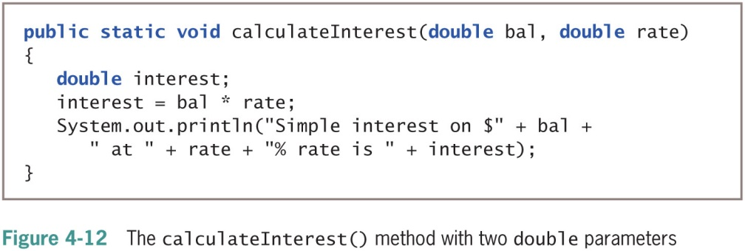
Overloading a Method (2 of 2)

Slide 12
Automatic Type Promotion in Method Calls (1 of 2)
If an application contains just one version of a method:
Call the method using a parameter of the correct data type or one that can be promoted to the correct data type
Order of promotion:
double, float, long, int

Slide 13
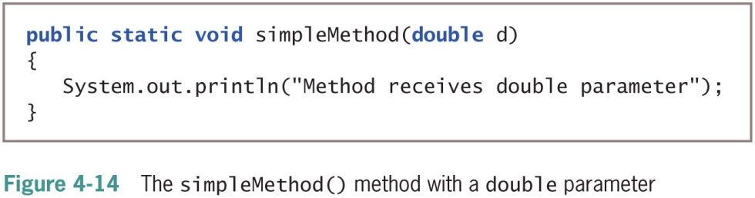
Automatic Type Promotion in Method Calls (2 of 2)

Slide 14
Learning About Ambiguity
Ambiguous situation
When the compiler cannot determine which method to use
Overload methods
Correctly provide different parameter lists for methods with the same name
Illegal methods
Methods with identical names that have identical argument lists but different return types

Slide 15
Creating and Calling Constructors with Parameters (1 of 2)
Java automatically provides a constructor method when class-created default constructors do not require parameters
Writing your own constructor method:
Ensures that fields within classes are initialized to appropriate default values
Constructors can receive parameters
Used for initialization purposes

Slide 16
Creating and Calling Constructors with Parameters (2 of 2)
When you write a constructor for a class, you no longer receive the automatically provided default constructor
If a class’s only constructor requires an argument, you must provide an argument for every object of the class

Slide 17
Overloading Constructors (1 of 2)
Use constructor parameters to initialize field values, or any other purpose
If constructor parameter lists differ, there is no ambiguity about which constructor method to call

Slide 18
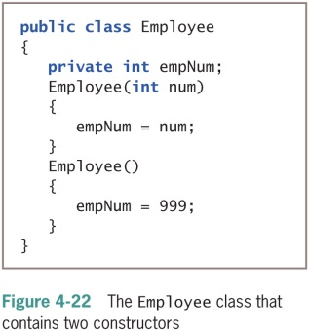
Overloading Constructors (2 of 2)

Slide 19
Learning About the this Reference (1 of 5)
Instantiating an object from a class
Memory is reserved for each instance field in the class
It is not necessary to store a separate copy of each variable and method for each instantiation of a class
In Java:
One copy of each method in a class is stored
All instantiated objects can use one copy

Slide 20
Learning About the this Reference (2 of 5)
Reference
An object’s memory address
Implicit
Automatically understood without actually being written

Slide 21
Learning About the this Reference (3 of 5)
this reference
The reference to an object
Passed to any object’s nonstatic class method
A reserved word in Java
You do not need to use the this reference in methods you write in most situations

Slide 22
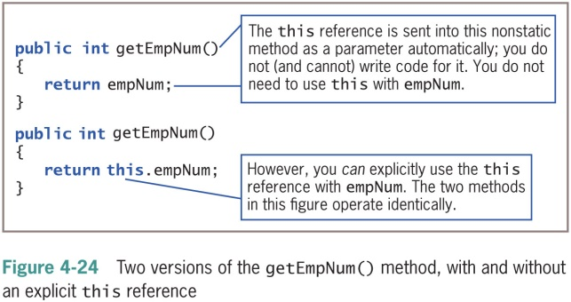
Learning About the this Reference (4 of 5)

Slide 23
Learning About the this Reference (5 of 5)
this reference (cont’d.)
Implicitly received by instance methods
Use to make classes work correctly
When used with a field name in a class method, the reference is to the class field instead of to the local variable declared within the method

Slide 24
Using the this Reference to Make Overloaded Constructors More Efficient (1 of 3)
Avoid repetition within constructors
Constructor calls other constructor
this()
More efficient and less error-prone

Slide 25
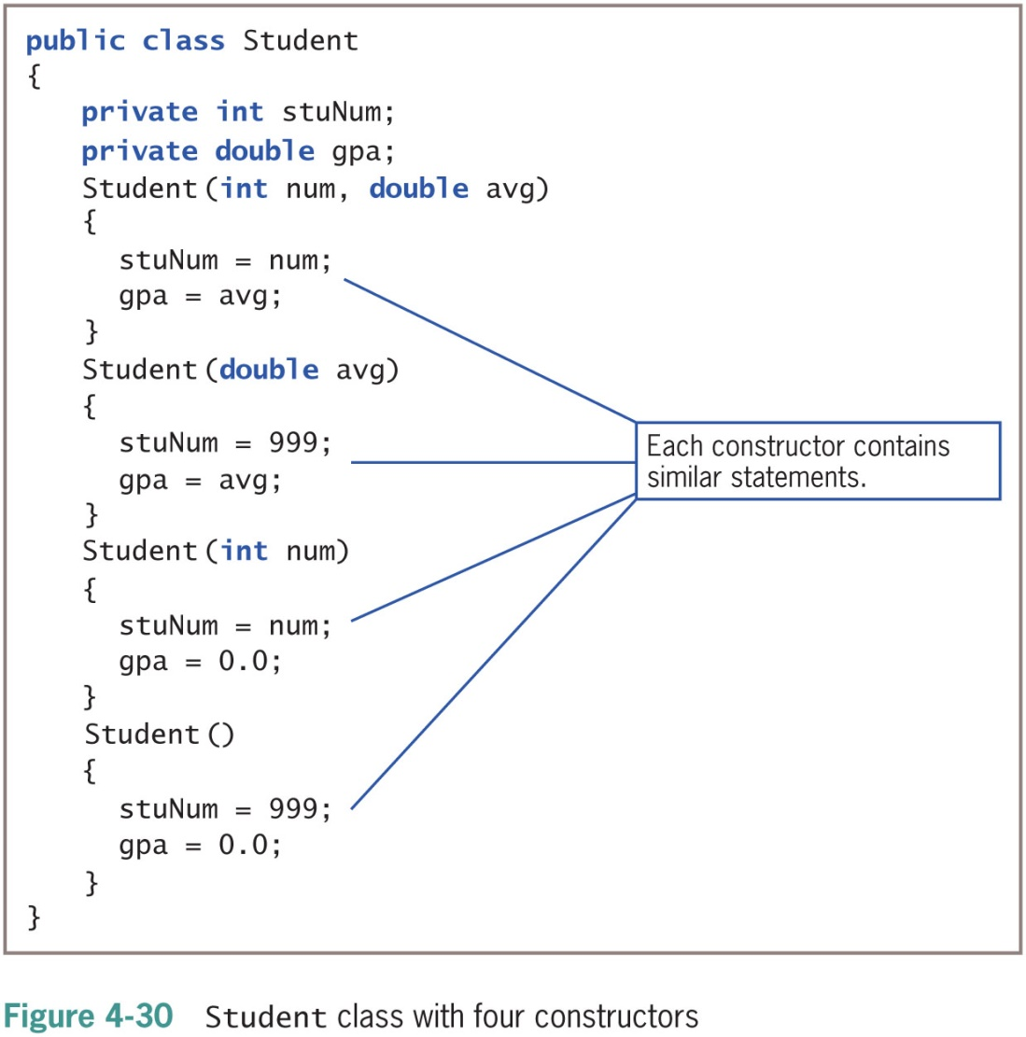
Using the this Reference to Make Overloaded Constructors More Efficient (2 of 3)

Slide 26
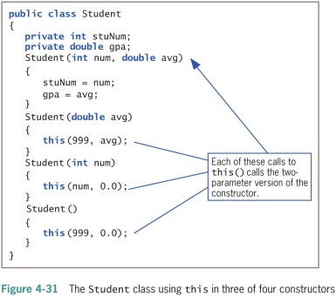
Using the this Reference to Make Overloaded Constructors More Efficient (3 of 3)

Slide 27
Using static Fields
Class methods
Do not have the this reference
Have no object associated with them
Class variables
Shared by every instantiation of a class
Only one copy of a static class variable per class

Slide 28
Using Constant Fields (1 of 2)
Create named constants using the keyword final
Make its value unalterable after construction
Can be set in the class constructor
After construction, you cannot change the final field’s value

Slide 29
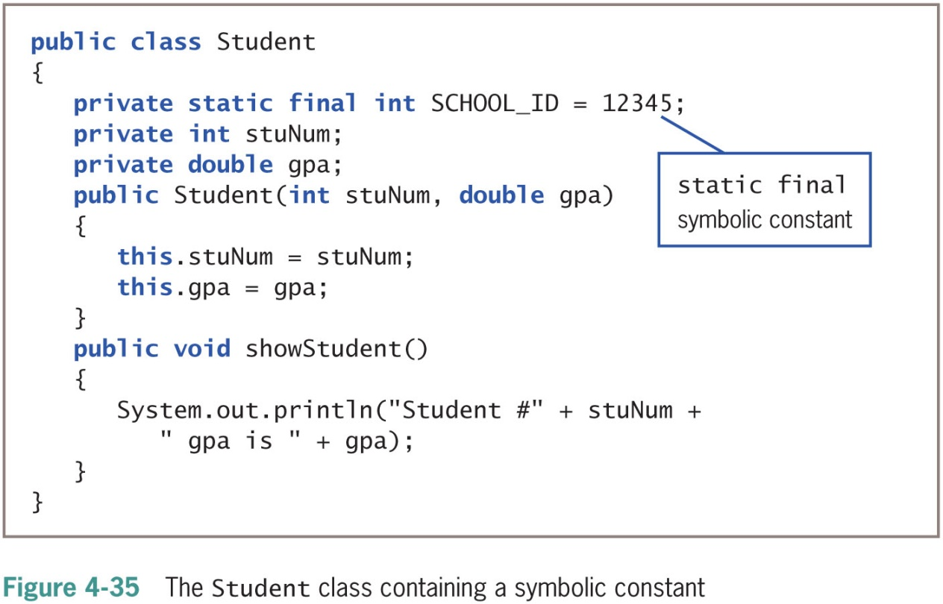
Using Constant Fields (2 of 2)

Slide 30
Using Automatically Imported, Prewritten Constants and Methods (1 of 5)
Many classes are commonly used by a wide variety of programmers
Package or library of classes
A folder that provides a convenient grouping for classes
Many contain classes available only if they are explicitly named within a program
Some classes are available automatically

Slide 31
Using Automatically Imported, Prewritten Constants and Methods (2 of 5)
java.lang package
Implicitly imported into every Java program
The only automatically imported, named package
The classes it contains are fundamental classes (or basic classes)
Optional classes
Must be explicitly named

Slide 32
Using Automatically Imported, Prewritten Constants and Methods (3 of 5)
java.lang.Math class
Contains constants and methods used to perform common mathematical functions
No need to create an instance
Imported automatically
Cannot instantiate objects of type Math
The constructor for the Math class is private

Slide 33
Using Automatically Imported, Prewritten Constants and Methods (4 of 5)
Table 4-1 Common Math class methods (continues)
Method | Value that the Method Returns
abs(x) | Absolute value of x
acos(x) | Arc cosine of x
asin(x) | Arc sine of x
atan(x) | Arc tangent of x
atan2(x, y) | Theta component of the polar coordinate (r, theta) that corresponds to the Cartesian coordinate x, y
ceil(x) | Smallest integral value not less than x (ceiling)
cos(x) | Cosine of x
exp(x) | Exponent, where x is the base of the natural logarithms
floor(x) | Largest integral value not greater than x
log(x) | Natural logarithm of x

Slide 34
Using Automatically Imported, Prewritten Constants and Methods (5 of 5)
Table 4-1 Common Math class methods (continued)
Method | Value that the Method Returns
max(x, y) | Larger of x and y
min(x, y) | Smaller of x and y
pow(x, y) | x raised to the y power
random() | Random double number between 0.0 and 1.0
rint(x) | Closest integer to x (x is a double, and the return value is expressed as a double)
round(x) | Closest integer to x (where x is a float or double, and the return value is an int or long)
sin(x) | Sine of x
sqrt(x) | Square root of x
tan(x) | Tangent of x

Slide 35
Importing Classes That Are Not Imported Automatically (1 of 2)
Use prewritten classes
Use the entire path with the class name
Import the class
Import the package that contains the class

Slide 36
Importing Classes That Are Not Imported Automatically (2 of 2)
Wildcard symbol
An alternative to importing the class
Import the entire package of classes
Asterisk wildcard
Can be replaced by any set of characters
Represents all classes in a package
There is no disadvantage to importing extra classes
Importing each class by name can be a form of documentation

Slide 37
Using the LocalDate Class (1 of 4)
LocalDate class
No time zone information included with this class (local date only)
Static methods now() and of()
Class constructors are non-public
Various methods provided to perform date arithmetic
Enumeration
Data type that consists of a list of values, such as:
JANUARY, FEBRUARY, MARCH etc.

Slide 38
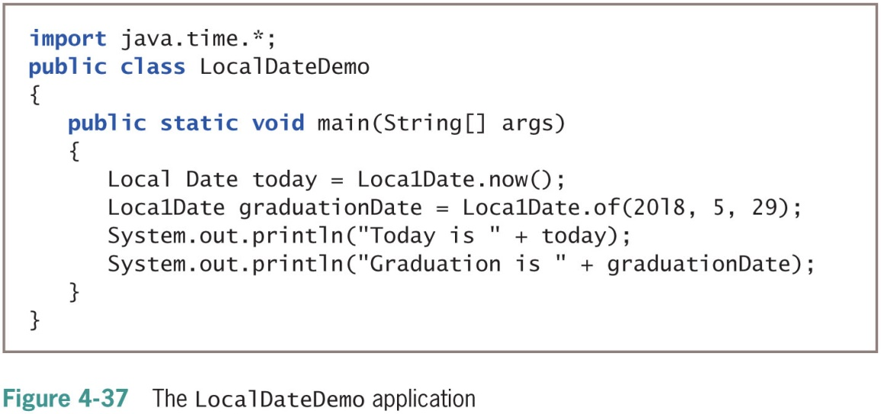
Using the LocalDate Class (2 of 4)

Slide 39
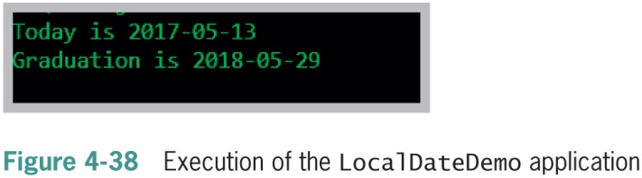
Using the LocalDate Class (3 of 4)

Slide 40
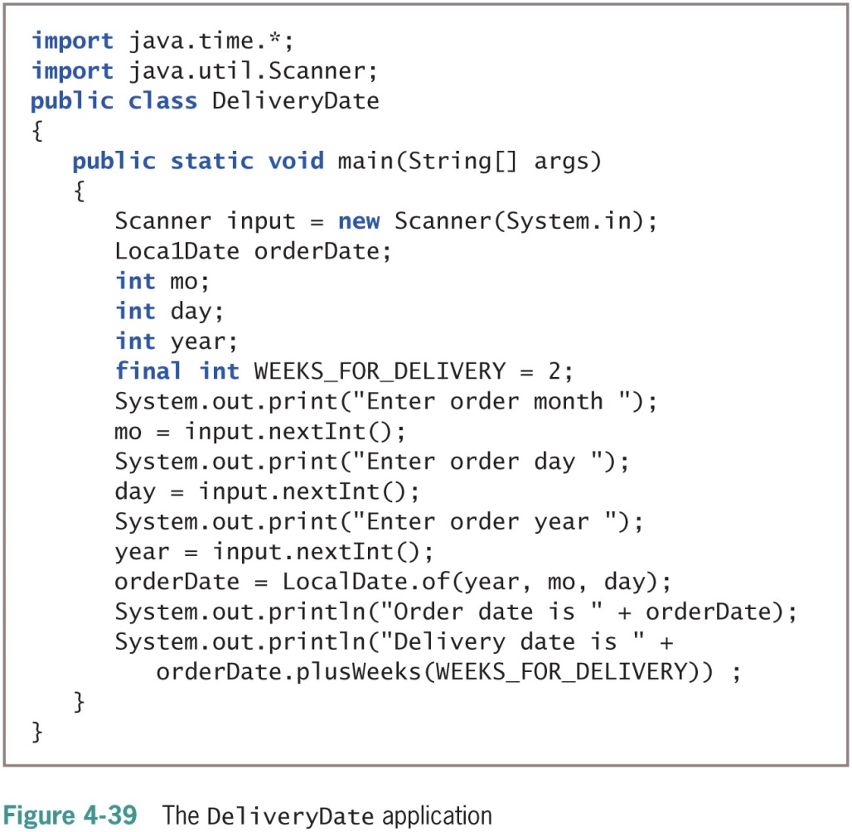
Using the LocalDate Class (4 of 4)

Slide 41
Understanding Composition and Nested Classes (1 of 2)
Composition
Describes the relationship between classes when an object of one class data field is within another class
Called a has-a relationship
Because one class “has an” instance of another
Remember to supply values for a contained object if it has no default constructor

Slide 42
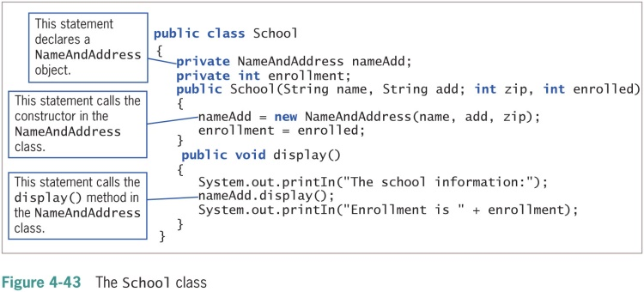
Understanding Composition and Nested Classes (2 of 2)

Slide 43
Nested Classes
Nested classes
A class within another class
Stored together in one file
Nested class types
static member classes
Nonstatic member classes
Local classes
Anonymous classes

Slide 44
Don’t Do It
Don’t try to use a variable that is out of scope
Don’t assume that a constant is still a constant when passed to a method’s parameter
Don’t overload methods by giving them different return types
Don’t think that default constructor means only the automatically supplied version
Don’t forget to write a default constructor for a class that has other constructors
Don’t assume that a wildcard in an import statement works like a DOS or UNIX wildcard. The wildcard works only with specific packages and does not import embedded packages.

Slide 45
Summary (1 of 2)
Variable’s scope
The portion of a program in which you can reference a variable
Block
Code between a pair of curly braces
Overloading
Writing multiple methods with the same name but different argument lists
Store separate copies of data fields for each object
But just one copy of each method

Slide 46
Summary (2 of 2)
static class variables
Shared by every instantiation of a class
Prewritten classes
Stored in packages
import statement
Notifies the Java program that class names refer to those within the imported class
A class can contain other objects as data members
You can create nested classes that are stored in the same file

