Slide 1

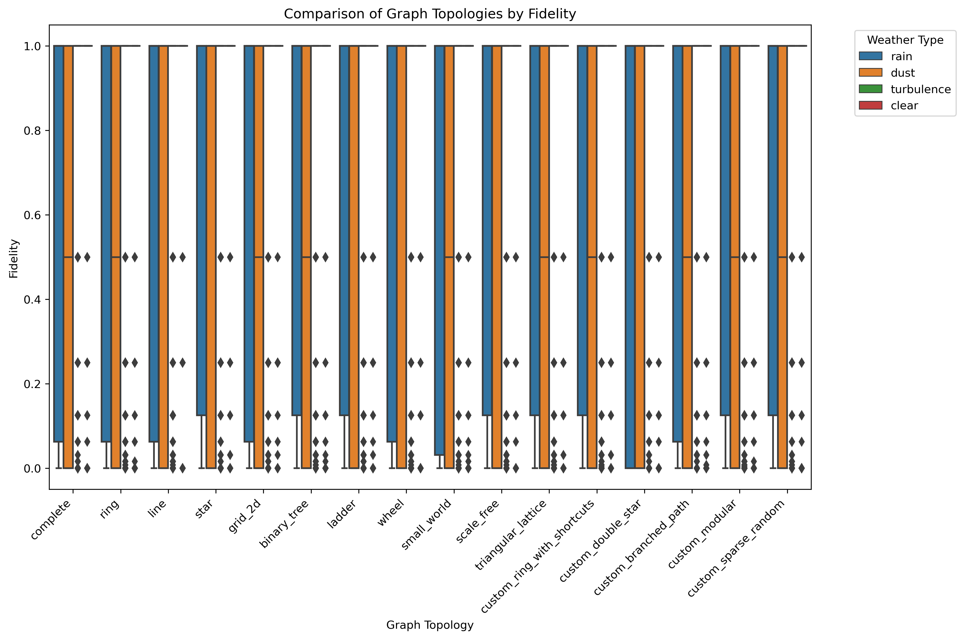
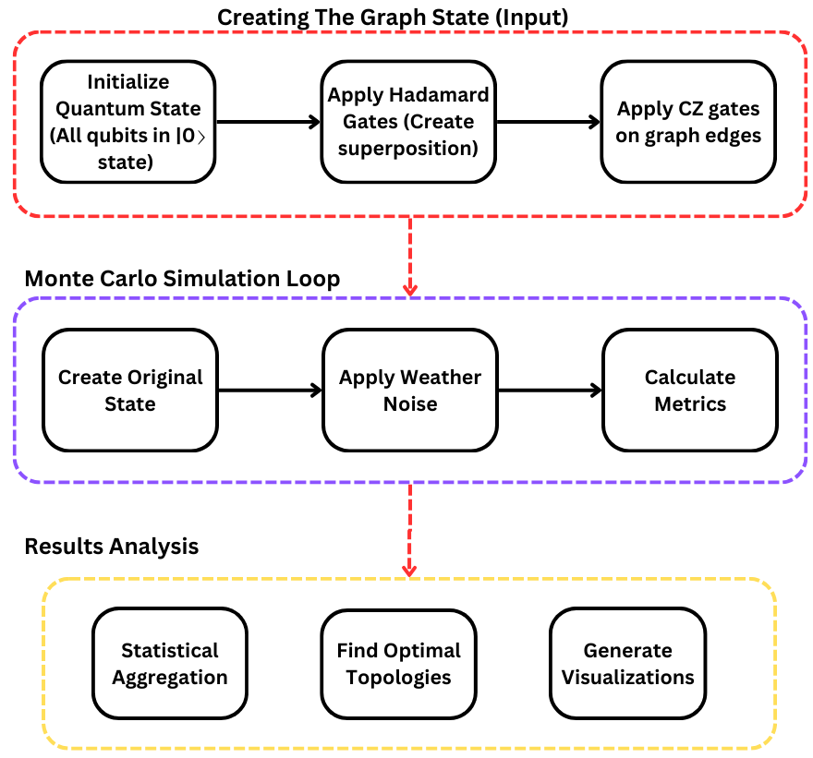
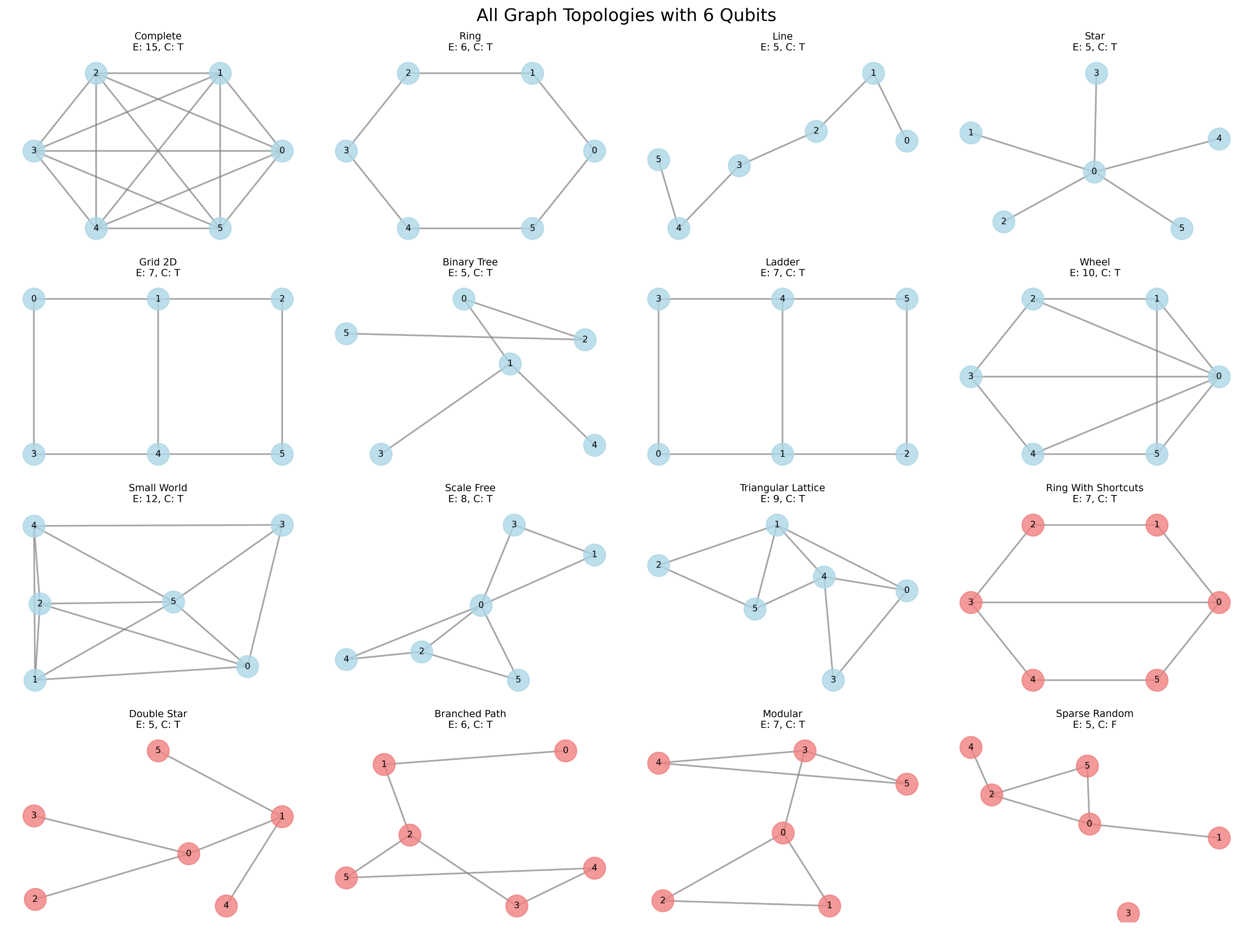
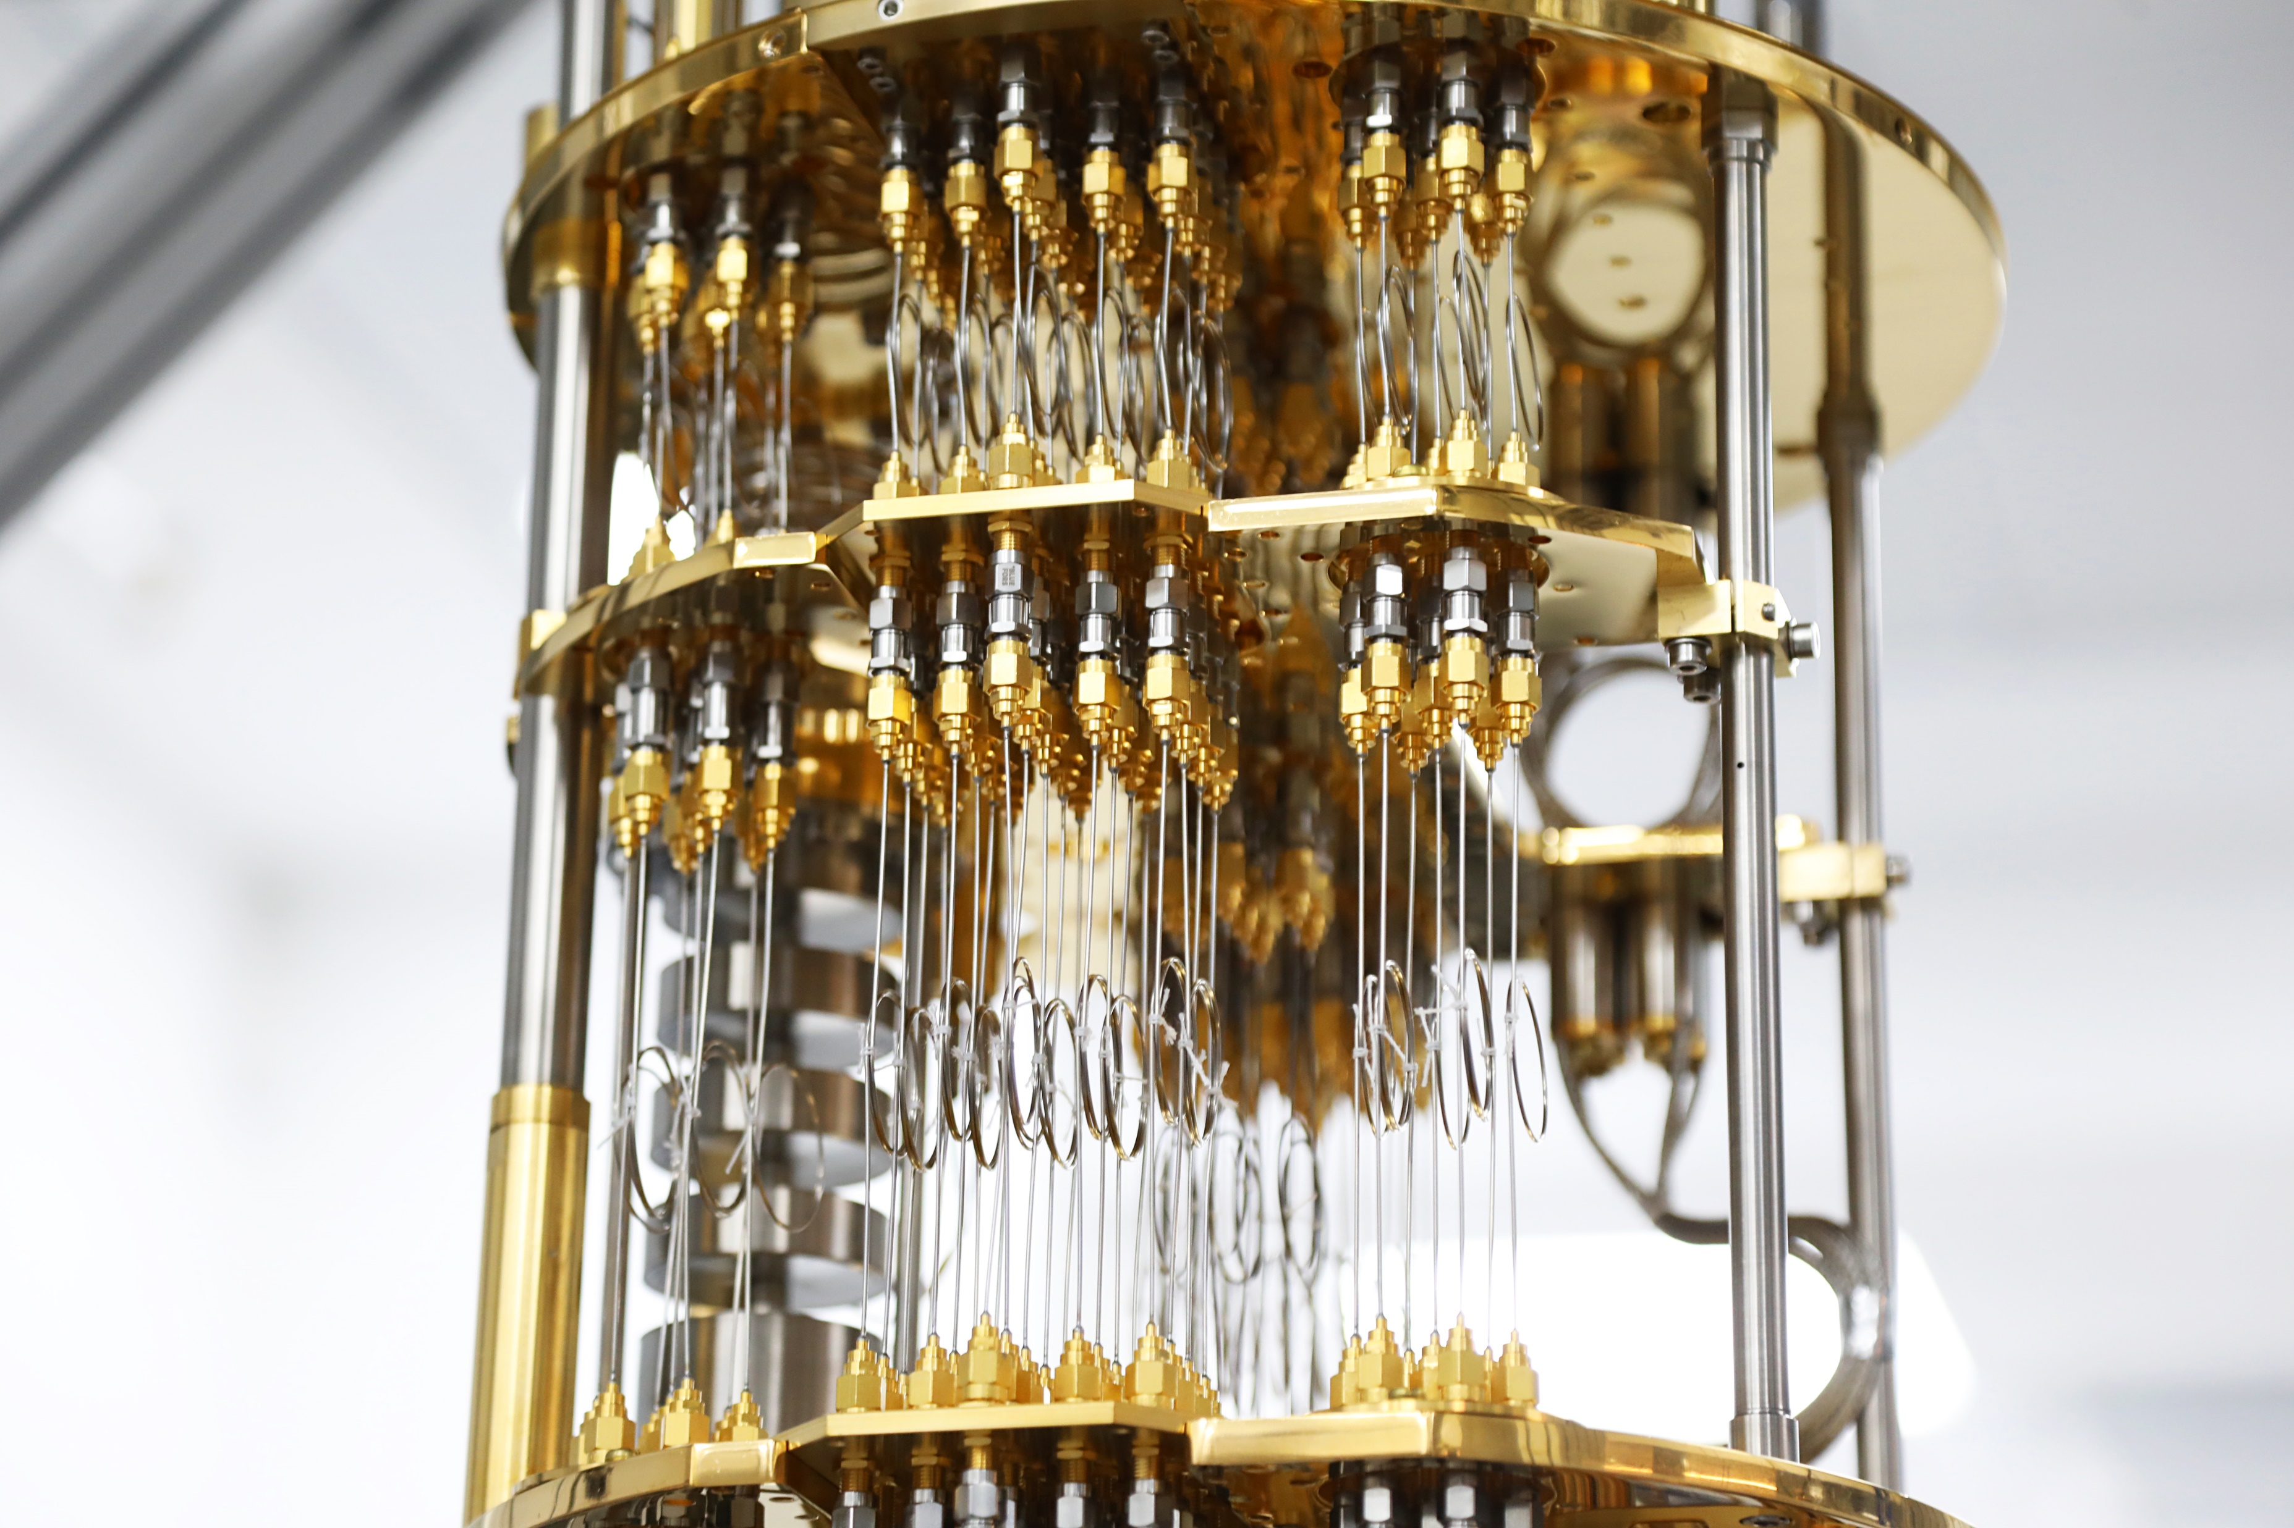
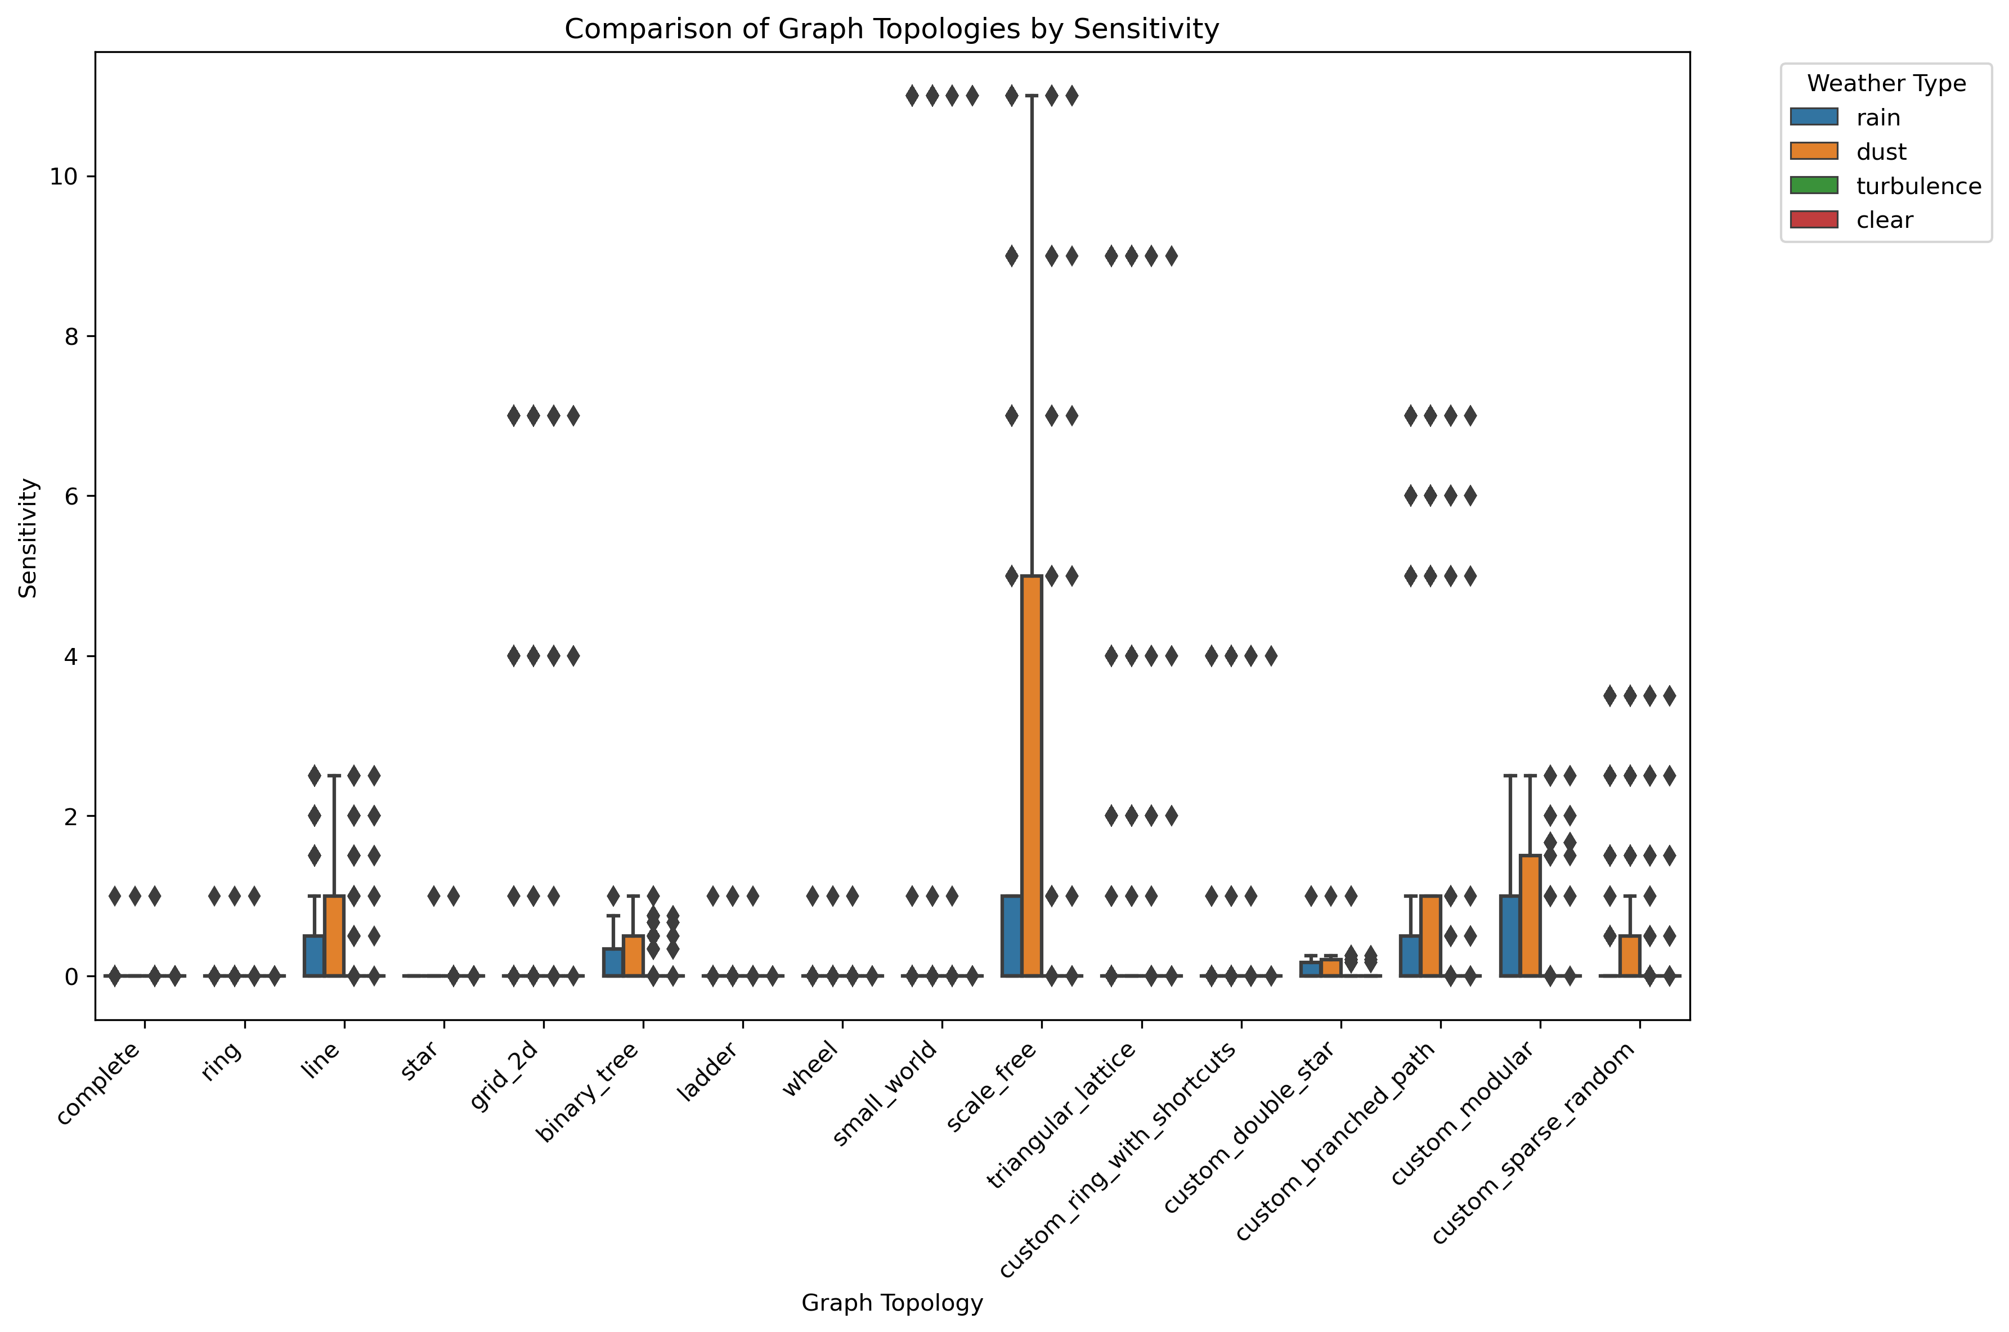
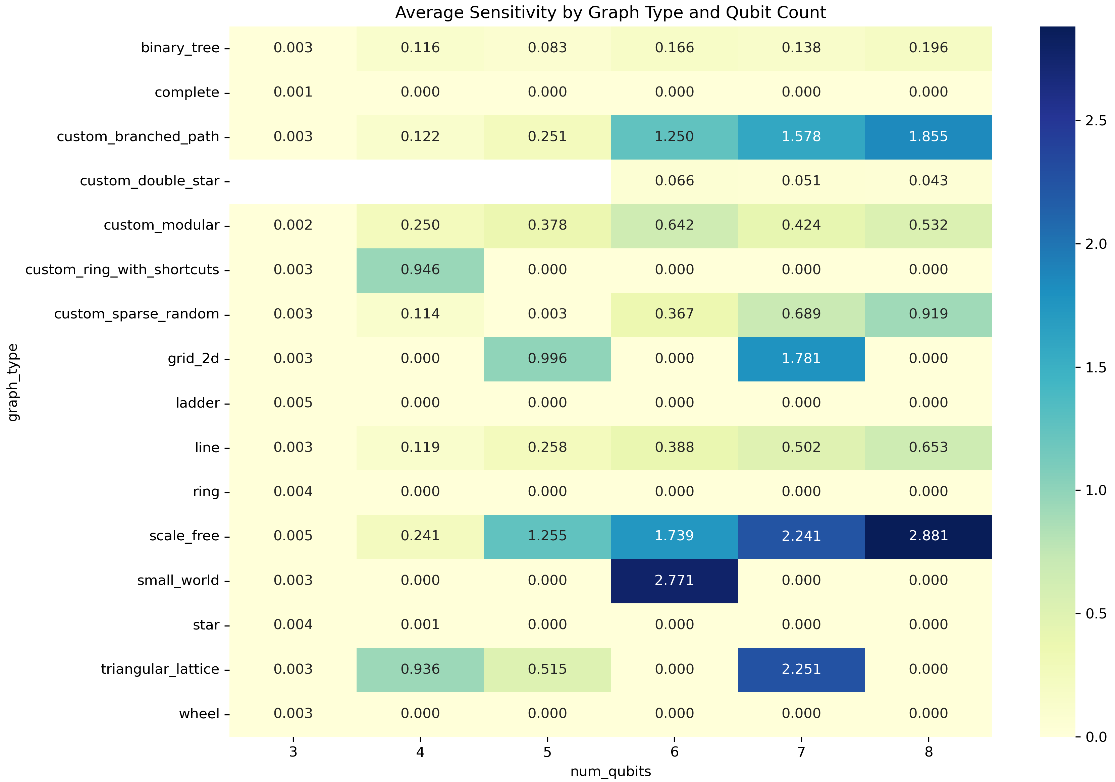
Quantum Sensing for the weather
Project Number: 24-1-1-3121
Name: Mohammad Shalabi
Advisor: Khen Cohen
Introduction Quantum technologies are highly sensitive to environmental noise. This sensitivity, typically viewed as a limitation, can be harnessed for sensing applications. Our project explores opportunistic weather sensing using quantum graph states. Unlike classical sensors, quantum systems can encode and reveal subtle changes in their environment, such as atmospheric disturbances. We study how quantum graph states degrade under different weather-inspired noise models to evaluate their potential as robust environmental sensors. Motivation Classical sensing methods, such as microwave link attenuation, are widely used for rainfall estimation but lack sensitivity to smaller-scale phenomena like turbulence. Quantum graph states, being inherently entangled, could offer higher-resolution detection. Our goal is to identify which graph topologies are most sensitive to weather-induced noise, and how they can be used for environmental monitoring or to improve the resilience of quantum communication systems. | Implementation Our simulation pipeline models the creation of entangled graph states, subjects them to noisy channels inspired by rain, dust, turbulence, and evaluates how fidelity, entanglement, and mutual information degrade. A Monte Carlo simulation is run across different noise intensities and graph topologies. Results We simulated the effect of different weather-like noise patterns on a variety of graph states, measuring their fidelity, entanglement, and mutual information. The results reveal clear differences in how various graph structures respond to changes in noise intensity. | Some graphs maintain high fidelity under noise, while others show stronger changes in entanglement or correlation. These differences help distinguish between graphs that are better suited for robust communication and those that are more sensitive and thus more useful for sensing. Conclusions The structure of a quantum graph state significantly influences its behavior under noisy conditions. Graphs that retain fidelity under noise are promising candidates for stable quantum communication. Graphs that exhibit measurable changes in entanglement or correlations can be used as quantum sensors. This study demonstrates that quantum graph states can serve dual purposes in communication and environmental sensing, and that simulation tools can help guide the design of such systems.

