Slide 1


Elective AI&R : Reasoning Agents
A.A. 2019/20
Learning Reward Machines for Partially Observable Reinforcement Learning
Francesco Caputo
Pagina 1
Riccardo Gozzovelli
Mario Vetrini
Pagina 1
Notes:
1

Slide 2
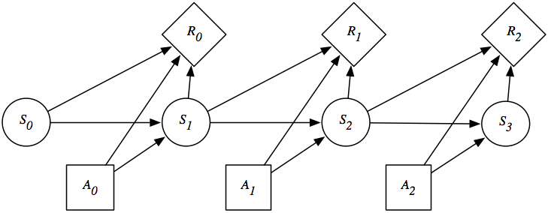

REINFORCEMENT LEARNING
SETTING
Markovian Decision Process (MDP) assumption: $M=\left\{S,A,r,p,γ\right\}$
PROBLEM
Maximize the future expected discounted reward for every state in S
SOLUTION
Optimal policy: $\text{π}\text{∗}\left(\left.{\text{a}}_{\text{t}}\right|{\text{s}}_{\text{t}}\right)$
ALGHORITMS
Q-Learning, SARSA, A3C, PPO
DEEP REINFORCEMENT LEARNING
RL algorithms combined with DL principles.
25/05/2020
Page 2

Slide 3
PARTIALLY OBSERVABLE DOMAINS
Many real-world applications have partially observable domains
Industry
Science
Business
Military
Social
Marketing
Weapon allocation
Education
Machine maintenance
Autonomous robots
Structural inspection
Behavioral ecology
Network troubleshooting
Search
&
rescue
Medical diagnosis
A partially observable domain can have:
non-markovian dynamics or
non-markovian rewards or
both
25/05/2020
Page 3

Slide 4
RL & POMDPs
How to apply RL to a problem described as a POMDP?
Learn non-markovian rewards
Learn non-markovian dynamics
Non-Markovian Regular Decision Process
(NMRDP)
Reward Machine (RM)
Belief states
Non-Markovian
Decision Process
(NMDP)
Regular Decision
Process
(RDP)
Predictive State
Representation
(PSR)
We learn policies and automata!
25/05/2020
Page 4

Slide 5
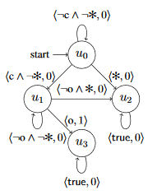
REWARD MACHINEs
Structured Finite State Automata (FSA) representation.
Expose the reward function and speed up learning.
Provide «memory» to a learning agent.
Variant of Q-Learning algorithm used (QRM).
Initially handcrafted and suitable only for fully observable environments.
25/05/2020
Page 5

Slide 6
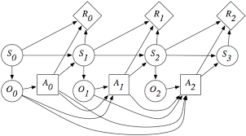
WHY LEARN RMs
SETTING
Partially Observable Markovian Decision Process (POMDP) : $M=\left\{S,O,A, r,p,w,γ\right\}$
Markovian Decision Process (MDP) assumption: $M=\left\{S,A,r,p,γ\right\}$
PROBLEM
Maximize the future expected discounted reward for every state in S
SOLUTION
Optimal policy: $\text{π}\text{∗}\left(\left.{\text{a}}_{\text{t}}\right|{\text{s}}_{\text{t}}\right)$
ALGHORITMS
Transition probabilities and reward function not necessarily Markovian w.r.t. O
Q-Learning, SARSA, A3C, PPO
DEEP REINFORCEMENT LEARNING
Mostly recurrent neural networks.
RL algorithms combined with DL principles.
25/05/2020
Page 6

Slide 7
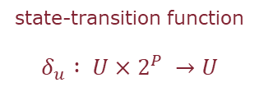
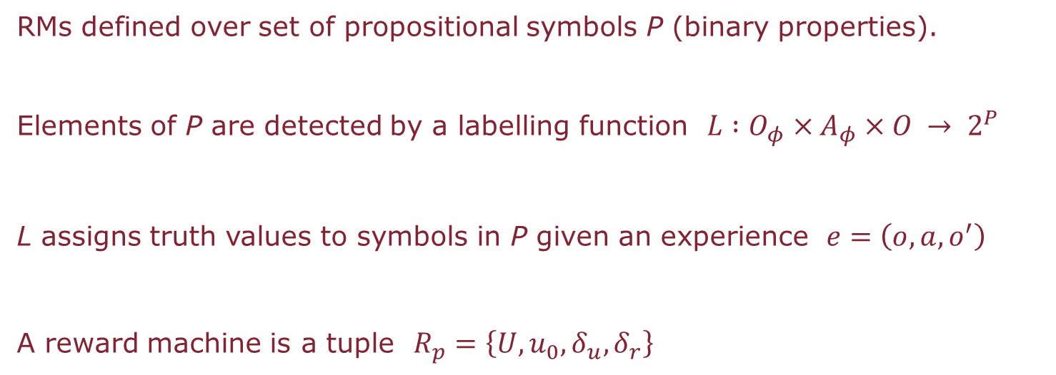
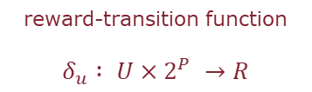
RMs AND POMDPs
RMs defined over set of propositional symbols P (binary properties).
Elements of P are detected by a labelling function $L :O_{φ}×A_{φ}×O → 2^{P}$
L assigns truth values to symbols in P given an experience $ⅇ=\left(o,a,o^{′}\right)$
A reward machine is a tuple $R_{p}=\left\{U,u_{0},δ_{u},δ_{r}\right\}$
state-transition function
$$δ_{u} : U×2^{P} →U$$
reward-transition function
$$δ_{u} : U×2^{P} →R$$
25/05/2020
Page 7

Slide 8


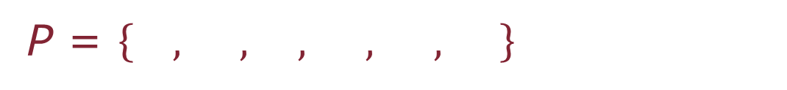
RM – MACHINE MAINTENANCE EXAMPLE
P = $\left\{ , , , , , \right\}$
Robot ended experience in the machine room 1.
Robot ended experience in the machine room 2.
Robot ended experience in a room with a broken machine.
Robot repaired a broken machine.
Robot recharged.
Robot ended experience in the recharge room.
What properties should an RM should have?
25/05/2020
Page 8

Slide 9
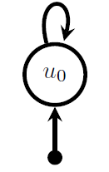
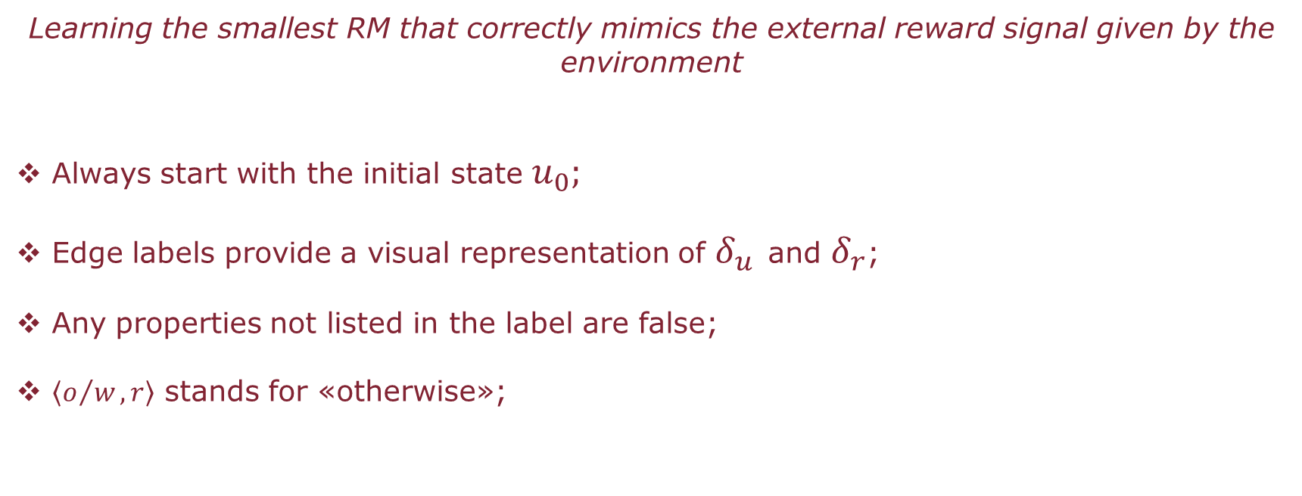


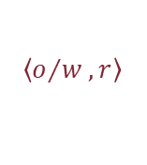
RM – CASE 1
Learning the smallest RM that correctly mimics the external reward signal given by the environment
Always start with the initial state $u_{0};$
Edge labels provide a visual representation of $δ_{u}$ and $δ_{r}$;
Any properties not listed in the label are false;
$\left\langle o/w,r\right\rangle$ stands for «otherwise»;
$$\left\langle ,1\right\rangle$$
$$\left\langle ,1\right\rangle$$
$$\left\langle o/w,r\right\rangle$$
NAIVE RM
25/05/2020
Page 9

Slide 10
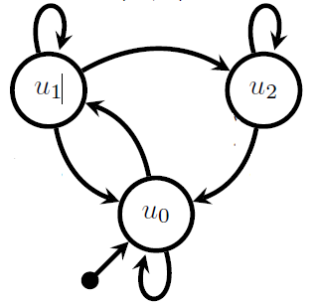








RM – CASE 2
Learn the RM whose optimal policy receives the most reward
$$\left\langle o/w,r\right\rangle$$
$$\left\langle ,0\right\rangle$$
$$\left\langle o/w,r\right\rangle$$
$$\left\langle ,0\right\rangle$$
$$\left\langle ,0\right\rangle$$
$$\left\langle ,1\right\rangle$$
$$\left\langle ,1\right\rangle$$
$$\left\langle o/w,r\right\rangle$$
OPTIMAL RM
25/05/2020
Page 10

Slide 11
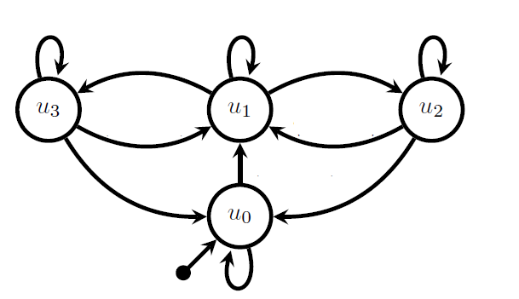













RM – CASE 3
Learning the RM that remembers sufficient information about the history to make accurate Markovian predictions about the next observation
$$\left\langle o/w,r\right\rangle$$
$$\left\langle ,0\right\rangle$$
$$\left\langle o/w,r\right\rangle$$
$$\left\langle ,0\right\rangle$$
$$\left\langle o/w,r\right\rangle$$
$$\left\langle ,0\right\rangle$$
$$\left\langle ,0\right\rangle$$
$$\left\langle ,0\right\rangle$$
$$\left\langle ,0\right\rangle$$
$$\left\langle ,0\right\rangle$$
$$\left\langle ,1\right\rangle$$
$$\left\langle ,1\right\rangle$$
$$\left\langle o/w,r\right\rangle$$
PERFECT RM
25/05/2020
Page 11

Slide 12
25/05/2020
Page 2

Slide 13
25/05/2020
Page 2

Slide 14
25/05/2020
Page 2

Slide 15
25/05/2020
Page 2

Slide 16
25/05/2020
Page 2

Slide 17
25/05/2020
Page 2

Slide 18
25/05/2020
Page 2

Slide 19
25/05/2020
Page 2

Slide 20
25/05/2020
Page 2

Slide 21
25/05/2020
Page 2

Slide 22
25/05/2020
Page 2

Slide 23
25/05/2020
Page 2

Slide 24
25/05/2020
Page 2

Slide 25
25/05/2020
Page 2

Slide 26
25/05/2020
Page 2

Slide 27
25/05/2020
Page 2

Slide 28
25/05/2020
Page 2

Slide 29
25/05/2020
Page 2

Slide 30
25/05/2020
Page 2

