Slide 1


Elective AI&R : Reasoning Agents
A.A. 2019/20
Learning Reward Machines for Partially Observable Reinforcement Learning
Francesco Caputo
Pagina 1
Riccardo Gozzovelli
Mario Vetrini
Pagina 1
Notes:
1

Slide 2
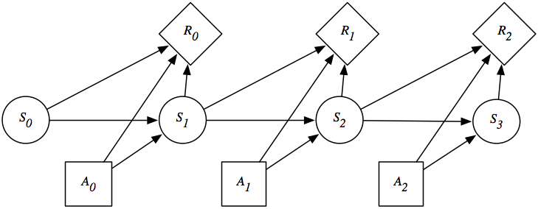

REINFORCEMENT LEARNING
SETTING
Markovian Decision Process (MDP), $M=\left\{S,A,r,p,γ\right\}$
PROBLEM
Maximize the future expected discounted reward for every state in S
SOLUTION
Optimal policy: $\text{π}\text{∗}\left(\left.{\text{a}}_{\text{t}}\right|{\text{s}}_{\text{t}}\right)$
ALGHORITMS
Q-Learning, SARSA, A3C, PPO
DEEP REINFORCEMENT LEARNING
RL algorithms combined with DL principles.
25/05/2020
Page 2

Slide 3
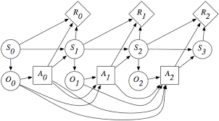
WHY LEARN RMs
SETTING
Partially Observable Markovian Decision Process (POMDP), $M=\left\{S,O,A, r,p,w,γ\right\}$
Markovian Decision Process (MDP), $M=\left\{S,A,r,p,γ\right\}$
PROBLEM
Maximize the future expected discounted reward for every state in S
SOLUTION
Optimal policy: $\text{π}\text{∗}\left(\left.{\text{a}}_{\text{t}}\right|{\text{s}}_{\text{t}}\right)$
ALGHORITMS
Transition probabilities and reward function not necessarily Markovian w.r.t. O
Q-Learning, SARSA, A3C, PPO
DEEP REINFORCEMENT LEARNING
Mostly recurrent neural networks.
RL algorithms combined with DL principles.
25/05/2020
Page 6

Slide 4
PARTIALLY OBSERVABLE DOMAINS
Many real-world applications have partially observable domains
Industry
Science
Business
Military
Social
Marketing
Weapon allocation
Education
Machine maintenance
Autonomous robots
Structural inspection
Behavioral ecology
Network troubleshooting
Search
&
rescue
Medical diagnosis
A partially observable domain can have:
non-markovian dynamics or
non-markovian rewards or
both
25/05/2020
Page 3

Slide 5
RL & POMDPs
How to apply RL to a problem described as a POMDP?
Learn non-markovian rewards
Learn non-markovian dynamics
Non-Markovian Regular Decision Process
(NMRDP)
Reward Machine (RM)
Belief states
Non-Markovian
Decision Process
(NMDP)
Regular Decision
Process
(RDP)
Predictive State
Representation
(PSR)
We learn policies and automata!
25/05/2020
Page 4

Slide 6
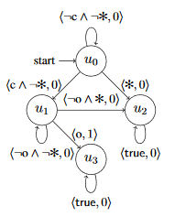
REWARD MACHINEs
Structured Finite State Automata (FSA) representation.
Expose the reward function and speed up learning.
Provide «memory» to a learning agent.
Variant of Q-Learning algorithm used (QRM).
Initially handcrafted and suitable only for fully observable environments.
25/05/2020
Page 5

Slide 7
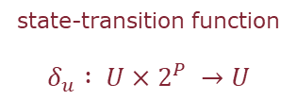
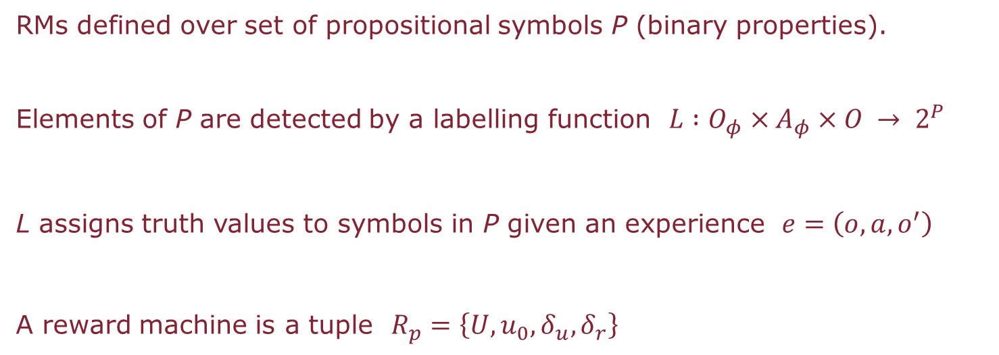
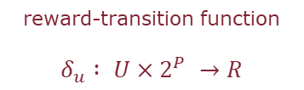
RMs AND POMDPs
RMs defined over set of propositional symbols P (binary properties).
Elements of P are detected by a labelling function $L :O_{φ}×A_{φ}×O → 2^{P}$
L assigns truth values to symbols in P given an experience $ⅇ=\left(o,a,o^{′}\right)$
A reward machine is a tuple $R_{p}=\left\{U,u_{0},δ_{u},δ_{r}\right\}$
state-transition function
$$δ_{u} : U×2^{P} →U$$
reward-transition function
$$δ_{u} : U×2^{P} →R$$
25/05/2020
Page 7

Slide 8


RM – MACHINE MAINTENANCE EXAMPLE
P = $\left\{ , , , , , \right\}$
Robot ended experience in the machine room 1.
Robot ended experience in the machine room 2.
Robot ended experience in a room with a broken machine.
Robot repaired a broken machine.
Robot recharged.
Robot ended experience in the recharge room.
Assumptions: only one machine is broken, the robot can only repair it if it’s charged
25/05/2020
Page 8

Slide 9
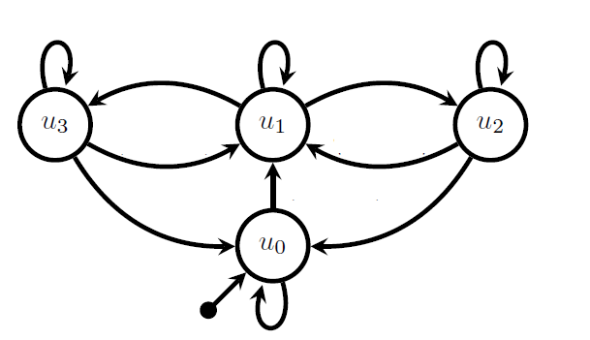

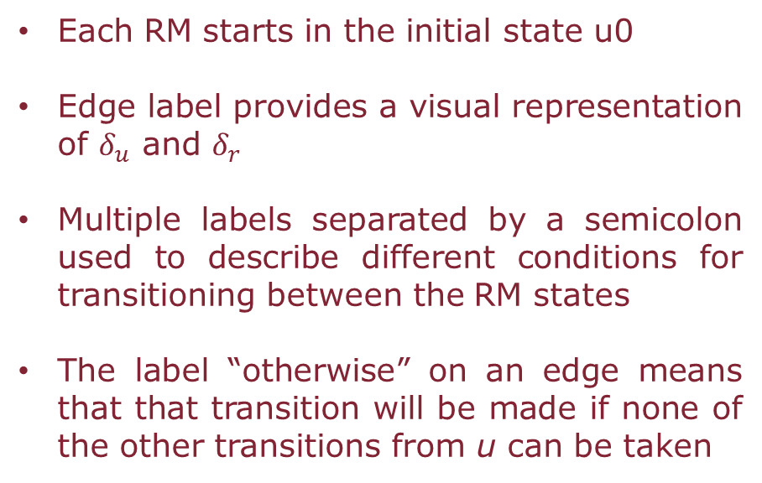
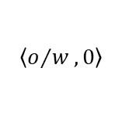




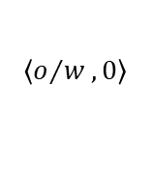
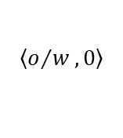


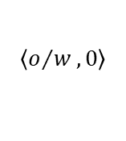


RM – MACHINE MAINTENANCE EXAMPLE
$$\left\langle o/w,0\right\rangle$$
$$\left\langle ,0\right\rangle ;$$
$$\left\langle o/w,0\right\rangle$$
$$\left\langle ,0\right\rangle ;$$
$$\left\langle o/w,0\right\rangle$$
Each RM starts in the initial state u0
Edge label provides a visual representation of $δ_{u}$ and $δ_{r}$
Multiple labels separated by a semicolon used to describe different conditions for transitioning between the RM states
The label “otherwise” on an edge means that that transition will be made if none of the other transitions from u can be taken
$$\left\langle ,0\right\rangle$$
$$\left\langle ,0\right\rangle$$
$$\left\langle ,0\right\rangle$$
$$\left\langle ,0\right\rangle$$
$$\left\langle ,0\right\rangle$$
$$\left\langle ,1\right\rangle$$
$$\left\langle ,1\right\rangle$$
$$\left\langle o/w,0\right\rangle$$
25/05/2020
Page 9

Slide 10
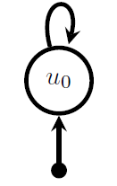
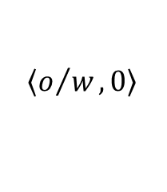


SEARCHING FOR AN RM – CASE 1
$\left\langle ,1\right\rangle$;
$\left\langle ,1\right\rangle$;
$$\left\langle o/w,0\right\rangle$$
Learning the smallest RM that correctly mimics the external reward signal given by the environment
This naive RM correctly predicts reward in the domain but provides no memory in support of solving the task
NAIVE RM
25/05/2020
Page 10

Slide 11
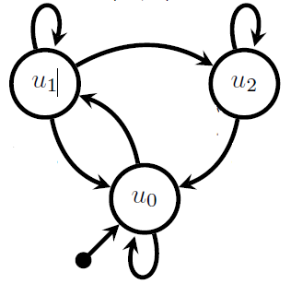
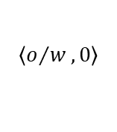



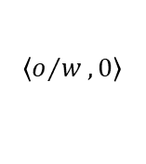

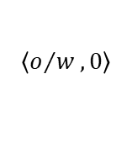

SEARCHING FOR AN RM – CASE 2
$$\left\langle o/w,0\right\rangle$$
$$\left\langle ,0\right\rangle ;$$
$$\left\langle o/w,0\right\rangle$$
$$\left\langle ,0\right\rangle$$
$$\left\langle ,0\right\rangle$$
Looking for the RM whose optimal policy receives the most reward
Requires computing optimal policies in order to compare the relative quality of RMs, which seems prohibitively expensive
$$\left\langle ,1\right\rangle$$
$$\left\langle ,1\right\rangle$$
$$\left\langle o/w,0\right\rangle$$
OPTIMAL RM
25/05/2020
Page 11

Slide 12

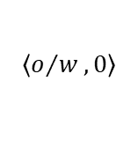




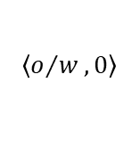
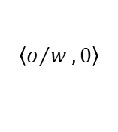


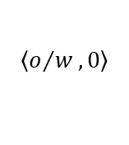


SEARCHING FOR AN RM - CASE 3
$$\left\langle o/w,0\right\rangle$$
$$\left\langle ,0\right\rangle ;$$
$$\left\langle o/w,0\right\rangle$$
$$\left\langle ,0\right\rangle ;$$
$$\left\langle o/w,0\right\rangle$$
$$\left\langle ,0\right\rangle$$
$$\left\langle ,0\right\rangle$$
Learning the RM that remembers sufficient information about the history to make accurate Markovian predictions about the next observation (w.r.t. O x U)
Since keeping track of more information will not result in better predictions, this RM is perfect
$$\left\langle ,0\right\rangle$$
$$\left\langle ,0\right\rangle$$
$$\left\langle ,0\right\rangle$$
$$\left\langle ,1\right\rangle$$
$$\left\langle ,1\right\rangle$$
$$\left\langle o/w,0\right\rangle$$
PERFECT RM
25/05/2020
Page 12

Slide 13
PERFECT RM - DEFINITIONS AND THEOREMS
DEFINITION: An RM Rp is considered perfect for a POMDP Po with respect to a labelling function L if and only if for every trace generated by any policy over Po, the following holds:
THEOREM: Given any POMDP Po with a finite reachable belief space, there will always exists at least one perfect RM Rp for Po with respect to some labelling function L.
THEOREM: Let Rp be a perfect RM for a POMDP PO w.r.t. a labelling function L, then any optimal policy for Rp w.r.t. the environmental reward is also optimal for Po.
25/05/2020
Page 13

Slide 14
PERFECT RM - LEARNING
Learning a perfect RM from traces, assuming one exists w.r.t. the given labelling function L
One solution can be to fit a predictive model for the previously probability and picking the RM that makes better predictions but it’s very expensive
Alternative that focuses on a necessary condition for a perfect RM: the RM must predict what is possible and impossible in the environment at the abstract level
25/05/2020
Page 14

Slide 15

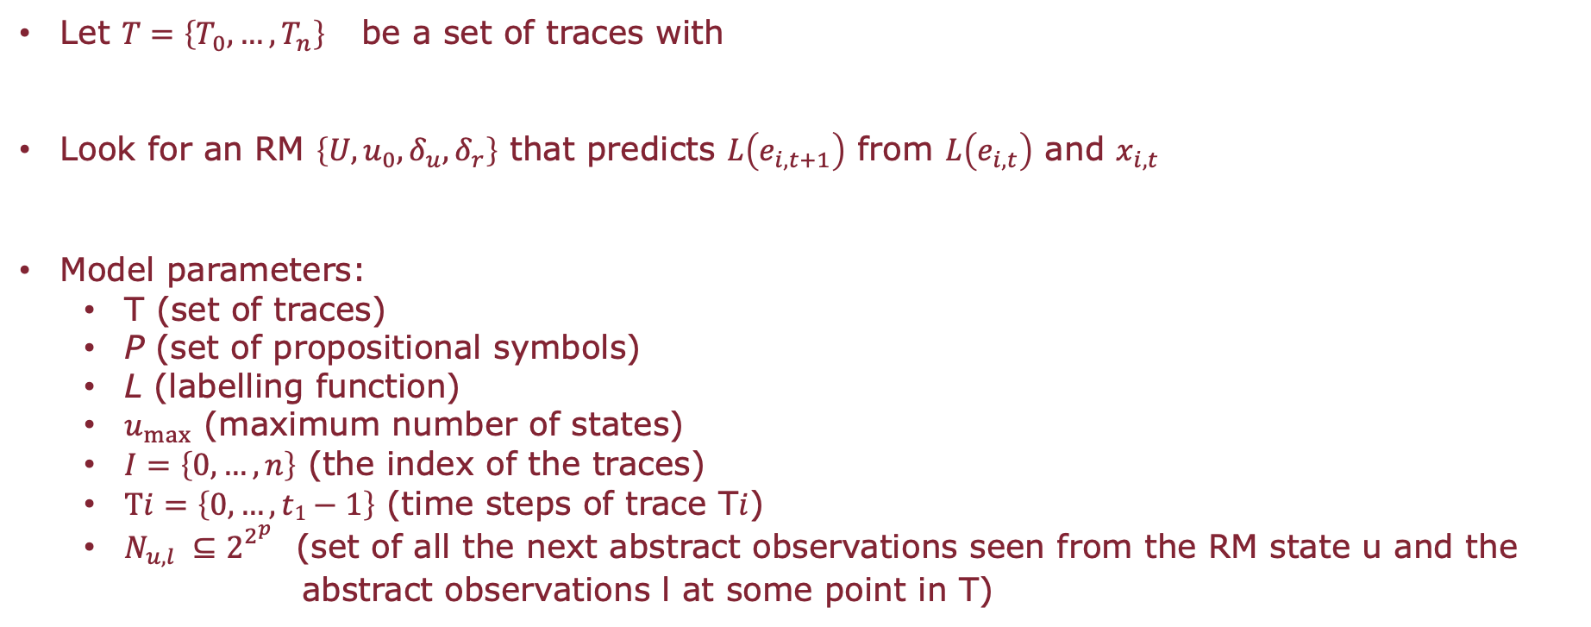
PERFECT RM - LEARNING
Let $T=\left\{T_{0},…,T_{n}\right\}$be a set of traces with
Look for an RM $\left\{U,u_{0},δ_{u},δ_{r}\right\}$ that predicts $L\left(e_{i,t+1}\right)$ from $L\left(e_{i,t}\right)$ and $x_{i,t}$
Model parameters:
T (set of traces)
P (set of propositional symbols)
L (labelling function)
$u_{max}$ (maximum number of states)
$I=\left\{0,…,n\right\}$ (the index of the traces)
$Ti=\left\{0,…,t1−1\right\}$ (time steps of trace T$i$)
$N_{u,l} ⊆2_{}^{2^{p}}$ (set of all the next abstract observations seen from the RM state u and the
abstract observations l at some point in T)
25/05/2020
Page 15

Slide 16
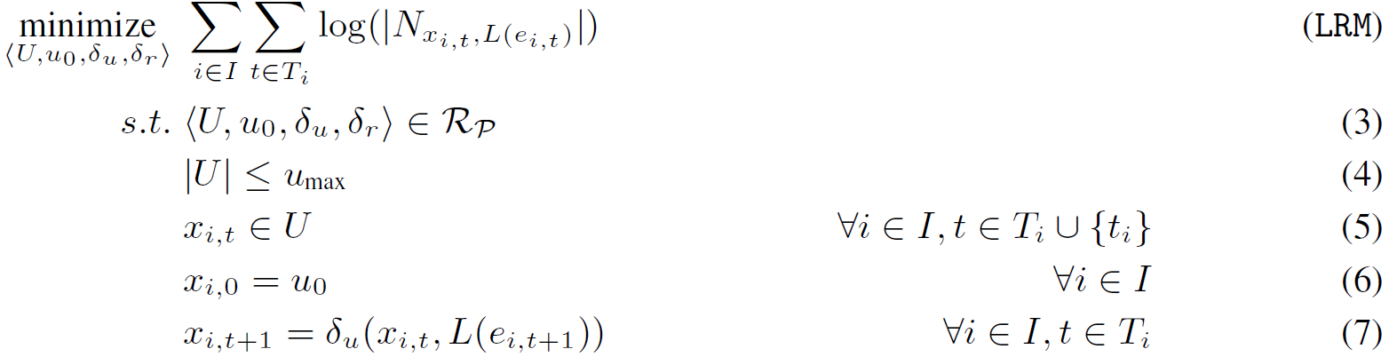
LRM OPTIMIZATION PROBLEM
The objective function comes from maximizing the log-likelihood for predicting L(ei,t+1) using a uniform distribution over all the possible options given by Nu,l.
25/05/2020
Page 16

Slide 17
PERFECT RM – SOLVING THE MINIMIZATION PROBLEM
Local search was the most effective category of methods
Tabu search guarantees convergence
Start from a random RM and iteratively evaluates neighbouring RMs
The new RM will be the one with the minimum value of the objective function
Pruning and methods to avoid local minima also used
25/05/2020
Page 17

Slide 18
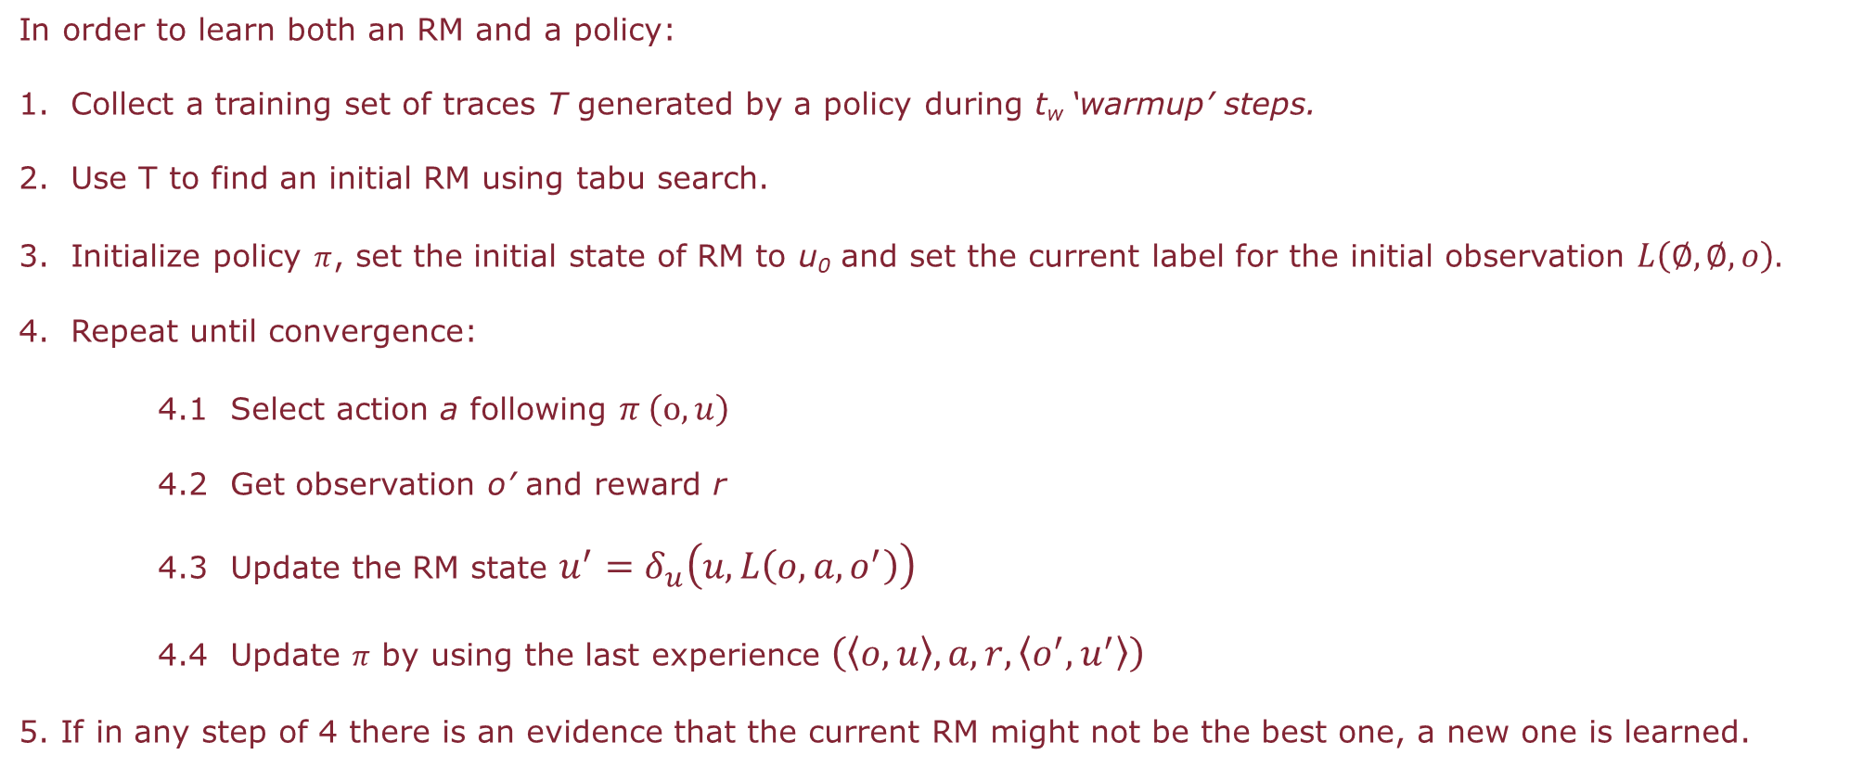
PERFECT RM – SIMULTANEOUS LEARNING
In order to learn both an RM and a policy:
Collect a training set of traces T generated by a policy during t_{w} ‘warmup’ steps.
Use T to find an initial RM using tabu search.
Initialize policy $π$, set the initial state of RM to u₀ and set the current label for the initial observation $L\left(∅,∅,o\right).$
Repeat until convergence:
4.1 Select action a following $π \left(o,u\right)$
4.2 Get observation o’ and reward r
4.3 Update the RM state $u^{′}=δ_{u}\left(u,L\left(o,a,o^{′}\right)\right)$
4.4 Update $π$ by using the last experience $\left(\left\langle o,u\right\rangle ,a,r,\left\langle o^{′},u^{′}\right\rangle \right)$
5. If in any step of 4 there is an evidence that the current RM might not be the best one, a new one is learned.
25/05/2020
Page 18

Slide 19

PERFECT RM – LEARNING A NEW RM
What can be an evidence that a new RM must be learned?
RM R is selected in order to:
If the current abstract observation l’ is not in N_{u,l} then the current trace will increase the size of N_{u,l} and the cost of R.
So the trace will be add to T and a new RM is found using the Tabu search.
If the new RM is better than R then a new policy must be learned from scratch.
Learning Reward Machines for Partially Observable Reinforcement Learning
25/05/2020
Page 19

Slide 20
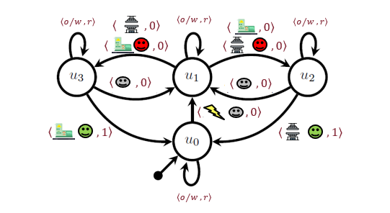
PERFECT RM – DQRM UNDER PARTIAL OBSERVABILITY
An experience e=(o,a,o’) can be more or less likely depending on the RM state where the experience was collected.
Update q_{u} using (o,a,o’) if and only if L(o,a,o’) ∈ N_{u,l} with l abstract observation that generated e.
Learning Reward Machines for Partially Observable Reinforcement Learning
25/05/2020
Page 20

Slide 21
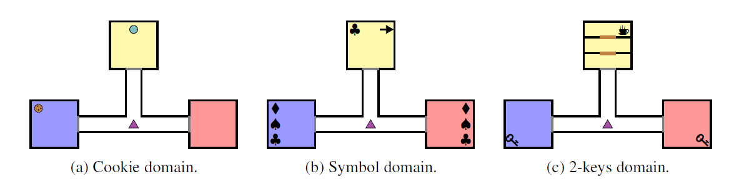
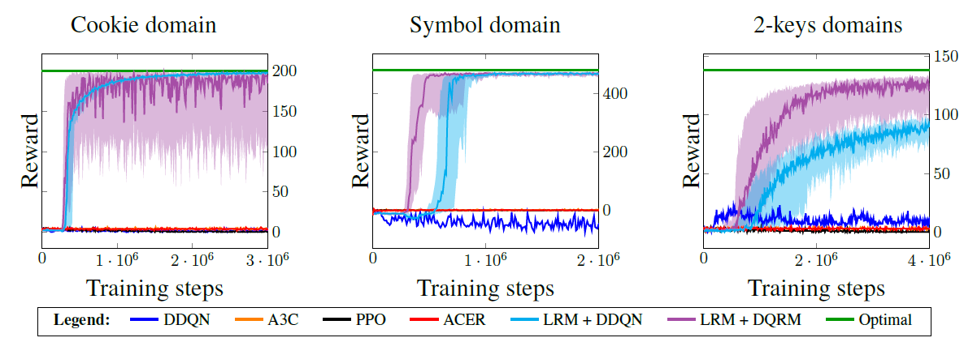
EVALUTION
Stochastic partially observable domains.
Tested two versions of LRM:
- LRM + DDQN
- LRM + DQRM
Cumulative reward every 10,000 training steps.
Median of 30 training runs per domain.
The LRM versions outperform every baseline.
LRM-DQRM faster but more unstable than LRM-DDQN.
25/05/2020
Page 21

Slide 22
ADVANTAGES AND LIMITATIONS
RMs proved to be able to predict possible and impossible future observations.
Defining high-level properties might not be trivial for more complex environments.
Tabu search is the main bottleneck of the entire procedure.
RMs might ignore (relevant) low-level informations.
Unclear how to handle noise over the L detectors and how to apply transfer learning from previously learned policies when a new RM is learned.
25/05/2020
Page 22

Slide 23

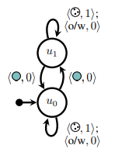

RM LIMITATION - EXAMPLE
Given a perfect RM is very simple.
LRM might not find it because the button changes only the low level probability and nothing on the abstract level.
The heuristic in QRM would not work since the experience with the force on will be used to learn a policy in both RM states.
25/05/2020
Page 23

Slide 24
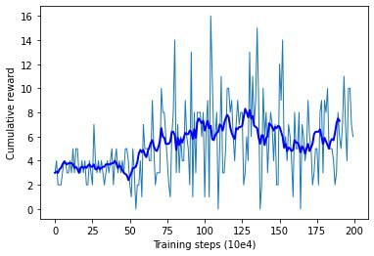

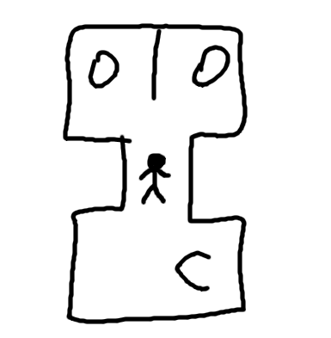
OUR OWN WORLD
Waiter world: P=<0,1,2,3,*,C,O>
Learning Reward Machines for Partially Observable Reinforcement Learning
25/05/2020
Page 24

Slide 25
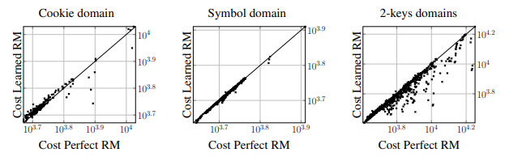
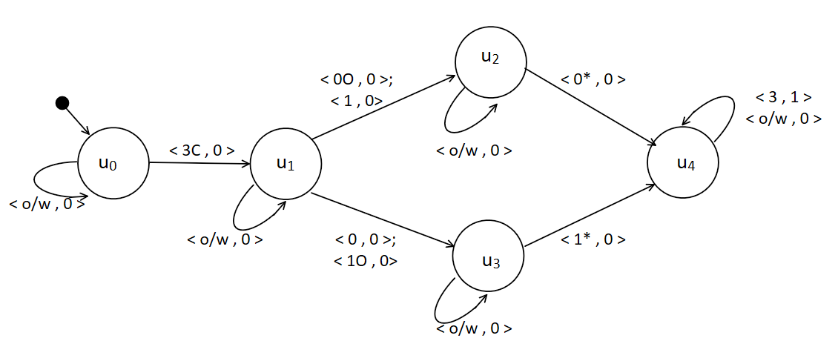
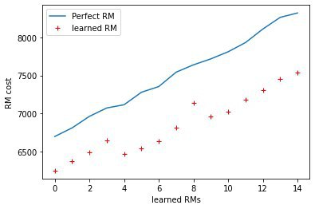
RESULTS
Learning Reward Machines for Partially Observable Reinforcement Learning
25/05/2020
Page 25

Slide 26
CONCLUSIONS
This work showed how RL agents can solve cognitively challenging partially observable tasks.
High level abstraction with RM and low-level policy using deep RL.
The study showed some obstacles regarding:
Abstraction
Observability
Properties of language used for RM construction
Learning Reward Machines for Partially Observable Reinforcement Learning
25/05/2020
Page 26

