Slide 2
How to find a Date for Valentine’s?
As a computer scientist
Marvin Beckmann
PhD Student in Cybersecurity Engineering at DTU

Slide 3
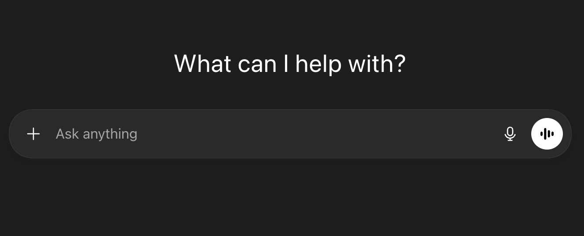
How can I find a date for valentines

Slide 4
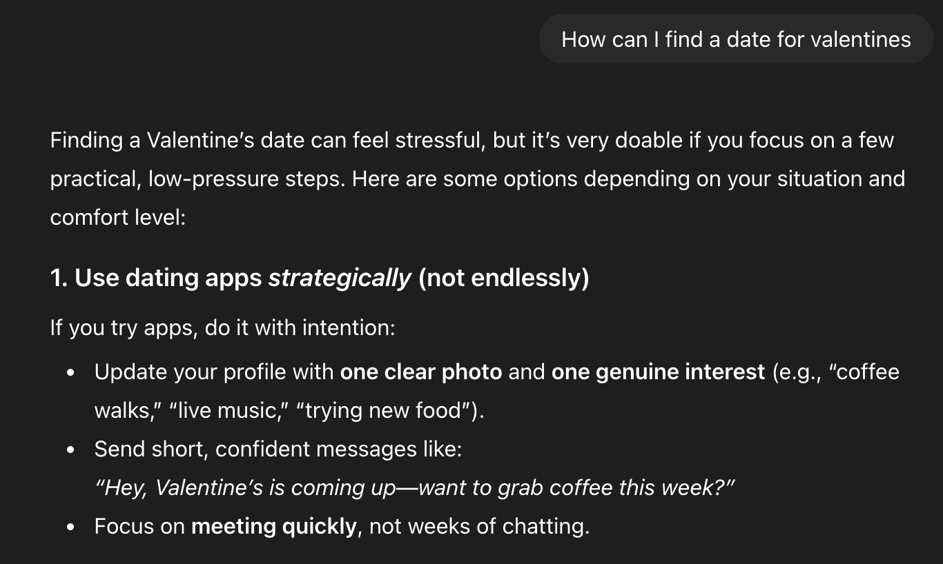
Finding a Valentine’s date can feel stressfull, but it’s very doable if you focus on a few pracitcal, low-pressure steps.
How to Find a Valentine’s Date
Choose who to ask: A friend, classmate, coworker, or someone you already know.
Check your feelings: Do you know them well? Are there already feelings or curiosity?
Decide how to ask: A letter can be romantic and reduce pressure.
Pick a good location: Choose a comfortable place where you can talk.
Mark the moment (optional): If the date goes well, a small symbolic gift.

Slide 5
How do I write the perfect letter?

Slide 6
Do you want to go out with me?
yes
no
maybe

Slide 7




What are your fears?
Confidentiality Somone else can read it
Integrity Someone changed the content
Authenticity The recipient needs to know it is from you
Deniability They can prove that you send it

Slide 8

It is not just about Romance!
Protests
Journalistic Sources
Whistleblowers

Slide 9





What keeps your Messages Secret?
Key Exchange
Encrypted Communication
Tries to steal your Valentine’s
(and your data)

Slide 10
Why is he a Threat to me?
Has a lot of muscles (more computing power)
Has better genetics (quantum computers)
Problem: I can not get more or better muscles in time (I want to keep using my phone)
Tries to steal your data (and your Valentine’s)

Slide 11
What can I do now?

Slide 12

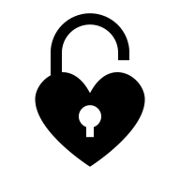
Make it bigger?

Slide 13

Use a Different Approach!

Slide 14

Side Effects?
The simple and well-studied padlock is replaced
The new approach might not be as resilient as hoped
The new approach is more complex and needs additional modifications

Slide 15



What Changes for your Letter?
You need a different way to deliver your letter
You want to keep (confidentiality, authentication, integrity, deniability)
Most promising solution: Ring Signatures
It all comes down to choosing the ring

Slide 16


What are Ring Signatures
An extension of digital signatures
Every member of the ring can sign on behalf of all the members.
Unforgeability: no one outside of the ring can produce a valid signature.
Anonymity: no one outside of the ring can figure out which member signed.
Full Anonymity: anonymous even for the members of the ring.

Slide 17

Conclusion
If you do not have a Valentine’s, now you know how to proceed!
If you want to be save from this guy long term, you need to:
Choose a good ring
Thanks for listening!

