Slide 1
NPP-GUARD
从分类器到可审计的
核电事故诊断原型
NPPAD 仿真时序数据 · 01–19 研究路线 · v1 release protocol
会拒答 · 可解释 · 可复现
科研汇报 / 创新竞赛 / 面试展示
2026-09-22
Notes:
Source: NPP-Guard repository README and results/20_release_validation_summary.json. All claims are research-prototype claims.

Slide 2
01 · WHY
02
问题与场景
事故诊断的难点首先是证据边界，而不是模型数量。
早期窗口
标签与耦合
评估泄漏
分布偏移
30/60 s 可能没有足够可辨识信息
严重度与过程变量可能高度耦合
随机拆分时间行会共享同一条轨迹
severity extrapolation 会改变任务难度
项目目标
在证据不足时明确输出 Unknown / Requires Review，并把数据质量、模型依据和限制一起交付。
research prototype · simulation data · not for safety-critical deployment
Notes:
Source: docs/NPP-Guard_Final_Technical_Report.md, sections Problem and Methodological Design.

Slide 3
02 · DATA
03
NPPAD 数据与评估挑战
固定输入边界，让模型只能使用明确声明的过程信号。
NPPAD
1216 条轨迹
17 个事故类别
38 个严格过程变量
TIME + 约 10 s 采样
190 个派生特征
last / delta / mean / std / slope
数据审计结论
独立 Normal reference 不足 · 事故前仅有 t=0 · singleton 类别延后 · 时间行不随机拆分
research prototype · simulation data · not for safety-critical deployment
Notes:
Sources: results/09_multi_accident_audit_summary.json; artifacts/v1/manifest.json; docs/figures/20_research_route.mmd.

Slide 4
03 · RESEARCH ROUTE
04
研究路线：从负结果到 release protocol
01–06
07–08
09–14
15–16
17–19
数据与 Normal
审计
LOCA severity
与 protection-time
多事故、稳健性
与 OOD
coverage-aware
与 Unknown policy
冻结 release、解释
与 Dashboard
方法学转折：不把 random split 的高分直接当作外部泛化
research prototype · simulation data · not for safety-critical deployment
Notes:
Source: docs/figures/20_research_route.mmd and docs/NPP-Guard_Final_Technical_Report.md.

Slide 5
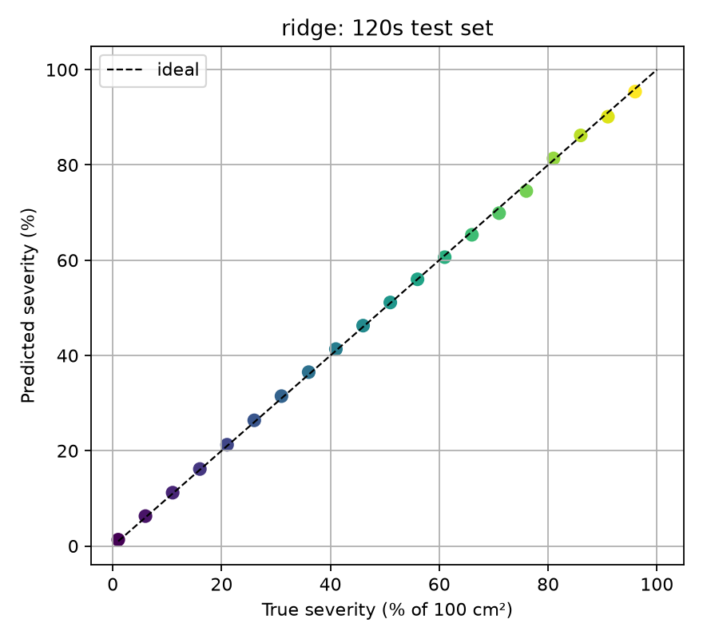
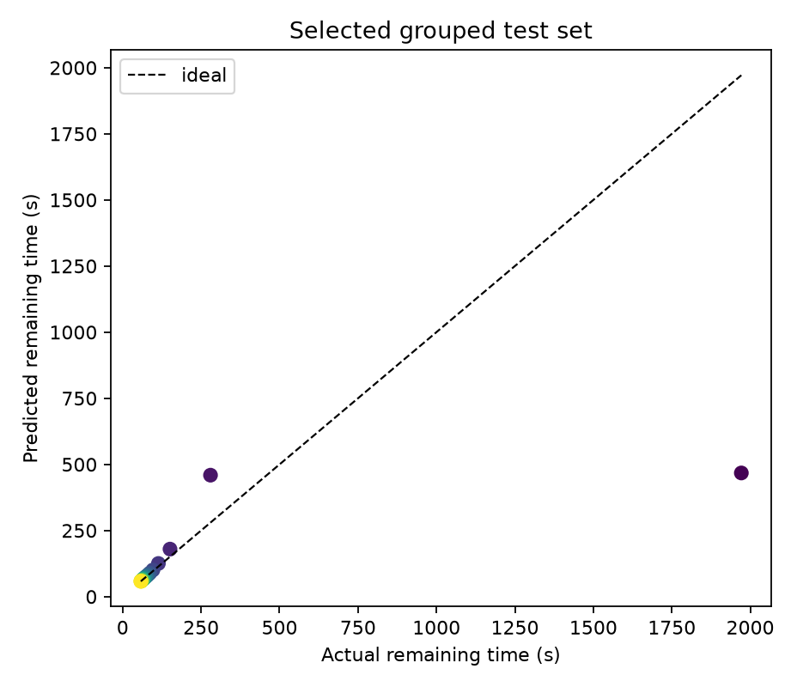
04 · LOCA
05
LOCA 专项：严重度可估计，保护时间仍有限
07 · Ridge + 120 s
08 · 60 s + Random Forest
MAE 0.4492 percentage points · R² 0.9996
MAE 86.826 s · R² 0.3303
research prototype · simulation data · not for safety-critical deployment
Notes:
Sources: results/07_severity_summary.json; results/08_protection_time_summary.json; results/figures/07_true_vs_predicted_severity.png; results/figures/08_predicted_vs_actual_remaining_time.png.

Slide 6
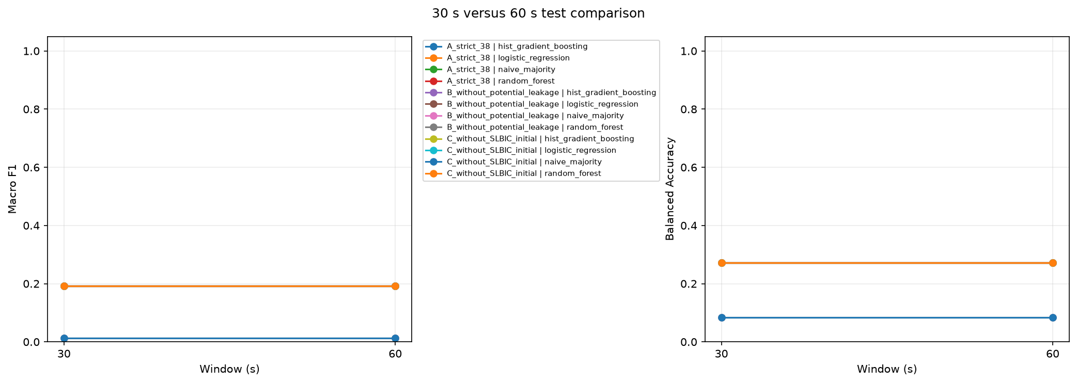
05 · DIAGNOSABILITY
06
多事故诊断：120 s 才出现可见区分度
A strict 38 · test
30 s
0.1928
60 s
0.1928
120 s
0.7526
Macro-F1
30/60 s 相同结果触发了特征、采样点、cohort 与预测分布审计；120 s 只作为探索窗口，不是早期预警保证。
research prototype · simulation data · not for safety-critical deployment
Notes:
Source: results/10_multi_accident_metrics.csv and results/figures/10_30_vs_60_comparison.png. Values are all-sample random grouped test metrics for A_strict_38.

Slide 7
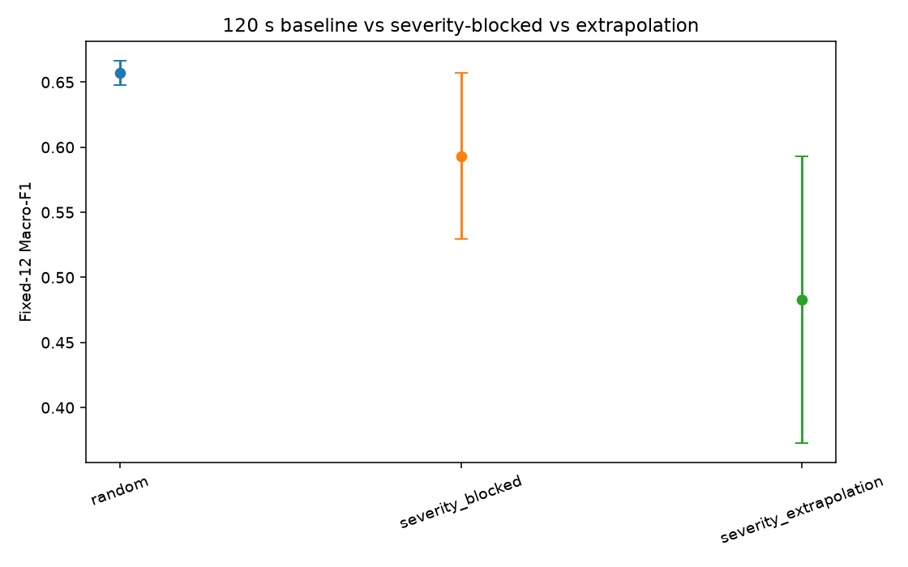
06 · OOD
07
OOD 验证：severity extrapolation 会拉低结果
120 s · A strict 38
random
0.6573
severity-blocked
0.5931
extrapolation
0.4826
结论
跨严重度压力测试仍不足以支持直接进入深度学习或部署泛化声明。
research prototype · simulation data · not for safety-critical deployment
Notes:
Source: results/13_ood_summary.json and results/figures/13_baseline_blocked_extrapolation_macro_f1.png.

Slide 8
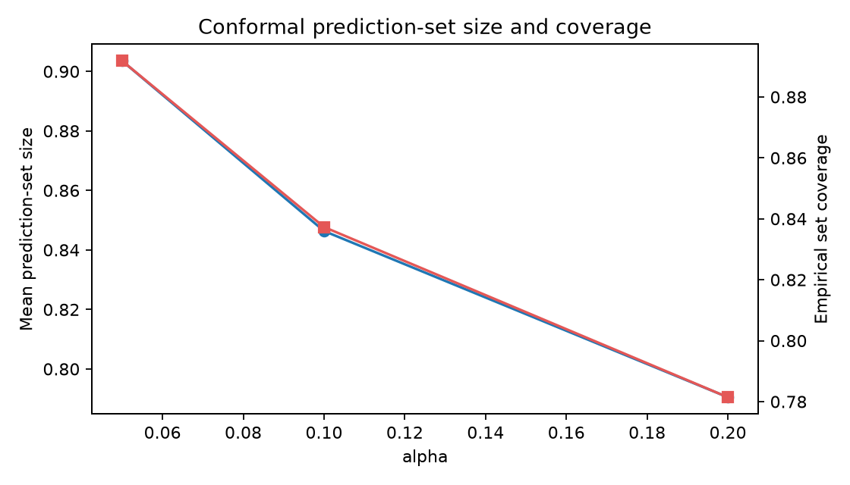
07 · SELECTIVE
08
Selective diagnosis：拒答本身也是输出
16 · alpha = 0.10
经验 set coverage
68.9%
Selective Macro-F1
0.6700
Distance OOD proxy AUROC
0.8221
经验覆盖率不等于统计保证；v1 保留 Unknown / Requires Review。
research prototype · simulation data · not for safety-critical deployment
Notes:
Source: results/16_summary.json and results/figures/16_conformal_set_size_coverage.png. OOD AUROC is a severity-shift proxy.

Slide 9
08 · INFERENCE CORE
09
NPP-Guard v1 架构
CSV /
DataFrame
Data
Quality
120 s
Features
Family
Classifier
Calibration
+ Conformal
Distance
OOD
Status
Policy
accepted
requires_review
unknown
invalid_input
LOCA severity
exploratory gated path
accepted + LOCA family + Tier A
research prototype · simulation data · not for safety-critical deployment
Notes:
Source: docs/figures/20_npp_guard_architecture.mmd and artifacts/v1/manifest.json.

Slide 10
09 · RELEASE
10
17.2 release protocol：先隔离，再比较
locked release test = 101 条轨迹
release test 与所有 fit / calibration 集 zero overlap
train
probability
calibration
conformal
calibration
distance
fit
locked
release test
API / batch exact parity
101/101 = 100%
最大浮点绝对差 0 · regression 18/18 · SHA-256 10/10
research prototype · simulation data · not for safety-critical deployment
Notes:
Sources: results/17_v1_pipeline_parity.json; results/17_v1_regression_tests.csv; results/18_summary.json.

Slide 11
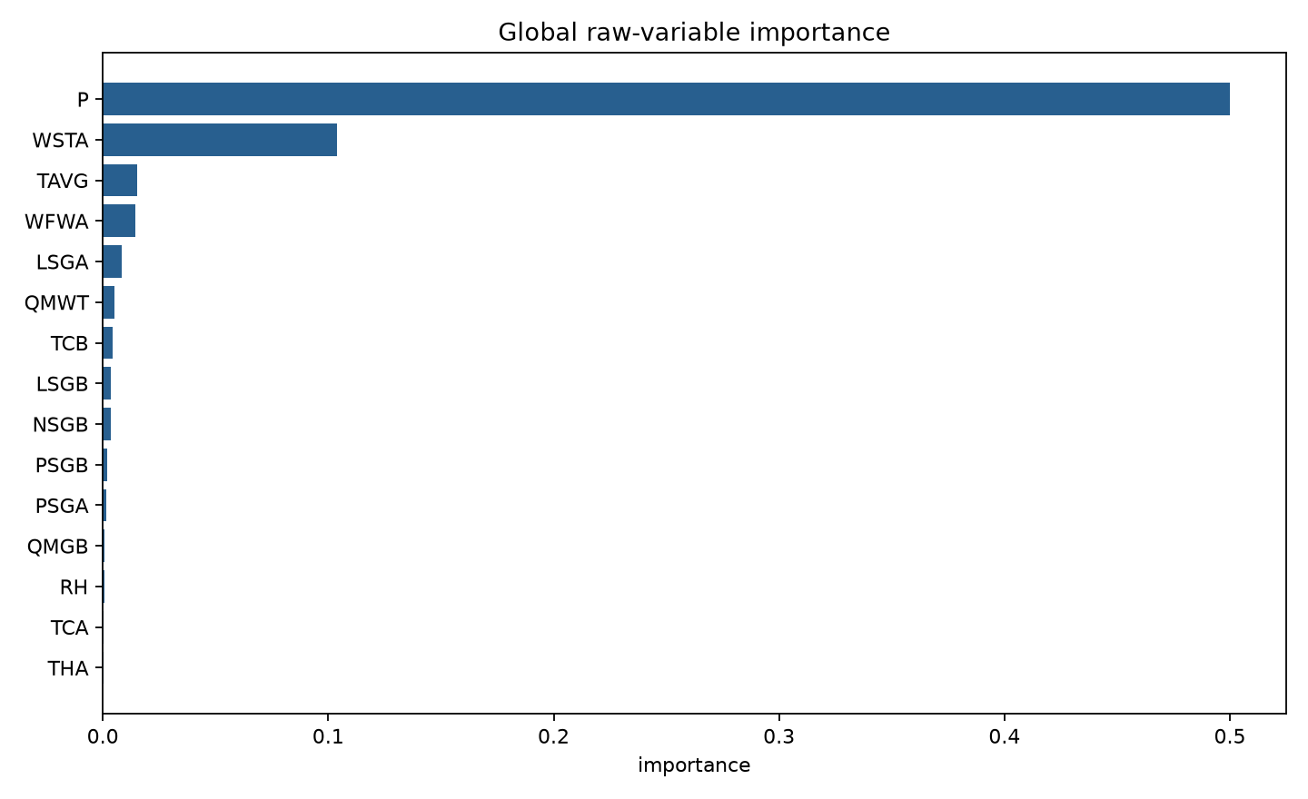
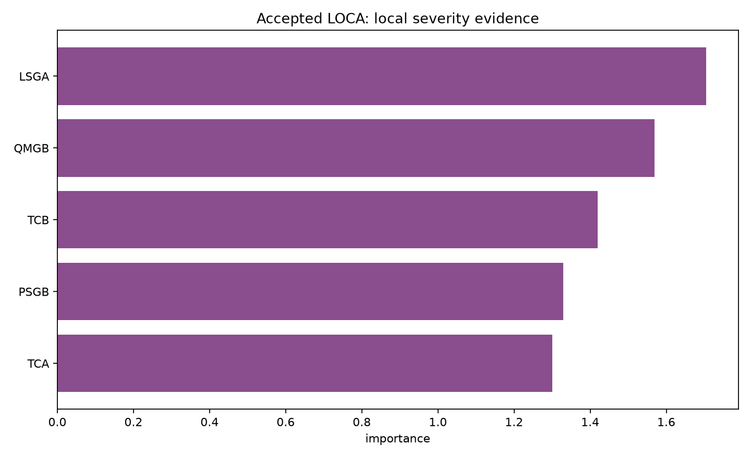
10 · EXPLAINABILITY
11
Explainability：解释模型如何判断，不伪装成因果
Top variables: P / WSTA / TAVG / WFWA / LSGA
Top-5 Jaccard 0.9722 · family faithfulness +0.7532
18 gate：artifact SHA-256 10/10 · parity 101/101 · regression 18/18
research prototype · simulation data · not for safety-critical deployment
Notes:
Sources: results/18_summary.json; results/figures/18_global_variable_importance.png; results/figures/18_accepted_loca_severity_explanation.png. Attribution is not physical causality.

Slide 12
11 · DASHBOARD
12
Dashboard：把诊断、拒答和解释放进同一页面
真实样例路径
FLB/10.csv · LOCAC/19.csv · LOCAC/12.csv · LR/93.csv · 50 s truncation
accepted
requires_review
unknown
invalid_input
研究模型接受
OOD / 能力边界
证据不足
预测前拒绝
5/5 smoke · 3/3 helper · HTTP 200 · AppTest 0 exceptions · JSON export excludes raw CSV
本次交付未生成虚构截图；演示使用仓库中的真实样例路径。
research prototype · simulation data · not for safety-critical deployment
Notes:
Sources: results/19_dashboard_summary.json; results/19_dashboard_smoke_tests.csv; docs/demo_script.md. No fabricated screenshot is used.

Slide 13
12 · RESULTS
13
关键实验总表：数字必须连同协议一起看
阶段 | 协议 / 窗口 | 指标 | 记录
07 | grouped · 120 s | LOCA MAE | 0.4492 pp
08 | strict · 60 s | Protection MAE | 86.826 s
10 | random · 30/60/120 s | Macro-F1 | 0.1928 / 0.1928 / 0.7526
13 | blocked / extrapolation · 120 s | Macro-F1 | 0.5931 / 0.4826
16 | extrapolation · alpha .10 | Coverage / F1 | 68.9% / 0.6700
17.2 | locked · 101 | Parity / regression | 101/101 / 18/18
19 | Streamlit local | Dashboard tests | 5/5 / 3/3 / HTTP 200
协议差异、支持度与限制见 docs/NPP-Guard_Key_Results_Table.md
research prototype · simulation data · not for safety-critical deployment
Notes:
Source: results/20_key_results.csv generated from existing milestone JSON/CSV files.

Slide 14
13 · CONTRIBUTION
14
方法学贡献与项目化交付
方法学
交付形态
1 完整 trajectory/sample_id 分组
1 conformal + distance 的主动拒答
2 train-only preprocessing + leakage flags
2 冻结 artifact + exact parity
3 random / blocked / extrapolation 分开报告
3 解释层与 Streamlit Dashboard
重点不是把系统包装成“99% 分类器”，而是让每个结论带着协议、证据和边界。
research prototype · simulation data · not for safety-critical deployment
Notes:
Source: docs/competition_materials.md and docs/resume_project_bullets.md.

Slide 15
14 · LIMITS
15
局限性与下一步
当前能交付的，是一个可审计的研究原型。
— Normal reference 不足，early-warning 仍不充分
下一步
— severity extrapolation 性能下降，部分类支持度低
固定功率 Normal
跨工况外部测试
更多 severity 覆盖
更严格 uncertainty calibration
— conformal 经验 coverage 不是统计保证
— subtype OOD 与 protection-time 链式输入未解决
在这些边界补齐前，不把 NPP-Guard 表述为真实核电站安全系统。
research prototype · simulation data · not for safety-critical deployment
Notes:
Source: docs/NPP-Guard_Final_Technical_Report.md and docs/NPP-Guard_v1_Release_Checklist.md.

