Slide 1
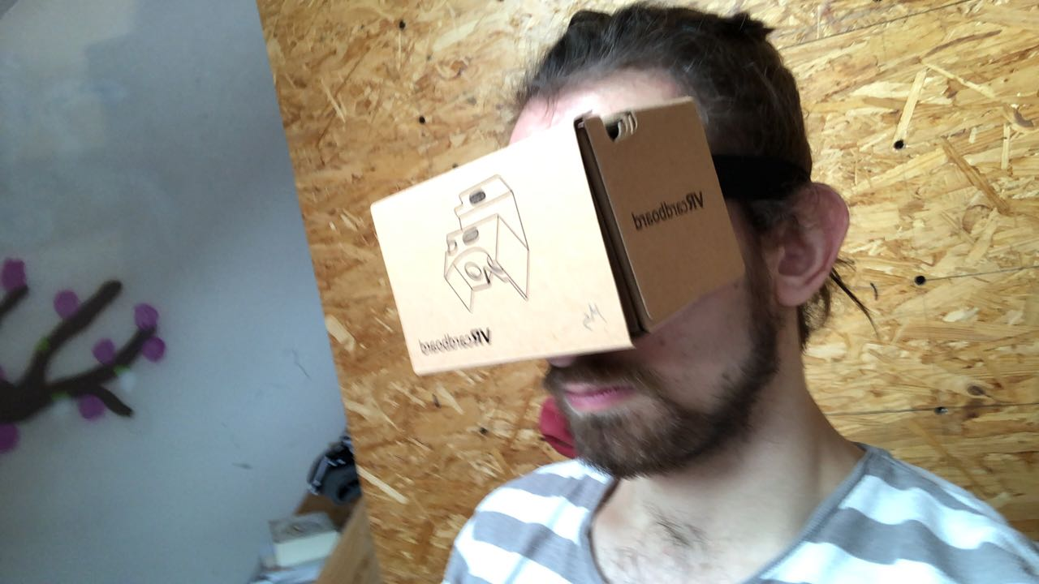
Media Transformation II
Interactive Storytelling in Virtual Reality
Busch, Eckmann, Sprenger und Thiel

Slide 2
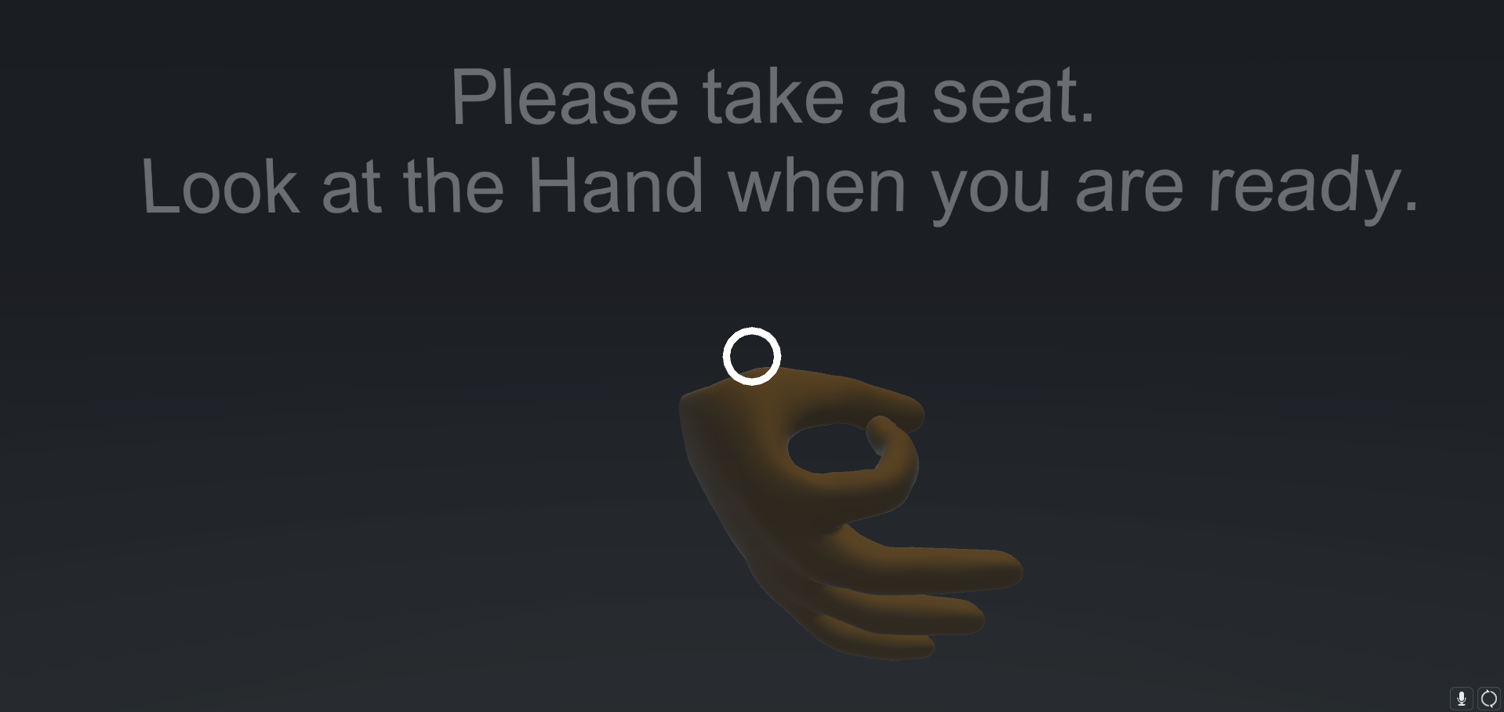
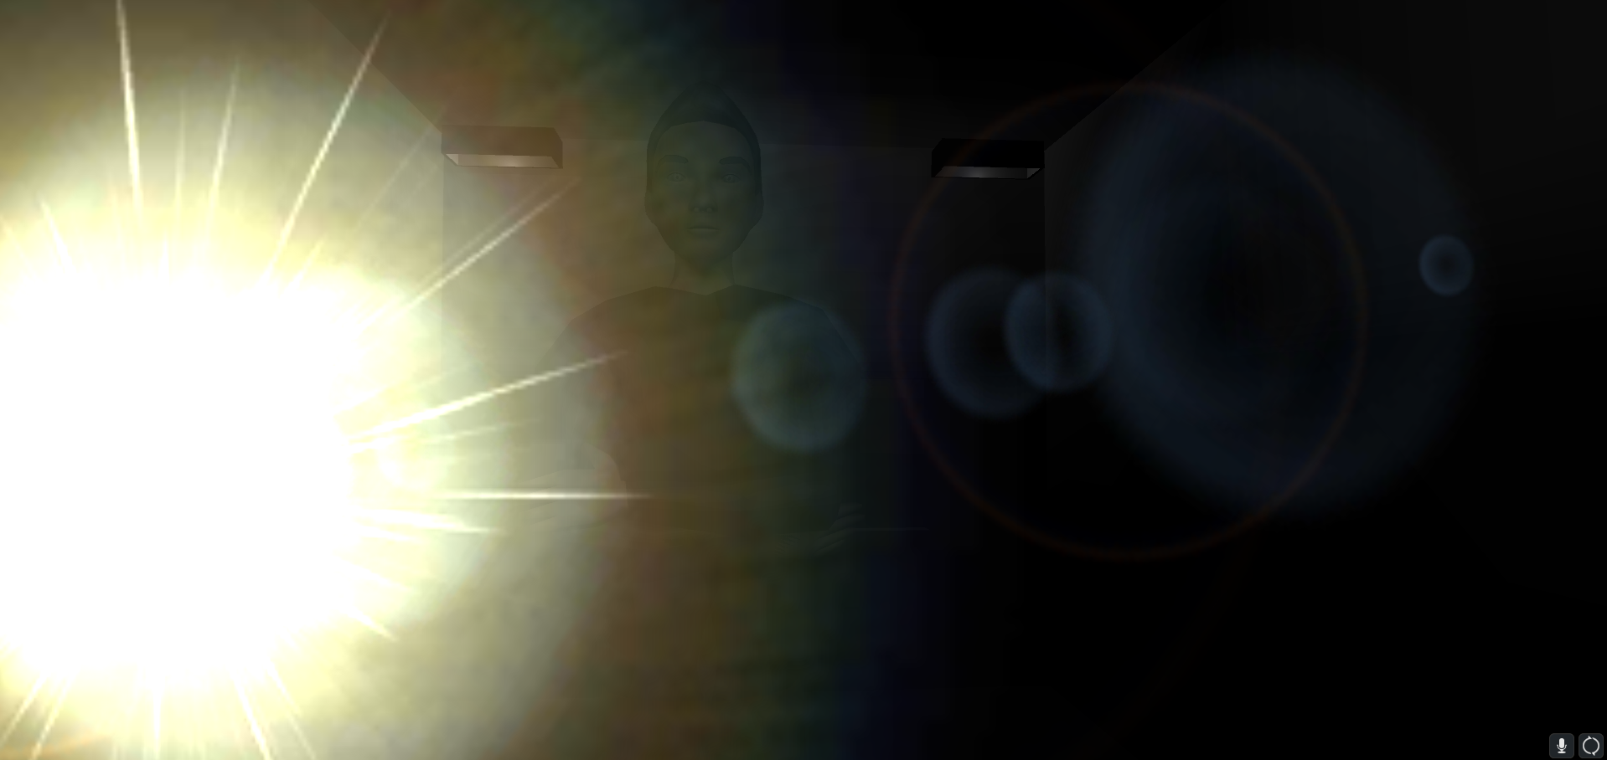
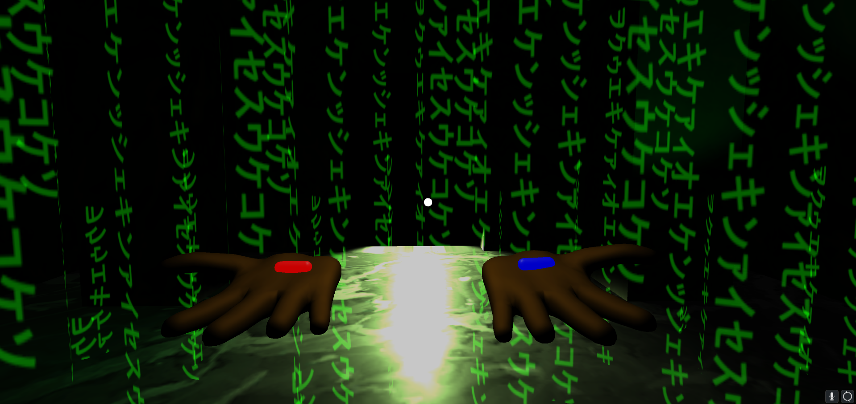
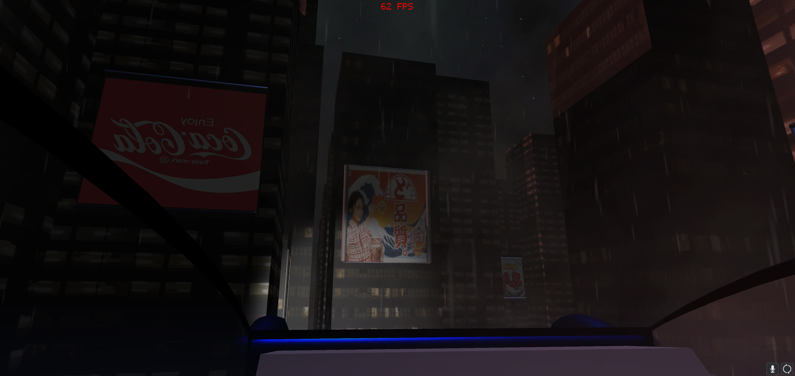
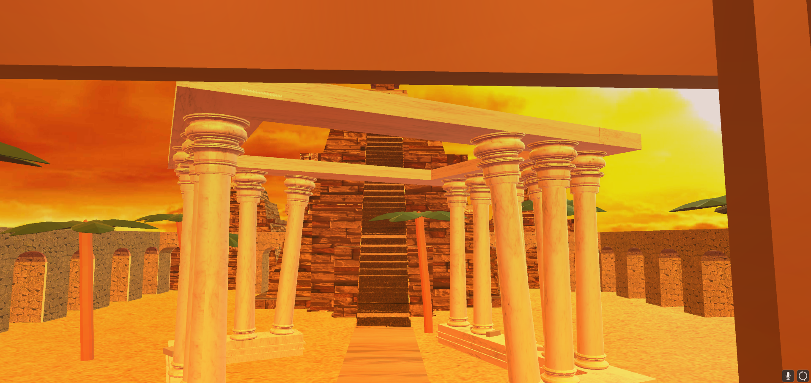
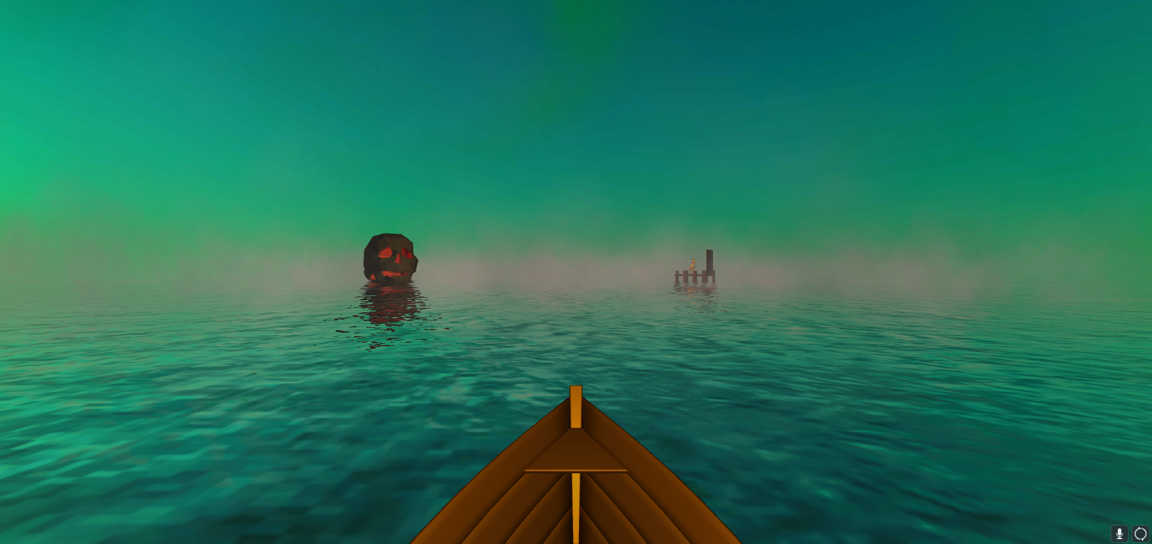
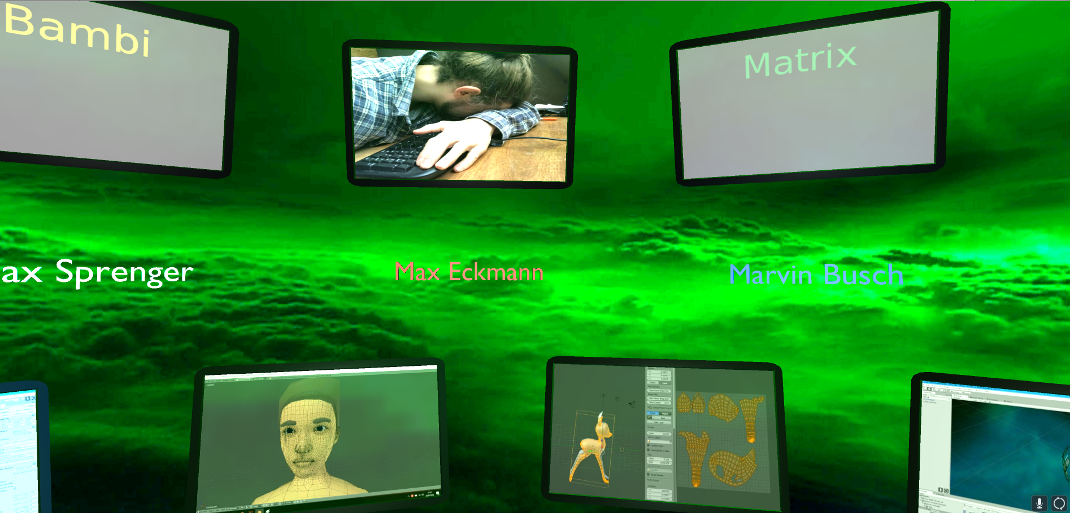
Current Status
Busch, Eckmann, Sprenger und Thiel

Slide 3
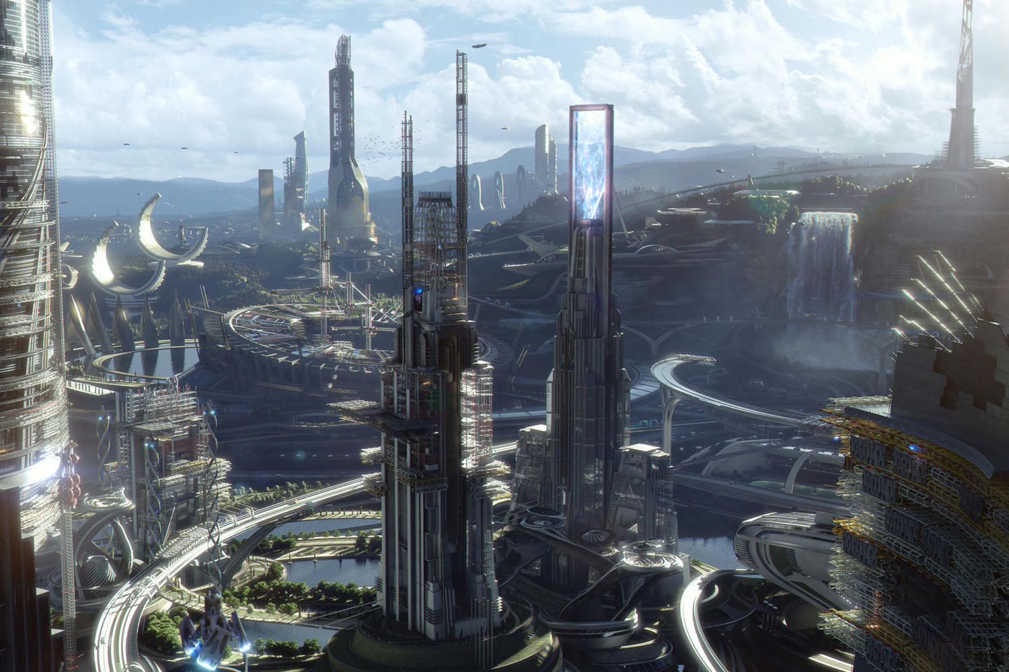
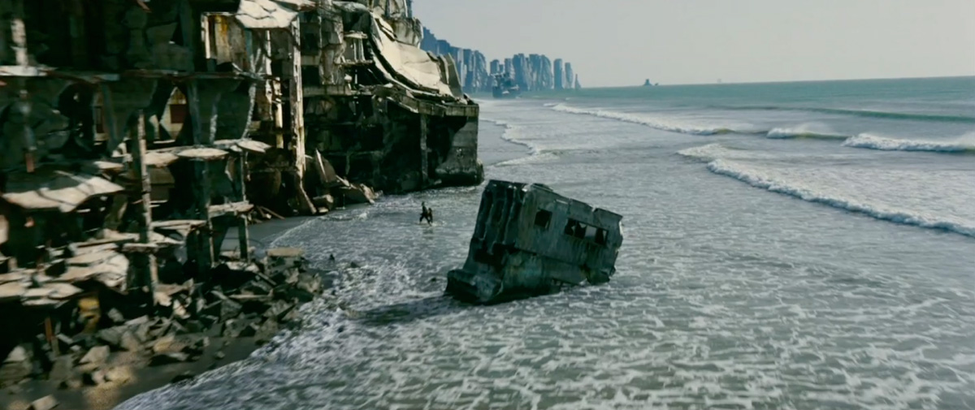
New Idea
New
New
Busch, Eckmann, Sprenger und Thiel

Slide 4
New Idea
New
New
New
Interrogation Scene: (frame)
- Using an interrogation as a frame to our project.
-> Jumping in different sub-stories
- The user is telling a story to the interrogator.
-> Sub-stories as
daydreams,
thoughts,
told by the user to the interrogator.
- Head tracking: 3 conditions -> {nodding, shaking, no reaction}
New
Busch, Eckmann, Sprenger und Thiel

Slide 5
New Idea
New
New
New
Matrix Scene: (1st Sub-story)
Reference:
The Matrix (1999)
A green Matrix rain is falling from the sky.
Decision -> red pill or blue pill
(Utopia or Dystopia)
New
Busch, Eckmann, Sprenger und Thiel

Slide 6
New Idea
New
New
New
New
Utopia Scene: (1st Sub-story A)
Reference:
Tomorrowland - A World Beyond (2015)
Scene has to be build yet.
Same interactive actions as in Dystopia.
Dystopia Scene: (1st Sub-story B)
Reference:
Blade Runner (1982)
Two ideas:
- Searching someone or something
in the scene.
-> end condition:
finding or failing (time)
- Directing the car through
the city to a target.
New
Busch, Eckmann, Sprenger und Thiel

Slide 7
New Idea
New
New
New
ElDorado Scene: (2nd Sub-story)
Reference:
The Road to El Dorado (2000)
A palanquin is carried through a crowd of people.
Task: to get the stones out of the way.
-> failure: if the palanquin has to stop.
success: palanquin gets to the temple.
New
Busch, Eckmann, Sprenger und Thiel

Slide 8
New Idea
New
New
New
River Scene: (3rd Sub-story)
References:
Bambi (1942)
The secret of Monkey Island (1990)
A small ship is sailing to a skull or a pier.
The previous decisions will direct the ship towards one target.
New
Busch, Eckmann, Sprenger und Thiel

Slide 9
New Idea
New
New
New
New
Limbus Scene: (death scene)
Reference:
Inception (2010)
Scene has to be build yet.
If the user is failing in one of the previous sub-scenes he or she is falling into the Limbus.
End Condition:
-> Time,
Door,
Something to go through.
New
Busch, Eckmann, Sprenger und Thiel

Slide 10
New Idea
New
New
New
Start Scene:
- Idea:
Sitting in a train, looking at a Case.
(Reference: Inception)
End Scene: (credits)
Using TV screens as credits.
Self-Reference to our Project.
-> Clips of the project on TV.
(Media transformation)
- Idea:
A spinning top ist spinning in the middle.
(Reference: Inception)
New
Busch, Eckmann, Sprenger und Thiel

Slide 11
New Idea
New
New
Busch, Eckmann, Sprenger und Thiel

