Slide 1
SAT & ACT Analysis
Marvin Fong

Slide 2
Problem Statement
Given that one of the Key Performance Indicator (KPI) of the College Board is to improve participation rates of standardized tests, I will be examining recent trends made by the 2018-19 SAT & ACT cohorts to find out which state(s) should the College Board focus their effort and resources on in order to improve SAT participation rates and also taking note that the increase in participation rate should not drastically decrease overall college acceptance rate.

Slide 3
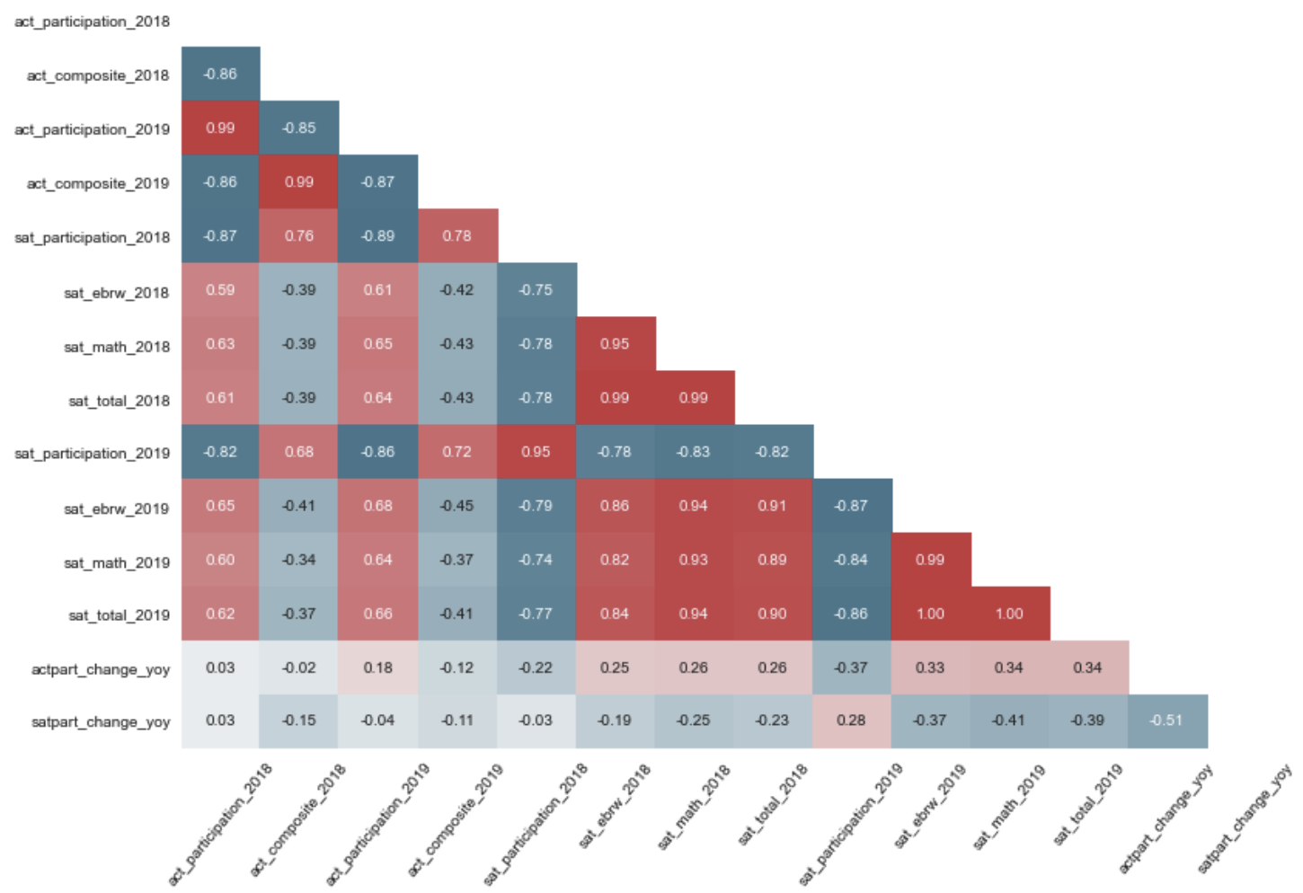
Brief overview of relationships observed between SAT & ACT:
Participation Rates vs. Total Mean Score
Participation Rates of SAT vs. ACT
Scores in 2018 vs. 2019

Slide 4
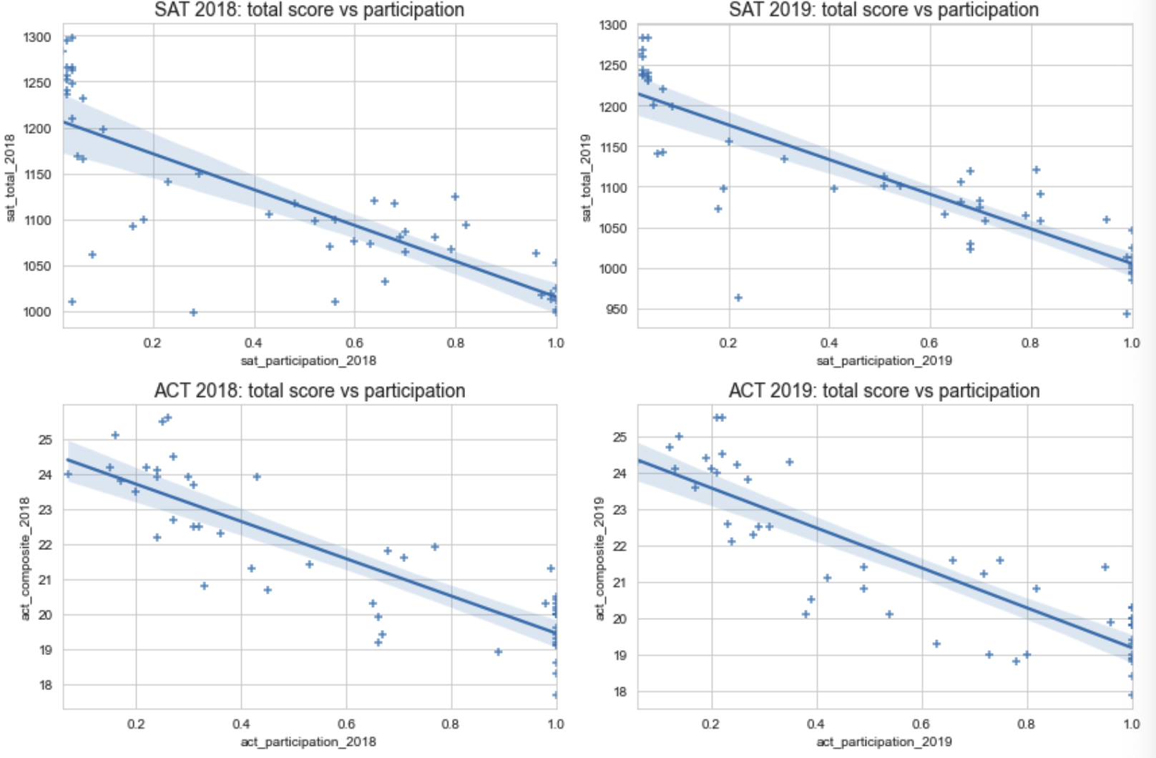
Inverse relationship between participation rates & total mean score

Slide 5
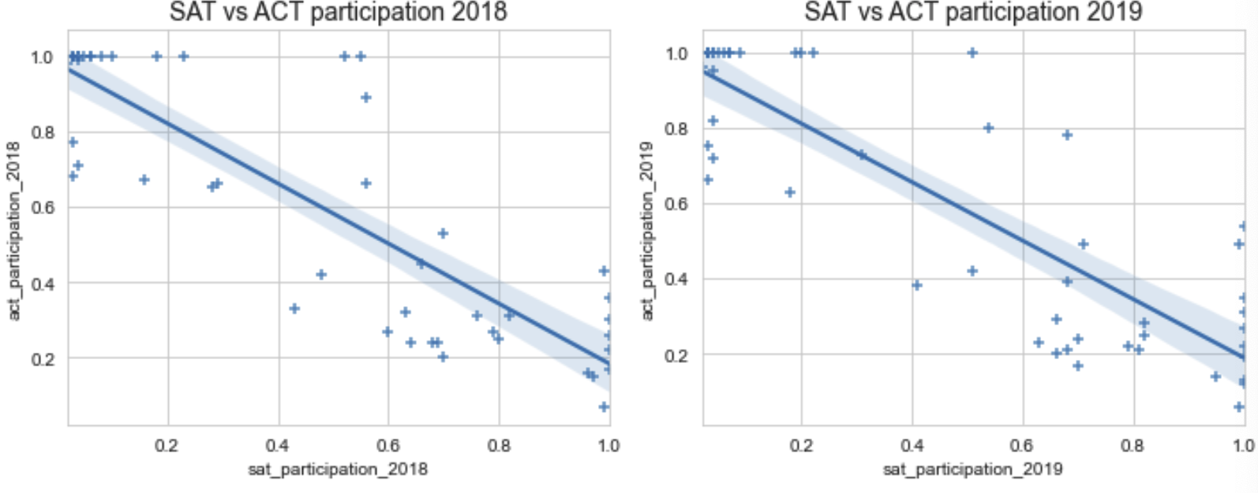
Inverse relationship between participation rates of sat & act

Slide 6
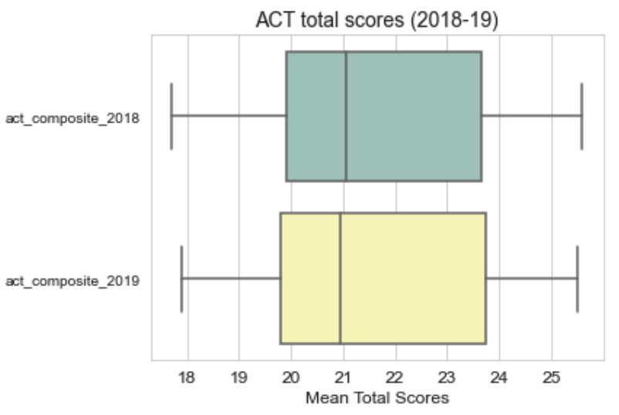
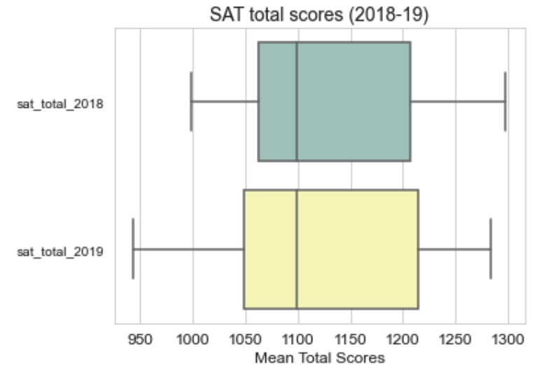
sat scores & act scores remained largely similar when comparing 2018 with 2019

Slide 7
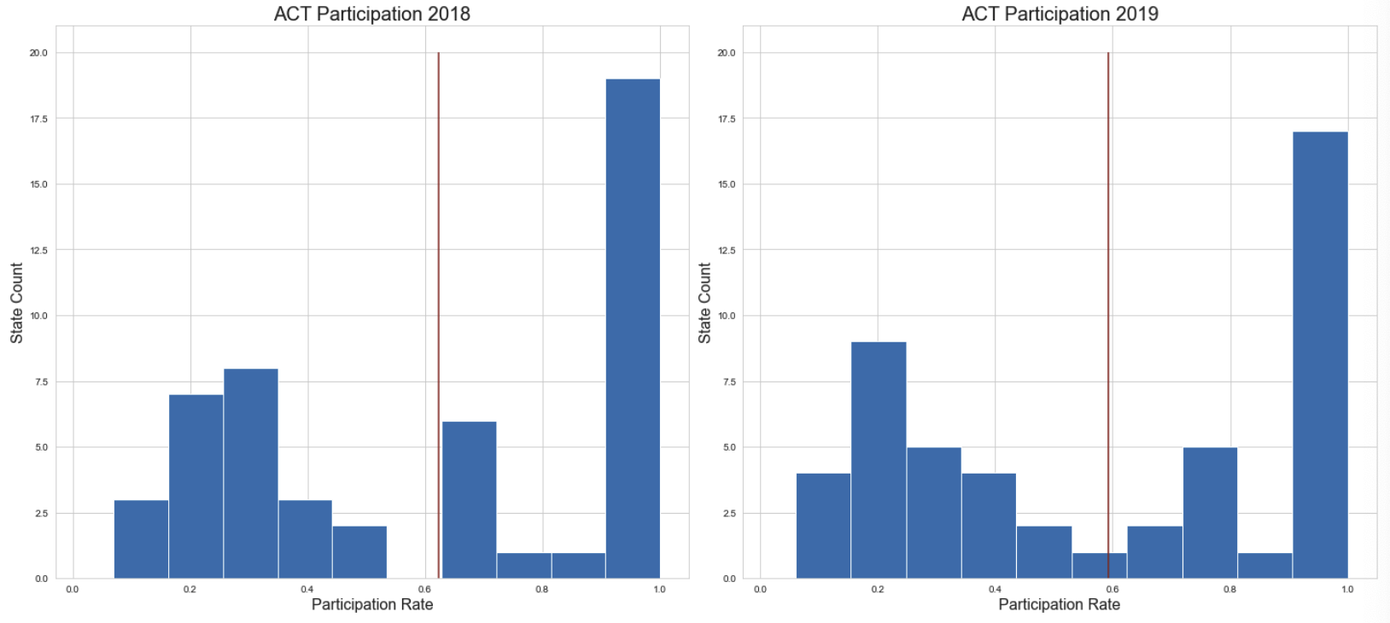
Distribution of ACT Participation in 2018 and 2019

Slide 8
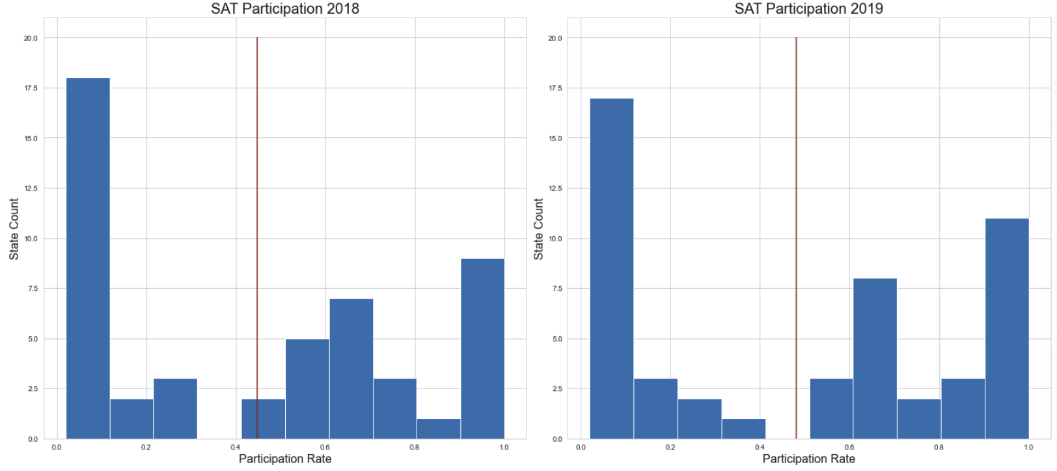
Distribution of SAT Participation in 2018 and 2019

Slide 9
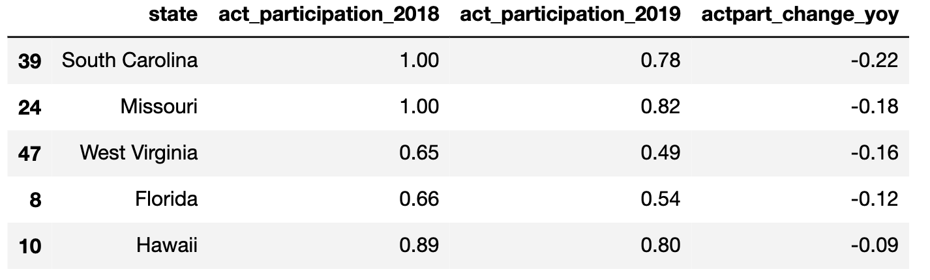
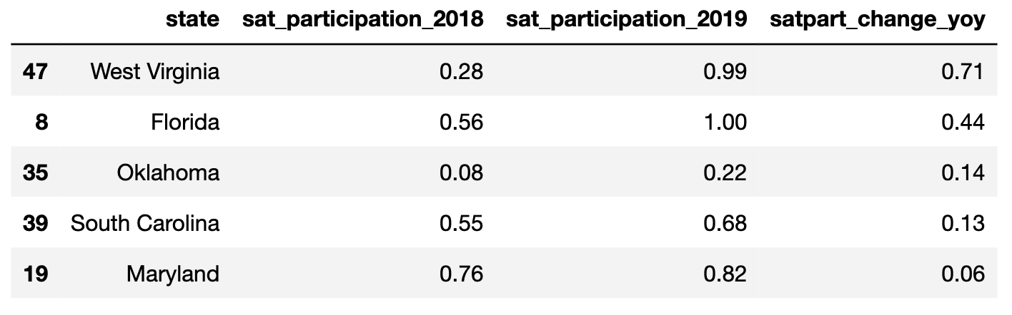
State with the Biggest change in participation rate

Slide 10
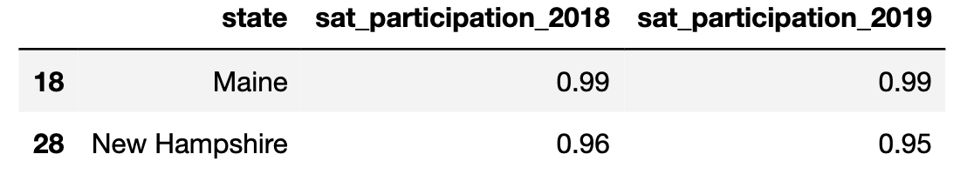
States with SAT participation rate between 90% & 99% for two years

Slide 11
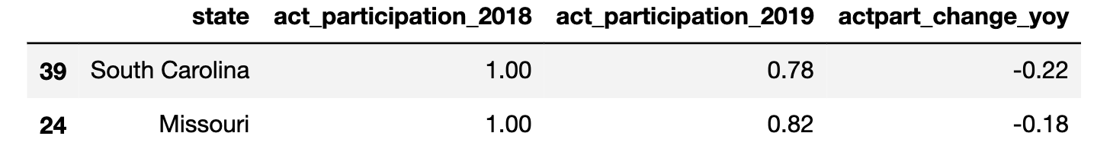
States with SAT participation rate decreased from 100% in 2018 to <100%

Slide 12
Conclusion
As it is ultimately the decision of the state to make it a requirement for all its students to take either the SAT or ACT, the College Board could only do so much in encouraging students to opt for taking the SAT rather than ACT or local state tests. The College Board has been successful thus far in raising its SAT participation rates and in raising the number of states requiring student to take the SAT (from only 3 states in 2014-15 to 10 states in 2017-18) through efforts such as the 'SAT School Day' in 2010 and redesigned SAT in 2016. It is only a matter of time until the SAT gains popularity and more states recognises the value making SAT a state-wide test requirement.
Hence, I would recommend focusing efforts on states that have already made SAT a requirement for all its students, especially these states: West Virginia, Maine & New Hampshire.
In addition, if there are extra resources, the College Board should also focus on South Carolina.

Slide 13
recommendations
Visits to schools to educate students on the importance of taking a standardized test (Maine & New Hampshire)
Hold conferences and road shows for parents to share success stories of children graduating from colleges (Maine & New Hampshire)
Hold talks and provide brochures on comparisons between an globally recognised test and a local state test (West Virginia)
Expand the SAT School Day partnership to South Carolina or to reduce the SAT fees further to encourage the state to adopt state-wide SAT testing and encourage students to choose the SAT over other tests (South Carolina)

